Slide 1
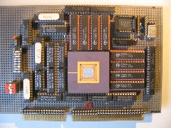
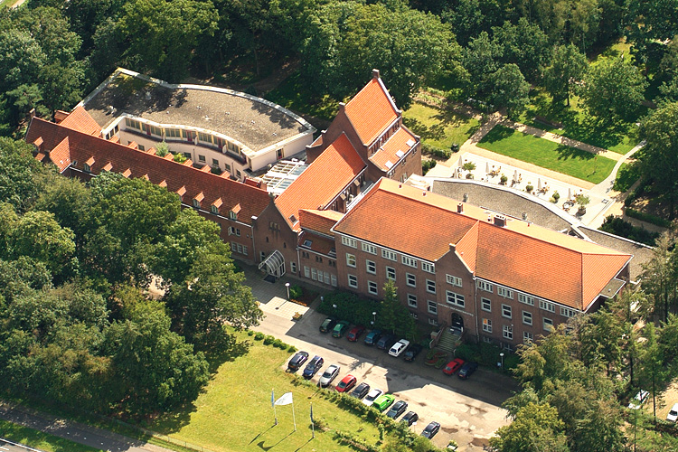
Introduction to
Embedded Systems
A Cyber-Physical Systems Approach
Henk Corporaal
www.ics.ele.tue.nl/~heco
ASCI Autumn School on
Cyber Physical Systems
Soesterberg, 30Sept – 3 Oct 2014

Slide 2
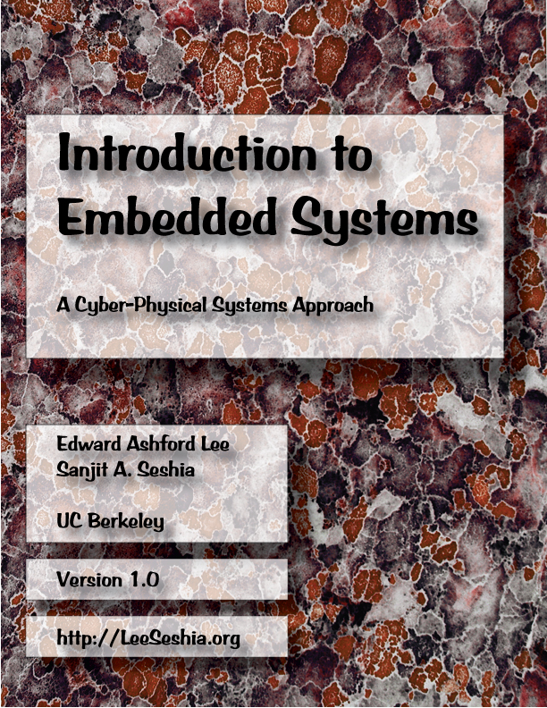
This textbook strives to identify and introduce the durable intellectual ideas of embedded systems as a technology and as a subject of study.
The emphasis is on modeling, design, and analysis of cyber-physical systems, which integrate computing, networking, and physical processes.
Download book:
http://LeeSeshia.org
slides adapted from Ed.Lee

Slide 3
Embedded Systems : what systems are we talking about?
Embedded system =
the autonomously operating information processing and controlling part of an embedding system,
for which it largely determines its functionality

Slide 4
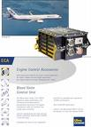
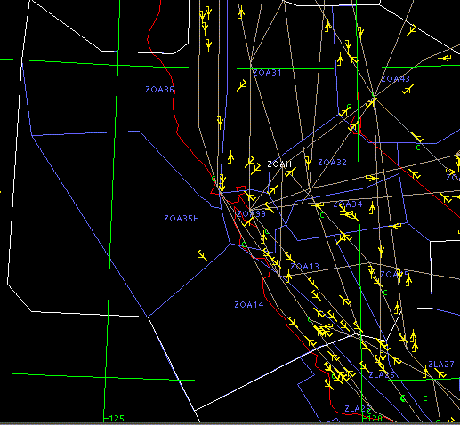
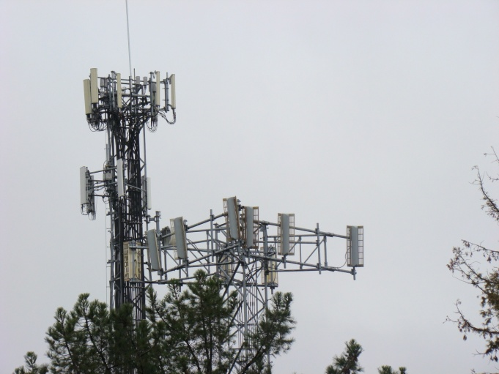
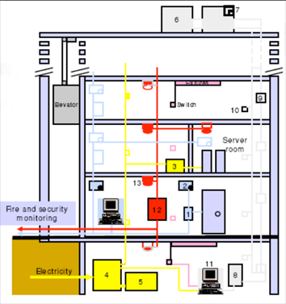
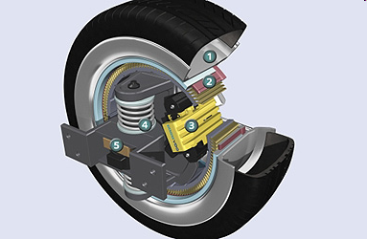
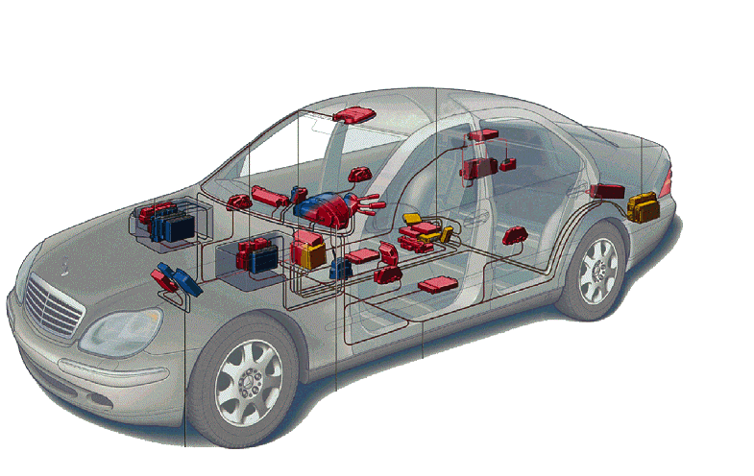
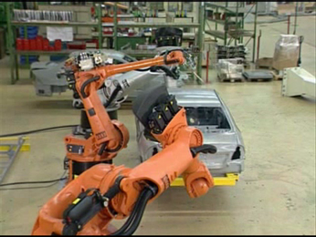
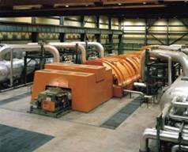
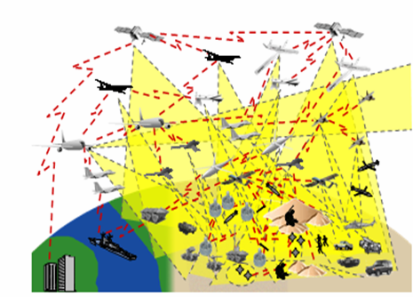
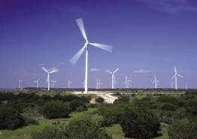
Cyber-Physical Systems (CPS):
Orchestrating networked computational resources with physical systems
Transportation
(Air traffic control at SFO)
Avionics
Building Systems
Telecommunications
Automotive
Instrumentation
(Soleil Synchrotron)
E-Corner, Siemens
Factory automation
Power generation and distribution
Daimler-Chrysler
Military systems:
Courtesy of Doug Schmidt
Courtesy of
General Electric
Courtesy of Kuka Robotics Corp.

Slide 5
CPS definition
Term Cyber Physical System was coined by Helen Gill (2006):
  integration of computation and physical processes
Relation to cybernetics (Norbert Wiener, 1948)
  computer-based feedback control systems
  closed loop control
Embedded processing system which controls a physical system (plant), using a closed loop with sensors and actuators

Slide 6
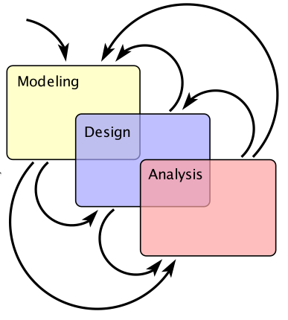
Modeling, Design, Analysis
Modeling is the process of
gaining a deeper understanding
of a system through imitation.
Models specify what a system does.
Design is the structured creation of a system.
It specifies how a system does what it does.
Analysis is the process of gaining a deeper understanding of a system through dissection.
It specifies why a system does what it does
(or fails to do what a model says it should do).

Slide 7
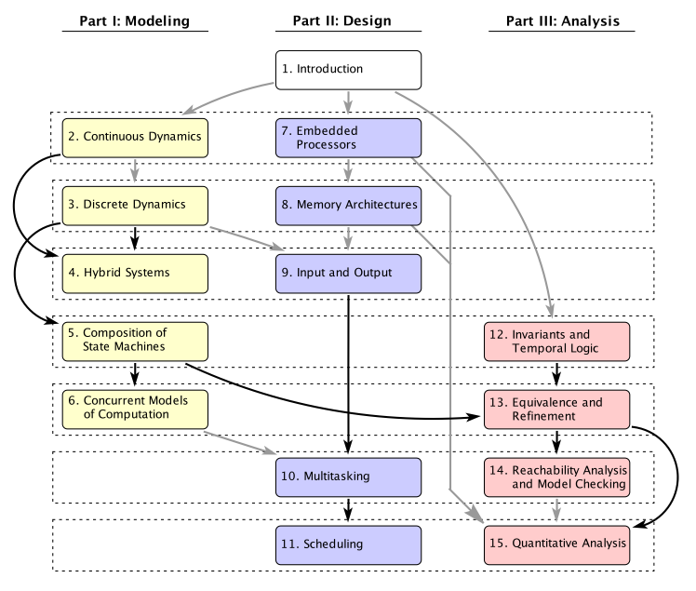
Book Map
The three threads are designed to be read concurrently and fit nicely within a 15-week semester.

Slide 8
Modeling
system
  system is just a combination of parts
  physical system, realized in matter
  logical system, like software and algorithms
dynamics of a system
  evolution in time
modeling a system:
  abstraction, formal?
  description of certain aspects (could be static and/or dynamic aspects)
  distinction between aspect models and design (for synthesis) models
Q: why do we make models?

Slide 9
Modeling in the book
Continuous-time models
  models of physical dynamics
  extended to “hybrid systems” to embrace computation
State machines
  sequential decision logic
Synchronous/reactive concurrent composition
  concurrent computation
  composes well with state machines
Dataflow models
  exploitable parallelism
  well suited to signal processing
Discrete-event models
  explicit about time
Time-driven
  suitable for periodic, timed actions
Hybrid models

Slide 10
Overview
We will treat the modeling part:
Continuous Dynamics Models (Ch2)
Discrete Models (Ch3)
Hybrid Models (Ch4)
Models of Computation (only touch this, Ch 6)
CPS example from Sorama: Cutter vibrations

Slide 11
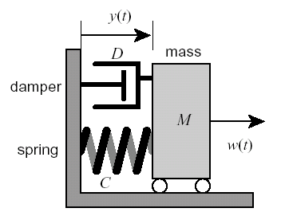
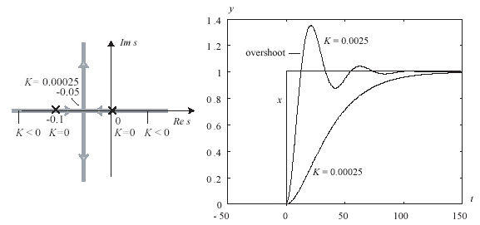
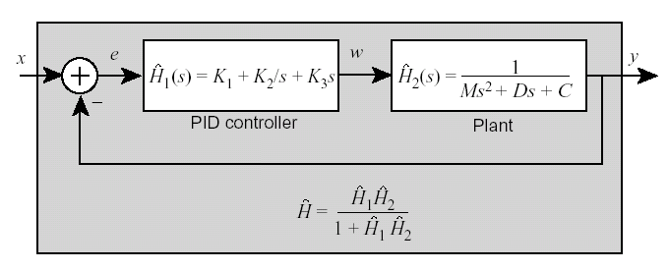
Modeling of Continuous Dynamics (Ch2)
Ordinary differential equations (ODEs)
feedback control systems
stability analysis, robustness analysis, …

Slide 12
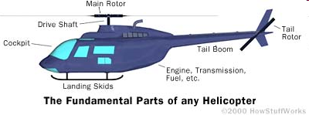
Example: Modeling Helicopter Continuous Dynamics
Notes:
Ask students what the function of the two rotors is. Start with the top/main rotor.

Slide 13
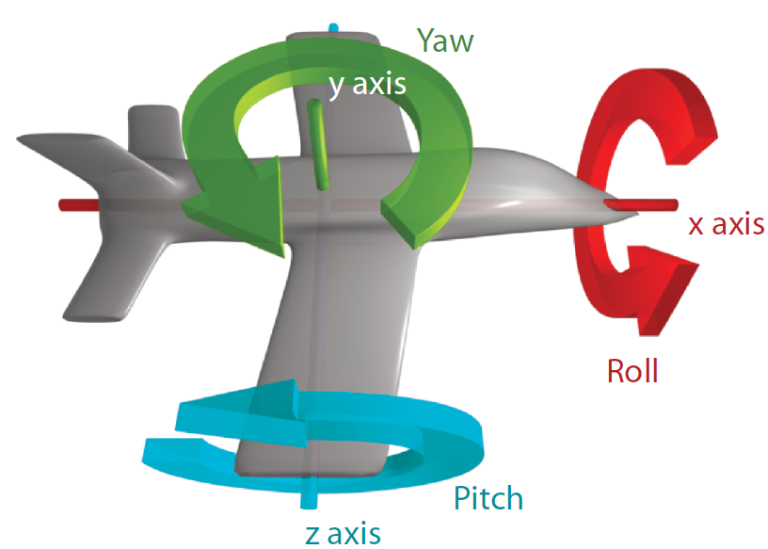
Modeling Physical Motion
Six degrees of freedom:
  Position: x, y, z
  Orientation: pitch, yaw, roll

Slide 14
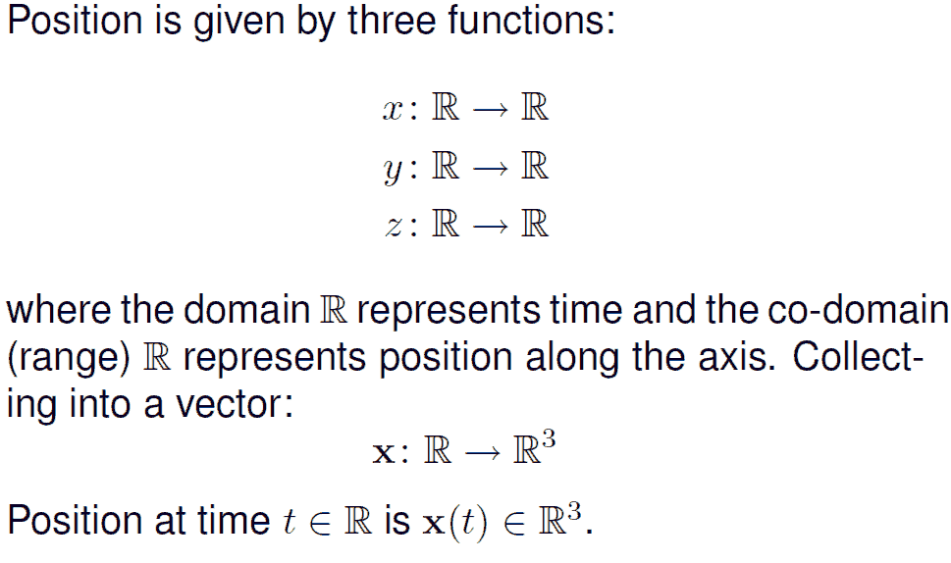
Notation

Slide 15
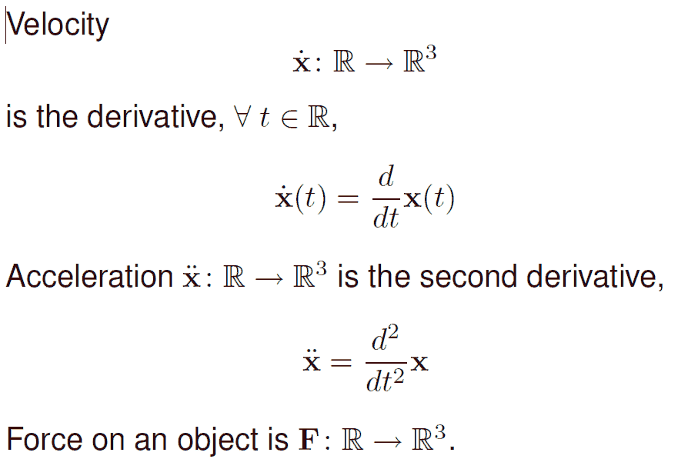
Notation
Notes:
Ask the students to give the relation between x and velocity and accel.

Slide 16
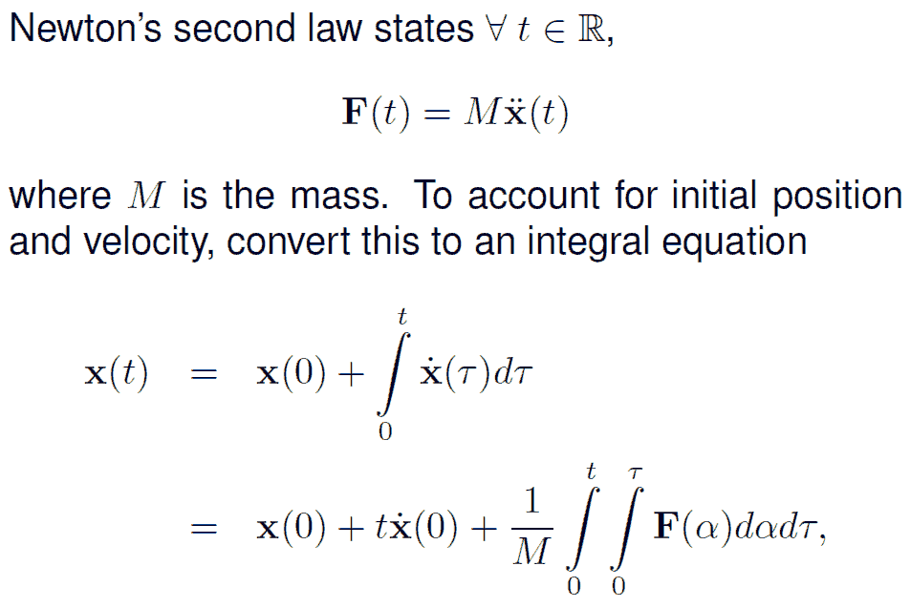
Newton’s Second Law

Slide 17
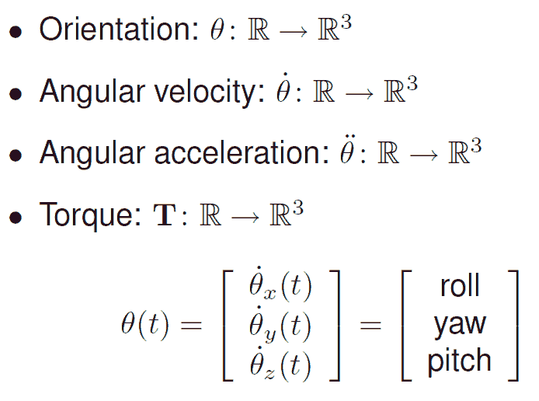
Orientation

Slide 18
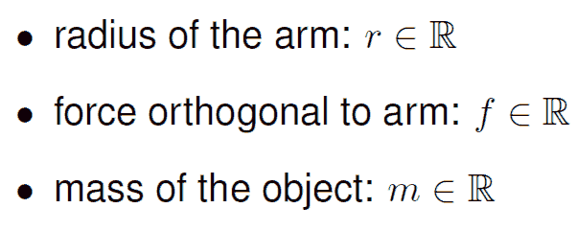
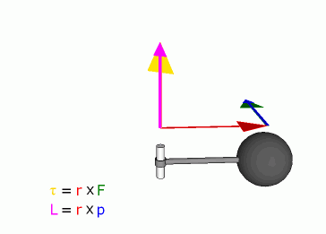
Torque
T_{y}(t ) = r f (t )
Just as force is a push or a pull, a torque is a twist.

Slide 19
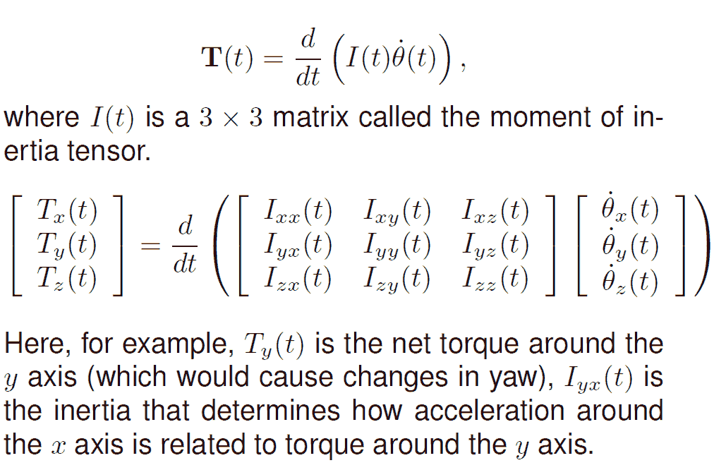
Rotational Version of Newton’s Second Law

Slide 20
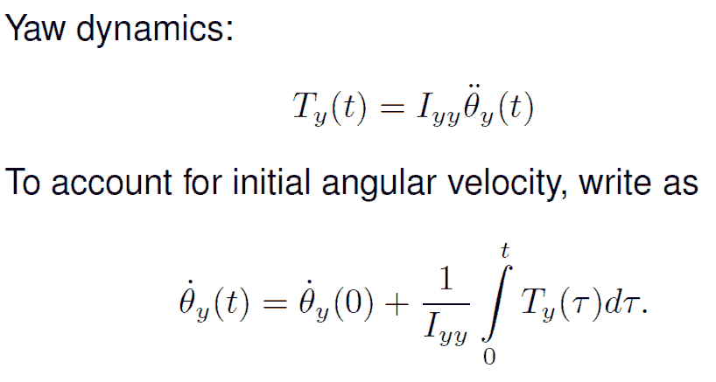
Simple Example

Slide 21
Feedback Control Problem
A helicopter without a tail rotor, like the one below, spins uncontrollably due to the torque induced by friction in the rotor shaft.
Control system problem: Apply torque using the tail rotor to counterbalance the torque of the top rotor.
(see book for model details)

Slide 22
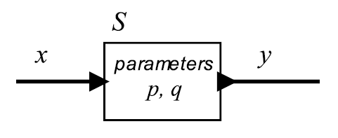



Actor Model of Systems
A system is a function S that accepts an input signal and yields an output signal.
The domain and range of the system function are sets of signals, which themselves are functions.
Parameters may affect S

Slide 23
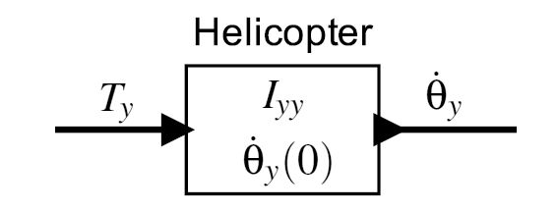
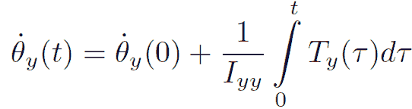
Actor model of the helicopter
Input is the net torque of the tail rotor and the top rotor. Output is the angular velocity around the y axis.
Parameters of the model are shown in the box. The input and output relation is given by the equation to the right.

Slide 24

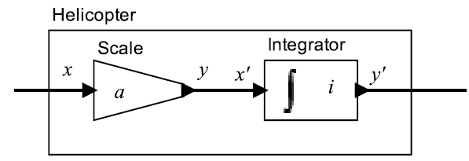


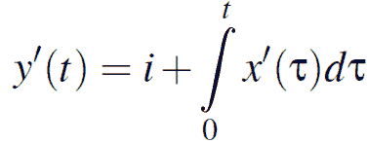




Composition of actor models

Slide 25
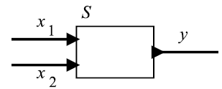

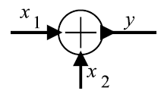
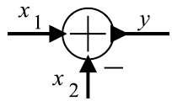


Actor models with multiple inputs

Slide 26
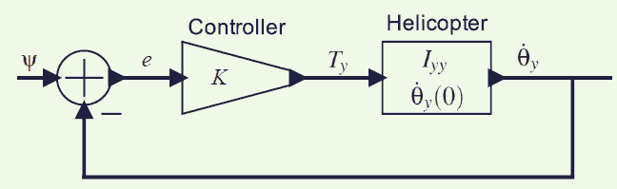


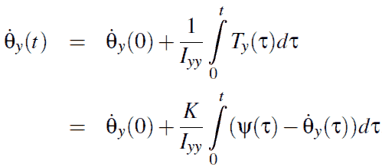
Proportional controller
desired
angular
velocity
error
signal
net
torque
Note that the angular velocity appears on both sides, so this equation is not trivial to solve.

Slide 27
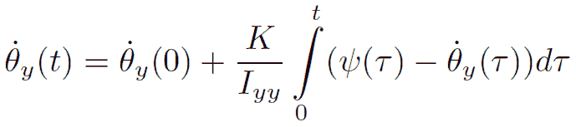
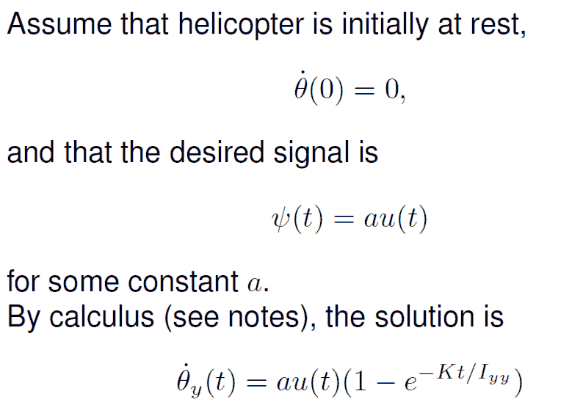
Behavior of the controller

Slide 28
Properties of systems
causal: output S(x) depends only on current and past inputs
strictly causal: output depends only on past inputs
memoryless: output depends only on current input
linear: S(ax+by) = aS(x) + bS(y)
    see lecture of Marc Geilen on advantages of linear systems
time invariant: S depends only on x, not on time, although x often depends on time
  can be formally defined using the delay (D) operator; see book
stable: output is bounded

Slide 29
Discrete systems (Ch 3)
operates in a sequence of discrete steps
  discrete dynamics

Slide 30
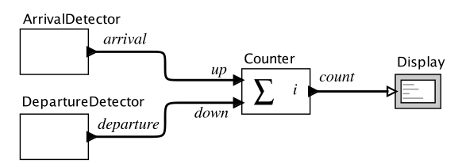
Discrete Systems Example
Count the number of cars that enter and leave a
parking garage:
Pure signal:
Discrete actor:
P is set of input ports:
Notes:
\port{up}\colon \rr \to \{ \absent, \present \}
\set{Counter}\colon (\rr \to \{ \absent, \present \})^P \to ( \rr \to \{ \absent \} \cup \nn)
P = \{ \port{up}, \port{down} \}

Slide 31
Reaction
Notes:
\noindentFor any $t \in \rr$ where $\set{up}(t) \neq \absent$ or $\port{down}(t) \neq \absent$ the Counter \textbf{reacts}. It produces an output value in $\nn$ and changes its internal \textbf{state}.

Slide 32
State Space
Notes:
\noindentA practical parking garage has a finite number $M$ of spaces, so thestate space for the counter is\[\States = \{ 0, 1, 2, \cdots , M \} ~.\]

Slide 33
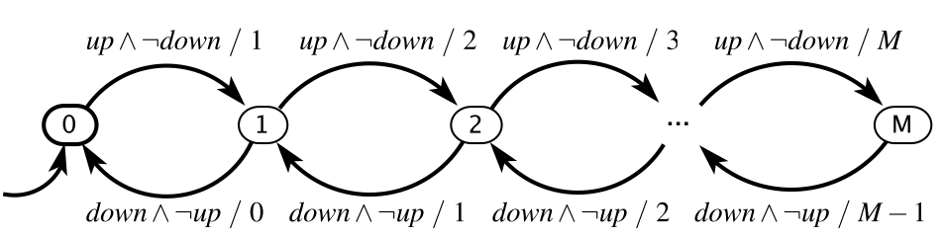
Garage Counter (FSM)
guard
Notes:
\noindentGuard $g \subseteq \Inputs$ is specified using the shorthand$$\port{up} \wedge \neg \port{down}$$, which means\[g = \{ \{\port{up} \} \} ~.\]

Slide 34
Garage Counter (FSM)
Initial state
Notes:
\noindentGuard $g \subseteq \Inputs$ is specified using the shorthand$$\port{up} \wedge \neg \port{down}$$, which means\[g = \{ \{\port{up} \} \} ~.\]

Slide 35
Garage Counter (FSM)
Output
Notes:
\noindentGuard $g \subseteq \Inputs$ is specified using the shorthand$$\port{up} \wedge \neg \port{down}$$, which means\[g = \{ \{\port{up} \} \} ~.\]

Slide 36
Garage Counter Mathematical Model
The picture above defines the update function.
Notes:
\noindentFormally: $(\States, \Inputs, \Outputs, \update, \initialState)$, where\begin{itemize}\item $\States = \{0, 1, \cdots , M \}$\item $\Inputs = (\{\port{up}, \port{down}\} \to \{\absent , \present \}$\item $\Outputs = (\{\set{count} \} \to \{ \absent \} \cup \nn )$\item $\update : \States \times \Inputs \rightarrow \States \times \Outputs$ \item $\initialState = 0$\end{itemize}

Slide 37
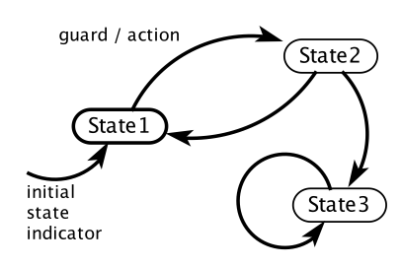
general FSM Notation
state
initial state
transition
self loop

Slide 38
Examples of Guards for Pure Signals
Notes:
\begin{tabular}{cl}
\textit{true} & Transition is always enabled. \\
$p_1$ & Transition is enabled if $p_1$ is $\present$. \\
$\neg p_1$ & Transition is enabled if $p_1$ is $\absent$. \\
$p_1 \wedge p_2$ & Transition is enabled if both $p_1$ and $p_2$ are $\present$. \\
$p_1 \vee p_2$ & Transition is enabled if either $p_1$ or $p_2$ is $\present$. \\
$p_1 \wedge \neg p_2$ & Transition is enabled if $p_1$ is $\present$ and $p_2$ is
$\absent$.
\end{tabular}

Slide 39
Examples of Guards for Signals with Numerical Values
Notes:
\begin{tabular}{cl}
$p_3$ & Transition is enabled if $p_3$ is $\present$ (not $\absent$). \\
$p_3 = 1$ & Transition is enabled if $p_3$ is $\present$ and has value 1. \\
$p_3 = 1 \wedge p_1$ & Transition is enabled if $p_3$ has value 1 and $p_1$ is $\present$. \\
$p_3 > 5$ & Transition is enabled if $p_3$ is $\present$ with value greater than 5.
\end{tabular}

Slide 40
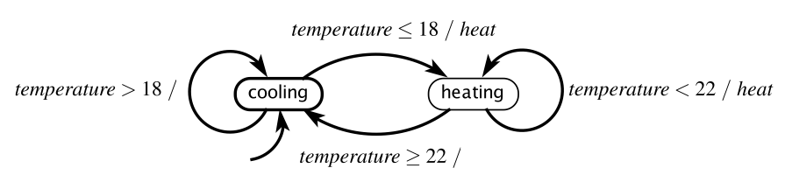
Example: Thermostat
Note: Model includes Hysteresis

Slide 41
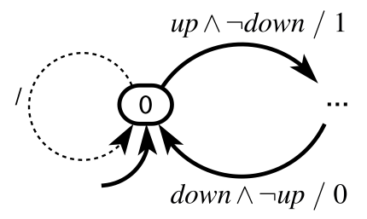
More Notation: Default Transitions
A default transition is enabled if no non-default transition is enabled and it either has no guard or the guard evaluates to true. When is the above default transition enabled?

Slide 42
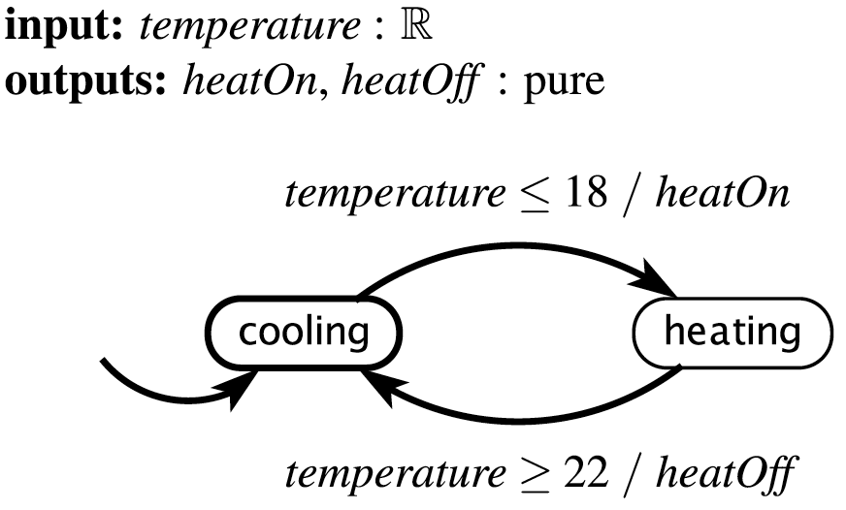
Default transitions need not be shown
Exercise: From this picture, construct the formal mathematical model.

Slide 43
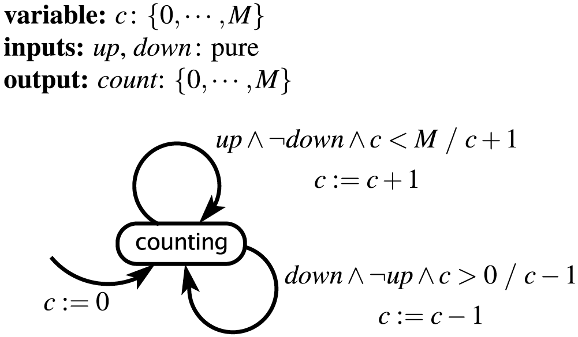
Extended State Machines

Slide 44
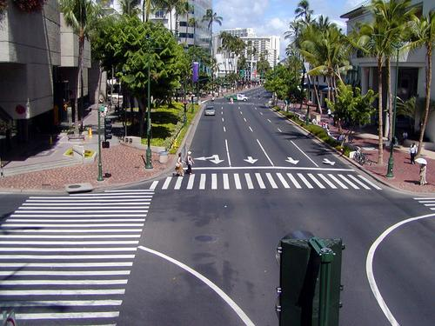
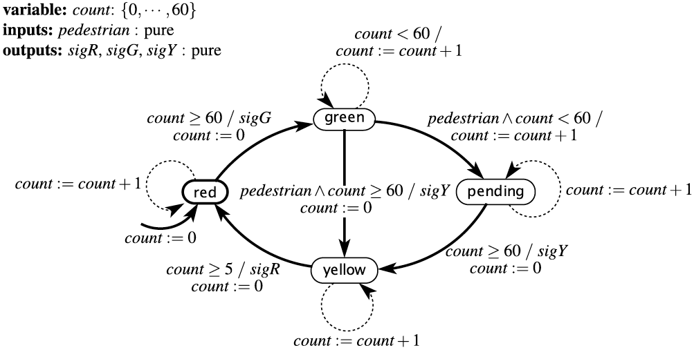
Traffic Light Controller: extended FSM
Note: time triggered model, e.g. one reaction/second

Slide 45
Non-determinism
Determinism: In every state, for all input values, exactly one (possibly implicit) transition is enabled
Notes:
  Non-deterministic ≠ Probabilistic
  Non-determinism ≠ Data dependent variability

Slide 46
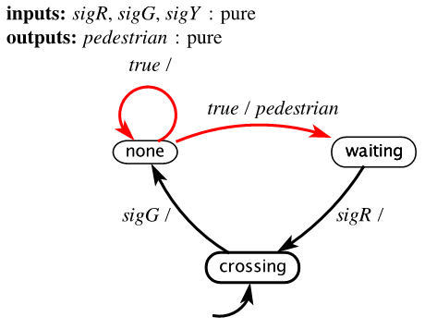
Nondeterminate FSM
Pedestrian arriving at a crosswalk:
Note: output of this model is
input for traffic light FSM, and
vice versa

Slide 47
Uses of nondeterminism
Modeling unknown aspects of the environment or system
Hiding detail in a specification of the system
Any other reasons why nondeterministic FSMs might be preferred over deterministic FSMs?

Slide 48
Size Matters
Non-deterministic FSMs are more compact than deterministic FSMs
  A classic result in automata theory shows that a nondeterministic FSM has a related deterministic FSM that is equivalent in a technical sense (language equivalence, covered in Chapter 13).
  But the deterministic machine has, in the worst case, many more states (exponential in the number of states of the nondeterministic machine, see Appendix B).

Slide 49
Non-deterministic Behavior: Tree of Computations
For a fixed input sequence:
  A deterministic system exhibits a single behavior
  A non-deterministic system exhibits a set of behaviors
  visualized as a computation tree
Deterministic FSM behavior:
. . .
Non-deterministic FSM behavior:
. . .
. . .
. . .
. . .

Slide 50

Actor Model of an FSM
This model enables composition of state machines.

Slide 51
What can we do with FSMs?
FSMs provide:
A way to represent the system for:
  Mathematical analysis
  So that a computer program can manipulate it
A way to model the environment
A way to represent what the system must do and
must not do – its specification.
A way to check whether the system satisfies its
specification in its operating environment.

Slide 52

Exercise
Suppose we use the next model for pedestrian arrival (see slides 44 and 46)
Q: show that it is possible that after arrival the car traffic light does never turn to red

Slide 53
Intermezzo: FSM in processors
- e.g. multicycle implementation
P
C
0
0
I
n
s
t
r
u
c
t
i
o
n
R
e
a
M
d
M
A
d
d
r
e
s
s
[
2
5
–
2
1
]
r
e
g
i
s
t
e
u
r
1
u
x
R
e
a
x
I
d
A
n
s
t
r
u
c
t
i
o
n
R
e
a
d
Z
e
r
M
e
m
o
o
r
1
y
d
a
t
[
a
1
1
2
0
–
1
6
]
r
e
g
i
s
t
e
r
2
A
L
U
A
L
U
A
L
U
O
u
M
e
m
D
a
0
t
t
a
R
e
g
i
s
t
e
r
s
r
e
s
u
l
I
t
n
s
t
r
u
c
t
i
o
n
W
r
i
t
M
e
R
e
a
[
d
1
5
–
0
]
r
e
g
i
s
t
e
u
r
d
a
B
0
t
I
a
2
n
s
t
r
u
c
t
i
o
W
n
r
i
t
e
[
x
1
5
–
1
1
I
]
M
n
s
t
r
u
c
t
i
o
n
W
4
1
r
i
t
d
a
e
t
a
r
1
u
e
g
i
s
t
e
r
d
a
t
a
2
x
I
0
n
s
t
r
u
c
t
i
o
n
3
[
1
5
–
0
]
M
u
x
M
e
m
o
r
y
1
d
a
1
6
3
2
t
a
S
h
i
f
S
t
i
r
g
n
e
g
i
s
t
e
r
l
e
f
e
x
t
2
t
e
n
d

Slide 54
FSM control
- 10 states
- variable #cycles/ instruction
I
n
s
t
r
u
c
t
i
o
n
f
e
t
c
h
I
n
s
t
r
u
c
t
i
o
n
d
e
c
o
d
e
/
0
r
e
g
i
s
t
e
r
f
e
t
c
h
A
M
e
m
R
e
a
d
1
L
U
S
r
c
A
=
0
I
o
r
D
=
0
A
L
U
S
r
c
A
=
0
S
t
a
r
t
A
L
I
R
W
r
i
t
e
A
L
U
S
r
c
B
=
1
1
A
U
S
r
c
B
=
0
1
A
L
U
O
p
=
0
0
L
U
O
p
=
0
0
P
C
P
C
W
r
i
t
e
S
o
u
r
c
e
=
0
0
e
)
'
)
y
p
Q
)
-
t
E
'
R
B
J
p
=
'
'
'
)
(
O
p
=
=
M
e
m
o
r
y
a
d
d
r
e
s
s
'
S
W
B
r
a
n
c
h
O
p
p
=
(
O
J
u
m
p
c
o
m
p
u
t
a
t
i
o
n
W
'
)
o
r
(
O
E
x
e
c
u
t
i
o
n
c
o
m
p
l
e
t
i
o
n
(
c
o
m
p
l
e
t
i
o
n
2
(
O
p
=
'
L
6
8
9
A
L
U
S
r
c
A
=
1
A
A
L
U
S
r
c
A
=
1
A
L
U
S
r
c
B
=
1
0
A
L
U
S
r
c
A
=
1
L
U
S
r
c
B
=
0
0
P
C
W
r
i
t
e
A
L
U
O
p
=
0
0
A
L
U
S
r
c
B
=
0
0
A
L
U
O
p
=
0
1
P
C
S
o
u
r
c
e
=
1
0
A
L
U
O
p
=
1
0
P
P
C
W
r
i
t
e
C
o
n
d
C
S
o
u
r
c
e
=
0
1
)
(
O
p
'
=
W
'
L
S
'
W
=
'
)
p
M
e
m
o
r
y
M
e
m
o
r
y
O
(
a
c
c
e
s
s
a
c
c
e
s
s
R
-
t
y
p
e
c
o
m
p
l
e
t
i
o
n
3
5
7
M
e
m
R
e
a
d
M
e
m
W
r
i
t
e
R
e
g
D
s
t
=
1
I
o
r
D
=
1
I
o
r
D
=
1
M
e
R
e
g
W
r
i
t
e
m
t
o
R
e
g
=
0
4
W
r
i
t
e
-
b
a
c
k
s
t
e
p
R
e
g
D
s
t
=
0
R
e
g
W
r
i
t
e
M
e
m
t
o
R
e
g
=
1

Slide 55
Implementing this FSM

Slide 56
PLA Implementation
opcode
current
state
Q: If I picked a horizontal or vertical line could you explain it ?
Q: What type of FSM is used?
Mealy or Moore?
datapath control
next
state

Slide 57
Pipelined processor: any FSM?
P
C
S
r
c
0
I
D
/
E
X
M
W
B
u
E
X
/
M
E
M
x
1
C
o
n
t
r
o
l
M
W
B
M
E
M
/
W
B
I
F
/
I
D
E
X
M
W
B
A
d
d
4
A
d
d
r
e
A
d
d
e
s
u
l
t
t
i
r
B
r
a
n
c
h
W
S
h
i
f
t
g
l
e
f
t
2
e
e
t
R
i
A
L
U
S
r
c
r
W
n
R
e
a
d
m
g
o
r
e
g
i
s
t
e
r
1
e
e
P
C
A
d
d
r
e
s
s
i
M
R
t
R
e
a
d
c
o
u
d
a
t
a
1
t
r
m
t
R
e
a
d
s
Z
e
r
o
e
n
r
e
g
i
s
t
e
r
2
M
I
n
s
t
r
u
c
t
i
o
n
I
R
e
g
i
s
t
e
r
s
R
e
a
d
A
L
U
A
L
U
m
e
m
o
r
y
W
r
i
t
e
d
a
t
a
2
0
r
e
s
u
l
t
A
d
d
r
e
s
s
R
e
a
d
1
r
e
g
i
s
t
e
r
M
D
a
t
a
d
a
t
a
M
W
r
i
t
e
u
m
e
m
o
r
y
u
d
a
t
a
x
x
1
W
r
i
t
e
0
d
a
t
a
I
n
s
t
r
u
c
t
i
o
n
1
6
3
2
6
[
1
5
–
0
]
S
i
g
n
A
L
U
M
e
m
R
e
a
d
e
x
t
e
n
d
c
o
n
t
r
o
l
I
n
s
t
r
u
c
t
i
o
n
[
2
0
–
1
6
]
0
A
L
U
O
p
M
I
n
s
t
r
u
c
t
i
o
n
u
[
1
5
–
1
1
]
x
1
R
e
g
D
s
t

Slide 58
Other FSMs in processors
Memory hierarchy: cache controler, controling cache misses
access address

Slide 59
Other FSMs in processors: Cache coherence control
Snooping: 3 states for each cache line:
  invalid, shared (read only), modified (also called exclusive, you may write it)
FSM per cache, gets requests from processor and bu
Processor
Processor
Processor
Processor
Cache
Cache
Cache
Cache
Main memory
I/O System

Slide 60
Snoopy FSM controler
CPU Read hit
State machine
for CPU requests
for each
cache block
CPU Read
Shared
(read-only)
Invalid
Place read miss
on bus
CPU Write
CPU Read miss
Place read miss
on bus
CPU read miss
Write back block
Place Write
Miss on bus
CPU Write
Place Write Miss on Bus
Cache Block
State
Exclusive
(read/write)
CPU read hit
CPU write hit
CPU Write Miss
Write back cache block
Place write miss on bus

Slide 61

When does a reaction occur?
When a reaction occurs is not specified in the state machine itself. It is up to the environment.
This traffic light controller design assumes one reaction per second. This is a time-triggered model.

Slide 62

When does a reaction occur?
Suppose all inputs are discrete and a reaction occurs when any input is present. Then the above transition will be taken whenever the current state is s1 and x is present.
This is an event-triggered model.

Slide 63

When does a reaction occur?
Suppose x and y are discrete and pure signals.
When does the transition occur?
Answer: when the environment triggers a reaction and x is absent.
If this is a (complete) event-triggered model, then the transition will never be taken because the reaction will only occur when x is present!

Slide 64
Hybrid systems (Ch 4)
Combine Continuous + Discrete dynamics
Examples:
Digital controller of physical “plant”
  thermostat
  intelligent cruise control in cars
  aircraft auto pilot
Phased operation of natural phenomena
  bouncing ball
  biological cell growth
Multi-agent systems
  ground and air transportation systems
  interacting robots

Slide 65
Discrete System (FSM)
Continuous System
jump
Hybrid System
flow

Slide 66

An alternative to FSMs that is explicit about the passage of time: Timed automata, a special case of hybrid systems.

Slide 67

Example: “Tick” Generator (Timer)
How would you model a timer that generates a ‘tick’
each time T time units elapses?
A similar timed automaton can model a generator
of a timer interrupt.

Slide 68

Example: Mouse Double Click Detector
x(t) = time counter
= timed automaton, where the dynamics is just passage of time.

Slide 69
Example: Mouse Double Click Detector
How many states does this automaton have?
Notes:
According to Wikipedia page (which cites MSDN site), the default time bound between clicks to distinguish single clicks from a double click is about 500 ms.

Slide 70

Hybrid automaton model of a traffic light controller
Light remains green at least 60 seconds, and then turns yellow if a pedestrian has requested a crossing. It then remains red for 60 seconds.

Slide 71
When do reactions occur in a hybrid automaton?
Reactions are occurring continually, with the continuous state variable x being continually updated.

Slide 72


Hybrid Automaton for Bouncing Ball
y – vertical distance from ground (position)
a – coefficient of restitution, 0 · a · 1
If you plotted y(t), what would it look like?

Slide 73
Hybrid Automaton for Bouncing Ball
y – vertical distance from ground (position)
a – coefficient of restitution, 0 · a · 1

Slide 74




Sticky mass system
Spring constant k
p1 / p2 neutral positions
No friction
Masses stick together when touching
Split after some time

Slide 75

Timed Automaton for Sticky Mass

Slide 76
Models of Computation (MoC, Ch6)
A model of computation assigns semantics
(meaning) to the syntax defined in the actor model.
The MoC gives operational rules for executing a
model.
  These rules determine when actors perform
  internal computation, update their internal state,
  and perform external communication.
An MoC also defines the nature of communication
between components (e.g., buffered I/O).

Slide 77

Recall: Actor Model for State Machines
Expose inputs and outputs, enabling composition:

Slide 78
Recall: Actor Model of Continuous-Time Systems
A system is a function that accepts an input signal and yields an output signal.
The domain and range of the system function are sets of signals, which themselves are functions.
Parameters may affect the definition of the function S.

Slide 79
Recall: Actor model of the helicopter
Input is the net torque of the tail rotor and the top rotor. Output is the angular velocity around the y axis.
Parameters of the model are shown in the box. The input and output relation is given by the equation to the right.

Slide 80
Recall: Composition of actor models

Slide 81
Recall: Feedback Composition
Angular velocity appears on both sides. The semantics (meaning) of the model is the solution to this equation.

Slide 82

Observation: Any Composition is a
Feedback Composition
s ∈ S ^{N}
The behavior of the system is a “fixed point.”

Slide 83

Model of Computation (MoC):
Continuous Time (CT)

Slide 84

Discrete-Time (DT) Actor Models
Discrete-time helicopter model looks the same:

Slide 85


Time-Triggered Reactions of FSMs use a
Discrete-Time MoC
sigY
sigG
sigR
sigR
pedG
pedR

Slide 86

Mixed Signal Models
A more reasonable model of a discrete helicopter controller would be a mixed-signal model:
Signals inside the blue area are continuous-time signals, and the ones outside are discrete-time signals.

Slide 87

To jointly model discrete and continuous-time signals in the same MoC, use the notion of “absent” values
Event-triggered composition of state machines uses a discrete-event MoC.

Slide 88
Models of Computation (MoCs, Ch6)
Synchronous-Reactive
  global clock triggers execution of all actors (simultaneous, synchronous) and instantaneous
  execution does not take time
  languages: Esterel, Lustre, Statecharts

Slide 89
Models of Computation (MoCs)
Dataflow
  asynchronous execution
  actor dependences due to flow of data
  communication between actors : sequence of messages (called tokens)
  actor executes (fires) if (sufficient) input data (tokens) are available
  Many models: SDF, HSDF, DynamicDF, Kahn Process Networks, etc.
  See e.g. Tuesday lecture of Bart Theelen and Friday lecture of Twan Basten.

Slide 90
Models of Computation (MoCs)
Timed
  TTA: time triggered architecture
  Global clock triggers execution
  Comparable to Synchrounous-Reactive, but now: Actions take time

Slide 91


A CPS example from Sorama

Slide 92

Cutter
Notes:
Lathe machining tool.
The cutting tool ‘scans’ the processed piece surface.

Slide 93

Problem:
Undesired vibrations
Example application: tool / workpiece chattering
Notes:
Workpiece chattering – machine vibration.
Corresponds to the relative movement between the workpiece and the cutting tool, which result in waves on the machined surface.

Slide 94
Proposed solution:
Vibration detection & control loop
PNAH – Planar Near-Field Acoustic Holography
- Real-time control
Vibration Detection Algorithm
1024 channel microphone array
Machining tool
Machined piece
Mounting table and actuators
Control Loop
Notes:
Mill machining example, where a vibration counteracter has been implemented.
For the vibration detection algorithms, the real-time PNAH is proposed.

Slide 95




Solution tool
Planar Near-field Acoustic Holography (PNAH)
Method to visualize sound (Pressure Distribution)
Source
plane hologram
PNAH
Measurement plane
hologram
Sorama Cam
1024
mics.
Notes:
Introduce concept of hologram

Slide 96









PNAH Algorithm Overview
Spatial-Time Processing
Spatial
Time-to-Freq. Transform
Spatial-Freq. Processing
K-space Domain Transform
K-space Domain
Processing
K-space
Dom. Inverse
Transform
11010…
Decimation filter
2D FFT
1024
32-bit streams
Spatial-Freq. Domain
Windowing
1D FFT
Regularization + Inverse Propagator
1024 channels
2D Extrapolation
n Holograms
2D Inverse FFT
Spatial-Time Domain
2D Windowing
Spatial-Freq. Domain
K-space Domain
Notes:
The result of the time-spatial domain processing are several holograms, describing the pressure field of a certain frequency component.
Regularization is needed to avoid potential blow-up of noise (cut-off and slope iteration filtering)

Slide 97









Current system: Implementation
Spatial-Time
Domain
Spatial-Frequency Domain
K-Space
Domain

Slide 98

What did you learn?

Slide 99


Embedded system -> CPS
  environment interaction, control
Modeling dynamic behavior
  continuous
  discrete
  hybrid
  many MoCs
Want more?:
  see book
  next: Ptolemy book

Slide 100

CPS: please HELP !!

