Slide 1
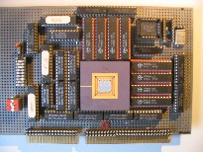
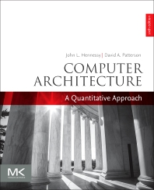
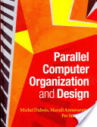
Embedded Computer Architecture
5SAI0
Technology
Henk Corporaal
www.ics.ele.tue.nl/~heco/courses/ECA
h.corporaal@tue.nl
TUEindhoven
2019-2020

Slide 2
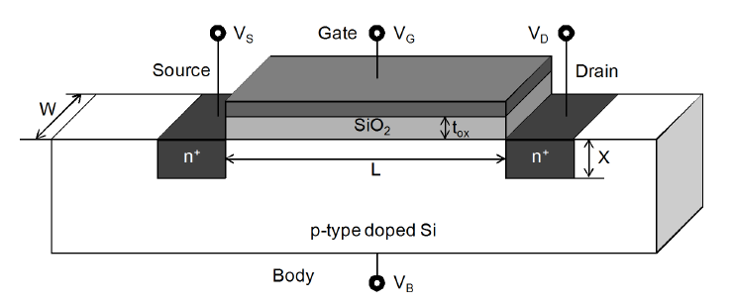
Impact of Technology
(slides based on book: Parallel Computer Organization and Design)
Transistor basics
Power issues
  Dynamic
  Static
Reliability
  AVF
  ACE
  NBTI
  EM
  TDDB
  ... what is all of this?

Slide 3
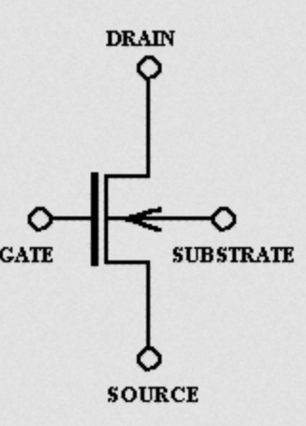
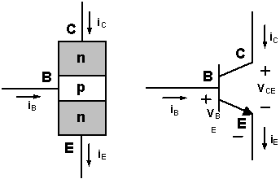
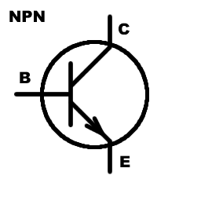
Transistor basics
Operation
Scaling issues
Inverter
nMOS transistor
Symbols for transistors

Slide 4
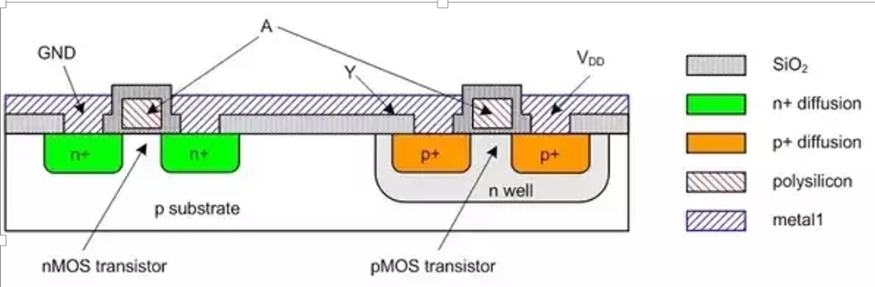
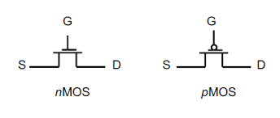
pMOS and nMOS transistors
SiO₂
Gate
PolySilicon
SiO₂
Gate
PolySilicon
Source
Drain
Source
Drain
n+
n+
p+
p+
p
Body Si
n
Body Si
nMOS transistor
pMOS transistor
Symbols n/pMOS transistors
Combining nMos and pMOS transistor
- inverter with input A, output Y

Slide 5
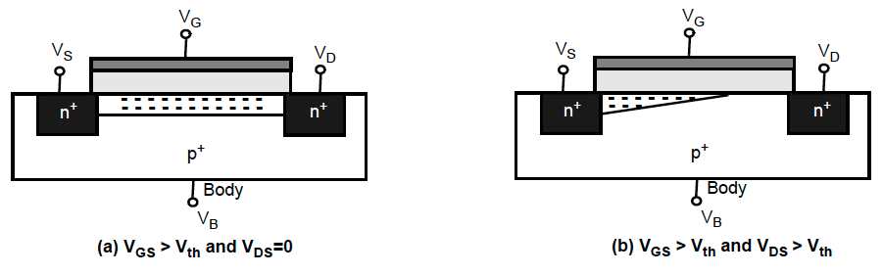
nMOS transistor operation
V_{G} (gate voltage) controls current by changing the thickness of conduction channel:
  V_{GS} < 0 then holes populate between source and drain
  V_{GS} > V_{th} minority carriers (electrons) are attracted to the gate forming a conductive channel
  V_{DS} > 0 leaves positive potential between drain and source and electrons move from source to drain
  V_{DS} > V_{th} then I_{DS} increases but V_{GD} decreases; when V_{GD}< V_{th} channel is pinched off

Slide 6
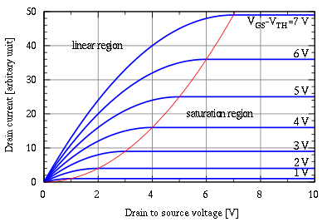
Three regions of operation
V_{GS}-V_{th}=V_{DS}
Cut-off
V_{DS}

Slide 7
Three regions of operation
Cut-off/sub-threshold region
  V_{GS}< V_{th} when no current flows
Linear region (acts as resistor)
  V_{GS}> V_{th} & V_{GS} > V_{DS} + V_{th}
  I_{DS} ~ β*(V_{GS} - V_{th})*V_{DS}
    β is transistor gain factor = μ*C_{ox}*(W/L), so β ~ W/L
Saturation region
  V_{GS}> V_{th} & V_{GS} > V_{DS} + V_{th}
  I_{DS} = (β/2)*(V_{GS} - V_{th})²
Cut-off

Slide 8
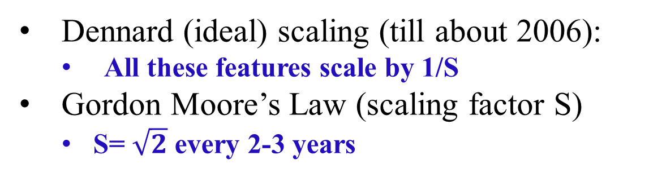
Technology Scaling
Feature/Voltage | Variable
Channel Length | L
Channel Width | W
Oxide Thickness | t_{ox}
Junction Depth | X
Supply Voltage | V_{dd}
Threshold Voltage | V_{th}
Wire width Wire spacing Wire height | w s h
Dennard (ideal) scaling (till about 2006):
    All these features scale by 1/S
Gordon Moore’s Law (scaling factor S)
  S= $\sqrt{2}$ every 2-3 years

Slide 9
Impact of scaling on characteristics
Device Characteristics | Feature Dependence | Scaling
Transistor Gain (β) | W/(L. t_{ox}) | S
Current (I_{ds}) | β(V_{dd}-V_{th})² | S
Resistance | V_{dd}/I_{ds} | 1
Gate Capacitance | (W.L)/t_{ox} | 1/S
Gate delay | R.C | 1/S
Clock Frequency | 1/(R.C) | S
Circuit Area | W.L | 1/S²
Wire Resistance (per unit length) | 1/(w.h) | S²
Wire Capacitance (per unit length) | h/s | 1

Slide 10
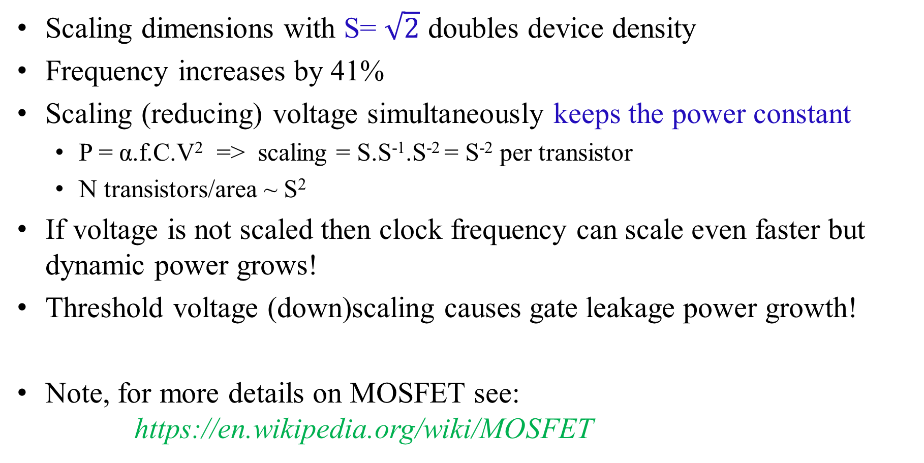
Benefits of scaling
Scaling dimensions with S= $\sqrt{2}$ doubles device density
Frequency increases by 41%
Scaling (reducing) voltage simultaneously keeps the power constant
  P = α.f.C.V² => scaling = S.S⁻¹.S⁻² = S⁻² per transistor
  N transistors/area ~ S²
If voltage is not scaled then clock frequency can scale even faster but dynamic power grows!
Threshold voltage (down)scaling causes gate leakage power growth!
Note, for more details on MOSFET see:
https://en.wikipedia.org/wiki/MOSFET

Slide 11
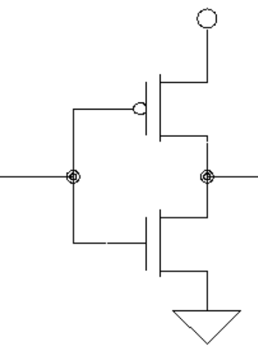
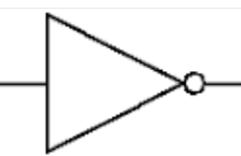
CMOS inverter
Vdd
Inverter Symbol
Vin
Vout
pMOS
Vin
Vout = Vin
nMOS
Vss = ground

Slide 12
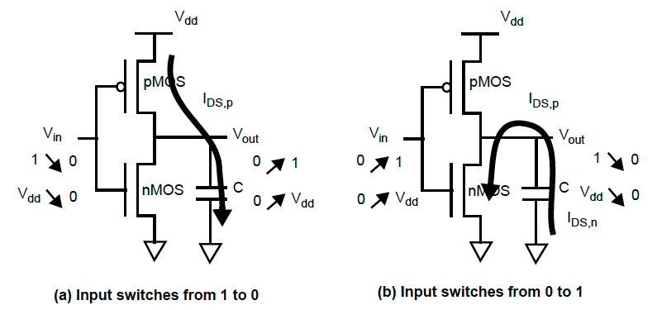
CMOS inverter
Dynamic power is consumed when device changes ON->OFF and OFF->ON
  1->0 current flows to move charge to the capacitance
  0->1 current flows from capacitance to ground
Charging and discharging of capacitance causes power dissipation:
  C*V_{dd} per charge + discharge
  see https://en.wikipedia.org/wiki/CMOS

Slide 13
Impact of Technology
Transistor basics
Power issues
  Dynamic
  Static
Reliability
  MTTF
  AVF
  ACE
  NBTI
  EM
  TDDB
  ... what is all of this?

Slide 14
Scaling dynamic power
P_{dynamic} = α.f.C.V_{dd}²
  α = fraction of clock cycles when gate switches (at most ½) = activity factor
  C and V_{dd} ~1/S and f ~S => P_{dynamic} scales like 1/S²
  Number of transistor in unit area ~ S²
Hence power density (power/area) = constant with ideal scaling
If V_{dd} does not scale (down with factor S) then power density grows
  Serious issue since voltage can not reduce very much beyond current levels
  If chip size grows then total power grows
Power dissipation leads to heat generation
  When heat is not removed at the same rate it causes thermal emergencies

Slide 15
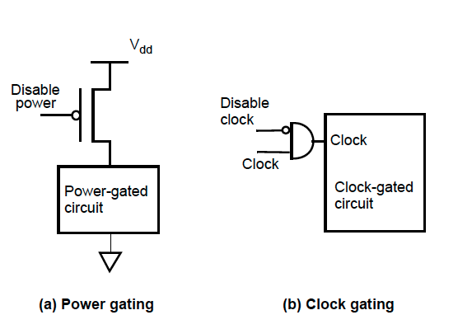
Reducing dynamic power: P_{dynamic} = α.f.C.V_{dd}²
Reduce α (switching activity)
  Power gating cuts off power from idle units
  Clock gating cuts off power-hungry clock

Slide 16
Reducing dynamic power: P_{dynamic} = α.f.C.V_{dd}²
Reduce V_{dd} – most effective approach
  Voltage scaling
  For correct circuit operation it also requires simultaneous reduction in frequency since transistor becomes slower at lower voltage
Reducing both V_{dd} and f reduces power cubically
  Reduction comes at the cost of performance
Smart Scaling is the key to preserve performance

Slide 17
Other scaling approaches: adapting V_{th}
Reduce V_{dd} and V_{th} simultaneously so frequency does not need to reduce
  Reducing V_{th} increases leakage !!
Use multiple threshold CMOS devices (MTCMOS)
  Use high leakage, i.e. lower V_{th} but faster, devices when speed is critical
  Use low leakage devices, i.e. higher V_{th} but slower, on non critical paths
  Or use (dynamic) Body Biasing, i.e. changing body voltage
    Forward Body Biasing (FBB):
    reduces V_{th}, increases performance and leakage
    Backward Body Biasing (BBB):
    increases V_{th}, reduces performance and leakage

Slide 18
Other scaling approaches: power islands
Use multiple power (adaptive voltage & frequency) domains
  Eg. when caches run at a different voltage than logic

Slide 19
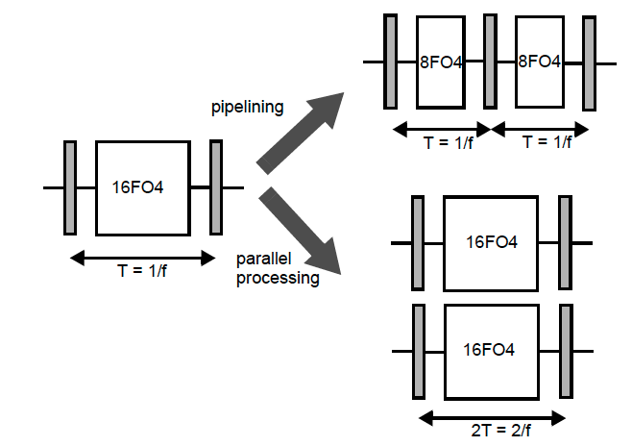
Parallelism impact on Energy
Two choices for the same design:
  Pipeline the design so each of the two stages runs at the same frequency but does half the work
  Divide the work into two parallel units each running at half the frequency
  What happens to P_{dynamic} = α.f.C.V_{dd}² ?
  And to E = P_{dynamic} * t ?
Notes:
Use P_{dynamic} = αCV_{dd}²f
Example has logic with delay of 16 FO4 (the delay of an inverter with fan-out of 4)
Pipelining
C and V do not change, f doubles, P doubles, t halves, E same;
however, if we keep f the same (as in picture, i.e. same performance), than we can reduce V and therefore P and E
Parallel units
C doubles, f same, V same, P doubles, t halves, E same
however, if we halve f (as in picture, i.e. same performance), than we can reduce V and therefore P and E

Slide 20
Static power
Higher V_{th} and lower T are better
P_{static} = V.I_{sub} ~ V.e^{-kVth/T}
When V_{GS} drops below V_{th}, I_{DS} still exists, leading to static power dissipation
The current in sub-threshold region is exponentially dependent on V_{th} as well as the operating temperature.
  Hence as V_{th} decreases static power increases exponentially
Techniques to reduce static power are similar to dynamic power
  HOWEVER, from a static power point of view, pipelining is better than parallelism (why?)

Slide 21
Metrics
Power is good metric for deciding on the thermal envelope of the processor
Energy is good metric in battery constrained environments
  E.g., app executed at ½ speed but ¼ power means: ½ the energy (2T * ¼ P = ½ E) =>
  2X battery life!
Energy*Delay (ED) metric gives higher weight to performance
  Same example above, ED ((2T)² * ¼ P) stays same
Energy*Delay² gives even more weight to performance
  Same example above shows that ½ speed is 2X worse on ED² metric

Slide 22
Impact of Technology
Transistor basics
Power issues
Reliability
  MTTF
  SDC
  SER
  AVF
  ACE
  NBTI
  EM
  TDDB
  ... what is all of this?

Slide 23
Scaling problems
Shekhar Borkar
Smaller dimensions leads to:
  Increased magnitude of within-die parameter variations
  Greater susceptibility to soft errors
  More rapid wear-out
Notes:
Simply stated, variations occur when we have too few dopant atoms. In a 65 NM technology roughly 100 dopant toms are present per transistor. If we loose a couple of those dopant atoms that is essentially 2% variability in the electrical characteristics of that device.

Slide 24
Definitions
SDC = Silent Data Corruption (= not detected)
DUE = Detected and Unrecoverable Error
SER = Soft Error Rate = SDC + DUE
Failure is measured as
  MTTF = Mean Time to Failure
  FIT = Failure in Time ; 1 FIT = 1 failure in billion hours
    MTTF = 1 => 1 failure in 24*365 hours => 1 billion/(24*365)= 114,155 FIT
  FIT is commonly used because FIT is additive

Slide 25
Fault => Error => Failure
Bit
Read?
yes
no
Bit has error protection?
benign fault
no error
no
detection &
correction
no error
detection only
affects program
outcome?
affects program
outcome?
yes
no
yes
yes
no
no
SDC
benign fault
no error
True DUE
False DUE
Silent Data Corruption
Detected and unrecoverable error
A fault (e.g. cause by alpha particle) can give an error (bit toggle in memory or flip-flop)
When an error affect correct execution it becomes a failure
Vulnerability Factor = fraction of faults that become errors
Source: Shubhu Mukherjee, INTEL
Notes:
Parity will convert SDC into True DUE, but also convert “benign fault no error” into False DUE
EXAMPLE of False DUE: strike on wrong-path instruction in instruction queue, show the similarity with other branch of tree

Slide 26
Error detection & correction
adding redundancy bits to the data
e.g. even parity: add a parity bit to every byte
  0 0 1 1 0 1 0 0 + 1 makes even parity
  detects single bit errors
  no correction possible
SECDED: single error correction, double error detection
Many codes:
  hash function / signature;
  checksum (like the 1-bit parity)
  CRC (cyclic redundancy check)
  Hamming codes: 2 valid codes have a minimum hamming distance > 1
    parity is a code with Hamming Distance = 2
    SECDED has Hamming Distance = 3

Slide 27
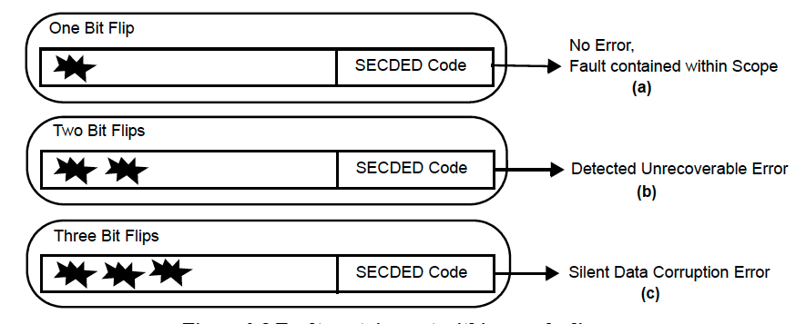
Fault Containment
SECDED = Single Error Correction, Double Error Detection
An SDC or a DUE becomes a failure if it affects program execution

Slide 28
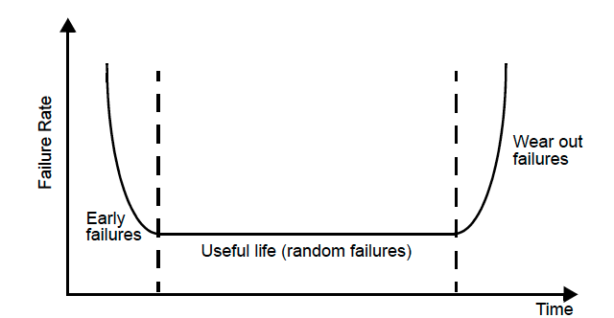
Lifetime failure rates
Failure rate follows bathtub curve:
  Higher failure rates at the initial stage of the manufacturing and operation
  Long useful life
  Finally ageing-related wear-out errors
Burn-in testing removes early failure components

Slide 29
SEUs: Single Event Upsets
Single Event Upset
Neutron Strike
Gate
Insulation
n⁺
+ -
+ -
+ -
+ -
n⁺
p substrate
Electron-Hole Tunneling
Body
High energy neutron strike:
  Creates electron-hole pairs by splitting silicon nucleus
  The charge from the pairs travels toward gate diffusion region
  Causes the transistor charge to flip
  Causes a bit to flip
  Both 0 or 1 stored can be flipped (depending on holes or electron interactions)

Slide 30
BIT Soft Error Rates
SER: λ ~ flux * bit_area * e^{Qcritical/Qcollect}
  Particle Flux depends on altitude
  Bit_area is silicon area required to implement 1 bit
  Q_{collect} is charge collection efficiency also technology dependent
  Charge needed to flip a bit Q_{critical}
    Q_{critical} ~ C_{node} * V_{dd}
    According to scaling rules both C and V decrease and hence Q decreases rapidly
Probability of a soft error in a clock cycle P_{SE}
  P_{SE} = Σe^{-λ} T_{c}(λT_{c})^{k}/k! for all odd k (only odd number of bit-flips gives an error)
  T_{c} and bit_area decrease, but λ depends exponentially on Q_{critical}
  Hence probability of soft error is largely dependent on Q_{critical}

Slide 31
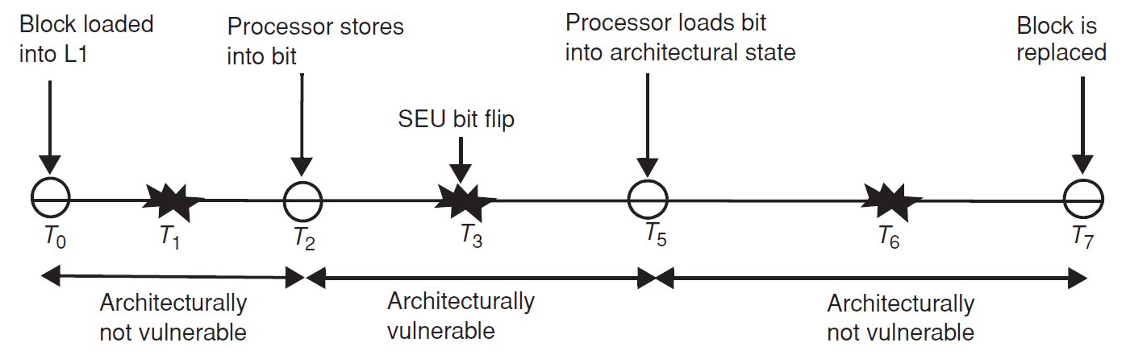
AVF (Architectural Vulnerability Factor)
AVF_{bit} = Probability that bit matters
  = # of Errors visible to user / Total # of possible Bit Flips
  If we assume AVF = 100% then we will be over-designing the system
  Need to estimate AVF to optimize the system design for reliability
Example: timeline of events cache bit (in a cache block):

Slide 32
ACE/unACE BITS IN microARCHITECTURE
Computing AVF requires identifying ACE bits (required for Architecturally Correct Execution) and unACE bits
Microarchitectural unACE bits (i.e. bits that do not change behavior):
  Idle/Invalid State: instructions where the opcode bits do not matter or reserved opcode bits
  Mis-Speculated State: instructions that are being executed speculatively and are not going to retire due to mis-speculation (or exceptions)
  All forms of predictors: Branch predictor, RAS
  Dead bits: Physical registers that have been read by the last consumer but are not deallocated

Slide 33
ARCHITECTURAL unACE BITS
More unACE cases:
  NOP instructions: Plenty of them around (particularly in VLIW style processors)
    Only opcode must be protected; everything else is a don’t care
  Performance-enhancing instructions: Prefetch, Hint bits
  Predicated-false instructions: Itanium ISA supports predication to remove branch prediction (only predicate is ACE)
  Dynamically dead instructions: due to compiler inefficiencies
  Logical masking: Bit masking operations

Slide 34
Electromigration (EM)
Electron Flow
Metal Layer 2
Void Creation
Metal Atom Flow
Hillock Deposition
Metal Layer 1
Wire width decreases with scaling
  But current density increases
  Nearly 1000 amps can move through a wire
Metal atoms in wire gather momentum and move with the electron flow
Leads to shorts and opens in the wires

Slide 35
EM in SRAM cells
Precharge
WL
P1
P2
BL
BL
Unidirectional
Current Flow
Sense Amp
Both the BL and BL-bar have unidirectional current causing EM effects

Slide 36
NBTI (Negative Bias Temperature Instability)
+ : interface trap
H : hydrogen
←: electric field
Stress Phase
Recovery Phase
V_{G} = 0
V_{G} = V_{DD}
V_{S} = V_{DD}
V_{S} = V_{DD} or 0
V_{D} = V_{DD}
H H H H H H H H
H H H H
V_{D} = V_{DD}
p⁺
+ + + + + + + + + +
p⁺
p⁺
+ + +
p⁺
n substrate
n substrate
Body
Body

Slide 37
NBTI Impact
NBTI affects when a negative bias is applied on PMOS
The effect goes away when the bias is removed
  Partially recovers
Potential to fully recover if the bias is flipped to positive
  Yet, only partially recovery
  is possible
Threshold Voltage Increase (|V_{th}|)
T0
T1
T2
Stress Time
Recovery Time
Time

Slide 38
TDDB (Time Dependent Dielectric Breakdown)
Wearout process breaking the gate dielectric material, creating a conductive path in the gate oxide
Traps
Gate Insulation
+
+
+
n⁺
n⁺
Trap Accumulation
Leading to Conducting
Path
p⁺ substrate
Body
Gate Insulation
+
+
+
+
+
n⁺
+
n⁺
p⁺ substrate
Body

Slide 39

What did you learn?
nMOS transistor characteristics
Inverter: structure, operation
Dennard Scaling impact, and Moore's law
Faults – Errors – Failure
Error classification
  SEUs, Soft Errors, Silent data corruption, Permanent errors
FIT, MTTF
AVF: Architectural Vulnerability Factor
  ACE & unACE bits

