Slide 1
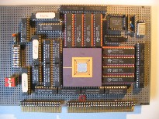
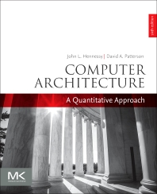
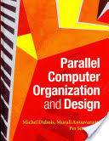
Embedded Computer Architecture 5SAI0 Multi-Processor Systems
Henk Corporaal
www.ics.ele.tue.nl/~heco/courses/ECA
h.corporaal@tue.nl
TUEindhoven
2019-2020

Slide 2
Overview
Multi-Processors
Shared memory architectures
symmetric
distributed
Message passing architectures
Programming model
Material, books:
Dubois: Chapter 5-5.4.1
H&P: Chapter 5-5.2

Slide 3
Should we go Multi-Processing?
Diminishing returns for exploiting ILP
limited Instruction Level Parallelism costly to exploit
Power issues
Wiring issues (faster transistors do not help that much)
More vector and task-level parallel applications
Multi-core architectures hit all markets (even embedded)
lower energy (due to same performance with lower V_{dd})
silicon technology still scales => abundance of transistors

Slide 4
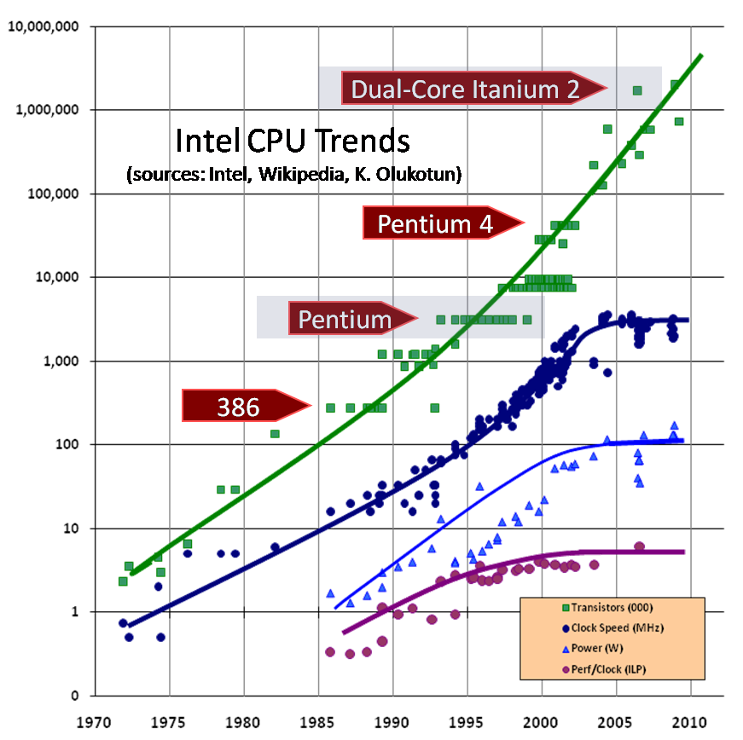
Next?
Core i7
3GHz
100W
Trends:
#transistors follows Moore
but not freq. and performance/core
5

Slide 5
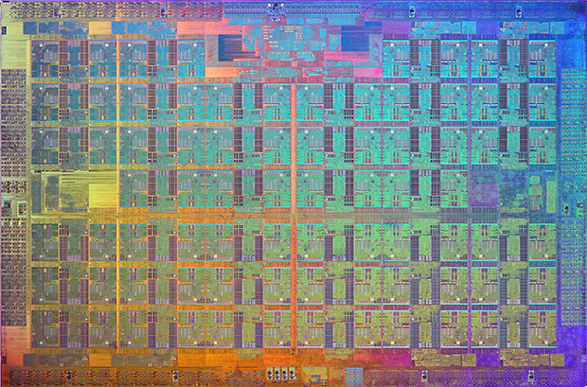
Intel’s 72-core ‘Knight’s Landing’ XEON Phi
- 14 nm
3D Tri-gate transistors
3 TFlops double / 6 TFlops single precision
512-bit SIMD/Vector processing per core

Slide 6
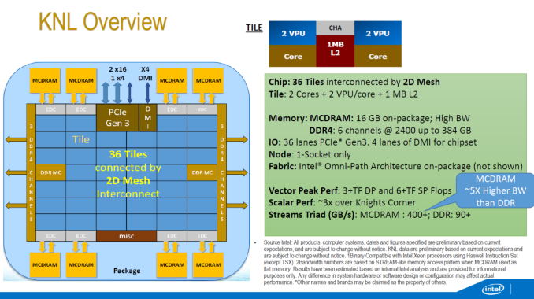
Intel’s 72-core ‘Knight’s Landing’ XEON Phi

Slide 7
Multi-core Architecture
Parallel / Multi-core Architecture extends traditional computer architecture with a communication network
abstractions (HW/SW interface)
organizational structure to realize abstraction efficiently
Memory
I/O
Communication Network
Processing
node
Processing
node
Processing
node
Processing
node
Processing
node

Slide 8
Parallel programming models
How parallel computations can be expressed in a high-level language?
Simple extensions through an API (application-programming interface) of common programming languages such as C/C++ or FORTRAN:
Shared-memory: OpenMP or Pthreads
Message-passing: MPI (message-passing interface)
Parallelizing compilers translate a sequential program into parallel threads
Threads or processes must communicate and coordinate their activity (synchronization)

Slide 9
Data vs function parallelism
Data parallelism:
Partition the data set
Apply the same function to each partition
SPMD (= single program multiple data)
SPMD ≠ SIMD; what's the difference?
Massive parallelism
Function (Task-level) parallelism
Partition the functionality
Independent functions are executed on different processors
E.G.: Streaming--software pipeline
More complex, limited parallelism
Combine both: function + data parallelism

Slide 10
Communication models: Shared Memory
Shared
Memory
(read, write)
(read, write)
Process P1
Process P2
3 Issues:
Coherence problem
Memory consistency issue
Synchronization problem

Slide 11
Shared memory multiprocessors
Key characteristic:
all memory addresses visible by every processor
communication by (normal) loads and stores
synchronization needed to control order between loads and store (for proper communication)

Slide 12
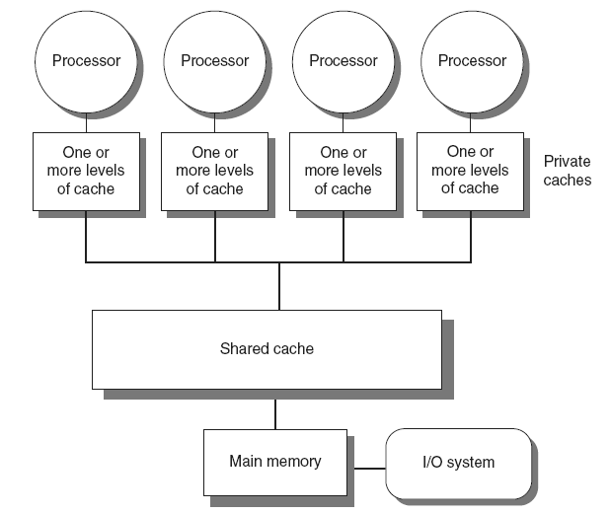
Shared memory multiprocessors: Type 1
1. Symmetric multiprocessors (SMP)
Small number of cores
Share single memory with uniform memory latency

Slide 13
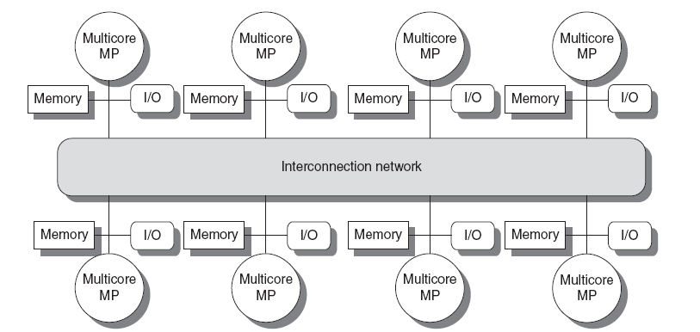
Shared memory multiprocessors: Type 2
2. Distributed shared memory (DSM)
Memory distributed among processors
Non-uniform memory access/latency (NUMA)
Processors connected via direct (switched) and non-direct (multi-hop) interconnection networks

Slide 14
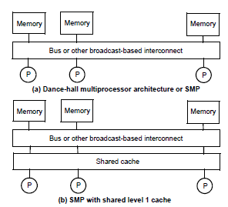
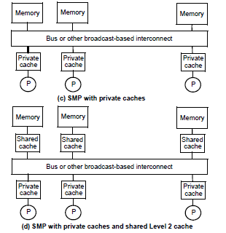
4 Cache organizations for SMPs
Rest of discussion considers organizations (c) and (d)

Slide 15
Example: matrix multiply + sum
Sequential program:
1 sum = 0;
2 for (i=0,i<n, i++)
3 for (j=0,j<n, j++){
4 C[i,j] = 0;
5 for (k=0,k<n, k++)
6 C[i,j] = C[i,j] + A[i,k]*B[k,j];
7 sum += C[i,j];
8 }
- Multiply A[n,n] by B[n,n] and store result in C[n,n]
- Add all elements of matrix C

Slide 16
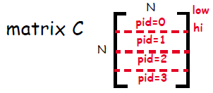
Shared mem: matrix multiply + sum
/* A, B, C, bar, lv and sum are shared, all others are private
*/
1a low = pid*n/nproc; /pid=0...Nproc-1
1b hi = low + n/nproc; /each proc sums rows
1c mysum = 0; sum = 0; /low to hi
2 for (i=low,i<hi, i++)
3 for (j=0,j<n, j++){
4 C[i,j] = 0;
5 for (k=0,k<n, k++)
6 C[i,j] = C[i,j] + A[i,k]*B[k,j];
7 mysum +=C[i,j]; /C summed in shared memory
8 }
9 barrier(bar);
10 lock(lv);
sum += mysum;
unlock(lv);
Synchronization
Mutual exclusion

Slide 17
Why Mutual Exclusion?
Assume the following statements are executed by 2 threads, T1 and T2, on sum
T1 T2
sum<- sum+1 sum<- sum+1
Compiled code on a RISC machine includes several instructions
A possible interleaving of execution is:
T1 T2
r1 <- sum
R1 <- sum
r1 <- r1 + 1
r1 <- r1 + 1
sum <- r1
sum <- r1
At the end the result is that sum is incremented by 1 (not 2)

Slide 18
Communication models: Message Passing
Communication primitives
e.g., send, receive library calls
standard MPI: Message Passing Interface
www.mpi-forum.org
Note that MP can be build on top of SM and vice versa !
receive
send
Process P2
Process P1
send
receive
FiFO

Slide 19
Message Passing Model
Explicit message send and receive operations:
Send specifies local buffer + receiving process on remote computer
Receive specifies sending process on remote computer + local buffer to place data
Typically blocking communication, but may use DMA
DMA = Direct Memory Access (check this out!)
Message structure
Header
Data
Trailer

Slide 20
Message passing communication
Processor
Processor
Processor
Processor
Cache
Cache
Cache
Cache
Memory
Memory
Memory
Memory
DMA
DMA
DMA
DMA
Network
interface
Network
interface
Network
interface
Network
interface
Interconnection Network

Slide 21
Synchronous message-passing
Thread T1: Thread T2:
a = 10; b = 5;
send(&a,sizeof(a),t2,send_a); recv(&b,sizeof(b),t1,send_a);
a = a+1; b=b+1;
recv(&a,sizeof(a),t2,send_b); send(&b,sizeof(b),t1,send_b);
printf(a);
Each send/recv has 4 operands:
Starting address in memory
Size of message
Destination/source thread id
Tag connecting sends and receives
Synchronous communication = sender blocks until recv is completed and receiver blocks until message has been sent
What is the value printed under synchronous MP?
Tag, not really
needed; why not?

Slide 22
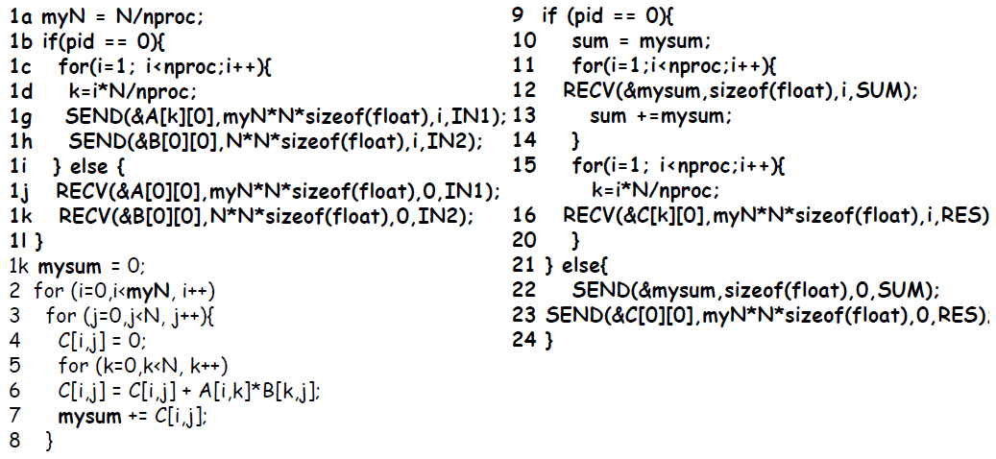
Message-passing: matrix multiply + sum
Notes:
pid = process id
pid 0 is the controlling process, distributing data, collecting results

Slide 23
Synchronous message-passing
Advantage:
Communication protocol enforces synchronization
Disadvantages:
Prone to deadlock
Block threads: no overlap of communication with computation
Deadlock example:
thread T1: thread T2:
a = 10; b = 5;
send(&a,sizeof(a),t2,send_a); send(&b,sizeof(b),t1,send_b)
recv(&c,sizeof(c),t2,send_b); recv(&d,sizeof(d),t1,send_a);
To eliminate the deadlock: swap the send/recv pair in T2
Or employ asynchronous message-passing

Slide 24
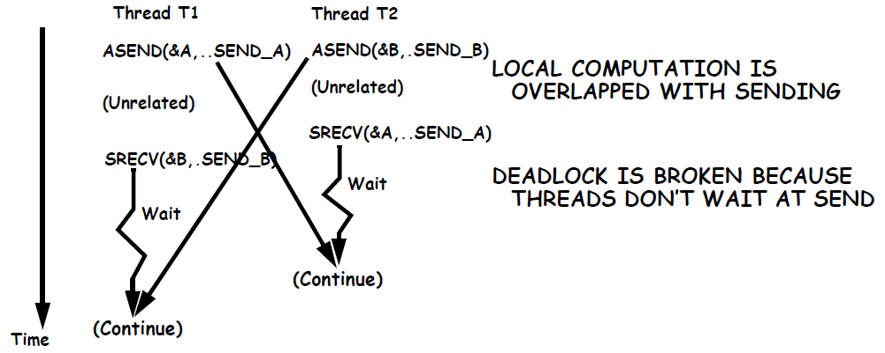
(A)Synchronous message-passing
thread T1: thread T2:
a = 10; b = 5;
asend(&a,sizeof(a),t2,send_a); asend(&b,sizeof(b),t1,send_b);
<unrelated computation;> <unrelated computation;>
srecv(&b,sizeof(b),t2,send_b); srecv(&a,sizeof(b),t1,send_a);

Slide 25
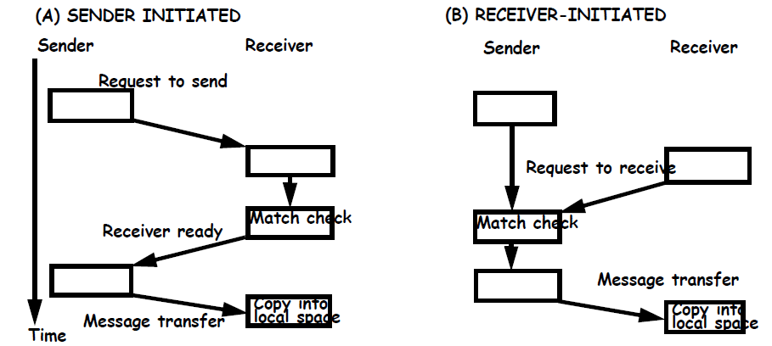
(A)Synchronous message-passing
In general multiple threads are running on a core
This handshake is for synchronous message passing
Can also be applied to blocking or non-blocking asynchronous
Sender continues after send (a) and receiver after recv (b)
If blocking, sender must make a copy of message first

Slide 26
Support for message passing protocols
Data must be copied from/to memory to/from NI (NW interf.)
Processor could do it
DMA (direct memory access) unit can speed up message transfers and off-load the processor
programmed by the processor by specifying start address and size
Dedicated message processors
Use a special processor to process messages on both ends
Thus relieving the compute O/S from doing it
Support for user-level messages by OS (operating system):
DMA engine controlled by OS
Message is first copied into system space and then into user space (receive)
Message is copied from user space to system space (send)
Tag user messages so that they are picked up and delivered directly in user memory space (zero copy)

Slide 27
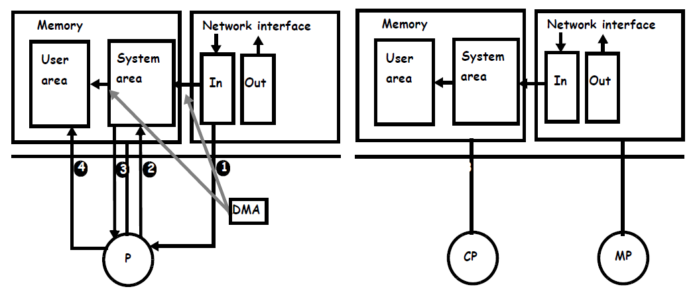
Message-passing support

Slide 28
Communication Models: Comparison
Shared-Memory (used by e.g. OpenMP)
Compatibility with well-understood (language) mechanisms
Ease of programming for complex or dynamic communications patterns
Shared-memory applications; sharing of large data structures
Efficient for small items
Supports hardware caching
Messaging Passing (used by e.g. MPI)
Simpler hardware
Explicit communication
Implicit synchronization (with any communication)
What do you prefer?

Slide 29
Next: 3 fundamental issues for shared memory multiprocessors
Coherence, about: Do I see the most recent data?
Consistency, about: When do I see a written value?
e.g. do different processors see writes at the same time (w.r.t. other memory accesses)?
Synchronization How to synchronize processes?
how to protect access to shared data?

Slide 30
Concluding remarks
Number of transistors still scales well
However power/energy limits reached
Frequency not further increased
Therefore: After 2005 going Multi-Core
exploiting task / thread level parallelism (TLP)
can be combined with exploiting DLP (SIMD / Sub-word parallelism)
2 types of systems and programming models
Shared memory
Message passing
What are the pros and cons of both systems?

