Slide 1
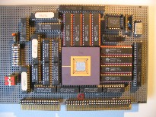
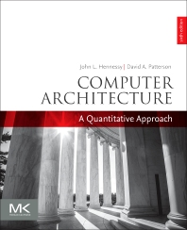
Embedded Computer Architecture 5SAI0 Simulation (ch9)
Henk Corporaal
www.ics.ele.tue.nl/~heco/courses/ECA
h.corporaal@tue.nl
TUEindhoven
2019-2020

Slide 2
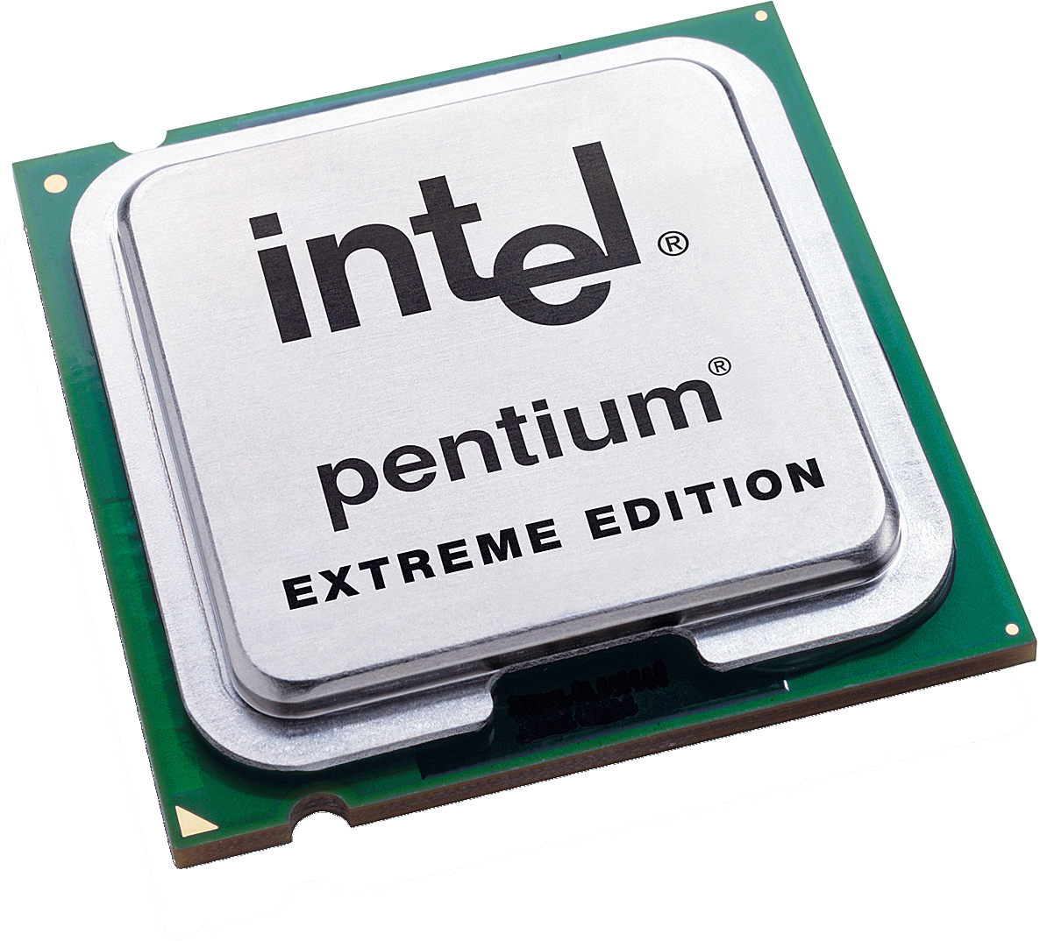
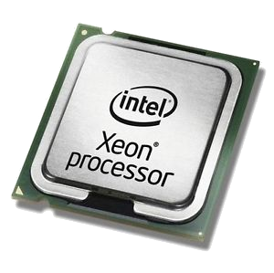
Processors Processing Processors
The meta-lecture

Slide 3
Why Simulators?
Your Friend Harm

Slide 4
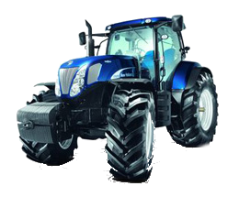
Why Simulators?
Harm Loves Tractors
Harm

Slide 5
Why Simulators?
The outside world
Unfortunately for Harm you need to go outside to drive tractors
Harm

Slide 6
Why Simulators?
The outside world
And the outside world is filled with dangers
Harm

Slide 7
Why Simulators?
The outside world
And the outside world is filled with dangers
Rain!
Harm

Slide 8
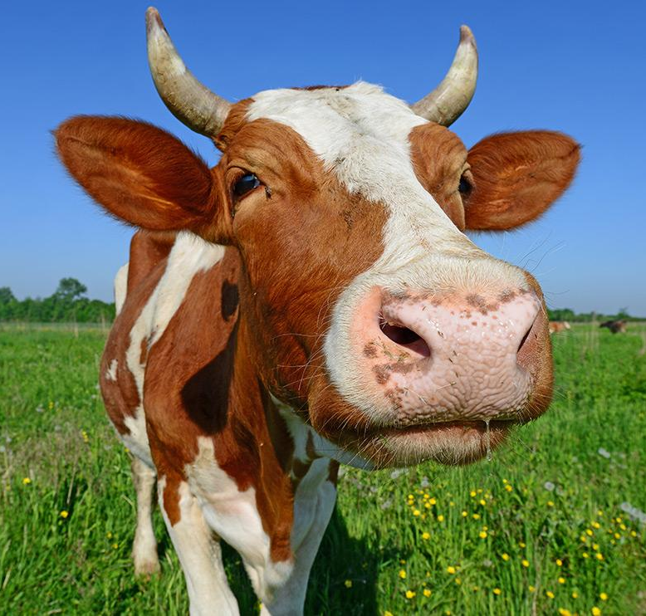
Why Simulators?
The outside world
And the outside world is filled with dangers
Rain!
Scary Animals!
Harm

Slide 9
Why Simulators?
Harm

Slide 10
Why Simulators?
So Harm uses his PC
Harm

Slide 11
Why Simulators?
Harm

Slide 12
Why Simulators?
Oh No! My PC is too slow to run Farming Simulator
Harm

Slide 13
Why Simulators?
Oh No! My PC is too slow to run Farming Simulator
You
Harm

Slide 14
Why Simulators?
Oh No! My PC is too slow to run Farming Simulator
Stand back!
I’m a computer architect!
Obligatory cape
You
Harm

Slide 15
How to help Harm?
Of course you have many ideas on how to speed-up Harms computer.
But which ones should you apply?
You

Slide 16
Design Space Exploration Options

Slide 17
Design Space Exploration Options
Buy (or build) all hardware options

Slide 18
Design Space Exploration Options
Gee that sounds expensive...
Buy (or build) all hardware options

Slide 19
Design Space Exploration Options
Buy (or build) all hardware options
Use analytical models

Slide 20
Design Space Exploration Options
How reliable
is that?
Buy (or build) all hardware options
Use analytical models

Slide 21
Design Space Exploration Options
Buy (or build) all hardware options
Use analytical models
Simulate the design points!

Slide 22
Design Space Exploration Options
Hey, I like simulators, That sounds promising :)
Buy (or build) all hardware options
Use analytical models
Simulate the design points!

Slide 23
What to simulate for?

Slide 24
What to simulate for?
Performance
Energy
Power (!=Energy)
Thermal

Slide 25
What to simulate for?
What details to simulate?
Performance
Energy
Power (!=Energy)
Thermal

Slide 26
What to simulate for?
What details to simulate?
Performance
Energy
Power (!=Energy)
Thermal
Cycle accurate vs Functionality
Caches
Full operating system
Disk accesses
Background tasks
...

Slide 27
What to simulate for?
What details to simulate?
Performance
Energy
Power (!=Energy)
Thermal
Cycle accurate vs Functionality
Caches
Full operating system
Disk accesses
Background tasks
...

Slide 28
All the details: RTL Simulation

Slide 29
All the details: RTL Simulation
Simulate at gate level:

Slide 30
All the details: RTL Simulation
Simulate at gate level:
modelsim/questasim (Mentor)
ncsim (Cadence)
VCS (Synopsys)
Icarus Verilog (Open Source!)
...

Slide 31
All the details: RTL Simulation
Simulate at gate level:
modelsim/questasim (Mentor)
ncsim (Cadence)
VCS (Synopsys)
Icarus Verilog (Open Source!)
...
Advantages:
No need to build a custom simulator if you need RTL to build hardware anyway
Highest level of precision and detail

Slide 32
All the details: RTL Simulation
Simulate at gate level:
modelsim/questasim (Mentor)
ncsim (Cadence)
VCS (Synopsys)
Icarus Verilog (Open Source!)
...
Advantages:
No need to build a custom simulator if you need RTL to build hardware anyway
Highest level of precision and detail
Disadvantage:
Horribly slow for realistic designs

Slide 33
All the details: RTL Simulation
Simulate at gate level:
modelsim/questasim (Mentor)
ncsim (Cadence)
VCS (Synopsys)
Icarus Verilog (Open Source!)
...
Advantages:
No need to build a custom simulator if you need RTL to build hardware anyway
Highest level of precision and detail
Disadvantage:
Horribly slow for realistic designs
Nvidia GPU with > 1 Billion transistors
Small tests take over 8 hours! [1]
[1] http://www.deepchip.com/items/0523-04.html

Slide 34
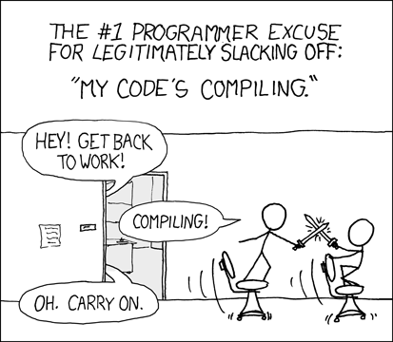
Computer Architect
Simulating
Simulating!
modified from http://xkcd.com/303/

Slide 35
Slightly less horribly slow: Hardware Emulation
RTL description
of Target Architecture

Slide 36
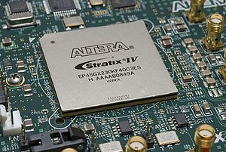
Slightly less horribly slow: Hardware Emulation
RTL description
of Target Architecture
Synthesize for
FPGA (slow)

Slide 37
Slightly less horribly slow: Hardware Emulation
RTL description
of Target Architecture
Synthesize for
FPGA (slow)
Emulate on FPGA (fast!)
Note: instrumentation required to get detailed information out!

Slide 38
Levels of detail in Simulation
Full-System versus User-level
Cycle Accurate versus Functional
Execution- versus Trace-driven

Slide 39
Full-system versus User-Level
To OS or not to OS?

Slide 40
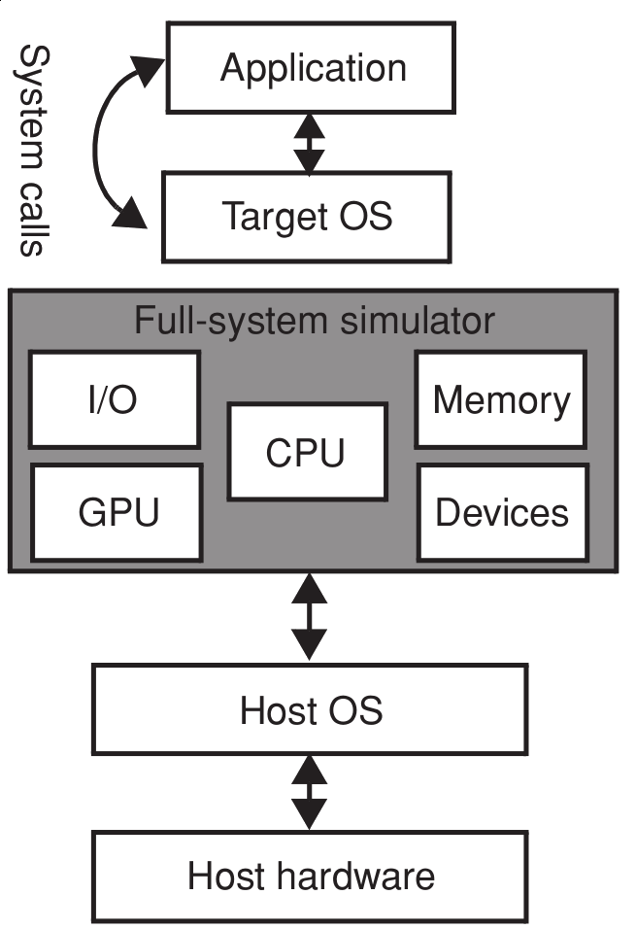
Full-system versus User-Level
To OS or not to OS?
Full-System

Slide 41
Full-system versus User-Level
To OS or not to OS?
Full-System

Slide 42
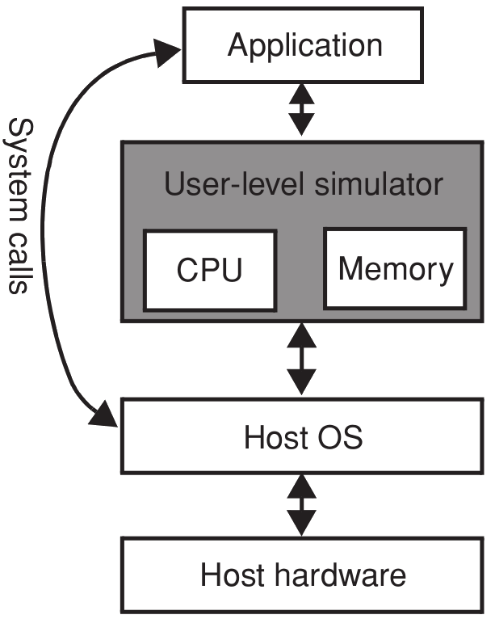
Full-system versus User-Level
To OS or not to OS?
Full-System
User-Level

Slide 43
User-Level
Famous example: Simple Scalar [1]
Advantages
Fast to develop and update to new architectures
Usually ‘accurate enough’
Disadvantages
Any time spent in the OS is not modelled accurately. Can have severe impact, database applications spent 20-30% of their time in OS mode.
[1] http://www.simplescalar.com/

Slide 44
Cycle Accurate versus Functional
Notes:
orthogonal classification to full-system vs user-level

Slide 45
Cycle Accurate versus Functional
Cycle Accurate
Notes:
orthogonal classification to full-system vs user-level

Slide 46
Cycle Accurate versus Functional
Cycle Accurate
Notes:
orthogonal classification to full-system vs user-level

Slide 47
Cycle Accurate versus Functional
Cycle Accurate
Functional
Notes:
orthogonal classification to full-system vs user-level

Slide 48
Cycle Accurate versus Functional
Functional - no/limited model of the micro architecture
An (add) instruction of the target can be translated to an (add) instruction on the host, and be simulated that way.
Example 1: Simple Scalar sim-fast
Example 2: QEMU, Full-system emulator using dynamic translation
Cycle Accurate - includes model of the micro architecture
Block resources in the pipeline when instruction executes
Use target branch predictor scheme
Out-of-order execution
Example: Simple Scalar sim-outorder

Slide 49
Intermezzo - Internals of dynamic translation
Target
Binary
Native
Instructions
Magic
Translate

Slide 50
Intermezzo - Internals of dynamic translation
int32_t instructions[]={
0x3FE9,
0xA701,
0xEF02,
0x8FF0
};
execute(instructions);
Target
Binary
Native
Instructions
Magic
Translate

Slide 51
Intermezzo - Internals of dynamic translation
int32_t instructions[]={
0x3FE9,
0xA701,
0xEF02,
0x8FF0
};
execute(instructions);
Target
Binary
Native
Instructions
Magic
Translate
Question
Implement the execute function in regular C

Slide 52
Intermezzo - Internals of dynamic translation
void execute(int32_t* instructions){
//declare a pointer to a function that returns void
// and has no arguments
void (fp*)(void);
//set the function pointer to the first instruction
fp=instructions;
//call the function
//Note: make sure the last instruction in the list returns
fp();
}
int32_t instructions[]={
0x3FE9,
0xA701,
0xEF02,
0x8FF0
};
execute(instructions);

Slide 53
Execution- versus Trace-driven

Slide 54
Execution- versus Trace-driven
Application Binary
Execution-Driven
Simulator
Metrics
Execution Driven: Application executes on simulator

Slide 55
Execution- versus Trace-driven
Application Binary
Execution-Driven
Simulator
Metrics
Execution Driven: Application executes on simulator
Application Binary
Execution-Driven
Simulator
Instruction
Trace
Trace-Driven
Simulator
Metrics
Trace Driven: simulator uses trace as input

Slide 56
Execution- versus Trace-driven
Application Binary
Execution-Driven
Simulator
Metrics
mov edx,len
mov ecx,msg
mov ebx,1
mov eax,4 int 0x80
Execution Driven: Application executes on simulator
Application Binary
Execution-Driven
Simulator
Instruction
Trace
Trace-Driven
Simulator
Metrics
Trace Driven: simulator uses trace as input

Slide 57
Execution- versus Trace-driven
Application Binary
Why would a sane person do this?
Execution-Driven
Simulator
Metrics
mov edx,len
mov ecx,msg
mov ebx,1
mov eax,4 int 0x80
Execution Driven: Application executes on simulator
Application Binary
Execution-Driven
Simulator
Instruction
Trace
Trace-Driven
Simulator
Metrics
Trace Driven: simulator uses trace as input

Slide 58
Execution- versus Trace-driven
Application Binary
Execution-Driven
Simulator
Metrics
mov edx,len
mov ecx,msg
mov ebx,1
mov eax,4 int 0x80
Execution Driven: Application executes on simulator
Execution-Driven
Simulator
Application Binary
Instruction
Trace
Trace-Driven
Simulator
OR
Metrics
ISA compatible
Processor
Trace Driven: simulator uses trace as input

Slide 59
Trace-driven Simulation
Advantages
Trace collection only required once
Trace collection can be done with ISA compatible processor
Trace simulator does not need to simulate all instructions, can skip ahead in trace if not implemented

Slide 60
Trace-driven Simulation
Advantages
Trace collection only required once
Trace collection can be done with ISA compatible processor
Trace simulator does not need to simulate all instructions, can skip ahead in trace if not implemented
Disadvantages
Cannot speculatively execute code (trace is fixed)
Trace file can become huge for large applications (hundreds of GBs)

Slide 61
Mixing Simulation Strategies
Direct-execution
Parts execute directly on the host (e.g. using dynamic translation such as QEMU)
Other parts are executed on cycle accurate simulation
Use case:
Interested in memory accesses and memory behavior. Execute only loads and
stores on the simulator, emulate the rest directly on the host machine

Slide 62
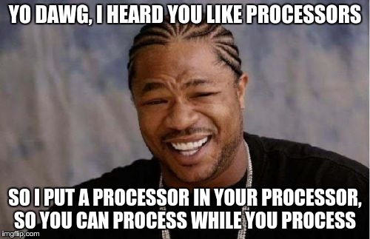
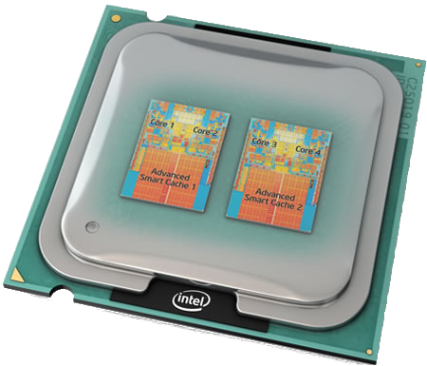
Simulation in the Multiprocessor Era

Slide 63
Simulation in the Multiprocessor Era

Slide 64
Parallelisation in all levels of the simulation stack
Benchmark
Target Processor
Simulator
Host Platform

Slide 65
Parallelisation in all levels of the simulation stack
Benchmark
Multi-threaded application
...
0
1
N
Target Processor
Simulator
Host Platform

Slide 66
Parallelisation in all levels of the simulation stack
Benchmark
Multi-threaded application
...
A multi-threaded application running on a single core target processor.
Question: Does this make sense?
0
1
N
Target Processor
Simulator
Host Platform

Slide 67
Parallelisation in all levels of the simulation stack
Benchmark
Multi-threaded application
...
0
1
N
Target Processor
Multi-core target processor
A
B
...
?
Simulator
Host Platform

Slide 68
Parallelisation in all levels of the simulation stack
Benchmark
Multi-threaded application
...
A multi-core processor running on a single threaded simulator.
Question: Does this make sense?
0
1
N
Target Processor
Multi-core target processor
A
B
...
?
Simulator
Host Platform

Slide 69
Parallelisation in all levels of the simulation stack
Benchmark
Multi-threaded application
...
0
1
N
Target Processor
Multi-core target processor
A
B
...
?
Multi-threaded simulator
Simulator
0
1
...
N
Host Platform

Slide 70
Parallelisation in all levels of the simulation stack
Benchmark
Multi-threaded application
...
A multi-threaded simulator running on a single-core host.
Question: Does this make sense?
0
1
N
Target Processor
Multi-core target processor
A
B
...
?
Multi-threaded simulator
Simulator
0
1
...
N
Host Platform

Slide 71
Parallelisation in all levels of the simulation stack
Benchmark
Multi-threaded application
...
0
1
N
Target Processor
Multi-core target processor
A
B
...
?
Multi-threaded simulator
Simulator
0
1
...
N
Multi-core host platform
Host Platform
A
B
...
?

Slide 72
Parallelisation at all levels of the simulation stack
Benchmark
Multi-threaded application
...
0
1
N
But how to build a fast, multi-threaded simulator?
Target Processor
Multi-core target processor
A
B
...
?
Multi-threaded simulator
Simulator
0
1
...
N
Multi-core host platform
Host Platform
A
B
...
?

Slide 73
Parallelisation in all levels of the simulation stack
But how to build a fast, multi-threaded simulator?
Multi-threaded simulator
Simulator
0
1
...
N

Slide 74
Parallel Simulation Techniques
Discrete event simulation
Quantum simulation
Slack simulation

Slide 75
Parallel Simulation Techniques
Discrete event simulation
Quantum simulation
Slack simulation
Not schrödinger's cat ‘quantum’ though

Slide 76
Space Granularity
The textbook implicitly assumes the smallest hardware block that can be mapped to a simulator thread is a full target core.
Holds for almost all real-world simulators, which severely limits the parallelism

Slide 77
Space Granularity
The textbook implicitly assumes the smallest hardware block that can be mapped to a simulator thread is a full target core.
Holds for almost all real-world simulators, which severely limits the parallelism
Exception is RTL simulation, there the blocks can be smaller.
The Rocketick simulator even appears to use GPUs! [1]
[1] http://www.deepchip.com/items/0523-04.html

Slide 78
Discrete-Event Simulation
A logical choice for a simulator “time step” is one cycle for the fastest core.

Slide 79
Discrete-Event Simulation
Disadvantage

Slide 80
Discrete-Event Simulation
Disadvantage
Under utilisation of the host platform if threads are idle for synchronisation

Slide 81
Discrete-Event Simulation
Is it really this bad? What assumption did the author of the book make here?
Disadvantage
Under utilisation of the host platform if threads are idle for synchronisation

Slide 82
Discrete-Event Simulation
Every target processor Pn is mapped to a separate host core
Is it really this bad? What assumption did the author of the book make here?
Disadvantage
Under utilisation of the host platform if threads are idle for synchronisation

Slide 83
Target vs Host Cores
There is no relation between the number of target cores and the number of host cores!!!

Slide 84
Target vs Host Cores
There is no relation between the number of target cores and the number of host cores!!!

Slide 85
Benchmark
Multi-threaded application
...
0
1
N
Target Processor
Multi-core target processor
A
B
...
?
Multi-threaded simulator
Simulator
0
1
...
N
Multi-core host platform
Host Platform
A
B
...
?

Slide 86
Discrete-Event Simulation

Slide 87
Discrete-Event Simulation
Utilisation of host depends on variation in processing time of a cycle, but also on the amount of host cores!
1
P4
P3
P2
P1
Host core 1

Slide 88
Quantum Simulation
Synchronize threads at larger time-steps, e.g. 3 cycles

Slide 89
Quantum Simulation
Synchronize threads at larger time-steps, e.g. 3 cycles
Advantage
Utilisation improves, because the variation of processing is amortized over longer sections of simulation
Disadvantage
No longer cycle accurate

Slide 90
Slack Simulation
Start with discrete-event simulation schedule

Slide 91
Slack Simulation
Instead of waiting in the red areas, use slack to process ahead

Slide 92
Slack Simulation
Instead of waiting in the red areas, use slack to process ahead

Slide 93
Slack Simulation
Side-effect: Drift
The cores might be simulating different points in time, and could drift apart
Mitigation
Allow a maximum drift (or slack), and synchronize when this value is exceeded

Slide 94
Slack Simulation
Side-effect: Drift
The cores might be simulating different points in time, and could drift apart
Mitigation
Allow a maximum drift (or slack), and synchronize when this value is exceeded
Max slack of 2

Slide 95
Slack versus Quantum simulation
In quantum simulation, the core simulation times always stay within a cycle window, which is fixed in global time.
Also in slack simulation the simulation times stay within a window, but with the key difference that this is a sliding window.

Slide 96
Slack versus Quantum simulation
In quantum simulation, the core simulation times always stay within a cycle window, which is fixed in global time.
Also in slack simulation the simulation times stay within a window, but with the key difference that this is a sliding window.
Typically much less synchronisation!

Slide 97
Still not good enough
From the paper Graphite: a Distributed Parallel Simulator for Multicores
“Simulation slowdown is as low as 41× versus native execution”
[1] Graphite: A Distributed Parallel Simulator for Multicores - Jason E. Miller et al.

Slide 98
Still not good enough
From the paper Graphite: a Distributed Parallel Simulator for Multicores
“Simulation slowdown is as low as 41× versus native execution”
That still sounds slow
[1] Graphite: A Distributed Parallel Simulator for Multicores - Jason E. Miller et al.

Slide 99
Still not good enough
From the paper Graphite: a Distributed Parallel Simulator for Multicores
“Simulation slowdown is as low as 41× versus native execution”
That still sounds slow
Well...
[1] Graphite: A Distributed Parallel Simulator for Multicores - Jason E. Miller et al.

Slide 100
Still not good enough
From the paper Graphite: a Distributed Parallel Simulator for Multicores
“Simulation slowdown is as low as 41× versus native execution”
That still sounds slow
Yes :(
[1] Graphite: A Distributed Parallel Simulator for Multicores - Jason E. Miller et al.

Slide 101
Question
What can we do if it still takes weeks or months to simulate a full benchmark?
cycles
0
1e16

Slide 102
Workload Sampling
Naive Approach
Only simulate first X cycles
fixed length
cycles
0
1e12

Slide 103
Workload Sampling
Often benchmarks start with reading settings and initialisation. Most likely not representative of workload!
fixed length
cycles
0
1e12

Slide 104
Workload Sampling
Fix
Use functional simulation to skip over the initial section
init
skip init with
functional sim
fixed length
cycles
0
1e12

Slide 105
Workload Sampling
Question
Is the window always a good representation of the benchmark?
Why/why not?
init
skip init with
functional sim
fixed length
cycles
0
1e12

Slide 106
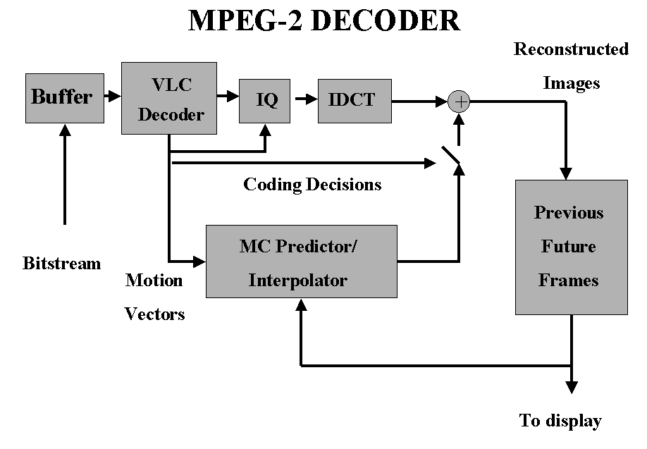
Program Modes
Real world programs spend time in different modes,
which can have very different characteristics

Slide 107
Workload Sampling
Sample uniformly over the program, hopefully capturing the dominant modes
uniform sampling
init
skip init with
functional sim
fixed length
cycles
0
1e12

Slide 108
Workload Sampling
Sample uniformly over the program, hopefully capturing the dominant modes
uniform sampling
init
However, if the window size is very small, the micro-architecture is not initialized correctly!
E.g.: the branch predictor and caches
skip init with
functional sim
fixed length
cycles
0
1e12

Slide 109
Workload Sampling
Solution: add warm up period before every window
uniform sampling
init
skip init with
functional sim
fixed length
cycles
0
1e12

Slide 110
Workload Sampling
Solution: add warm up period before every window
uniform sampling
init
Question
How long should we warm-up?
skip init with
functional sim
fixed length
cycles
0
1e12

Slide 111
Workload Sampling
[1] SMARTS: accelerating microarchitecture simulation via rigorous statistical sampling - Roland E. Wunderlich et al.
Solution: add warm up period before every window
uniform sampling
init
Some numbers suggested by SMARTS [1] to get a feeling for the scale:
Initializing caches 500.000 cycles
Initializing branch prediction, reorder buffers, etc (micro architectural structures.) 4000 cycles
window size 1000 cycles
skip init with
functional sim
fixed length
cycles
0
1e12

Slide 112
Workload Sampling
uniform sampling
init
skip init with
functional sim
fixed length
cycles
0
1e12

Slide 113
Workload Sampling
“mode
sampling”
uniform sampling
init
skip init with
functional sim
fixed length
cycles
0
1e12

Slide 114
Workload Sampling
“mode
sampling”
uniform sampling
init
Profile for modes in the application,
and select representative windows.
Typically the window size can be larger,
so less windows + warm-up is required
skip init with
functional sim
fixed length
cycles
0
1e12

Slide 115
Summary
Why Simulators
More accurate than models
Cheaper than building hardware
Simulation detail
Full-System vs User-level
Functional vs Cycle Accurate (micro-arch.) vs Gate-Level
Execution- vs Trace-driven
(Fast) Multiprocessor Simulation
Discrete event
Quantum
slack
Workload Sampling
Summary (the meta lecture)

Slide 116
Summary
Why Simulators
More accurate than models
Cheaper than building hardware
Simulation detail
Full-System vs User-level
Functional vs Cycle Accurate (micro-arch.) vs Gate-Level
Execution- vs Trace-driven
(Fast) Multiprocessor Simulation
Discrete event
Quantum
slack
Workload Sampling
Summary (the meta lecture)
You can read about all of this in your
textbook, chapter 9

