Slide 1
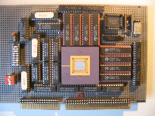
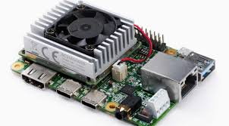
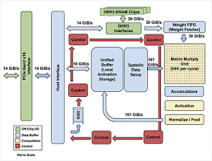
Intelligent Architectures
5LIL0
Recap
TPU board
Henk Corporaal
www.ics.ele.tue.nl/~heco/courses/IA
h.corporaal@tue.nl
TUEindhoven
2021
TPU datapath

Slide 2
Intelligent Architectures (IA, 5LIL0)
Experimental course, with focus on Deep Learning
What's Deep Learning?
  self learning algorithms
  using huge data sets to learn
  deep: many "learning layers"
  brain inspired, based on neurons and synapses (connections)
  high classification accuracy
Many applications; the hype started with: ImageNet

Slide 3
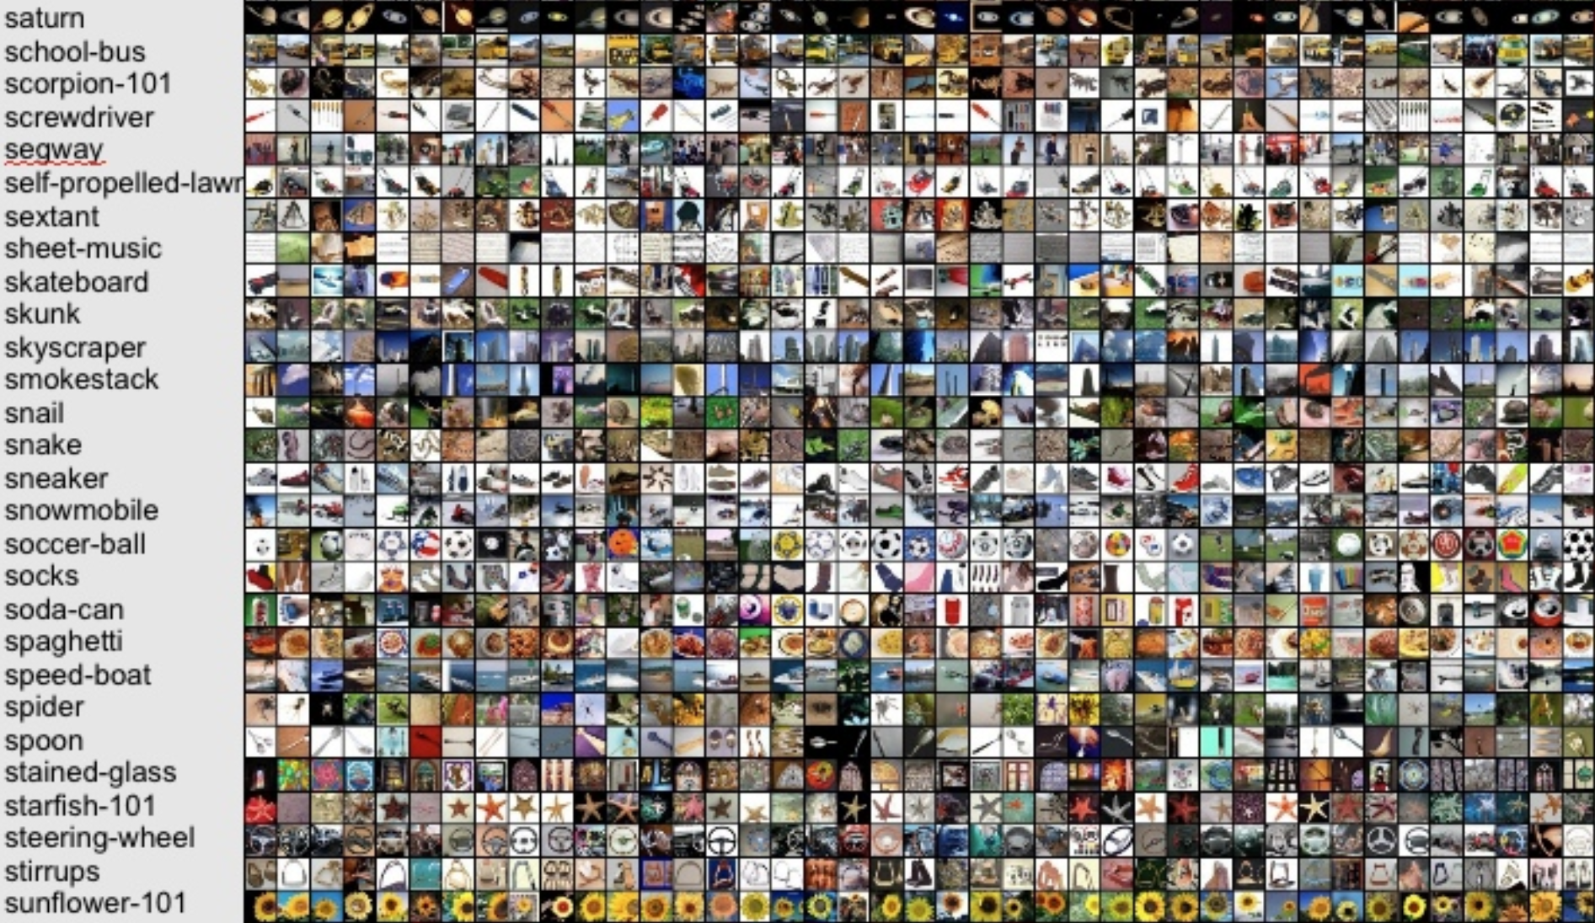
ImageNet challenge: 10M images, 10000 classes

Slide 4
ImageNet Winners (top-5 classification error)
2012: DL beats traditional methods
2015: DL beats human!

Slide 5
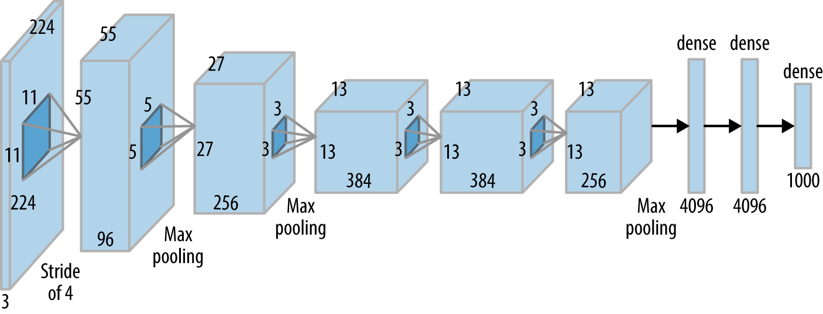
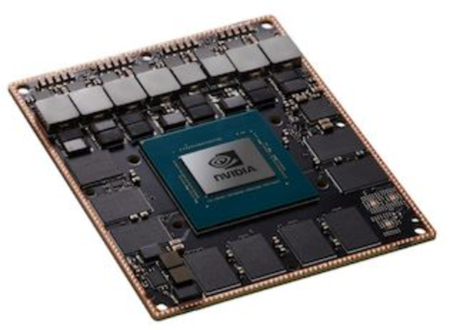
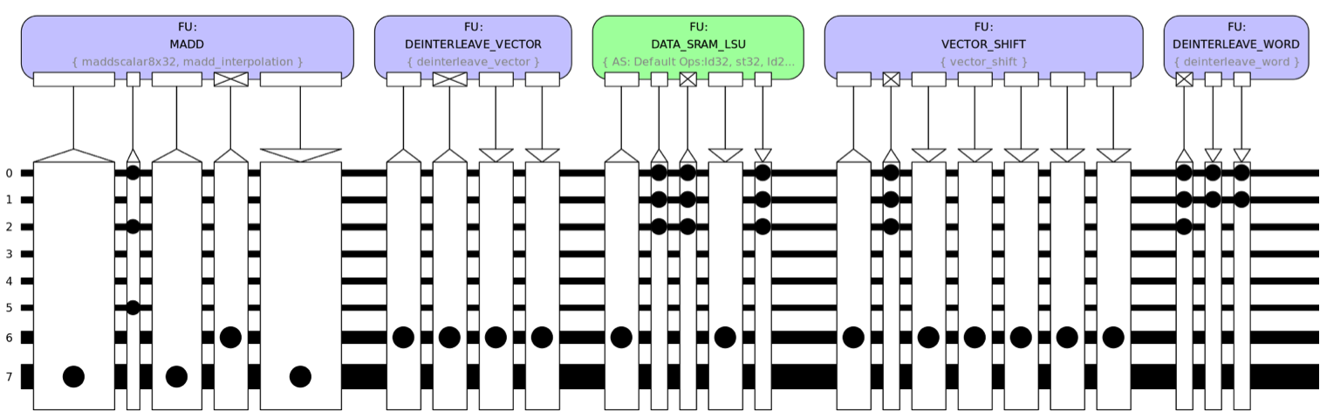
Intelligent Architectures
Summary
AlexNet (partly)
AivoTTA (partly)
NVIDIA Xavier
embedded GPU
Notes:
Photo is of an Intel Conroe (Core 2 Duo Desktop processor). Photo taken from Intel web site.

Slide 6

Learning goals
Understanding deep learning, including:
  network architectures
  inference
  learning methods
Design of Deep Neural Networks (ANNs/DNNs), using current frameworks
  in particular Convolutional Neural Networks (CNNs) using PyTorch
Implement and optimize ANNs using various optimization methods
Current deep ANNs, including newer operators
Special processing hardware efficiently supporting Deep Learning
Alternative approaches to the ''classical‘’ ANNs, like:
  Bayesian learning and Neuromorphic computing

Slide 7
Prerequisites
Basic background in computer architecture
  like pipelining, caching, instruction-sets, assembly programming
  e.g. as presented in Computation I (5EIA0)
Good SW programming skills, e.g. in C, C++ or Python
Basic knowledge of GPU programming
  as taught in e.g. ECA, 5SIA0
Differential calculus skills
Optional: HDL experience,
  like in Verilog or VHDL
  (optional part of lab3)
#include <stdio.h>
void
main(void) { neuzel(1);
}
neuzel(t,_,a)
char *a;
{return!0<t?t<3?neuzel(-79,-13,a+neuzel(-87,1-_,
neuzel(-86, 0, a+1 )+a)):1,t<_?neuzel(t+1, _, a ):3,neuzel ( -94, -27+t, a
)&&t == 2 ?_<13 ?neuzel ( 2, _+1, "%s %d %d\n" ):9:16:t<0?t<-72?neuzel(_,
t,"@n'+,#'/*{}w+/w#cdnr/+,{}r/*de}+,/*{*+,/w{%+,/w#q#n+,/#{l,+,/n{n+\
,/+#n+,/#;#q#n+,/+k#;*+,/'r :'d*'3,}{w+K w'K:'+}e#';dq#'l q#'+d'K#!/\
+k#;q#'r}eKK#}w'r}eKK{nl]'/#;#q#n'){)#}w'){){nl]'/+#n';d}rw' i;# ){n\
l]!/n{n#'; r{#w'r nc{nl]'/#{l,+'K {rw' iK{;[{nl]'/w#q#\
n'wk nw' iwk{KK{nl]!/w{%'l##w#' i; :{nl]'/*{q#'ld;r'}{nlwb!/*de}'c \
;;{nl'-{}rw]'/+,}##'*}#nc,',#nw]'/+kd'+e}+;\
#'rdq#w! nr'/ ') }+}{rl#'{n' ')# }'+}##(!!/")
:t<-50?_==*a ?putchar(a[31]):neuzel(-65,_,a+1):neuzel((*a == '/')+t,_,a\
+1 ):0<t?neuzel ( 2, 2 , "%s"):*a=='/'||neuzel(0,neuzel(-61,*a, "!ek;dc \
i@bK'(q)-[w]*%n+r3#l,{}:\nuwloca-O;m .vpbks,fxntdCeghiry"),a+1);
}
this is compilable C-code,
but you can do much better

Slide 8
Schedule
Q3, 2021
Nr | Date | Day | Lecturer(s) | Topic(s)
1 | Feb 2 | Tuesday | Henk Corporaal | Overview Lecture
 |  |  |  | \- Introduction to ML and CNNs
 |  |  | Berk Ulker | Lab 1 Introduction: ANN design; deadline Feb 25
2 | Feb 5 | Friday | Berk Ulker | Learning principles
3 | Feb 9 | Tuesday | Berk Ulker | Learning principles, continued
 |  |  |  | NW design and Frameworks
4 | Feb 12 | Friday | Maurice Peemen | Optimizations 1: Making the NW cheaper
 |  |  | (ThermoFisher) | \- Compact aware NW design
5 | Feb 23 | Tuesday | Floran de Putter | Optimizations 2: Making the calculations and storage cheaper
 |  |  |  | \- ANN Quantization
 |  |  | Ali Banagozar | Lab 2 Introduction: GPU mapping; deadline Mar 14
6 | Feb 26 | Friday | Henk Corporaal | Optimizations 3: Exploting data reuse by scheduling and buffering
 |  |  |  | \- Advanced loop transformations + Intro Halide
7 | Mar 2 | Tuesday | Henk Corporaal | Optimizations 3, cont'd: Halide details
 |  |  |  | \- Halide language and ANN mapping
8 | Mar 5 | Friday | Henk Corporaal | Optimizations 1, cont'd Filter Decomposition
 |  |  | Floran de Putter | Optimization 2, cont'd: Extreme Quantization:BNNs & TNNs

Slide 9
Schedule
Q3, 2021
Nr | Date | Day | Lecturer(s) | Topic(s)
9 | Mar 9 | Tuesday | Alexios Balatsoukas | Advanced DNNs
 |  |  |  | DNN applications
10 | Mar 12 | Friday | Kanishkan Vadivel | Specific Architectures for ANNs
 |  |  | Kanishkan Vadivel | Lab 3 Introduction: ASIP mapping; deadline Apr 1
11 | Mar 16 | Tuesday | Kanishkan Vadivel | Finishing Specic architectures and
 |  |  |  | General Architectures for ANNs
12 | Mar 19 | Friday | WIllem Sanberg (NXP) | NAS: network architecture search
 |  |  | Floran de Putter | TimeLoops and ZigZag
13 | Mar 23 | Tuesday | Amir Yousefzadeh (IMEC) | Beyond ANNs
 |  |  | Sherif Eissa | \- Spinking Neural Networks (SNNs) and SNN architectures
14 | Mar 26 | Friday | Martin Villescas & | Beyond ANNs
 |  |  | Patrick Wijnings | \- Bayesian learning, architectures, and its relation to ANNs
15 | Mar 30 | Tuesday | Henk Corporaal | Recap
16 | Apr 2 | Friday |  | No Lecture (Good Friday)

Slide 10
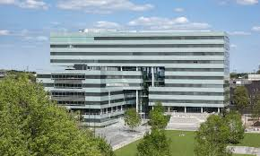

Course Administration
Credits:
  5LIL0: 5 credit points (ECTS)
Labs
  finish Lab 3: < Friday, Apr 2, 23.59h
Oral exams on April 14/15
Bonus: article presentation on April 21
Resit: June 30
  Read the notes on Canvas !

Slide 11
Intelligent Architectures Team
Lectures:
  Maurice Peemen (ThermoFisher)
  Willem Sanberg (NXP)
  Alexios Balatsoukas
  Amir Yousefzadeh (IMEC)
  Martin Villescas
  Henk Corporaal
Lab support and lectures:
  Berk Ulker (lab 1)
  Sherif Eissa (lab 1)
  Ali Banagozar (lab 2)
  Mohammad Emad (lab 2)
  Floran de Putter (lab 3)
  Kanishkan Vadivel (lab 3)
  Backup: Barry de Bruin

Slide 12
Material
IA 5LIL0 Web resources
  http://www.es.ele.tue.nl/~heco/courses/IA-5LIL0
  https://canvas.tue.nl/courses/15854
Articles
  Efficient Processing of Deep Neural Networks: A Tutorial and Survey by Vivienne Sze, e.a.; arXiv, August 2017 (also slides available)
Study recent (>= 2018) article from top conferences and journals
  http://www.guide2research.com/topconf/machine-learning
  http://www.guide2research.com/journals/machine-learning
  http://www.es.ele.tue.nl/~heco/lit/conf+journals.html

Slide 13

Recap topics
What is learning?
1. What is a DNN, and in particular a CNN?
2-3. DNN Learning principles
4. Optimization 1: Pruning
5+8. Optimization 2: Quantization
6-7. Optimization 3: Data reuse
9: Optimization 4: NW restructuring
10: Applications (not treated separately in recap)
11-12. DNN Hardware support
13. NAS and DSE
14. Beyond DNNs: Neuromorphic and Bayesian networks

Slide 14
Learning
Traditional CS
Program
Output
Data
Machine Learning
Data
Program
Output
Concl: We learn 'by example'

Slide 15
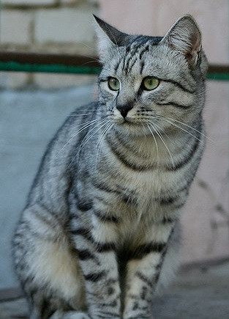
3 key components
Score function (Classifier) : Function to map input to output
Loss Function : Evaluate quality of mapping
Optimization Function : Update classifier
Label 'cat'
Classifier
(DNN or Bayesian model)
Loss
(measure of the error)
Class
values
Optimization:
Improve
classifier

Slide 16
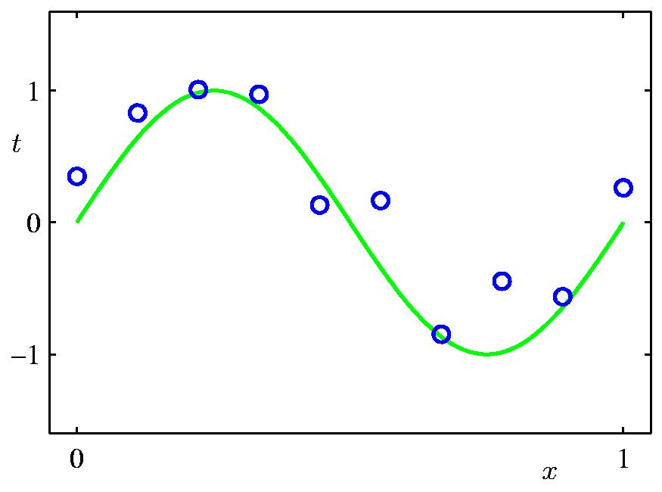
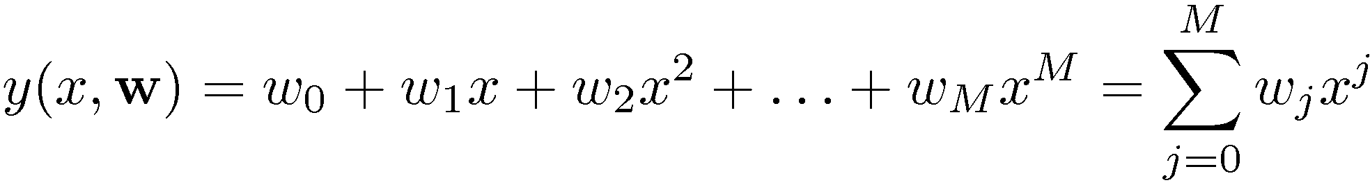
Example: Polynomial Curve Fitting
Measured values (x_{i},t_{i})
Generated by t=sin(x) + noise
Can we learn this curve from
the measurements?
Example taken from C.M. Bishop: Pattern Recognition and Machine Learning

Slide 17
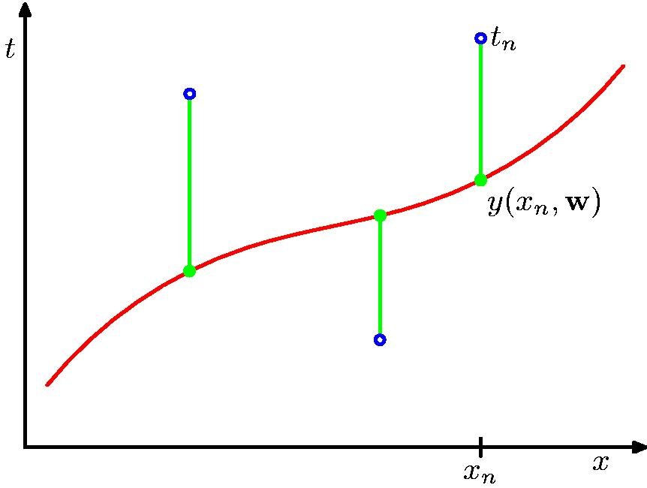
Loss E(w): Sum-of-Squares Error Function
t_{n}
Model
error = (y_{n}-t_{n})
y_{n}
Total error: E(w) = ∑ {y_{n} – t_{n}}²
Tune model such that difference
between y_{n} and t_{n} gets smaller

Slide 18
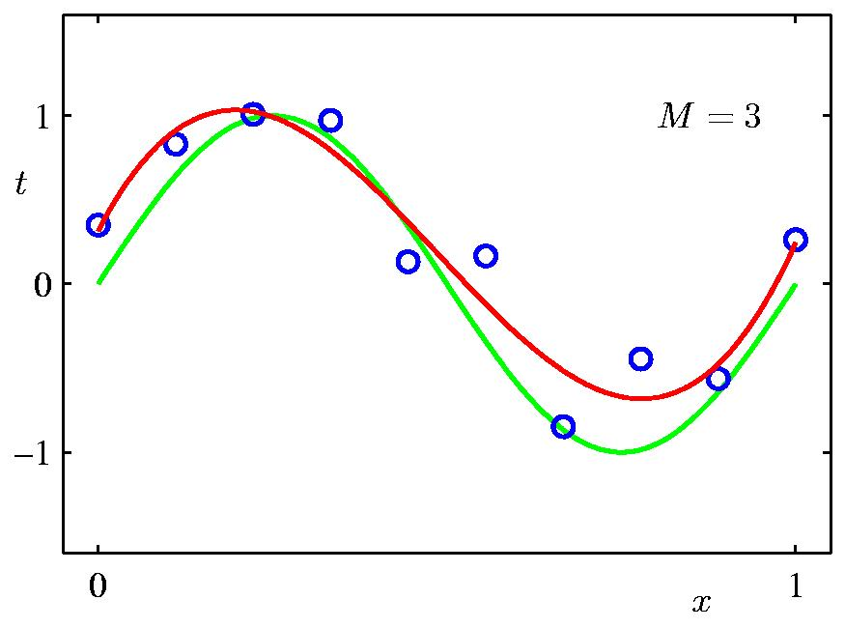
Much better: 3rd Order Polynomial
4 parameters
Model
Parameter | Value
w₀ | 0.31
w₁ | 7.99
w₂ | -25.43
w₃ | 17.37
Model: y(x,w) = w₀ + w₁x + w₂x² + w₃x³

Slide 19
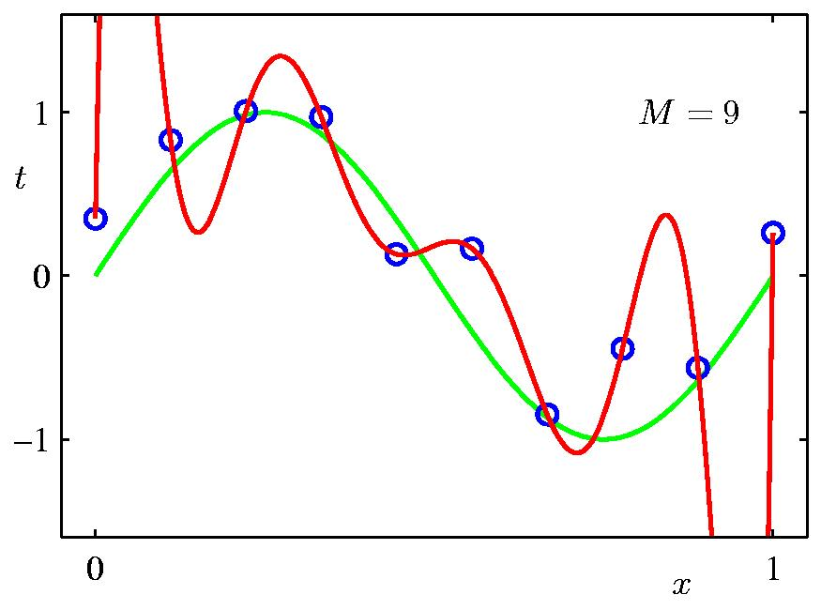
9th Order Polynomial => Overfitting
10 parameters
Parameter | Value
w₀ | 0.35
w₁ | 232
w₂ | -5321
w₃ | 45688
w₄ | -231630
w₅ | 640042
w₆ | -1061800
w₇ | 1042400
w₈ | -557682
w₉ | 125201
Model
Model: y(x,w) = w₀ + w₁x + w₂x² + ... + w₉x⁹

Slide 20
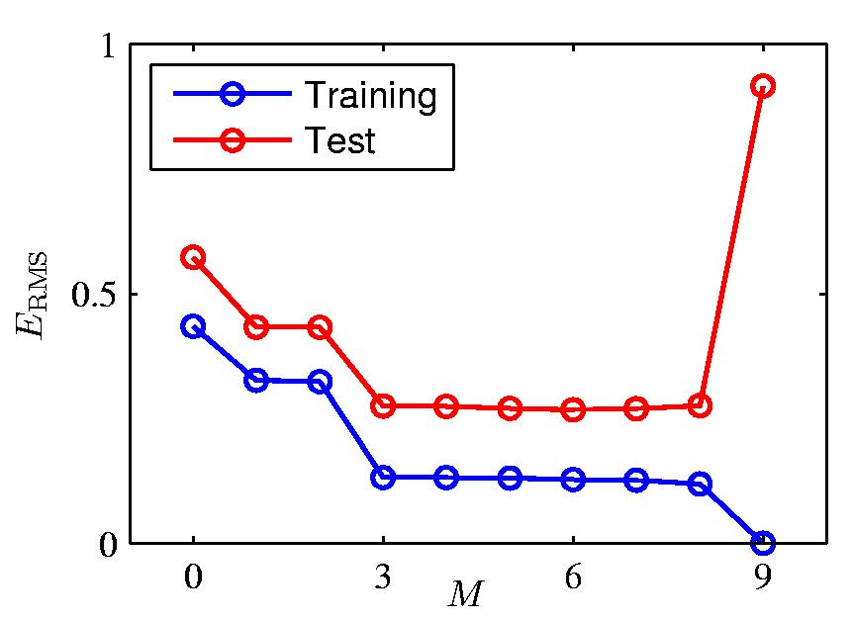
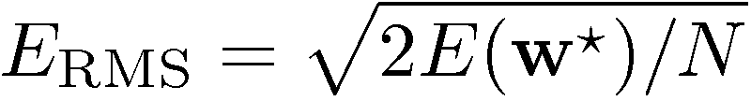
Over-fitting
Overfitting
Root-Mean-Square (RMS) Error:

Slide 21
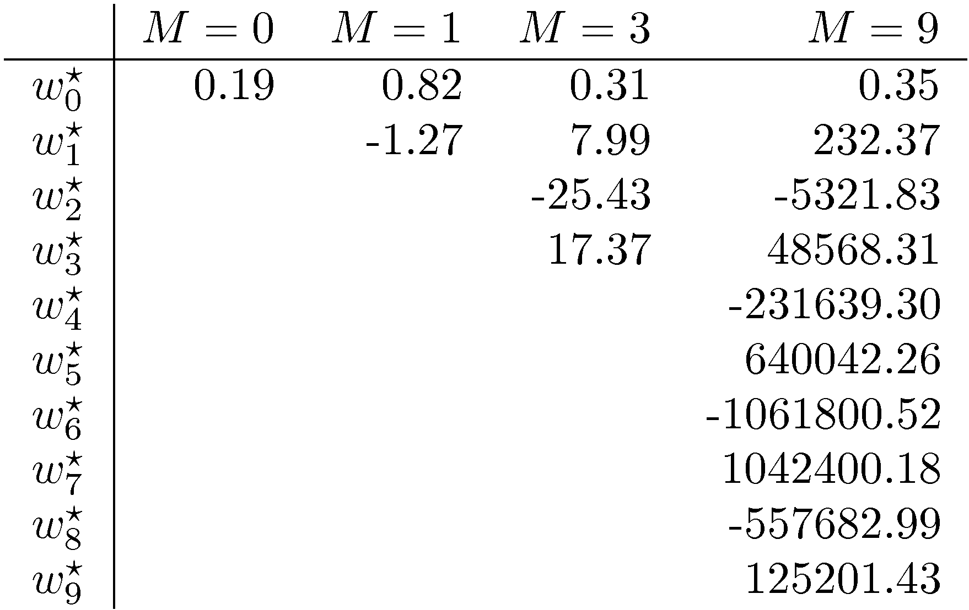
Polynomial Coefficients

Slide 22
Over-fitting
Overfitting
Root-Mean-Square (RMS) Error:

Slide 23
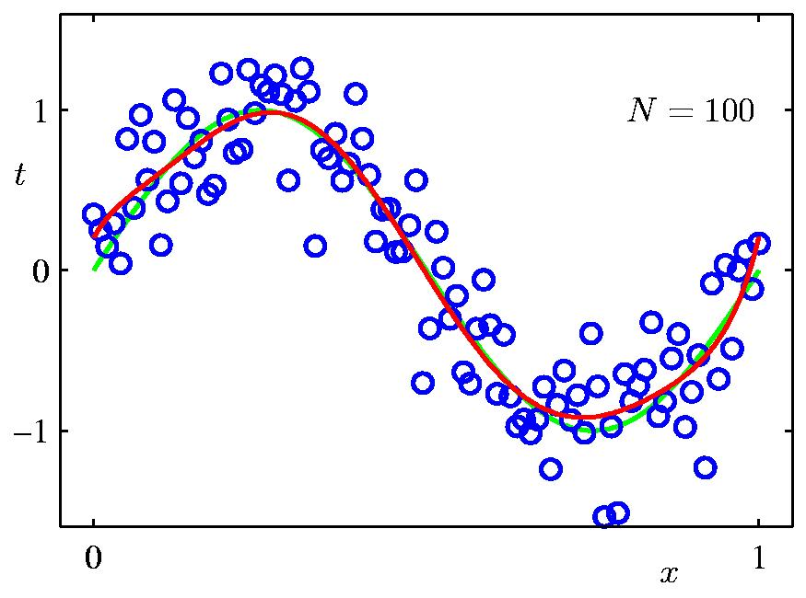
Increasing Data Set Size to 100 points
9th Order Polynomial
N = 100
Model: y(x,w) = w₀ + w₁x + w₂x² + ... + w₉x⁹

Slide 24
Regularization
Penalize large coefficient values =>
add regularization term:
E(w) = ∑ {y_{n} – t_{n}}² + λ|w|²
λ is one of the many hyper parameters for learning

Slide 25
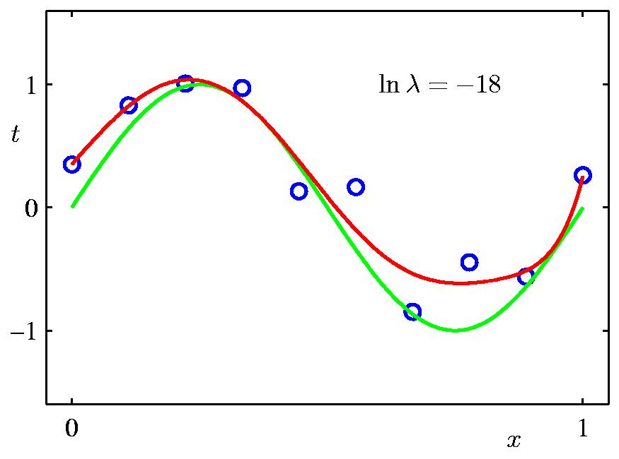
Regularization: ln λ = -18

Slide 26
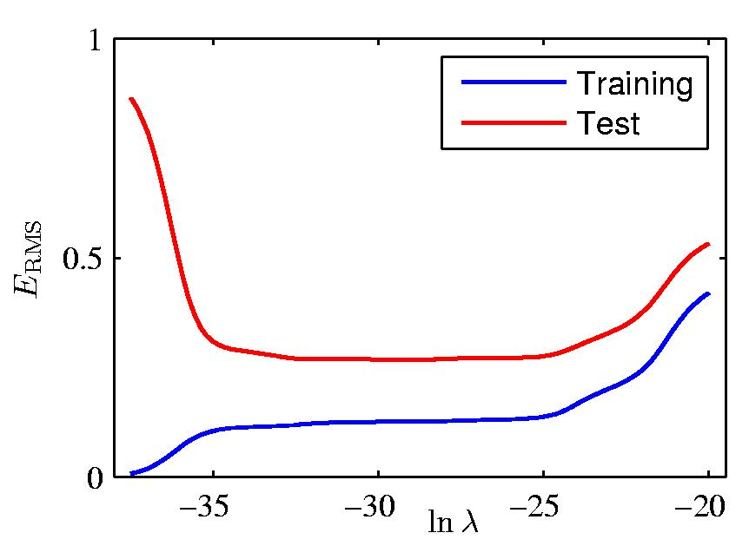
Regularization: E_{RMS} vs. ln λ
Right value of
λ is critical !

Slide 27
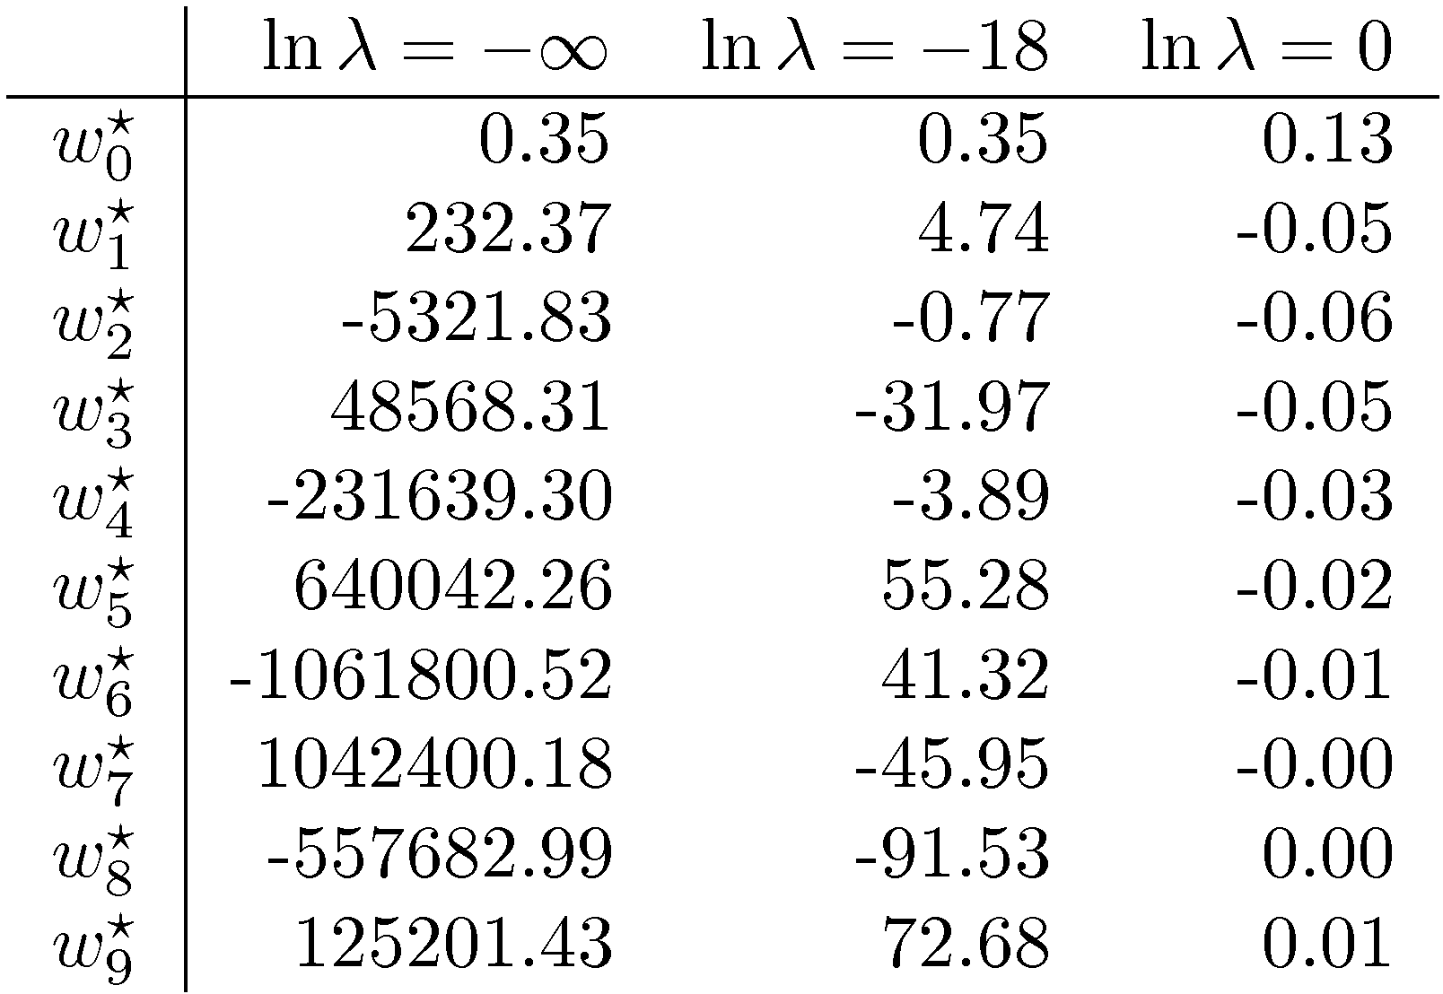
Polynomial Coefficients

Slide 28
Terminology & Learning Methods
training or learning phase: determine a model for y(x) on the basis of the training data
  training set, validation set, test set
  inference: use the learned model for classification
supervised learning (input/target vectors in the training data)
classification (discrete categories) vs. regression (continuous variables)
unsupervised learning (no target vectors in the training data) also called clustering, or density estimation
reinforcement learning, credit assignment, exploration, exploitation
overfitting, generalization

Slide 29
Recap topics
What is learning?
What is a DNN, and in particular a CNN?
DNN Learning principles
Optimization 1
Optimization 2
Optimization 3
Optimization 4
DNN Hardware support
NAS and DSE
Beyond DNNs: Neuromorphic and Bayesian networks

Slide 30
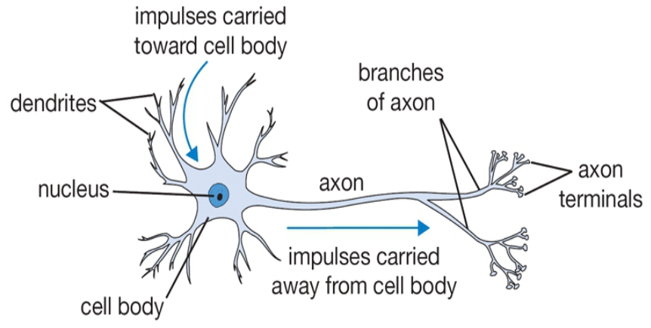
Our Brain
The basic computational unit of the brain is a neuron
  about 80 Billion neurons in our brain
  Neurons are connected with nearly 10¹⁴ – 10¹⁵ synapses
  Neurons receive input signals from dendrites and produce output signal along axon, which interact with the dendrites of other neurons via synaptic weights
Synaptic weights – learnable & control influence strength

Slide 31
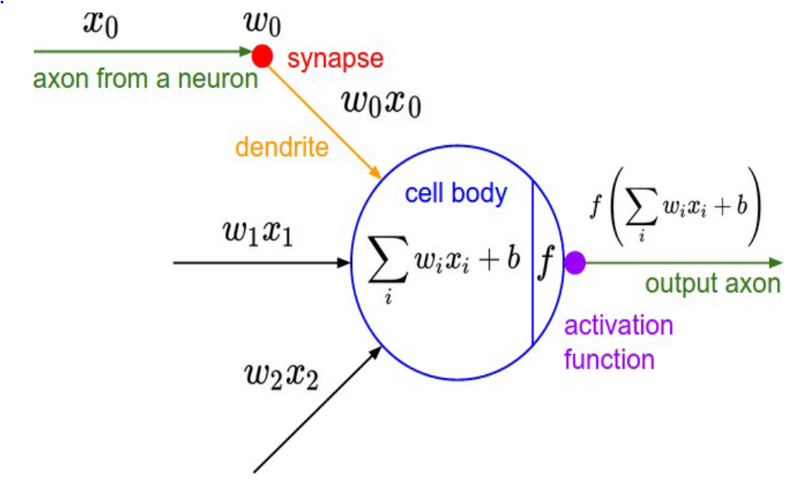
Artificial Neuron

Slide 32
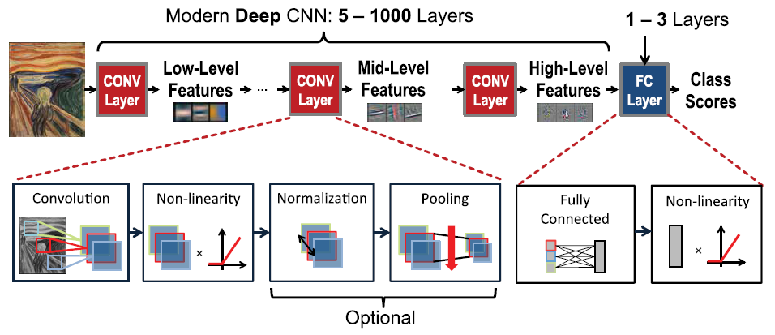
DNN structure

Slide 33
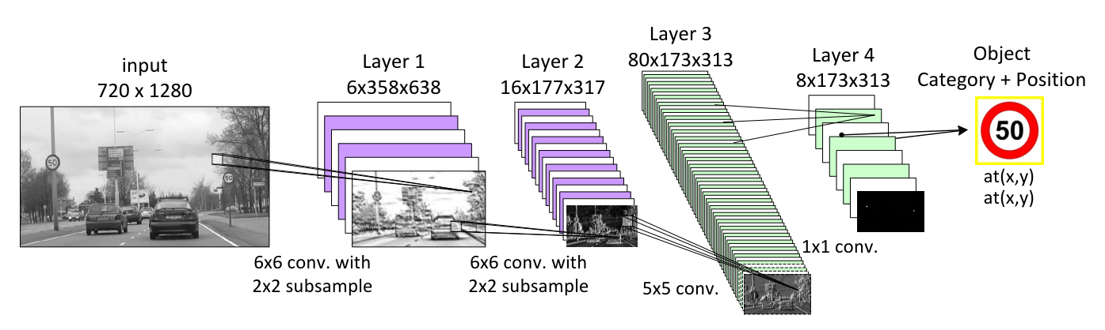
A (small) CNN for traffic sign recognition

Slide 34
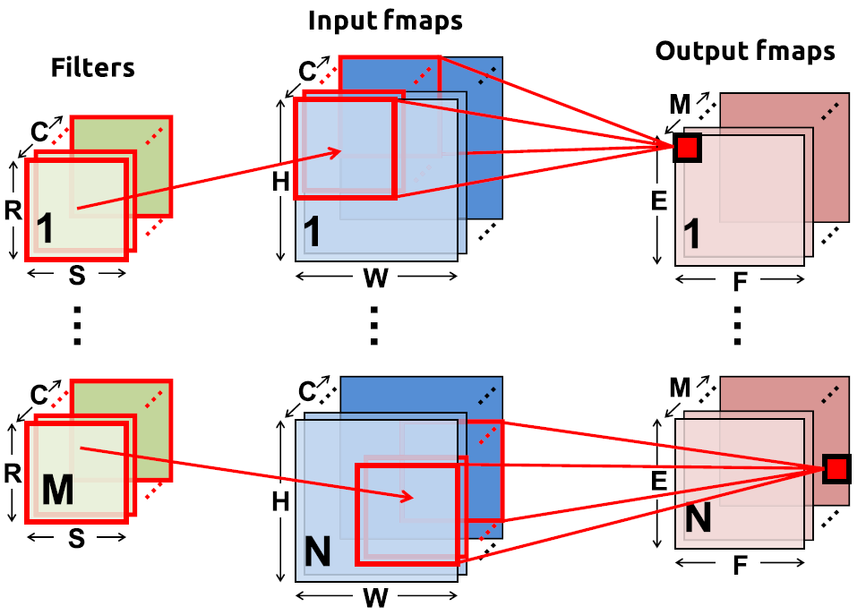
Convolution in CNNs
N = batch size
C input feature maps of size HxW
M output feature maps of size ExF
M filters of size RxS

Slide 35
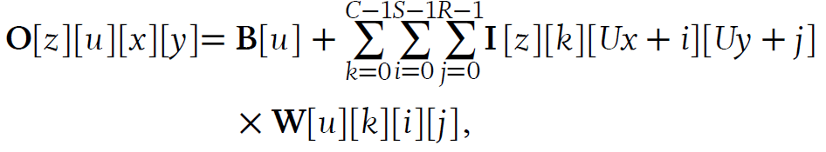
Convolution equations
U = stride
B = bias vector
Note: W has 4-dimensions
  i,j for kernel
  k for input feature maps
  u for output feature maps

Slide 36
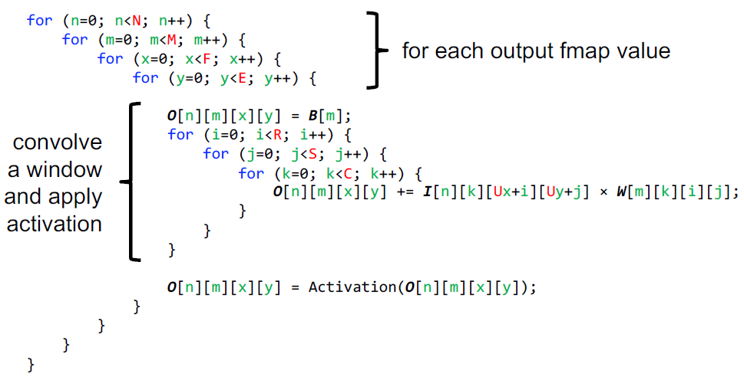
Convolution code

Slide 37
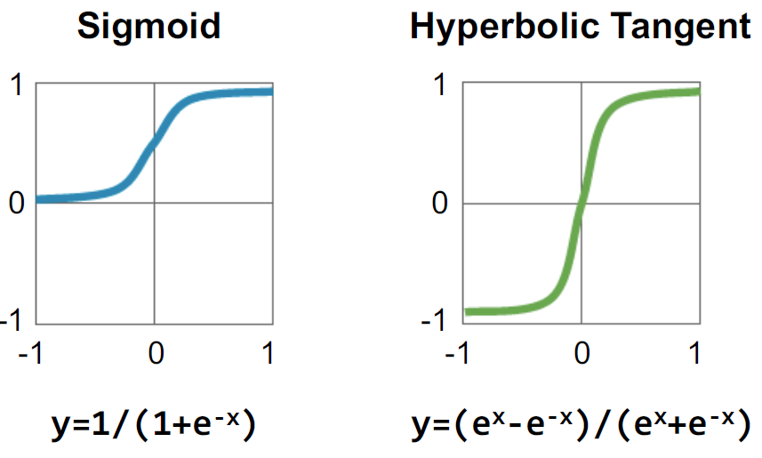
Activation functions: traditional

Slide 38
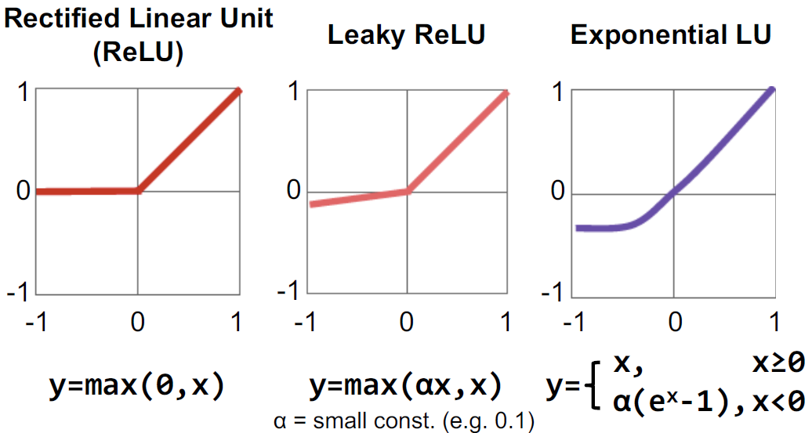
Activation functions: modern

Slide 39
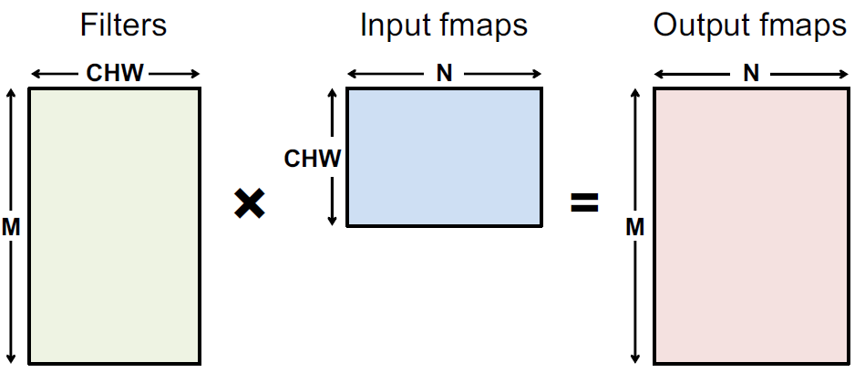
Fully Connected (FC) layer
FC can be viewed as a special case of convolution, with:
  H=R
  W=S
  E=F=1
Size of input fmaps = size of convolution kernel
Output fmaps have size 1x1, i.e. each output fmap represents 1
output neuron

Slide 40
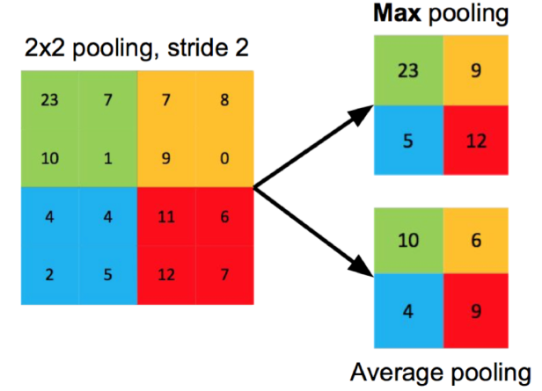
Pooling
Reduce resolution
Increase receptive (input) area of outputs
Overlapping or
Non-overlapping,
depending on stride U
Using the max or average

Slide 41
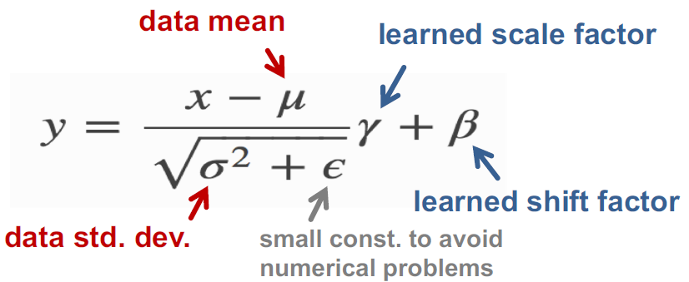
Normalization: correction of activation y
this equation can be ''absorbed'' in the weights => no overhead

Slide 42

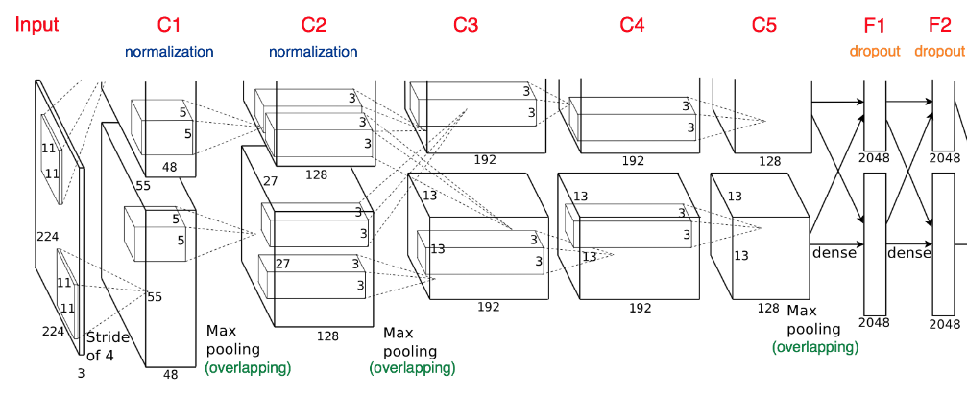
Example: Alexnet
Fully-Connected:
4096 to 1000
Class Scores
Cat: 0.9
Dog: 0.05
Car: 0.01
Vector:
4096

Slide 43
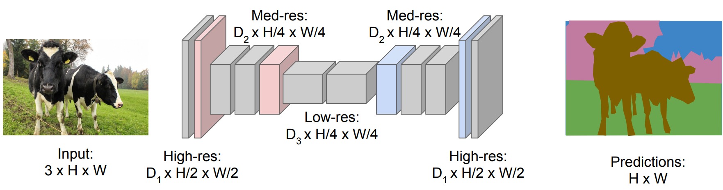
Semantic Segmentation: Fully Convolutional
Downsampling: Pooling or strided convolution
Upsampling: ???
Long et al. “Fully Convolutional Networks for Semantic Segmentation” CVPR 2015

Slide 44
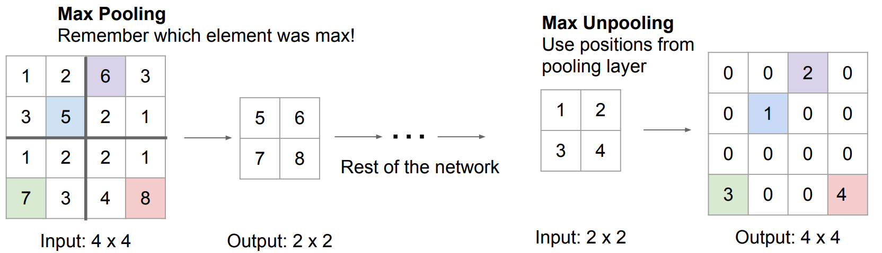
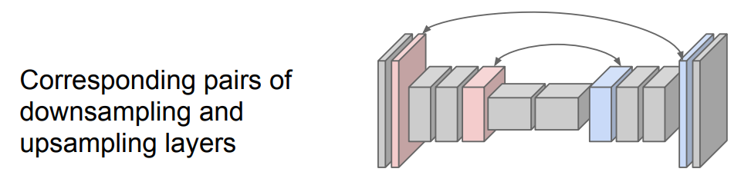
In-Network upsampling: “Max Unpooling”

Slide 45
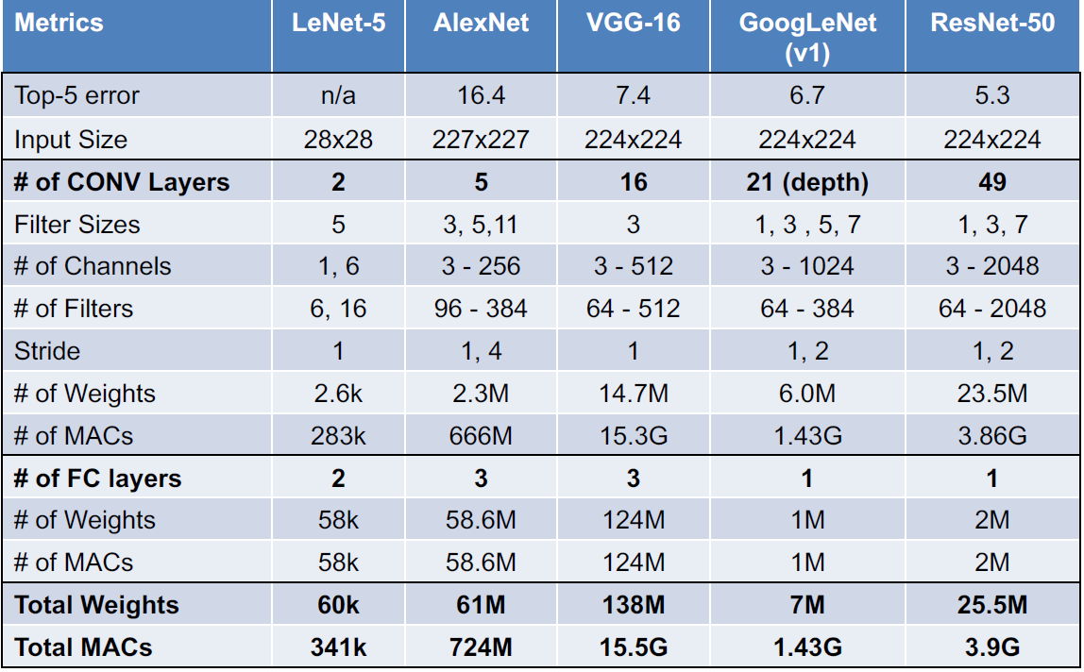
Popular
DNNs

Slide 46
Recap topics
What is learning?
What is a DNN, and in particular a CNN?
DNN Learning principles
Optimization 1
Optimization 2
Optimization 3
Optimization 4
DNN Hardware support
NAS and DSE
Beyond DNNs: Neuromorphic and Bayesian networks

Slide 47
How to learn a DNN?
Use backpropagation => Chain rule
Loss function
  Regularization terms can be added to loss function
Stochastic Gradient Descent (SGD), and several varieties
Batch learning
Learning rate

Slide 48
A Recipe for Machine Learning
1. Given training data:
3. Define goal:
2. Choose each of these:
  Decision function
  Loss function
4. Train with SGD:
(take small steps opposite the gradient)

Slide 49
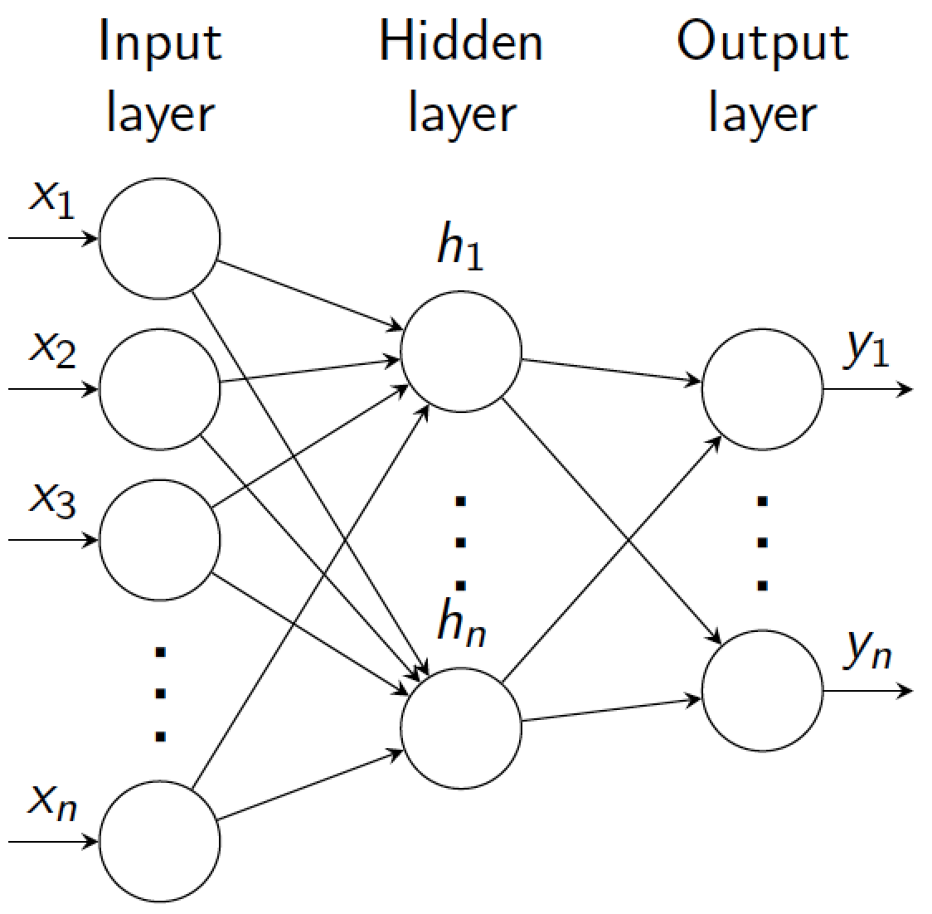
Backpropagation in multiple layers
(output)
x_{n}
Output layer n
F_{n}(x_{n-1}, W_{n})
x_{n-1}
…
…
x_{i}
Layer i
F_{i}(x_{i-1}, W_{i})
…
x_{i-1}
…
…
x₁
Layer 1
F₁(x₀, W₁)
Input layer
(input)
x₀

Slide 50
Training a model: overview
Given a training dataset {x^{m}; y^{m}}_{m=1,…,M}, pick appropriate cost function C
Forward-pass (= inference) training examples through the model to get network output.
Get error (loss) using cost function C to compare outputs to targets y^{m}
Use Stochastic Gradient Descent (SGD) to update weights
  adjusting parameters to minimize loss/energy E (sum of the costs for each training example)

Slide 51
Cost function
E
C(x_{n}, y)
Consider model with n layers. Layer i has weights W_{i}
Forward pass: takes input x and passes it through each layer F_{i}:
x_{i} = F_{i} (x_{i-1}, W_{i})
Output of layer i is x_{i}. Network output (top layer) is x_{n}
Cost function C compares x_{n} to y
Overall energy is the sum of the cost over all training examples:
(output)
x_{n}
F_{n}(x_{n-1}, W_{n})
x_{n-1}
…
x_{i}
F_{i}(x_{i-1}, W_{i})
x_{i-1}
…
x₂
F₂(x₁, W₂)
x₁
F₁(x₀, W₁)
(input)
x₀
y

Slide 52

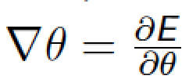
Stochastic gradient descend
Minimize overall loss function E = sum of individual losses over each example
In gradient descent, we start with some initial set of parameters θ
Update parameters:
  k is iteration index, η is learning rate (negative scalar; set semi-manually).
Gradients computed by backpropagation.
In SGD, compute gradient on sub-set (batch) of data:
  If batchsize=1 then θ is updated after each example.
  If batchsize=N (full set) then this is standard gradient descent.
  Gradient direction is noisy, relative to average over all examples

Slide 53
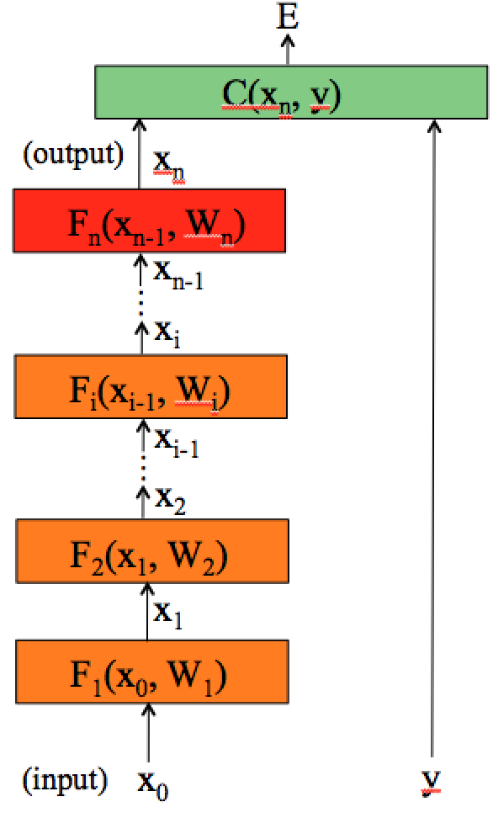
Computing gradients
To compute the gradients, we could start by wring the full energy E as a function of the network parameters.
And then compute the partial derivatives… instead, we can use the chain rule to derive a compact algorithm: back-propagation

Slide 54
Computing gradients
The energy E is the sum of the costs associated to each training example x^{m}, y^{m}
Its gradient with respect to the networks parameters is:
Indicates how much E varies when the parameter θ_{i} is varied.

Slide 55
Computing gradients: cost layer
If we compute the gradient with respect to the parameters of the last layer (output layer) w_{n}, using the chain rule:
Will depend on the
layer structure and
non-linearity.
For example, for an Euclidean loss:
The gradient is:

Slide 56
Computing gradients: layer i
We could write the full cost function to get the gradients:
If we compute the gradient with respect to w_{i}, using the chain rule:
And this can be
computed iteratively!
This is easy.

Slide 57
Backpropagation: layer i
Layer i has two inputs (during training)
x_{i-1}
F_{i+1}
For layer i, we need the derivatives:
x_{i}
Layer i
F_{i}(x_{i-1}, W_{i})
x_{i-1}
We compute the outputs
F_{i-1}
Forward
pass
Backward
pass
The weight update equation is:
(sum over all training examples to get E)
Notes:
During training, each layer will have three outputs:
the forward pass. To compute the operating point for each layer and training example
the backwards pass to propagate the energy derivative with respect to the input of the layer
- and the derivative of the energy with respect to the weights.

Slide 58
Backpropagation: summary
E
Forward pass: for each training example. Compute the outputs for all layers
Backwards pass: compute cost derivatives iteratively from top to bottom:
Compute gradients and update weights
C(X_{n},Y)
(output)
x_{n}
F_{n}(x_{n-1}, W_{n})
x_{n-1}
…
x_{i}
F_{i}(x_{i-1}, W_{i})
x_{i-1}
…
x₂
F₂(x₁, W₂)
x₁
F₁(x₀, W₁)
(input)
x₀
y

Slide 59
Recap topics
What is learning?
What is a DNN, and in particular a CNN?
DNN Learning principles
Optimization 1: Pruning the Network
Optimization 2
Optimization 3
Optimization 4
DNN Hardware support
NAS and DSE
Beyond DNNs: Neuromorphic and Bayesian networks

Slide 60
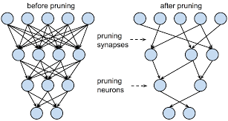
Pruning: update ***
Reduce the Network
Fine grain pruning
  removing connections with small weigths
  remove
Structured pruning:
  try to keep e.g. SIMD regularity (vector computing)
Coarse grain pruning
  remove kernel (2D): i.e., skip input feature map for a certain filter
  removing complete filter (3D), i.e. reduce nr. of output feature maps

Slide 61
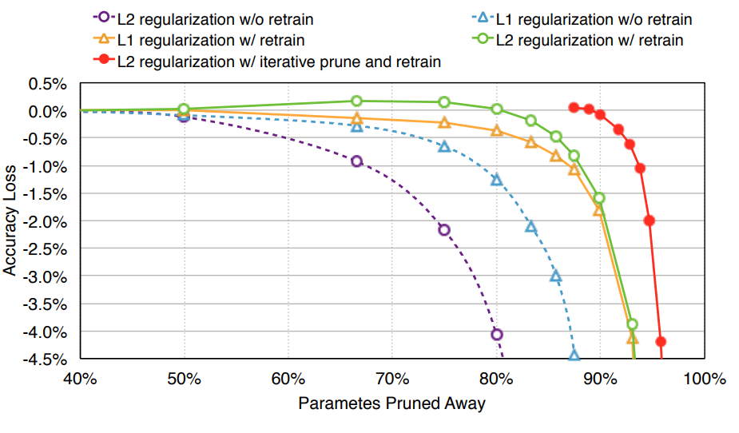
Iterative Pruning and Retraining: Alexnet
With one retraining to recover from pruning damage
    L2 regularization performs better
    85% pruning of parameters, 6.7x reduction
    From 61M to 9.1M Parameters
    Or 233MB to 34.7MB
Iterative pruning even better
    Without loss of quality prune 90%
    10x reduction, from 61M to 6.1M
    Or 233MB to 23.3MB

Slide 62
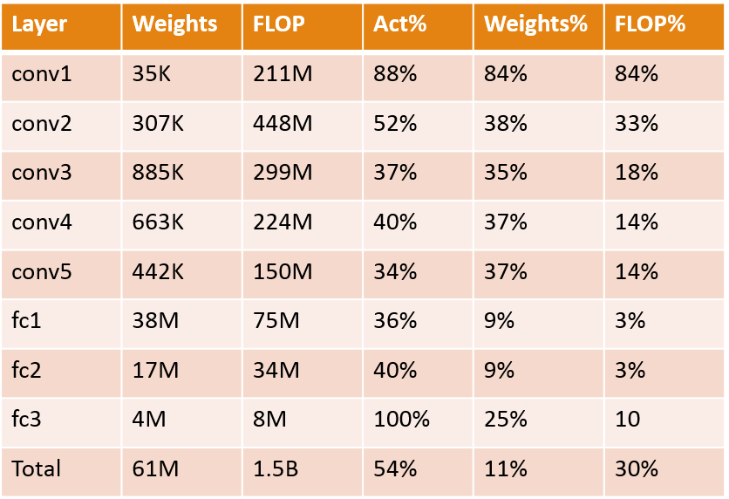
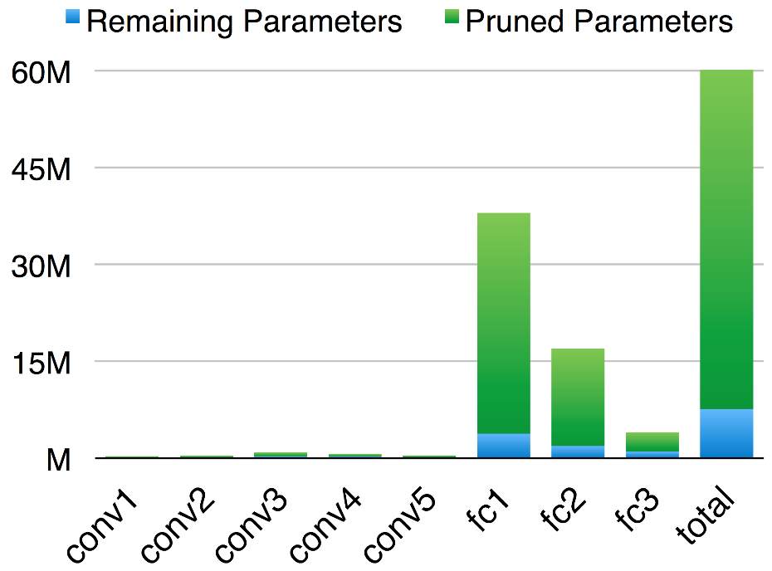
Analysis: What happened to Alexnet?

Slide 63
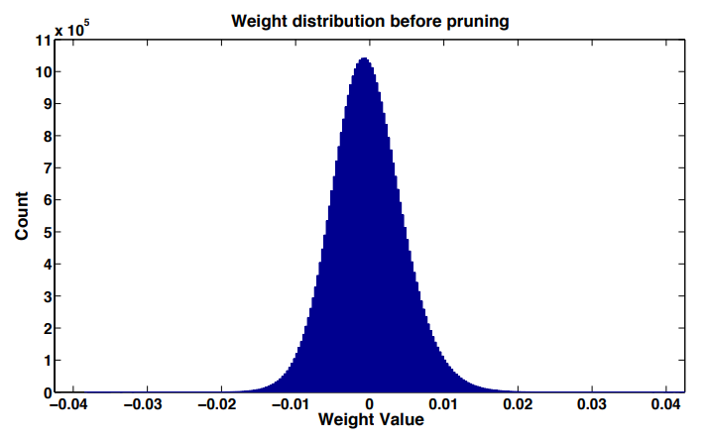
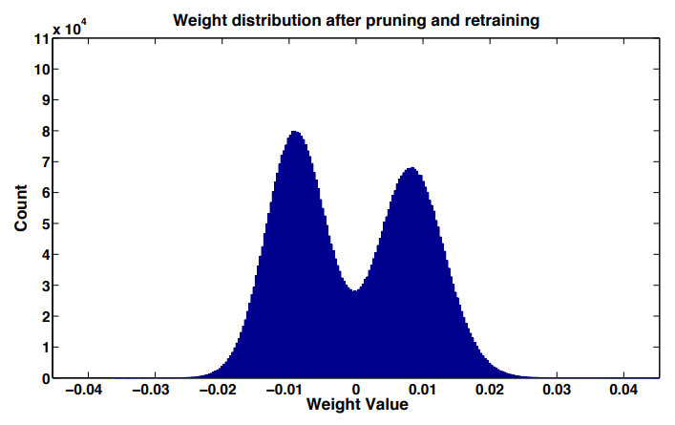
What happens to the weight distribution?
Before: Most weights are close to zero; almost all between [-0.015, 0.015]
After pruning: Bimodal distribution and more spread across x-axis, between [-0.025, 0.025]

Slide 64
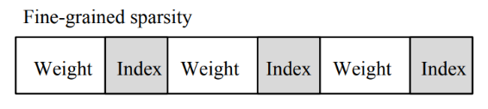
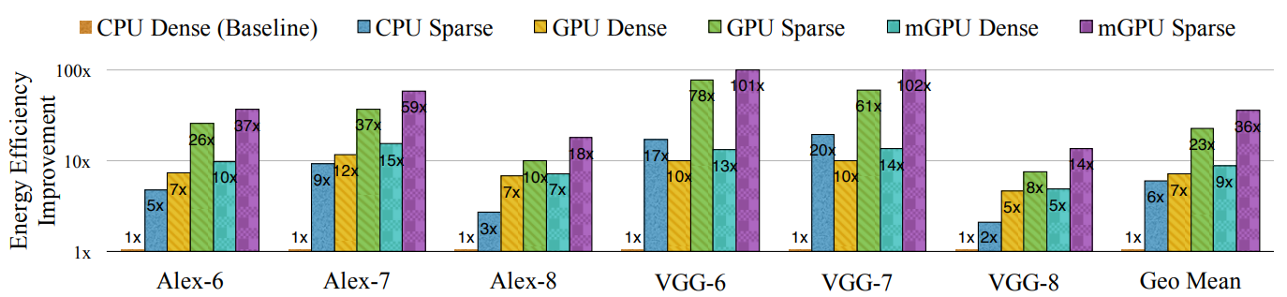
Energy Efficiency: Alexnet results
6x improvement CPU 3.2x improvement GPU 4x embedded GPU
Difficult to exploit the large parameter reduction due to irregularity
    Sparse matrices have also storage overhead; 16% for storing indices

Slide 65
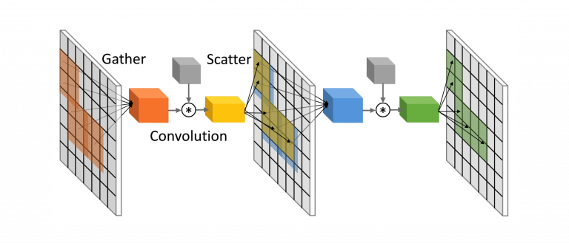
Need to find more sparsity
Sparsity in Activations

Slide 66

Activation Sparsity
Modern network contain ReLU activations
During inference plenty of these are 0
Activation Sparsity is high
    Resnet50 | 53% Natural AS
    Resnet101 | 57% Natural AS

Slide 67


Implement: Compress your feature maps and reuse
CSR (Compressed Sparse Row) format

Slide 68

Implement Convolutions as Sparse SIMD operations

Slide 69


From Fine to Coarse-Grained Pruning
Prune to match the underlying data-parallel hardware
    E.g. prune by eliminating entire filter planes
H. Mao et al. “Exploring the regularity of sparse structure in ConvNets” (CVPR 2017)

Slide 70
Summary: Pruning
Networks with many parameters are not efficient: Storage, Speed, Energy
Data-Free pruning: up to 1.5x reduction
L1 regularization: up to 4x reduction
Retraining: up to 6.7x reduction
Iterative retraining up to 10x reduction
Speed and energy advantages are lower 3 and 6x due to irregularity
Use a model for Sparsity
Activation Sparsity
Structured pruning can help
    Less storage overhead and much more regular
    Architecture dependent

Slide 71
Recap topics
What is learning?
What is a DNN, and in particular a CNN?
DNN Learning principles
Optimization 1: Pruning
Optimization 2: Quantization
Optimization 3
Optimization 4
DNN Hardware support
NAS and DSE
Beyond DNNs: Neuromorphic and Bayesian networks

Slide 72

Quantization: why?

Slide 73

Number representations

Slide 74

Float vs Fixpoint

Slide 75

How many bits can your MAC unit handle?
For no loss in precision, M is determined based on largest
filter size (in the range of 10 to 16 bits for popular DNNs)

Slide 76

Quatization method
Reducing the number of levels (bit width) for weights and/or activations
E.g., Caffe-Restretto tool (2016):

Slide 77


Non-linear (non-uniform) quantization
Non-linear implies variable step size $∆$
    Variability follows a regular pattern:
      Example: power-of-two step
Concept:
    More likely (smaller) values should be more accurately quantized
    Less likely (larger) values should be coarsely quantized

Slide 78

Codebook quantization
Useful when distribution of values is not normally distributed
Quantized values (codewords) are represented by a codebook
Codewords are selected using a clustering algorithm or training process
    E.g., values acquired by K-means clustering
Codebook example
Index | Value | Interval
0 | -0.07 | [-0.08, -0.04]
1 | 0 | [-0.04, 0.05]
2 | 0.01 | [0.05, 0.011]
3 | 0.012 | [0.011, 0,013]

Slide 79

Bit width selection
What bit-width to choose where?
Heuristics needed
  second derivative
  learned quantization

Slide 80


Second derivative as quantization heuristic
Taylor expansion of L for a single weight w:
  $L\left(w+∆w\right)≈L\left(w\right)+L′\left(w\right)∆w+\frac{1}{2}L′′\left(w\right){∆w}^{2}$
Assume a fully-trained network => $L^{′}\left(w\right)=\frac{dL}{dw}=0$
$⇒ ∆L\left(w\right)≈\frac{1}{2}L′′\left(w\right){∆w}^{2}$
For many weights: $∆L\left(W\right)≈\frac{1}{2}{∆W}^{T}\hat{H}\left(W\right)∆W$
  H: Hessian, second order derivatives
  If we know H we know the effect of quantization
Loss
$$W$$

Slide 81



Quantizers: how to backpropagate?
$$y=\text{quantize}(x)$$
4-bits
input
Straight-through
estimator
output

Slide 82
Quantization procedures – Summary
Approach | Training time | Quantization time | Quality of results
Quantization of pre-trained model | +++ | ++ | +
Quantization of pre-trained model with fine-tuning | ++ | + | ++ / +++
Quantization-aware training | + | +++ | +++
Quantized training procedure | ++* | +++ | +++
* on platforms that are specialized for high-throughput integer computations (e.g. FPGAs).

Slide 83
Conclusions
Quantization is an essential tool for efficient model deployment
These techniques can be combined with other compression methods, such as pruning
8-bit data and weights with 32-bit accumulators is sufficient for recent DNNs
  Next up: extreme quantization (bitwise networks)

Slide 84

Extreme quantization
Usually 8-bit quantization is sufficient for many applications
Can we do better?
Yes, to the extremes:
  Binary values $\{−1, +1\}$
    Single bit per symbol
  Ternary values $\{−1, 0, +1\}$
    1.585 bits per symbol ($\log_{2}{3 }≈1.585$)
Reminder: during training all values are kept in full-precision!

Slide 85


Binary multiply-accumulate
Multiplication and addition are replaced by bitwise XNOR and PopCount.
Why $\left\{−1, +1\right\}$ and not $\{0, +1\}$?
  XNOR- vs AND-gate multiply

Slide 86

Ternary multiply-accumulate
Multiplication and addition are replaced by Gated XNORs and two PopCounts.
Encoding
+1 | 11
0 | 00
-1 | 10
$$=PopCount(+1^{′}s)−PopCount(−1^{′}s)$$

Slide 87
Recap topics
What is learning?
What is a DNN, and in particular a CNN?
DNN Learning principles
Optimization 1
Optimization 2
Optimization 3: Exploiting Data Reuse (Loop Transformations / Halide)
Optimization 4
DNN Hardware support
NAS and DSE
Beyond DNNs: Neuromorphic and Bayesian networks

Slide 88

Reducing external memory accesses
VGG16 example
Original code
Rescheduled code
Conclusion: we need advanced loop transformation to exploit data locality (in local buffers),
reducing external accesses

Slide 89

What can we reuse in a CNN layer?

Slide 90

Types of reuse

Slide 91
Exploiting reuse
Iteration Scheduling (Mapping) Options
  output stationary
  input stationary
  weight stationary
  row stationary (Eyeriss)
Advanced loop transformations needed, in particular
  Tiling: making sure data/weights fit into local memory/cache
  Loop interchange (permutation)
  Fusion of loops
    bringing production and consumption close together
If you don't like these transformations ... use Halide

Slide 92
Loop Fusion (Merging):
Location
Production/Consumption
for (i=0; i<N; i++)
B[i] = f(A[i]);
for (j=0; j<N; j++)
C[j] = f(B[j],A[j]);
Consumption(s)
Time
Location
for (i=0; i<N; i++)
B[i] = f(A[i]);
C[i] = f(B[i],A[i]);
Production/Consumption
Consumption(s)
Consumptions of second loop closer to
productions and consumptions of first loop
Time

Slide 93
Recap topics
What is learning?
What is a DNN, and in particular a CNN?
DNN Learning principles
Optimization 1: Pruning
Optimization 2: Quantization
Optimization 3: Exploiting Data Reuse by Loop Transformations / Halide
Optimization 4: Network Restructuring
DNN Hardware support
NAS and DSE
Beyond DNNs: Neuromorphic and Bayesian networks

Slide 94

Reducing filter sizes: filter decomposition

Slide 95

Reducing filter sizes: decouple correlations
Decouple the cross-channels correlations and spatial correlations in the feature maps of the DNN: depth wise convolution
+
Number of operations for M output channels reduces dramatically:
Left: H*W*(R*S*C)*M
Right: H*W*(R*S)*C + H*W*C*M = H*W*C*(R*S + M)

Slide 96
Network scaling
Different scaling options
  Width scaling: more channels, i.e. more filters
  Depth scaling: more layers
  Resolution scaling: increase image size
Some methods do this in systematic ways
  EfficientNet: Rethinking model scaling for CNNs
  Searching for MobileNetV3
  Many NAS, Network Architecture Search, methods

Slide 97

Different scaling methods, combined in EfficientNet

Slide 98
Recap topics
What is learning?
What is a DNN, and in particular a CNN?
DNN Learning principles
Optimization 1
Optimization 2
Optimization 3
Optimization 4: Network Restructuring
DNN Hardware support
NAS and DSE
Beyond DNNs: Neuromorphic and Bayesian networks

Slide 99

General processors
Most processors have: SIMD / Vector units
Special units: e.g. Tensor Cores in GPU
  act on 4x4 matrices
  16 bit floating point precision

Slide 100
GPUs: support for fine grain weight sparsity
NIVIDA ampere architecture
2:4 sparsity
In 4 successive weights 2 should be zero
Compressed storage => upto 2x mem. BW

Slide 101
Accelerators: Google's TPU

Slide 102

  For BNNs and TNNs: XNOR-popcount
Current systems cannot execute BNNs efficiently
Need for a hardware accelerator that supports various levels of precision

Slide 103

Binary AivoTTA
MADD: xnor+popcount+acc scalar-vector 32b x (32x32b) into 32x16b
VOPS: shift, insert, activation, max; relu
DMA
LSU: multiple widths
2 wide busses
Notes:
MADD: xnorpopcountacc scalar-vector 32b x 32x32b into 32x16b
VOPS: shift, insert, activation, max; relu
DMA
LSU: multiple widths
Add-fu: not needed, already 2 addr calcs
2 wide busses: more not needed

Slide 104

CUTIE: Ternary DNN Inference
Completely unrolled data path
  all feature maps
  all filter dimensions
  reduces data transfer cost
Inherent sparsity of TNNs
Tunes training to increase sparsity
Reduces switching activity
0.32 fJ/Op in 7 nm!

Slide 105

Roofline Model: how good is my application mapping?
Performance bottleneck: computation bound v.s. bandwidth bound
Note the log-log scale
Roofline for
8800 Nvidia GPU
Where is your
application
in this space?
Notes:
The Roofline model is a first-order model for bottleneck analysis:
http://dx.doi.org/10.1145/1498765.1498785
For the architecture, it takes peak performance and memory bandwidth into account.
For the algorithm, it take operational intensity (or computation to off-chip memory ratio) into account
The figure is taken from 8800 GPU. According to the analysis, if an algorithm has an operational intensity of 8 or higher, the algorithm will hit the peak performance of the GPU, which is computation bounded. If an algorithm has an operational intensity less than 8, the algorithm will hit the bandwidth limit, thus making it bandwidth bounded.

Slide 106
Recap topics
What is learning?
What is a DNN, and in particular a CNN?
DNN Learning principles
Optimization 1
Optimization 2
Optimization 3
Optimization 4
DNN Hardware support
NAS (Network Architecture Search) and DSE (Design Space Expl.)
Beyond DNNs: Neuromorphic and Bayesian networks

Slide 107


Slide 108
Architecture-Mapping DSE for DNN Accelerators
Workload
(e.g. Conv2D, FC)
Search space constructor
Architecture
(e.g. Eyeriss)
Energy
Search space
Mapping
Constraints
(e.g. tile size)
Mapping analysis model
Cost estimator
Performance
Area
Best mapping
Technology cost model
(e.g. TSMC 45nm or Accelergy)
Search strategy
(e.g. exhaustive)
Key features of Timeloop and ZigZag:
  Expressive: generic, template-based hardware model
  Fast: faster than native execution
  Accurate: validated against design-specific models

Slide 109
Summary on NAS/DSE
Key features of Design Space Exploration tools:
  Expressive: generic, template-based hardware model
  Fast: faster than native execution
  Accurate: validated against design-specific models
Both Timeloop and ZigZag allow many architecture-mapping combinations to be evaluated quickly and accurately
  ZigZag allows more mappings and has an architecture search space
What about combining NAS and DSE? Covering the Accelerator-Mapping-Network design space

Slide 110
Recap topics
What is learning?
What is a DNN, and in particular a CNN?
DNN Learning principles
Optimization 1
Optimization 2
Optimization 3
Optimization 4
DNN Hardware support
NAS and DSE
Beyond DNNs: Neuromorphic and Bayesian networks

Slide 111

Beyond DNNs: Neuromorphic computing
Neuromorphic computing
  mimic our brain
  using spiking neurons
Why?
  Brain proven to work, and
  our Brain is orders of magnitude more energy efficient

Slide 112

Brain as extremely efficient computing machine
Power = 20 Watt
Speed = 1000 Exa Op/s*
Energy/operation =
Power/Speed =
2x10⁻⁸ pJ/operation
*Tim Dettmers:
"making deep learning accessible"
2015
Notes:
3.2*10^9 more efficient
Spikes x100
Double x100
Brain is sparse active so only 1-10% active x100
Leaky bucket 10x suppresses propagation

Slide 113

Top 500 computers: Performance and Energy
Brain consumes
about 20 Watt
Compare this to
current super
computer
(top 500)
Summit
  Power = 13 MW
  Speed = 200 PFlop/s
  Energy/op. = 65 pJ/op
Summit
200 PF/s
13 MW
Notes:
3.2 x 10^9

Slide 114

Beyond DNNs: Bayesian learning
everything is a distribution / density function
using a (causality) model
Why?
  Taking uncertainty into account
  Can deal with small data set
  DNNs can only determine correlation, not causality

Slide 115


Bayes' theorem
posterior ∝ likelihood × prior

Slide 116
The 3 levels of cognitivity
From: The Book of Why
Judea Pearl, Dana Mackenzie
Claim: Deep Learning does not
go beyond level 1 (Association)
- DL only learns correlations

Slide 117

Can you answer all questions?
What was the main goal of this course?
What is the essense of computer learning?
What is a DNN, and in particular a CNN? Calculate its complexity!
How do the newest DNNs look like, and what new operators do they use?
How do we learn DNNs? What is backpropagation? Learning tricks?
What optimizations can we apply?
Can you explain the different scheduling options of CNNs, exploiting reuse?
What specific HW support can make DNNs execute energy efficiently
How do Neuromorphic Neurons operate, and what are their advantages?
What is Bayesian learning, and what are its advantages?

Slide 118

Intelligent Architectures, 5LIL0
Deep & Automated, Learning
is even more fun
We hope you learned a lot and
enjoyed our course !!
Questions?
Making it efficient, that's really fun

