Slide 1
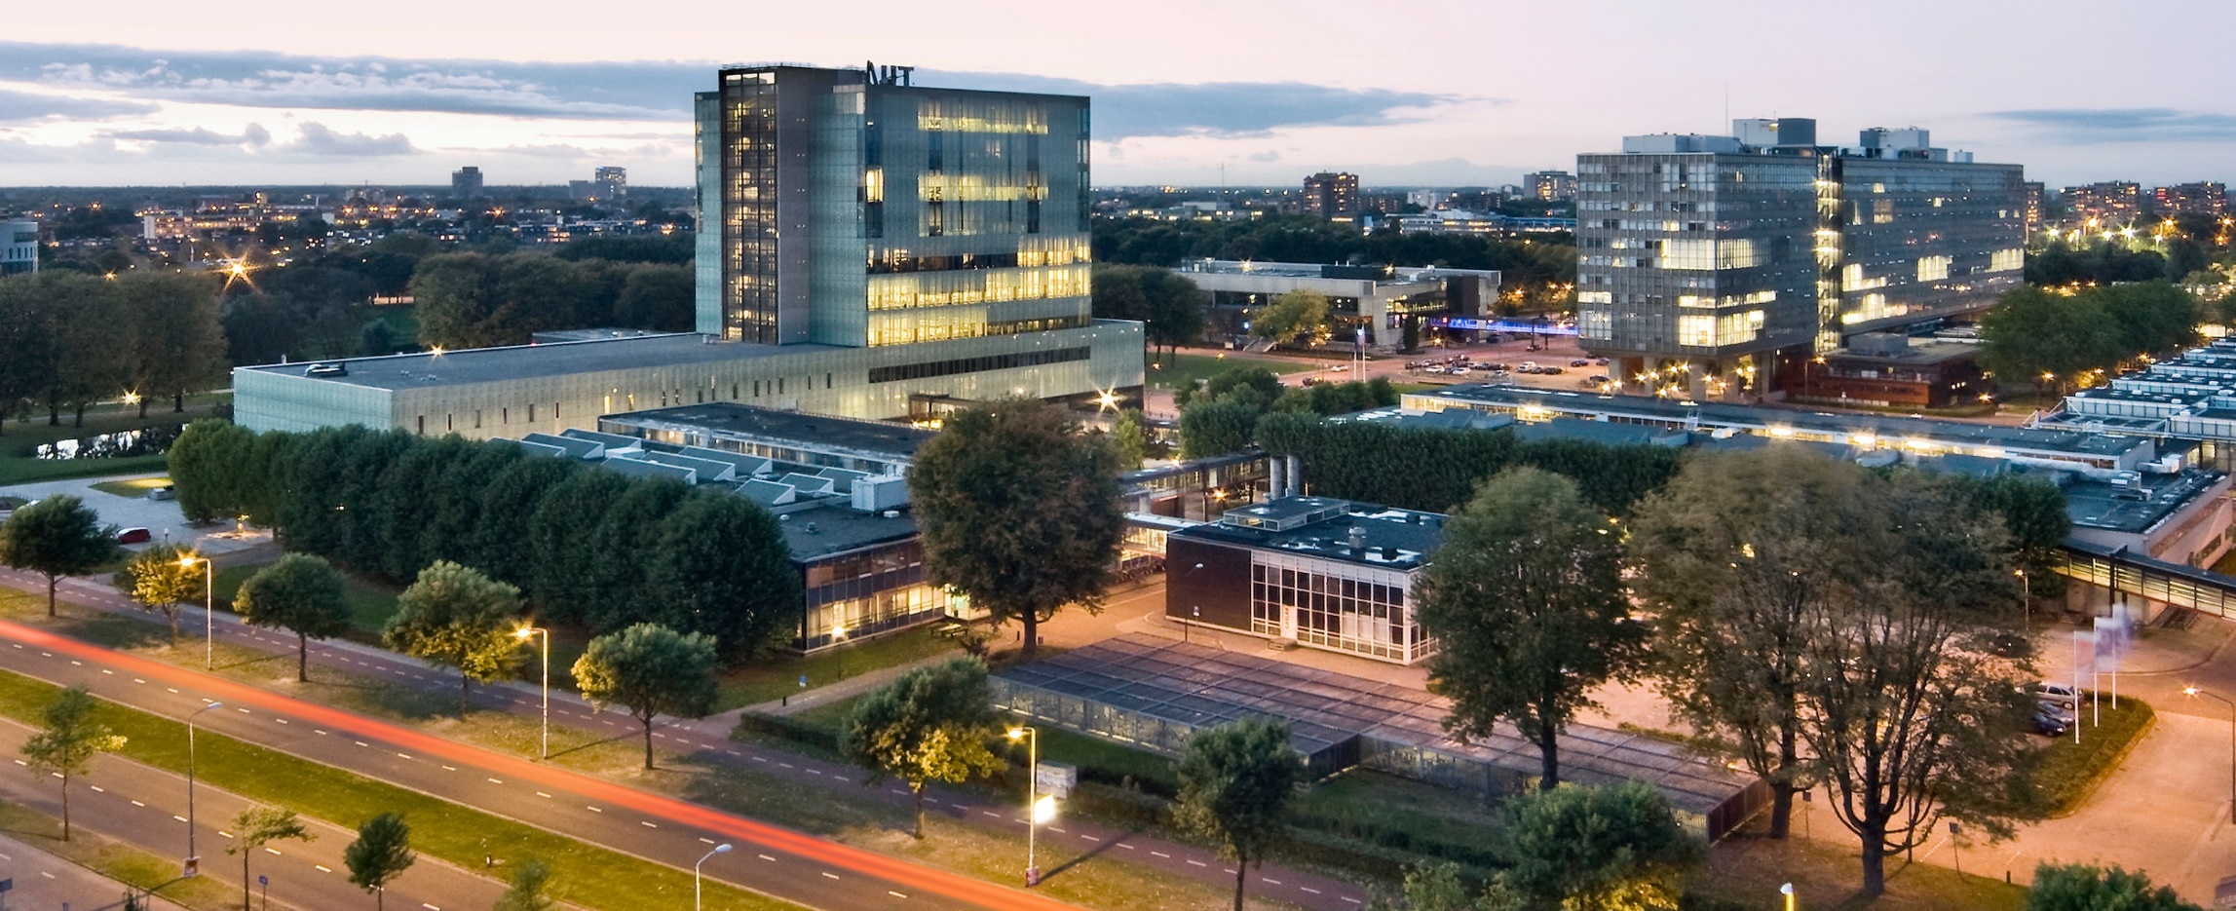
Deep Learning Applications and Advanced DNNs
Dr. Alexios Balatsoukas-Stimming & Dr. ir. Maurice Peemen
Electrical Engineering

Slide 2
Outline of Today’s Lecture
Main theme: applications and corresponding “specialized” NNs
CNNs with upsampling
Temporal neural networks
Deep unfolding

Slide 3

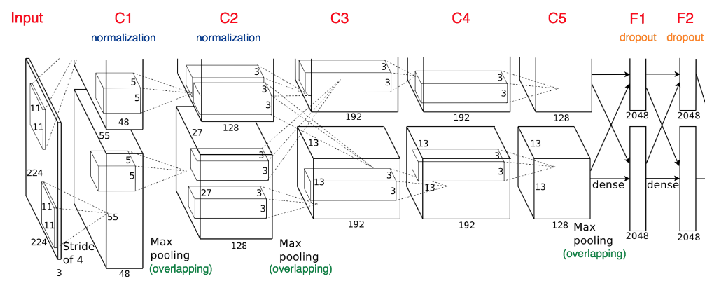
So far: Image Classification
Image Recognition: By AlexNet
Fully-Connected:
4096 to 1000
Class Scores
Cat: 0.9
Dog: 0.05
Car: 0.01
Vector:
4096

Slide 4
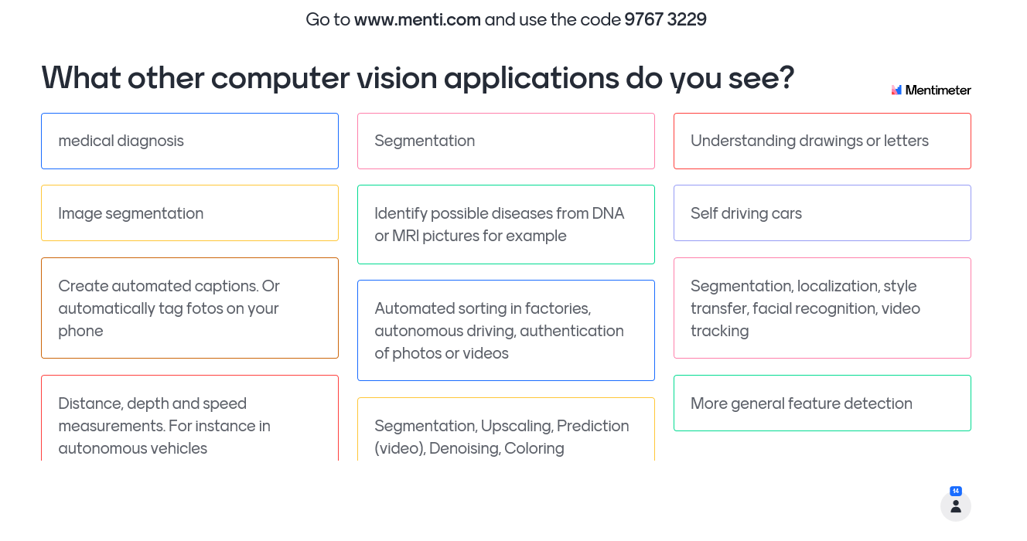

Slide 5
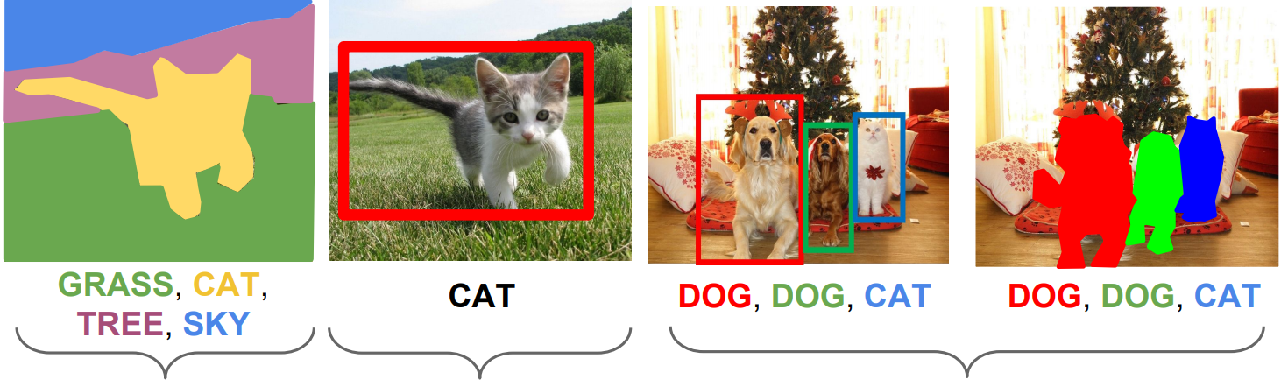
Other Computer Vision Tasks
Semantic
Segmentation
Classification
+Localization
Object
Detection
Instance
Segmentation
Pixel Classes
Single Object
Multiple Object

Slide 6
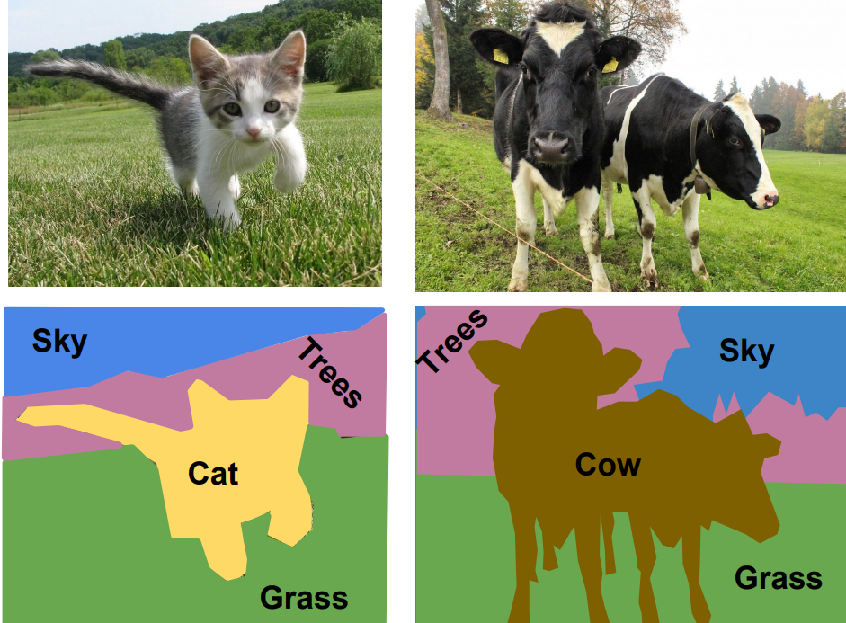
Semantic Segmentation
Label each pixel in the image with
a category label
Don’t differentiate instances,
only care about pixels

Slide 7
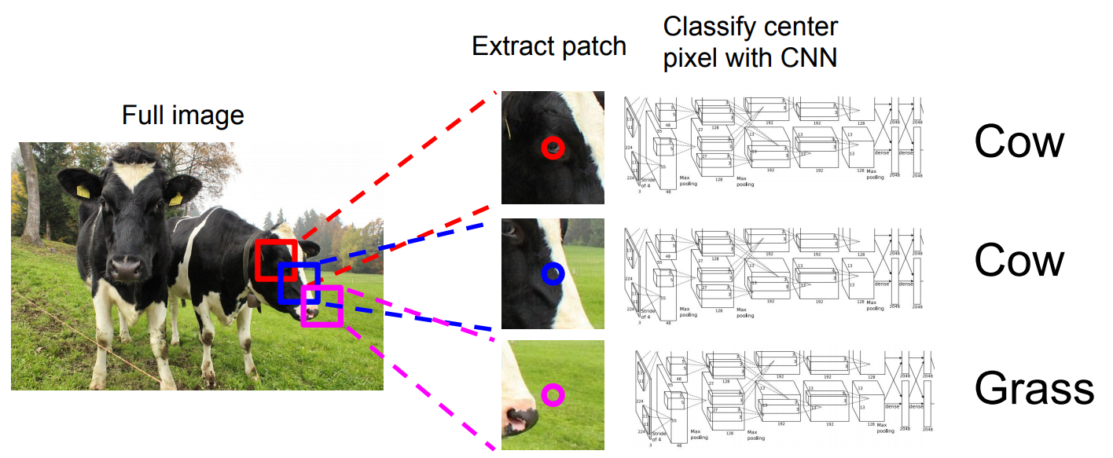
Naïve Semantic Segmentation Idea: a Sliding Window
Very inefficient, no reuse of features between overlapping patches
Farabet et al. “Learning Hierachical Features for Scene Labeling” (TPAMI 2013)

Slide 8
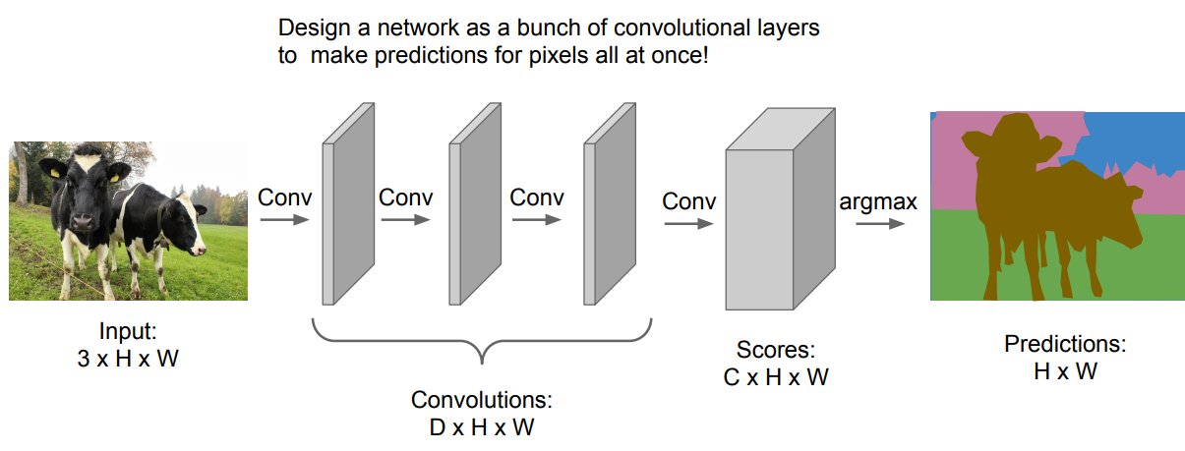
Semantic Segmentation Idea: Fully Convolutional
Convolutions at the original image resolution will be very expensive

Slide 9
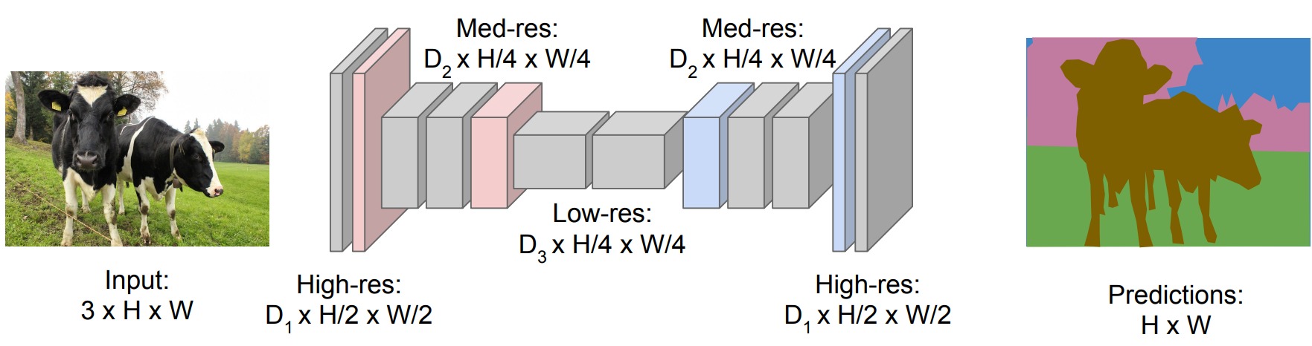
Semantic Segmentation Idea: Fully Convolutional
Design a network as series of convolution layers, with downsampling and upsampling
Downsampling: Pooling or strided convolution
Upsampling: ???
Long et al. “Fully Convolutional Networks for Semantic Segmentation” CVPR 2015

Slide 10
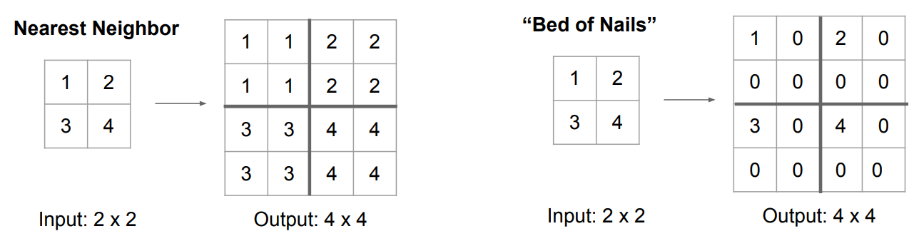
In-Network Upsampling: “Unpooling”

Slide 11
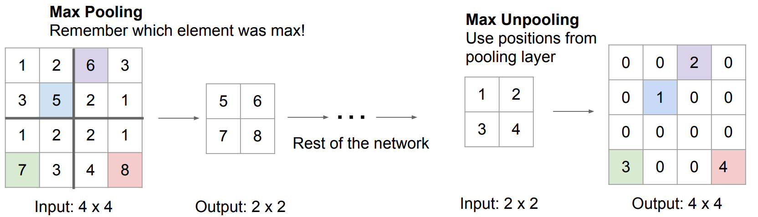
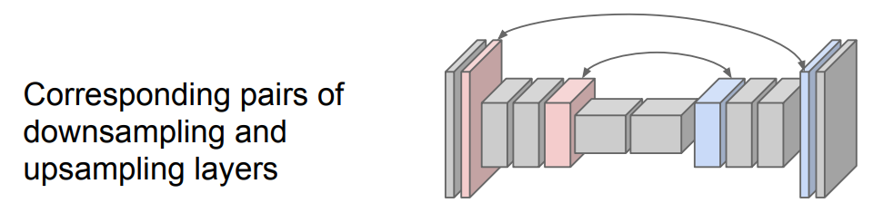
In-Network upsampling: “Max Unpooling”

Slide 12
Learnable Upsampling: Transpose Convolution
Recall: Normal 3x3 convolution, stride 1 pad 1
Input: 4x4
Output: 4x4

Slide 13
Learnable Upsampling: Transpose Convolution
Recall: Normal 3x3 convolution, stride 1 pad 1
Dot product between
filter and input
Input: 4x4
Output: 4x4

Slide 14
Learnable Upsampling: Transpose Convolution
Recall: Normal 3x3 convolution, stride 1 pad 1
Dot product between
filter and input
Input: 4x4
Output: 4x4

Slide 15
Learnable Upsampling: Transpose Convolution
Recall: Normal 3x3 convolution, stride 2 pad 1
Input: 4x4
Output: 2x2

Slide 16
Learnable Upsampling: Transpose Convolution
Recall: Normal 3x3 convolution, stride 2 pad 1
Dot product between
filter and input
Input: 4x4
Output: 2x2

Slide 17
Learnable Upsampling: Transpose Convolution
Recall: Normal 3x3 convolution, stride 2 pad 1
Dot product between
filter and input
Input: 4x4
Output: 2x2

Slide 18
Learnable Upsampling: Transpose Convolution
3x3 transpose convolution, stride 2 pad 1
Input: 2x2
Output: 4x4

Slide 19
Learnable Upsampling: Transpose Convolution
3x3 transpose convolution, stride 2 pad 1
Input gives weight
for filter
Input: 2x2
Output: 4x4

Slide 20
Learnable Upsampling: Transpose Convolution
3x3 transpose convolution, stride 2 pad 1
Filter moves 2 pixels
in the output for
every one pixel in
the input
Input gives weight
for filter
Stride gives ratio
between movement
in output and input
Input: 2x2
Output: 4x4

Slide 21
Learnable Upsampling: Transpose Convolution
3x3 transpose convolution, stride 2 pad 1
Filter moves 2 pixels
in the output for
every one pixel in
the input
Input gives weight
for filter
Stride gives ratio
between movement
in output and input
Sum where output
overlaps
Input: 2x2
Output: 4x4

Slide 22
Learnable Upsampling: Transpose Convolution
3x3 transpose convolution, stride 2 pad 1
Other names: Deconvolution (bad), Upconvolution, Fractionally strided convolution
Filter moves 2 pixels
in the output for
every one pixel in
the input
Input gives weight
for filter
Stride gives ratio
between movement
in output and input
Sum where output
overlaps
Input: 2x2
Output: 4x4

Slide 23
Semantic Segmentation Idea: Fully Convolutional
Design a network as series of convolution layers, with downsampling and upsampling
Downsampling: Pooling or Strided Convolution
Upsampling: Unpooling or Strided Transpose Convolution
Long et al. “Fully Convolutional Networks for Semantic Segmentation” CVPR 2015

Slide 24
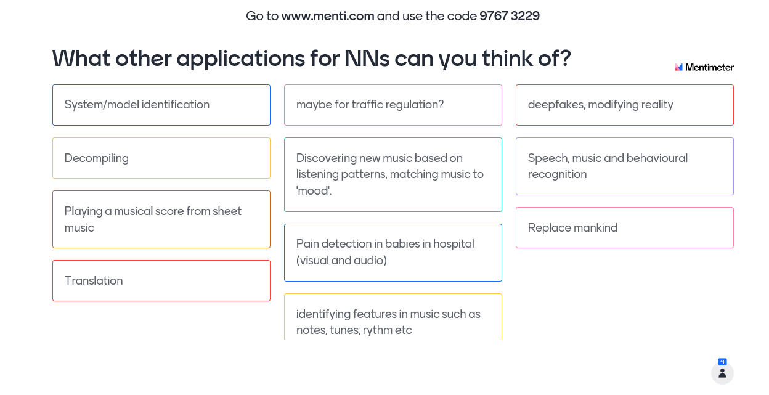
😨
😨

Slide 25
What Else Can Deep Neural Nets Do?
Classification
Approximation
Optimization
Clustering
25
Notes:
Four example application domains that ANN can solve very well

Slide 26
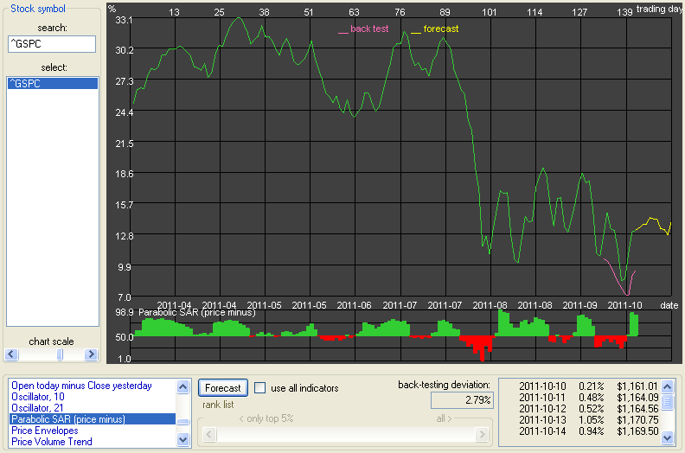
Application: Stock Market Prediction
Inputs:
      Previous values
      Sentiments from news
      Expert knowledge
  Output:
      Price prediction
What changes fundamentally?
Notion of time!
26

Slide 27
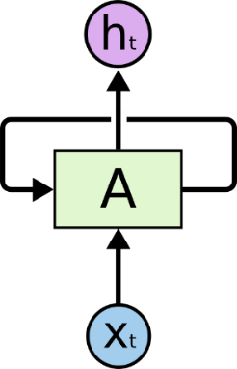
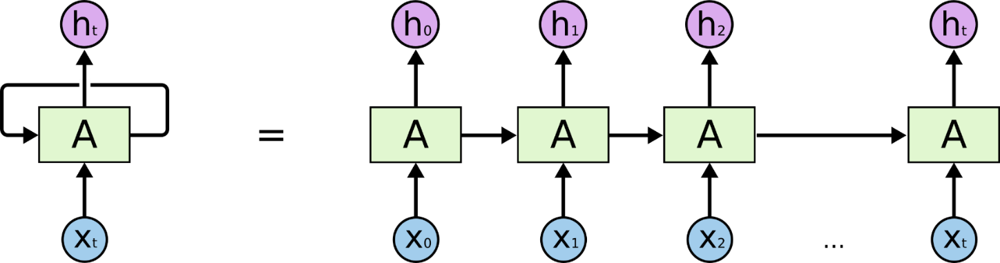
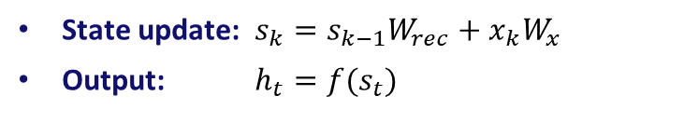
Recurrent Neural Networks - Structure
State update: $s_{k}=s_{k−1}W_{rec}+x_{k}W_{x}$
Output: $h_{t}={f(s}_{t})$
Similar to a feed-forward neural network, but very deep!
Based on: https://colah.github.io/posts/2015-08-Understanding-LSTMs/

Slide 28
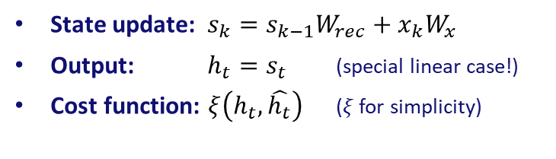

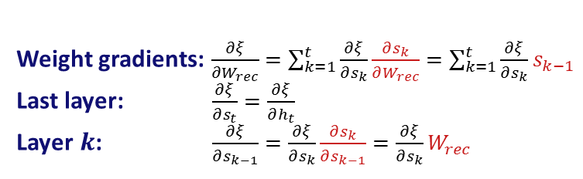
Recurrent Neural Networks - Training
State update: $s_{k}=s_{k−1}W_{rec}+x_{k}W_{x}$
Output: $h_{t}=s_{t}$ (special linear case!)
Cost function: $ξ\left(h_{t},\hat{h_{t}}\right)$ ($ξ$ for simplicity)
Weight gradients: $\frac{∂ξ}{∂W_{rec}}=\sum_{k=1}^{t}{\frac{∂ξ}{∂s_{k}}\frac{∂s_{k}}{∂W_{rec}}}=\sum_{k=1}^{t}{\frac{∂ξ}{∂s_{k}}s_{k−1} }$
Last layer: $\frac{∂ξ}{∂s_{t}}=\frac{∂ξ}{∂h_{t}}$
Layer $k$: $\frac{∂ξ}{∂s_{k−1}}=\frac{∂ξ}{∂s_{k}}\frac{∂s_{k}}{∂s_{k−1}}=\frac{∂ξ}{∂s_{k}}W_{rec}$
Similar derivation for $W_{x}$

Slide 29
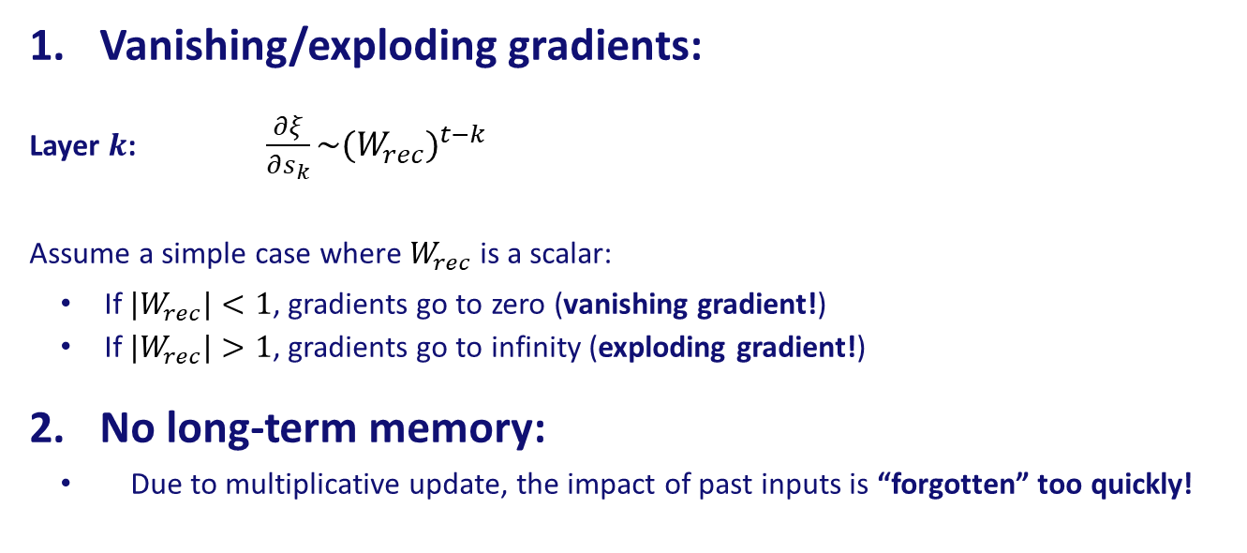
Recurrent Neural Networks - Problems
Vanishing/exploding gradients:
Layer $k$: $\frac{∂ξ}{∂s_{k}}\sim {(W_{rec})}^{t−k}$
Assume a simple case where $W_{rec}$ is a scalar:
    If ${|W}_{rec}|<1$, gradients go to zero (vanishing gradient!)
    If ${|W}_{rec}|>1$, gradients go to infinity (exploding gradient!)
  No long-term memory:
    Due to multiplicative update, the impact of past inputs is “forgotten” too quickly!

Slide 30
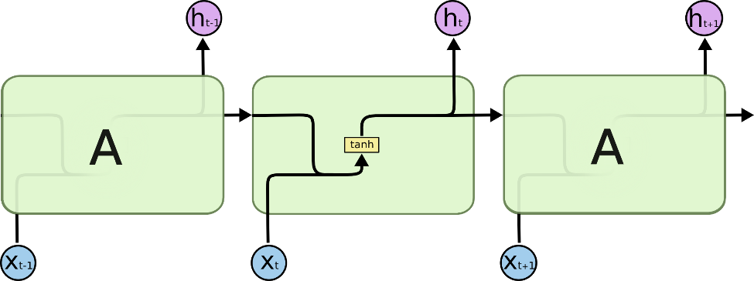
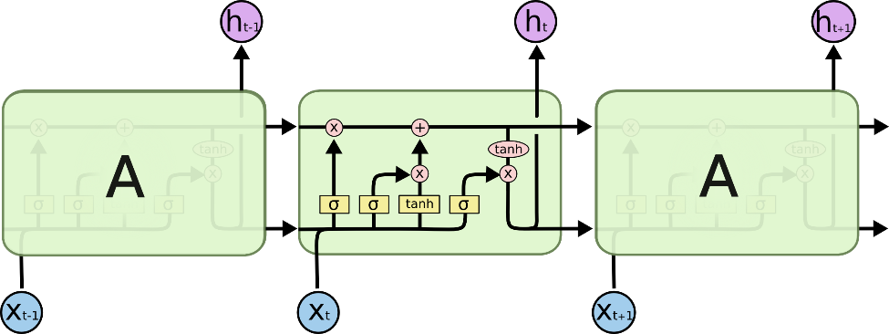
Long Short-Term Memory (LSTM) RNNs
Classic RNN:
LSTM RNN:
S. Hochreiter, J. Schmidhuber, "Long Short-Term Memory,“ 1997.

Slide 31
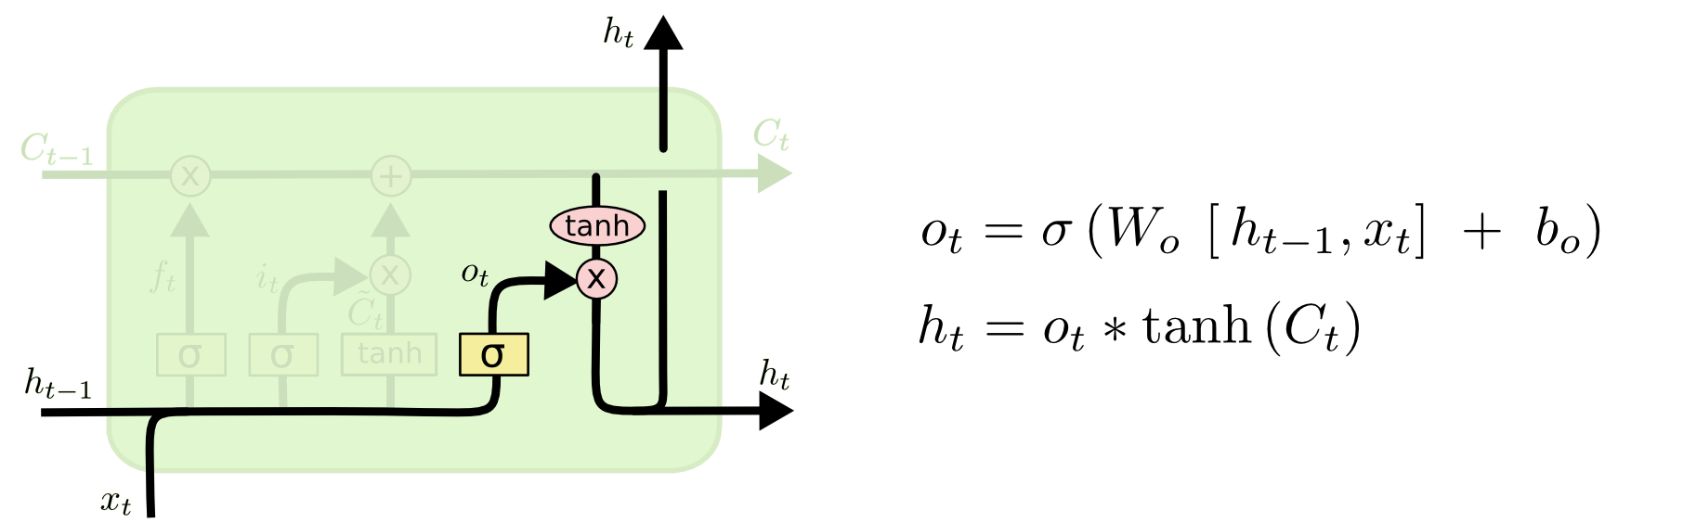
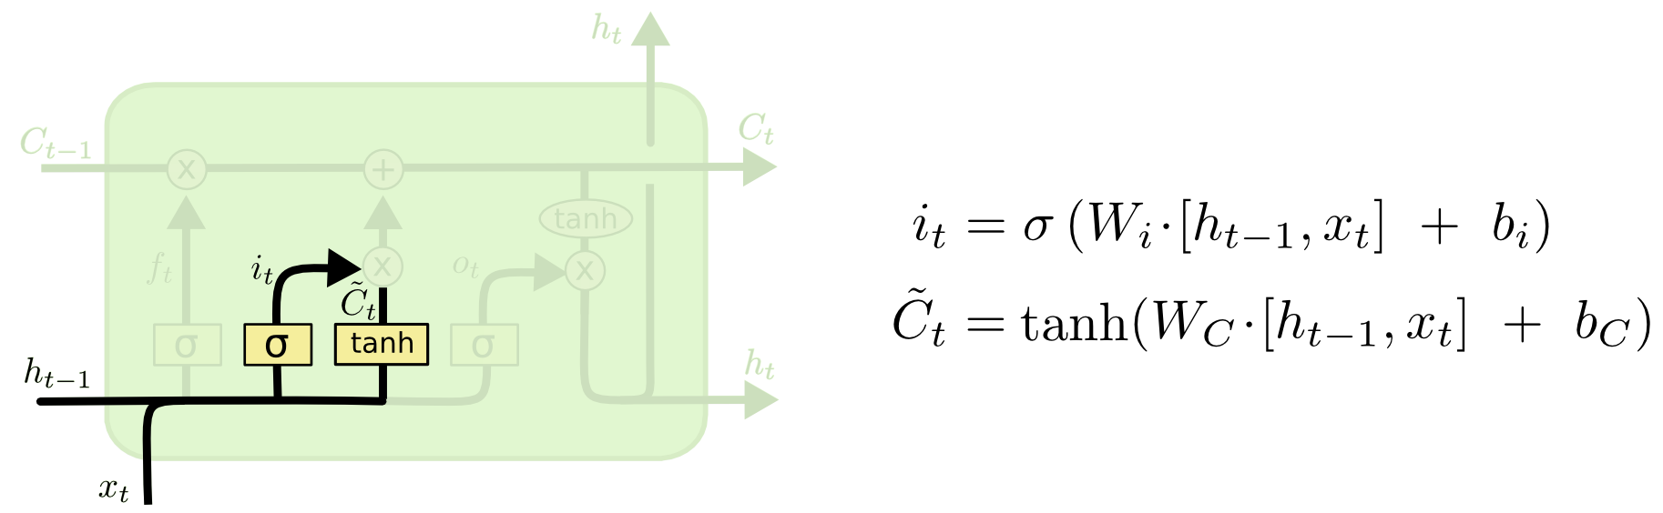
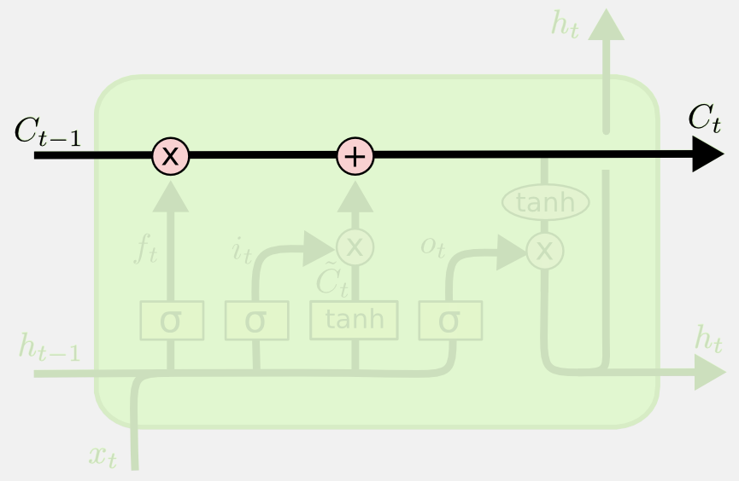
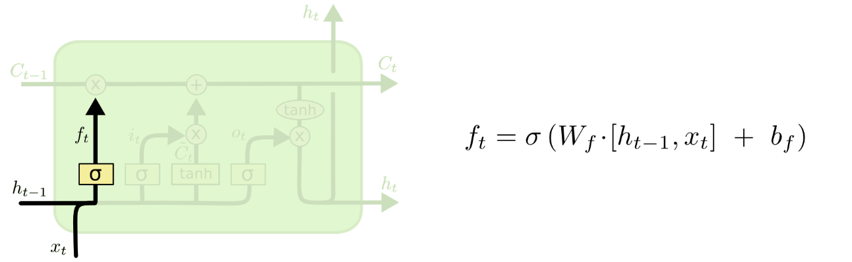
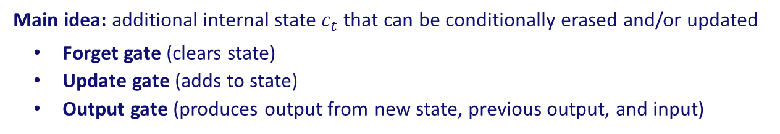
Long Short-Term Memory (LSTM) RNNs
Main idea: additional internal state $c_{t}$that can be conditionally erased and/or updated
    Forget gate (clears state)
    Update gate (adds to state)
    Output gate (produces output from new state, previous output, and input)

Slide 32
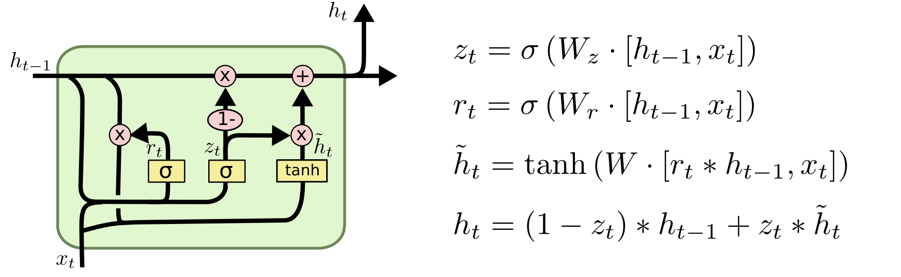
Gated Recurrent Unit (GRU) RNNs
Simpler variant of the LSTM, but very powerful and popular
      Cell state and output state are merged into one (like in classic RNNs)
      Single “forget/update” gate so that amount of update depends on amount of forgetting
Next big thing?
Temporal Convolutional Networks
S. Bai, J. Z. Kolter, V. Koltun, “An empirical evaluation of generic convolutional and recurrent networks for sequence modeling,” 2018.
Next big thing!
Temporal Convolutional Networks
S. Bai, J. Z. Kolter, V. Koltun, “An empirical evaluation of generic convolutional and recurrent networks for sequence modeling,” 2018.
K. Cho, B. van Merrienboer, C. Gulcehre, D. Bahdanau, F. Bougares, H. Schwenk, Y. Bengio, “Learning Phrase Representations using RNN Encoder-Decoder for Statistical Machine Translation,” 2014.

Slide 33
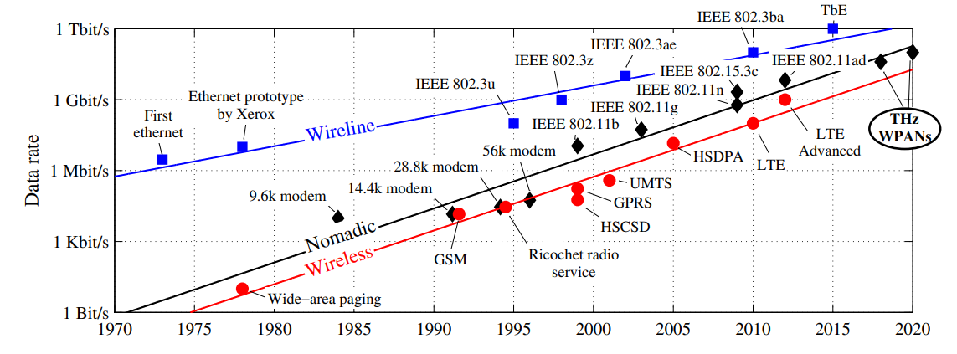
ML & Communications: An Unlikely Alliance?
Encoding
Modulation
D/A Conv.
A/D Conv.
Demodulation
Decoding
Transmitter
Receiver
Communications are traditionally model-based and rigorous
These models have worked exceptionally well in the past
T. Kürner & S. Priebe, “Towards THz Communications - Status in Research, Standardization and Regulation,” 2014.
What’s the point of using neural networks in communications?
Communications channels start becoming very difficult to model
Ever-increasing network complexity makes tasks such as scheduling difficult to optimize

Slide 34
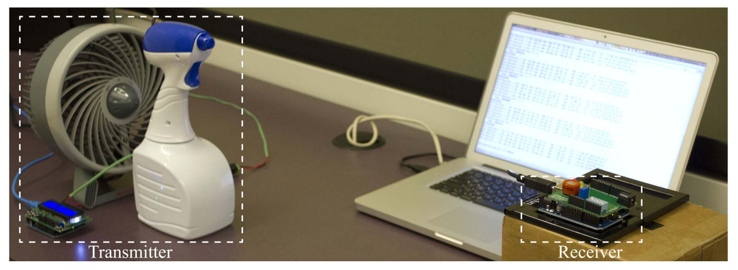
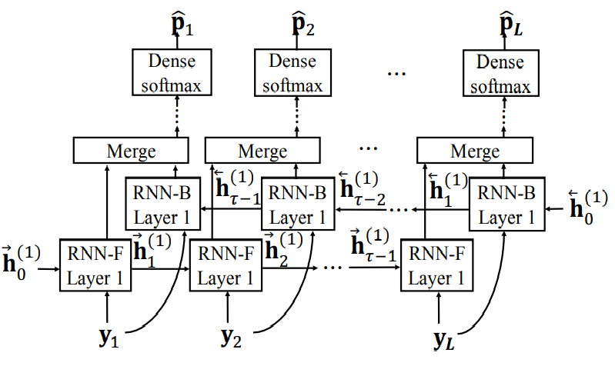
Application: Molecular Communications
Molecular Communications:
Use the presence or absence of specific molecules to encode information
No antennas required and very low power!
But: very challenging to model transmission channel!
N. Farsad, N.-R. Kim, A. W. Eckford, C.-B. Chae, “Channel and Noise Models for Nonlinear Molecular Communication Systems,” 2014.
When using experimentally measured data, sliding window bi-directional RNN has better performance than conventional methods!
N. Farsad, A. Goldsmith, “Neural Network Detectors for Molecular Communication Systems,” 2018.

Slide 35
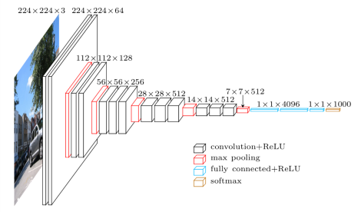
Problems With Traditional DNNs
DNNs achieve remarkable performance for a wide range of applications (e.g., VGG network for image recognition)
But traditional DNNs are “black boxes”:
Difficult to interpret results
Difficult to improve architectures
Difficult to include prior information

Slide 36
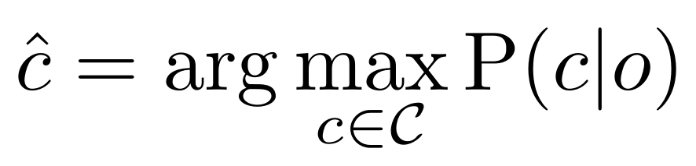
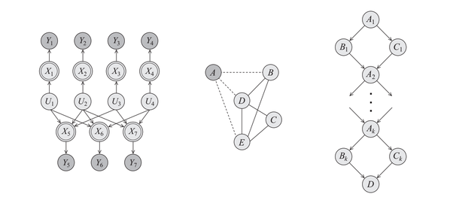
Inference Using Probabilistic Models & Optimization
Many inference tasks can be expressed using probabilistic models:
Probabilistic models are intuitive and knowledge about the problem can be easily incorporated

Slide 37
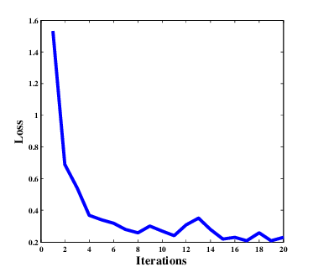
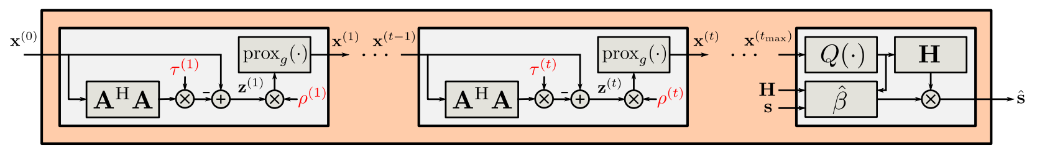
Deep Unfolding: Principle
Solving probabilistic models involves solving very complex optimization problems (often NP-hard), and iterative algorithms (e.g., gradient descent) are used in practice
In deep unfolding, every iteration of an iterative algorithm forms a layer of a DNN with trainable parameters
Layer 1
Layer t
Post-processing (optional)

Slide 38
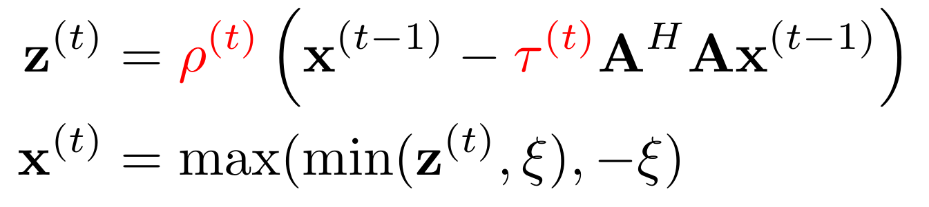
Deep Unfolding: Training
Iterative constrained optimization algorithms typically consist of:
A linear operation (gradient step)
A non-linear operation (constraint satisfaction)
Example:
The gradients of these operations w.r.t. their inputs are usually well-defined, so we can use standard backpropagation to train deep unfolded networks!

Slide 39
Deep Unfolding: Training
Cool observation:
The iterative algorithm is obtained assuming some cost function (e.g., MSE)
BUT: The deep unfolded network can be optimized for any differentiable cost function!!!
Training problems:
Non-linear operators may not be differentiable replace with “soft” versions!
Vanishing gradients 1) good known initial values, 2) incremental training, 3) windowed training, 4) multi-layer cost functions
Layer 1
Layer t
Post-processing (optional)

Slide 40
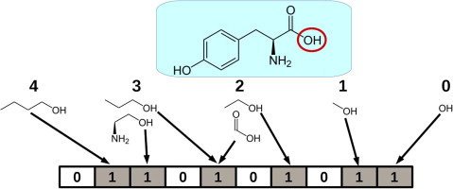
Applications: Learning Molecular Fingerprints
Cheminformatics applies information-related methods to chemistry:
Experiment-less prediction of properties of chemical compounds
Mimicking of patented active ingredients in medicine
Molecular fingerprints:
One of the main tools in cheminformatics
One-hot encoding of molecular interactions

Slide 41
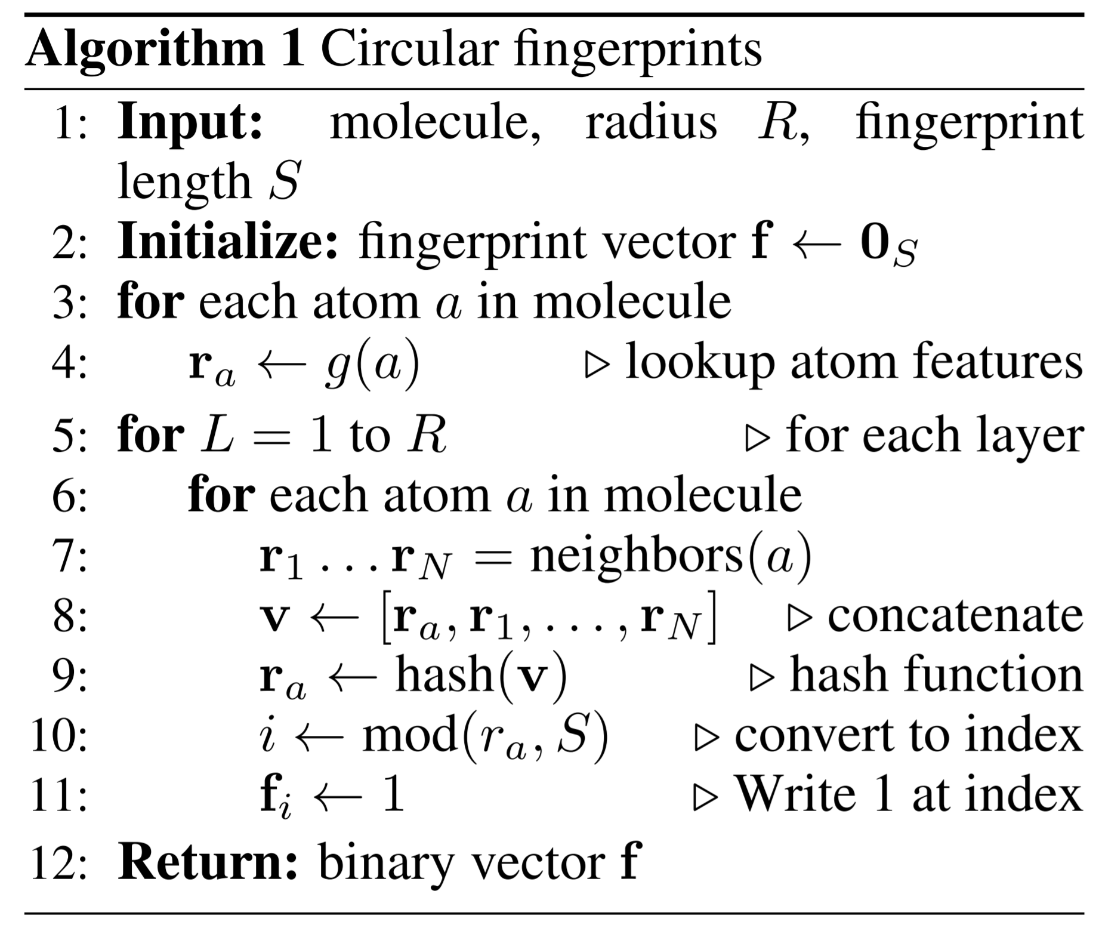
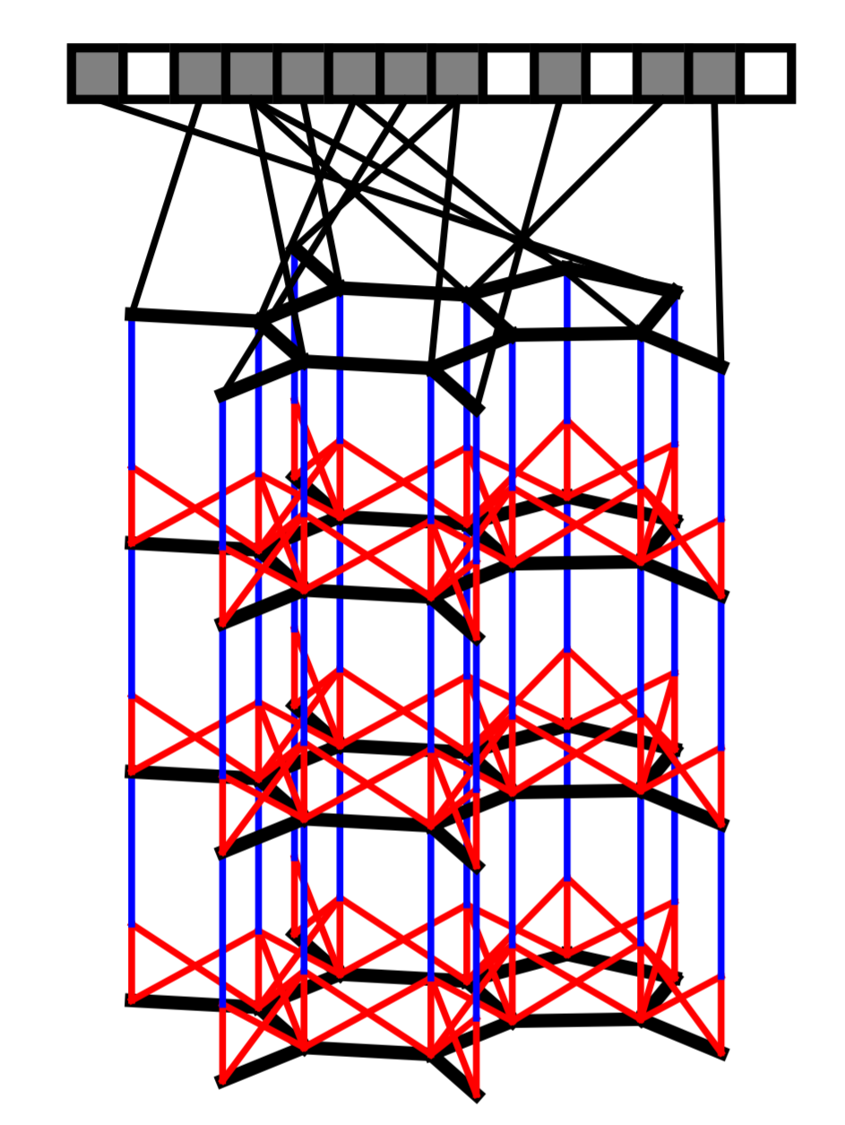
Applications: Learning Molecular Fingerprints
Molecular fingerprints are computed using iterative procedures that involve hash functions
Computation Graph
D. K. Duvenaud, D. Maclaurin, J. Iparraguirre, R. Bombarell, T. Hirzel, A. Aspuru-Guzik, R. P. Adams, “Convolutional Networks on Graphs for Learning Molecular Fingerprints,” NIPS 2015.

Slide 42
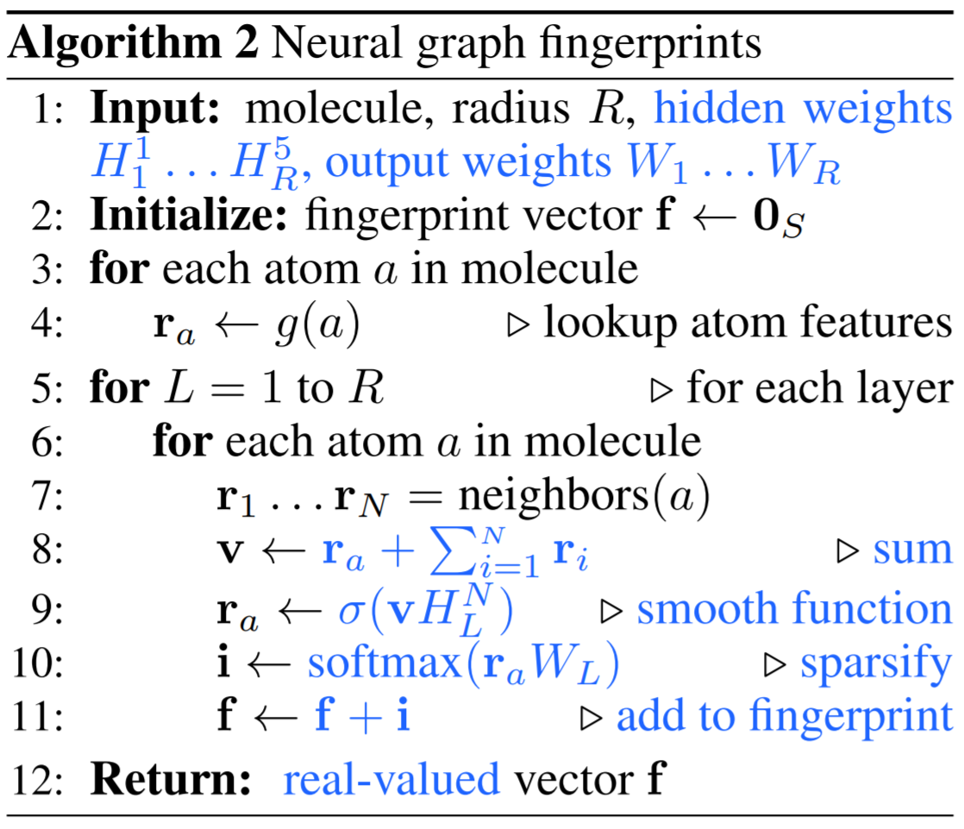
Applications: Learning Molecular Fingerprints
Do you see any problems for unfolding?
“Softify”

Slide 43
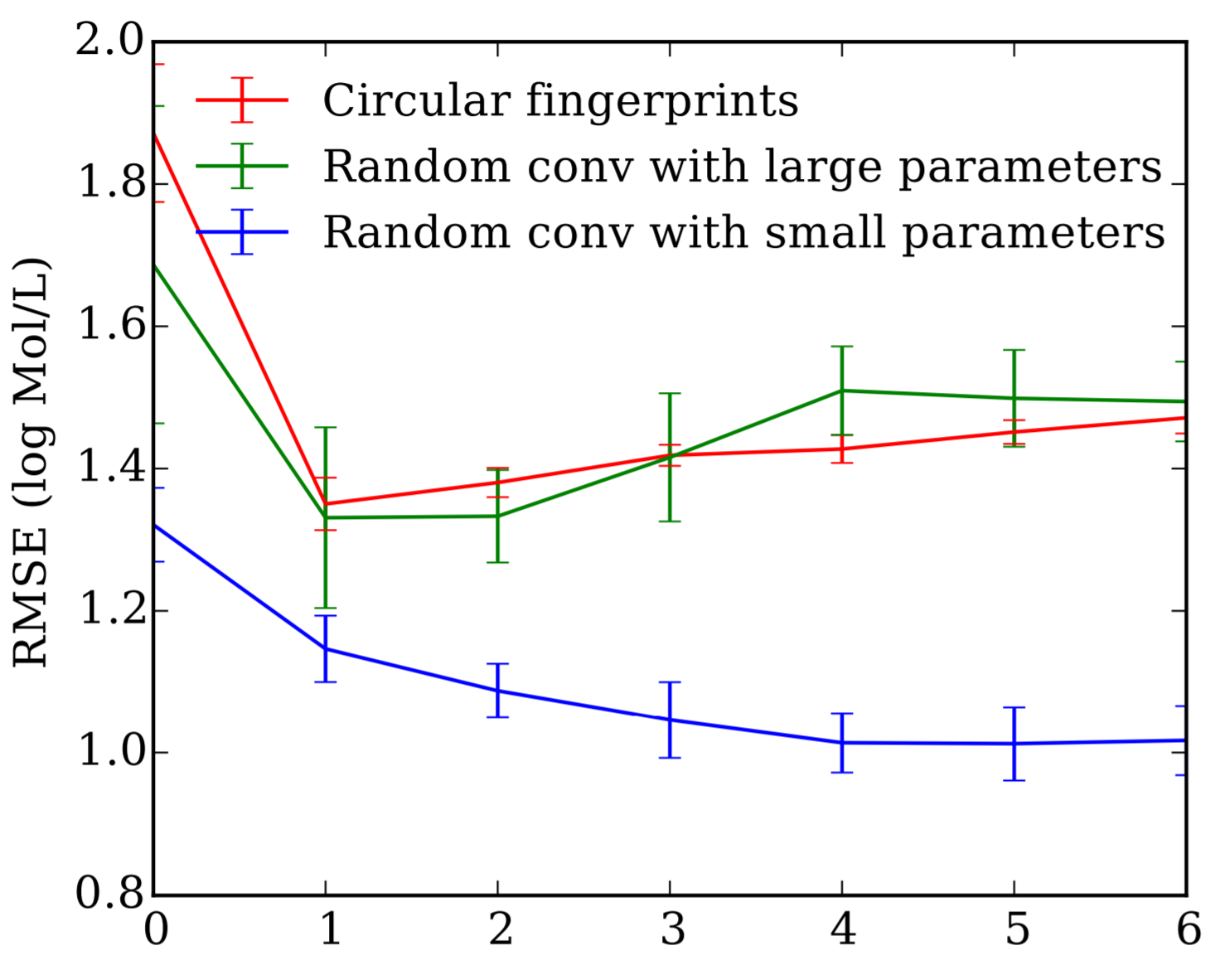
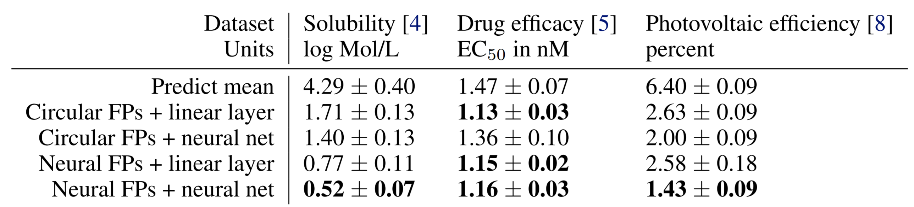
Applications: Learning Molecular Fingerprints
Performance evaluation
Even with randomly initialized weights and no training, unfolding improves performance
With training, the unfolded network significantly outperforms other methods

Slide 44
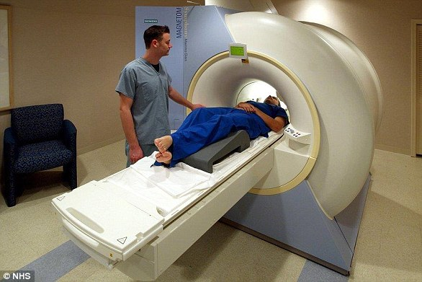
Applications: Compressed Sensing MRI
Magnetic Resonance Imaging (MRI):
A non-invasive medical imaging technique used commonly for diagnostic reasons.
Issues:
Uncomfortable for patient.
Patient movement destroys image.
Highly desirable to minimize imaging duration!

Slide 45
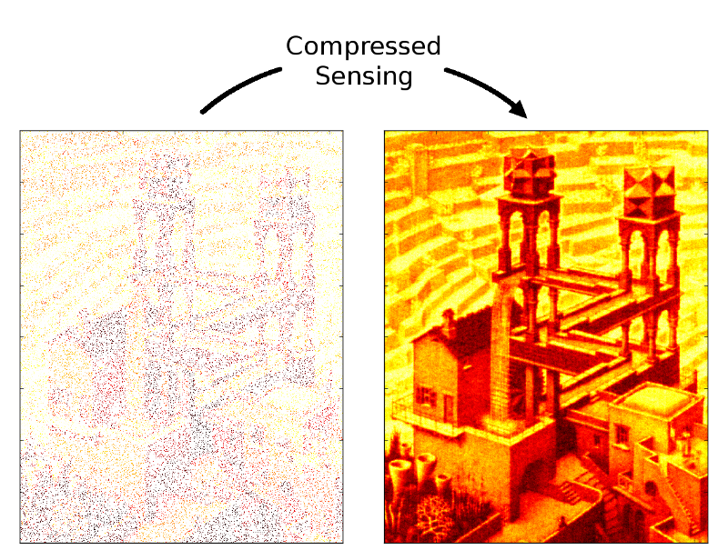
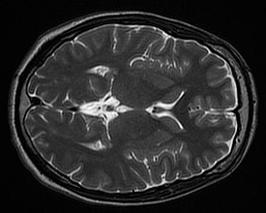
Applications: Compressed Sensing MRI
Compressed Sensing:
A principled method to reconstruct sparse signals from very few samples.
MRI images are typically very sparse!

Slide 46
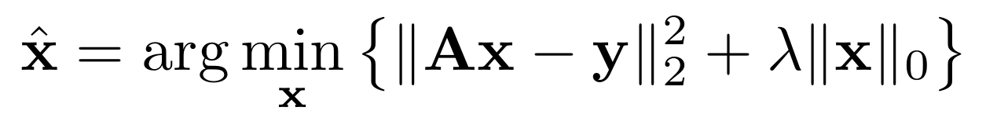
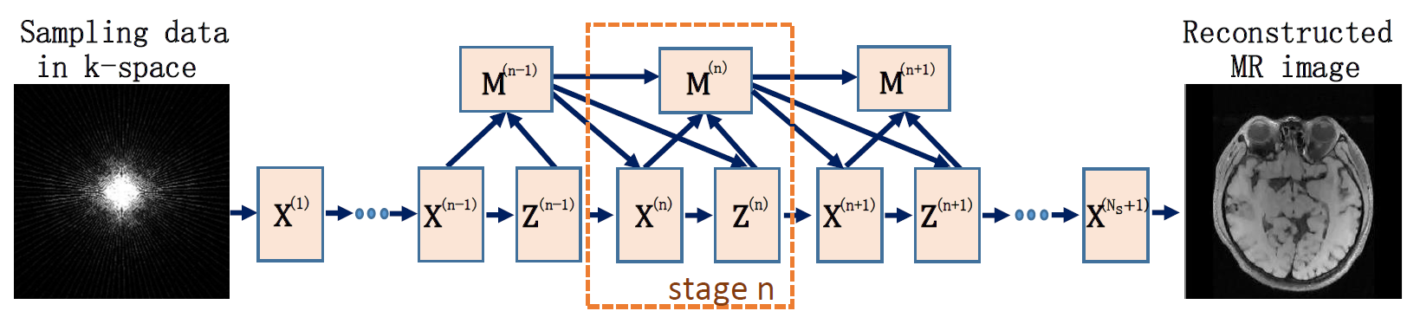
Applications: Compressed Sensing MRI
Mathematical formulation of compressed sensing:
A is the sampling matrix, x is the (sparse) signal to be reconstructed, y are the samples.
Solved using iterative methods in practice, which can be unfolded!
Y. Yang, J. Sun, H. Li, Z. Xu, “ADMM-Net: A Deep Learning Approach for Compressive Sensing MRI,” NIPS 2016.

Slide 47
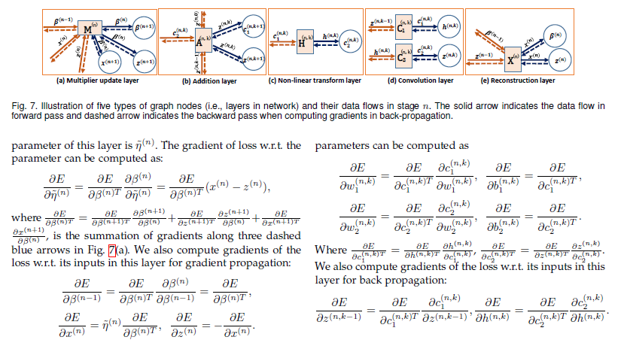
Applications: Compressed Sensing MRI
Don’t be afraid!
In most cases the gradients can be computed automatically using standard neural network frameworks (e.g., Keras).

Slide 48
Applications: Compressed Sensing MRI
Sparse signal recovery for MRI.
Ground-truth image

Slide 49
Take-Home Messages
Main theme: applications and corresponding “specialized” NNs
Applications:
    There’s more to computer vision than classification!
    Neural networks are more than just classifiers!
    Applications may be found in unexpected places!
  Techniques:
    Unpooling (Nearest Neighbor, Bed of Nails, Learned Upsampling)
    Temporal NNs (RNNs, LSTMs, GRUs)
    Model-based NNs (Deep Unfolding)

Slide 50
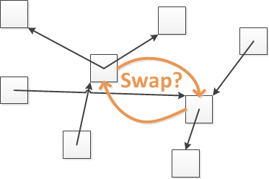
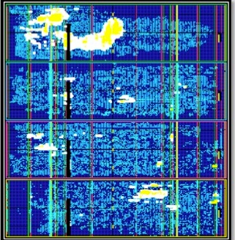

Application: Placement Optimization
Chip routing: Canneal
Minimize wire length
Hopfield Neural Network
FPGA Placement Optimization
Xilinx Vivado tools
50
Notes:
Read the paper on applications that can be solved with Neural networks:
BenchNN: T.Chen, Y.Chen, M.Duranton, Q. Guo, A. Hashmi, M.Lipasti, A.Nere, S.Qiu, M. Sebag, O.Temam. On the Broad Potential Application Scope of Hardware Neural Network Accelerators, IEEE International Symposium on Workload Characterization (IISWC), November 2012

Slide 51


Residual CNN U-net for segmentation
U-Net
Fusion-Net
(residual)
Quan et al. “FusionNet: A deep fully residual ConvNet for image segmentation,” 2016.
Ronneberger et al. “U-Net: ConvNets for Biomedical Image Segmentation,” 2015.
51

Slide 52

Application: Non-Linear Signal Processing
Uplink and downlink are typically separated in time or in frequency
What if we could do both at the same time? (full-duplex communications)
Fundamental Challenge:
very strong “echo” (self-interference) from transmitter!
D. Bharadia, E. McMilin, S. Katti, “”Full Duplex Radios,” 2013.

Slide 53


Application: Non-Linear Signal Processing
In principle: the echo is known!
In practice: analog parts add non-linearities
Non-linearities can be modeled, but the complexity is high:
Y. Kurzo, A. Burg, A. Balatsoukas-Stimming, “Design and Implementation of a Neural Network Aided Self-Interference Cancellation Scheme for Full-Duplex Radios,” 2018.
Why not use a neural network to learn the non-linearities?

Slide 54

Application: Molecular Communications
Transmission channel has memory!
A sliding window bi-directional RNN can be used
No knowledge of the transmission channel required!
N. Farsad, A. Goldsmith, “Neural Network Detectors for Molecular Communication Systems,” 2018.
When using theoretical channel models, BDRNN has lower complexity than conventional methods!
When using experimentally measured data, BDRNN has better performance than conventional methods!
N. Farsad, A. Goldsmith, “Neural Network Detectors for Molecular Communication Systems,” 2018.

Slide 55


Application: Super Resolution from NNs
Low Resolution Image
Kim et al. “Accurate Image Super-Resolution Using Very Deep Convolutional Networks” CVPR16

Slide 56

Very Deep Super Resolution: VDSR
Residual learning
Kim et al. “Accurate Image Super-Resolution Using Very Deep Convolutional Networks” CVPR16
56

Slide 57


Problems: Deep Hallucination
Hieronymous Bosch would be proud!

