Slide 1
Neural Architecture search public
Willem Sanberg
Research Engineer Embedded AI Systems
NXP - CTO Automotive System Innovations
March 2021

Slide 2
Intro & Background

Slide 3
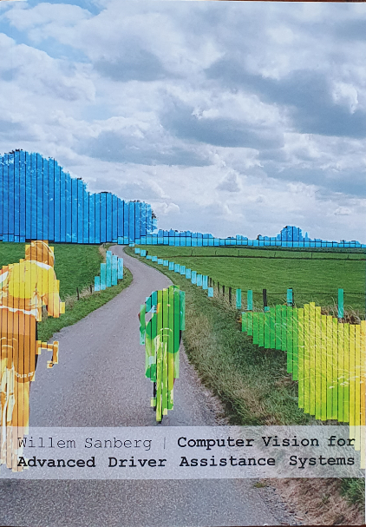
About Willem Sanberg, regarding this talk:
PhD in “Computer Vision for Advanced Driver Assistance Systems”
TU/e - Electrical Engineering - Mobile Perception Systems Lab
Stereo Camera-based environment perception
Algorithm/Software-oriented with several in-vehicle prototypes
Research Engineer for embedded AI Systems
NXP Semiconductors
CTO Automotive System Innovations (‘R&D department’)
My job in a nutshell:
Scouting & analysing AI research (self & via university collaborations etc.)
Translate to NXP requirements & research projects
Execute such a project in a team (small, but cross NXP)
NXP headquarters in Eindhoven
(High Tech Campus)

Slide 4
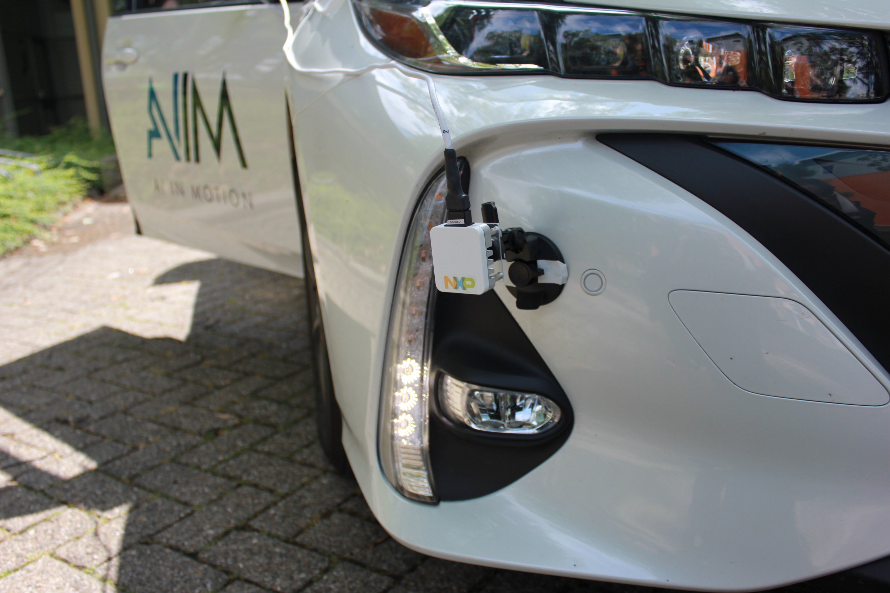
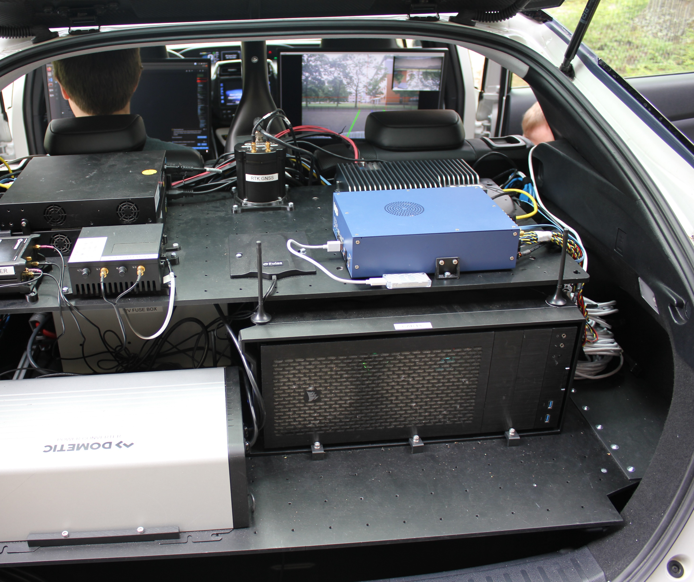
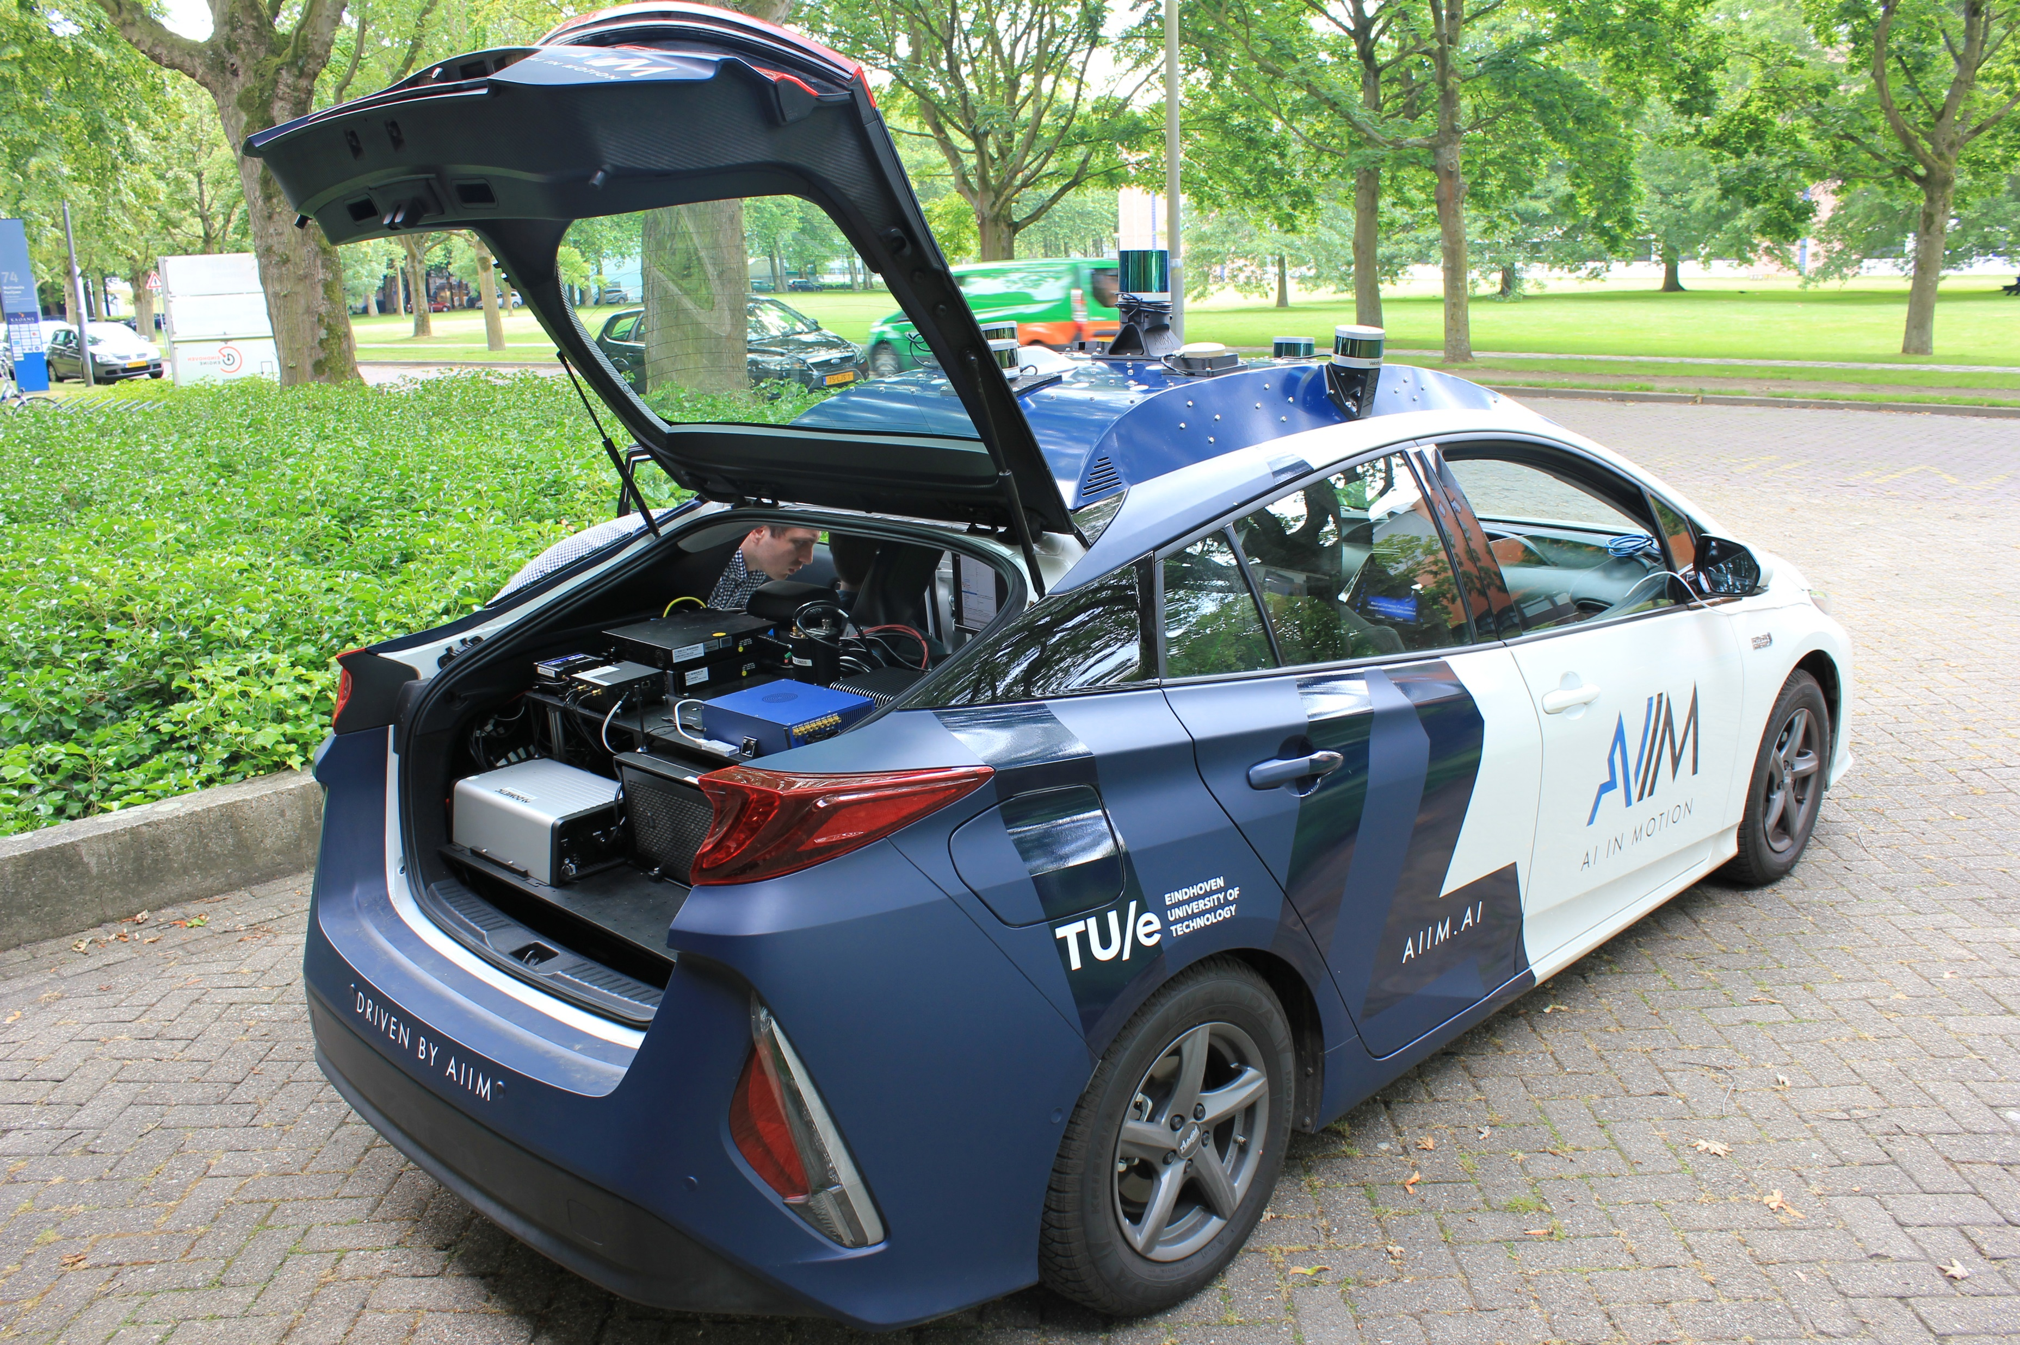
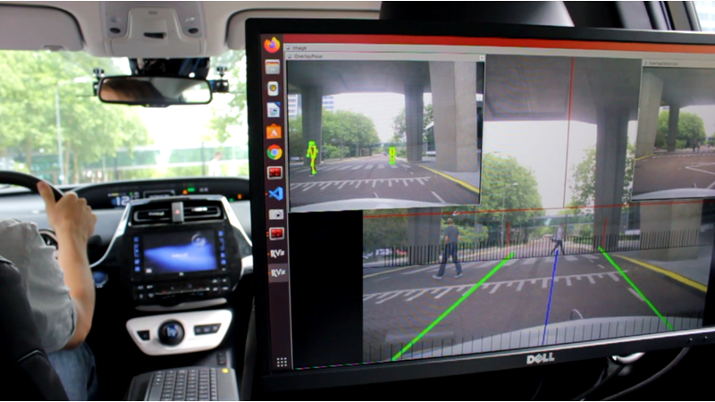
CTO Automotive System Innovations (R&D):
Protoyping systems with NXP chips, e.g.:
Radar, AI/ML ‘brain’, network
In-house & collaborations
Demo Pedestrian pose detection (left)
Lane estimation (right)

Slide 5
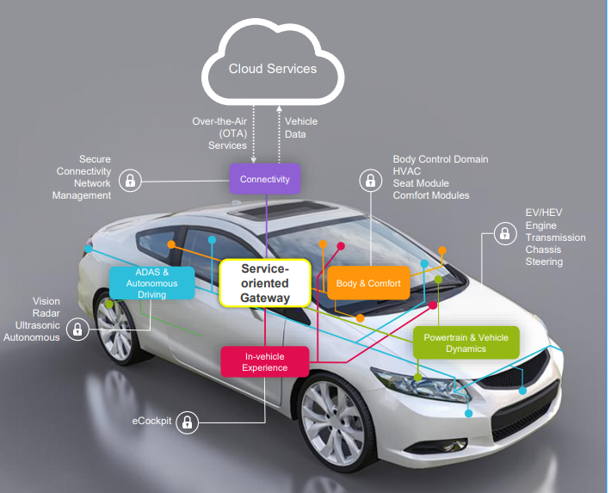
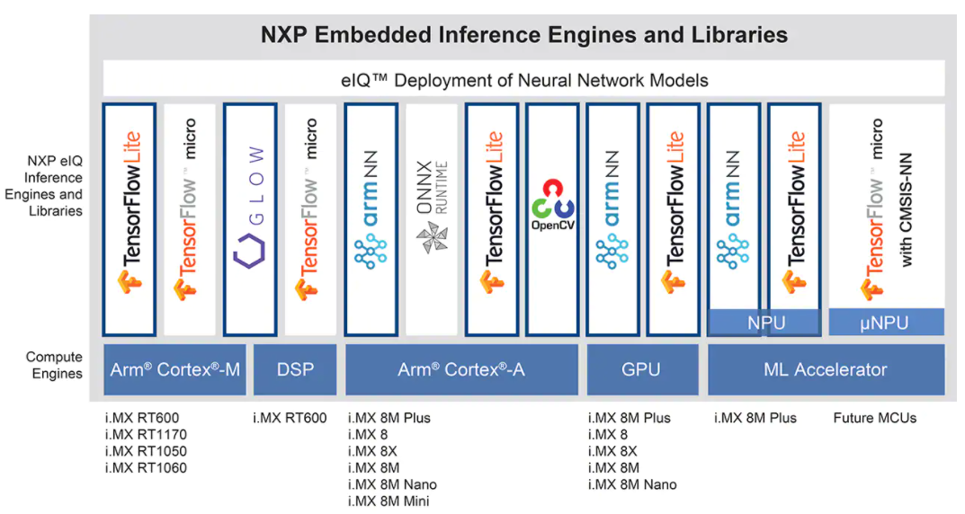
Nxp has a broad portfolio
Different functionality:
Compute
Connectivity
Audio/Display
Different data:
Rada
Analytics
UWB
Vision
Different context:
Automotive
Drones
IoT/edge
Industrial automation
So, for AI deployment:
Many different applications
Many different chips
Many different constraints
→ Many different networks to design
Notes:
many different target platforms & cores, each with several different SW routes, hence many considerations if you want to design optimal neural networks.

Slide 6
Contents
Neural Architectures
Neural Architecture Search
Overview & example
Hardware-aware Neural Architecture Search
Overview and example

Slide 7
Neural Architecture Search: overview

Slide 8
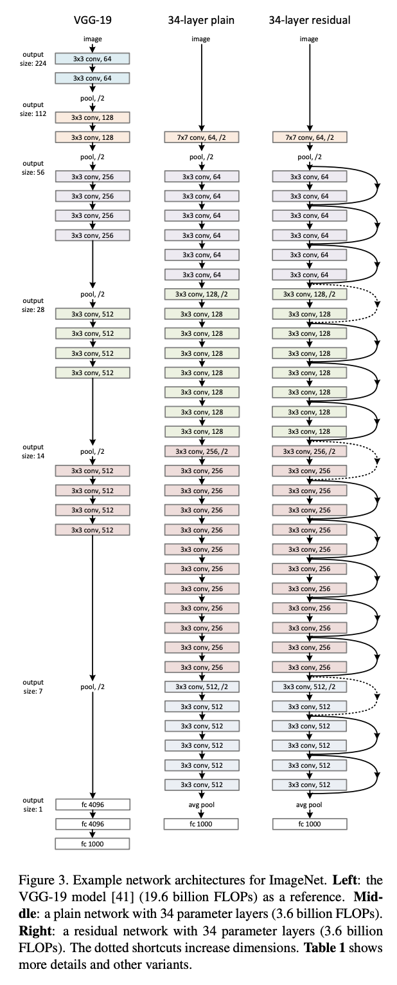
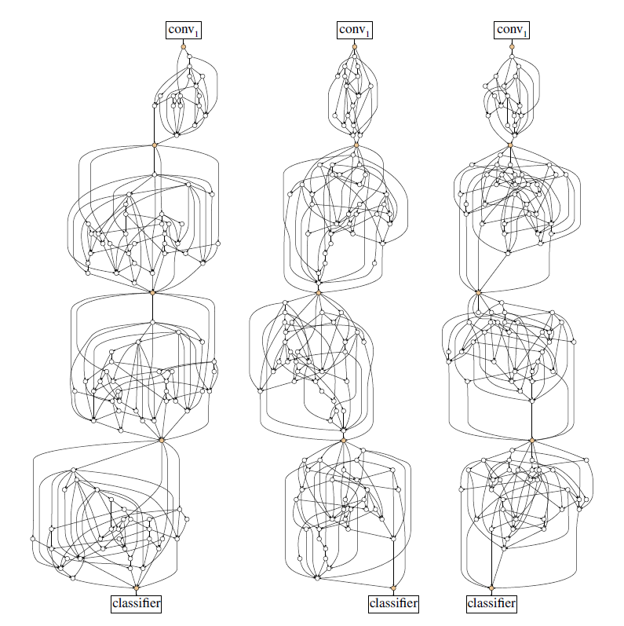
Neural architectures
Neural architectures:
well-structured patterns
operations and connections,
manually designed by D.L. experts
However:
Search space is much bigger
Variety/constraints intractable for manual design
Accuracy, speed, energy, memory…
NAS aims at automatically finding ‘better’ solutions in a scalable way
Several randomly generated networks
outperform ResNet-50 on ImageNet classification
(+2% top-1 acc @ same #FLOPS)
He et al., 2016, Deep Residual Learning for Image Recognition
Simonyan et al., 2014, Very Deep Convolutional Networks for Large-Scale Image Recognition
Xie et al., 2019, Exploring Randomly Wired Neural Networks for Image Recognition
Notes:
NN Design & solution coverage
Traditional, manually designed NN architectures do not cover all relevant solutions
Due to, i.e., human bias in what a feasible or good architecture should look like

Slide 9
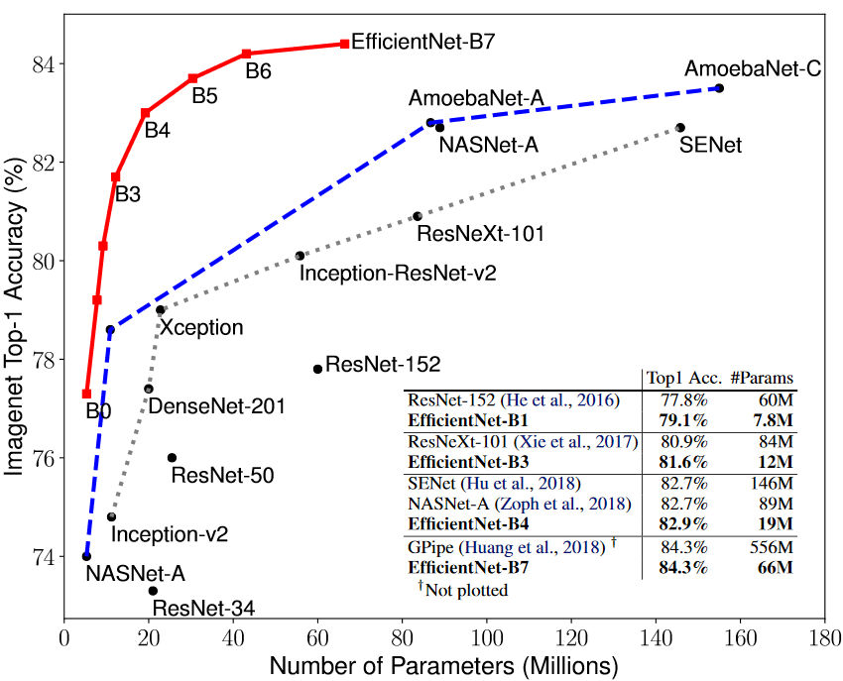
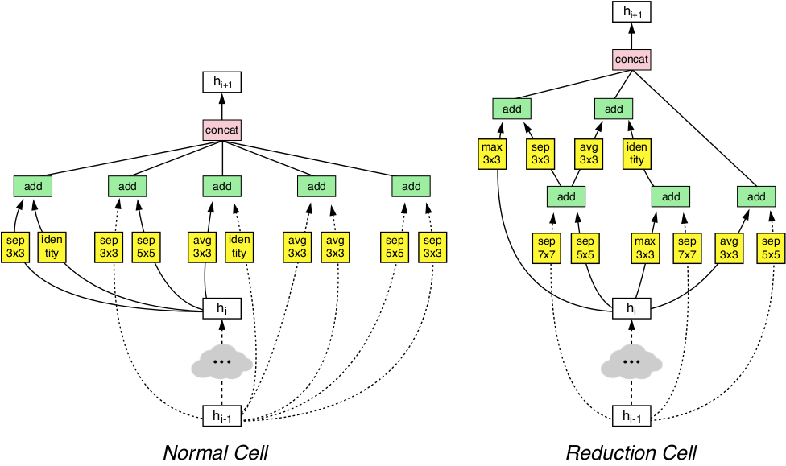
Neural Architecture Search finds effective & efficient solutions
Automated NAS finds significantly more accurate yet efficient solutions than expert data scientist have created
Hand-crafted architectures (most competitive solutions)
Early Neural Architecture Search (2017) [2]
Recent Neural Architecture Search (2019) [1]
NAS offers an automated approach especially suitable for multi-objective optimization of DNNs
Interesting hardware-aware secondary objectives: #params, #ops, latency, energy, bandwidth, compute utilization, etc.
Found solutions may incorporate complex structures human experts would not intuitively design
[1]
Slide credit: Sebastian Vogel (NXP)
[2]
[1] EfficientNet: Rethinking Model Scaling for Convolutional Neural Networks, ICML 2019
[2] Learning Transferable Architectures for Scalable Image Recognition, CVPR 2018

Slide 10
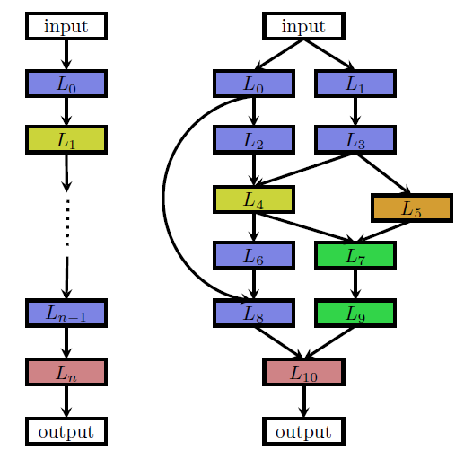
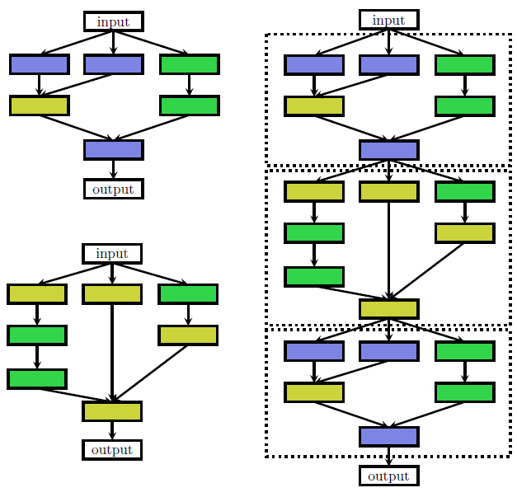
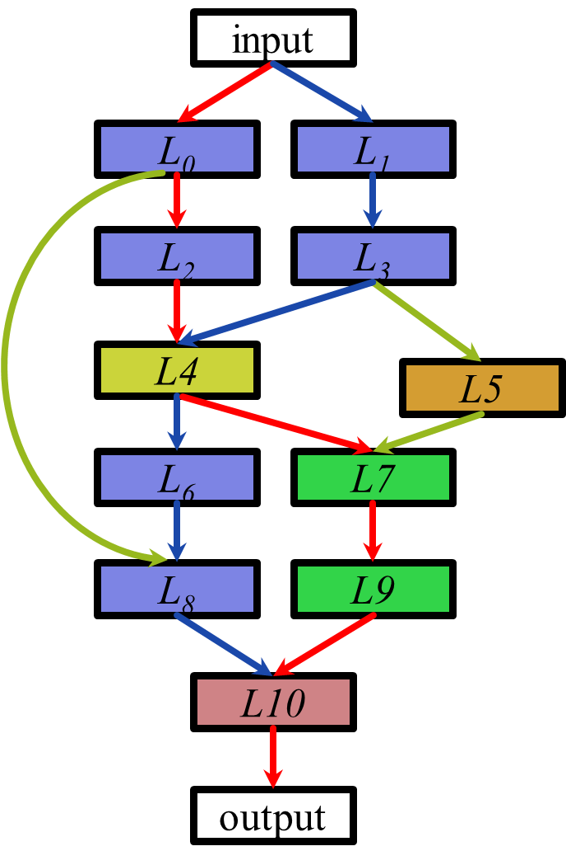
How does NAS work? NAS is coarsely defined by three aspects: 1) Search Space, 2) Search Strategy, 3) performance Estimation
Methods differ based on three main aspects of NAS
Search space → Which architectures & HPs* can be found?
Search strategy → How to explore possible solutions?
Performance estimation → How does a solution perform wrt. accuracy, hardware-cost, etc.?
[1]
Design decisions w.r.t these 3 aspects impact on NAS resource requirements and evaluation time
Search Space
Multi-branch networks incl. HPs*
Chain structured DNNs**
Cell-based
Macro-architecture/One-shot model
Search strategy
Random search
Reinforcement learning
Evolutionary/Genetic Alg.
Bayesian optimization esp. for HPs*
Differentiable architecture search
Performance Estimation
Full training
Learning curve extrapolation
Additionally, for 2ndary objectives:
Profiling, MIL#, HIL##
Surrogate-model-based evaluation
Smaller space
Faster convergence
Faster estimation
Acc. [%]
Acc. [%]
Slide credit: Sebastian Vogel (NXP)
[1]
#Params
Epochs
[1] Neural Architecture Search: A Survey, JMLR 2019
* HP – hyper parameters
** DNN – deep neural network
# MIL – model in the loop
## HIL – hardware in the loop

Slide 11
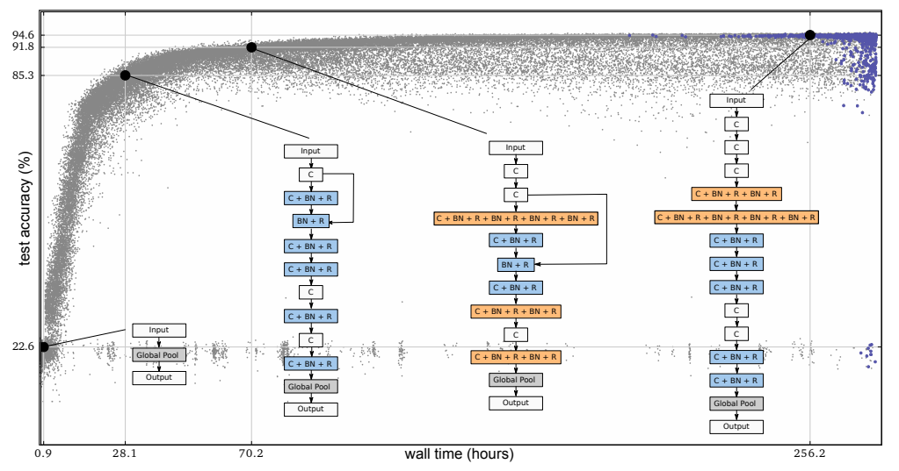
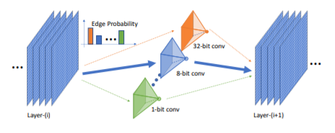
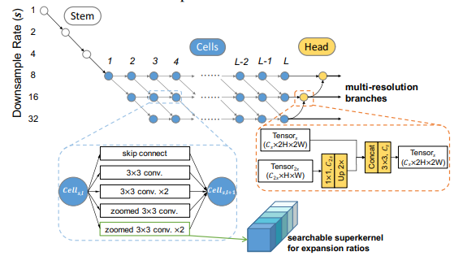
The field of NAS is exploding
Increasing number of commercial services around AutoML & NAS available
Microsoft NNI & ArchAI, Google AutoML, etc.
Large-scale evolution of Image Classifiers (2017)
Mixed Precision Quantization in D. NAS (2018)
Source on numbers in graph above: - HA-NAS from Benmeziane et al., 2021, A Comprehensive Survey on Hardware-Aware Neural Architecture Search - NAS from http://www.ml4aad.org/automl/literature-on-neural-architecture-search/
FasterSeg (2020)

Slide 12
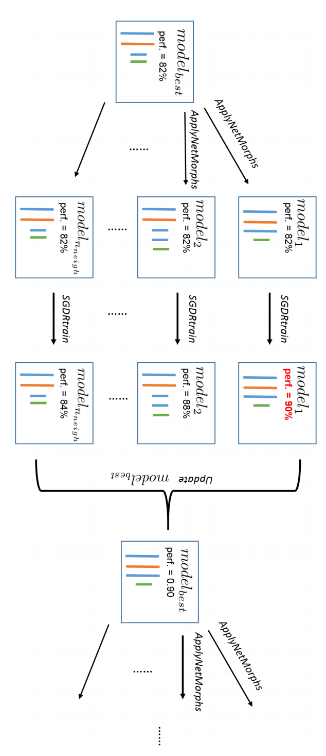
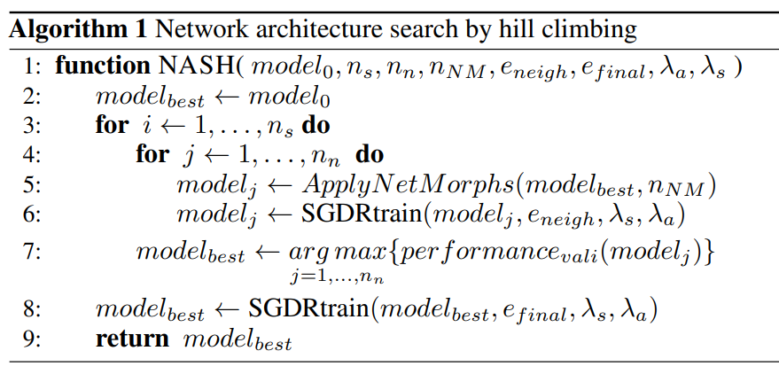
Nash: Nas by hill climbing (concept)
NAS with Evolutionary search
Search guided via selection of parents
Select most successful child after quick training
Elsken et al., 2017, Simple and Efficient Architecture Search for CNNs
Notes:
Our proposed algorithm is a simple hill climbing strategy. We start with a small, pretrained network. Then, we apply network morphisms to generate larger ones that may perform better when trained further. Due to the network morphism, the child networks start at the same performance as their parent. In essence, network morphisms can thus be seen as a way to initialize child networks to perform well, avoiding the expensive step of training them from scratch and thereby reducing the cost of their evaluation. The various child networks can then be trained further for a brief period of time to exploit the additional capacity, and the search can move on to the best resulting child network. This constitutes one step of our proposed algorithm, which we dub Neural Architecture Search by Hill-climbing (NASH). In our implementation, ApplyNetMorphs(model, n) applies n network morphisms, each of them sampled randomly from the following three: 1) Make the network deeper. 2) Make the network wider. 3) Add a skip connection. See appendix B for more details. Since a lot of networks need to be trained, the child networks can only be trained for a few epochs. Hence, an optimization algorithm with good anytime performance is required - we chose the cosine annealing strategy from Loshchilov & Hutter (2017), whereas the learning rate is implicitly restarted: the training always starts with a learning rate λs which is annealed to λa after eneigh epochs. We use the same learning rate scheduler in the final training (aside from a different number of epochs).
SGDR: STOCHASTIC GRADIENT DESCENT WITH WARM RESTARTS Loshchilov & Hutter ICLR 2017 (https://arxiv.org/pdf/1608.03983.pdf)
LR schedule not as staircase, but quick drops and then restart. Results in faster and more stable improvement of test error, and even ‘better anytime performance’ (consistently below default training schedules).

Slide 13
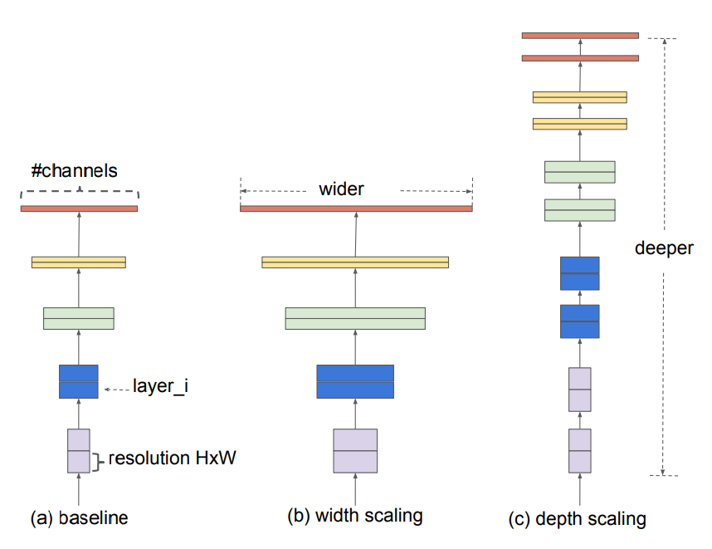
Nash: Nas by hill climbing (concept)
Three morphisms (sampled uniformly):
Make deeper (add [Conv, BN, Relu] block)
Sample uniformly: position, kernel size {3,5};
#channels from predecessor
Make wider (increase #channels)
Sample uniformly:
Target conv layer
Widening factor {2,4}
Add bypass/skip connection
Sample uniformly:
Target layers to connect
Concatenation or addition
EfficientNet, Tan & Le, 2018
Elsken et al., 2017, Simple and Efficient Architecture Search for CNNs

Slide 14
Nash: Nas by hill climbing (Results)
Three morphisms (sampled uniformly):
Make deeper (add [Conv, BN, Relu] block)
Sample uniformly: position, kernel size {3,5};
#channels from predecessor
Make wider (increase #channels)
Sample uniformly:
Target conv layer
Widening factor {2,4}
Add bypass/skip connection
Sample uniformly:
Target layers to connect
Concatenation or addition
Results:
Similar performance as other NAS methods
…. with way faster convergence
… but still outperformed by some handcrafted methods
 | Resources | CIFAR-10 error
Real et al. (2017) | 250 GPUs, 10 days | 5.4
NASH (2017) | 12 hrs, 1 GPU | 5.7
handcrafted (Gastaldi 2017) | 2 GPUs 2 days | 2.9
Elsken et al., 2017, Simple and Efficient Architecture Search for CNNs

Slide 15
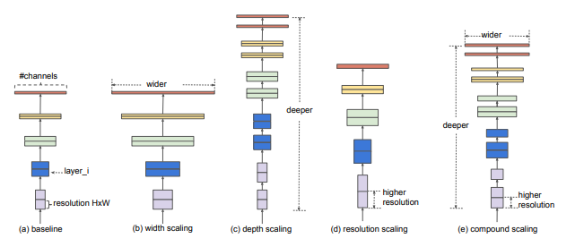
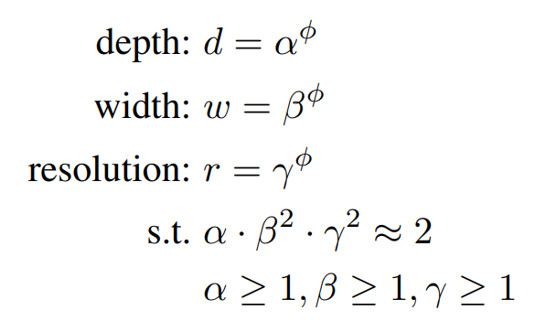
Nash: Nas by hill climbing (improvements)
Three morphisms (sampled uniformly):
Make deeper (add [Conv, BN, Relu] block)
Sample uniformly: position, kernel size {3,5};
#channels from predecessor
Make wider (increase #channels)
Sample uniformly:
Target conv layer
Widening factor {2,4}
Add bypass/skip connection
Sample uniformly:
Target layers to connect
Concatenation or addition
Where to improve?
Better search guidance:
Bayesian Optimization instead of uniform sampling (e.g. Auto-Keras)
Consider morphisms jointly
E.g. compound scaling in EfficientNet
Auto-Keras: An Efficient Neural Architecture Search System, Jin et al., 2019 EfficientNet: Rethinking Model Scaling for Convolutional Neural Networks, Tan & Le, 20120

Slide 16
NAS recap
NAS aims at automatically finding ‘better’ solutions in a scalable way
Motivation:
Variety/constraints intractable for manual design
Accuracy, speed, energy, memory…
Embedded deployment
Additional complexity
Each platform different strengths & weaknesses
Do Hardware-aware NAS
Jointly optimize accuracy and efficiency

Slide 17
Hardware-aware Neural Architecture Search: motivation

Slide 18
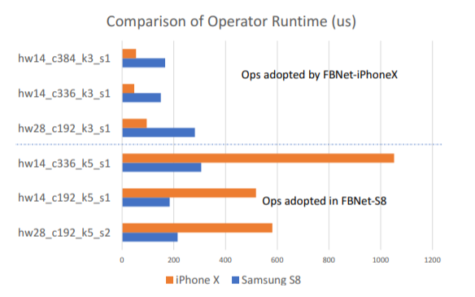
networks on different embedded devices
FBNet example: NN for iPhoneX & NN for Samsung S8
Similar #params & accuracy
Different latency when swapping platforms
Wu et al., 2019, FBNet: Hardware-Aware Efficient ConvNet Design via Differentiable Neural Architecture Search

Slide 19
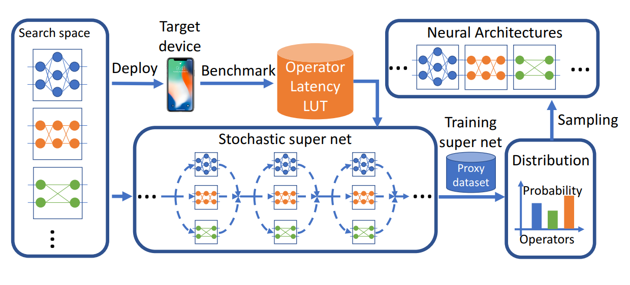
Hardware-aware Neural architecture search
Incorporate platform-specific deployment cost (latency) in architecture design
Exploit unique strengths of embedded platform
Example of FBNet:
Measure latency of building blocks on target platform
Do multi-objective NAS: optimize both task-accuracy & platform latency
Wu et al., 2019, FBNet: Hardware-Aware Efficient ConvNet Design via Differentiable Neural Architecture Search

Slide 20
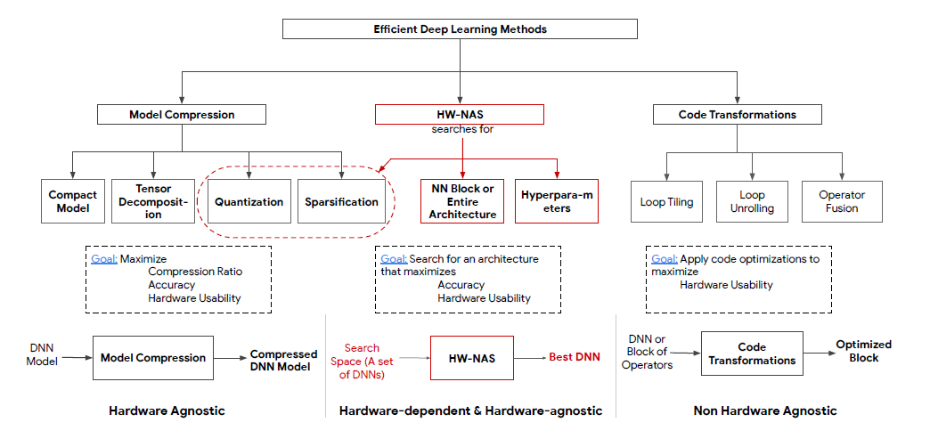
Hardware-aware NAS is a method for efficient deep learning
Benmeziane et al., 2021, A Comprehensive Survey on Hardware-Aware Neural Architecture Search

Slide 21
Hardware-aware NAS is a method for efficient deep learning
Benmeziane et al., 2021, A Comprehensive Survey on Hardware-Aware Neural Architecture Search

Slide 22
Hardware-aware Neural Architecture Search: example

Slide 23
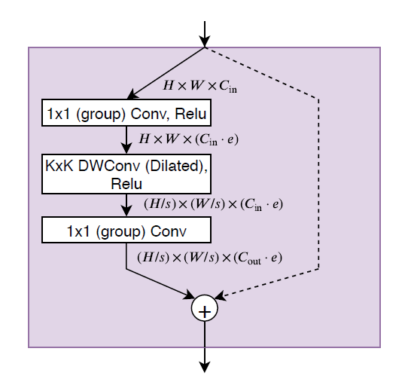
Example: Strategy from SqueezeNAS (concept)
Concept
Search space
Sample optimal realization architecture for inference
Choice 1…13 are different versions of a parametrized module:
Shaw et al., 2019, SqueezeNAS: Fast neural architecture search for faster semantic segmentation

Slide 24
Example: Strategy from SqueezeNAS (method)
More formally:
Cast NAS as a path-selection problem within a stochastic supernetwork
Optimize the loss
Where
And C(i,j) contains the cost-of-interest to use candidate module ‘i’ as block ‘j’ in the network
Cost-of-interest?
MACs, latency (estimated or measured from specialized profiling effort), memory, etc.
Can be independent, weighted, correlated, etc.
In SqueezeNAS: assumed that blocks are executed independently & consecutively
Architecture parameters
Conv. weights
(Weighted) Resource- specific loss
Problem- specific loss
HW stats
HW stats
HW stats
Shaw et al., 2019, SqueezeNAS: Fast neural architecture search for faster semantic segmentation

Slide 25
Example: Strategy from SqueezeNAS (Key findings)
Similar or better accuracy
Orders of magnitude faster convergence (7-15 GPU days versus 1000s for MobileNetv3)
HW-aware Latency-optimized networks are faster architectures, even while they have more MACs than MAC-optimized networks
→ Reducing MACs is just a proxy for efficiency
→HA-NAS can develop richer models that better utilize target HW
Architecture | Class mIOU | Latency (ms) | MACs (G) | MACs/sec (G) | Params (M) | GPU days
C3[41] | 61.96 | - | 6.29 | - | 0.19 | -
EDANet[42] | 65.11 | - | 8.97 | - | 0.68 | -
MobileNetV2[40] | 70.71 | - | 21.27 | - | 5.75 | -
MobileNetV3-Small[36] | 68.38 | 44.01 | 2.90 | 65.89 | 0.47 | -
MobileNetV3-Large[36] | 72.36 | 92.78 | 9.74 | 104.97 | 1.51 | >2,000
SqueezeNAS MAC Small | 66.76 | 46.01 | 3.01 | 65.37 | 0.30 | 7.0
SqueezeNAS MAC Large | 72.40 | 102.90 | 9.39 | 91.21 | 0.73 | 9.7
SqueezeNAS MAC Xlarge | 74.54 | 156.41 | 21.84 | 139.63 | 1.80 | 14.6
SqueezeNAS LAT Small | 68.02 | 34.57 | 4.47 | 129.17 | 0.48 | 8.7
SqueezeNAS LAT Large | 73.62 | 98.28 | 19.57 | 199.17 | 1.90 | 9.4
SqueezeNAS LAT Xlarge | 75.19 | 152.98 | 32.73 | 213.94 | 3.00 | 11.5
Shaw et al., 2019, SqueezeNAS: Fast neural architecture search for faster semantic segmentation

Slide 26
Hardware-aware Neural Architecture Search: there is way more…

Slide 27
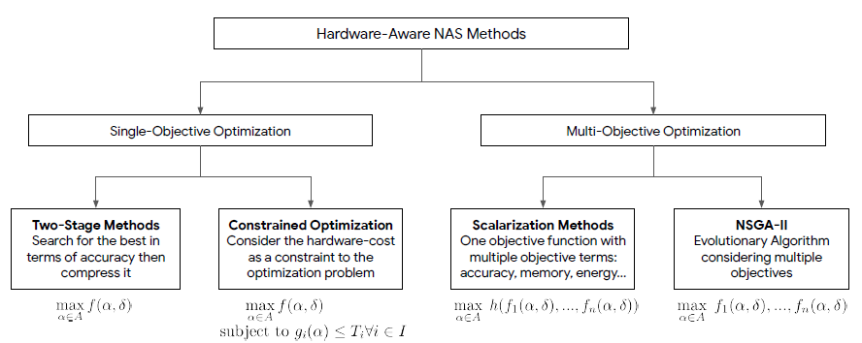
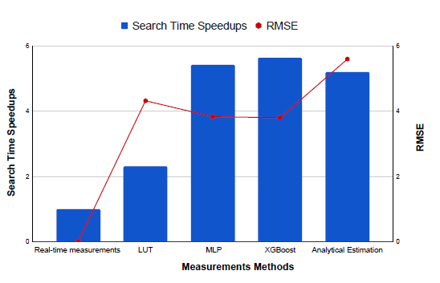
Hardware-awareness adds more complexity to NAS
Key impact of hardware-awareness on the three elements of NAS
Search space
Which graph structures and which building blocks are feasible and supported on HW?
Search Strategy
Should be additionally guided by the deployment cost, which is a conflicting ‘landscape’ with accuracy.
Performance Estimation
How to incorporate deployment cost in a scalable manner?
HiL: accurate, but slow
LUT: fast and accurate, but constrains search to a fixed set of options
Model: fast and ‘unconstrained’, but additional problem to solve.
And… is this enough?
How about optimizing the scheduling etc. as well?
Example: MCUNet

Slide 28
Hardware-aware neural architecture search – take home messages
Automatically design NN architectures that jointly optimize
Accuracy on application task (e.g. image classification, object detection)
and hardware utilization of the target inference platform
by taking HW and SW constraints of the latter into account in the training process.
Three key strengths of HA-NAS as a tool for efficient deep learning:
Extend design space coverage for neural networks beyond bias from human expert
Provide optimal performance on a case-by-case basis (task, data, HW)
Mitigate desired deployment bottlenecks directly (speed, energy, memory, compatibility, etc.)
… but it requires
Compute resources
Research into search space design, cost functions, modeling strategies, training re-use,…
… a lot to do for new researchers!
Graduation projects are possible, but limited availability – willem.sanberg@nxp.com

Slide 30
Exploring New designs automatically and efficiently is relevant to counter Several common assumptions and shortcomings
1. NN Design & solution coverage
Traditional, manually designed NN architectures do not cover all relevant solutions
Due to, i.e., human bias in what a feasible or good architecture should look like
2. NN Design & task transfer
NN architectures that are optimal for classification are not automatically also optimal for another task like segmentation
Due to, i.e., fundamental differences in abstraction level w.r.t. resolution
However, commonly (mis-)used to speed up AI dev for new applications/domains (e.g. via model zoo’s)
3. NN Optimization:
Reducing MACs (multiply-accumulate ops) does not automatically improve latency on target platform
Due to specialized optimized HW & mapping of operations, #MACs is a proxy metric for latency
eg.: redistributing same #MACs over different dimensions of convolutions can have high impact on different HW
More generic: every HW platform has its own ‘optimal’ NN building blocks
Data-heavy, compute-heavy, etc.
4. NN Design (deployment):
- NN architectures that are optimal in research are not automatically transferable to embedded environments
Due to, i.e., new constructs and elements that are not supported by the compiler/scheduler, etc.

