Slide 1
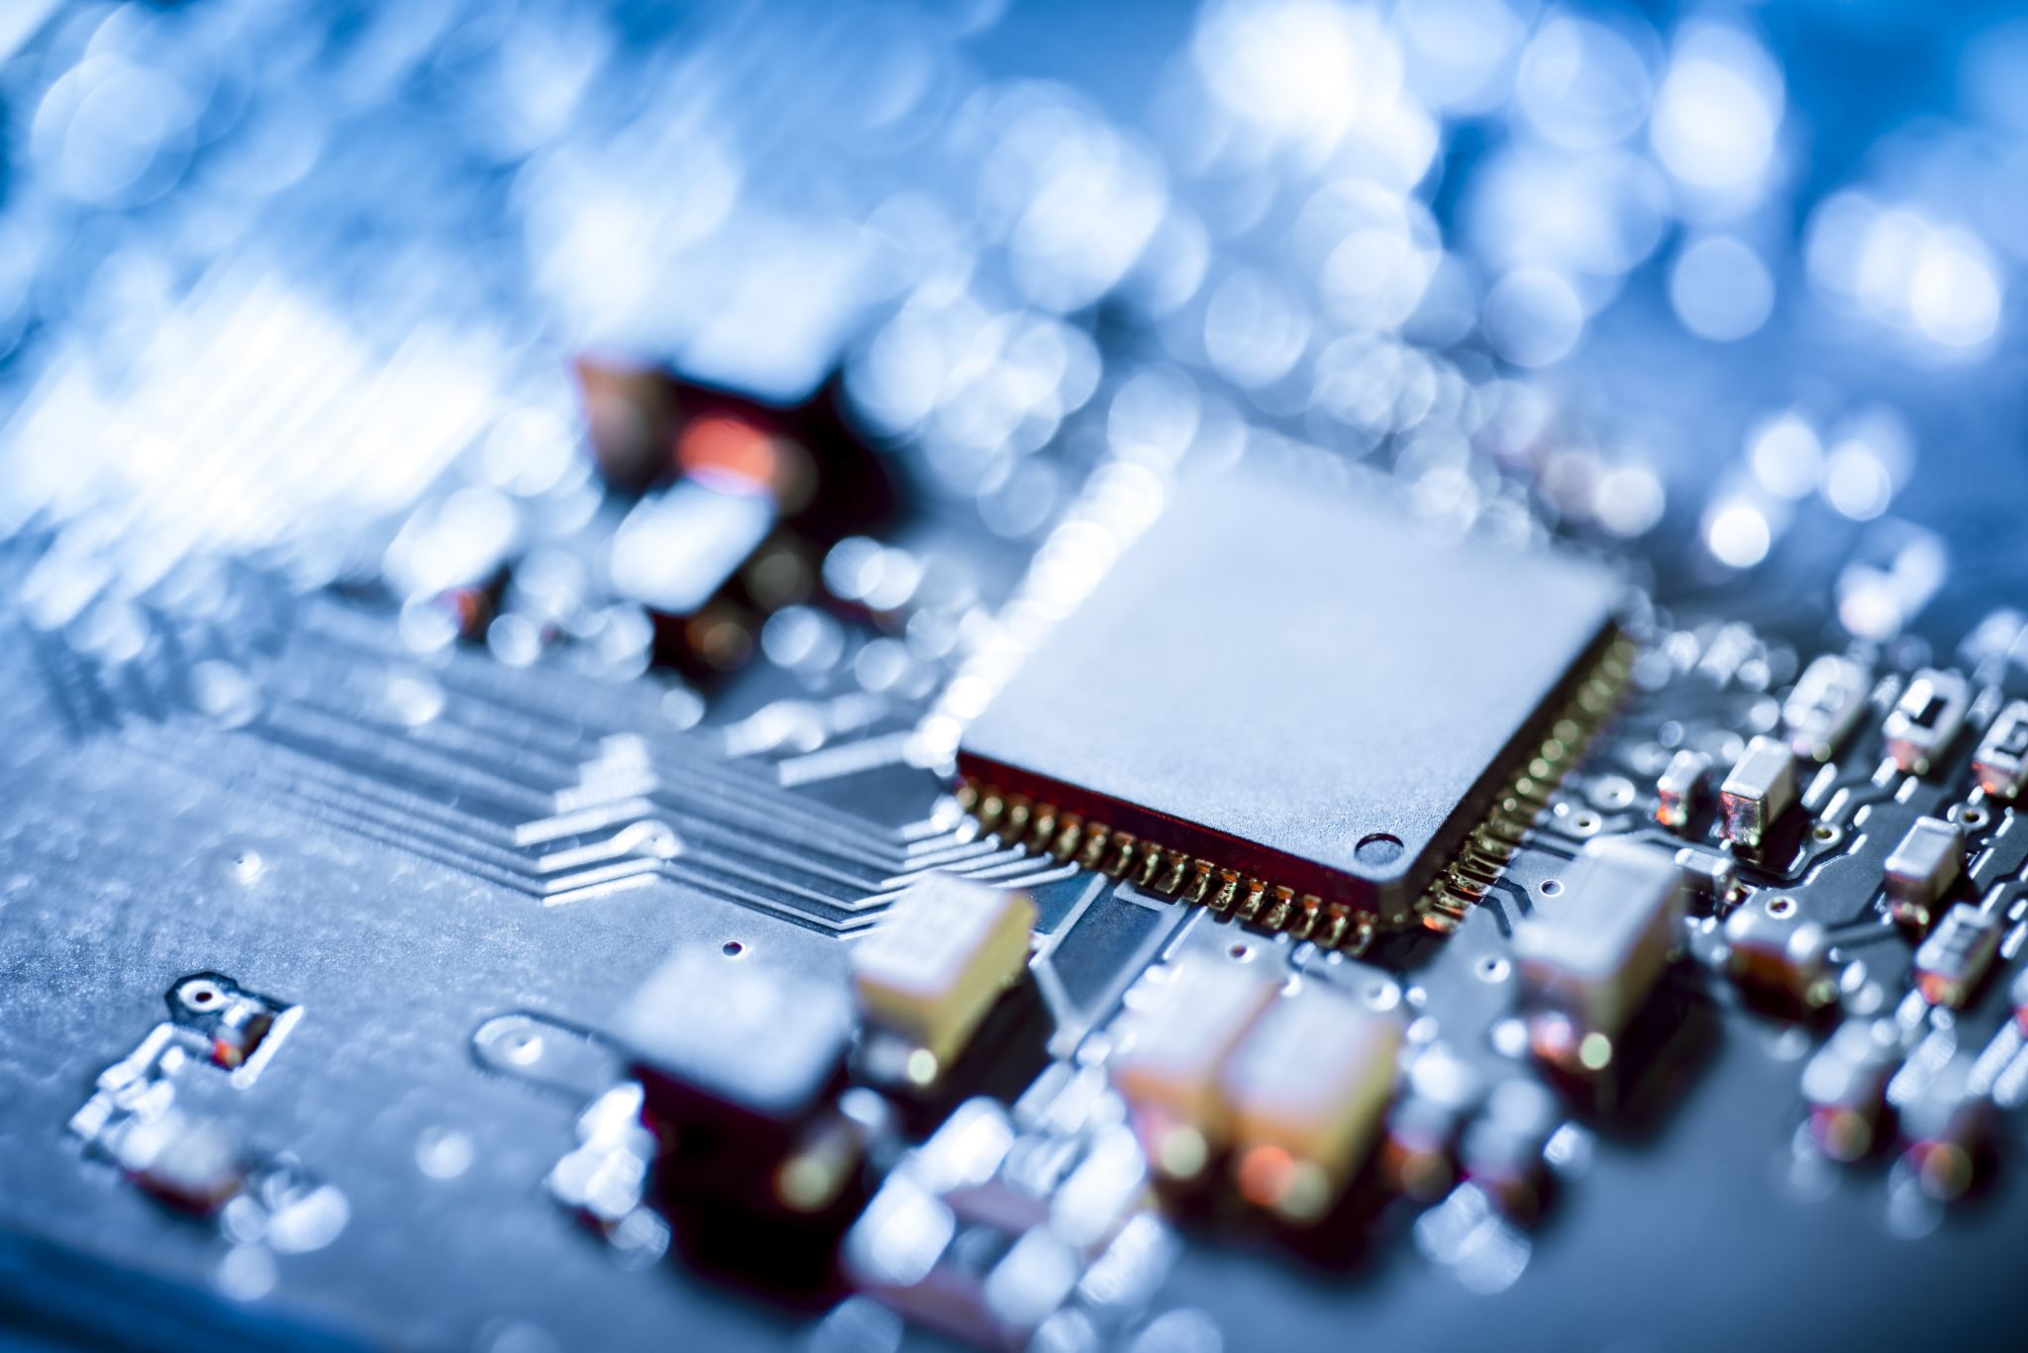
Neuromorphic Sensors and Processors
Amirreza Yousefzadeh (Amirreza.Yousefzadeh@imec.nl)
March 2021

Slide 2
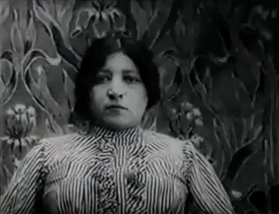
Sensing by Periodic sampling
Videos are made by continues capturing of static pictures
Sampling rates -> fixed (24fps, 60fps, 120fps)
Same for Audio (and other sensors)
https://en.wikipedia.org/wiki/Stop_motion

Slide 3
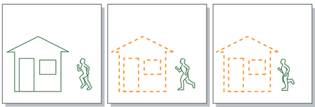
Fixed sampling rate is not optimal for machine vision
Low rate → motion blur
High rate → Redundancy
Optimum rate changes with time and location of pixels (background vs moving object)
The processing of recorded data happens on every sample individually
Processing of high amount of redundant data

Slide 4
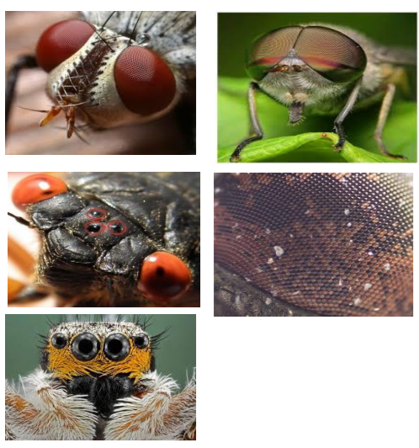
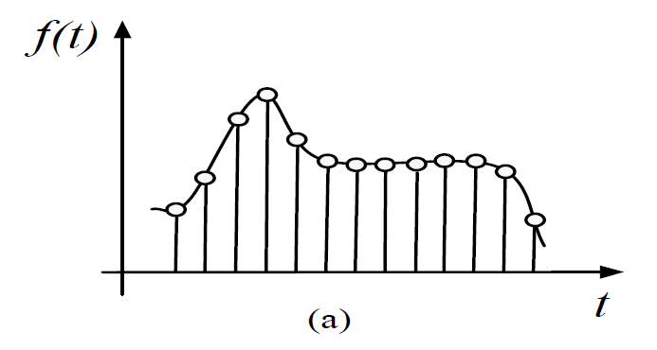
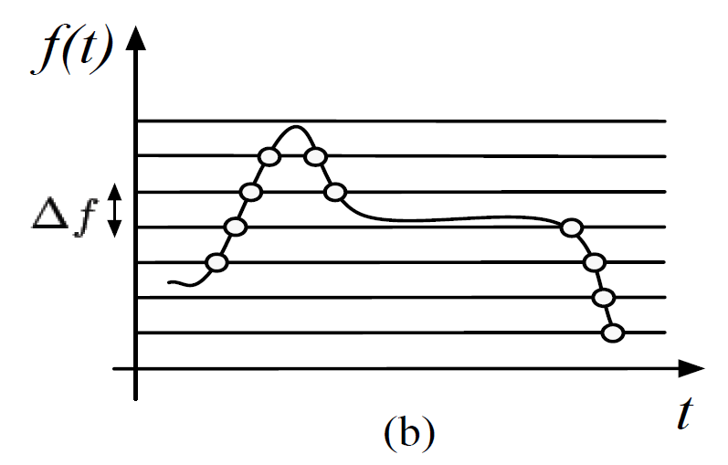
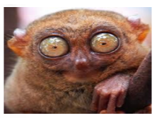
Bio-inspired sensors
Adaptive spatio-temporal sampling rate (Asynchronous sampling)
Every photo-receptor in the eye only fires when there is a change in the light intensity
Processing of compressed samples (events) is energy efficient
When nothing happens, nothing is sent or processed (event-based processing)
"What is Neuromorphic Event-based Computer Vision? Sensors, Theory and Applications," a Presentation from Ryad B. Benosman

Slide 5
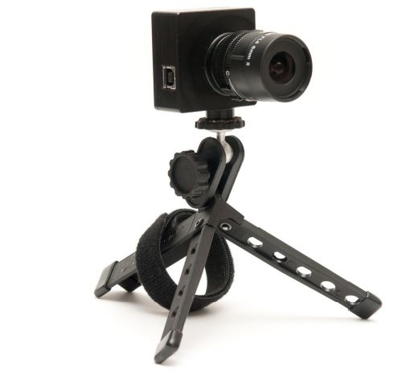
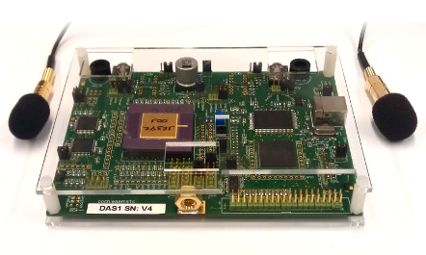
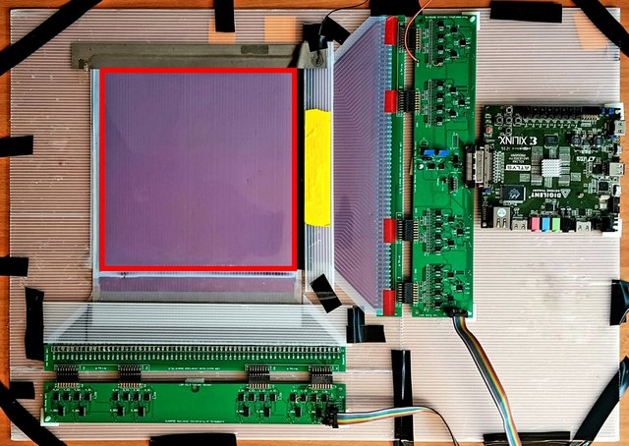
Neuromorphic Sensors
Only produce output events (spikes) when detect a change in the scene
(Event-Driven)
Dynamic Vision Sensor
(DVS)
Dynamic Audio Sensor
(DAS)
Neuromorphic tactile sensor

Slide 6
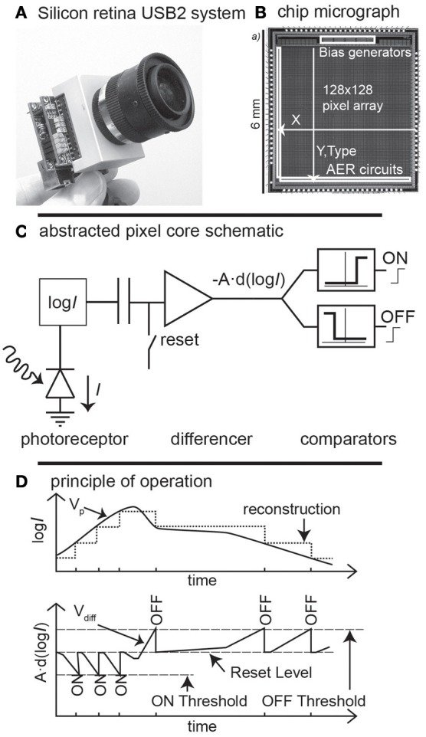
Dynamic Vision Sensor (DVS)
"E. Mueggler, B. Huber, D. Scaramuzza, Event-based, 6-DOF Pose Tracking for High-Speed Maneuvers", IEEE/RSJ International Conference on Intelligent Robots and Systems (IROS), Chicago, 2014.
https://youtu.be/LauQ6LWTkxM
https://www.frontiersin.org/articles/10.3389/fnins.2013.00223/full

Slide 7
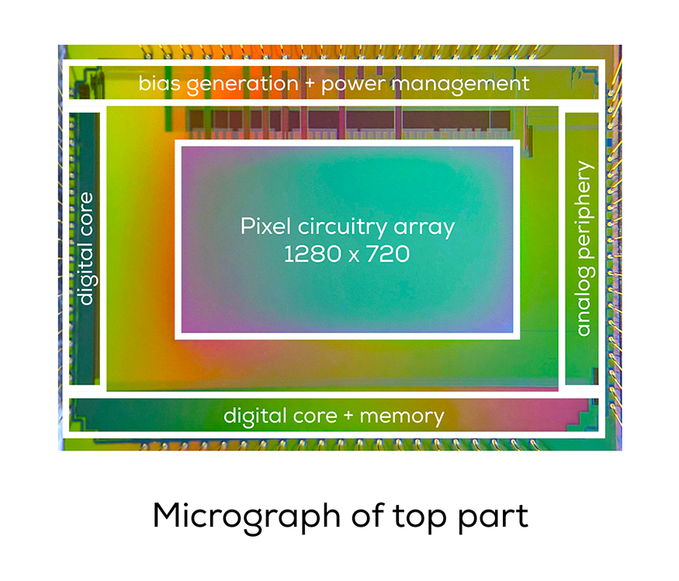
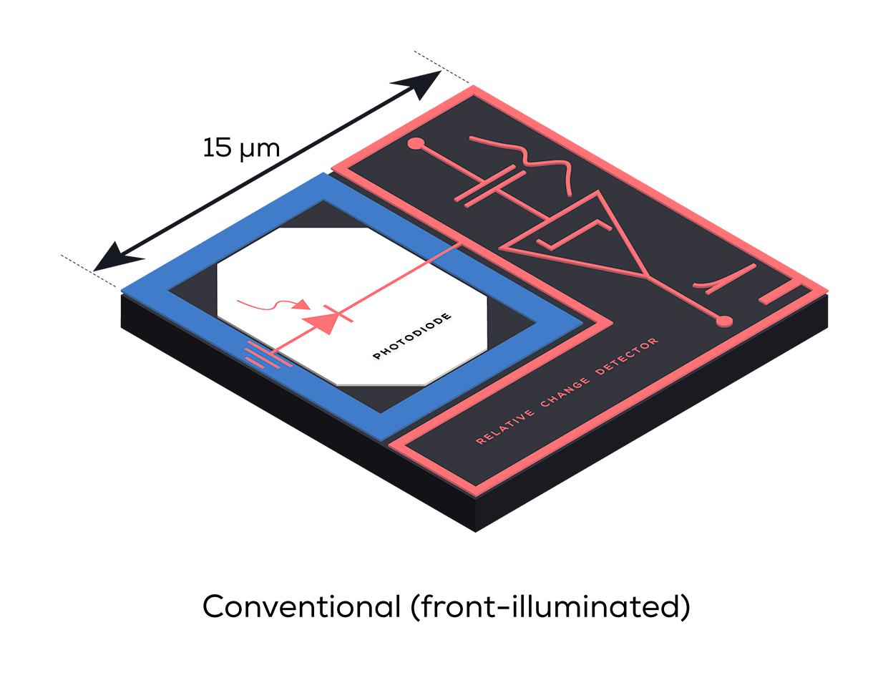
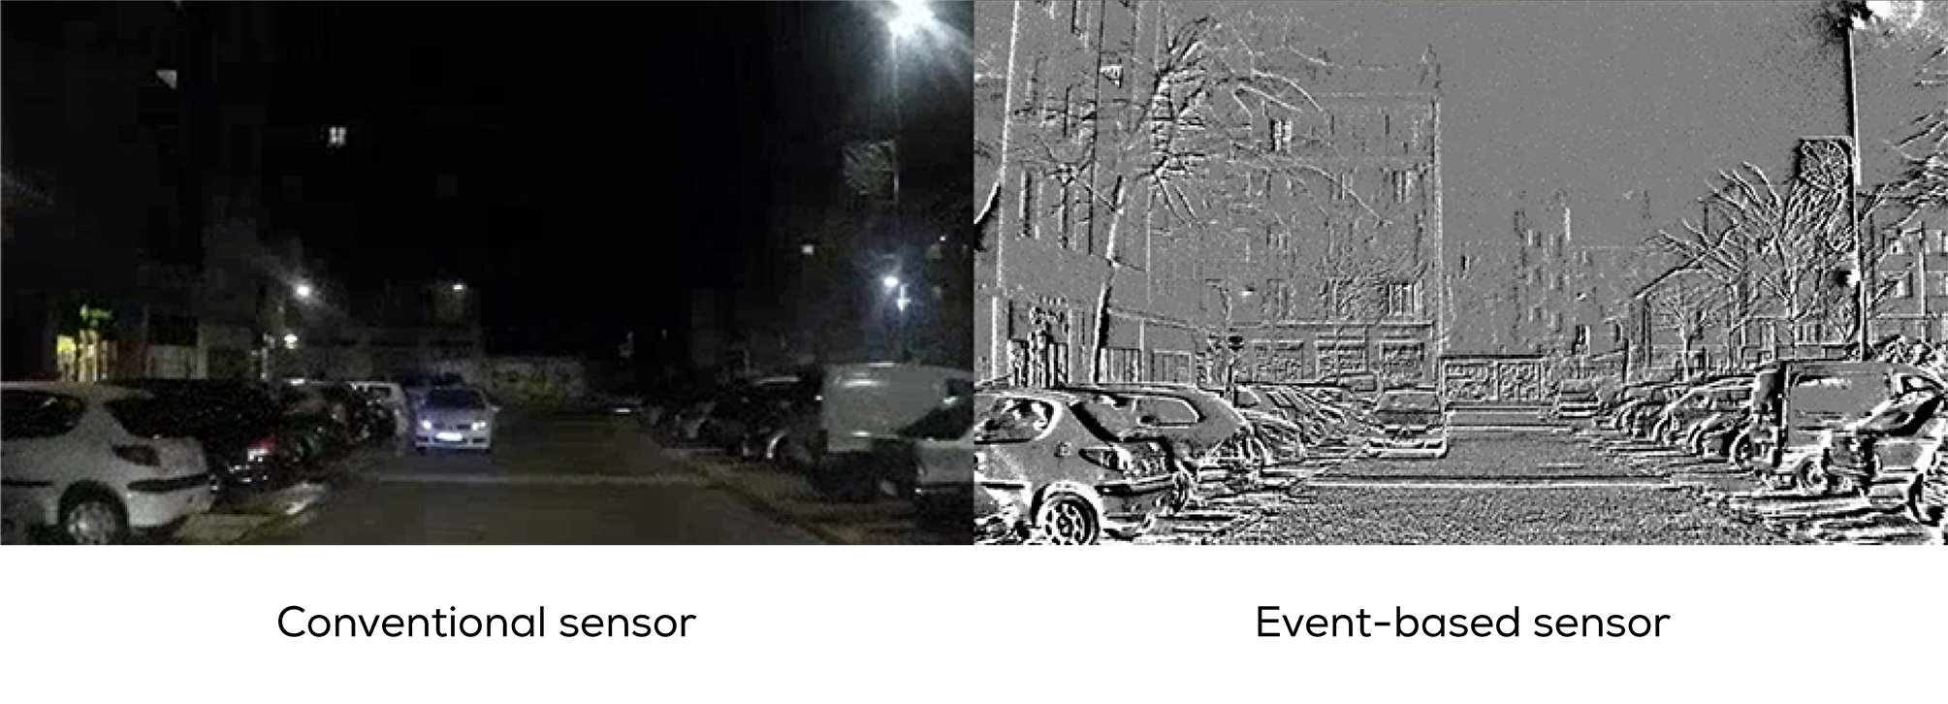
Dynamic Vision Sensor
Many companies started building their own silicon retinas!
March 2020: Prophesee built 1280x720 event-based vision sensor (link)

Slide 8
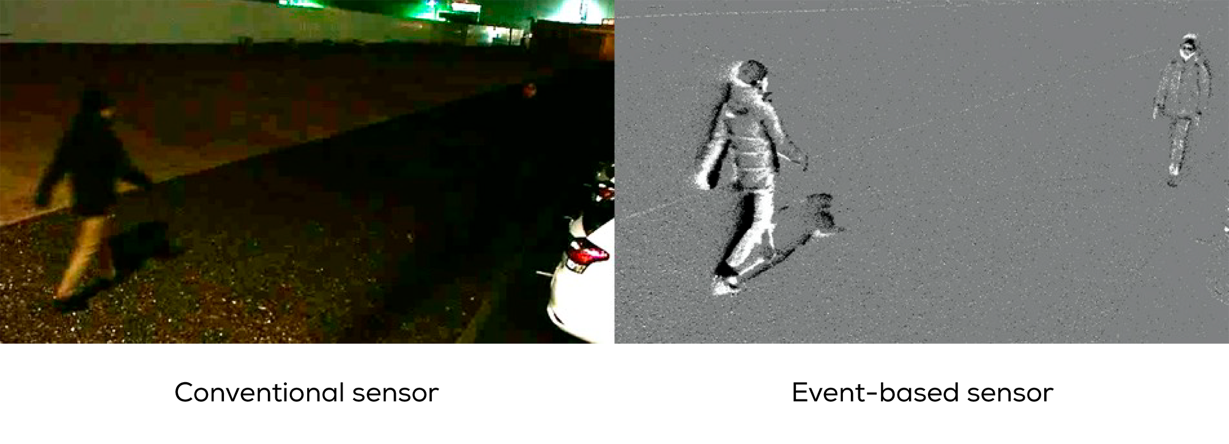
Dynamic Vision Sensor
Many companies started building their own silicon retinas!
March 2020: Prophesee built 1280x720 event-based vision sensor (link)

Slide 9
Neuromorphic processors
Conventional signal processing algorithms and processors are designed to process time-sampled signals
Neuromorphic processors (inspired by the brain) are design to optimally process events from these sensors.
Artificial Neural Networks → Spiking Neural Networks (SNN)

Slide 10
Von-Neumann processors
Biological
processing
Conventional processors:
Biological Brain:
Separated Memory and processor
High power consumption on data transfer
Memory bottleneck issue for scalability
Centralized processing
Not scalable anymore!
Static and fully synchronous programing
Always executing something! even NOP
In-memory processing
Memory and processor are the same
Fully distributed memory/processing
Highly scalable
Sparse event-driven processing/communication
Only process relevant data
Designed to perform exact calculation
Not good for signal processing!
Human Brain*
86B neurons, 150T Synapses (20 Watt)
Visual Processing -> 30%
Auditory Processing -> 3%
We are halfway!
area
*Provided numbers are estimations and averaged

Slide 11
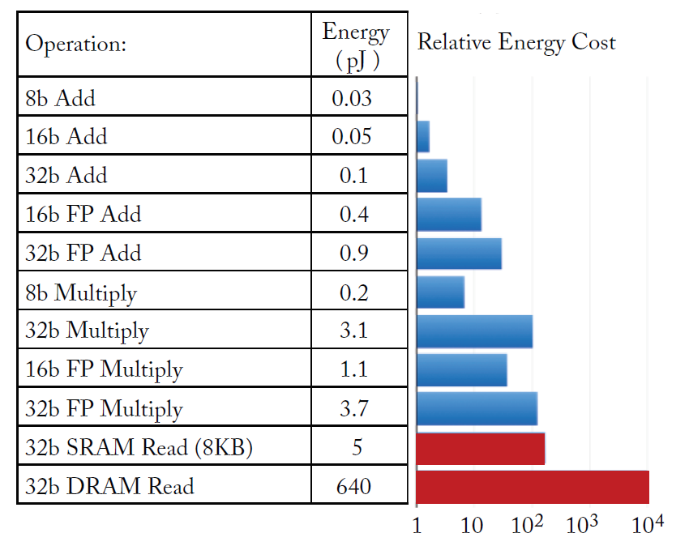
Towards Biological Processing
Parallel Processing
Going towards higher number of small processors
Distributed Memory
Having more tightly coupled data memory, cache, ...
Bring more memory closer to the processor
Sparse Event-Driven processing
Skipping redundant operations
Data-flow Communication
Data moves toward the place it is consumed
Direct communication between processors

Slide 12
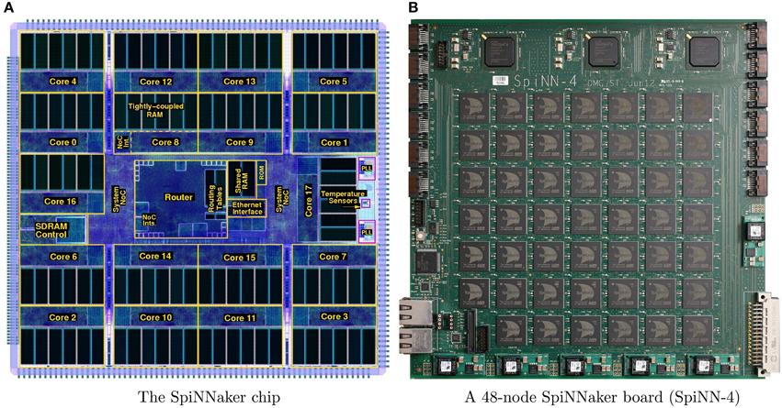
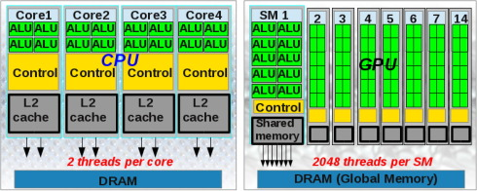
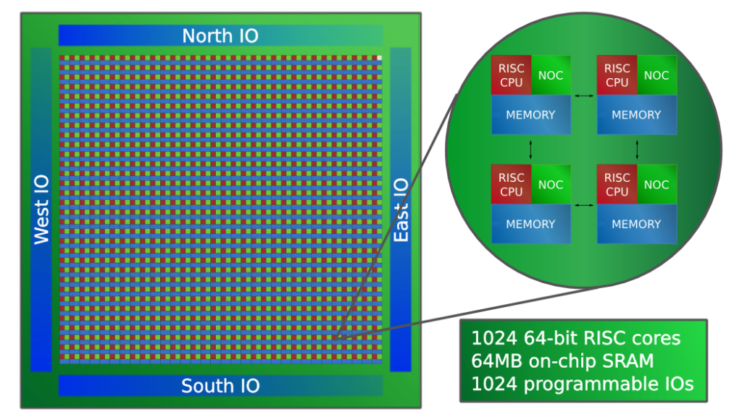
Communications between Processors
Learning from biology →
Direct communication of neurons with spikes!
Spikes can be a packet of data containing the address of the source neuron or it can be a pulse for a short time
SpiNNaker 16-ARM Processors
http://www.adapteva.com/announcements/epiphany-v-a-1024-core-64-bit-risc-processor/
EPIPHANY 1024-RISC Processors

Slide 13
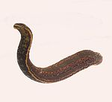
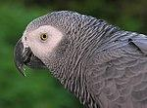
Asynchronous Processing and Communication
Learning from Biology → Asynchrony is the key feature for scalability
Not possible with off the shelf processors
10K
250K
960K
310M
1.5B
28B
Similar architecture, scaling up 10⁶ times!!!

Slide 14
Event driven ...vs... vector processing
 |  | 2 |  |  |  | 6
0 | 0 | 7 | 0 | 0 | 0 | 5 | 0 | 0 | 0
Sparse Vector
(2,7), (6,5)
Sparse vector representation
Event-based processing only process relevant input data (here it is non-zero)

Slide 15
Typical Large scale Neuromorphic Architectures
RAM
ROM
GALS Architecture :
Extremely Scalable to many core and many chip connectivity
Event-Driven Processing:
Extremely low power for sparse activity
High density Memory Technology:
Near memory low power computation
Scalable connectivity:
network on chip
ED-Proc

Slide 16
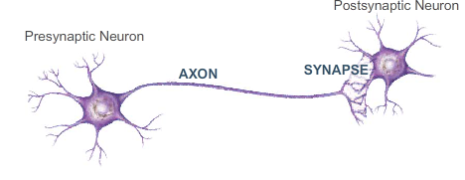
Event Driven Processor
Synapse Memory
Event Driven Processor
Neuron State Memory
Axon Memory
Synapse Memory:
Synaptic parameters (weights)
State Memory:
Neurons’ state
Axon Memory:
Destination core address (to store the graph of DNN)
One processing core updates the state of many neurons, based on the input events

Slide 17
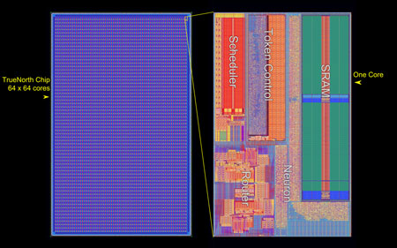
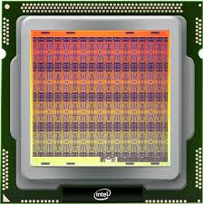
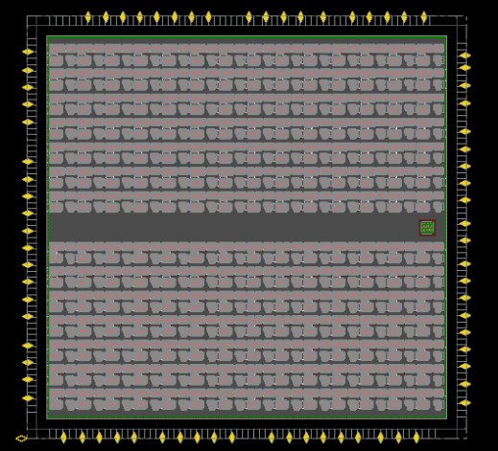
Some Neuromorphic Processors
IBM TrueNorth 2014
Intel LOIHI 2018
GML GrAI-One
4096 cores (digital 28nm, GALS)
256 Neurons/Core (time-multiplex)
1 axon per neuron
256 Synapses/N (Binary) no learning
Resources per neuron and 256 synapses:
426b of SRAM
5k Transistors
$20μm×20μm$
26pJ per synaptic operation
128 cores (digital 14nm, fully asynchronous)
1024 Neurons/C (time-multiplex)
4096 axons per core (shared)
1M Synapses/core (shared, Binary) With Learning
Resources per neuron and its synapses:
2000b per neuron
15k Transistors
$21μm×21μm$
80pJ per synaptic operation
196 cores (digital 28nm, fully synchronous)
1024 Neurons/C (time-multiplex)
1024 axons per core (shared)
1024 Synapses/core (8b weights, shared)
Resources per neuron and its synapses:
120b per neuron
$10μm×10μm$
20pJ per synaptic operation
Many-core Parallel Processors – Near/Inside Memory Processing – Event-driven Communication

Slide 18
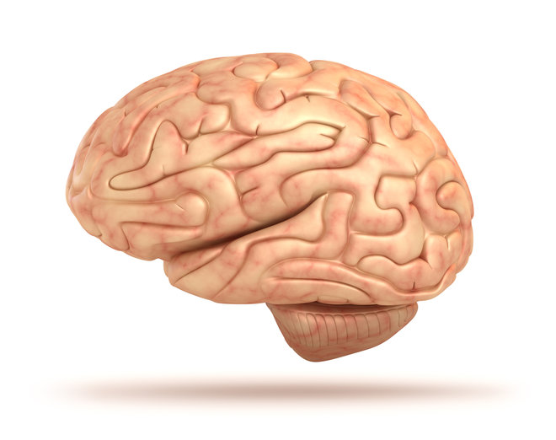
Some Neuromorphic Processors
DYNAPs 2017
Honeybees
Human brain
4 cores (analog 180nm, fully asynchronous)
256 Neurons/C (physically implemented)
65 Synapses/N (4b) With plasticity
Resources per neuron and 65K synapses:
$210μm×210μm$
0.13pJ per synaptic operation
1M Neurons
1B Synapses (non-binary) With plasticity
Total size of 1mm³
Resources per neuron and 1024 synapses:
$10μm×10μm×10μm$
80B Neurons
150T Synapses (nonbinary) With plasticity
Total size of 1274cm³
Total power consumption of 20W
Resources per neuron and 2000 synapses:
25$μm×25μm×25μm$
Learning from Biology → 3D construction is needed!

Slide 19
SpiNNakeR
18 ARM cores per chip
GALS packet-switched network
3D mounted HBM memory
1Watt per chip
Scaled-up to 1M cores
SpiNNaker2 will be released soon
https://en.wikipedia.org/wiki/SpiNNaker

Slide 20
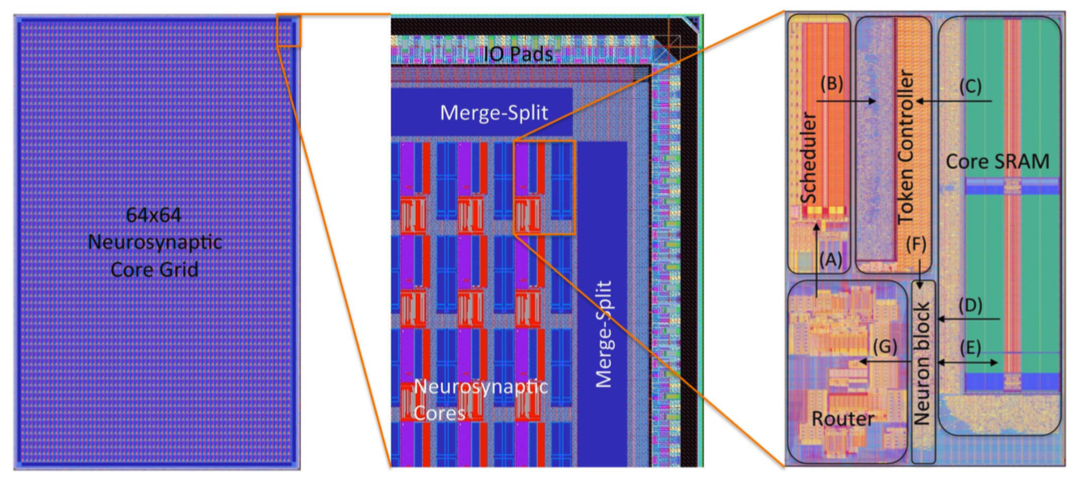
IBM True-North
1M neurons
256M synapses
Each neuron can only connect to one core (All 256 neurons inside one core)

Slide 21
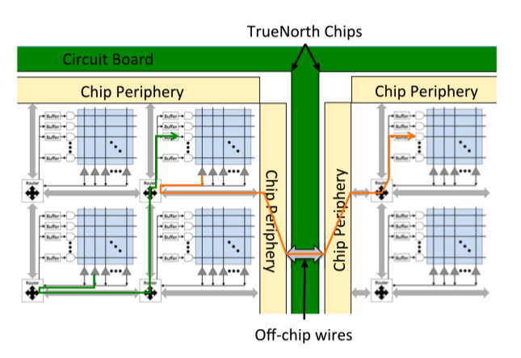
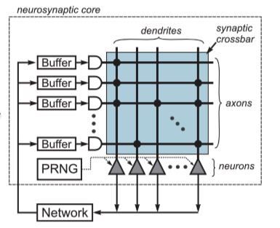
IBM True-North

Slide 22
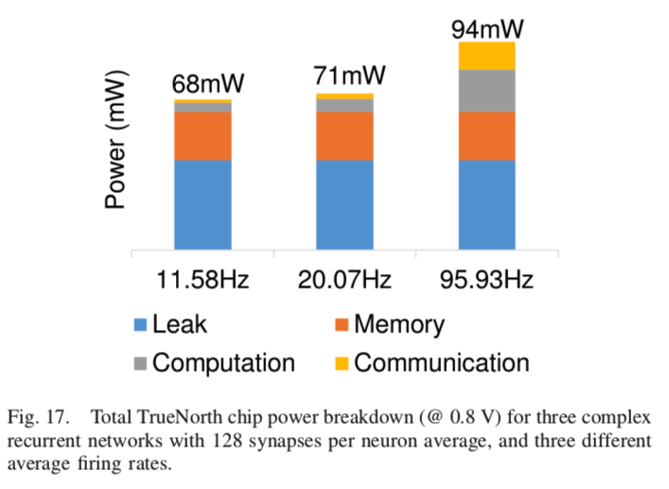
IBM TN
Power consumption
Leak: 42mW (0.70 V, 0 Hz firing rate)
323mW (1.05 V, 200 Hz firing rate, 256 synapses/neuron)

Slide 23
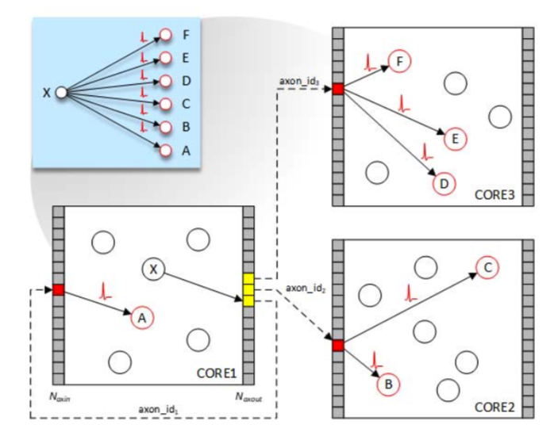
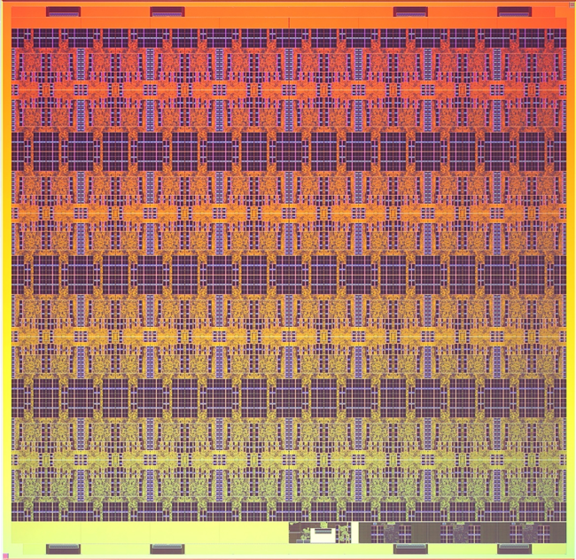
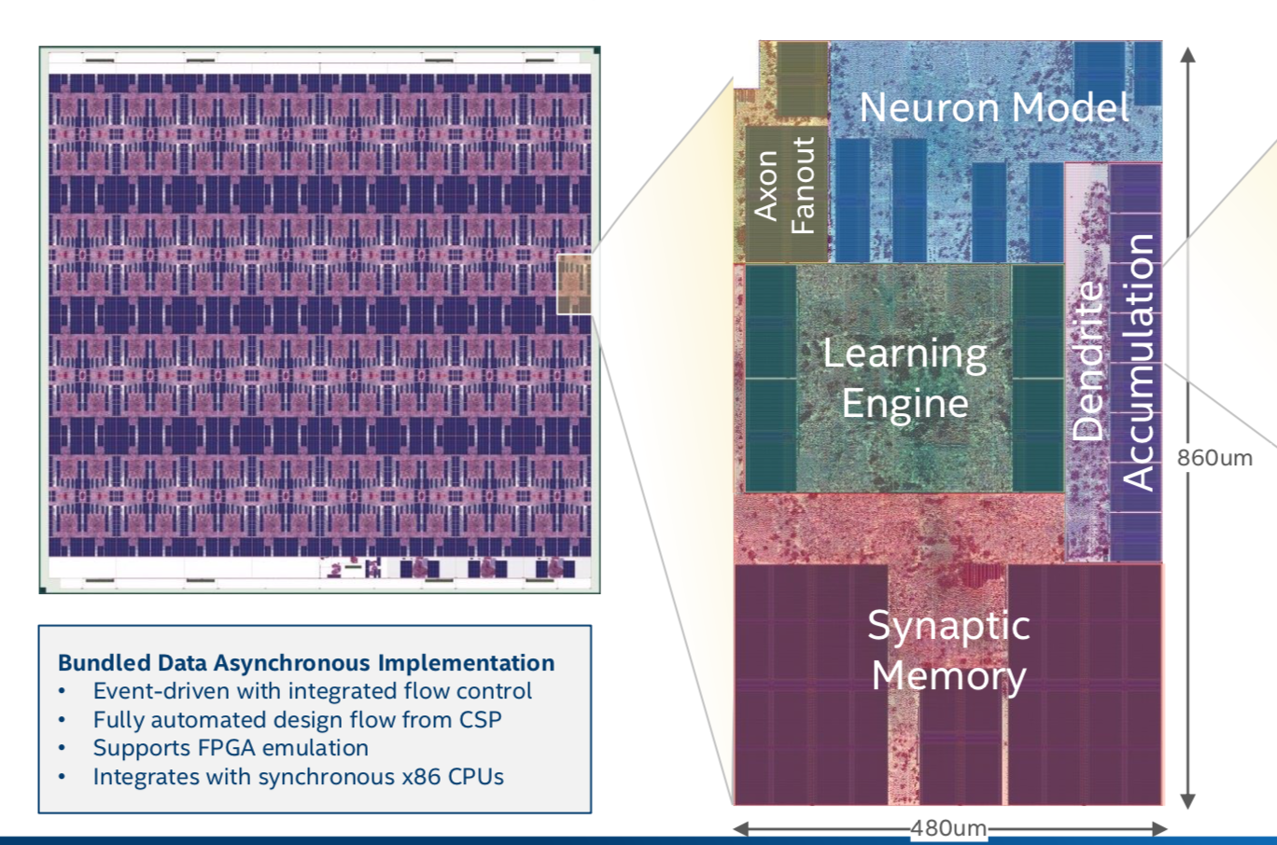
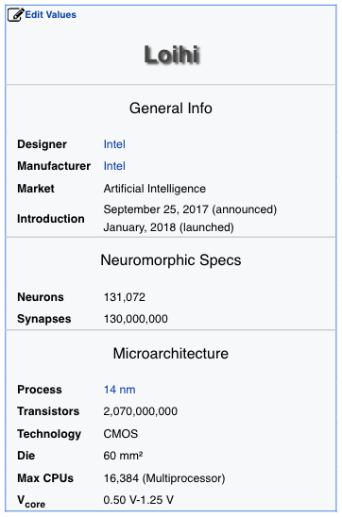
Intel loihi
128 cores
1024 neurons/core
1M synapses/core
More flexible connectivity than True-North
Variable precision for synaptic weights
Weight Sharing (for CNN)
Fully asynchronous
Online learning

Slide 24
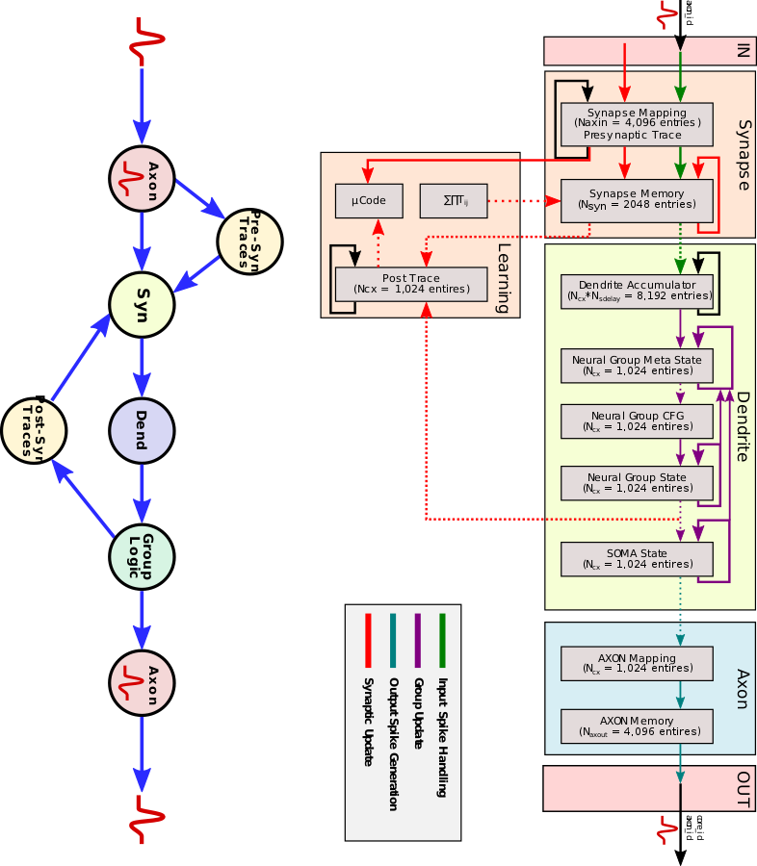
Intel Loihi
1,024 spiking neural units per core
1Mb of synaptic memory per core
Ten architectural memories per core
total of 2 Mb (including ECC) → 2Kb per neuron

Slide 25
Prominent neuromorphic enterprises
Intel (Munich)
IBM (Zurich)
Imec (Eindhoven, Leuven)
BrainChip (Toulouse)
GraiMatterLabs (Eindhoven, Paris)
Innatera (Delft)
Prophesee (Paris)
Inilab (Zurich)
SynSense (Zurich)
....

Slide 26
Challenges
Limited On-Chip memory (synaptic parameters, topology of the graph, Neuron’s state)
 | Add int32 | Add FP16 | Mult int32 | Mult FP16 | SRAM SP 4096x32b (R&W) | SRAM SP 4096x16b (R&W)
Area (um²) | 200 | 500 | 2000 | 700 | 15000 | 9000
Energy (pJ) | 0.3 | 0.3 | 1.2 | 0.4 | 3.5 | 2.1

Slide 27
Challenges
Idle power consumption (power consumption when no event is being processed)
Dynamic (related to Clock)
Dynamic clock gating
Globally Asynchronous (GALS) or fully asynchronous design
Sleeping modes for memory peripherals
Static (related to Leakage)
Low leak memory → Non-Volatile Memory for configuration (no leakage)
Power-down strategy for not used circuits

Slide 28
Challenges
Event :
Core Addr
Neuron Addr
Data
Communication and Network-on-Chip
Overhead of Address Event Representation (Computation/communication load)
Multi-casting
Relative addressing
Hyperthreading (increasing the size of a core)
NoC congestion
Smart routing + Event dropping mechanism
Multiple independent NoC
I/O bandwidth limitation for tiling
Efficient event-driven LVDS communication links

Slide 29
Challenges
Programmability and Flexibility
Flexible neuron models
Heterogeneous processing cores (allows efficient mapping)

Slide 30
Challenges
On-Chip Learning
Application!
Scalable HW efficient Algorithm (Local learning)

Slide 31
References
Asynchronous Spiking Neurons, the natural key to exploit temporal sparsity, IEEE Journal on Emerging and Selected Topics in Circuits and Systems, 2019
Stochastic Spike Timing Dependent Plasticity with Binary Weights, Frontiers in Neuroscience, 2018
NeuronFlow: a neuromorphic processor architecture for Live AI applications, DATE 2020
BrainChip AKIDA is a fast learner, Spiking-Neural-Network Processor Identifies Patterns in Unlabeled Data, The Linley Group 2019
GrAI Matter Labs exploits Sparse Video, Neuromorphic Chip implements Convolutional Neural Networks, The Linley Group 2019

Slide 32
Topics to discuss further
Sparsity types and how to exploit them
Advantages and Disadvantages of having stateful neurons
Asynchronous design challenges
Challenges in SNN trainings

Slide 33
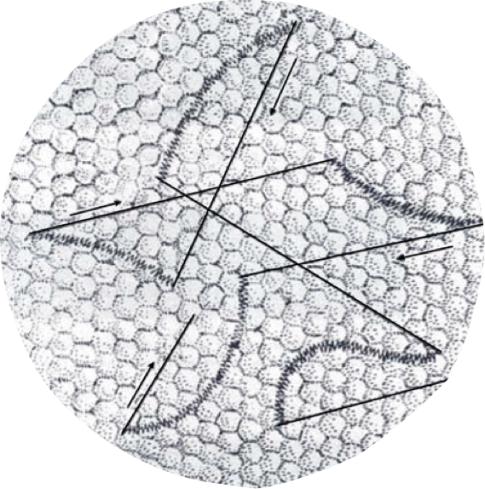
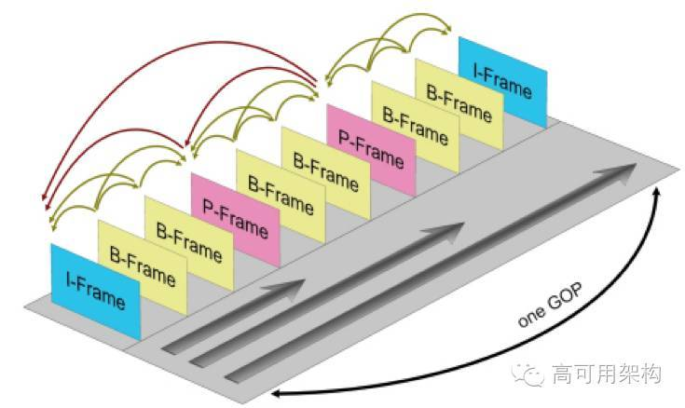
Temporal sparsity in human vision
Microsaccades (MS)
Rapid ballistic jumps of amplitude up to 1°, which occur at irregular intervals, only once or twice per second. They carry the retinal image over dozens of photoreceptor width or more, in only 20-30 ms.
Speed: 30 deg/s
Each Micro-saccade captures one frame!
One full frames per second is enough
Between micro-saccades, our vision system relies on the deltas (or motion events)
http://bbs.fmuser.com/t/what-is-gop-in-hdmi-sdi-h-264-iptv-streaming-video-encoder/139
bigger
http://bbs.fmuser.com/t/what-is-gop-in-hdmi-sdi-h-264-iptv-streaming-video-encoder/139
Conventional video compression techniques seem to have similar features as the human eye.

Slide 34
Dynamic Vision Sensor
DVS with sunglasses
https://youtu.be/5NNoq1Gq4sc
DVS : only send events when there is a change in log(light intensity)
1us temporal resolution
No grey scale information (only $±1$)
DAVIS (Dynamic and Active-pixel Vision Sensor)
Events (1us resolution) + Grey scaled frames (30fps)
ATIS (Asynchronous Time-based Image)
Two events per change (encode the grey level in time interval)
Quadcopter localization with DVS
https://youtu.be/RFcjUBN3pw0
Compressed sensing
Temporally sparse
High temporal resolution (1us)
High dynamic range (140dB)

