Slide 1
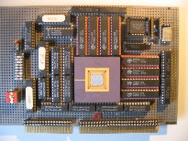
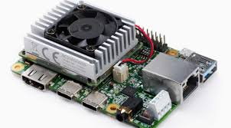
Intelligent Architectures
5LIL0
Learning Principles for Deep ANNs
Berk Ulker
b.ulker@tue.nl
TUEindhoven
2022

Slide 2

Assignment 1 is online
Deep neural network based verbal command recognition
Deadline is 25 Feb, 23:59
Goals :
To gain experience on the DL tools and environment
To practice network design principles for keyword classification
To explore some optimization knobs that enable efficient model deployment

Slide 3

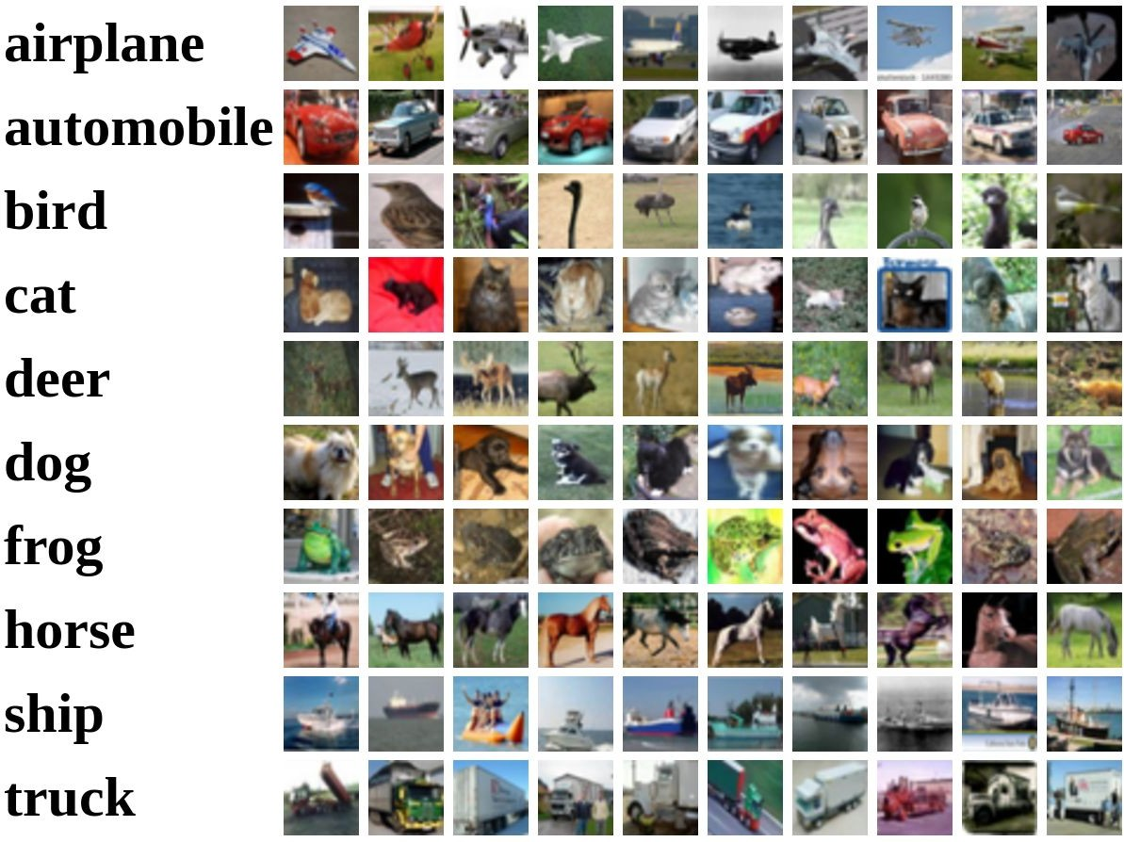
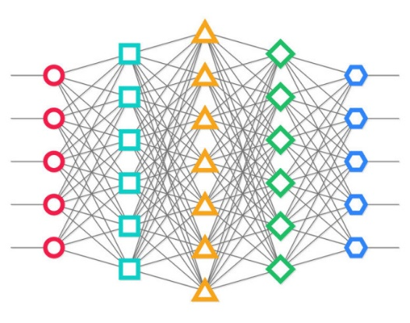
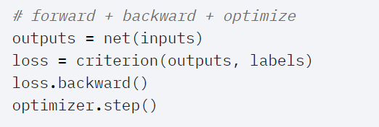
Learning – Training of Deep Neural Networks
PyTorch

Slide 4
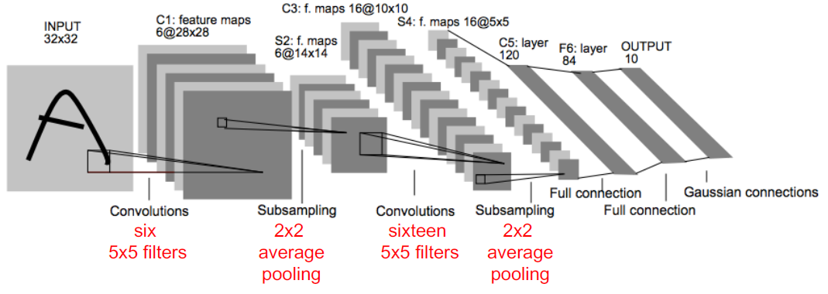
LeNet-5 structure
2 Conv layers
2 FC layers
60k weights, 341k MACs (mult-acc) per input picture
[Lecun e.a. Proc. of the IEEE, 1998]

Slide 5
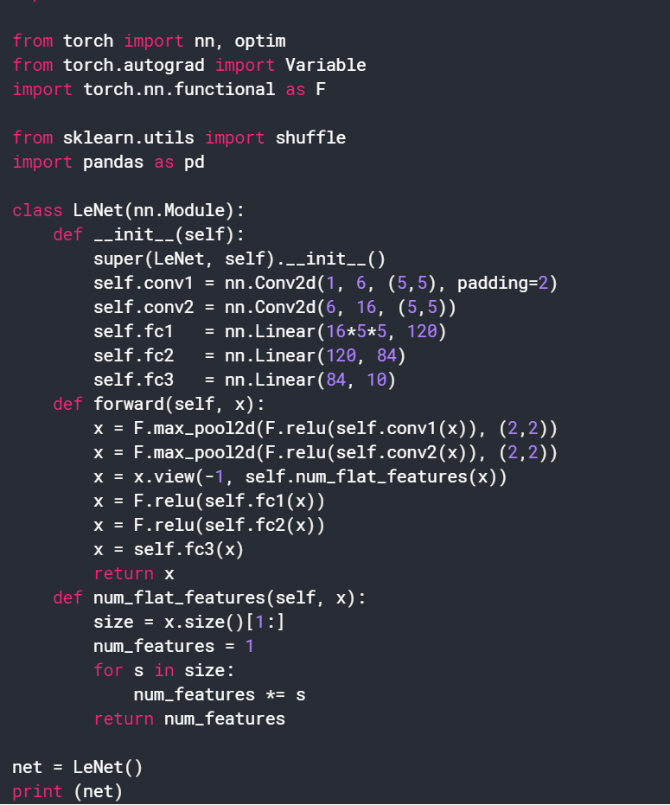
LeNet-5 implementation in Pytorch

Slide 6
Learning Goals - Classification
We are going to discuss in detail:
  How a classifier works
  Optimize a classifier function (= ANN model)
  Regularization
Other key concepts:
  Hyperparameter selection
  Data preprocessing
  Weight initialization

Slide 7
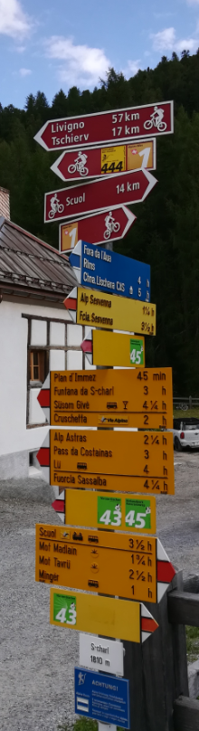
Topics Covered
Basic components for Learning
Loss functions
Basics of learning: Backpropagation
Optimization methods
Regularization
Other key concepts as hyperparameter selection, data preprocessing, weight initialization

Slide 8

Classification Problem
{dog, cat, truck, plane, ...}
cat

Slide 9
Three key components for Machine Learning :
Score function : Function to map input to output
Loss Function : Evaluate quality of mapping
Optimization Function : Update classifier
Score Function
- ANN model
f(x,W)
Loss Function L
Optimization Procedure

Slide 10

Score Function : Linear Classifier
E.g. 10 outputs
= class scores for each class
f(x,W) = Wx + b
Weights
Biases

Slide 11
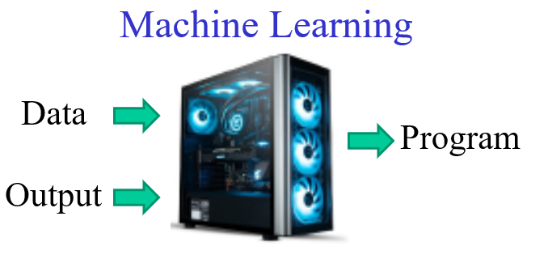
Score Function : Linear Classifier
Recall :
f(x,W) = Wx + b
Class Scores
Update Score Function/Classifier

Slide 12
Loss Function : Linear Classifier
Class Scores
Cat : 0.5
Car : 0.4
Frog : 0.2
f(x,W)
Output Quality
Update
(Optimizer)
Loss Function L
Why a loss function is needed?
  Optimizer requires a “hint” for update

Slide 13
Topics Covered
Classifiers
Loss functions
  Loss formulation
  SVM Multiclass loss
  Softmax + Cross Entropy loss
Basics of learning: Backpropagation
Optimization methods
Regularization
Other key concepts

Slide 14

Loss Functions
Loss function (L) evaluates quality of overall mapping:
  How well we find the correct label
  How well we distinguish it from others
  Loss compares all scores (positives & negatives) with ground truth
How to update W?
  Higher accuracy means lower Loss! ‘Ideal’ classifier has 0 loss
Input
f(x,W)
Class Scores
Cat : 0.5
Car : 0.4
Frog : 0.2
Dataset
Loss Function
Labels (Cat)

Slide 15
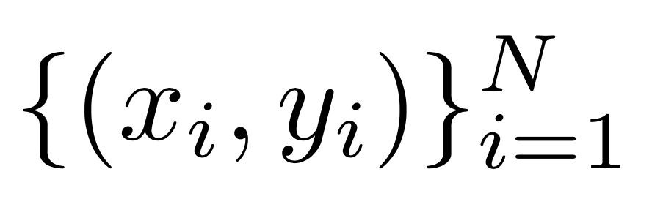


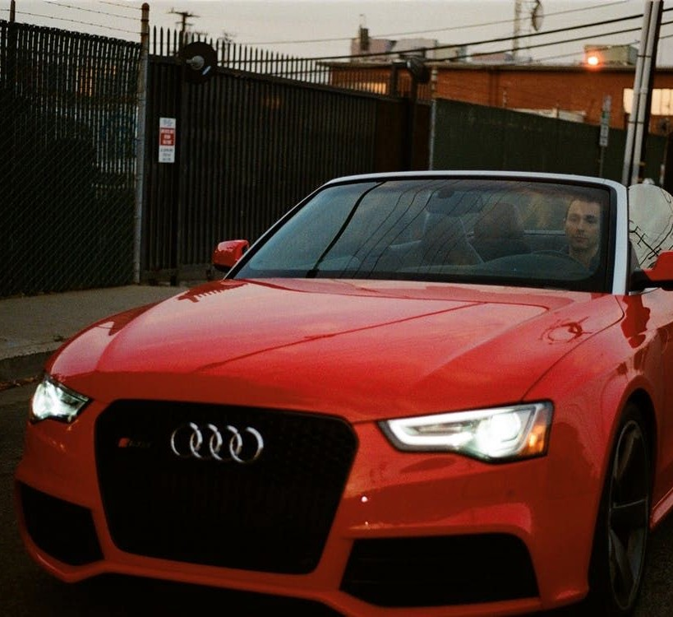
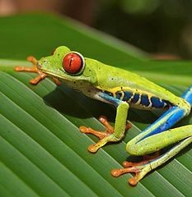

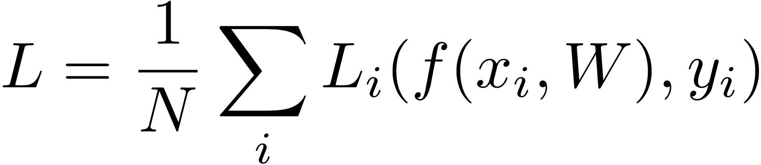
Loss Function : Linear Classifier
Given a dataset of examples
Scores from f(x,W) = Wx are:
: image
: label
where
Single Sample Loss:
Class | Output labels
cat | 3.2 | 1.3 | 2.2
car | 5.1 | 4.9 | 2.5
frog | -1.7 | 2.0 | -3.1
Loss over total dataset:
Totally wrong!

Slide 16
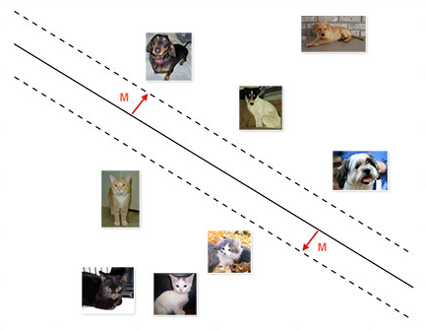
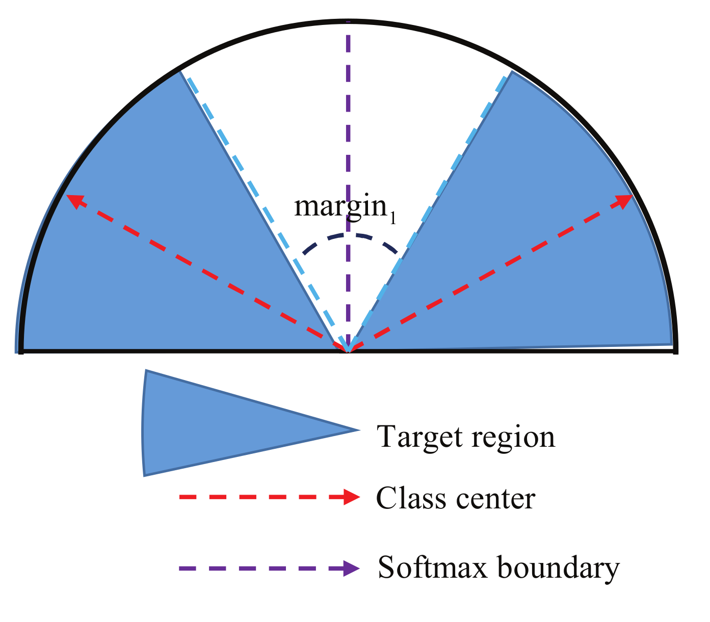
Loss Functions
Widely used loss functions:
SVM Multiclass Loss (Hinge Loss)
  Intuitively, this loss functions checks to see if the correct score is a “margin” better than the other scores
Softmax Regression : Softmax + Cross Entropy Loss
  Promises that the probability of each class is between 0 and 1, and that the sum of all probabilities equals 1

Slide 17
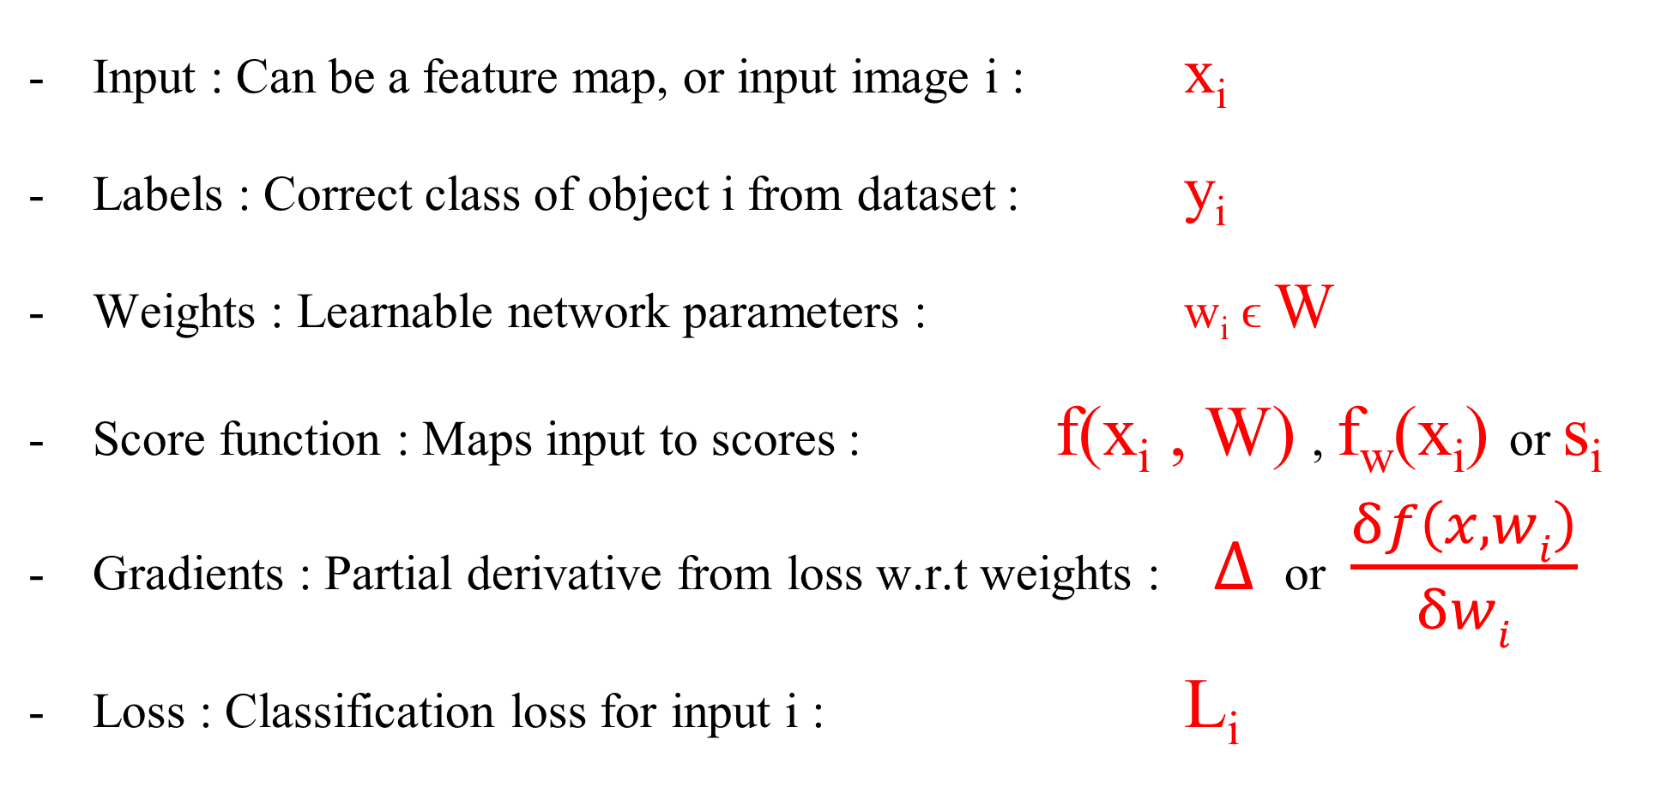
Notation and terminology
Input : Can be a feature map, or input image i : x_{i}
Labels : Correct class of object i from dataset : y_{i}
Weights : Learnable network parameters : w_{i} ϵ W
Score function : Maps input to scores : f(x_{i} , W) , f_{w}(x_{i}) or s_{i}
Gradients : Partial derivative from loss w.r.t weights : $∆$ or $\frac{δf\left(x,wi\right)}{δwi}$
Loss : Classification loss for input i : L_{i}

Slide 18

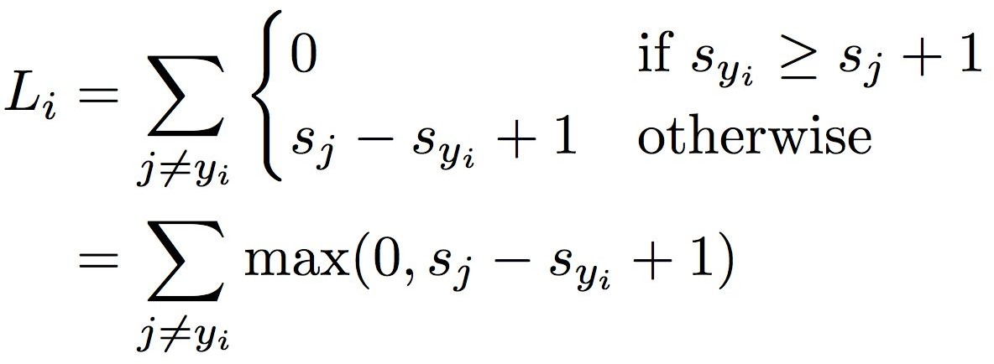



SVM Multiclass Loss Definition
Given:
  Scores vector: s = f(x_{i} , W)
  Object labels : ${ y}_{i}$
SVM loss L_{i} has the form:
L_{i}
1

Slide 19


SVM Multiclass Loss Example
SVM loss has the form:
Class | Output labels:
cat | 3.2 | 1.3 | 2.2
car | 5.1 | 4.9 | 2.5
frog | -1.7 | 2.0 | -3.1
Loss L_{i}: | 2.9 | 0 | 12.9
Loss over full dataset is average:
L= 5.27
e.g. 12.9 = (2.2- (-3.1)+1 ) + (2.5 – (-3.1)+1)
Notes:
e.g. 12.9 = (2.2- (-3.1)+1 ) + (2.5 – (-3.1)+1)

Slide 20

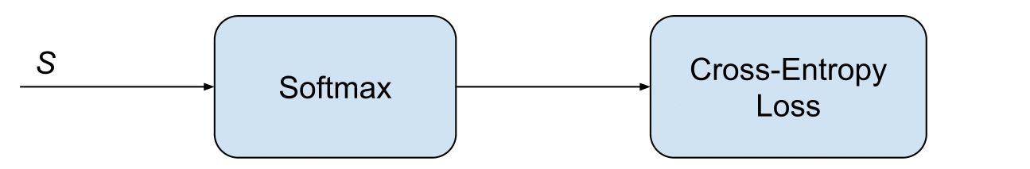
Softmax Classifier & Cross Entropy Loss
Formulated as following :
“Softmax” function converts scores to probabilities in last layer
(given observation x_{i}, e.g. a cat, what is the probality of output = k)
Loss = cross entropy between class probabilities and ground truth

Slide 21

Softmax Classifier: Example
Want to interpret raw classifier scores as probabilities
Softmax
Function
Probabilities must be >= 0
cat car frog
3.2
5.1
-1.7
24.5
164.0
0.18
exp
Unnormalized
unnormalized
log-probabilities / logits
probabilities

Slide 22
Softmax Classifier
Want to interpret raw classifier scores as probabilities
Softmax
Function
Probabilities must be >= 0
Probabilities must sum to 1
cat car frog
3.2
5.1
-1.7
24.5
164.0
0.18
0.13
0.87
0.00
exp
normalize
Unnormalized
unnormalized
probabilities
log-probabilities / logits
probabilities

Slide 23

Softmax Classifier
Want to interpret raw classifier scores as probabilities
Softmax Function
Probabilities must be >= 0
Probabilities must sum to 1
Cross Enthropy
cat car frog
3.2
5.1
-1.7
24.5
164.0
0.18
0.13
0.87
0.00
1.00
0.00
0.00
exp
normalize
Unnormalized
unnormalized
probabilities
Correct
log-probabilities / logits
probabilities
see: https://programmathically.com/an-introduction-to-neural-network-loss-functions/

Slide 24
Softmax Classifier
Want to interpret raw classifier scores as probabilities
Softmax Function
Probabilities must be >= 0
Probabilities must sum to 1
cat car frog
3.2
5.1
-1.7
24.5
164.0
0.18
0.13
0.87
0.00
L_{i} = - log(0.13)
= 2.04
exp
normalize
Unnormalized
unnormalized
probabilities
log-probabilities / logits
probabilities
see: https://programmathically.com/an-introduction-to-neural-network-loss-functions/

Slide 25
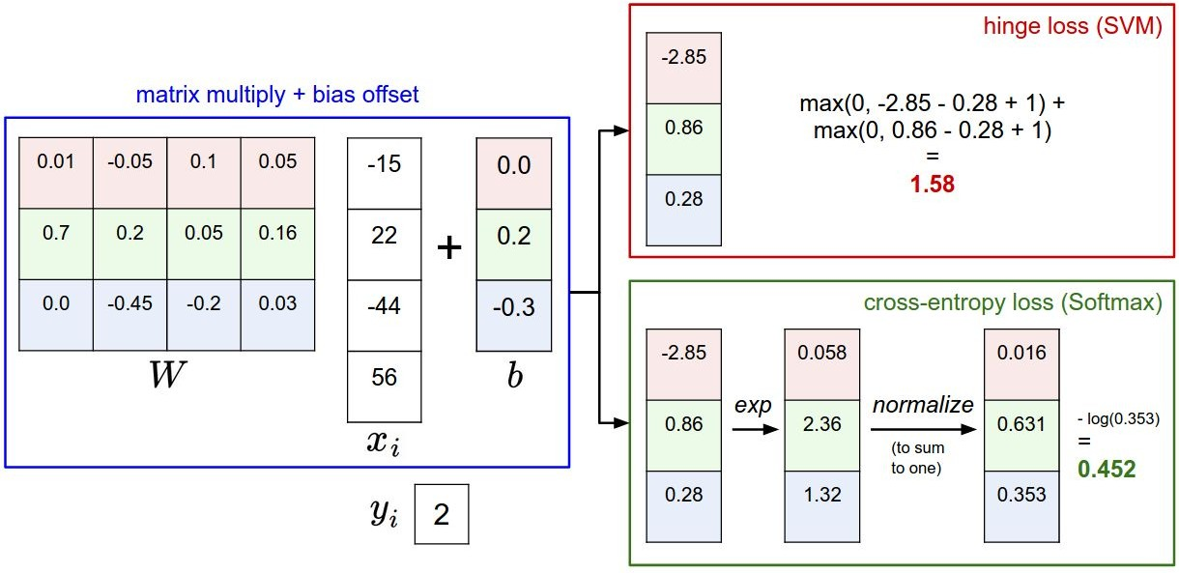
Softmax vs. SVM
(other example)

Slide 26


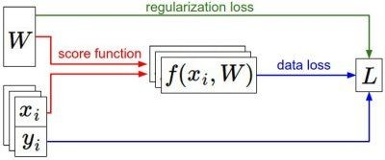


Summary – Loss Functions
We have some dataset of (x,y)
We have a score function:
We have a loss function:
regularization loss
Softmax
SVM
score loss
labels
Generalized Full loss
Notes:
Note Loss L is a function of W

Slide 27
Summary – Loss Functions
Have two components
  Score loss evaluates quality of score function
  Regularization loss evaluates weight distribution
SVM loss
  Checks if the correct score is a “margin” better than the other scores
Softmax classifier ( Softmax + Cross entropy)
  Converts scores to probabilities
  Loss can never be zero
More loss functions:
  https://www.theaidream.com/post/loss-functions-in-neural-networks

Slide 28
Learning Principles
Classifiers
Loss functions
Optimization
  Backpropagation
  Gradient descent & other methods
  Performance discussion
Regularization
Other key concepts

Slide 29
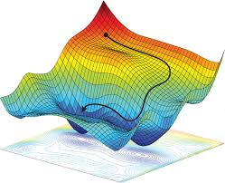
Optimization
We need to find the (close to) optimal solution of weights
CNN training is an iterative process
  We need a method to guide search
We want to achieve
  Minimum loss at convergence
    usually not achievable !
  With minimum amount of computation (iteration steps)
2-parameter space
We may have millions of
parameters with a very
complex surface
Notes:
Note: here we show a 2 D design space (2 parameters in the horizontal plane). A real NN has millions of parameters. Its design space can be extremely complex.

Slide 30
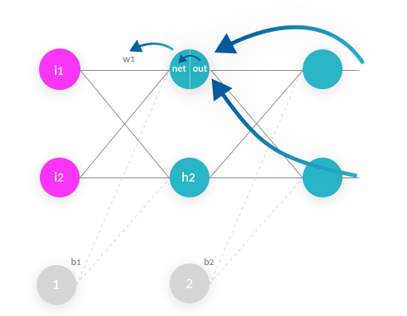
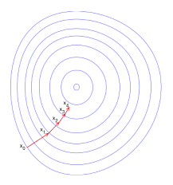
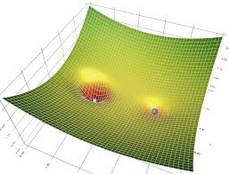
Optimization
Weight update calculation, 3 steps:
  Inference => Loss L
  Backpropagation => determine δL/ δw_{i}
  Update all w_{i} using gradient descent, e.g.
    w_{i} = w_{i} + η (δL/ δw_{i} )
Many gradient descent methods:
  SGD
  AdaGrad
  RMSProp
  ADAM
Notes:
SGD: stochastic gradient descent

Slide 31
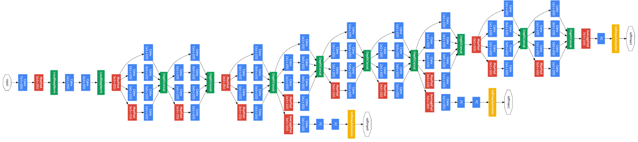
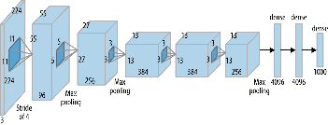
Optimization – Following gradient
How about deriving analytic gradient of all weights for this network?

Slide 32


Chain Rule: passing the derivative ‘through’ a neuron
f

Slide 33


Chain Rule
“local gradient”
f

Slide 34

Chain Rule
“local gradient”
f
“Upstream gradient”

Slide 35
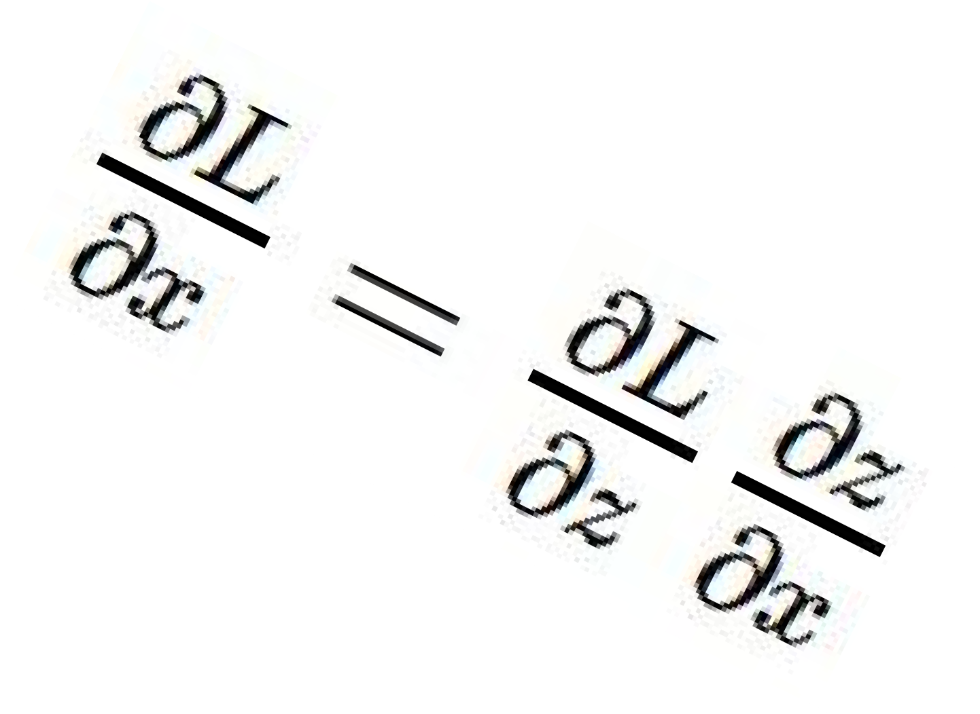
Chain Rule
“local gradient”
f
“Downstream gradients”
“Upstream gradient”

Slide 36
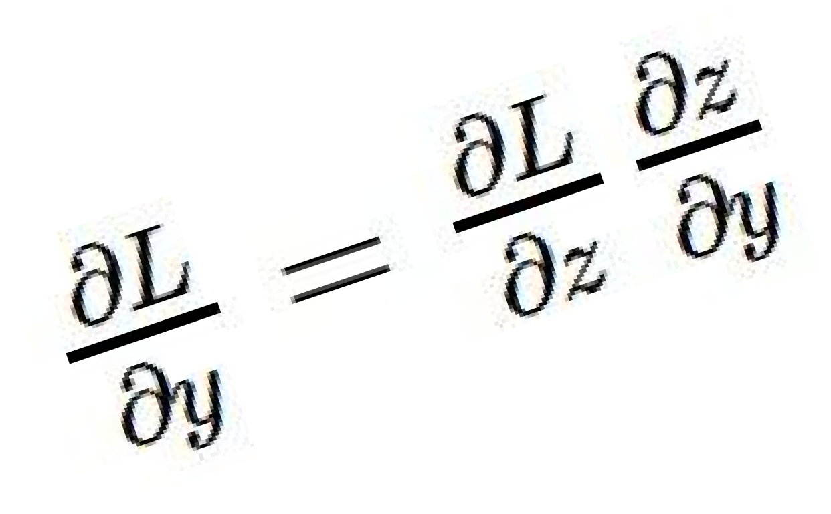
Chain Rule
“local gradient”
f
“Downstream gradients”
“Upstream gradient”

Slide 37

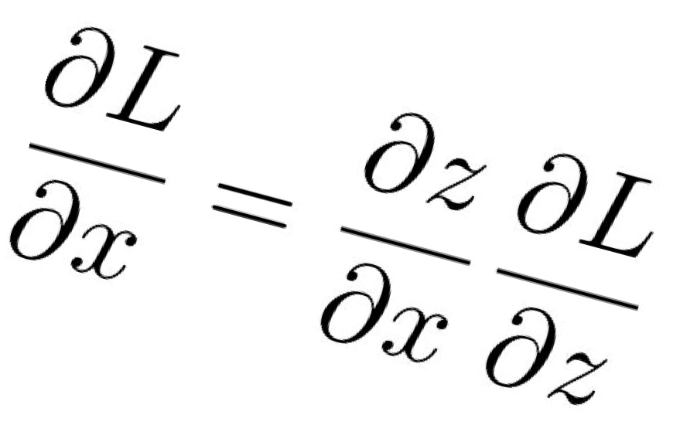
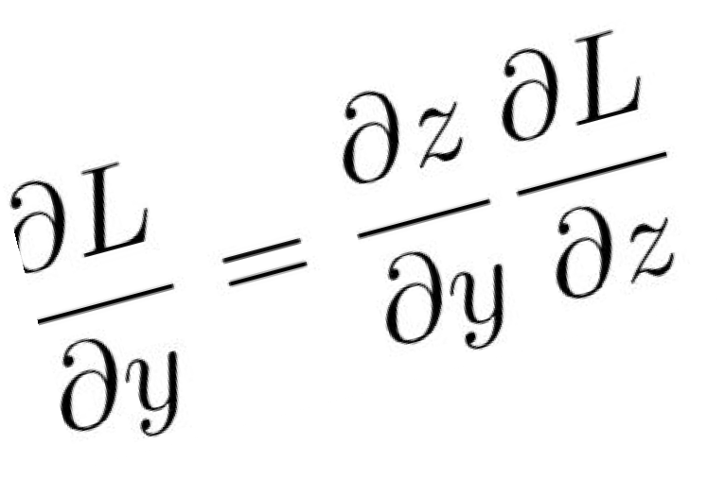
Backprop with Vectors
Loss L still a scalar!
D
“local gradients”
x
D_{z}
f
“Downstream
gradients”
D_{y}
“Upstream gradient”
Notes:
D = dimensioin

Slide 38
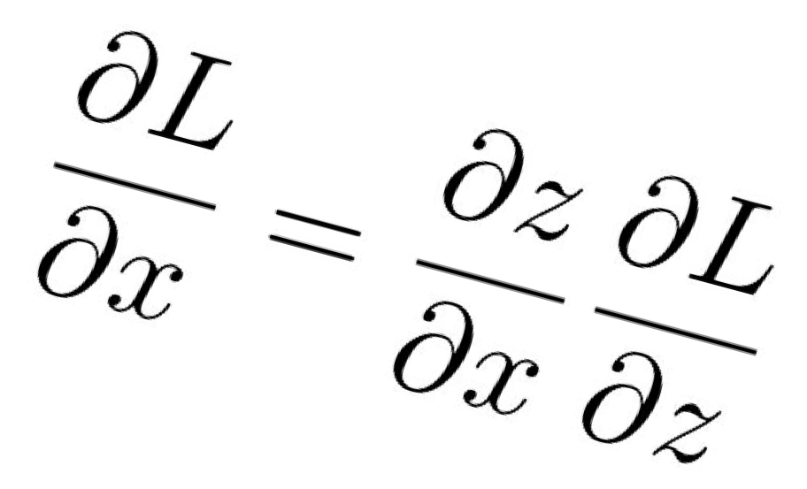
Backprop with Vectors
Loss L still a scalar!
D
“local gradients”
x
D_{z}
f
“Downstream
gradients”
D_{z}
D_{y}
“Upstream gradient” For each element of z, how much does it influence L?

Slide 39
Backprop with Vectors
Loss L still a scalar!
D
“local gradients”
[D_{x} x D_{z}]
f
[D_{y} x D_{z}]
Jacobian matrices
x
D_{z}
“Downstream
gradients”
D_{z}
D_{y}
“Upstream gradient” For each element of z, how much does it influence L?

Slide 40
Backprop with Vectors
Loss L still a scalar!
D
“local gradients”
[D_{x} x D_{z}]
f
x
D_{x}
D_{z}
“Downstream
Matrix-vector multiply
gradients”
[D x D ]
D_{z}
D_{y}
y z
Jacobian matrices
“Upstream gradient” For each element of z, how much does it influence L?
D_{y}

Slide 41
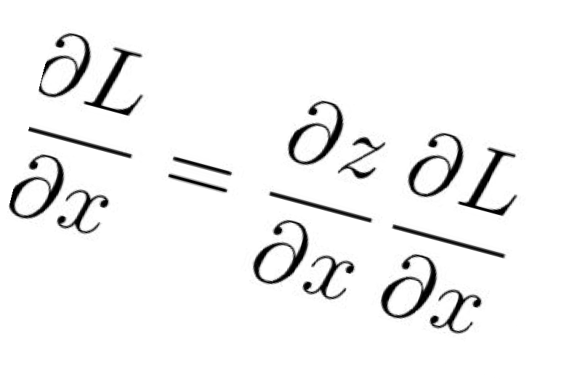
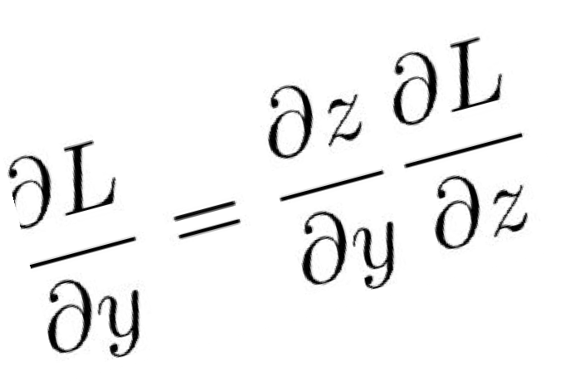
Backprop with Matrices (or Tensors)
Loss L still a scalar!
[D_{x}×M_{x}]
[D_{x}×M_{x}]
dL/dx always has the same shape as x!
[D_{z}×M_{z}]
“local gradients”
“Downstream
Matrix-vector multiply
gradients”
[D_{y}×M_{y}]
[D_{y}×M_{y}]
[D_{z}×M_{z}]
“Upstream gradient” For each element of z, how much does it influence L?
Jacobian matrices
For each element of y, how much does it influence each element of z?

Slide 42
Backprop with Matrices (or Tensors)
Loss L still a scalar!
[D_{x}×M_{x}]
[D_{x}×M_{x}]
dL/dx always has the same shape as x!
“local gradients”
[(D_{x}×M_{x})×(D_{z}×M_{z})]
[D_{z}×M_{z}]
“Downstream
Matrix-vector multiply
gradients”
[(D_{y}×M_{y})×(D_{z}×M_{z})]
[D_{y}×M_{y}]
[D_{z}×M_{z}]
Jacobian matrices
[D_{y}×M_{y}]
“Upstream gradient” For each element of z, how much does it influence L?
For each element of y, how much does it influence each element of z?

Slide 43
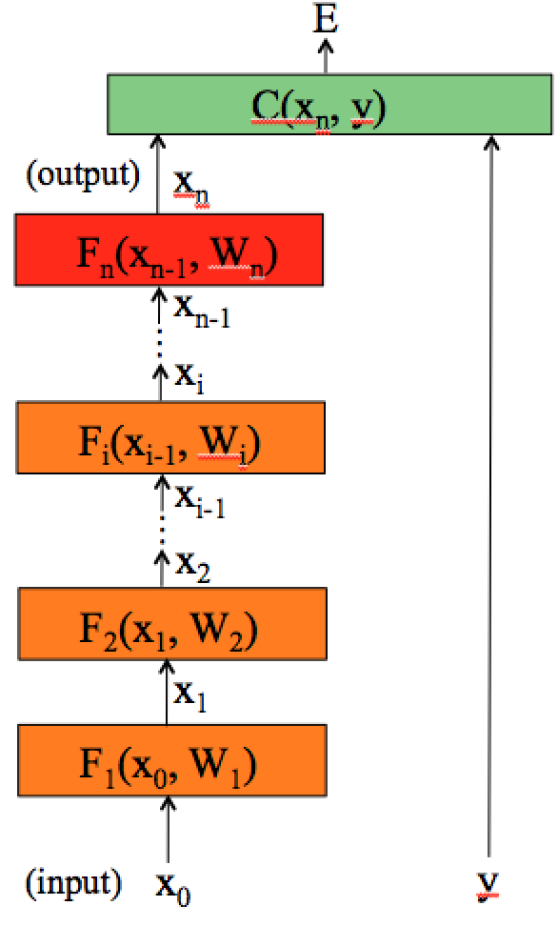
Backpropagation for multiple neuron layers
To compute the gradients, write the energy E (= Loss L) as a function of the network parameters (ϴ, also called W):
Sum over all inputs
Compute the partial derivative,
we use the chain rule to derive a compact algorithm: back-propagation

Slide 44
Computing gradients: cost layer
Compute gradient with respect to the parameters of the last layer (output layer) w_{n}, :
use our chain rule:
For example, for an Euclidean loss:
Will depend on the
layer structure and
non-linearity
The gradient is:

Slide 45
Computing gradients: layer i
We could write the full cost function to get the gradients:
If we compute the gradient with respect to w_{i}, using the chain rule:
And this can be
computed iteratively!
This is easy

Slide 46
Backpropagation in layer i
Layer i has two inputs (during training)
x_{i-1}
F_{i+1}
For layer i, we need 2 derivatives:
x_{i}
Layer i
F_{i}(x_{i-1}, W_{i})
x_{i-1}
We compute the outputs:
F_{i-1}
Forward
pass
Backward
pass
The weight update equation is:
(sum over all training examples to get E)
Notes:
During training, each layer will have three outputs:
the forward pass. To compute the operating point for each layer and training example;
the backwards pass to propagate the energy derivative with respect to the input of the layer;
- and the derivative of the energy with respect to the weights.

Slide 47
Backpropagation: summary
E (total Loss L)
Forward pass: for each training example. Compute the outputs for all layers:
Backward pass: compute cost derivatives iteratively from top to bottom:
Compute gradients and update weights:
C(X_{n},Y)
(output)
x_{n}
F_{n}(x_{n-1}, W_{n})
Layer n
x_{n-1}
…
x_{i}
F_{i}(x_{i-1}, W_{i})
Layer i
x_{i-1}
…
x₂
F₂(x₁, W₂)
Layer 2
x₁
(sum C over all training examples to get total loss L)
F₁(x₀, W₁)
Layer 1
(input)
x₀
y

Slide 48
Topics Covered
Classifiers
Loss functions
Basics of learning: Backpropagation
Optimization methods
  Gradient Descent (GD)
  Stochastic Gradient Descent (SGD)
  Adding Momentum: Adam
  Others: AdaGrad, RMSProp
Regularization
Other key concepts

Slide 49
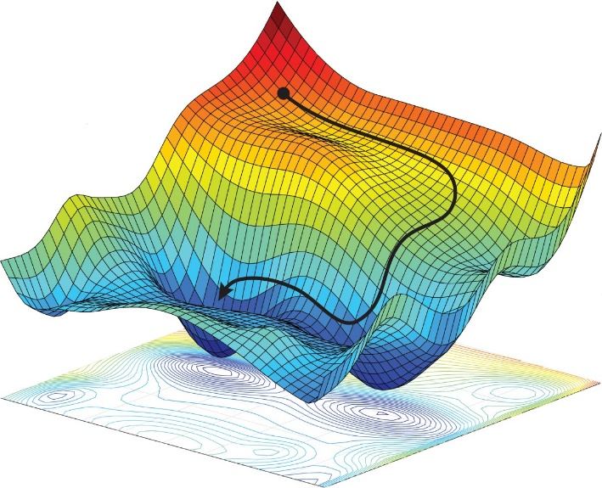
Optimization
We have the gradients of the loss (backprop)
How to update weights to achieve
minimum loss?
We have two hints
  Sign of the gradient, direction of the update
  Magnitude of the gradient, size of the update
Optimization function updates network parameters (weights)
Optimization have own hyperparameters we control

Slide 50
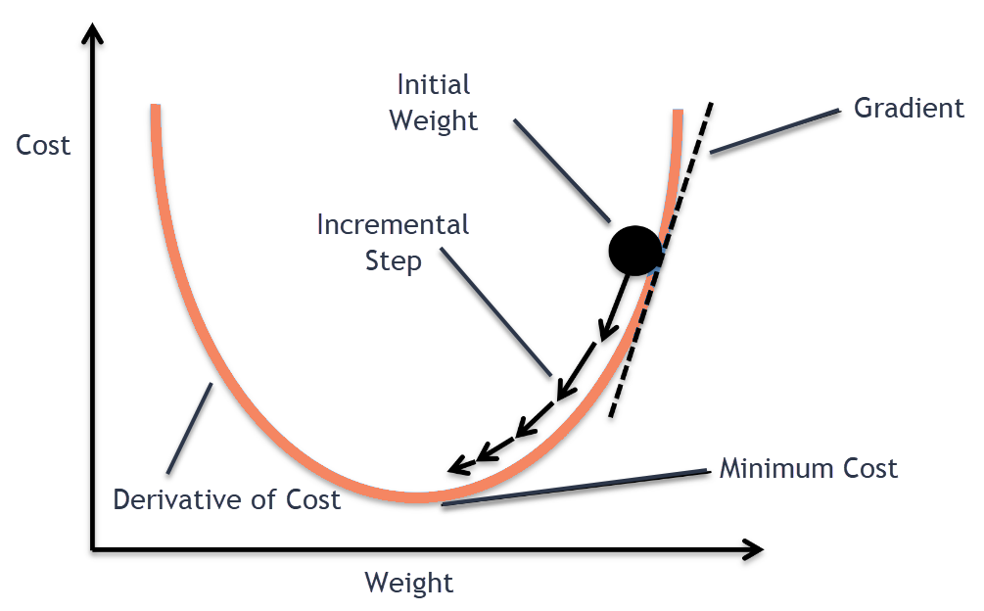
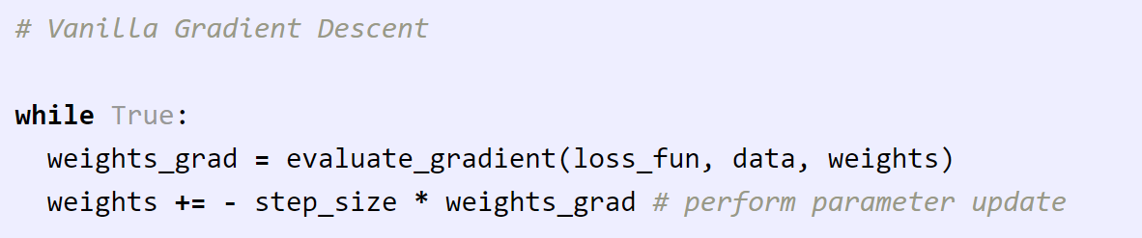
Optimization - Gradient Descent (GD)
Most common optimization algorithm in deep learning for learning weights
‘First order’ optimization – uses only first derivatives
- Step size on negative gradient is learning rate
- Batch, Minibatch and Stochastic GD
-
All samples
Batch of samples
Single sample

Slide 51
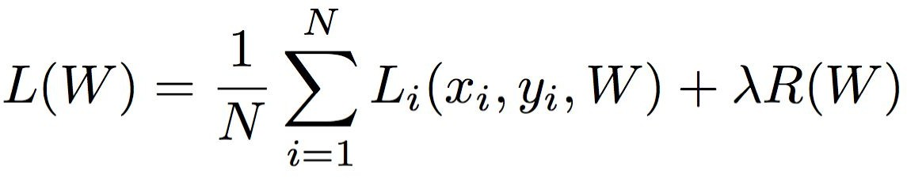
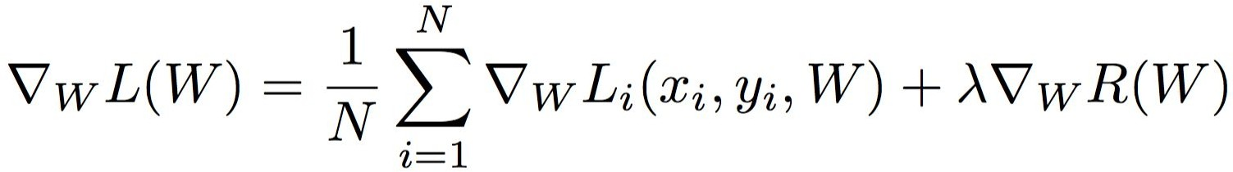
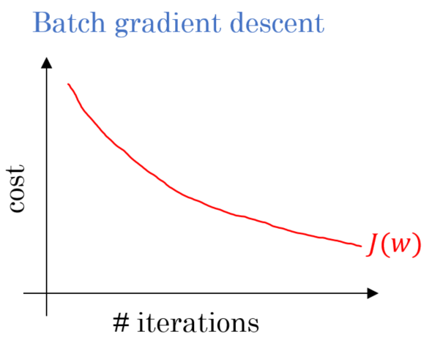
Batch Gradient Descent
Uses all sample results (entire dataset) for loss calculation
Expensive, but less noisy
Stable loss gradient
Can easily converge to bad local minima

Slide 52
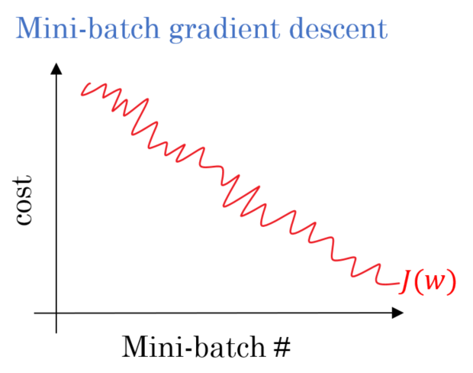
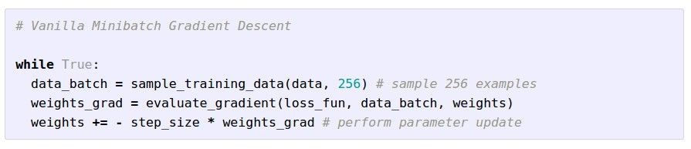
Minibatch Gradient Descent
Uses batches N of 32, 64 or 128
Approximate sum using a
minibatch of examples

Slide 53
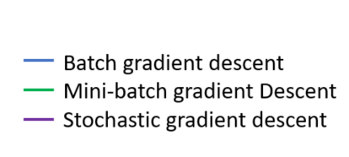
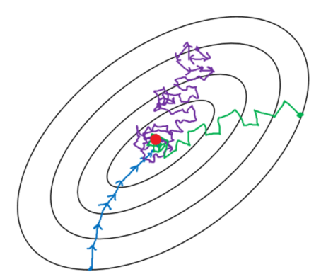
Per sample: Stochastic Gradient Descent (SGD)
Weights are updated after every sample
  = Minibatch gradient descent with batch size = 1
Less commonly used as vectorized ops are more efficient
  batch inference processing may also give more reuse, e.g. in weights
You can assume most implementations use minibatches!

Slide 54
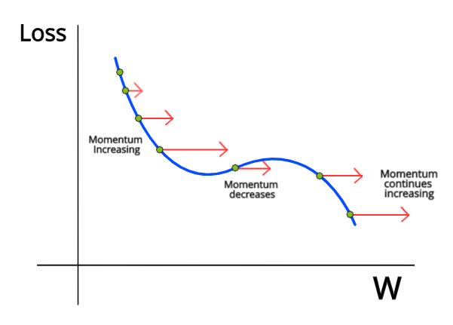
Momentum
Momentum can help convergence:
  Cancels out the noise
  Amplifies consistent gradients
  Can help getting out of local minima
Local minimum

Slide 55
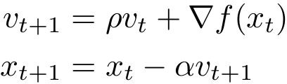

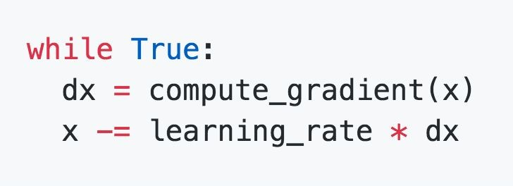
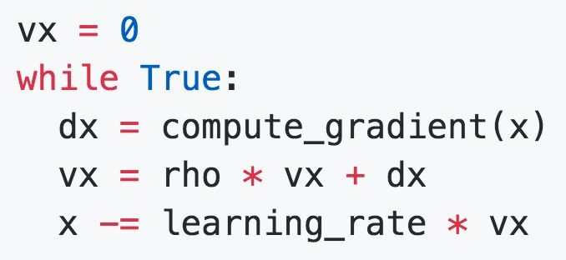
SGD + Momentum
SGD
SGD+Momentum
Build up “velocity” v_{t} as a running mean of gradients
ρ gives “friction”; typically ρ=0.9 or 0.99
https://colab.research.google.com/github/d2l-ai/d2l-pytorch-colab/blob/master/chapter_optimization/momentum.ipynb
Check notebook :

Slide 56
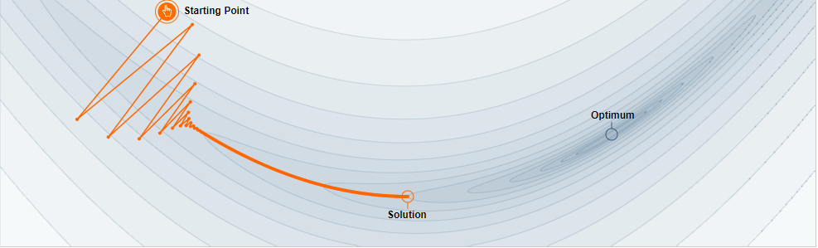

Momentum
Link for experiment
Step size = 0.003
Momentum = 0
Step size = 0.003
Momentum = 0.85

Slide 57


Gradient Descent - Problems
No independent parameter update – same learning rate for all
  Solved by: AdaGrad, RMSProp
Getting stuck in local minima
  Relaxed by adding Momentum: Adam
Saddle points – GD can move very slowly
  AdaGrad, RMSProp escapes quickly
First order – Curvature information is not used

Slide 58

Saddle Point Behavior
Saddle points are critical
  All partial derivatives are zero
  Not minima or maxima in all dimensions
Saddle points are more frequent than local minimas!
Efficiency problem!

Slide 59


AdaGrad
Recall learning rate:
  How much we allow update of the weights
AdaGrad adapts learning rate for b features
  Works well for sparse dataset
Elementwise adaptation :
  Accumulates gradient
Problem : Learning rates decay very quickly
Duchi et al, “Adaptive subgradient methods for online learning and stochastic optimization”, JMLR 2011

Slide 60

RMSProp
Improves AdaGrad by combining:
  Adaptive step size
  Keep the moving average of the squared gradients
moving average
Tieleman and Hinton, 2012

Slide 61

Adam
Improves RMSProp
  Introduces momentum terms, which is calculated by accumulating gradients
Momentum
Bias correction
Kingma and Ba, “Adam: A method for stochastic optimization”, ICLR 2015

Slide 62

Adam
SGD
SGD+Momentum RMSProp
Adam
Provides smoother path

Slide 63
Topics Covered
Classifiers
Loss functions
Basics of learning: Backpropagation
Optimization methods
Regularization
  Problem
  Adding Loss terms (L1, L2..)
  Dropping Nodes or Connections
  Data augmentation & Noise addition & Others
Other key concepts

Slide 64


Regularization
One of the biggest problems in optimization step is overfitting:
  Overfitting : Accurate in training set & Inaccurate in test set
  Basically, network overlearns specific features to training set
  Regularization helps by penalizing large coefficients

Slide 65



Recall Regularization
In common use:
L2 regularization
L1 regularization
Elastic net (L1 + L2)
  L2 penalizes larger weights more than L1

Slide 66

Regularization: Dropout
In each forward pass, randomly remove neurons
  Probability of dropping is a hyperparameter; 0.5 is common
Srivastava et al, “Dropout: A simple way to prevent neural networks from overfitting”, JMLR 2014

Slide 67


Regularization : Dropout code example
Example forward pass with a
3-layer network using dropout

Slide 68


Regularization: A common pattern
Training: Add some kind of randomness
Testing: Average out randomness (sometimes approximate)

Slide 69
Regularization: Data Augmentation
“cat”
Load image and label
Compute loss
CNN
This image by Nikita is licensed under CC-BY 2.0

Slide 70

Regularization: Data Augmentation
“cat”
Load image and label
Compute loss
CNN
Transform image

Slide 71

Data Augmentation : Horizontal Flips

Slide 72
Data Augmentation: Random crops and scales
Training: sample random crops / scales
ResNet:
  Pick random L in range [256, 480]
  Resize training image, short side = L
  Sample random 224 x 224 patch
Testing: average a fixed set of crops
ResNet:
  Resize image at 5 scales: {224, 256, 384, 480, 640}
  For each size, use 10 224x224 crops: 4 corners + center, + flips

Slide 73

Data Augmentation: Color Jitter
Simple:
Randomize contrast and brightness
More complex:
Apply PCA (Principle Component Analysis) to all [R, G, B] pixels in training set
Sample a “color offset” along principal component directions
Add offset to all pixels of a training image
(As seen in [Krizhevsky et al. 2012], ResNet, etc)

Slide 74
Regularization: A common pattern
Training: Add random noise
Testing: Marginalize over the noise
Examples:
Dropout
Data Augmentation
… there are more ….

Slide 75
Regularization: DropConnect
Training: Add random noise
Testing: Marginalize over the noise
Examples:
Dropout
Data Augmentation
DropConnect:
Wan et al, “Regularization of Neural Networks using DropConnect”, ICML 2013

Slide 76

Regularization: Fractional Pooling
Training: Add random noise
Testing: Marginalize over the noise
Examples:
Dropout
Data Augmentation
DropConnect
Fractional Max Pooling:
Graham, “Fractional Max Pooling”, arXiv 2014

Slide 77
Regularization: Stochastic Depth
Training: Add random noise
Testing: Marginalize over the noise
Examples:
Dropout
Data Augmentation
DropConnect
Fractional Pooling
Stochastic Depth: shrink NW depth during training
(while unchanged during testing)
Huang et al, “Deep Networks with Stochastic Depth”, ECCV 2016

Slide 78
Regularization: Cutout
Training: Add random noise
Testing: Marginalize over the noise
Examples:
Dropout
Data Augmentation
DropConnect
Fractional Pooling
Stochastic Depth
Cutout:
Works very well for small datasets like CIFAR
less common for large datasets like ImageNet
DeVries and Taylor, “Improved Regularization of Convolutional Neural Networks with Cutout”, arXiv 2017

Slide 79


Regularization: Mixup
Training: Add random noise
Testing: Marginalize over the noise
Examples:
Dropout
Data Augmentation
DropConnect
Fractional Pooling
Stochastic Depth
Cutout
Mixup:
Target
labels:
cat: 0.4
dog: 0.6
CNN
Randomly blend the pixels of pairs of training images
e.g. 40% cat, 60% dog
Zhang et al, “mixup: Beyond Empirical Risk Minimization”, ICLR 2018

Slide 80
Regularization
Training: Add random noise
Testing: Marginalize over the noise
Examples:
Dropout
Data Augmentation
DropConnect
Fractional Pooling
Stochastic Depth
Cutout
Mixup
Consider dropout for large fully-connected layers
Batch normalization and data augmentation almost always a good idea
Try cutout and mixup especially for small classification datasets

Slide 81
Topics Covered
Classifiers
Loss functions
Basics of learning: Backpropagation
Optimization methods
Regularization
Other key concepts
  Hyper parameter selection
  Data preprocessing
  Weight initialization
  Batch normalization (vs Layer, Instance & Group normal.)

Slide 82

Hyperparameters
Hyperparameters directly control the training behavior
Choosing good hyperparameters provides two main benefits:
  Efficient search across the space of possible hyperparameters
  Easier management of a large set of experiments for hyperparameter tuning

Slide 83
Hyperparameters
Some optimizer configuration variables :
  Learning Rate: Controls gradient step size
  Batch Size: Controls regularization indirectly, affects resource use
  Number of Epochs: How many times, a dataset is repeated
Some model inbuilt hyperparameters
  Hidden Layers
  Hidden Units
  Activation Functions

Slide 84
Choosing Hyperparameters
Step 1: Check initial loss
Step 2: Overfit a small sample
Try to train to 100% training accuracy on a small sample of training data (~5-10 minibatches)
  fiddle with architecture, learning rate, weight initialization
Loss not going down? LR too low, bad initialization
Loss explodes to Inf or NaN? LR too high, bad initialization

Slide 85
Choosing Hyperparameters
Step 1: Check initial loss
Step 2: Overfit a small sample
Step 3: Find LR that makes loss go down
Use the architecture from the previous step:
  use all training data
  turn on small weight decay
  find learning rate that makes the loss drop significantly within ~100 iterations
Good learning rates to try: 1e-1, 1e-2, 1e-3, 1e-4

Slide 86
Choosing Hyperparameters
Step 1: Check initial loss
Step 2: Overfit a small sample
Step 3: Find LR that makes loss go down
Step 4: Coarse grid, train for ~1-5 epochs
Choose a few values of learning rate and weight decay
  around what worked from Step 3
  train a few models for ~1-5 epochs.
Good weight decay to try: 1e-4, 1e-5, 0

Slide 87
Choosing Hyperparameters
Step 1: Check initial loss
Step 2: Overfit a small sample
Step 3: Find LR that makes loss go down
Step 4: Coarse grid, train for ~1-5 epochs
Step 5: Refine grid, train longer
Pick best models from Step 4
  train them for longer (~10-20 epochs) without learning rate decay

Slide 88
Choosing Hyperparameters
Step 1: Check initial loss
Step 2: Overfit a small sample
Step 3: Find LR that makes loss go down
Step 4: Coarse grid, train for ~1-5 epochs
Step 5: Refine grid, train longer
Step 6: Analyse loss curves

Slide 89


Loss curves
Losses may be noisy
use a scatter plot, and also
plot moving average to see trends better
Training Loss
Train & Validation Accuracy

Slide 90
Loss Curve Analysis
Loss
Bad initialization
time

Slide 91
Loss Curve Analysis
Loss plateaus: Try learning rate decay
Loss
time

Slide 92
Loss Curve Analysis
Learning rate step decay
Loss was still going down when learning rate dropped, you decayed too early!
Loss
time

Slide 93
Accuracy still going up, you need to train longer
Loss Curve Analysis
Accuracy
Train
Val
time

Slide 94
Huge train / val gap means overfitting! Increase regularization, get more data
Loss Curve Analysis
Accuracy
Train
Val
time

Slide 95
No gap between train / val means underfitting: train longer, use a bigger model
Loss Curve Analysis
Accuracy
Train
Val
time

Slide 96
Choosing Hyperparameters
Step 1: Check initial loss
Step 2: Overfit a small sample
Step 3: Find LR that makes loss go down
Step 4: Coarse grid, train for ~1-5 epochs
Step 5: Refine grid, train longer
Step 6: Analyse loss curves
If loss curves not ok, GOTO step 5

Slide 97



Data Preprocessing
Assume X [NxD] is data matrix, each example in a row

Slide 98

Data Preprocessing
In practice, you may also see PCA and Whitening of the data
data has diagonal covariance matrix
covariance matrix is the identity matrix

Slide 99
Data Preprocessing
Before normalization:
  classification loss very sensitive to changes in weight matrix
  hard to optimize
After normalization:
  less sensitive to small changes in weights
  easier to optimize

Slide 100
In practice for Images:
Consider CIFAR-10 with [32, 32, 3] images:
Subtract the mean image
  e.g. AlexNet
  mean image = [32,32,3] array
Subtract per-channel mean
  e.g. VGGNet
  mean along each channel = 3 numbers
Subtract per-channel mean and Divide by per-channel st_deviation
  e.g. ResNet
  mean along each channel = 3 numbers
32
32

Slide 101

Weight Initialization
- Q: what happens when W=constant init is used?

Slide 102
Weight Initialization
First idea: Small random numbers
  E.g., gaussian with zero mean and 1e-2 standard deviation:
Works for small networks, but problems with deeper networks
Notes:
NP NumPy: returns values from a Normal distribution, wih st_dev = 1
Weight array produced of size Din x Dout

Slide 103

Weight Initialization: Activation statistics
Forward pass for a 6-layer net with hidden size 4096
Notes:
What is zip: makes from 2 lists one by merge. Din, Dout select the next 2 elements from this list
dims = [4096, …., 4096] 7 elements
dims[:-1] selects first 6 elements, 0-5
dims[1:] selects last 6, from 1-6
h: hidden layer

Slide 104

Weight Initialization: Activation statistics
Forward pass for a 6-layer net with hidden size 4096
All activations tend to zero for deeper network layers
Q: What do the gradients dL/dW look like?
A: All zero, no learning

Slide 105

Weight Initialization: Activation statistics
Increase st_dev of initial weights from 0.01 to 0.05

Slide 106

Weight Initialization: Activation statistics
All activations saturate
Q: What do the gradients look like?
A: Local gradients all zero, no learning
Increase std of initial weights from 0.01 to 0.05
Notes:
Is this caused by the clipping through tanh

Slide 107

Weight Initialization: “Xavier” Initialization
“Xavier” initialization: std = 1/sqrt(Din)
Glorot and Bengio, “Understanding the difficulty of training deep feedforward neural networks”, AISTAT 2010
Notes:
Din = number of inputs
std => 1/64, that’s inbetween 0.01 and 0.05

Slide 108

Weight Initialization: “Xavier” Initialization
“Xavier” initialization: std = 1/sqrt(Din)
Activations are nicely scaled for all layers!
For conv layers:
Din = kernel_size² * input_channels
Glorot and Bengio, “Understanding the difficulty of training deep feedforward neural networks”, AISTAT 2010

Slide 109
Weight Initialization: “Xavier” Initialization
“Xavier” initialization: std = 1/sqrt(Din)
Activations are nicely scaled for all layers!
For conv layers:
Din = kernel_size² * input_channels
Derivation:
Var(y_{i}) = Din * Var(x_{i}w_{i})
= Din * (E[x_{i}²]E[w_{i}²] - E[x_{i}]² E[w_{i}]²)
= Din * Var(x_{i}) * Var(w_{i})
If Var(w_{i}) = 1/Din then Var(y_{i}) = Var(x_{i})
Assume x & w are iid =
x & w independant
x & w are zero-mean
y = Wx= Σ_{i}(x_{i}w_{i})
h = f(y)
Glorot and Bengio, “Understanding the difficulty of training deep feedforward neural networks”, AISTAT 2010
Notes:
iid = indepent and identically distrubted

Slide 110

Batch Normalization
Consider a batch of activations at some layer
To make each dimension zero-mean unit-variance, apply:
this is a differentiable function...
[Ioffe and Szegedy, 2015]

Slide 111



Batch Normalization
Input: x: N x D
Per-channel mean
Shape is D
X
Per-channel var
Shape is D
N
Normalized x
Shape is N x D
D
Problem: Zero-mean, unit variance are too hard of a constraint?
[Ioffe and Szegedy, 2015]

Slide 112

Batch Normalization
Estimates depend on minibatch; can’t do this at test-time!
Input x: N x D
Learnable scale and shift parameters:
  γ, β : D
Learning γ = β, and β = μ
will recover the
identity function!
Per-channel mean
Shape is D
Per-channel var
Shape is D
Normalized x
Shape is N x D
Output
Shape is N x D
[Ioffe and Szegedy, 2015]
Notes:
Check identity function!

Slide 113
Batch Normalization: Test-Time
Input x: N x D
Learnable scale and shift parameters:
  γ, β : D
During testing batchnorm becomes a linear operator! Can be fused with the previous fully-connected or conv layer
(Running) average of values seen during training
(Running) average of values seen during training
Normalized x, Shape is N x D
Output,
Shape is N x D
[Ioffe and Szegedy, 2015]

Slide 114
Batch Normalization for ConvNets
Batch Normalization for fully-connected networks
  x: N × D
Normalize
μ , σ : 1 × D
γ, β : 1 × D
y = γ (x-μ) / σ+β
Batch Normalization for convolutional networks
Spatial BatchNorm, BatchNorm2D
x: N×C×H×W
Normalize
μ , σ : 1×C×1×1
γ, β : 1×C×1×1
y = γ (x-μ) / σ+β
Notes:
Check

Slide 115
Batch Normalization
FC
Usually inserted
after Fully Connected or
after Convolutional layers, and
before Non-Linearity
BN
tanh
FC
BN
tanh
...
[Ioffe and Szegedy, 2015]

Slide 116
Batch Normalization
Makes deep networks much easier to train!
Improves gradient flow
Allows higher learning rates, faster convergence
Networks become more robust to initialization
Acts as regularization during training
Zero overhead at test-time: can be fused with conv!
Behaves differently during training and testing: this is a very common source of bugs!
FC
BN
tanh
FC
BN
tanh
...
[Ioffe and Szegedy, 2015]
[Ioffe and Szegedy, 2015]

Slide 117
Batch Normalization for ConvNets
Batch Normalization for fully-connected networks
  x: N × D
Normalize
μ , σ : 1 × D
γ, β : 1 × D
y = γ (x-μ) / σ+β
Layer Normalization for fully-connected networks
Same behavior at train and test! Can be used in recurrent networks
x: N × D
Normalize
μ , σ : N × 1
γ, β : 1 × D
y = γ (x-μ) / σ+β
Ba, Kiros, and Hinton, “Layer Normalization”, arXiv 2016
Notes:
Check

Slide 118
Batch Normalization for ConvNets
Batch Normalization for fully-connected networks
  x: N × D
Normalize
μ , σ : 1 × D
γ, β : 1 × D
y = γ (x-μ) / σ+β
Instance Normalization for convolutional networks
Same behavior at train / test!
x: N×C×H×W
Normalize
μ , σ : N×C×1×1
γ, β : 1×C×1×1
y = γ (x-μ) / σ+β
Ulyanov et al, Improved Texture Networks: Maximizing Quality and Diversity
in Feed-forward Stylization and Texture Synthesis, CVPR 2017
Notes:
Check

Slide 119

Comparison of Normalization Layers
Wu and He, “Group Normalization”, ECCV 2018

Slide 120

Group Normalization
Wu and He, “Group Normalization”, ECCV 2018

Slide 121
Recap, we covered:
Classifiers
  Linear Classifiers, SVM
Loss functions
  Loss function : Evaluates the mapping
  SVM loss, Softmax loss commonly used
Optimization methods
  We can have an analytical solution to optimization problem
  Backpropagation -> iteratively updates coefficients

Slide 122
Recap, we covered:
Optimization methods
  Gradient descent
    Momentum improves robustness to noise & ability to avoid local minimums
  SGD, ADAM, AdaProp, RMSProp are commonly used

Slide 123
Recap, we covered:
Regularization
  Regularization prevents overfitting by reducing model complexity
    L1 and L2 norm behave differently on how they modify coefficients
  Dropout, data augmentation
Other key points
  Hyperparameter selection
  Weight initialization
  Batch normalization
The End of Topic 2

Slide 124
Further reading:
Ian Goodfellow, Yoshua Bengio, and Aaron Courville (2016). Deep Learning. MIT Press.
Goh, "Why Momentum Really Works", Distill, 2017.
Li et al., CS231n: Convolutional Neural Networks for Visual Recognition
He et al., Deep Residual Learning for Image Recognition
Tieleman and Hinton Lecture 6.5-rmsprop: Divide the gradient by a running average of its recent magnitude

Slide 125
Backup material
Optimization
  Details on chain rule and back propagation
Details on:
  SVM multiclass loss
  Softmax theory
  L1 vs L2 regularization
  Dropout issues

Slide 126
Optimization
We need to find the (close to) optimal solution of weights
CNN training is an iterative process
  We need a method to guide search
We want to achieve
  Best solution possible – minimum loss at convergence
  With minimum amount of computation (iteration steps)

Slide 127
Optimization
Weight update calculation:
  Backpropagation
Gradient descent methods:
  SGD
  AdaGrad
  RMSProp
  ADAM

Slide 128

Optimization
How can we find best W for our score function
Naïve approach : Randomize
Improving, but very slow

Slide 129

Optimization
Another approach : Local random search
Add random perturbation: W` = W + ∂W
Better than weight randomization. But expensive and slow to converge.

Slide 130



Optimization: Following the gradient
$$\frac{df\left(x,w\right)}{dw}= \lim_{∆→0}{\frac{f\left(x,w+∆\right)−f\left(x,w\right)}{∆}}$$
$$J\left(w\right)=$$
Derivative of score function :
In multiple dimensions, the gradient is a vector of (partial derivatives) along each dimension:
The slope in any direction is the dot product of the direction with the gradient
The direction of steepest descent is the negative gradient

Slide 131

Optimization – Following gradient
Current W
W + $∆$:
gradient
[0.34,
-1.11,
0.78]
loss 1.25347
[?,
?,
?]

Slide 132
Optimization – Following gradient
Current W
W + $∆$:
gradient
[0.34,
-1.11,
0.78]
loss 1.25347
[0.34 + 0.0001,
-1.11,
0.78]
loss 1.25322
[?,
?,
?]

Slide 133

Optimization – Following gradient
Current W
W + $∆$:
gradient
[0.34,
-1.11,
0.78]
loss 1.25347
[0.34 + 0.0001,
-1.11,
0.78]
loss 1.25322
[-2.5,
?,
?]
(1.25322 - 1.25347)/0.0001
= -2.5
$$\frac{df\left(x,w\right)}{dw}= \lim_{∆→0}{\frac{f\left(x,w+∆\right)−f\left(x,w\right)}{∆}}$$

Slide 134
Optimization – Following gradient
Current W
W + $∆$:
gradient
[0.34,
-1.11,
0.78]
loss 1.25347
[0.34,
-1.11 + 0.0001,
0.78]
loss 1.25353
[-2.5,
0.6,
?]
(1.25322 - 1.25347)/0.0001
= -2.5
?,
?,
?,
?,
$$\frac{df\left(x,w\right)}{dw}= \lim_{∆→0}{\frac{f\left(x,w+∆\right)−f\left(x,w\right)}{∆}}$$

Slide 135

Optimization – Following gradient
Numerical evaluation of gradient :
Very slow
Need iteration for every dimension
Approximate
We need a function of W : Analytic gradient
Exact
Fast, once expression is derived
Error-prone, Gradient Check with numerical gradient

Slide 136
Optimization – Following gradient
Numerical evaluation was simple on previous example
How about deriving analytic gradient of all weights for this network?

Slide 137


Better Idea: Computational graphs + Backpropagation
x
*
s (scores)
SVM Loss
+
L
W
R

Slide 138

Backpropagation: a simple example
Given score function :

Slide 139

Backpropagation: a simple example

Slide 140
Backpropagation: a simple example
Given inputs :
x = -2, y = 5, z = -4

Slide 141





Backpropagation: a simple example
x = -2, y = 5, z = -4
Want:

Slide 142

Backpropagation: a simple example
e.g. x = -2, y = 5, z = -4
Start from here:
Want:

Slide 143
Backpropagation: a simple example
e.g. x = -2, y = 5, z = -4
= 1
Want:

Slide 144

Backpropagation: a simple example
e.g. x = -2, y = 5, z = -4
Want:

Slide 145
Backpropagation: a simple example
e.g. x = -2, y = 5, z = -4
Want:

Slide 146

Backpropagation: a simple example
e.g. x = -2, y = 5, z = -4
Chain rule, we first calculate partial derivative w.r.t. q
Want:

Slide 147
Backpropagation: a simple example
e.g. x = -2, y = 5, z = -4
Want:

Slide 148



Backpropagation: a simple example
e.g. x = -2, y = 5, z = -4
Chain rule:
Want:
Upstream gradient
Local gradient

Slide 149
Backpropagation: a simple example
e.g. x = -2, y = 5, z = -4
Chain rule:
Want:
Upstream gradient
Local gradient

Slide 150

Backpropagation: a simple example
e.g. x = -2, y = 5, z = -4
Chain rule:
Want:
Upstream gradient
Local gradient

Slide 151
Backpropagation: a simple example
e.g. x = -2, y = 5, z = -4
Chain rule:
Want:
Upstream gradient
Local gradient

Slide 152
Chain Rule
f

Slide 153
Chain Rule
“local gradient”
f

Slide 154
Chain Rule
“local gradient”
f
“Upstream gradient”

Slide 155
Chain Rule
“local gradient”
f
“Downstream gradients”
“Upstream gradient”

Slide 156
Chain Rule
“local gradient”
f
“Downstream gradients”
“Upstream gradient”

Slide 157


Backpropagation sigmoid example:

Slide 158
Backpropagation sigmoid example:

Slide 159


Backpropagation sigmoid example:

Slide 160
Backpropagation sigmoid example:

Slide 161

Backpropagation sigmoid example:
Upstream gradient
Local gradient

Slide 162
Backpropagation sigmoid example:

Slide 163
Backpropagation sigmoid example:
Upstream gradient
Local gradient

Slide 164
Backpropagation sigmoid example:

Slide 165
Backpropagation sigmoid example:
Upstream gradient
Local gradient

Slide 166
Backpropagation sigmoid example:

Slide 167
Backpropagation sigmoid example:
Upstream gradient
Local gradient

Slide 168
Backpropagation sigmoid example:

Slide 169
Backpropagation sigmoid example:
[upstream gradient] x [local gradient] [0.2] x [1] = 0.2
[0.2] x [1] = 0.2 (both inputs!)

Slide 170
Backpropagation sigmoid example:

Slide 171

Backpropagation sigmoid example:
[upstream gradient] x [local gradient] x0: [0.2] x [2] = 0.4
w0: [0.2] x [-1] = -0.2

Slide 172

Backpropagation sigmoid example:
Sigmoid function
Sigmoid
Computational graph representation may not be unique. Choose one where local gradients at each node can be easily expressed!

Slide 173
Backpropagation sigmoid example:
Sigmoid function
Sigmoid
Sigmoid local gradient:

Slide 174
Backpropagation sigmoid example:
Sigmoid function
Sigmoid
[upstream gradient] x [local gradient] [1.00] x [(1 - 0.73) (0.73)] = 0.2
Sigmoid local gradient:

Slide 175
Patterns in gradient flow
add gate: gradient distributor 3
2
4
₊ 7
inputs
2
2
upstream gradient

Slide 176
Patterns in gradient flow
add gate: gradient distributor 3
mul gate: “swap multiplier” 2
2
4
₊ 7
5*3=15
3
× 6
2
5
2
2*5=10

Slide 177
Patterns in gradient flow
add gate: gradient distributor 3
mul gate: “swap multiplier” 2
2
4
₊ 7
5*3=15
3
× 6
2
5
2
copy gate: gradient adder
7
7
4+2=6
2*5=10
4
7
2

Slide 178
Patterns in gradient flow
add gate: gradient distributor 3
mul gate: “swap multiplier” 2
2
4
₊ 7
5*3=15
3
× 6
2
5
2
copy gate: gradient adder
7
7
4+2=6
2*5=10
2*5=10
max gate: gradient router 4
4
7
0
5
5
9
max
2
9

Slide 179



Backprop Implementation:
Forward pass: Compute output
Backward pass: Compute grads

Slide 180
Backprop Implementation:
Forward pass: Compute output
Base case

Slide 181
Backprop Implementation:
Forward pass: Compute output
Sigmoid

Slide 182
Backprop Implementation:
Forward pass: Compute output
Add gate

Slide 183
Backprop Implementation:
Forward pass: Compute output
Add gate

Slide 184
Backprop Implementation:
Forward pass: Compute output
Multiply gate

Slide 185
Backprop Implementation:
Forward pass: Compute output
Multiply gate

Slide 186

Backprop Implementation: Modularized API
Graph (or Net) object (rough pseudo code)

Slide 187

Modularized implementation: forward / backward API
Gate / Node / Function object: Actual PyTorch code
x
z
Need to stash some values for use in backward
*
y
(x,y,z are scalars)
Upstream gradient
Multiply upstream and local gradients

Slide 188

PyTorch sigmoid layer
Forward

Slide 189

PyTorch sigmoid layer
Forward

Slide 190

PyTorch sigmoid layer
Forward

Slide 191








Vector derivatives
Scalar to Scalar
Vector to Scalar
Vector to Vector
Regular derivative:
Derivative is Gradient:
Derivative is Jacobian:
If x changes by a small amount, how much will y change?
For each element of x, if it changes by a small amount then how much will y change?
For each element of x, if it changes by a small amount then how much will each element of y change?

Slide 192
Backprop with Vectors
Loss L still a scalar!
D
“local gradients”
x
D_{z}
f
“Downstream
gradients”
D_{y}
“Upstream gradient”

Slide 193
Backprop with Vectors
Loss L still a scalar!
D
“local gradients”
x
D_{z}
f
“Downstream
gradients”
D_{z}
D_{y}
“Upstream gradient” For each element of z, how much does it influence L?

Slide 194
Backprop with Vectors
Loss L still a scalar!
D
“local gradients”
[D_{x} x D_{z}]
f
[D_{y} x D_{z}]
Jacobian matrices
x
D_{z}
“Downstream
gradients”
D_{z}
D_{y}
“Upstream gradient” For each element of z, how much does it influence L?

Slide 195
Backprop with Vectors
Loss L still a scalar!
D
“local gradients”
[D_{x} x D_{z}]
f
x
D_{x}
D_{z}
“Downstream
Matrix-vector multiply
gradients”
[D x D ]
D_{z}
D_{y}
y z
Jacobian matrices
“Upstream gradient” For each element of z, how much does it influence L?
D_{y}

Slide 196
Backprop with Vectors
4D input x:
4D output y:
[ 1 ]
[ -2 ]
[ 3 ]
[ -1 ]
f(x) = max(0,x)
(elementwise)
[ 1 ]
[ 0 ]
[ 3 ]
[ 0 ]

Slide 197
Backprop with Vectors
4D input x:
4D output y:
[ 1 ]
[ -2 ]
[ 3 ]
[ -1 ]
f(x) = max(0,x)
(elementwise)
[ 1 ]
[ 0 ]
[ 3 ]
[ 0 ]
4D dL/dy:
Upstream gradient
[ | 4 ]
[ | -1 ]
[ | 5 ]
[ | 9 ]

Slide 198
Backprop with Vectors
4D input x:
4D output y:
[ 1 ]
[ -2 ]
[ 3 ]
[ -1 ]
f(x) = max(0,x)
(elementwise)
[ 1 ]
[ 0 ]
[ 3 ]
[ 0 ]
Jacobian dy/dx [ 1 0 0 0 ]
[ 0 0 0 0 ]
[ 0 0 1 0 ]
[ 0 0 0 0 ]
4D dL/dy:
[ 4 ]
[ -1 ]
[ 5 ]
[ 9 ]
Upstream gradient

Slide 199
Backprop with Vectors
4D input x:
4D output y:
[ 1 ]
[ -2 ]
[ 3 ]
[ -1 ]
f(x) = max(0,x)
(elementwise)
[ 1 ]
[ 0 ]
[ 3 ]
[ 0 ]
[dy/dx] [dL/dy] [ 1 0 0 0 ] [ 4 ]
[ 0 0 0 0 ] [ -1 ]
[ 0 0 1 0 ] [ 5 ]
[ 0 0 0 0 ] [ 9 ]
4D dL/dy:
[ 4 ]
[ -1 ]
[ 5 ]
[ 9 ]
Upstream gradient

Slide 200
Backprop with Vectors
4D input x:
4D output y:
[ 1 ]
[ -2 ]
[ 3 ]
[ -1 ]
f(x) = max(0,x)
(elementwise)
[ 1 ]
[ 0 ]
[ 3 ]
[ 0 ]
4D dL/dx: [ 4 ]
[ 0 ]
[ 5 ]
[ 0 ]
[dy/dx] [dL/dy] [ 1 0 0 0 ] [ 4 ]
[ 0 0 0 0 ] [ -1 ]
[ 0 0 1 0 ] [ 5 ]
[ 0 0 0 0 ] [ 9 ]
4D dL/dy:
[ 4 ]
[ -1 ]
[ 5 ]
[ 9 ]
Upstream gradient

Slide 201
Backprop with Vectors
4D input x:
4D output y:
[ 1 ]
[ -2 ]
[ 3 ]
[ -1 ]
f(x) = max(0,x)
(elementwise)
[ 1 ]
[ 0 ]
[ 3 ]
[ 0 ]
Jacobian is sparse:
off-diagonal = zero!
Never explicitly form Jacobian
instead use implicit multiplication
4D dL/dx: [ 4 ]
[ 0 ]
[ 5 ]
[ 0 ]
[dy/dx] [dL/dy] [ 1 0 0 0 ] [ 4 ]
[ 0 0 0 0 ] [ -1 ]
[ 0 0 1 0 ] [ 5 ]
[ 0 0 0 0 ] [ 9 ]
4D dL/dy:
[ 4 ]
[ -1 ]
[ 5 ]
[ 9 ]
Upstream gradient

Slide 202

Backprop with Vectors
4D input x:
4D output y:
[ 1 ]
[ -2 ]
[ 3 ]
[ -1 ]
f(x) = max(0,x)
(elementwise)
[ 1 ]
[ 0 ]
[ 3 ]
[ 0 ]
Jacobian is sparse:
off-diagonal = zero!
Never explicitly form Jacobian
instead use implicit multiplication
4D dL/dx: [ 4 ]
[ 0 ]
[ 5 ]
[ 0 ]
[dy/dx] [dL/dy]
4D dL/dy:
[ 4 ]
[ -1 ]
[ 5 ]
[ 9 ]
Upstream gradient

Slide 203
Backprop with Matrices (or Tensors)
Loss L still a scalar!
[D_{x}×M_{x}]
[D_{x}×M_{x}]
dL/dx always has the same shape as x!
[D_{z}×M_{z}]
“local gradients”
“Downstream
Matrix-vector multiply
gradients”
[D_{y}×M_{y}]
[D_{y}×M_{y}]
[D_{z}×M_{z}]
“Upstream gradient” For each element of z, how much does it influence L?
Jacobian matrices
For each element of y, how much does it influence each element of z?

Slide 204
Backprop with Matrices (or Tensors)
Loss L still a scalar!
[D_{x}×M_{x}]
[D_{x}×M_{x}]
dL/dx always has the same shape as x!
“local gradients”
[(D_{x}×M_{x})×(D_{z}×M_{z})]
[D_{z}×M_{z}]
“Downstream
Matrix-vector multiply
gradients”
[(D_{y}×M_{y})×(D_{z}×M_{z})]
[D_{y}×M_{y}]
[D_{z}×M_{z}]
Jacobian matrices
[D_{y}×M_{y}]
“Upstream gradient” For each element of z, how much does it influence L?
For each element of y, how much does it influence each element of z?

Slide 205

Backprop with Matrices
y: [N×M]
[13 9 -2 -6 ]
[ 5 2 17 1 ]
x: [N×D]
Matrix Multiply
[ 2 1 -3 ]
[ -3 4 2 ]
dL/dy: [N×M] [ 2 3 -3 9 ]
[ -8 1 4 6 ]
w: [D×M]
[ 3 2 1 -1]
[ 2 1 3 2]
[ 3 2 1 -2]

Slide 206
Backprop with Matrices
y: [N×M]
[13 9 -2 -6 ]
[ 5 2 17 1 ]
x: [N×D]
Matrix Multiply
[ 2 1 -3 ]
[ -3 4 2 ]
dL/dy: [N×M] [ 2 3 -3 9 ]
[ -8 1 4 6 ]
w: [D×M]
[ | 3 | 2 | 1 -1]
[ | 2 | 1 | 3 2]
[ | 3 | 2 | 1 -2]
Jacobians: dy/dx: [(N×D)×(N×M)]
dy/dw: [(D×M)×(N×M)]
For a neural net we may have N=64, D=M=4096
Each Jacobian takes 256 GB of memory!
Must work with them implicitly!

Slide 207
Backprop with Matrices
y: [N×M]
[13 9 -2 -6 ]
[ 5 2 17 1 ]
x: [N×D]
Matrix Multiply
[ 2 1 -3 ]
[ -3 4 2 ]
dL/dy: [N×M] [ 2 3 -3 9 ]
[ -8 1 4 6 ]
w: [D×M]
[ 3 2 1 -1]
[ 2 1 3 2]
[ 3 2 1 -2]
Q: What parts of y are affected by one element of x?

Slide 208



Backprop with Matrices
y: [N×M]
[13 9 -2 -6 ]
[ 5 2 17 1 ]
x: [N×D]
Matrix Multiply
[ 2 1 -3 ]
[ -3 4 2 ]
dL/dy: [N×M] [ 2 3 -3 9 ]
[ -8 1 4 6 ]
w: [D×M]
[ 3 2 1 -1]
[ 2 1 3 2]
[ 3 2 1 -2]
Q: What parts of y are affected by one element of x?
A: affects the whole row

Slide 209

Backprop with Matrices
y: [N×M]
[13 9 -2 -6 ]
[ 5 2 17 1 ]
x: [N×D]
Matrix Multiply
[ 2 1 -3 ]
[ -3 4 2 ]
dL/dy: [N×M] [ 2 3 -3 9 ]
[ -8 1 4 6 ]
w: [D×M]
[ 3 2 1 -1]
[ 2 1 3 2]
[ 3 2 1 -2]
Q: What parts of y are affected by one element of x?
Q: How much
does
affect ?
A: affects the whole row

Slide 210


Backprop with Matrices
y: [N×M]
[13 9 -2 -6 ]
[ 5 2 17 1 ]
x: [N×D]
Matrix Multiply
[ 2 1 -3 ]
[ -3 4 2 ]
dL/dy: [N×M] [ 2 3 -3 9 ]
[ -8 1 4 6 ]
w: [D×M]
[ 3 2 1 -1]
[ 2 1 3 2]
[ 3 2 1 -2]
Q: What parts of y are affected by one element of x?
Q: How much
does
affect ?
A: affects the
A:
whole row

Slide 211

Backprop with Matrices
y: [N×M]
[13 9 -2 -6 ]
[ 5 2 17 1 ]
x: [N×D]
Matrix Multiply
[ 2 1 -3 ]
[ -3 4 2 ]
dL/dy: [N×M] [ 2 3 -3 9 ]
[ -8 1 4 6 ]
w: [D×M]
[ 3 2 1 -1]
[ 2 1 3 2]
[ 3 2 1 -2]
Q: What parts of y are affected by one element of x?
Q: How much
does
affect ?
A: affects the
A:
[N×D] [N×M] [M×D]
whole row

Slide 212

Backprop with Matrices
y: [N×M]
[13 9 -2 -6 ]
[ 5 2 17 1 ]
x: [N×D]
Matrix Multiply
[ 2 1 -3 ]
[ -3 4 2 ]
dL/dy: [N×M] [ 2 3 -3 9 ]
[ -8 1 4 6 ]
w: [D×M]
[ | 3 | 2 | 1 -1]
[ | 2 | 1 | 3 2]
[ | 3 | 2 | 1 -2]
By similar logic:
[N×D] [N×M] [M×D]
[D×M] [D×N] [N×M]

Slide 213
Summary – Backpropagation
We need gradients, to navigate search space for weights
  Why not compute directly?
    We need to compute for every individual weight
    Not practical
  Backpropagation enables efficient computation of gradients
    We can follow patterns for each operator
    Easy to implement & chain for computational graphs

Slide 214
Backup material
Optimization
  Details on chain rule and back propagation
Details on:
  SVM multiclass loss
  Softmax theory
  L1 vs L2 regularization
  Dropout issues

Slide 215

SVM Multiclass Loss: Uniqueness of W?
Suppose that we found a set of weights W such that L = 0 ?
Is this W unique?
No! 2W is also has L = 0!

Slide 216

SVM Multiclass Loss: Uniqueness of W?
How do we choose between W and 2W?
Given the data points, which
function is better trained?

Slide 217

SVM Multiclass Loss: Uniqueness of W?
How do we choose between W and 2W?
Overfitting : Performs better
in training set, worse in test set
We prefer simpler models to
avoid overfitting to the
noise in data

Slide 218



Regularization
= regularization strength
Data loss: Model prediction
Regularization Loss: Regularization loss prevents overfitting via penalizing large weights
R(W)
L2 regularization:
L1 regularization:
Elastic net (L1 + L2):
All grow with increasing
weight magnitudes!

Slide 219

Softmax Classifier & Cross Entropy Loss
Softmax Classifier interprets scores as class probabilities
Scores vector:
given image of cat, output(probability) of outcome
Softmax function :
We have 2 probability distributions!
Q : How to measure difference?
A : Cross Entropy
Outcome
Labels
Cross Entropy Loss :
0.13
0.87
0.00
cat
car
frog
1.00
0.00
0.00
Predicted
q(x)
Target
p(x)

Slide 220




Softmax Classifier & Cross Entropy Loss
Outcome
Labels
Formulation of cross entropy loss:
0.13
0.87
0.00
cat
car
frog
1.00
0.00
0.00
Predicted q(x)
Target p(x)
Cross entropy can also be calculated using Kullback-Leibler Divergence :
1.00
0.00
0.00
Using P(x)
1.00
0.00
0.00
$$−log\left(Q\left(x\right)\right)=−\log\left(\frac{e^{s_{y_{i}}}}{\sum_{j}{e^{s_{j}}}}\right)$$
$$=−log\left(Q\left(x\right)\right)$$
= 0
Final Loss for single sample :
see: https://programmathically.com/an-introduction-to-neural-network-loss-functions/
Notes:
See e.g. https://programmathically.com/an-introduction-to-neural-network-loss-functions/

Slide 221


Regularization
– L1 and L2
L1
L2
What is the difference?
L1 tends to get more zero coefficients than L2
L2 tends to reduce coefficients close to zero (but not exactly zero)
L1 norm is more useful in feature selection
L2 norm is more useful when you have co-dependent features

Slide 222
Regularization: Dropout
In each forward pass, randomly set some neurons to zero
  Probability of dropping is a hyperparameter; 0.5 is common
Srivastava et al, “Dropout: A simple way to prevent neural networks from overfitting”, JMLR 2014

Slide 223
Regularization : Dropout code example
Example forward pass with a
3-layer network using dropout

Slide 224
Regularization : Dropout code example
Example forward pass with a
3-layer network using dropout

Slide 225

Dropout: Test time
Dropout makes our output random!
Want to “average out” the randomness at test-time
Output (label)
Input (image)
Random mask

Slide 226




Dropout: Test time
Want to approximate the integral:
Consider a single neuron:
a
At test time we have:
w₁
w₂
During training we have:
x
y
At test time, multiply
by dropout probability

Slide 227

Dropout: Test time
At test time all neurons are active always =>
We must scale the activations so that for each neuron: output at test time = expected output at training time

Slide 228

Dropout
Summary
drop in forward pass
scale at test time

