Slide 1
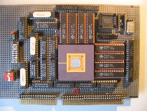
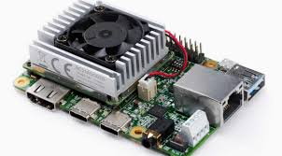
Intelligent Architectures
5LIL0
Deep Learning Software Tools
Berk Ulker
b.ulker@tue.nl
TUEindhoven
2021

Slide 2
Overview
Deep Learning environment :
DL tools
Tool hierarchy, properties
Network data exchange formats

Slide 3










Available Deep Learning Software Frameworks

Slide 4
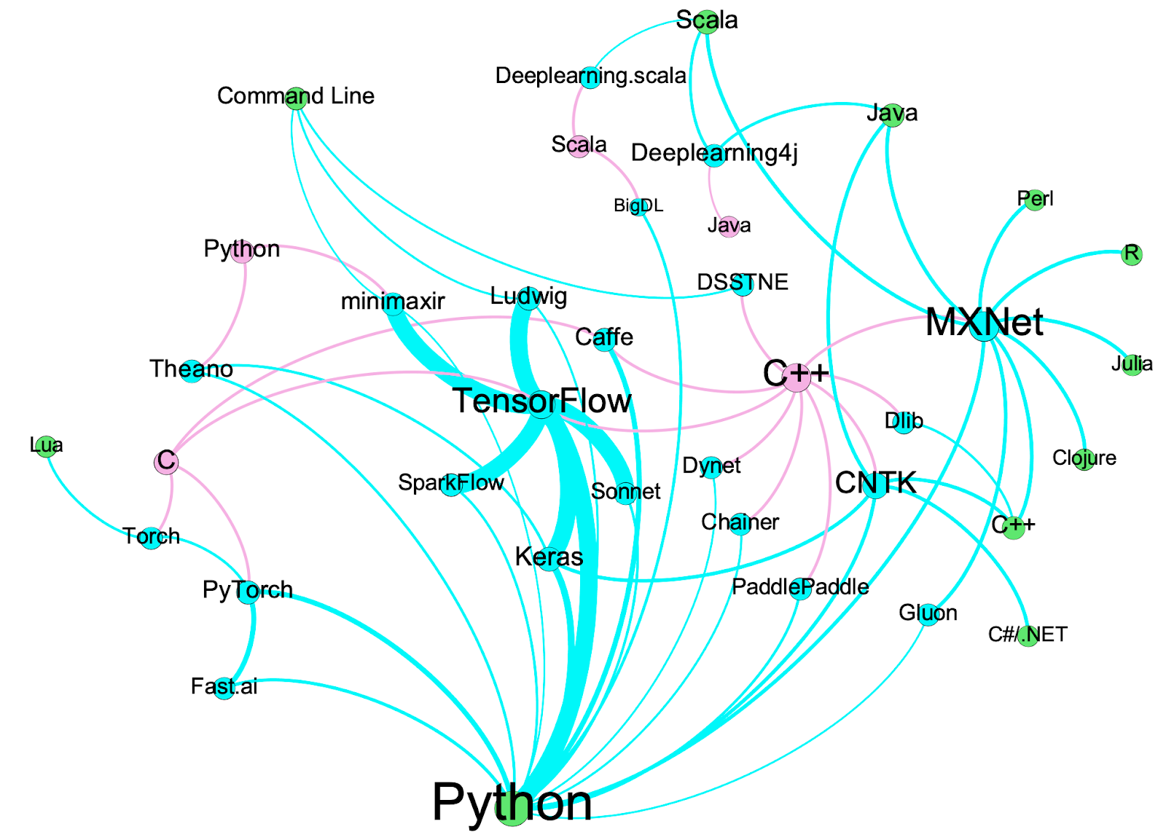
Deep learning tools - implementation
API
DL Tools
Backend

Slide 5
Deep learning stack

Slide 6
Deep learning stack
High Level API : Provides abstraction for application use
Low level API : Integrate system level support libraries and provide DL functionality
System level support libraries provide efficient kernel implementations of
  Basic linear algebra subprograms (BLAS)
  DNN primitives
  GPU kernels

Slide 7
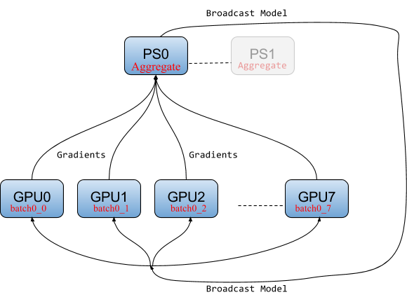
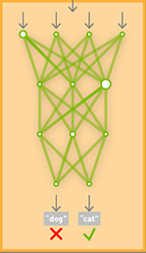
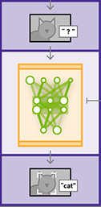
Deep learning frameworks
How frameworks are different?
Capabilities : Training, inference, support for multiprocessing
  Focus on different stages of deployment
  Set of available tools / third party tool integration
  Multi-GPU training

Slide 8
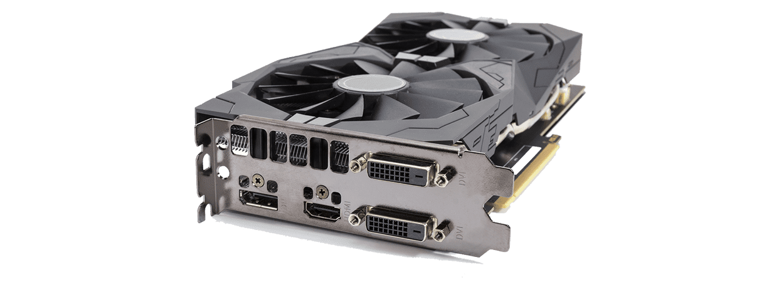
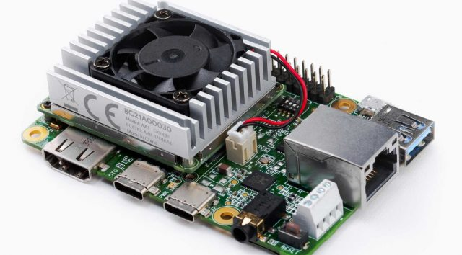
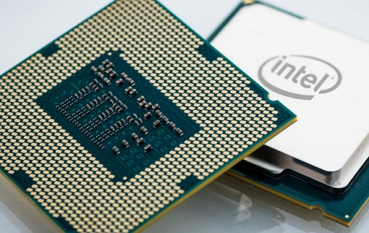
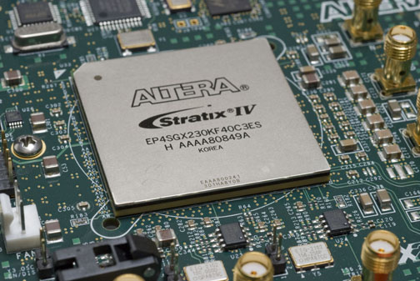
Deep learning frameworks
How frameworks are different?
  Target Platforms
    CPU
    GPU
    TPU
    FPGA

Slide 9
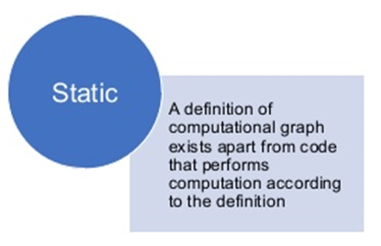
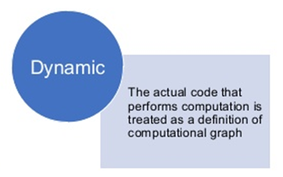
Deep learning frameworks
  How frameworks are different?
    Network model and execution graph structure

Slide 10
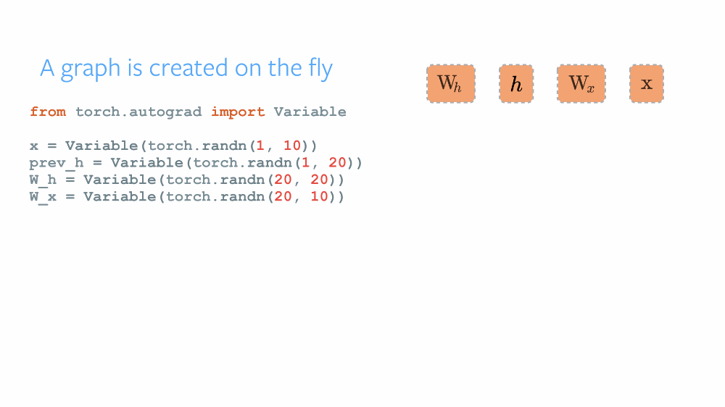
Deep learning frameworks
    Dynamic computation graph

Slide 11
Deep learning frameworks
    Differences from static computation graph
    Computational graph is built up dynamically, immediately after we declare variables
    This graph is thus rebuilt after each iteration of training
    Enables computation with different input sizes, without pre-definition
      Natural language processing is a good example, with varying input sizes
    Additional resources used for rebuilding graph

Slide 12
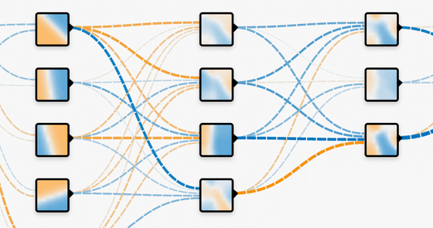
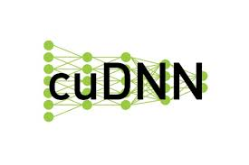


Deep learning frameworks
How frameworks are different?
  Support, tools and third-party software integration
    Performance analysis tools
      Profilers
    Visualization tools
      Training
      Network architecture
    Library integration
      cuDNN, QNNPACK

Slide 13
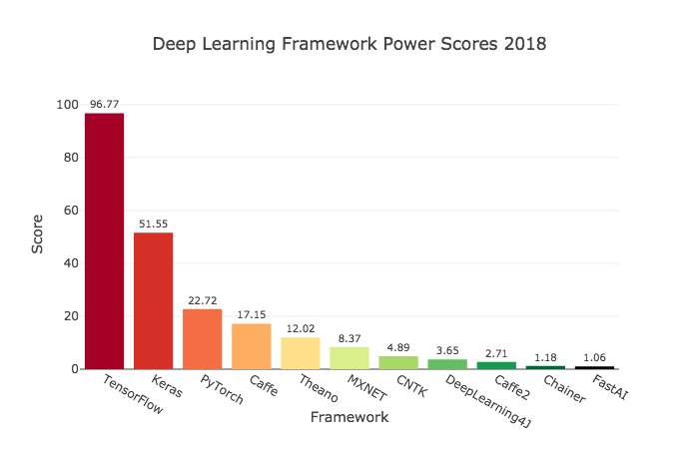
Deep learning frameworks - Popularity
Scores are calculated by combining usage, search volume, related publications, GitHub activity

Slide 14
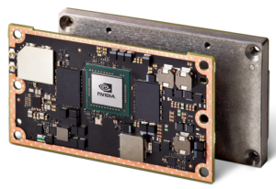
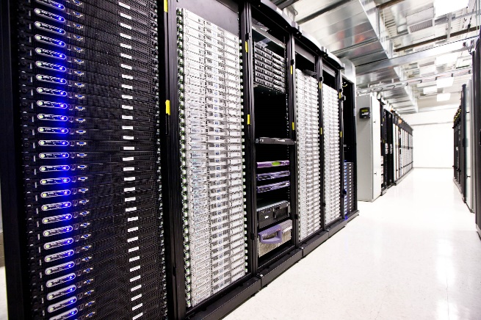
Problem : Interoperability
  Typical scenarios include
    Training in and deployment in different frameworks
    Using data or trained network from another framework

Slide 15


Interoperability
  Translation tools
    Mostly third party implementations
    Need frequent update
  Neural network data exchange formats
    Define operators, computation graph and data format
    Provides single point of synchronization
    ONNX, NNEF

Slide 16
Why format exchange needed?
Deep learning models are developed in different environments
Training and deployment is often executed in different environments

Slide 17
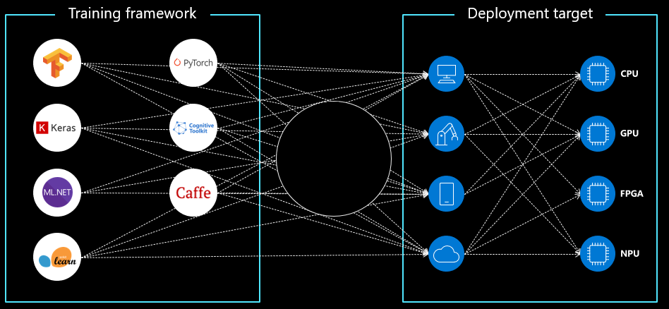
Why format exchange needed?
Format Exchange

Slide 18
Neural Network Exchange Format (NNEF)
  Released by Khronos Group
    Targets conversion from Training tools to inference engines
    Need frequent update
    Not widely supported among frameworks, recently released

Slide 19
Open Neural Network Exchange (ONNX)
  Initiated by Facebook & Microsoft
    Open source
    Targets software stack flexibility
    Widely supported by DL frameworks
    Many popular pre-trained networks are available ready to use

Slide 20
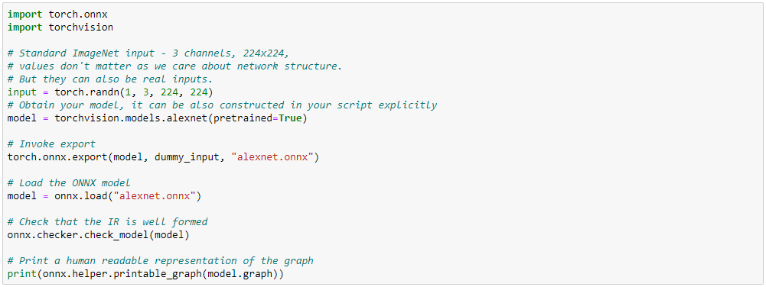
Open Neural Network Exchange (ONNX)
PyTorch example

Slide 21
Intelligent Architectures
5LIL0
Convolutional Neural Network Design
Berk Ulker
b.ulker@tue.nl
TUEindhoven
2021

Slide 22
Overview
Network design :
Design space
Tradeoffs
Common and practical methods

Slide 23
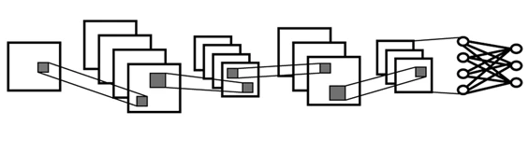
Network Design
  Designing deep neural networks is still more art than science
    Large design space
    Many architecture solutions for a single problem
  Recent research focuses on
    Automated design
    Guided optimization

Slide 24
Network Design
  Network design procedure
    Understand problem
    Evaluate application requirements and resource limitations
    Design the architecture
    Training, validation and reiteration

Slide 25
Design space
  Network design space has many dimensions
    Network size, depth and width
    Operator composition
    Specialized building blocks
    Optimizations

Slide 26

Common Trade-offs in NN Design
  We can move in design space with tradeoffs on:
    Accuracy / memory use
    Accuracy / latency
    Accuracy / energy consumption
    Energy consumption / speed

Slide 27
Speed-Accuracy Tradeoff – Object Detection
  We can control these:
    Model complexity
      Detector architecture (e.g., SSD, YOLO, Faster R-CNN etc.)
      Backbone feature extractor (e.g., ResNet, Inception, Mobilenet, VGG)
    Model parameters
      Input resolution
      Number of proposals (for object detection)
    Quantization (e.g., FP32/FP16)

Slide 28
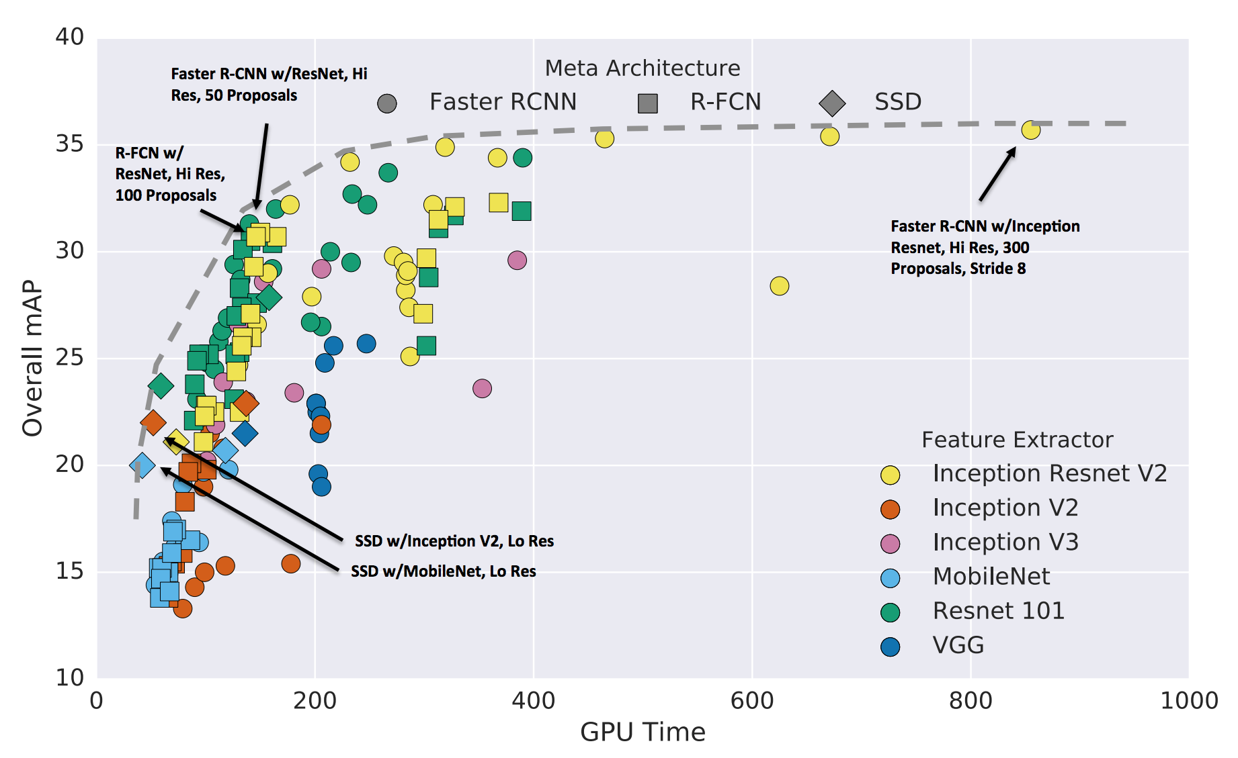
Speed-Accuracy Tradeoff
[Huang et al. Speed/accuracy trade-offs for modern convolutional object detectors]
Backbone
Detector head
Number of proposals
Input resolution

Slide 29
Network Optimization Techniques
  Several techniques exist to optimize network execution efficiency
    Pruning
    Quantization
    Weight scaling
    Tensor decomposition

Slide 30
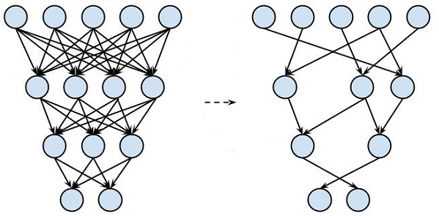
Network Pruning
  Network pruning is removal of nodes, connections or kernels
    Can be part of the training – learning both
    weights and connections
    Can be adaptively/selectively applied
    Benefits may be limited for non-structured pruning

Slide 31
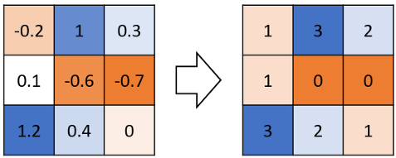
Quantization
  Quantization reduces precision of stored data and operators
    Reduce overall memory use
    Compress network, exploiting redundancy
    Supported for several HW platforms with different precision levels
    FP16, INT16, INT8 are most common
    Training may require full precision

Slide 32
Quantization

Slide 33
Quantization

Slide 34
Kernel Decomposition
    Decomposing a kernel into smaller kernels
    Assumes layers are over-parameterized
    CP Decomposition and Tucker Decomposition for convolutional layers
    Operates on a weights of a linear layer
    Applied per layer

Slide 35
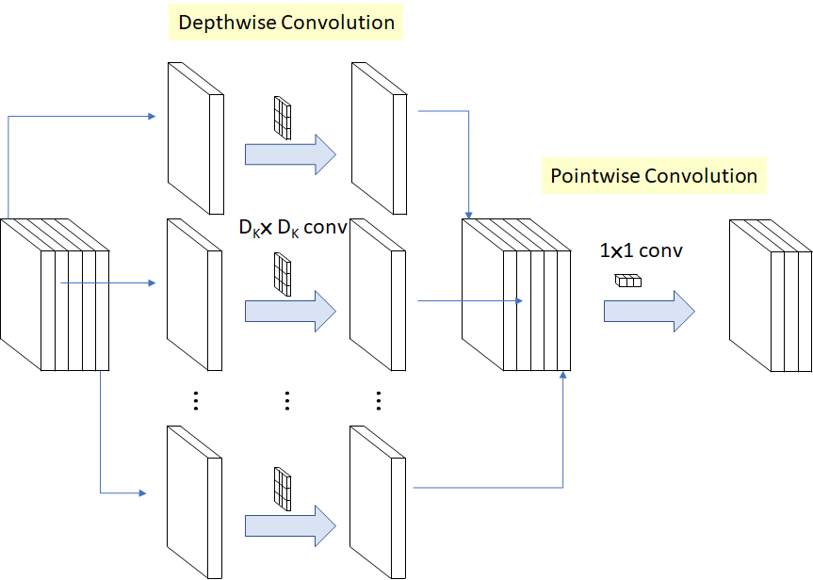

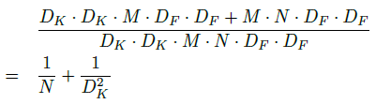
Mobilenet
Standard Conv Cost:
Mobilenet Conv Cost:
Reduction :

Slide 36
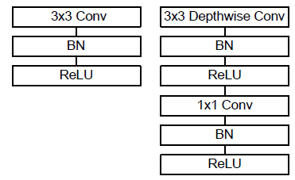
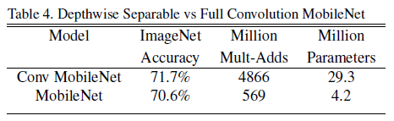
Mobilenet
Activation needs to be used after each convolution
Standard Convolution vs Depthwise Separable Convolution for ImageNet :

Slide 37
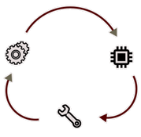
Optimization Problem
  Optimization methods have also “hyperparameters”
    Pruning threshold or percentage
    Quantization level
  How to find optimal values?

Slide 38
Optimization Problem – Automatizing design
  Search for network architecture can be automatized.
    Need heuristics to narrow down search space
    Need translation of functional requirements or limits to design parameters
      Accuracy
      Execution time
      Memory size
      Energy consumption

Slide 39
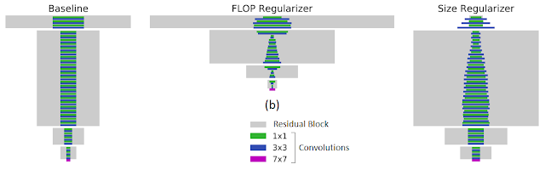
Case study : MorphNet
  MorphNet optimizes an existing network architecture in one shot
    Based on training accuracy and required ops, re-scales layer widths
    Entire filters\layers can be removed
    Guided optimization

Slide 40
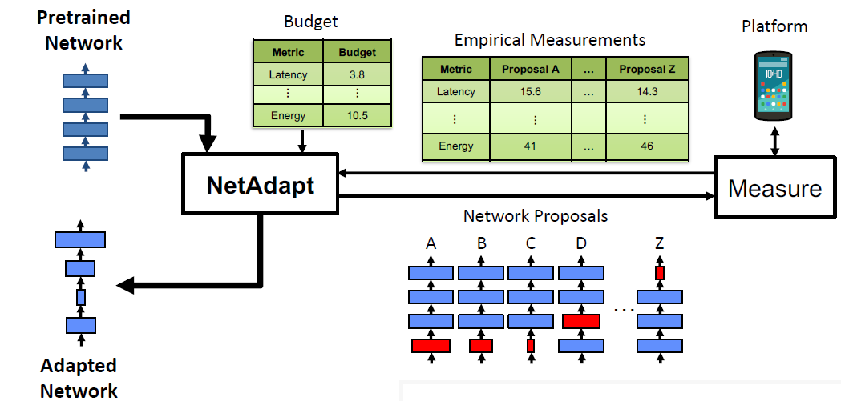
Case study : NetAdapt

Slide 41
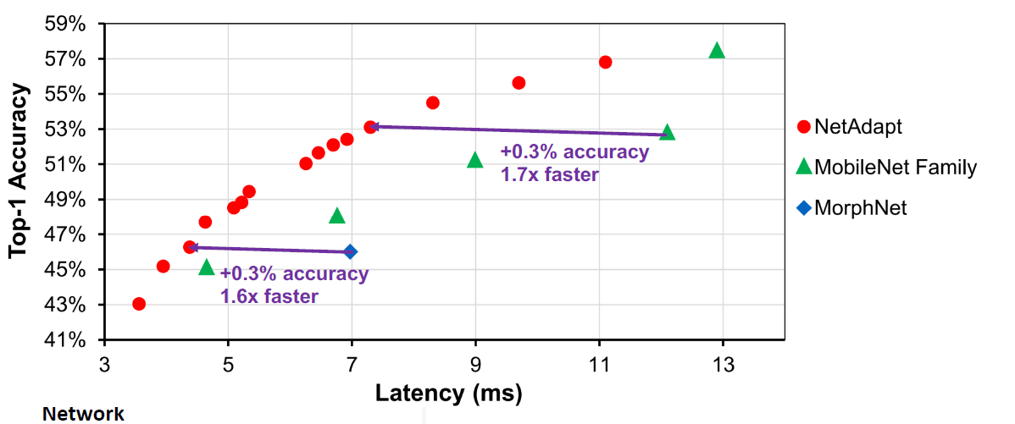
Case study : NetAdapt
Automatically adapts DNN architecture to fit into budget

