Slide 1
Optimizing neural networks for deployment and execution
Quantization: from float32 to int8 and beyond
Floran de Putter
Electrical Engineering – Electronic Systems group

Slide 2
AI is everywhere!
Object detection
Speech recognition
Autonomous driving

Slide 3
DNN challenge: model size and compute power
2015
2012

Slide 4
DNN challenge: energy efficiency
Main energy consumers are the memory accesses, not the actual computation itself.
Why is the RF dominant in conv layers and DRAM in FC layers?
INT16 AlexNet on 65nm Eyeriss architecture

Slide 5
How to reduce energy consumption?
Previous lecture: pruning
Eliminating as many neurons/connections as possible while preserving accuracy
Today: quantization
Transforming a real-valued number to a finite number of distinct values
Example: each pixel in a grayscale image is represented by 8 bits (256-levels)
Advantage:
Reducing the size of the weights and activations to save energy
Disadvantage:
Quantization is an irreversible process and causes information loss
Next lecture: data reuse
Preventing costly data movements as much as possible
Does not influence the accuracy

Slide 6
Quantized grayscale image example
8 bits/pixel
4 bits/pixel
2 bits/pixel

Slide 7
Relative energy cost of memory access and computation for various bitwidths
We see that:
DRAM access is expensive (~100x times more than SRAM)
SRAM access energy is linear
MAC energy is superlinear
units and technology to be checked

Slide 8
Overview of today’s lecture
Motivation
Data formats
Common data types
Fixed-point number format
Quantization schemes
Quantization heuristics
Quantization procedures
Assignment 1 internals
Conclusion

Slide 9
Typical data formats used in DNNs
Number formats |  |  |  | Absolute range | Precision
 |  | 8 bits | 23 bits
float32 |  |  |  | $${1\text{e}}^{−38} \text{to} {3\text{e}}^{38}$$ | $${6\text{e}}^{−6}\%$$
 |  | 5 bits | 10 bits
float16 |  |  |  | $${6\text{e}}^{−5} \text{to} {6\text{e}}^{5}$$ | $$0.05\%$$
 |  | 8 bits | 7 bits
bfloat16 |  |  |  | $${1\text{e}}^{−38} \text{to} {3\text{e}}^{38}$$ | $$0.4\%$$
 |  | 15 bits
int16 |  |  |  | $$0 \text{to} {3\text{e}}^{4}$$ | 0.5
 |  | 7 bits
int8 |  |  |  | $$\text{0 }\text{to} 127$$ | 0.5
Notes:
The higher dynamic range of bfloat16 is useful for gradients. Float16 typically requires loss scaling, whereas bfloat16 can represent such gradients directly

Slide 10
Typical data formats used in DNNs
Number formats |  |  |  | Absolute range | Precision
 |  | 8 bits | 23 bits
float32 |  |  |  | $${1\text{e}}^{−38} \text{to} {3\text{e}}^{38}$$ | $${6\text{e}}^{−6}\%$$
 |  | 5 bits | 10 bits
float16 |  |  |  | $${6\text{e}}^{−5} \text{to} {6\text{e}}^{5}$$ | $$0.05\%$$
Floating-point numbers have (roughly) constant relative precision
Float32 can represent a very wide range of numbers!
Notes:
The higher dynamic range of bfloat16 is useful for gradients. Float16 typically requires loss scaling, whereas bfloat16 can represent such gradients directly

Slide 11
Typical data formats used in DNNs
Number formats |  |  |  | Absolute range | Precision
 |  | 8 bits | 23 bits
float32 |  |  |  | $${1\text{e}}^{−38} \text{to} {3\text{e}}^{38}$$ | $${6\text{e}}^{−6}\%$$
 |  | 5 bits | 10 bits
float16 |  |  |  | $${6\text{e}}^{−5} \text{to} {6\text{e}}^{5}$$ | $$0.05\%$$
 |  | 8 bits | 7 bits
bfloat16 |  |  |  | $${1\text{e}}^{−38} \text{to} {3\text{e}}^{38}$$ | $$0.4\%$$
Google introduced bfloat16 on the observation that “neural networks are far more sensitive to the size of the exponent than that of the mantissa”
Moreover: the physical size of a bfloat16 multiplier is roughly two times smaller than that of float16
Notes:
The higher dynamic range of bfloat16 is useful for gradients. Float16 typically requires loss scaling, whereas bfloat16 can represent such gradients directly

Slide 12
Typical data formats used in DNNs
Number formats |  |  |  | Absolute range | Precision
 |  | 8 bits | 23 bits
float32 |  |  |  | $${1\text{e}}^{−38} \text{to} {3\text{e}}^{38}$$ | $${6\text{e}}^{−6}\%$$
 |  | 5 bits | 10 bits
float16 |  |  |  | $${6\text{e}}^{−5} \text{to} {6\text{e}}^{5}$$ | $$0.05\%$$
 |  | 8 bits | 7 bits
bfloat16 |  |  |  | $${1\text{e}}^{−38} \text{to} {3\text{e}}^{38}$$ | $$0.4\%$$
 |  | 15 bits
int16 |  |  |  | $$0 \text{to} {3\text{e}}^{4}$$ | 0.5
 |  | 7 bits
int8 |  |  |  | $$\text{0 }\text{to} 127$$ | 0.5
Notes:
The higher dynamic range of bfloat16 is useful for gradients. Float16 typically requires loss scaling, whereas bfloat16 can represent such gradients directly

Slide 13
Data format summary
Integers are cheap, but their relative precision fluctuates
Floats are expensive, but their relative precision is constant
Other interesting data format is posit (https://posithub.org/docs/Posits4.pdf)
Range problem of integers can be solved by the fixed-point number format

Slide 14
Fixed-point number format
Bit Width = Fractional (Word) Length + Integer (Word) Length + 1 (Sign)
Approximate real value $x$ by computing $\hat{x}=Round\left(x⋅2^{FL}\right)⋅2^{−FL}$
Representable range: $−2^{IL}≤\hat{x}≤2^{IL}−2^{−FL}$ with precision/step size $2^{−FL}$
Integer
Length (3)
Fractional Length (4)
IL = -1
FL = 5
0
0
1
0
1
0
1
0
$=42⋅2^{−4}$ $= 2.625$
0
1
0
1
1
$=11⋅2^{−5}$ $=0.34375$
Bit Width (8)
BW = 5

Slide 15
Dynamic Fixed-point 16-bit multiplication example
FL = 4
FL = 5
0
0
1
0
1
0
1
0
$$= 2.625$$
0
1
0
1
1
$$=0.34375$$
BW = 8
BW = 5
FL = 5 + 4
0
0
0
1
1
1
0
0
1
1
1
0
$$=0.90234375$$
BW = 8 + 5 – 1*

Slide 16
Example: integer-based MAC data path
K times
Inputs I
X
+
Accumulator
Scale
Weights W
$$I_{1,1}W_{1,1}+I_{1,2}W_{2,1}+I_{1,3}W_{3,1}+…$$
Operands width are ${BW}_{I}$ or ${BW}_{w}$
Products width are ${BW}_{I}+{BW}_{W} −1$
Accumulation width = $\left({BW}_{I}+{BW}_{W} −1\right)+\left\lceil {\text{log}}_{2}K\right\rceil$
Input/output precision between layers is aligned using scale

Slide 17
Overview of today’s lecture
Motivation
Data formats
Quantization schemes
Linear (uniform) quantization
Non-linear (non-uniform) quantization
Codebook quantization
Quantization heuristics
Quantization procedures
Assignment 1 internals
Conclusion

Slide 18
Linear (uniform) quantization
Linear implies constant step size $∆$
Step size is determined by the range of the tensor
Symmetric mode
Asymmetric mode
$\hat{x}$ the quantized version of $x$: $\hat{x}=\frac{round\left(x⋅∆\right)}{∆}$
3 bits quantization example

Slide 19
Symmetric mode
Conventional fixed-point format
Quantization range is symmetric around 0
Step size given by:
$$∆= \frac{2^{n}−1}{2∗max\left|x\right|}$$

Slide 20
Asymmetric mode
Useful when the distribution of values is not symmetric around 0
Step size given by:
$$∆= \frac{2^{n}−1}{\max{x}−\min{x}}$$
Use a zero-point $z$ to shift the distribution:
$$\hat{x}=\frac{round\left(x⋅∆− z\right)}{∆}+z$$
In practice, $z=round\left(\min{x}⋅∆\right),$which means that zero is exactly representable by an integer in the quantized range

Slide 21
Non-linear (non-uniform) quantization
Non-linear implies variable step size $∆$
Variability follows a regular pattern:
Example: power-of-two step
Concept:
More likely (smaller) values should be more accurately quantized
Less likely (larger) values should be coarsely quantized

Slide 22
Codebook quantization
Useful when distribution of values is not normally distributed
Quantized values (codewords) are represented by a codebook
Codewords are selected using a clustering algorithm or training process
E.g., values acquired by K-means clustering
Codebook example
Index | Value | Interval
0 | -0.07 | [-0.08, -0.04]
1 | 0 | [-0.04, 0.05]
2 | 0.01 | [0.05, 0.011]
3 | 0.012 | [0.011, 0,013]

Slide 23
Quantization schemes summary
Scheme | Step size | Step size pattern
Linear | Fixed | Regular
Non-linear | Variable | Regular
Codebook | Variable | Irregular

Slide 24
Overview of today’s lecture
Motivation
Data formats
Quantization schemes
Quantization heuristics
Quantization procedures
Assignment 1 internals
Conclusion

Slide 25
Bit width selection
Which data format do we use for weights/activations in each layer?
Brute forcing the solution space is too costly…
One bit width influences other choices
We need to employ heuristics:
Second derivative
Learned quantization
Something else?

Slide 26
Second derivative as quantization heuristic
The loss function can be expanded by a Taylor series for a single weight w:
$$L\left(w+∆w\right)≈L\left(w\right)+L′\left(w\right)∆w+\frac{1}{2}L′′\left(w\right){∆w}^{2}$$
Assume a fully-trained network: weight w has converged into its (local) minimum ($L^{′}\left(w\right)=\frac{dL}{dw}=0$).
Then, we approximate this minima with a parabola.
The second derivative is a scalar that indicates the stability of the minima: the higher the scalar, the more the loss changes, when you introduce a quantization error ($∆w=quantize\left(w\right)−w$).
$$L\left(∆w\right)≈\frac{1}{2}L′′\left(w\right){∆w}^{2}$$
Loss
$$W$$
W*

Slide 27
Second derivative heuristic for a
In 1D calculus, our heuristic was simple.
$$L\left(∆w\right)≈\frac{1}{2}L′′\left(w\right){∆w}^{2}$$
What about our many-dimensional network?
$L\left(∆W\right)≈{g(W)}^{T}∆W+\frac{1}{2}{∆W}^{T}H\left(W\right)∆W$
The Hessian matrix is a square matrix of second-order partial derivatives of a scalar-valued function. It describes the local curvature of a function of many variables.
How to compute and analyze the Hessian?
$$H=\left[\begin{matrix}\begin{matrix}\frac{∂^{2}L}{{∂w}_{1}^{2}} & \frac{∂^{2}L}{{∂w}_{1}{∂w}_{2}} \\ \frac{∂^{2}L}{{∂w}_{2}{∂w}_{1}} & \frac{∂^{2}L}{{∂w}_{2}^{2}}\end{matrix} & \begin{matrix}⋯ & \frac{∂^{2}L}{{∂w}_{1}{∂w}_{n}} \\ … & \frac{∂^{2}L}{{∂w}_{2}{∂w}_{n}}\end{matrix} \\ \begin{matrix}⋮ & ⋮ \\ \frac{∂^{2}L}{{∂w}_{n}{∂w}_{1}} & \frac{∂^{2}L}{{∂w}_{n}{∂w}_{2}}\end{matrix} & \begin{matrix}⋱ & ⋮ \\ ⋯ & \frac{∂^{2}L}{{∂w}_{n}^{2}}\end{matrix}\end{matrix}\right]$$

Slide 28
Computing the Hessian
$$H=\left[\begin{matrix}\begin{matrix}\frac{∂^{2}L}{{∂w}_{1}^{2}} & \frac{∂^{2}L}{{∂w}_{1}{∂w}_{2}} \\ \frac{∂^{2}L}{{∂w}_{2}{∂w}_{1}} & \frac{∂^{2}L}{{∂w}_{2}^{2}}\end{matrix} & \begin{matrix}⋯ & \frac{∂^{2}L}{{∂w}_{1}{∂w}_{n}} \\ … & \frac{∂^{2}L}{{∂w}_{2}{∂w}_{n}}\end{matrix} \\ \begin{matrix}⋮ & ⋮ \\ \frac{∂^{2}L}{{∂w}_{n}{∂w}_{1}} & \frac{∂^{2}L}{{∂w}_{n}{∂w}_{2}}\end{matrix} & \begin{matrix}⋱ & ⋮ \\ ⋯ & \frac{∂^{2}L}{{∂w}_{n}^{2}}\end{matrix}\end{matrix}\right]$$
Computing the Hessian (n by n matrix) is quite intensive and not feasible for networks with many parameters.
For simplicity we ignore the off-diagonal elements, then our Hessian is a diagonal matrix. This implies its eigenvalues are on the diagonal.
To calculate the diagonal, we now have two options:
Directly calculate the 2nd derivatives
Using RandNLA we can find the trace of the matrix (sum of the diagonal elements)
$$H=\left[\begin{matrix}\begin{matrix}\frac{∂^{2}L}{{∂w}_{1}^{2}} & 0 \\ 0 & \frac{∂^{2}L}{{∂w}_{2}^{2}}\end{matrix} & \begin{matrix}⋯ & 0 \\ … & 0\end{matrix} \\ \begin{matrix}⋮ & ⋮ \\ 0 & 0\end{matrix} & \begin{matrix}⋱ & ⋮ \\ ⋯ & \frac{∂^{2}L}{{∂w}_{n}^{2}}\end{matrix}\end{matrix}\right]$$

Slide 29
Second derivative as quantization heuristic
Using the Taylor expansion of the loss function and an approximated Hessian:
$$∆L\left(W\right)≈\frac{1}{2}{∆W}^{T}\hat{H}\left(W\right)∆W$$
We can directly calculate the effects of selecting a certain quantization bit width for weights and therefore try many possible solutions quickly.
Note that this approach is also valid for activations.
Loss
$$W$$
W*

Slide 30
Learned mixed-precision quantization
Concept: use a separate, reinforcement learning, (RL) neural network (RL agent) that has learned how select the bit width of each layer based on measurements on real hardware
Observation of the authors: Latency of quantized DNNs is highly dependent on the hardware platform
Full precision DNN
RL agent
Predict
Quantization policy
Hardware resource constraints
Fine-tune and map on hardware

Slide 31
Training the RL agent
Full precision DNNs
RL agent
Predict
Quantization policy
Decrease bit width
DNN Accuracy as reward,
Update RL agent
Hardware evaluations
Resources < constraints?
Yes
No

Slide 32
Quantization vs Pruning
In previous lecture you have seen pruning, which removes a specific set of neurons. Or, in other words pruning sets weights to 0.
Is this not identical to heavy quantization?
No.. In quantization we are deviating a value slightly from its optimum.
In pruning we typically deviate so much, the parabola approximation of a minimum is no longer valid.
Note that the loss can stabilize even though a minimum is very sharp.
Loss
$$W$$
W*

Slide 33
Overview of today’s lecture
Motivation
Data formats
Quantization schemes
Quantization heuristics
Quantization procedures
Post-training quantization of a pretrained high-precision model
Quantization-aware training
Quantization of training procedure (not covered in this lecture)
Assignment 1 internals
Conclusion

Slide 34
Post-training quantization
Typical procedure for an accumulator-constraint data path:
Range Analysis to determine minimum integer length
Granularity: weights and/or activations within network, layer, or even channel?
Determine optimal bit width of fixed-point granularity group
Using exhaustive testing (with heuristics) on validation set or analytical model?
Check if quality of final solution is sufficient. If not, do some fine-tuning

Slide 35
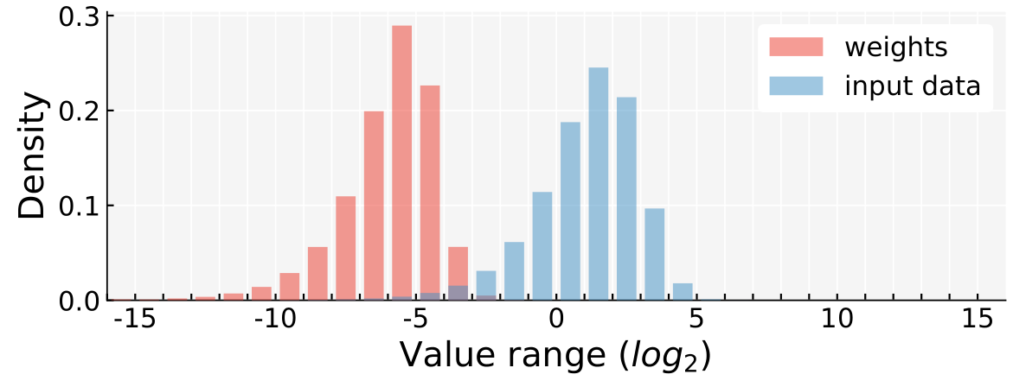
1. Determine Integer Length with Range Analysis
Forward small data set and monitor ranges.
Key observations:
Weights and activations are clustered.
Weights are small, activations are large.

Slide 36
1. Determine Integer Length with Range Analysis (2)
Determine integer length using heuristic:
$$IL=⌊\log_{2}{\max_{x∈x}{|x|}⌋+1}$$
Problem: many bits wasted!
$$BW= ?$$
$$IL=5$$

Slide 37
1. Determine Integer Length with Range Analysis (3)
Solution for dynamic range problem:
Multiple fixed-point groups in layers → wide dynamic range!
Only rescaling between layers → negligible overhead!
$$BW_{w}=8$$
$${IL}_{w}=−2$$
$$BW_{d}=8$$
$${IL}_{d}=5$$

Slide 38
Fixed-point group granularity
Multiple fixed-point groups result in superior accuracy:
Figure 5.3. Top-1 accuracy for CaffeNet on ILSVRC 2014 validation dataset. Integer length refers to the number of bits assigned to the integer part of fixed point numbers.

Slide 39
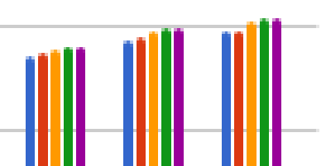
Fixed-point group granularity (2)
Fine-grained per kernel quantization results in slightly better results:
Figure 10: Comparison of quantization-aware training schemes: Mobilenet-v1

Slide 40
2. Find fixed-point solution for every layer
Solution space for 4-layer DNN
Difficult problem: find the best bit width for every fixed-point group.
Often boils down to testing many solutions on a small validation data set
Valid combinations are platform-dependent, for example:
Only 8-bit or 16-bit integer data types supported
Accumulator is only 16-bit wide

Slide 41
3. Impact of post-quantization fine-tuning
Fixed-point fine-tuning recovers some of the quantization precision loss.
Fig. 4. Top-1 accuracy drop of 8-bit networks. We show the accuracy difference between the approximated and the 32-bit FP network. Fine-tuned networks are denoted with FT. Our dynamic fixed point networks achieve best performance and are within 1% of the original network.

Slide 42
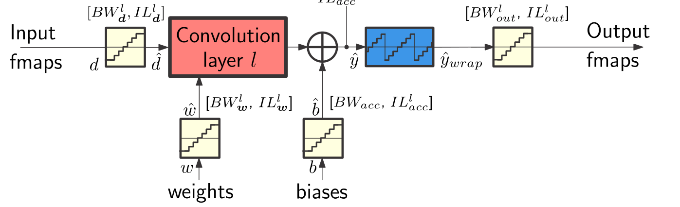
Quantization-aware training
Forward pass: simulated quantization to compute loss function
Backward pass: how to back propagate through the quantizers?

Slide 43
Backpropagation: recap
E
C(X_{n},Y)
(output)
x_{n}
Forward pass: for each training example. Compute the outputs for all layers
Backwards pass: compute cost derivatives iteratively from top to bottom:
Compute gradients and update weights
F_{n}(x_{n-1}, W_{n})
x_{n-1}
…
x_{i}
F_{i}(x_{i-1}, W_{i})
x_{i-1}
…
x₂
F₂(x₁, W₂)
x₁
F₁(x₀, W₁)
(input)
x₀
y

Slide 44
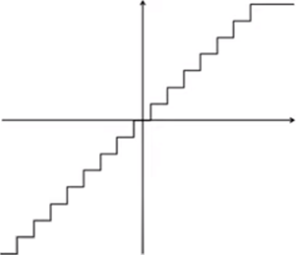
Quantizers: how to backpropagate?
$$y=\text{quantize}(x)$$
Forward pass
4-bits
$$x$$
quantize
$$y$$
Backward pass
input
$$\frac{∂C}{∂x}$$
quantize
$$\frac{∂C}{∂y}$$
$$\frac{∂C}{∂x}=\frac{∂C}{∂y}\frac{∂y}{∂x}$$
?
output

Slide 45
Quantizers: how to backpropagate?
$$y=\text{quantize}(x)$$
Forward pass
4-bits
$$x$$
quantize
$$y$$
Backward pass
input
$$\frac{∂C}{∂x}$$
quantize
$$\frac{∂C}{∂y}$$
Straight-through
estimator
$$\frac{∂C}{∂x}=\frac{∂C}{∂y}\frac{∂y}{∂x}$$
$$\frac{∂C}{∂y} 1$$
output

Slide 46
Quantization procedures – Summary
Approach | Training time | Quantization time | Quality of results
Quantization of pre-trained model | +++ | ++ | +
Quantization of pre-trained model with fine-tuning | ++ | + | ++ / +++
Quantization-aware training | + | +++ | +++
Quantized training procedure | ++* | +++ | +++
* on platforms that are specialized for high-throughput integer computations (e.g. FPGAs).

Slide 47
Overview of today’s lecture
Motivation
Data formats
Quantization schemes
Quantization heuristics
Quantization procedures
Assignment 1 internals
Conclusion

Slide 48
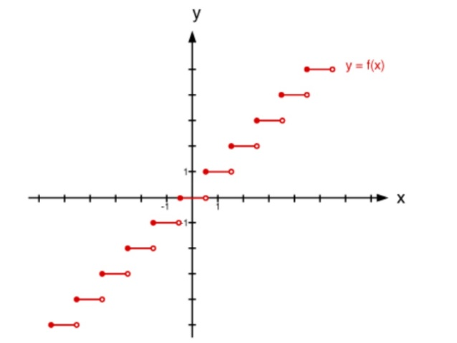
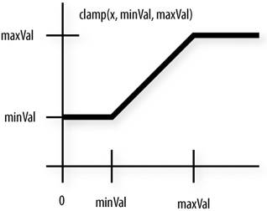
Quantizer implementation in PyTorch (IA assignment 1)
import math
import torch
pow2 = lambda x: math.pow(2,x)
def quantize(input, bits, frac_len, inplace=False):
# reduce precision
y = input if inplace else input.clone()
y.mul_(pow2(frac_len))
y.round_() # policy: Round half away from zero (ex: 23.5 becomes 24, -23.5 becomes -24)
y.mul_(pow2(-frac_len))
# clamp range
y_min = -pow2(bits-1) * pow2(-frac_len)
y_max = (pow2(bits-1)-1) * pow2(-frac_len)
y.clamp_(y_min, y_max)
return y
...
y = round(x)
Notes:
Two interesting functions:
Round(): has derivative of zero everywhere (and infinite at tie-breaking point (in theory))
Clamp(): has derivative of 1 inside range and 0 outside

Slide 49
Quantizer implementation in PyTorch (IA assignment 1)
...
# Create the graph and forward x
x = torch.tensor(2.0, requires_grad=True)
y = x ** 3
y.retain_grad()
z = quantize(y, bits=16, frac_len=8)
z.retain_grad()
# Backward pass: compute gradient of the output with respect to
# model parameters (all Tensors with requires_grad=True).
z.backward()
print(y.grad) # should print '1' which is dz/dy
print(x.grad) # should print '12' which is dz/dx
Actual console output:
>> tensor(0.)
>> tensor(0.)
Round() has derivative of zero almost everywhere. Result is actually correct, but not very useful!
Notes:
The values that we get are correct, but not what we want.

Slide 50
Quantizer implementation in PyTorch (IA assignment 1)
class Quantize(torch.autograd.Function):
"""
Symmetric Linear Quantizer. The forward pass reduces the precision and clamps the range.
The backward pass computes the unclipped Straight-Through Estimator (STE) i.e. the gradients
are not affected by this node.
"""
@staticmethod
def forward(ctx, input, bits, frac_len, inplace):
# reduce precision
y = input if inplace else input.clone()
y.mul_(pow2(frac_len))
y.round_() # policy: Round half away from zero (ex: 23.5 becomes 24, -23.5 becomes -24)
y.mul_(pow2(-frac_len))
# clamp range
y_min = -pow2(bits-1) * pow2(-frac_len)
y_max = (pow2(bits-1)-1) * pow2(-frac_len)
y.clamp_(y_min, y_max)
return y
@staticmethod
def backward(ctx, grad_output):
return grad_output, None, None, None # Straight-through estimator (unclipped). Only input needs gradient.
def quantize(input, bits, frac_len, inplace=False):
return Quantize.apply(input, bits, frac_len, inplace)

Slide 51
Quantizer implementation in PyTorch (IA assignment 1)
...
# Create the graph and forward x
x = torch.tensor(2.0, requires_grad=True)
y = x ** 3
y.retain_grad()
z = quantize(y, bits=16, frac_len=8)
z.retain_grad()
# Backward pass: compute gradient of the output with respect to
# model parameters (all Tensors with requires_grad=True).
z.backward()
print(y.grad) # should print '1' which is dz/dy
print(x.grad) # should print '12' which is dz/dx
Actual console output:
>> tensor(1.)
>> tensor(12.)
Notes:
The values that we get are correct, but not what we want.

Slide 52
Summary – quantization for off-the-shelf platforms
For efficient deployment on embedded or mobile devices models are converted to integer-only arithmetic. We can either convert a pre-trained model to reduced-precision or train a quantized model from scratch.
A symmetric linear quantizer is a conventional fixed-point format. Asymmetric linear quantizers are used if the value distribution is not symmetric. Non-linear quantizers are sometimes used in the literature, but difficult to efficiently use on general-purpose platforms.
Multiple fixed-point groups are used to capture the different distributions within layers of the network more efficiently.
Typically, a number of quantization solutions will be tested, depending on the platform characteristics (supported data types and accumulator size).
Model fine-tuning or retraining is essential to recover some of the lost accuracy. Some measures needs to be taken to enable simulated quantized fine-tuning.

Slide 53
Conclusions
Quantization is an essential tool for efficient model deployment
These techniques can be combined with other compression methods, such as pruning
8-bit data and weights with 32-bit accumulators is sufficient for recent DNNs
Next up: extreme quantization (bitwise networks)
For custom accelerators there is a huge shift from fixed-point to binary/ternary networks, which can potentially replace MACs by XNOR and POPCOUNT instructions
Next lecture we will investigate the training and deployment of a bitwise networks

