Slide 1
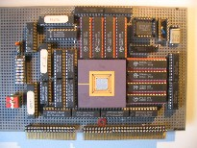
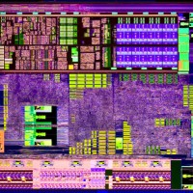
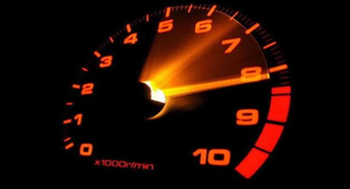
Intelligent Architectures 5LIL0 Exploiting Data Reuse: From Loop Transformations to Halide
Henk Corporaal
www.ics.ele.tue.nl/~heco/courses/IA
h.corporaal@tue.nl
TUEindhoven
2021

Slide 2
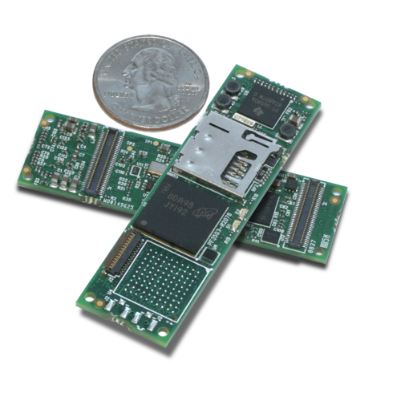
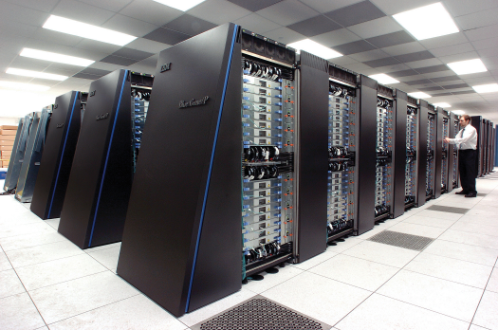
Application Excecution Time & Energy
High performance computing
Embedded computing
Small portions of the code dominate execution time
Hot spots
Loops
Apply Loop Transformations
for(i=0; i<N; i++){
for(j=0; j<N; j++){
for(k=0; k<N; k++)
c[i][j] += a[i][k] * b[k][j];
}}

Slide 3
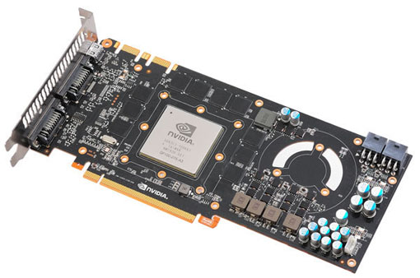
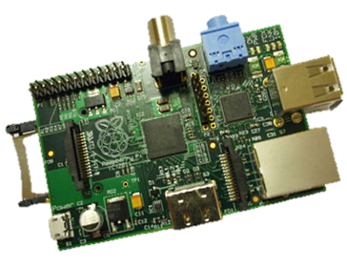
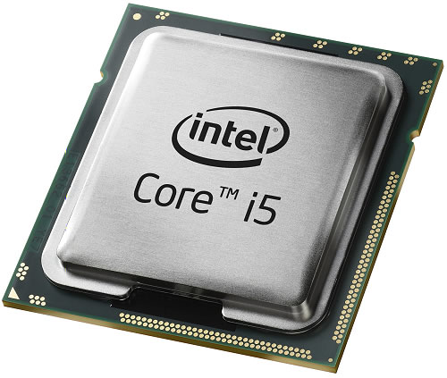
Loop Transformations
Can help you in many compute domains
Convert Loops to
GPU Threads
Embedded Devices
Fine-tune for architecture
CPU Code
Parallelism
Memory Hierarchy (multi-level caches)
ASICs & FPGAs
HDL, HW Description Languages

Slide 4
Overview
RECAP: Constructing a DNN / CNN
Neuron & Single layer
Network: multiple layers
Energy
Loop transformations
data flow
reordering
restructuring: tiling
Buffer management
Store and Compute level

Slide 5
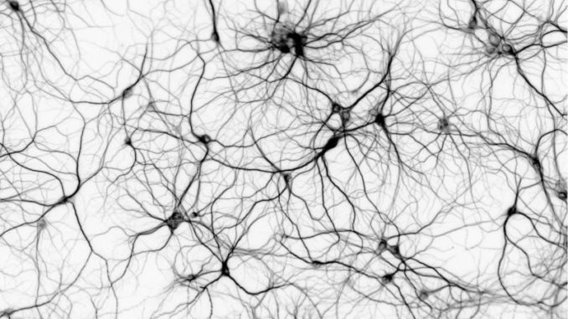
Background: Artificial Neural Networks

Slide 6
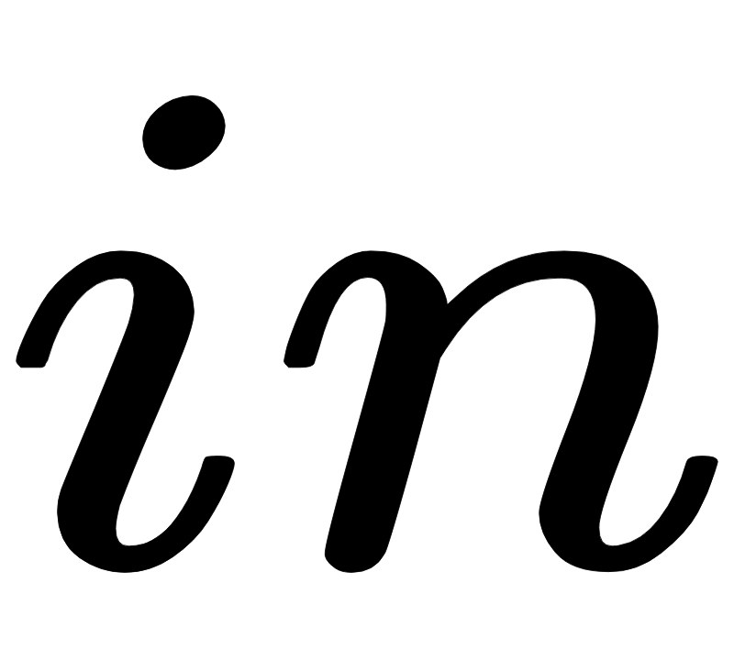
Artificial Neuron Model
Dot Product
Activation function:
Non Linear
Transformation

Slide 7
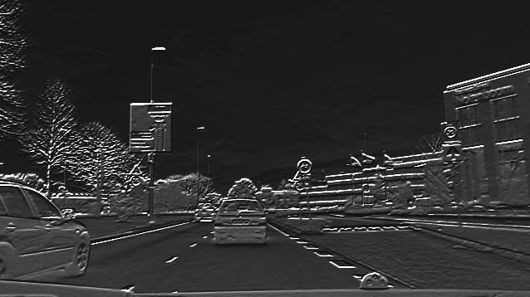
Neuron Applied to Image Region
Neuron detects features in region
Convolution: Same neuron applied to all regions in the image yields an output feature map

Slide 8
Input from multiple input (feature) maps
Input can be taken from multiple input feature maps

Slide 9
Multiple neurons / convolutions
Multiple neurons generate multiple output feature maps

Slide 10
Overview
RECAP: Constructing a DNN / CNN
Neuron & Single layer
Computational model of a single layer
Network: multiple layers
Energy
Loop transformations
data flow
reordering
restructuring: tiling
Buffer management
Store and Compute level

Slide 11
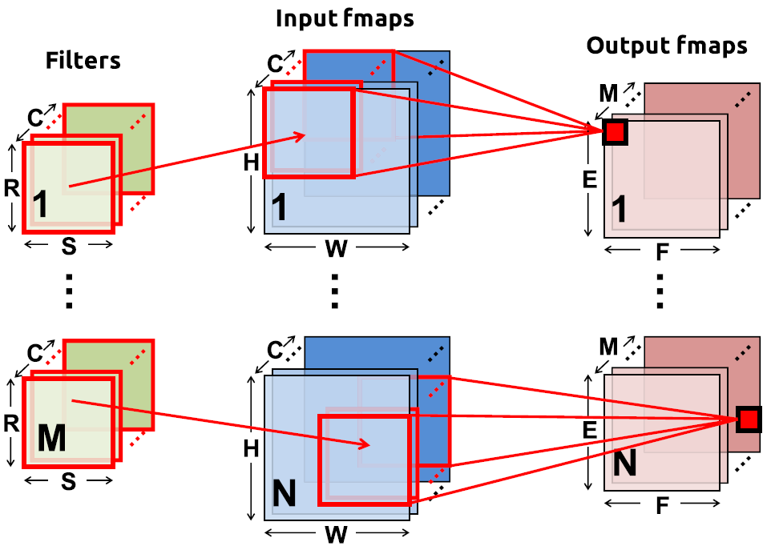
Convolution layer: Overview + Notation
N = batch size
C input feature maps of size HxW
M output feature maps of size ExF
M filters of size RxS
Note: for fully connected layer filter size is input size, RS = HW

Slide 12
Convolution equations
U = stride
B = bias vector
Note: W has 4-dimensions
i,j for kernel
k for input feature maps
u for output feature maps

Slide 13
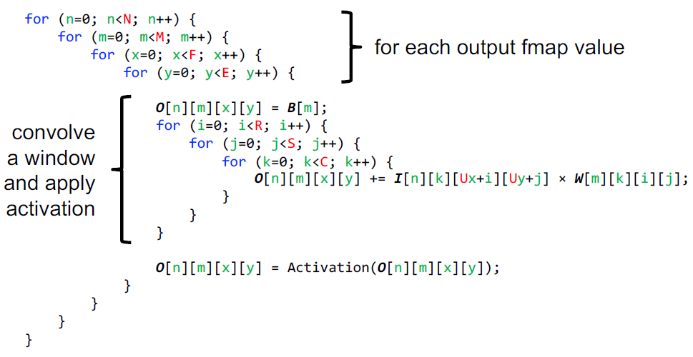
Convolution code, for 1 layer

Slide 14
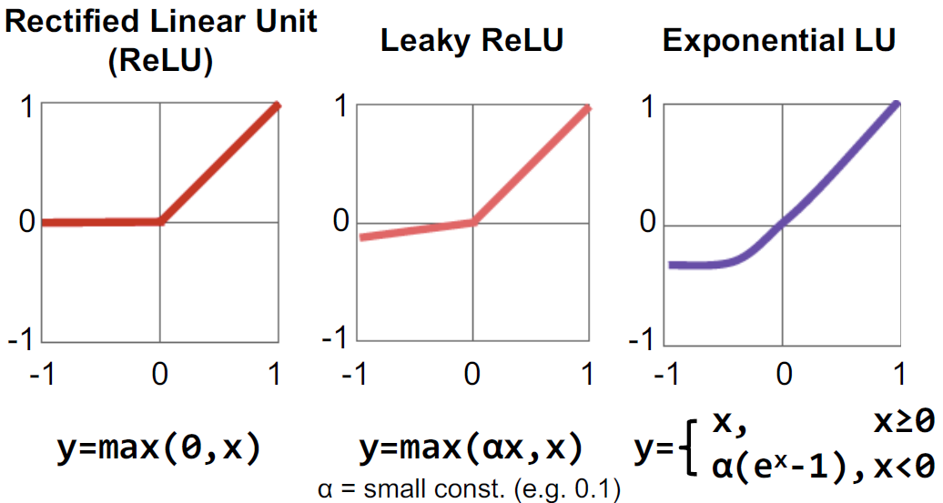
Several recent activation functions

Slide 15
Computation Model of a CNN Layer
Input fmap
C
weights
Output fmap
C
2
1
R
X
H
=
E
S
W
F
Number of MACs = R x S x (H – R + 1) x (W - S + 1) x C
E
F

Slide 16
Computation Model of a CNN Layer
Adding multiple (M) output Feature maps (fmap / output channels)
separate weights per output channel
Input fmap
weights
Output fmap
M
=
M
X
Number of MACs = R x S x (H – R + 1) x (W - S + 1) x C x M

Slide 17
Overview
RECAP: Constructing a DNN / CNN
Neuron & Single layer
Network: multiple layers
Energy
Loop transformations
data flow
reordering
restructuring: tiling
Buffer management
Store and Compute level

Slide 18
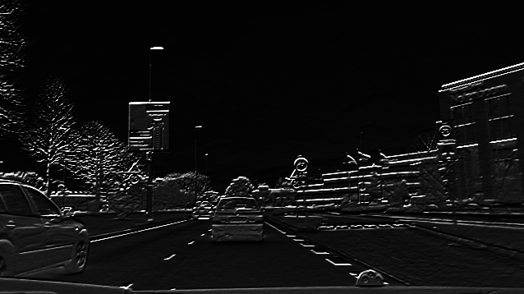
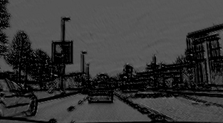
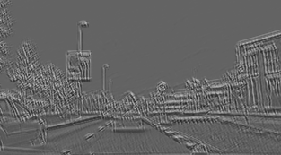
Sequence of feature maps forms the network

Slide 19
How does it suffer from the memory wall?
On Chip Memory
Data Path
MAC
MAC
MAC
MAC
CNN Accelerator

Slide 20
How does it suffer from the memory wall?
On Chip Memory
Data Path
MAC
MAC
MAC
MAC
CNN Accelerator

Slide 21
How does it suffer from the memory wall?
A lot of data!
Weights
Intermediate data
Input data
On Chip Memory
Data Path
MAC
MAC
MAC
MAC
CNN Accelerator

Slide 22
How does it suffer from the memory wall?
External memory needed to store all data
External
Memory
On Chip Memory
Data Path
MAC
MAC
MAC
MAC
CNN Accelerator

Slide 23
How does it suffer from the memory wall?
Huge amount of traffic between external memory and the processor!*
External
Memory
On Chip Memory
Data Path
MAC
MAC
MAC
MAC
CNN Accelerator
* Note: Off-chip requires about 200x more energy than on-chip memory - Jonathan Ragan-Kelley, Decoupling Algorithms from the Organization of Computation for High Performance Image Processing

Slide 24
Data Reuse – Ordering your computations
Data elements are used multiple times
Objective: Keep those uses close in time, and store data in on chip storage
All about ordering/scheduling
computations

Slide 25
Overview
RECAP: Constructing a DNN / CNN
Neuron & Single layer
Network: multiple layers
Energy
Loop transformations
data flow
reordering
restructuring: tiling
Buffer management
Store and Compute level

Slide 26
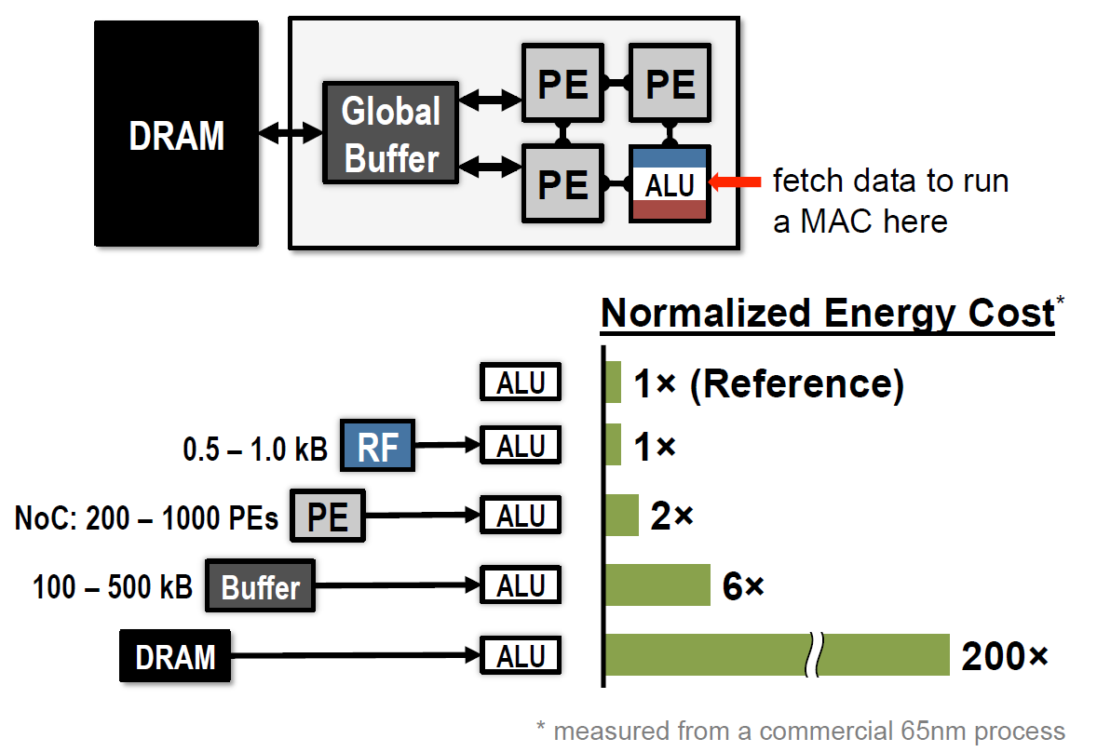
Where is the energy going

Slide 27
Deep Convolutional Neural Networks
Contributes more than 90% of
overall computation and memory access,
dominating runtime and energy consumption
Source: ICIP Tutorial, 2019

Slide 28
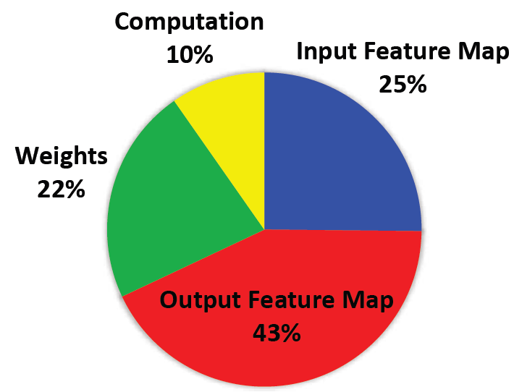
GoogLeNet: Energy
CNN layers: 21 depth, 57 in total
FC layer: 1
Weights: 7.0 M
MACs: 1.43 G per input
Yang.e.a CVPR'17

Slide 29
Recap: what did we treat so far?
Inference and Learning principles: Designing and Simulating a DNN
Improving Network Efficiency: Pruning, Quantization
Loop Optimizations - Software tricks to effectively use the Memory hierarchy
Quantization
fp32
S
E (8)
M (23)
fp16
S
E(5)
M(10)

Slide 30
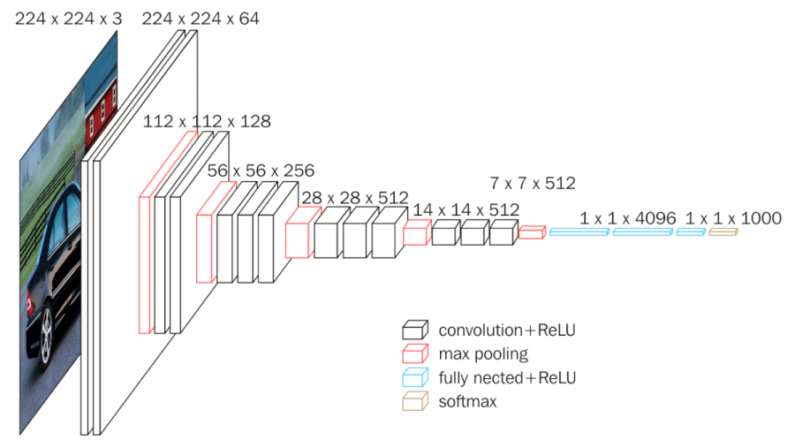
VGG16 example
Conv layers: 13
FC Layers: 3
Weights: 138 M
MACs: 15.5 G per input
Simonyan, ICLR 2015

Slide 31
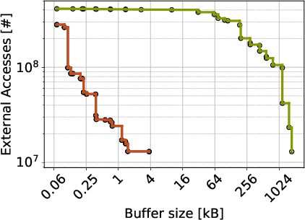
Reducing external memory accesses: VGG16
Original code
Rescheduled code
Conclusion: we need advanced loop transformation to exploit data locality (in local buffers),
reducing external accesses

Slide 32
Overview
RECAP: Constructing a DNN / CNN
Neuron & Single layer
Network: multiple layers
Energy
Loop transformations
data flow transformations
reordering
restructuring: tiling
Buffer management
Store and Compute level

Slide 33
Data-Flow-Based Transformations
Can be very useful in case of a:
Simple compiler
Simple architecture
No Hardware Multiplier
No Out-Of-Order Superscalar
No Speculative Branch Prediction
If you are in a hurry and missing a few percent
These are the easy tricks
To get ready for the more difficult ones ☺
* Examples are from: D.F. Bacon, S.L. Graham, and O.J. Sharp, Compiler transformations for high-performance computing. ACM Comput. Surv. 26, (1994)

Slide 34
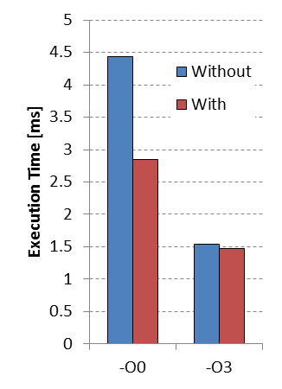
Loop-Based Strength Reduction
Replace an expensive operation
Can be multiplication, especially for embedded cores
No HW multiplier, e.g. MicroBlaze
An optimizing compiler can help
c=3;
for(i=0; i<N; i++){
a[i] = a[i] + i*c;
}
c=3;
T=0;
for(i=0; i<N; i++){
a[i] = a[i] + T;
T = T + c;
}

Slide 35
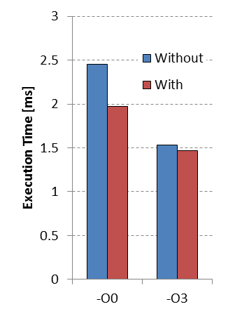
Induction Variable Elimination
Induction variable?
Compute loop exit conditions
Compute memory addresses
Given a known final value and relation to addresses
Possible to eliminate index calculations
Again an optimizing compiler can help
for(i=0; i<N; i++){
a[i] = a[i] + c;
}
A = &a[0];
T = &a[0] + N;
while(A<T){
*A = *A + c;
A++;
}
Notes:
Performing the control of a loop is basically overhead. I refer to the increment of i and the compare of i<N to check if the exit condition is not met.
With induction variable elimination we can reduce this overhead.

Slide 36
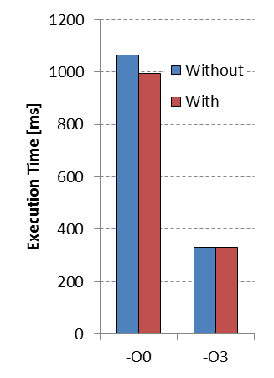
Loop-Invariant Code Motion
Index of c[] does not change
Move one loop up and store in register
Reuse it over iterations of inner loop
Most compilers can perform this
Example is similar to Scalar Replacement Transformation
for(i=0; i<N; i++){
for(j=0; j<N; j++){
a[i][j]=b[j][i]+c[i];
}
}
for(i=0; i<N; i++){
T=c[i];
for(j=0; j<N; j++){
a[i][j]=b[j][i]+T;
}
}

Slide 37
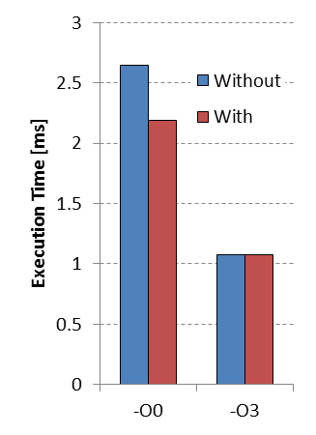
Loop Unswitching
Conditional execution inside a loop-body
Move it outside the loop
Each execution path independent loops
Increases code size
if(x<7){
for(i=0; i<N; i++){
a[i]=b[i];
a[i]+=5;
}
}
else{
for(i=0; i<N; i++){
a[i]=b[i];
}
}
for(i=0; i<N; i++){
a[i] = b[i];
if(x<7){a[i]+=5;}
}

Slide 38
Overview
RECAP: Constructing a DNN / CNN
Neuron & Single layer
Network: multiple layers
Energy
Loop transformations
data flow
reordering
restructuring: tiling
Buffer management
Store and Compute level

Slide 39
Iteration Reordering Transformations
Change the relative ordering
Expose parallelism by altering iteration dependencies
Improve locality by matching with a memory hierarchy
Normal compilers often don’t help you with this
Only state-of-the-art compilers can help
Often research compilers ;)
*Based on:
M. Wolf, M. Lam, A Data Locality Optimizing Algorithm. ACM SIGPLAN, PLDI (1991)

Slide 40
Loop representation as Iteration Space
for(i=0; i<N; i++){
for(j=0; j<N; j++){
A[i][j] = B[j+3][i+2];
Each position represents an iteration
At each position 1 or more array elements are accessed

Slide 41
Visitation order in Iteration Space
for(i=0; i<N; i++){
for(j=0; j<N; j++){
A[i][j] = B[j+3][i+2];
Iteration space is not data space

Slide 42
But we don’t have to be regular
A[j][j] = B[j+3][i+2];
But order can have huge impact on:
Memory Hierarchy
E.g. Reuse of data
Parallelism
Loop or control overhead

Slide 43
Can loop transformations reduce the memory wall?
Huge amount of traffic between external memory and the processor!*
External
Memory
On Chip Memory
Data Path
MAC
MAC
MAC
MAC
CNN Accelerator
* Note: Off-chip can require 200x more energy than on-chip memory

Slide 44
Data Reuse – Ordering your computations
Data elements are used multiple times
Objective: Keep those uses close in time, and store data in on chip storage
All about ordering/scheduling
computations

Slide 45
CNN: Just a Deep Loopnest
for l in layers:
for z in output_maps[l]:
for i in input_maps[l]:
for y in rows[l]:
for x in columns[l]:
for ky in kernel_height[l]:
for kx in kernel_widht[l]:
Y[l][z][x][y]+= X[l][i][x+kx][y+ky]* \
W[l][i][z][kx][ky]
Note: notation a little different; no Batch input, but Multiple layers in this code

Slide 46
Loop Interchange
for(j=0; j<N; j++)
for(i=0; i<M; i++) B[j][i]+=A[i];

Slide 47
Loop Interchange
N-1
for(j=0; j<N; j++)
for(i=0; i<M; i++) B[j][i]+=A[i];
j
0
0
i
M-1

Slide 48
Loop Interchange
N-1
for(j=0; j<N; j++)
for(i=0; i<M; i++) B[j][i]+=A[i];
j=0
i=0
j
0
0
i
M-1

Slide 49
Loop Interchange
N-1
for(j=0; j<N; j++)
for(i=0; i<M; i++) B[j][i]+=A[i];
j=0
i=1
j
0
0
i
M-1

Slide 50
Loop Interchange
N-1
for(j=0; j<N; j++)
for(i=0; i<M; i++) B[j][i]+=A[i];
j=0
i=2
j
0
0
i
M-1

Slide 51
Loop Interchange
N-1
for(j=0; j<N; j++)
for(i=0; i<M; i++) B[j][i]+=A[i];
j=0
i=M
j
0
0
i
M-1

Slide 52
Loop Interchange
N-1
for(j=0; j<N; j++)
for(i=0; i<M; i++) B[j][i]+=A[i];
j=1
i=0
j
0
0
i
M-1

Slide 53
Loop Interchange
N-1
for(j=0; j<N; j++)
for(i=0; i<M; i++) B[j][i]+=A[i];
j=2
i=0
j
0
0
i
M-1

Slide 54
Loop Interchange
N-1
for(j=0; j<N; j++)
for(i=0; i<M; i++) B[j][i]+=A[i];
j
Let’s have a look at the uses of
A[0]
0
0
i
M-1

Slide 55
Loop Interchange
N-1
for(j=0; j<N; j++)
for(i=0; i<M; i++) B[j][i]+=A[i];
j
Let’s have a look at the uses of
A[0]
0
0
i
M-1
Reuse distance of (M-1)

Slide 56
Loop Interchange
N-1
for(j=0; j<N; j++)
for(i=0; i<M; i++) B[j][i]+=A[i];
j
Let’s have a look at the uses of
A[0]
0
0
i
M-1

Slide 57
Loop Interchange
N-1
for(i=0; i<M; i++)
for(j=0; j<N; j++) B[j][i]+=A[i];
j=0
i=0
j
Let’s have a look at the uses of
A[0]
0
0
i
M-1

Slide 58
Loop Interchange
N-1
for(i=0; i<M; i++)
for(j=0; j<N; j++) B[j][i]+=A[i];
j=1
i=0
j
Let’s have a look at the uses of
A[0]
0
0
i
M-1

Slide 59
Loop Interchange
N-1
for(i=0; i<M; i++)
for(j=0; j<N; j++) B[j][i]+=A[i];
j=2
i=0
j
Let’s have a look at the uses of
A[0]
0
0
i
M-1

Slide 60
Loop Interchange
N-1
for(i=0; i<M; i++)
for(j=0; j<N; j++) B[j][i]+=A[i];
j=0
i=1
j
Let’s have a look at the uses of
A[0]
0
0
i
M-1
Reuse distance of 0

Slide 61
How can loop interchange help CNNs ?
keep weights, input or outputs stationary
for l in layers:
for z in output_maps[l]:
for i in input_maps[l]:
for x in columns[l]:
for y in rows[l]:
for ky in kernel_height[l]:
for kx in kernel_widht[l]:
Y[l][z][x][y]+= X[l][i][x+kx][y+ky]* \
W[l][i][z][kx][ky]

Slide 62
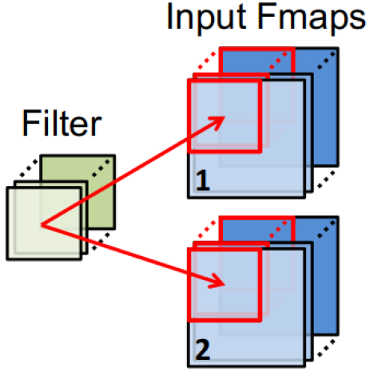
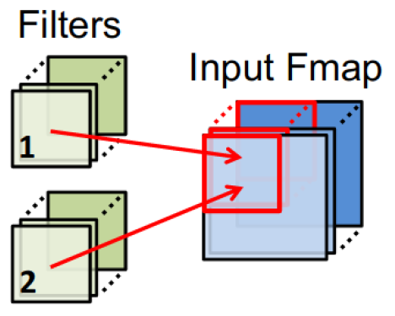
Types of reuse in CNNs
Convolutional reuse
(sliding window)
Input map reuse
Filter reuse for larger batch size
Reuse
activations
weights
Reuse
activations
Reuse
weights

Slide 63
Overview
RECAP: Constructing a DNN / CNN
Neuron & Single layer
Network: multiple layers
Energy
Loop transformations
data flow
reordering
restructuring: tiling
Buffer management
Store and Compute level

Slide 64
Loop Tiling
for(j=0; j<N; j++)
for(i=0; i<M; i++)
B[j][i]+=A[i]+C[j];

Slide 65
Loop Tiling
N-1
for(j=0; j<M; j++)
for(i=0; i<N; i++)
B[j][i]+=A[i]+C[j];
j
0
0
i
M-1

Slide 66
Loop Tiling
N-1
for(j=0; j<M; j++)
for(i=0; i<N; i++)
B[j][i]+=A[i]+C[j];
j
0
0
i
M-1

Slide 67
Loop Tiling
N-1
for(j=0; j<M; j++)
for(i=0; i<N; i++)
B[j][i]+=A[i]+C[j];
j
Reuse distances of:
A[0] = M-1
C[0] = 0
0
0
i
M-1

Slide 68
Loop Tiling
N-1
for(j=0; j<M; j++)
for(i=0; i<N; i++)
B[j][i]+=A[i]+C[j];
For M=8 a memory of size 5 with LRU policy would miss A[0]
j
Reuse distances of:
A[0] = M-1
C[0] = 0
0
0
i
M-1

Slide 69
Loop Tiling
N-1
for(i=0; i<M; i++)
for(j=0; j<N; j++)
B[j][i]+=A[i]+C[j];
j
Reuse distances of:
A[0] = M-1
C[0] = 0
0
0
i
M-1

Slide 70
Loop Tiling
N-1
for(i=0; i<M; i+=Ti)
for(j=0; j<N; j++)
for(ii=0; ii<i+Ti;ii++)
B[j][ii]+=A[ii]+C[j];
j
Reuse distances of:
A[0] = M-1
C[0] = 0
0
0
0
i
M-1

Slide 71
Loop Tiling
N-1
for(i=0; i<M; i+=Ti)
for(j=0; j<N; j++)
for(ii=0; ii<i+Ti;ii++)
B[j][ii]+=A[ii]+C[j];
j
Reuse distances of:
A[0] = M-1 → Ti-1
C[0] = 0 → 0 / N-1
0
0
i
M-1

Slide 72
Loop Tiling
N-1
for(i=0; i<M; i+=Ti)
for(j=0; j<N; j++)
for(ii=0; ii<i+Ti;ii++)
B[j][ii]+=A[ii]+C[j];
For M=8 a memory of size 5 with LRU policy would hit A and C*
j
Reuse distances of:
A[0] = M-1 → Ti-1
C[0] = 0 → 0 / j*Ti-1
0
0
i
M-1
* Except when: (i mod Ti) = 0 and j=0

Slide 73
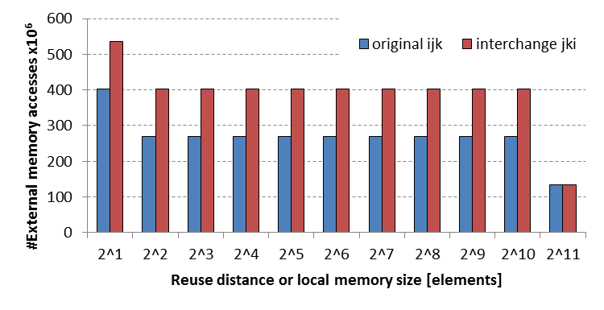
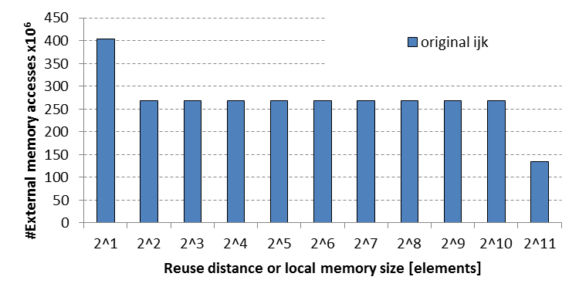
Study a matrix multiplication : Loop interchange
for(i=0; i<Bi; i++){
for(j=0; j<Bj; j++){
for(k=0; k<Bk; k++){
C[i][j] += A[i][k] * B[k][j];
for(j=0; j<Bj; j++){
for(k=0; k<Bk; k++){
for(i=0; i<Bi; i++){
C[i][j] += A[i][k] * B[k][j];

Slide 74
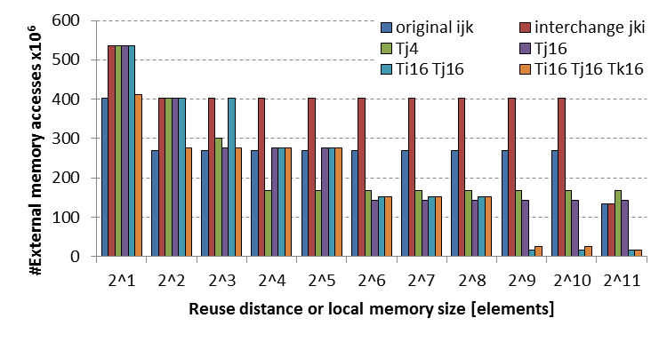
Adding Loop tiling
for(i=0; i<Bi; i++){
for(jj=0; jj<Bj; jj+=Tj){
for(k=0; k<Bk; k++){
for(j=jj; j<jj+Tj; j++)
C[i][j] += A[i][k] * B[k][j];
Can be done in multiple dimensions
Manual exploration is intractable
for(i=0; i<Bi; i++){
for(j=0; j<Bj; j++){
for(k=0; k<Bk; k++){
C[i][j] += A[i][k] * B[k][j];

Slide 75
Overview
RECAP: Constructing a DNN / CNN
Neuron & Single layer
Network: multiple layers
Energy
Loop transformations
data flow
reordering
restructuring: tiling
Buffer management
Store and Compute level

Slide 76
Scratchpads: explicit scheduling of memory transfers
On Chip Scratchpad Memory
Data Path
MAC
MAC
MAC
MAC
CNN Accelerator

Slide 77
Introducing: Store level
for y from 0->Dy:
for x from 0->Dx:
for l from 0->Ky:
for k from 0->Kx:
out[x][y]+=in[x+kx][y+ky]
Filter kernel
Implementation for 1 (input and output) Feature map*
*Weights omitted

Slide 78
Introducing: Store level
for y from 0->Dy:
for x from 0->Dx:
for l from 0->Ky:
for k from 0->Kx:
out[x][y]+=in[x+kx][y+ky]
Ky
Kx
y
x

Slide 79
Introducing: Store level
for y from 0->Dy:
for x from 0->Dx:
for l from 0->Ky:
for k from 0->Kx:
out[x][y]+=in[x+kx][y+ky]
Ky
Kx
y
x

Slide 80
Introducing: Store level
for y from 0->Dy:
for x from 0->Dx:
for l from 0->Ky:
for k from 0->Kx:
out[x][y]+=in[x+kx][y+ky]
Ky
Kx
y
x

Slide 81
Introducing: Store level
for y from 0->Dy:
for x from 0->Dx:
for l from 0->Ky:
for k from 0->Kx:
out[x][y]+=in[x+kx][y+ky]
Ky
Kx
y
x

Slide 82
Introducing: Store level
Store Level
for y from 0->Dy:
for x from 0->Dx:
for l from 0->Ky:
for k from 0->Kx:
out[x][y]+=in[x+kx][y+ky]
Ky
Kx
y
x

Slide 83
Introducing: Store level
Store Level
for y from 0->Dy:
for x from 0->Dx:
for l from 0->Ky:
for k from 0->Kx:
out[x][y]+=in[x+kx][y+ky]
Ky
Kx
y
Store level says what to store in local buffer (volume for 1 iteration)
For every iteration of y, we load
all required data once
x

Slide 84
Introducing: Store level
Store Level
for y from 0->Dy:
for x from 0->Dx:
for l from 0->Ky:
for k from 0->Kx:
out[x][y]+=in[x+kx][y+ky]
Ky
Kx
y
Store level says what to store in local buffer (volume for 1 iteration)
For every iteration of y, we load
all required data once
x

Slide 85
Introducing: Store level
for y from 0->Dy:
for x from 0->Dx:
for l from 0->Ky:
for k from 0->Kx:
out[x][y]+=in[x+kx][y+ky]
Ky
Store Level
Kx
y
Store level says what to store in local buffer (volume for 1 iteration)
For every iteration of x, we load
all required input data once
x

Slide 86
Introducing: Store level
for y from 0->Dy:
for x from 0->Dx:
for l from 0->Ky:
for k from 0->Kx:
out[x][y]+=in[x+kx][y+ky]
Store Level
y
Missed overlap!
But less buffer space required than higher store level.
Store level says what to store in local buffer (volume for 1 iteration)
For every iteration of x, we load
all required input data once
x

Slide 87
Transfer volume != Buffer size
Store Level
for y from 0->Dy:
for x from 0->Dx:
for l from 0->Ky:
for k from 0->Kx:
out[x][y]+=in[x+kx][y+ky]
Ky
Kx
y
x

Slide 88
Transfer volume != Buffer size
Store Level
for y from 0->Dy:
for x from 0->Dx:
for l from 0->Ky:
for k from 0->Kx:
out[x][y]+=in[x+kx][y+ky]
Ky
Kx
y
Live volume at any time is only KxKy
x

Slide 89
Transfer volume != Buffer size
Store Level
for y from 0->Dy:
for x from 0->Dx:
for l from 0->Ky:
for k from 0->Kx:
out[x][y]+=in[x+kx][y+ky]
Ky
Kx
y
Live volume at any time is only KxKy
x

Slide 90
Transfer volume != Buffer size
Store Level
for y from 0->Dy:
for x from 0->Dx:
for l from 0->Ky:
for k from 0->Kx:
out[x][y]+=in[x+kx][y+ky]
Ky
Kx
y
Live volume at any time is only KxKy
x

Slide 91
Introducing: Compute Level
Store Level
for y from 0->Dy:
for x from 0->Dx:
for l from 0->Ky:
for k from 0->Kx:
out[x][y]+=in[x+kx][y+ky]
Ky
Kx
y
Live volume at any time is only KxKy
By not transferring data at the start of y, but later a smaller buffer is required.
x

Slide 92
Introducing: Compute Level
Store Level
for y from 0->Dy:
for x from 0->Dx:
for l from 0->Ky:
for k from 0->Kx:
out[x][y]+=in[x+kx][y+ky]
Ky
Compute lvl
Kx
y
Live volume at any time is only KxKy
Compute level determines when data is transferred
x

Slide 93
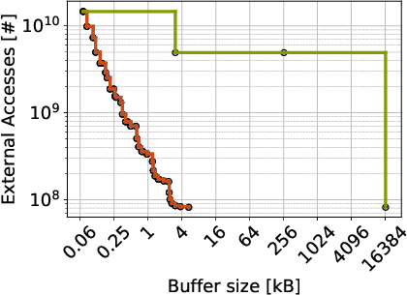
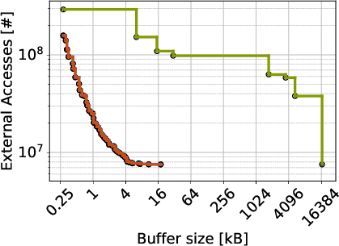
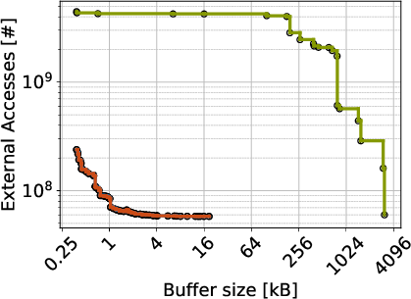
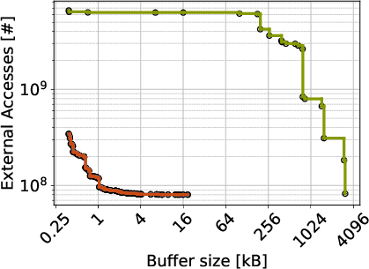
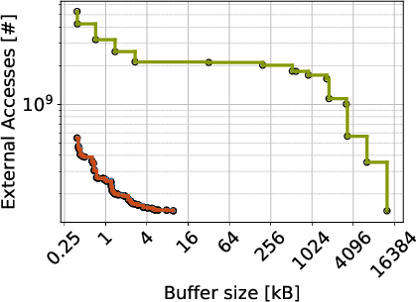
Pareto front of 6 CNNs
VDSR
Traffic Sign Detect
VGG16
Resnet 101
Resnet 152
MobileNet V2
Orders of Magnitude better than baseline!

Slide 94
#pragma omp parallel for
for (int yTile = 0; yTile < out.height(); yTile += 32) {
__m128i a, b, c, sum, avg;
__m128i tmp[(128/8) * (32 + 2)];
for (int xTile = 0; xTile < out.width(); xTile += 128) {
__m128i *tmpPtr = tmp;
for (int y = 0; y < 32+2; y++) {
const uint16_t *inPtr = &(in(xTile, yTile+y));
for (int x = 0; x < 128; x += 8) {
a = _mm_load_si128((const __m128i*)(inPtr));
b = _mm_loadu_si128((const __m128i*)(inPtr+1));
c = _mm_loadu_si128((const __m128i*)(inPtr+2));
sum = _mm_add_epi16(_mm_add_epi16(a, b), c);
avg = _mm_mulhi_epi16(sum,one_third);
_mm_store_si128(tmpPtr++, avg);
inPtr+=8;
}
}
tmpPtr = tmp;
for (int y = 0; y < 32; y++) {
__m128i *outPtr = (__m128i *)(&(out(xTile, yTile+y)));
for (int x = 0; x < 128; x += 8) {
a = _mm_load_si128(tmpPtr+(2*128)/8);
b = _mm_load_si128(tmpPtr+128/8);
c = _mm_load_si128(tmpPtr++);
sum = _mm_add_epi16(_mm_add_epi16(a, b), c);
avg = _mm_mulhi_epi16(sum, one_third);
_mm_store_si128(outPtr++, avg);
}
}
}
}
Code can become extremely complex after some transformations !!

Slide 95
#pragma omp parallel for
for (int yTile = 0; yTile < out.height(); yTile += 32) {
__m128i a, b, c, sum, avg;
__m128i tmp[(128/8) * (32 + 2)];
for (int xTile = 0; xTile < out.width(); xTile += 128) {
__m128i *tmpPtr = tmp;
for (int y = 0; y < 32+2; y++) {
const uint16_t *inPtr = &(in(xTile, yTile+y));
for (int x = 0; x < 128; x += 8) {
a = _mm_load_si128((const __m128i*)(inPtr));
b = _mm_loadu_si128((const __m128i*)(inPtr+1));
c = _mm_loadu_si128((const __m128i*)(inPtr+2));
sum = _mm_add_epi16(_mm_add_epi16(a, b), c);
avg = _mm_mulhi_epi16(sum,one_third);
_mm_store_si128(tmpPtr++, avg);
inPtr+=8;
}
}
tmpPtr = tmp;
for (int y = 0; y < 32; y++) {
__m128i *outPtr = (__m128i *)(&(out(xTile, yTile+y)));
for (int x = 0; x < 128; x += 8) {
a = _mm_load_si128(tmpPtr+(2*128)/8);
b = _mm_load_si128(tmpPtr+128/8);
c = _mm_load_si128(tmpPtr++);
sum = _mm_add_epi16(_mm_add_epi16(a, b), c);
avg = _mm_mulhi_epi16(sum, one_third);
_mm_store_si128(outPtr++, avg);
}
}
}
}
Func blur_3x3(Func in) {
Func bx, by;
Var x, y, xi, yi;
// The algorithm - no storage or order
bx(x, y) = (in(x-1, y) + in(x, y) + in(x+1, y));
by(x, y) = (bx(x, y-1) + bx(x, y) + bx(x, y+1));
// The schedule - defines order, locality; implies storage
by.tile(x, y, xi, yi, 128, 32)
.vectorize(xi, 8).parallel(y);
bx.compute_at(by, x).vectorize(x, 8);
return by;
}
Halide alternative

Slide 96
Main Take-Aways
Data-Flow-Based Transformations
Good compilers can help
Iteration Reordering Transformations
High-level transformations
Compilers are often not enough
Huge gains for parallelims and locality/data reuse
Be carefull with dependencies
Loop Restructuring Transformations
Similar to reordering
Halide can help you

