Slide 1
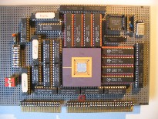
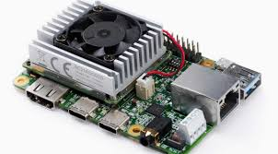
Intelligent Architectures 5LIL0 Introduction to Halide
Henk Corporaal
www.ics.ele.tue.nl/~heco/courses/IA
h.corporaal@tue.nl
TUEindhoven
2021

Slide 2
From the previous lecture
Data-Flow-Based Transformations
Good compilers can help
Iteration Reordering Transformations
High-level transformations
Compilers are often not enough
Huge gains for parallelims and locality/data reuse
Be carefull with dependencies
Loop Restructuring Transformations
Similar to reordering
Halide can help you !!!

Slide 3
Overview
Motivating example (2 blur filters cascaded)
Halide general scheduling and storage directives
GPU intermezzo
Halide GPU specific directives
Debugging

Slide 4
Example 3x3 box filter
Horizontal
blur
Vertical
blur
A simple, two-stage imaging pipeline: 3x3 blur.
Basic function: a summation over a 3x3 area:
$$bx\left(x,y\right)=in\left(x−1, y\right)+in\left(x,y\right)+in(x+1,y)$$
$$by\left(x,y\right)=bx\left(x, y−1\right)+bx\left(x, y\right)+bx\left(x, y+1\right)$$
We leave out the averaging step (i.e. dividing by 3).
Notes:
Its current front end is embedded in C++.
Should have divided by 3 but removed for simplicity (not important)

Slide 5
Blur Inline
Linearized the 2-d index into a 1-d index
C code
int in[W*H];
int by[W*H];
for(int y=1; y<(H-1); y++){
for(int x=1; x<(W-1); x++{
by[x + y*W] = in[(x-1) + (y-1)*W] + in[(x-1) + y*W] + in[(x-1) + (y+1)*W] +
in[x + (y-1)*W] + in[x + y*W] + in[x + (y+1)*W] +
in[(x+1) + (y-1)*W] + in[(x+1) + y*W] + in[(x+1) + (y+1)*W];
}
}
9 loads per output pixel
8 additions per output pixel
Completely parallelizable (independent pixels)
Unnecessary recomputation

Slide 6
Blur Inline
C code
int in[W*H];
int by[W*H];
for(int y=1; y<(H-1); y++){
for(int x=1; x<(W-1); x++{
by[x + y*W] = in[(x-1) + (y-1)*W] + in[(x-1) + y*W] + in[(x-1) + (y+1)*W] +
in[x + (y-1)*W] + in[x + y*W] + in[x + (y+1)*W] +
in[(x+1) + (y-1)*W] + in[(x+1) + y*W] + in[(x+1) + (y+1)*W];
}
}
9 loads per output pixel
8 additions per output pixel
Completely parallelizable (independent pixels)
Unnecessary recomputation

Slide 7
Blur Stored Implementation
C code
int in[W*H];
int bx[W*H];
int by[W*H];
for(int y=0; y<H; y++){
for(int x=1; x<(W-1); x++{
bx[x + y*W] = in[x-1 + y*W] + in[x + y*W] + in[x+1 +y*W];
}
}
for(int y=1; y<(H-1); y++){
for(int x=1; x<(W-1); x++{
by[x + y*W] = bx[x + (y-1)*W] + bx[x + y*W] + bx[x+ (y+1)*W];
}
}
6 loads, 1 store per output pixel
4 additions per output pixel
Very low locality (big buffer)
No recomputation
Still parallelizable

Slide 8
Blur Stored Implementation
C code
int in[W*H];
int bx[W*H];
int by[W*H];
for(int y=0; y<H; y++){
for(int x=1; x<(W-1); x++{
bx[x + y*W] = in[x-1 + y*W] + in[x + y*W] + in[x+1 +y*W];
}
}
for(int y=1; y<(H-1); y++){
for(int x=1; x<(W-1); x++{
by[x + y*W] = bx[x + (y-1)*W] + bx[x + y*W] + bx[x+ (y+1)*W];
}
}
6 loads, 1 store per output pixel
4 additions per output pixel
Very low locality (big buffer)
No recomputation
Still parallelizable

Slide 9
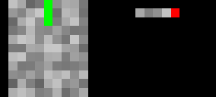
Blur Stored Implementation
C code
int in[W*H];
int bx[W*H];
int by[W*H];
for(int y=0; y<H; y++){
for(int x=1; x<(W-1); x++{
bx[x + y*W] = in[x-1 + y*W] + in[x + y*W] + in[x+1 +y*W];
}
}
for(int y=1; y<(H-1); y++){
for(int x=1; x<(W-1); x++{
by[x + y*W] = bx[x + (y-1)*W] + bx[x + y*W] + bx[x+ (y+1)*W];
}
}
6 loads, 1 store per output pixel
4 additions per output pixel
Very low locality (big buffer)
No recomputation
Still parallelizable

Slide 10
Blur Fusion
C code
int in[W*H];
int bx[W*H];
int by[W*H];
for(int y=0; y<2; y++){
for(int x=1; x<(W-1); x++{
bx[x + y*W] = in[x-1 + y*W] + in[x + y*W] + in[x+1 + y*W];
}
}
for(int y=1; y<(H-1); y++){
for(int x=1; x<(W-1); x++{
bx[x + (y+1)*W] = in[x-1 + (y+1)*W] + in[x + (y+1)*W] + in[x+1 + (y+1)*W];
}
for(int x=1; x<(W-1); x++{
by[x + y*W] = bx[x + (y-1)*W] + bx[x + y*W] + bx[x + (y+1)*W];
}
}
Not as easily parallelizable
High locality
producer bx & consumer by moved close together
No recomputation

Slide 11
Blur Fusion
C code
int in[W*H];
int bx[W*H];
int by[W*H];
for(int y=0; y<2; y++){ // calculate 2 lines of bx
for(int x=1; x<(W-1); x++{
bx[x + y*W] = in[x-1 + y*W] + in[x + y*W] + in[x+1 + y*W];
}
}
for(int y=1; y<(H-1); y++){ // repeat calculating, line by line
for(int x=1; x<(W-1); x++{ // 1 line of bx and 1 line of by
bx[x + (y+1)*W] = in[x-1 + (y+1)*W] + in[x + (y+1)*W] + in[x+1 + (y+1)*W];
}
for(int x=1; x<(W-1); x++{
by[x + y*W] = bx[x + (y-1)*W] + bx[x + y*W] + bx[x + (y+1)*W];
}
}
Not as easily parallelizable
High locality
producer bx & consumer by moved close together
No recomputation

Slide 12
Blur Fusion
C code
int in[W*H];
int bx[W*H];
int by[W*H];
for(int y=0; y<2; y++){
for(int x=1; x<(W-1); x++{
bx[x + y*W] = in[x-1 + y*W] + in[x + y*W] + in[x+1 + y*W];
}
}
for(int y=1; y<(H-1); y++){
for(int x=1; x<(W-1); x++{
bx[x + (y+1)*W] = in[x-1 + (y+1)*W] + in[x + (y+1)*W] + in[x+1 + (y+1)*W];
}
for(int x=1; x<(W-1); x++{
by[x + y*W] = bx[x + (y-1)*W] + bx[x + y*W] + bx[x + (y+1)*W];
}
}
Not as easily parallelizable
High locality
producer bx & consumer by moved close together
No recomputation

Slide 13
Blur Fusion – Folded storage
C code
int in[W*H];
int bx[W*3];
int by[W*H];
for(int y=0; y<2; y++){
for(int x=1; x<(W-1); x++{
bx[x + y*W] = in[x-1 + y*W] + in[x + y*W] + in[x+1 + y*W];
}
}
for(int y=1; y<(H-1); y++){
for(int x=1; x<(W-1); x++{
bx[(x + (y+1)*W)%3] = in[x-1 + (y+1)*W] + in[x + (y+1)*W] + in[x+1 + (y+1)*W];
}
for(int x=1; x<(W-1); x++{
by[x + y*W] = bx[(x + (y-1)*W)%3] + bx[(x + y*W)%3] + bx[(x + (y+1)*W)%3];
}
}
Same results as last slide, but:
With a smaller intermediate buffer (W*3 instead of W*H)

Slide 14
Some Remarks
C allows us to very specifically program the execution order (= ''the schedule'').

Slide 15
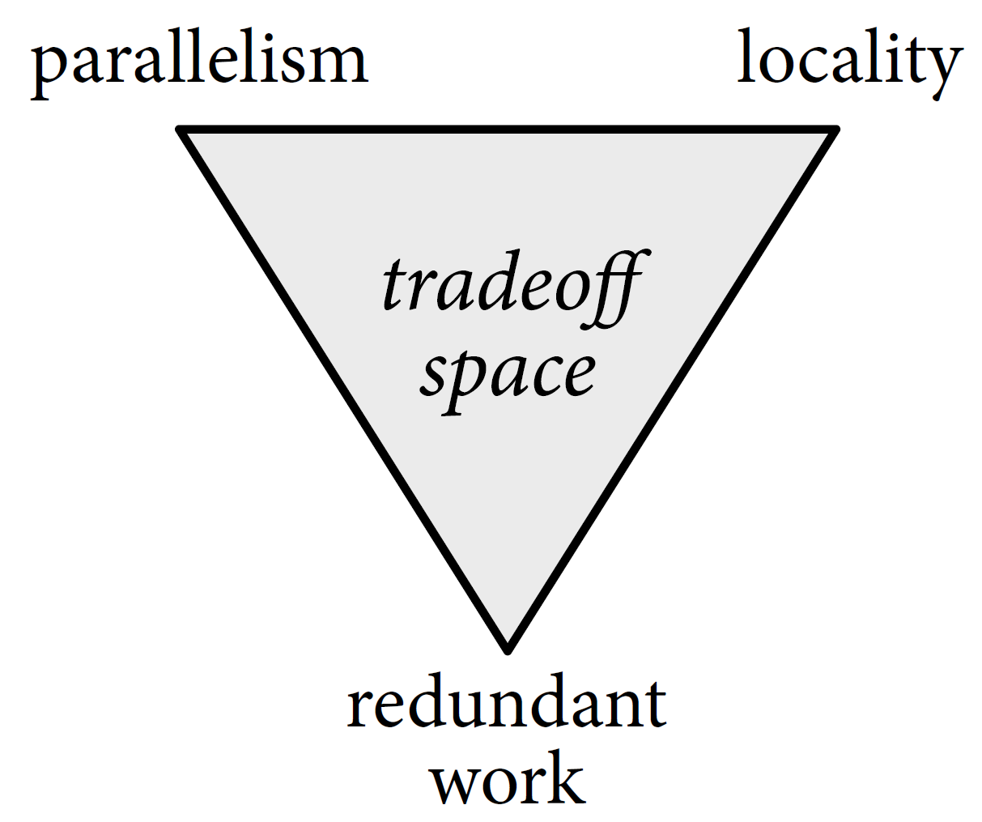
Some Remarks
C allows us to very specifically program the execution order.
Basically trade-off space :

Slide 16
Some Remarks
C allows us to very specifically program the execution order.
Basically trade-off space :
Loop fusion, storage folding can give us performance and storage size advantages.
(Many more possibilities: re-ordering, tiling, multithreading, vectorizing…)

Slide 17
Some Remarks
C allows us to very specifically program the execution order.
Basically trade-off space :
Loop fusion, storage folding can give us performance and storage size advantages.
(Many more possibilities: re-ordering, tiling, multithreading, vectorizing…)
Most of them obscure the functionality.
Most of them are architecture specific
Rewriting and debugging to efficiently optimize
High-level design-space exploration is discouraged by increasingly complex code.

Slide 18
Some Remarks
C allows us to very specifically program the execution order.
Basically trade-off space :
Loop fusion, storage folding can give us performance and storage size advantages.
(Many more possibilities: re-ordering, tiling, multithreading, vectorizing…)
Most of them obscure the functionality
Most of them are architecture specific
Rewriting and debugging to efficiently optimize
High-level design-space exploration is discouraged by increasingly complex code.
More stages even more complex, unreadable code

Slide 19
#pragma omp parallel for
for (int yTile = 0; yTile < out.height(); yTile += 32) {
__m128i a, b, c, sum, avg;
__m128i tmp[(128/8) * (32 + 2)];
for (int xTile = 0; xTile < out.width(); xTile += 128) {
__m128i *tmpPtr = tmp;
for (int y = 0; y < 32+2; y++) {
const uint16_t *inPtr = &(in(xTile, yTile+y));
for (int x = 0; x < 128; x += 8) {
a = _mm_load_si128((const __m128i*)(inPtr));
b = _mm_loadu_si128((const __m128i*)(inPtr+1));
c = _mm_loadu_si128((const __m128i*)(inPtr+2));
sum = _mm_add_epi16(_mm_add_epi16(a, b), c);
avg = _mm_mulhi_epi16(sum,one_third);
_mm_store_si128(tmpPtr++, avg);
inPtr+=8;
}
}
tmpPtr = tmp;
for (int y = 0; y < 32; y++) {
__m128i *outPtr = (__m128i *)(&(out(xTile, yTile+y)));
for (int x = 0; x < 128; x += 8) {
a = _mm_load_si128(tmpPtr+(2*128)/8);
b = _mm_load_si128(tmpPtr+128/8);
c = _mm_load_si128(tmpPtr++);
sum = _mm_add_epi16(_mm_add_epi16(a, b), c);
avg = _mm_mulhi_epi16(sum, one_third);
_mm_store_si128(outPtr++, avg);
}
}
}
}
Code can become complex after some transformations

Slide 20
#pragma omp parallel for
for (int yTile = 0; yTile < out.height(); yTile += 32) {
__m128i a, b, c, sum, avg;
__m128i tmp[(128/8) * (32 + 2)];
for (int xTile = 0; xTile < out.width(); xTile += 128) {
__m128i *tmpPtr = tmp;
for (int y = 0; y < 32+2; y++) {
const uint16_t *inPtr = &(in(xTile, yTile+y));
for (int x = 0; x < 128; x += 8) {
a = _mm_load_si128((const __m128i*)(inPtr));
b = _mm_loadu_si128((const __m128i*)(inPtr+1));
c = _mm_loadu_si128((const __m128i*)(inPtr+2));
sum = _mm_add_epi16(_mm_add_epi16(a, b), c);
avg = _mm_mulhi_epi16(sum,one_third);
_mm_store_si128(tmpPtr++, avg);
inPtr+=8;
}
}
tmpPtr = tmp;
for (int y = 0; y < 32; y++) {
__m128i *outPtr = (__m128i *)(&(out(xTile, yTile+y)));
for (int x = 0; x < 128; x += 8) {
a = _mm_load_si128(tmpPtr+(2*128)/8);
b = _mm_load_si128(tmpPtr+128/8);
c = _mm_load_si128(tmpPtr++);
sum = _mm_add_epi16(_mm_add_epi16(a, b), c);
avg = _mm_mulhi_epi16(sum, one_third);
_mm_store_si128(outPtr++, avg);
}
}
}
}
Func blur_3x3(Func in) {
Func bx, by;
Var x, y, xi, yi;
// The algorithm - no storage or order
bx(x, y) = (in(x-1, y) + in(x, y) + in(x+1, y));
by(x, y) = (bx(x, y-1) + bx(x, y) + bx(x, y+1));
// The schedule - defines order, locality; implies storage
by.tile(x, y, xi, yi, 128, 32)
.vectorize(xi, 8).parallel(y);
bx.compute_at(by, x).vectorize(x, 8);
return by;
}
Halide alternative

Slide 21
Halide
Halide DSL and compiler for image processing pipelines:
Front-end embedded in C++
Compiler can target many back-ends
Including x86/SSE, ARM v7/NEON, CUDA, Native Client, and OpenCL, WASM, Hexagon DSP
Support from industry (Google, Adobe)
Google Pixel camera / Pixel Core
Notes:
Halide is a new programming language designed to make it easier to write high-performance image processing code on modern machines.

Slide 22
Halide
Halide DSL and compiler for image processing pipelines:
Front-end embedded in C++
Compiler can target many back-ends
Including x86/SSE, ARM v7/NEON, CUDA, Native Client, and OpenCL, WASM, Hexagon DSP
Support from industry (Google, Adobe)
Google Pixel camera / Pixel Core
Main idea:
Decouples algorithm definition from optimization schedule
Apply optimizations without complicating the code
Notes:
Halide is a new programming language designed to make it easier to write high-performance image processing code on modern machines.

Slide 23
Halide
Halide DSL and compiler for image processing pipelines:
Front-end embedded in C++
Compiler can target many back-ends
Including x86/SSE, ARM v7/NEON, CUDA, Native Client, and OpenCL, WASM, The Qaulcomm Hexagon DSP
Support from industry (Google, Adobe)
Google Pixel camera / Pixel Core
Main idea:
Decouples algorithm definition from optimization schedule
Apply optimizations without complicating the code
Result:
Easier and faster design space exploration
Improved code readability and portability
For a new architecture we should only change/rewrite the schedule
Notes:
Halide is a new programming language designed to make it easier to write high-performance image processing code on modern machines.

Slide 24
Blur Example Halide
Horizontal
blur
Vertical
blur
$$bx\left(x,y\right)=in\left(x−1, y\right)+in\left(x,y\right)+in(x+1,y)$$
$$by\left(x,y\right)=bx\left(x, y−1\right)+bx\left(x, y\right)+bx\left(x, y+1\right)$$
Notes:
// A 'Func' object represents a pipeline stage. It's a pure // function that defines what value each pixel should have.
You // can think of it as a computed image.
Halide::Func gradient; // Var objects are names to use as variables in the definition of // a Func. They have no meaning by themselves. Halide::Var x, y; // We typically use Vars named 'x' and 'y' to correspond to the x // and y axes of an image, and we write them in that order. If // you're used to thinking of images as having rows and columns, // then x is the column index, and y is the row index. // Funcs are defined at any integer coordinate of its variables as // an Expr in terms of those variables and other functions. // Here, we'll define an Expr which has the value x + y. Vars have // appropriate operator overloading so that expressions like // 'x + y' become 'Expr' objects.

Slide 25
Blur Example Halide
Horizontal
blur
Vertical
blur
$$bx\left(x,y\right)=in\left(x−1, y\right)+in\left(x,y\right)+in(x+1,y)$$
$$by\left(x,y\right)=bx\left(x, y−1\right)+bx\left(x, y\right)+bx\left(x, y+1\right)$$
Func in, bx, by;
Var x, y;
bx(x,y) = in(x-1,y) + in(x,y), + in(x+1,y);
by(x,y) = bx(x,y-1) + bx(x,y) + bx(x,y+1);
by.realize(10,10); // build and execute the loop nest
over a 10x10 area
Notes:
// A 'Func' object represents a pipeline stage. It's a pure // function that defines what value each pixel should have.
You // can think of it as a computed image.
Halide::Func gradient; // Var objects are names to use as variables in the definition of // a Func. They have no meaning by themselves. Halide::Var x, y; // We typically use Vars named 'x' and 'y' to correspond to the x // and y axes of an image, and we write them in that order. If // you're used to thinking of images as having rows and columns, // then x is the column index, and y is the row index. // Funcs are defined at any integer coordinate of its variables as // an Expr in terms of those variables and other functions. // Here, we'll define an Expr which has the value x + y. Vars have // appropriate operator overloading so that expressions like // 'x + y' become 'Expr' objects.

Slide 26
Blur Example Halide
Func bx, by, in;
Var x, y;
bx(x, y) = in(x-1, y) + in(x, y) + in(x+1, y);
by(x, y) = bx(x, y-1) + bx(x, y) + bx(x, y+1);

Slide 27
Blur Example Halide
Func bx, by, in;
Var x, y;
bx(x, y) = in(x-1, y) + in(x, y) + in(x+1, y);
by(x, y) = bx(x, y-1) + bx(x, y) + bx(x, y+1);
Note that in the body, there is no notion of:
time (execution order).
space (buffer assignment, image size, memory allocation)
hardware (because no time and space)

Slide 28
Blur Example Halide
Func bx, by, in;
Var x, y;
bx(x, y) = in(x-1, y) + in(x, y) + in(x+1, y);
by(x, y) = bx(x, y-1) + bx(x, y) + bx(x, y+1);
Note that in the body, there is no notion of:
time (execution order).
space (buffer assignment, image size, memory allocation)
hardware (because no time and space)
a very clear, concise and readable algorithm.
we have not chosen any optimization strategy yet.
eg. we can use this same starting point on any target architecture.
(in C, a naïve implementation would already require scheduling decisions)

Slide 29
Scheduling Inter-stage scheduling - inline
x dimension
Halide
Func bx, by, in;
Var x, y;
bx(x, y) = in(x-1, y) + in(x, y) + in(x+1, y);
by(x, y) = bx(x, y-1) + bx(x, y) + bx(x, y+1);
by.realize(10,10);
y dimension
Internally, Halide converts this functional representation to a C-like loop nest.
By default, if nothing else is done, everything is inlined.

Slide 30
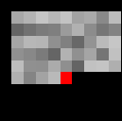
Scheduling Inter-stage scheduling - inline
Halide
Func bx, by, in;
Var x, y;
bx(x, y) = in(x-1, y) + in(x, y) + in(x+1, y);
by(x, y) = bx(x, y-1) + bx(x, y) + bx(x, y+1);
by.realize(10,10);
C equivalent
int in[W*H];
int out[W*H];
for(int y=1; y<(H-1); y++){
for(int x=1; x<(W-1); x++{
out[x + y*W] = in[(x-1) + (y-1)*W] + in[(x-1) + y*W] + in[(x-1) + (y+1)*W] +
in[x + (y-1)*W] + in[x + y*W] + in[x + (y+1)*W] +
in[(x+1) + (y-1)*W] + in[(x+1) + y*W] + in[(x+1) + (y+1)*W];
}
}

Slide 31
Scheduling Inter-stage scheduling
Halide
Func bx, by, in;
Var x, y;
bx(x, y) = in(x-1, y) + in(x, y) + in(x+1, y);
by(x, y) = bx(x, y-1) + bx(x, y) + bx(x, y+1);
bx.compute_root();
by.realize(10,10);
compute_root(): compute and store all outputs of a (producer) function
before starting computation of the next
More info on compute_root() : https://halide-lang.org/tutorials/tutorial_lesson_08_scheduling_2.html

Slide 32
Scheduling Inter-stage scheduling
Halide
Func bx, by, in;
Var x, y;
bx(x, y) = in(x-1, y) + in(x, y) + in(x+1, y);
by(x, y) = bx(x, y-1) + bx(x, y) + bx(x, y+1);
bx.compute_root();
by.realize(10,10);
C equivalent
int in[W*H];
int bx[W*H];
int by[W*H];
for(int y=0; y<H; y++){
for(int x=1; x<(W-1); x++{
bx[x + y*W] = in[x-1 + y*W] + in[x + y*W] + in[x+1 +y*W];
}
}
for(int y=1; y<(H-1); y++){
for(int x=1; x<(W-1); x++{
by[x + y*W] = bx[x + (y-1)*W] + bx[x + y*W] + bx[x+ (y+1)*W];
}
}

Slide 33
Scheduling Fusion
Halide
Func bx, by, in;
Var x, y;
bx(x, y) = in(x-1, y) + in(x, y) + in(x+1, y);
by(x, y) = bx(x, y-1) + bx(x, y) + bx(x, y+1);
bx.compute_at(by,y);
by.realize(10,10);
compute_root() is actually a special case of compute_at().
bx.compute_at(by, y) means: “Whenever stage by starts an iteration of the y loop, first calculate those pixels of stage bx that will be consumed.”
In other words: computation of bx is fused at the loop over y of by.
More info on compuate_at() : https://halide-lang.org/tutorials/tutorial_lesson_08_scheduling_2.html
Notes:
hblur.compute_at(out, y) means: “Whenever stage out starts an iteration of the y loop, first calculate the pixels of stage hblur that will be consumed.”

Slide 34
Scheduling Fusion
Halide
Func bx, by, in;
Var x, y;
bx(x, y) = in(x-1, y) + in(x, y) + in(x+1, y);
by(x, y) = bx(x, y-1) + bx(x, y) + bx(x, y+1);
bx.compute_at(by,y);
by.realize(10,10);
C equivalent
int in[W*H];
int by[W*H];
for(int y=1; y<(H-1); y++){
int bx[W*3];
for(int hy = y-1; hy<y+2; hy++){
for(int x = 1; x<W-1; x++) {
bx[hx + (hy-y+1)*W] = in[x-1 + hy*W] + in[x + hy*W] + in[x+1 + hy*W];
}
}
for(int x=1; x<(W-1); x++{
by[x + y*W] = bx[x] + bx[x + W] + bx[x + 2*W];
}
}
At this point in the nest:
Allocate a buffer for bx
Fill it with the required 3 lines.
Notes:
hblur.compute_at(out, y) means: “Whenever stage out starts an iteration of the y loop, first calculate the pixels of stage hblur that will be consumed.”

Slide 35
Scheduling Fusion
This is not equivalent to our initial fused C implementation yet, because the bx pixels are not being re-used but instead re-calculated.
Halide
Func bx, by, in;
Var x, y;
bx(x, y) = in(x-1, y) + in(x, y) + in(x+1, y);
by(x, y) = bx(x, y-1) + bx(x, y) + bx(x, y+1);
bx.compute_at(by,y);
by.realize(10,10);
C equivalent
int in[W*H];
int by[W*H];
for(int y=1; y<(H-1); y++){
int bx[W*3];
for(int hy = y-1; hy<y+2; hy++){
for(int x = 1; x<W-1; x++) {
bx[hx + (hy-y+1)*W] = in[x-1 + hy*W] + in[x + hy*W] + in[x+1 + hy*W];
}
}
for(int x=1; x<(W-1); x++{
by[x + y*W] = bx[x] + bx[x + W] + bx[x + 2*W];
}
}
Notes:
hblur.compute_at(out, y) means: “Whenever stage out starts an iteration of the y loop, first calculate the pixels of stage hblur that will be consumed.”

Slide 36
Scheduling Fusion
This is not equivalent to our initial fused C implementation yet, because the bx pixels are not being re-used but instead re-calculated.
Halide
Func bx, by, in;
Var x, y;
bx(x, y) = in(x-1, y) + in(x, y) + in(x+1, y);
by(x, y) = bx(x, y-1) + bx(x, y) + bx(x, y+1);
bx.compute_at(by,y);
by.realize(10,10);
C equivalent
int in[W*H];
int by[W*H];
for(int y=1; y<(H-1); y++){
int bx[W*3];
for(int hy = y-1; hy<y+2; hy++){
for(int x = 1; x<W-1; x++) {
bx[hx + (hy-y+1)*W] = in[x-1 + hy*W] + in[x + hy*W] + in[x+1 + hy*W];
}
}
for(int x=1; x<(W-1); x++{
by[x + y*W] = bx[x] + bx[x + W] + bx[x + 2*W];
}
}
Notes:
hblur.compute_at(out, y) means: “Whenever stage out starts an iteration of the y loop, first calculate the pixels of stage hblur that will be consumed.”

Slide 37
Scheduling Fusion
This is not equivalent to our initial fused C implementation yet, because the bx pixels are not being re-used but instead re-calculated.
Halide
Func bx, by, in;
Var x, y;
bx(x, y) = in(x-1, y) + in(x, y) + in(x+1, y);
by(x, y) = bx(x, y-1) + bx(x, y) + bx(x, y+1);
bx.compute_at(by,y);
by.realize(10,10);
C equivalent
int in[W*H];
int by[W*H];
for(int y=1; y<(H-1); y++){
int bx[W*3];
for(int hy = y-1; hy<y+2; hy++){
for(int x = 1; x<W-1; x++) {
bx[hx + (hy-y+1)*W] = in[x-1 + hy*W] + in[x + hy*W] + in[x+1 + hy*W];
}
}
for(int x=1; x<(W-1); x++{
by[x + y*W] = bx[x] + bx[x + W] + bx[x + 2*W];
}
}
Notes:
hblur.compute_at(out, y) means: “Whenever stage out starts an iteration of the y loop, first calculate the pixels of stage hblur that will be consumed.”

Slide 38
Scheduling Fusion-Folded storage
Halide
Func bx, by, in;
Var x, y;
bx(x, y) = in(x-1, y) + in(x, y) + in(x+1, y);
by(x, y) = bx(x, y-1) + bx(x, y) + bx(x, y+1);
bx.compute_at(by,y);
bx.store_root();
by.realize(10,10);
For this, we can separate computation from storage using store_at() and store_root().
bx.store_root() means: “Allocate the buffer for bx outside the loop nest.”
More info on store_root()

Slide 39
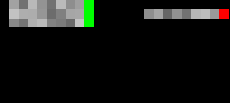
Scheduling Fusion-Folded storage
Halide
Func bx, by, in;
Var x, y;
bx(x, y) = in(x-1, y) + in(x, y) + in(x+1, y);
by(x, y) = bx(x, y-1) + bx(x, y) + bx(x, y+1);
bx.compute_at(by,y);
bx.store_root();
by.realize(10,10);
C equivalent
int in[W*H];
int bx[W*3];
int by[W*H];
for(int y=1; y<H; y++){
for(int hy = y + ((y>1) ? 1 : -1) ; hy < y -((y>1) ? 1 : -1) +3 ; hy++){
for(int x=0; x<W; x++{
bx[x + hy*W%3] = in[x-1 + hy*W] + in[x + hy*W] + in[x+1 + hy*W];
}
}
for(int x=0; x<W; x++{
by[x + y*W] = bx[x + (y-1)%3*W] + bx[x + y%3*W] + bx[x + (y+1)%3*W];
}
}

Slide 40
Scheduling Fusion-Folded storage
Halide
Func bx, by, in;
Var x, y;
bx(x, y) = in(x-1, y) + in(x, y) + in(x+1, y);
by(x, y) = bx(x, y-1) + bx(x, y) + bx(x, y+1);
bx.compute_at(by,y);
bx.store_root();
by.realize(10,10);
C equivalent
int in[W*H];
int bx[W*3];
int by[W*H];
for(int y=1; y<H; y++){
for(int hy = y + ((y>1) ? 1 : -1) ; hy < y -((y>1) ? 1 : -1) +3 ; hy++){
for(int x=0; x<W; x++{
bx[x + hy*W%3] = in[x-1 + hy*W] + in[x + hy*W] + in[x+1 + hy*W];
}
}
for(int x=0; x<W; x++{
by[x + y*W] = bx[x + (y-1)%3*W] + bx[x + y%3*W] + bx[x + (y+1)%3*W];
}
}

Slide 41
Scheduling Fusion-Folded storage
Halide
Func bx, by, in;
Var x, y;
bx(x, y) = in(x-1, y) + in(x, y) + in(x+1, y);
by(x, y) = bx(x, y-1) + bx(x, y) + bx(x, y+1);
bx.compute_at(by,y);
bx.store_root();
by.realize(10,10);
C equivalent
int in[W*H];
int bx[W*3];
int by[W*H];
for(int y=1; y<H; y++){
for(int hy = y + ((y>1) ? 1 : -1) ; hy < y -((y>1) ? 1 : -1) +3 ; hy++){
for(int x=0; x<W; x++{
bx[x + hy*W%3] = in[x-1 + hy*W] + in[x + hy*W] + in[x+1 + hy*W];
}
}
for(int x=0; x<W; x++{
by[x + y*W] = bx[x + (y-1)%3*W] + bx[x + y%3*W] + bx[x + (y+1)%3*W];
}
}

Slide 42
Scheduling Fusion-Folded storage
Halide
Func bx, by, in;
Var x, y;
bx(x, y) = in(x-1, y) + in(x, y) + in(x+1, y);
by(x, y) = bx(x, y-1) + bx(x, y) + bx(x, y+1);
bx.compute_at(by,y);
bx.store_root();
by.realize(10,10);
C equivalent
int in[W*H];
int bx[W*3];
int by[W*H];
for(int y=1; y<H; y++){
for(int hy = y + ((y>1) ? 1 : -1) ; hy < y -((y>1) ? 1 : -1) +3 ; hy++){
for(int x=0; x<W; x++{
bx[x + hy*W%3] = in[x-1 + hy*W] + in[x + hy*W] + in[x+1 + hy*W];
}
}
for(int x=0; x<W; x++{
by[x + y*W] = bx[x + (y-1)%3*W] + bx[x + y%3*W] + bx[x + (y+1)%3*W];
}
}
Halide automatically applies the storage folding as well!

Slide 43
Intra-Stage Scheduling
We looked at the syntax which interleaves computation between stages.

Slide 44
Intra-Stage Scheduling
We looked at the syntax which interleaves computation between stages.
There is also syntax which changes the order of computation within a single stage:
gradient.realize(4,4);
Default - >
Func gradient;
gradient(x,y)=x+y;

Slide 45
Intra-Stage Scheduling: loop interchange
We looked at the syntax which interleaves computation between stages.
There is also syntax which changes the order of computation within a single stage:
Reorder loop variables → gradient.reorder(y,x);
gradient.realize(4,4);
Default - >
gradient.reorder(y,x);
gradient.realize(4,4);
Loop interchange - >
Func gradient;
gradient(x,y)=x+y;
More info on loop interchange in Halide

Slide 46
Intra-Stage Scheduling: splitting
We looked at the syntax which interleaves computation between stages.
There is also syntax which changes the order of computation within a single stage:
Reorder loop variables → gradient.reorder(y,x);
Split loop variables into inner and outer → gradient.split(x, xout, xin, 4);
Tiling is a just combination of the above:
gradient.split(x, xout, xin, 4);
gradient.split(y, yout, yin, 4);
gradient.reorder(xin, yin, xout, yout);
Func gradient;
gradient(x,y)=x+y;

Slide 47
Intra-Stage Scheduling: tiling
We looked at the syntax which interleaves computation between stages.
There is also syntax which changes the order of computation within a single stage:
Reorder loop variables → gradient.reorder(y,x);
Split loop variables into inner and outer → gradient.split(x, xout, xin, 4);
Tiling is a just combination of the above:
gradient.split(x, xout, xin, 4);
gradient.split(y, yout, yin, 4);
gradient.reorder(xin, yin, xout, yout);
Because this is so common, syntactic sugar (a “shortcut”) is offered:
gradient.tile(x, y, xout, yout, xin, yin, 4, 4);
gradient.realize(8,8);
Loop tiling - >
Func gradient;
gradient(x,y)=x+y;

Slide 48
Intra-Stage Scheduling: vectorize
We looked at the syntax which interleaves computation between stages.
There is also syntax which changes the order of computation within a single stage:
Reorder loop variables → gradient.reorder(y,x);
Split loop variables into inner and outer → gradient.split(x, xout, xin, 4);
Tiling is a just combination of the above → gradient.tile(x, y, xout, yout ,
xin, yin, 4, 4);
Turn a loop into a (series of) vector operation(s):
gradient.vectorize(xin); //loop over xin, which has 4 iterations, is vectorized
gradient.vectorize(x,4); //shorter: split x into out and in of 4, then vectorize
gradient.vectorize(x,4)
gradient.realize(8, 4);
Vectorization - >
Func gradient;
gradient(x,y)=x+y;

Slide 49
Intra-Stage Scheduling
We looked at the syntax which interleaves computation between stages.
There is also syntax which changes the order of computation within a single stage:
Reorder loop variables → gradient.reorder(y,x);
Split loop variables into inner and outer → gradient.split(x, xout, xin, 4);
Tiling is a just combination of the above → gradient.tile(x, y, xout, yout ,
xin, yin, 4, 4);
Vectorize loop iterations → gradient.vectorize(x, 4);
Func gradient;
gradient(x,y)=x+y;

Slide 50
Intra-Stage Scheduling: multiple threads
We looked at the syntax which interleaves computation between stages.
There is also syntax which changes the order of computation within a single stage:
Reorder loop variables → gradient.reorder(y,x);
Split loop variables into inner and outer → gradient.split(x, xout, xin, 4);
Tiling is a just combination of the above → gradient.tile(x, y, xout, yout ,
xin, yin, 4, 4);
Vectorize loop iterations → gradient.vectorize(x, 4);
Execute loop iterations in parallel using multi-threading:
by.parallel(x); //executes each x iteration simultaneously in threads
Func gradient;
gradient(x,y)=x+y;

Slide 51
Intra-Stage Scheduling
We looked at the syntax which interleaves computation between stages.
There is also syntax which changes the order of computation within a single stage:
Reorder loop variables → gradient.reorder(y,x);
Split loop variables into inner and outer → gradient.split(x, xout, xin, 4);
Tiling is a just combination of the above → gradient.tile(x, y, xout, yout ,
xin, yin, 4, 4);
Vectorize loop iterations → gradient.vectorize(x, 4);
Parallelize loop iterations → gradient.parallel(x);
Many more! (unrolling, merging, prefetching, storage ordering etc)
Func gradient;
gradient(x,y)=x+y;

Slide 52
Intra-Stage Scheduling
We looked at the syntax which interleaves computation between stages.
There is also syntax which changes the order of computation within a single stage:
Reorder loop variables → gradient.reorder(y,x);
Split loop variables into inner and outer → gradient.split(x, xout, xin, 4);
Tiling is a just combination of the above → gradient.tile(x, y, xout, yout ,
xin, yin, 4, 4);
Vectorize loop iterations → gradient.vectorize(x, 4);
Parallelize loop iterations → gradient.parallel(x);
Many more! (unrolling, merging, prefetching, storage ordering, etc)
And of course combinations of the above!
gradient.tile(x, y, xout, yout, xin, yin, 2, 2)
.fuse(xout, yout, tile_index)
.parallel(tile_index);
gradient.realize(8, 8);
Parallel tiles - >
Func gradient;
gradient(x,y)=x+y;

Slide 53
Intra-Stage Scheduling
We looked at the syntax which interleaves computation between stages.
There is also syntax which changes the order of computation within a single stage:
Reorder loop variables → gradient.reorder(y,x);
Split loop variables into inner and outer → gradient.split(x, xout, xin, 4);
Tiling is a just combination of the above → gradient.tile(x, y, xout, yout ,
xin, yin, 4, 4);
Vectorize loop iterations → gradient.vectorize(x, 4);
Parallelize loop iterations → gradient.parallel(x);
Many more! (unrolling, merging, prefetching, storage ordering etc)
For more information visit: https://halide-lang.org/tutorials/tutorial_lesson_05_scheduling_1.html
53

Slide 54
GPU example
We start with the same functional definitions
Func in, bx, by;
Var x, y;
bx(x,y) = in(x-1,y) + in(x,y) + in(x+1,y);
by(x,y) = bx(x,y-1) + bx(x,y) + bx(x,y+1);
But first: a short GPU / CUDA recap

Slide 55
GPU recap: Let's Start Again from C
int A[2][4];
for(i=0;i<2;i++)
for(j=0;j<4;j++)
A[i][j]++;
convert into CUDA
int A[2][4];
kernelF<<<(2,1),(4,1)>>>(A);
__device__ kernelF(A){
i = blockIdx.x;
j = threadIdx.x;
A[i][j]++;
}
// define 2x4=8 threads
// all threads run the same kernel
// each thread block has its id
// each thread has its id
// each thread has different i and j
Notes:
Programmers explicitly express the available parallelism into threads. In this example, there are two thread blocks, each with four threads.

Slide 56
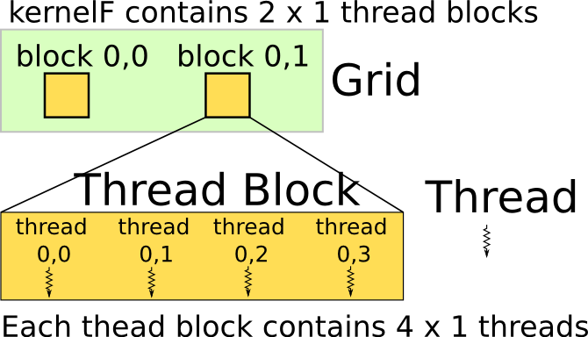
Thread Hierarchy
Example:
thread 3 of block 1 operates
on element A[1][3]
int A[2][4];
kernelF<<<(2,1),(4,1)>>>(A);
__device__ kernelF(A){
i = blockIdx.x;
j = threadIdx.x;
A[i][j]++;
}
// define 2x4=8 threads
// all threads run same kernel
// each thread block has its id
// each thread has its id
// each thread has different i and j
Notes:
The syntax of declaring the thread hierarchy is <<<(a,b,c),(d,e,f)>>>, in which
a,b,c are the three dimensions of the grid, which has (a*b*c) blocks
d,e,f, are the three dimensions of the block, which has (d*e*f) threads
If the a dimension is not specified, the default size of that dimension is one.

Slide 57
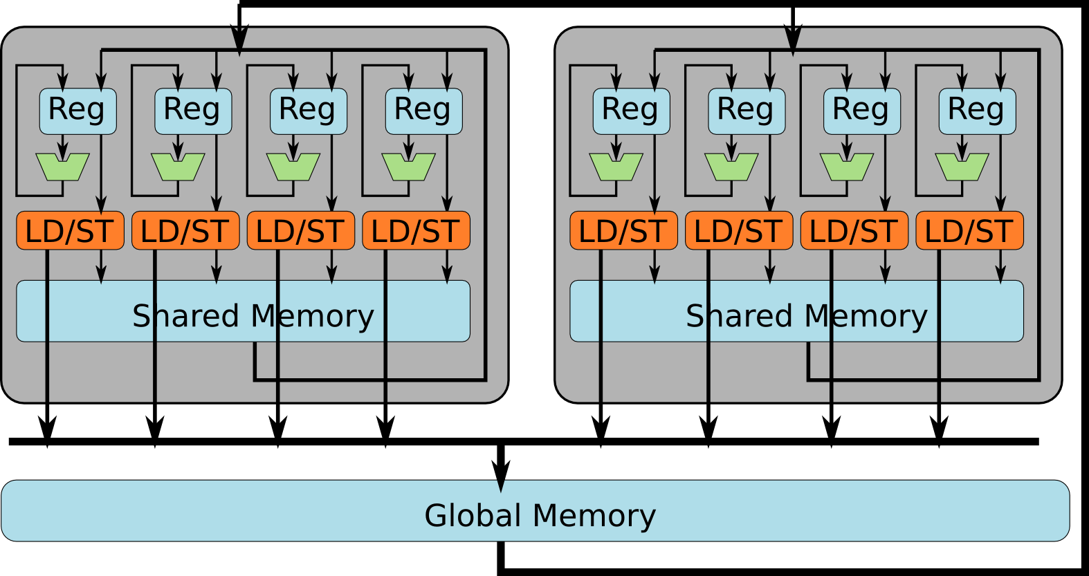
How Are Threads Scheduled?
Notes:
Each thread block can only run on one SIMD cluster.
Threads within the same thread block can share data via the same shared memory.
Threads in different blocks can only share data via global memory.

Slide 58
GPU example
Func in, bx, by;
Var x, y;
bx(x,y) = in(x-1,y) + in(x,y) + in(x+1,y);
by(x,y) = bx(x,y-1) + bx(x,y) + bx(x,y+1);
Var block, thread;
bx.split(x,block,thread,16);
Now let's compute the bx stage using the GPU in 16-wide one-dimensional thread blocks
First we split the index x of bx
into blocks of size 16
GPU in Halide

Slide 59
GPU example
Func in, bx, by;
Var x, y;
bx(x,y) = in(x-1,y) + in(x,y) + in(x+1,y);
by(x,y) = bx(x,y-1) + bx(x,y) + bx(x,y+1);
Var block, thread;
bx.split(x,block,thread,16);
bx.gpu_blocks(block)
.gpu_threads(threads);
bx.gpu_tile(x, block, thread, 16); // short-hand notation
Now let's compute the bx stage using the GPU in 16-wide one-dimensional thread blocks
First we split the index x of bx
into blocks of size 16
Then we tell cuda that our Vars 'block' and 'thread' correspond to CUDA's notions of blocks and threads, or OpenCL's notions of thread groups and threads.

Slide 60
GPU example
We can also combine these with all of the previous inter-stage scheduling
Func in, bx, by;
Var x, y;
bx(x,y) = in(x-1,y) + in(x,y) + in(x+1,y);
by(x,y) = bx(x,y-1) + bx(x,y) + bx(x,y+1);

Slide 61
GPU example (a better schedule)
Func in, bx, by;
Var x, y;
bx(x,y) = in(x-1,y) + in(x,y) + in(x+1,y);
by(x,y) = bx(x,y-1) + bx(x,y) + bx(x,y+1);
Var xo, yo, xin, yin;
by.compute_root().
.gpu_tile(x,y,xo,yo,
xin,yin,16,16);
by (output stage) is set to root
by tiled with tiles of size 16 (x,y dimensions)

Slide 62
GPU example (a better schedule)
Remember that root allocations mean large buffers!! (stored in the global memory)
Func in, bx, by;
Var x, y;
bx(x,y) = in(x-1,y) + in(x,y) + in(x+1,y);
by(x,y) = bx(x,y-1) + bx(x,y) + bx(x,y+1);
Var xo, yo, xin, yin;
by.compute_root().
.gpu_tile(x,y,xo,yo,
xin,yin,16,16);
by (output stage) is set to root
by tiled with tiles of size 16 (x,y dimensions)

Slide 63
GPU example (a better schedule)
Func in, bx, by;
Var x, y;
bx(x,y) = in(x-1,y) + in(x,y) + in(x+1,y);
by(x,y) = bx(x,y-1) + bx(x,y) + bx(x,y+1);
Var xo, yo, xin, yin;
by.compute_root().
.gpu_tile(x,y,xo,yo,
xin,yin,16,16);
bx.compute_at(by,xo)
by (output stage) is set to root
by tiled with tiles of size 16 (x,y dimensions)
Produce bx inside tiles (blocks) of by
Store bx in the shared (on-chip) memory
Increased producer consumer locality reduces the number of costly global memory accesses!!!

Slide 64
GPU example (a better schedule)
Func in, bx, by;
Var x, y;
bx(x,y) = in(x-1,y) + in(x,y) + in(x+1,y);
by(x,y) = bx(x,y-1) + bx(x,y) + bx(x,y+1);
Var xo, yo, xin, yin;
by.compute_root().
.gpu_tile(x,y,xo,yo,
xin,yin,16,16);
bx.compute_at(by,xo)
.gpu_threads(x,y);
by (output stage) is set to root
by tiled with tiles of size 16 (x,y dimensions)
Produce bx inside tiles (blocks) of by
Store bx in the shared (on-chip) memory
Assign x,y dimensions of bx to threads

Slide 65
GPU example (a better schedule)
Func in, bx, by;
Var x, y;
bx(x,y) = in(x-1,y) + in(x,y) + in(x+1,y);
by(x,y) = bx(x,y-1) + bx(x,y) + bx(x,y+1);
Var xo, yo, xin, yin;
by.compute_root()
.gpu_tile(x,y,xo,yo,
xin,yin,16,16);
bx.compute_at(by,xo)
.gpu_threads(x,y);
by (output stage) is set to root
by tiled with tiles of size 16 (x,y dimensions)
Produce bx inside tiles (blocks) of by
Store bx in the shared (on-chip) emory
Assign x,y dimensions of bx to threads
But tile sizes control the shared memory requirements for bx and therefore the shared memory allocation size and thread block dimensions!!

Slide 66
GPU example - compute per block (common GPU fusion strategy)
$$by\left(x,y\right)=bx\left(x, y\right)+bx\left(x, y+1\right)+bx\left(x, y+2\right)$$
bx.compute_at(by,xo)
.gpu_threads(x,y);
by.compute_root().gpu_tile(x,y,xo,yo,
xin,yin,4,4);
Ty=4
Tx=4

Slide 67
GPU example - compute per block (common GPU fusion strategy)
$$by\left(x,y\right)=bx\left(x, y\right)+bx\left(x, y+1\right)+bx\left(x, y+2\right)$$
bx.compute_at(by,xo)
.gpu_threads(x,y);
by.compute_root().gpu_tile(x,y,xo,yo,
xin,yin,4,4);
Ty=4
Tx=4

Slide 68
GPU example - compute per block (common GPU fusion strategy)
$$by\left(x,y\right)=bx\left(x, y\right)+bx\left(x, y+1\right)+bx\left(x, y+2\right)$$
bx.compute_at(by,xo)
.gpu_threads(x,y);
by.compute_root().gpu_tile(x,y,xo,yo,
xin,yin,4,4);
Ty=4
Tx=4
x ->
Tiling by causes generates a thread block of 4x4 (root allocations are stored in the global memory)
y

Slide 69
GPU example - compute per block (common GPU fusion strategy)
$$by\left(x,y\right)=bx\left(x, y\right)+bx\left(x, y+1\right)+bx\left(x, y+2\right)$$
bx.compute_at(by,xo)
.gpu_threads(x,y);
by.compute_root().gpu_tile(x,y,xo,yo,
xin,yin,4,4);
Ty=4
Tx=4
However, the actual grid will have 6x4 dimensions and 24 elements stored in the shared memory

Slide 70
GPU example - compute per block (common GPU fusion strategy)
$$by\left(x,y\right)=bx\left(x, y\right)+bx\left(x, y+1\right)+bx\left(x, y+2\right)$$
bx.compute_at(by,xo)
.gpu_threads(x,y);
by.compute_root().gpu_tile(x,y,xo,yo,
xin,yin,4,4);
Ty=4
Tx=4
GPUs have specific constraints for following metrics!
Max threads/block
(1024)
Max shared memory/block
(49 Kbytes)
Max registers per SM (Streaming Multi-processor) varies per CC (Compute Capability)
etc…
However, the actual grid will have 6x4 dimensions and 24 elements stored in the shared memory

Slide 71
GPU example - compute per block (common GPU fusion strategy)
$$by\left(x,y\right)=bx\left(x, y\right)+bx\left(x, y+1\right)+bx\left(x, y+2\right)$$
bx.compute_at(by,xo)
.gpu_threads(x,y);
by.compute_root().gpu_tile(x,y,xo,yo,
xin,yin,4,4);
Ty=4
Tx=4
GPUs have specific constraints for these following metrics!
Max threads/block
(1024)
Max shared memory/block
(49 Kbytes)
Max registers per SM
(varies per CC)
etc…
Threads/block, Shared memory allocation and registers/thread have a significant impact on occupancy and performance!!

Slide 72
GPU example - compute per block (common GPU fusion strategy)
$$by\left(x,y\right)=bx\left(x, y\right)+bx\left(x, y+1\right)+bx\left(x, y+2\right)$$
bx.compute_at(by,xo)
.gpu_threads(x,y);
by.compute_root().gpu_tile(x,y,xo,yo,
xin,yin,4,4);
Ty=4
Tx=4
Missed inter-tile reuse

Slide 73
Occupancy
by.compute_root().
.gpu_tile(x,y,xo,yo,
xin,yin,16,16);
bx.compute_at(by,xo)
.gpu_threads(x,y);
Occupancy = # active threads/block = f(required shared memory, required registers, threads)
Notes:
Occupancy = f(required shared mem, required registers, threads)
The figures for 71-72 were generated using NVIDIA's occupancy calculator for that example, it's an excel sheet provided online (there used to be a link to it in the slides as well).
It's basically a function of the required shared memory, registers and threads to calculate the amount of active threads/warps per block based on which of these three "resources" becomes the limiting factor.
In many cases, the limiting factor will change (e.g. shared memory might become the reason if it grows while the number of registers and threads remain the same, same for the other two).

Slide 74
Occupancy
by.compute_root().
.gpu_tile(x,y,xo,yo,
xin,yin,16,16);
bx.compute_at(by,xo)
.gpu_threads(x,y);

Slide 75
Wrapper functions
Using Func::in, we can interpose a new Func in between f and g using the schedule alone
Func f, g;
Var x, y;
f(x, y) = x + y;
g(x, y) = 2 * f(x, y) + 3;
f.compute_root();
f.in(g).compute_root();
g.realize(5, 5);
Func f, g;
Var x, y;
f(x, y) = x + y;
f_in_g(x, y) = f(x, y);
g(x, y) = 2 * f_in_g (x, y) + 3;
f.compute_root();
f_in_g.compute_root();
g.realize(5, 5);
Equivalent to
f.in(g)replaces all calls to 'f' inside 'g' with a wrapper Func and then returns that wrapper.

Slide 76
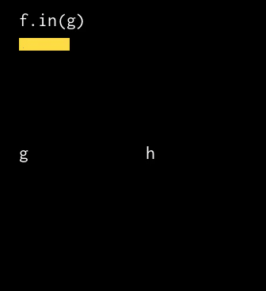
Wrapper functions
Func f, g, h;
Var x, y;
f(x, y) = x + y;
g(x, y) = 2 * f(x, y);
h(x, y) = 3 + g(x, y) - f(x + 93, y - 87);
// f.compute_root();
g.compute_root();
h.compute_root();
f.in(g).compute_at(g, y);
f.in(h).compute_at(h, y);
f.in(g).vectorize(x, 4);
f.in(h).split(x, xo, xi, 2).reorder(xo, xi);
h.realize(8, 8);
h wil use a far-away region
It computes a large region required by g and h, which would mostly be unused data
To see other applications of wrappers visit: https://halide-lang.org/tutorials/tutorial_lesson_19_wrapper_funcs.html

Slide 77
Debug halide code
Using trace_stores function. we tell Halide that we'd like to be notified of all evaluations.
Function print_loop_nest prints out pseudocode showing what loops Halide is generating:
Func gradient("gradient");
Var x, y;
gradient(x, y) = x + y;
gradient.reorder(y, x);
gradient.trace_stores()
gradient.realize(2, 2);
gradient.print_loop_nest()
> Begin pipeline gradient.0()
> Tag gradient.0() tag = …
> Store gradient.0(0, 0) = 0
> Store gradient.0(0, 1) = 1
> Store gradient.0(1, 0) = 1
> Store gradient.0(1, 1) = 2
> End pipeline gradient.0()
> produce gradient:
> for x:
> for y:
> gradient(...) = ...
To get more information about halide debug tools visit:
https://halide-lang.org/tutorials/tutorial_lesson_04_debugging_2.html
https://halide-lang.org/tutorials/tutorial_lesson_03_debugging_1.html

Slide 78
Observations
With Halide, the algorithm definition is clearer and more concise than with C.
by being separated from the optimization (scheduling & buffer allocation) strategy
transformations that would normally take a lot of effort are done in just a few, separate scheduling statements.
Saves time
Guaranteed correctness
Automatic handling of edge conditions (pro-, epilogues) and storage folding, among other optimizations
With Halide, we can easily port the algorithm to a different architecture
As long as a Halide back-end exists for that architecture
Code is not hardware-dependent
For good performance on the new architecture, only re-write the schedule

Slide 79
Limitations
As mentioned it is domain-specific to image processing. It is less suitable for other workloads because:
Not Turing-complete (no full recursion)
Only iterates over rectangular domains
Scheduling model only covers typical image processing optimizations
But this is the point of domain-specific languages:
if we aim to cover everything, we get something like C again!

Slide 80
Halide’s Status
An open-source project.
Because of that, there is ongoing work in many directions:
New architectures (i.e. Qualcomm Hexagon DSP)
Extensions to suit (sub-)domains (i.e. HLS code generation)
Auxiliary efforts:
Automatic tuning of Halide schedules
Automatic generation of Halide schedules
Automatic de-compilation of x86 binaries into Halide for easy porting

Slide 81
Assignment 2 - Halide
Using ResNet-50 as an application:
Use Halide to optimize it for a multicore CPU (Intel i9) and then for a GPU (Nvidia RTX 2080ti or RTX 2070)
Tiling
Fusion
Etc
http://halide-lang.org/tutorials/
Cuda occupancy calculator
(https://xmartlabs.github.io/cuda-calculator/)

Slide 82
What did you learn?
Scheduling C-code is labor intensive
Halide, a DSL, reduces the burden
split functionality from the schedule/storage/vectorization directives
functionality is platform/target independent
Some directives specifically for GPUs
Many directives like:
compute_at
store_at
reorder loops, fuse loop iteraters, split a loop iterater, tile
vectorize for using SIMD, parallel into threads
specify threads & blocks on GPUs
Debugging support
Halide is a functional language and not Turing complete
However, extensions are coming: Halide is an ongoing development (you can contribute!)

Slide 83
GPU example - compute per block (common GPU fusion strategy)
$$by\left(x,y\right)=bx\left(x, y\right)+bx\left(x, y+1\right)+bx\left(x, y+2\right)$$
bx.compute_at(by,xo)
.gpu_threads(x,y);
by.compute_root().gpu_tile(x,y,xo,yo,
xin,yin,2,2);
Ty=2
Tx=2
Tx
Ty
bx
by
By
Bx

Slide 84
GPU example - compute per block (common GPU fusion strategy)
$$by\left(x,y\right)=bx\left(x, y\right)+bx\left(x, y+1\right)+bx\left(x, y+2\right)$$
bx.compute_at(by,xo)
.gpu_threads(x,y);
by.compute_root().gpu_tile(x,y,xo,yo,
xin,yin,2,2);
Ty=2
Tx=2
bx
Tiling by causes generates a thread block of 2x2. (root allocations are stored in the global memory)
by

Slide 85
GPU example - compute per block (common GPU fusion strategy)
$$by\left(x,y\right)=bx\left(x, y\right)+bx\left(x, y+1\right)+bx\left(x, y+2\right)$$
bx.compute_at(by,xo)
.gpu_threads(x,y);
by.compute_root().gpu_tile(x,y,xo,yo,
xin,yin,2,2);
Ty=2
Tx=2
bx
by
However, the actual grid will have 4x2 dimensions and 8 elements stored in the shared memory

Slide 86
GPU example - compute per block (common GPU fusion strategy)
$$by\left(x,y\right)=bx\left(x, y\right)+bx\left(x, y+1\right)+bx\left(x, y+2\right)$$
bx.compute_at(by,xo)
.gpu_threads(x,y);
by.compute_root().gpu_tile(x,y,xo,yo,
xin,yin,2,2);
Ty=2
Tx=2
GPUs have specific constraints for these metrics!
Max threads/block
(1024)
Max shared memory/block
(49 Kbytes)
Max registers per SM
(varies per CC)
etc…
bx
by
However, the actual grid will have 4x2 dimensions and 8 elements stored in the shared memory
Bx

Slide 87
GPU example - compute per block (common GPU fusion strategy)
$$by\left(x,y\right)=bx\left(x, y\right)+bx\left(x, y+1\right)+bx\left(x, y+2\right)$$
bx.compute_at(by,xo)
.gpu_threads(x,y);
by.compute_root().gpu_tile(x,y,xo,yo,
xin,yin,2,2);
Ty=2
Tx=2
GPUs have specific constraints for these metrics!
Max threads/block
(1024)
Max shared memory/block
(49 Kbytes)
Max registers per SM
(varies per CC)
etc…
Threads/block, Shared memory allocation and registers/thread have a significant impact on occupancy and performance!!
bx
by
Bx

Slide 88
Brightening an Image Example Halide
#include "halide_image_io.h"
using namespace Halide::Tools;
Halide::Buffer<uint8_t> input = load_image("image_name");
Halide::Func brighter;
Halide::Var x, y, c;
Halide::Expr value = input(x, y, c);
value = Halide::cast<float>(value);
value = value * 1.5f;
value = Halide::min(value, 255.0f);
value = Halide::cast<uint8_t>(value);
Halide::Buffer<uint8_t> output = brighter.realize(input.width(),input.height(), input.channels());
save_image(output, "brighter.png");
More info on I/O
Notes:
// A 'Func' object represents a pipeline stage. It's a pure // function that defines what value each pixel should have.
You // can think of it as a computed image.
Halide::Func gradient; // Var objects are names to use as variables in the definition of // a Func. They have no meaning by themselves. Halide::Var x, y; // We typically use Vars named 'x' and 'y' to correspond to the x // and y axes of an image, and we write them in that order. If // you're used to thinking of images as having rows and columns, // then x is the column index, and y is the row index. // Funcs are defined at any integer coordinate of its variables as // an Expr in terms of those variables and other functions. // Here, we'll define an Expr which has the value x + y. Vars have // appropriate operator overloading so that expressions like // 'x + y' become 'Expr' objects.

