Slide 1
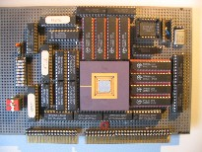
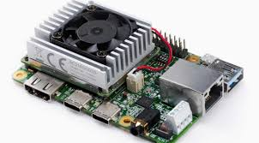
Intelligent Architectures 5LIL0 Network Restructuring
Henk Corporaal
www.ics.ele.tue.nl/~heco/courses/IA
h.corporaal@tue.nl
TUEindhoven
2021

Slide 2
Overview
We discussed 3 DNN optimizations:
Pruning, reducing connections / neurons
Quantization, from 32-bits float to …. 1-bit binary NWs
Scheduling to exploit data reuse and vector&thread-parallelim
In this lecture a 4th optimization, related to pruning:
Changing the Network Structure
filter decomposition
Structured approaches
But first some Halide scheduling options

Slide 3
Brightening an Image Example Halide code:
#include "halide_image_io.h"
using namespace Halide::Tools;
Halide::Buffer<uint8_t> input = load_image("image_name");
Halide::Func brighter;
Halide::Var x, y, c;
Halide::Expr value = input(x, y, c);
value = Halide::cast<float>(value);
value = value * 1.5f;
value = Halide::min(value, 255.0f);
value = Halide::cast<uint8_t>(value);
Halide::Buffer<uint8_t> output = brighter.realize(input.width(),input.height(), input.channels());
save_image(output, "brighter.png");
More info on I/O
Notes:
// A 'Func' object represents a pipeline stage. It's a pure // function that defines what value each pixel should have.
You // can think of it as a computed image.
Halide::Func gradient; // Var objects are names to use as variables in the definition of // a Func. They have no meaning by themselves. Halide::Var x, y; // We typically use Vars named 'x' and 'y' to correspond to the x // and y axes of an image, and we write them in that order. If // you're used to thinking of images as having rows and columns, // then x is the column index, and y is the row index. // Funcs are defined at any integer coordinate of its variables as // an Expr in terms of those variables and other functions. // Here, we'll define an Expr which has the value x + y. Vars have // appropriate operator overloading so that expressions like // 'x + y' become 'Expr' objects.

Slide 4
Implementing Convolutional Layers
Memory Read MAC Memory Write
filter weight fmap activation partial sum
updated partial sum
Dataflow taxonomy:
Output Stationary: minimize movement of partial sums
Weight Stationary: minimize movement of weights
Input Stationary: minimize movement of inputs

Slide 5
1D Convolution – Output Stationary (OS)
e = 0:
O[0] += I[0]*W[0]
O[0] += I[1]*W[1]
O[0] += I[2]*W[2]
Weights
Inputs
Outputs
*
=
R
H
E = H-R+1
int I[H]; // Input activations
int W[R]; // Filter weights
int O[E]; // Output activations
for (e = 0; e < E; e++)
for (r = 0; r < R; r++)
O[e] += I[e+r] * W[r];

Slide 6
1D Convolution – Output Stationary (OS)
Output movement is minimum
e = 1:
O[1] += I[1]*W[0]
O[1] += I[2]*W[1]
O[1] += I[3]*W[2]
Weights
Inputs
Outputs
*
=
R
H
E = H-R+1
int I[H]; // Input activations
int W[R]; // Filter weights
int O[E]; // Output activations
for (e = 0; e < E; e++)
for (r = 0; r < R; r++)
O[e] += I[e+r] * W[r];

Slide 7
1D Convolution – Output Stationary (OS)
Store O.0(0) = 0
Store O.0(1) = 0
Store O.0(2) = 0
Store O.0(3) = 0
Store O.0(0) = 0
Store O.0(0) = 1
Store O.0(0) = 3
Store O.0(1) = 1
Store O.0(1) = 3
Store O.0(1) = 6
Store O.0(2) = 2
Store O.0(2) = 5
Store O.0(2) = 9
Store O.0(3) = 3
Store O.0(3) = 7
Store O.0(3) = 12
Initialize by 0
for (e = 0; e < E; e++)
for (r = 0; r < R; r++)
O[e] += I[e+r] * W[r];
Final output
Func I, W, O;
Var x, e;
I(x) = x; // I = {0, 1, 2, 3, 4, 5}
W(x) = 1; // W = {1, 1, 1}
RDom r(0, 3); // r iterates from 0 to 2
O(e) = 0;
O(e) += I(e + r) * W(r);
O.trace_stores();
Buffer<int32_t> output = O.realize(4);
O.print_loop_nest();
produce O:
for e:
O(...) = ...
for e:
for r:
O(...) = ...
Study for more details: section 9 of the Halide tutorial
Notes:
RDom
Say we want an update that multiplies the first 10 rows by 3. We could do this by adding 10 update definitions. But it is easier to do it using a "reduction domain" and using it inside an update definition.
RDom r(0, 10);
f(x, r) = 3 * f(x, r);
If you want to study these in more depth with examples and visualizations I would strongly recommend you to quickly browse through section 9 of the Halide tutorial.

Slide 8
1D Convolution – Weight Stationary (WS)
r = 0:
O[0] += I[0]*W[0]
O[1] += I[1]*W[0]
O[2] += I[2]*W[0]
…
O[E-1] += I[E-1]*W[0]
Weights
Inputs
Outputs
*
=
R
H
E = H-R+1
int I[H]; // Input activations
int W[R]; // Filter weights
int O[E]; // Output activations
for (r = 0; r < R; r++)
for (e = 0; e < E; e++)
O[e] += I[e+r] * W[r];

Slide 9
1D Convolution – Weight Stationary (WS)
r = 1:
O[0] += I[1]*W[1]
O[1] += I[2]*W[1]
O[2] += I[3]*W[1]
…
O[E-1] += I[E]*W[1]
Weights
Inputs
Outputs
*
=
R
H
E = H-R+1
Weight movement is minimum
int I[H]; // Input activations
int W[R]; // Filter weights
int O[E]; // Output activations
for (r = 0; r < R; r++)
for (e = 0; e < E; e++)
O[e] += I[e+r] * W[r];

Slide 10
1D Convolution – Weight Stationary (WS)
Store O.0(0) = 0
Store O.0(1) = 0
Store O.0(2) = 0
Store O.0(3) = 0
Store O.0(0) = 0
Store O.0(1) = 1
Store O.0(2) = 2
Store O.0(3) = 3
Store O.0(0) = 1
Store O.0(1) = 3
Store O.0(2) = 5
Store O.0(3) = 7
Store O.0(0) = 3
Store O.0(1) = 6
Store O.0(2) = 9
Store O.0(3) = 12
Initialize by 0
for (r = 0; r < R; r++)
for (e = 0; e < E; e++)
O[e] += I[e+r] * W[r];
Note: update(0) indicates first non-functional update of O(e)
Func I, W, O;
Var x, e;
I(x) = x; // I = {0, 1, 2, 3, 4, 5}
W(x) = 1; // W = {1, 1, 1}
RDom r(0, 3); // r iterates from 0 to 2
O(e) = 0;
O(e) += I(e + r) * W(r);
O.update(0).reorder(e, r); //inner, outer
O.trace_stores();
Buffer<int32_t> output = O.realize(4);
O.print_loop_nest();
Final output
produce O:
for e:
O(...) = ...
for r:
for e:
O(...) = ...
Notes:
Func::update(int):
Assume that you want to define a function for the first time like:
f (x, y) = x + 2 * y;
This first definition is called the "pure" definition. Then, let's assume you want to change a particular point:
f (20, 10) = 33;
These extra definitions are called "update" definitions or "reduction" definitions. A reduction definition is an update definition that recursively refers back to the function's current value at the same site. If we confine our update to a single row, we can recursively refer to values in the same column:
f(x, 0) = f(x, 8);
For each realization of f, each step runs in its entirety before the next one begins. You can test this with trace_loads/stores() if you like.
We use Func::update(int) to get a handle to an update step for the purposes of scheduling. The following line vectorizes the second update step across x.
f.update(1).vectorize(x, 4);

Slide 11
1D Convolution – Input Stationary (IS)
h = 0:
O[0] += I[0]*W[0]
Weights
Inputs
Outputs
*
=
R
H
E = H-R+1
int I[H]; // Input activations
int W[R]; // Filter weights
int O[E]; // Output activations
for (h = 0; h < H; h++)
for (r = 0; r < R; r++)
O[h-r] += I[h] * W[r];
Beware h-r must be >= 0 and <E

Slide 12
1D Convolution – Input Stationary (IS)
h = 1:
O[1] += I[1]*W[0]
O[0] += I[1]*W[1]
Weights
Inputs
Outputs
*
=
R
H
E = H-R+1
int I[H]; // Input activations
int W[R]; // Filter weights
int O[E]; // Output activations
for (h = 0; h < H; h++)
for (r = 0; r < R; r++)
O[h-r] += I[h] * W[r];
Beware h-r must be >= 0 and <E

Slide 13
1D Convolution – Input Stationary (IS)
h = 2:
O[2] += I[2]*W[0]
O[1] += I[2]*W[1]
O[0] += I[2]*W[2]
Weights
Inputs
Outputs
*
=
R
H
E = H-R+1
Input movement is minimum
int I[H]; // Input activations
int W[R]; // Filter weights
int O[E]; // Output activations
for (h = 0; h < H; h++)
for (r = 0; r < R; r++)
O[h-r] += I[h] * W[r];
Because the iteration order is not rectangular anymore, we cannot implement input stationary in Halide
Beware h-r must be >= 0 and <E

Slide 14
2D Convolution for CNNs
for c in output_maps:
for y in rows:
for x in columns:
for kz in input_maps:
for ky in kernel_height:
for kx in kernel_widht:
output[c][y][x]+= input[kz][y+ky][x+kx] * \
W[c][kz][ky][kx]
Func input, weights, output;
Var x, y, c;
RDom k(0, kernel_widht, 0, kernel_height, 0, input_maps);
output(x, y, c) += weights(k.x, k.y, k.z, c) * input(x + k.x, y + k.y, k.z);

Slide 15
Overview
We discussed 3 DNN optimizations:
Pruning, reducing connections / neurons
Quantization, from 32-bits float to …. 1-bit binary NWs
Scheduling to exploit data reuse and vector&thread-parallelim
Changing the Network Structure
filter decomposition
Structured approaches

Slide 16
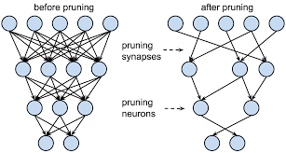
Pruning: reduce the Network
Fine grain pruning
removing connections with small weigths
remove neurons
Coarse grain pruning
remove kernel (2D): i.e., skip input feature map for a certain filter
removing complete filter (3D), i.e. reduce nr. of output feature maps
Structured pruning:
try to keep e.g. SIMD regularity (vector computing)
Typically fine tune weights after pruning steps

Slide 17
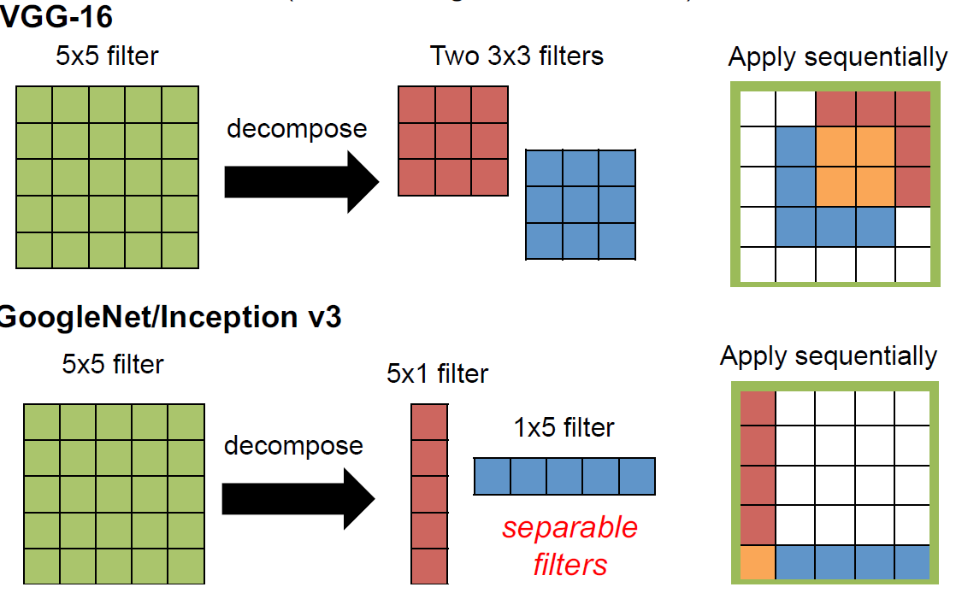
Reducing filter sizes: filter decomposition

Slide 18
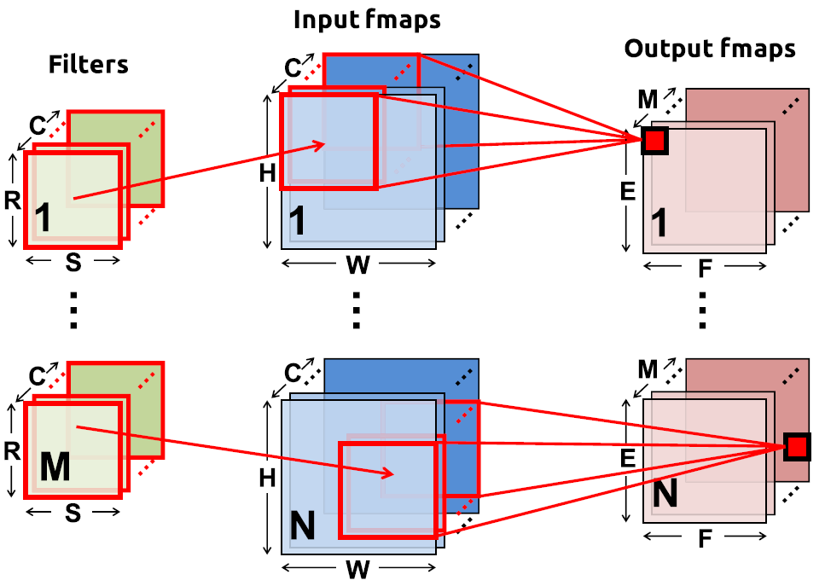
Remember the CNN terminology (single layer)
N = batch size
C input feature maps of size HxW
M output feature maps of size ExF
M filters of size RxS
Total filter size = Mx (RxSxC)
Dream this picture !

Slide 19
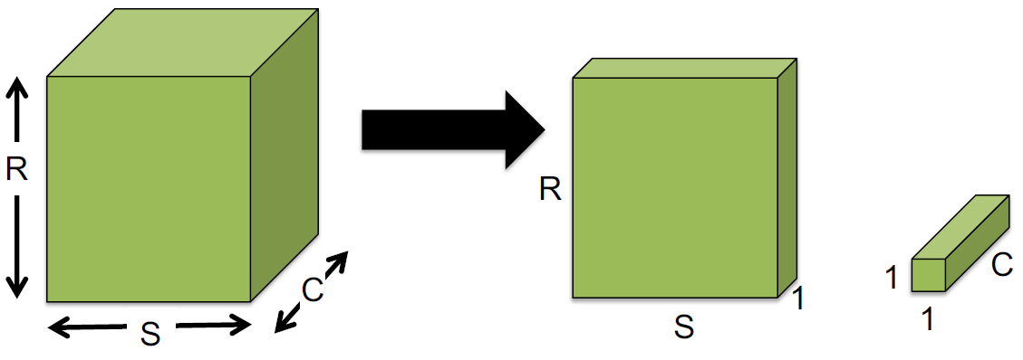
Reducing filter sizes: decouple correlations
Decouple the cross-channels correlations and spatial correlations in the feature maps of the DNN: depth wise convolution
+
Number of operations for M output channels reduces dramatically:
Left: H*W*(R*S*C)*M
Right: H*W*(R*S)*C + H*W*C*M = H*W*C*(R*S + M)

Slide 20
Network scaling
Different scaling options
Width scaling: more channels, i.e. more filters
Depth scaling: more layers
Resolution scaling: increase image size
Some methods do this in systematic ways
EfficientNet: Rethinking model scaling for CNNs
Searching for MobileNetV3
Many NAS, Network Architecture Search, methods

Slide 21
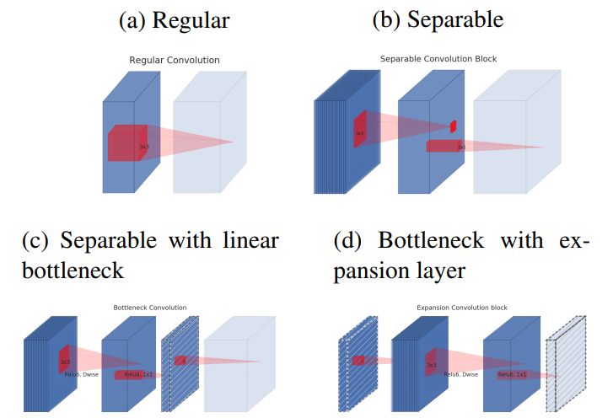
Evolution of separable convolution blocks
AlexNet, VGG
MobileNetV1
MobileNetV2/3
MnasNet
EfficientNet
Diagonally hatched layers do not use non-linearities.
Thickness of each block indicates its relative number of channels.
Note: c and d are equivalent blocks when stacked.
Notes:
see MobileNetv2 paper for more explanation

Slide 22
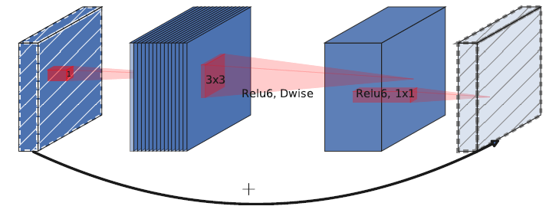
MobileNetV2: bottleneck with residual
C
D
D
C
Each MobileNetV2 block consists of
narrow C-channel input and output (low number of channels)
expansion by D (1x1xC) filters to much higher D-dimensional space: tunable dimension
depth wise convolution (followed by Relu6 activation)
projection by C (1x1xD) to lower C-dimensional space, i.e. reducing nr. of output channels
residual connection over the whole block

Slide 23
MnasNet: MobileNetV2 + Squeeze-and-Excite
Squeeze-and-Excite attention layer:
squeeze: averaging each input channel to 1 value
excite: determine scale factor
using C fully connected learnable convolutions
scale input channels

Slide 24
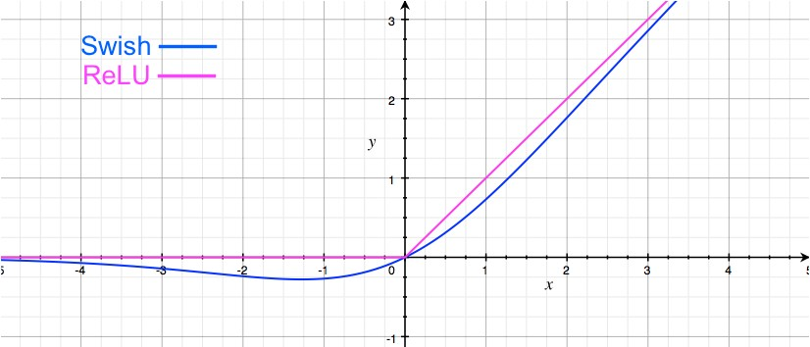
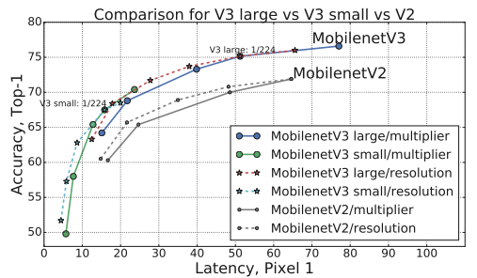
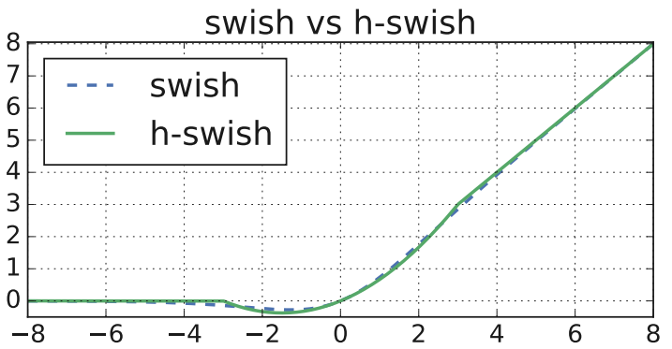
MobileNetV3
adds to MobileNetV2
replaces ReLU by Swish
actually an approximation:
h-swish(x) = x*(ReLU6(x+3))/6
network scaling using NAS

Slide 25
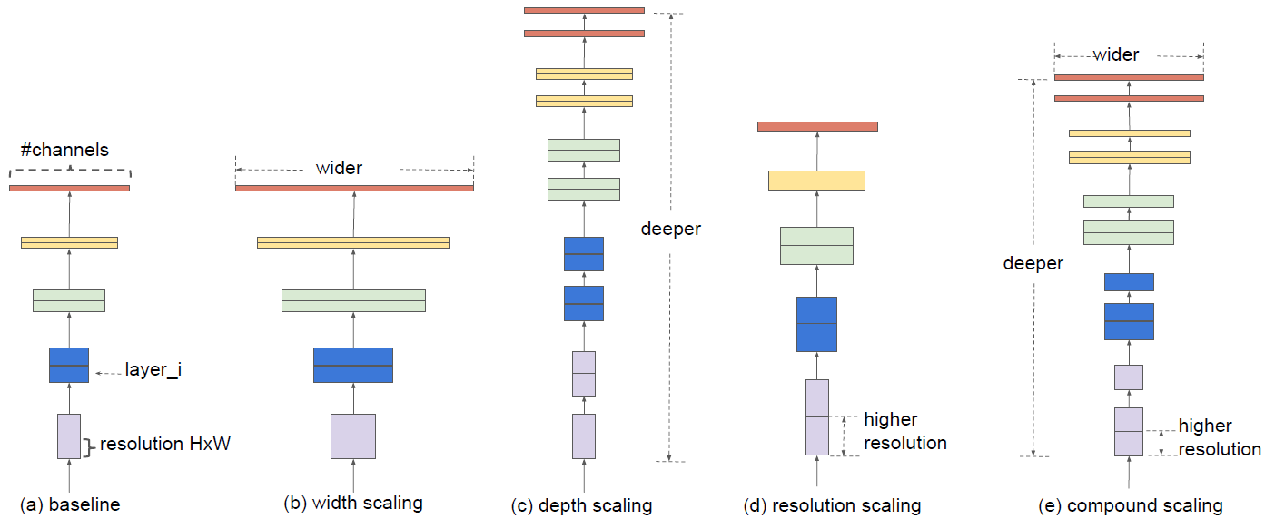
Different scaling methods, combined in EfficientNet

Slide 26
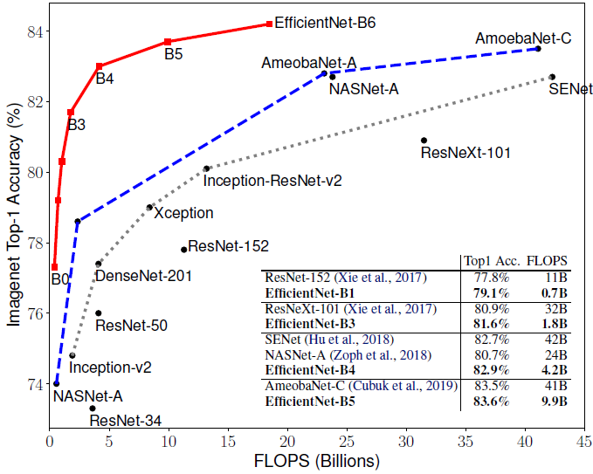
EfficientNet: Flops vs ImageNet Accuracy
Red line shows EfficientNet
options for different scalings

Slide 27
What did you learn
How to express reuse options in Halide for a 1-D convolution filter
4th Optimization: Several changes to Network Structure:
decomposition
depth wise convolution
squeeze-and-excite
scaling options: width, depth, resolution
adding more residual connections
Later we’ll discuss automated & structured approaches for this:
NAS: Network Architecture Search

