Slide 1
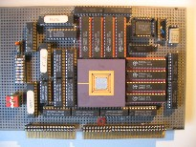
Embedded Computer Architecture 5SAI0 Memory hierarchy - an analogy -
Henk Corporaal
www.ics.ele.tue.nl/~heco/courses/ECA
h.corporaal@tue.nl
TUEindhoven
2019-2020

Slide 2
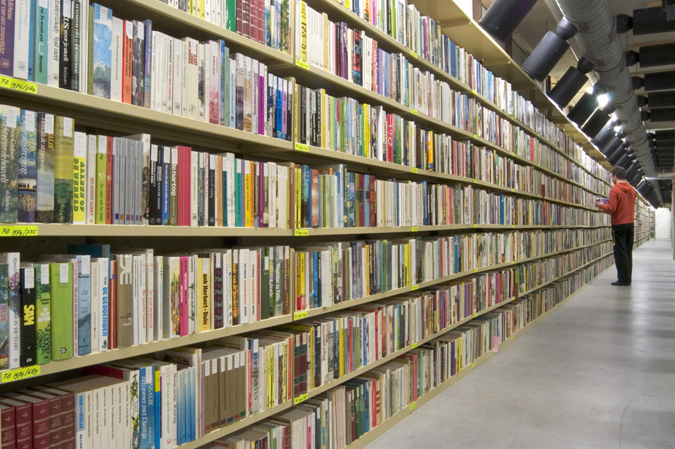
Huge book depot

Slide 3
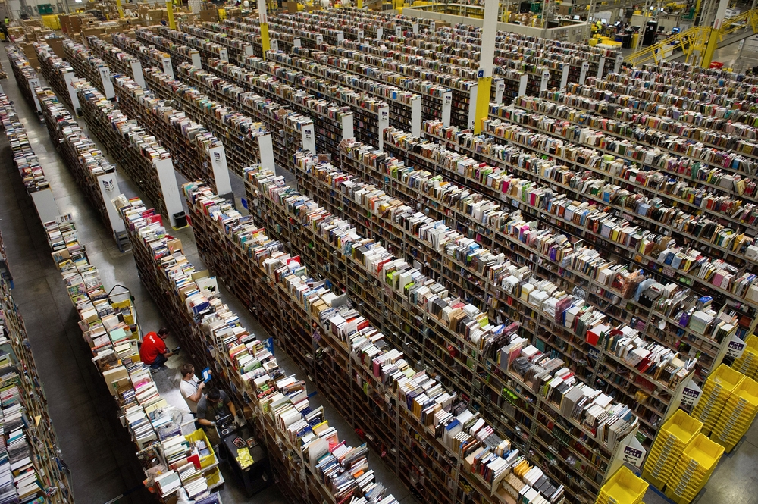
Really huge

Slide 4
You are “book depot manager”, a librarian
All your books are in a huge depot
Clients can borrow books from this depot
Getting or storing a book requires 10 minutes (on average; per customer)
Your clients don’t like this !
You neither !
You urgently need a solution; preferably cheap. Please find solutions !!

Slide 5
Suggested Solutions
More books at a time =>
higher throughput, but
longer delay (latency) per customer !
Borrowers have to send requests in advance
not customer friendly; perhaps he/she wants advice first
Robotize the depot =>
costs 2 Million €
Hire more people =>
higher throughput, but
same delay per customer
We need something else !

Slide 6
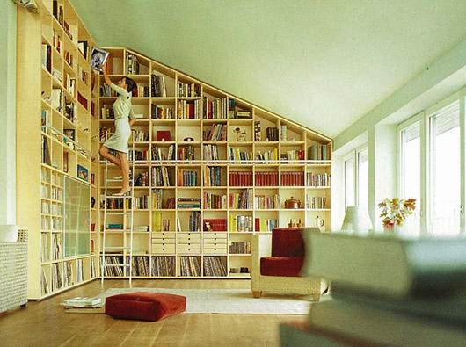
Local Shelves
Why does it work?
temporal locality !!
What about spatial locality?

Slide 7
Exercise 1: Local shelves
Assume getting/storing a book from/on the local shelves takes 10 seconds
Questions:
Calculate the average access time (AAT) of a book
Give also the general formula for AAT
You miss some information; what? Make reasonable assumption for this.

Slide 8
Answer 1
Getting/storing a book from/on the local shelves takes 10 seconds
Calculate the average access time (AAT) of a book
Give also the general formula for AAT
You miss some information; what? Make reasonable assumption for this
Answer
Missing knowledge is the ‘hit-rate’
assume f_hit = 90 % or 0.9 =>
miss-rate f_miss = 10 % or 0.1
AAT = hit-time + f_miss * miss-time = 10 s + 0.10*600 s = 70 s per book
(still over a minute / book; 7 times slower than the shelves)

Slide 9
Exercise 2: How to store books
What is an efficient storage system? How/where to store the books?
for the depot?
for the local shelves?
What are the issues to look at?
find a book:
how to quickly locate a book
what if a book is not on the shelves
adding new books:
how/where to store a returned book?
how/where to store a new book?
what if the shelves are full?
how to replace a book?

Slide 10
Answer 2
Issues
quickly finding the location
easy to store a book / adding a book
Depot:
could use linear / alphabetic numbering system
what if a certain shelve is full =>
dynamically linked shelves
Local shelves
use part of the number for indicating a shelve
E.g. if we have 100 shelves, and booknr. = 123456 =>
use shelvenr. 12 (or any other 2 digits)

Slide 11
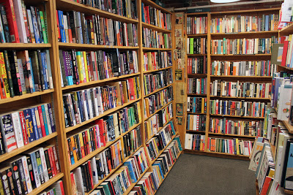
Still not fast enough
How can we further improve the AAT?
Intermediate (second) level shelves (= the traditional library)

Slide 12
Exercise 3: 2-level shelves
Assume for the library (= second level)
Book access time = 1 minute,
hit-rate = 80%
Shelves are in front of the library.
Questions:
Why is hit-rate_library (80%) < hit-rate_shelves (90%)?
What’s the AAT?
Give a general formula for 2 level shelve solution.

Slide 13
Answer 3
Assume for the library
Book access time = 1 minute,
hit-rate = 80%
Shelves are in front of the library.
Question
why is hit-rate_library < hit-rate_shelves?
what’s the AAT?
give also general formula for 2 level shelve solution
Answers
AAT = hit_time + miss_rate_shelves*miss_time_shelves = 10s + 0.10*180s = 28s per book
where
miss-time_shelves = hit_time_library + miss-rate_library* miss-time_library = 60s+0.2*600s=180s

Slide 14
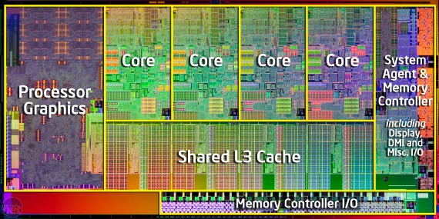
What has a library depot in common with a computer?
Computer has slow memory
Computer runs at 2 GHz (1 clock cycle = 0.5 ns)
Memory runs at 10 MHz (access = 100 ns) =>
memory access requires 200 clock cycles !!
slows down the calculation about 200 times.
Solution:
Multiple levels of cache between main memory and processor

Slide 15
Multi-level cache
Main
memory
Level-2
$
Level-1
$
processor
*,/,+,-
t = 0.5 ns
t = 1 ns
hit-rate = 90%
t = 10 ns
hit-rate = 70%
t = 100 ns
hit-rate = 100%
how can this
be 100% ?
Questions:
Calculate the AAT in ns.
A program executes 10^10 instructions; every instruction requires 1 processor cycle; what is the total execution time (including memory delay)?
Invent an efficient storage system for a cache

