Slide 1
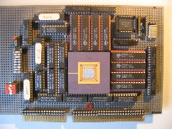
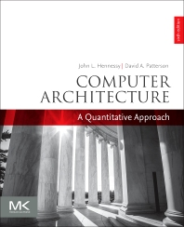

Embedded Computer Architecture
5SAI0
Introduction
Henk Corporaal
www.ics.ele.tue.nl/~heco/courses/ECA
h.corporaal@tue.nl
TUEindhoven
2019-2020

Slide 2
Lecture overview
Trends
  Performance increase
  Technology factors
Computing classes
Cost
Performance measurement
  Benchmarks
  Metrics
Dependability

Slide 3

Trends
International Roadmap for Devices and Systems (IRDS)
en.wikipedia.org/wiki/International_Roadmap_for_Devices_and_Systems
https://irds.ieee.org
before 2017 this was the ITRS roadmap,
International Technology Roadmap Semiconductors

Slide 4
Performance Improvement: from where?
Semi-conductor Technology
  More transistors per chip
  Faster logic
Micro Architecture: Machine Organization
  Deeper pipelines
  More instructions executed in parallel
Architecture: ISA, etc.
  Reduced Instruction Set Computers (RISC > 1985)
  Multimedia extensions
  Explicit parallelism
Compiler technology (see lecture 5LIM0 in Q3)
  Finding more parallelism in code
  Greater levels of optimization
Computer
(Micro) Architecture

Slide 5
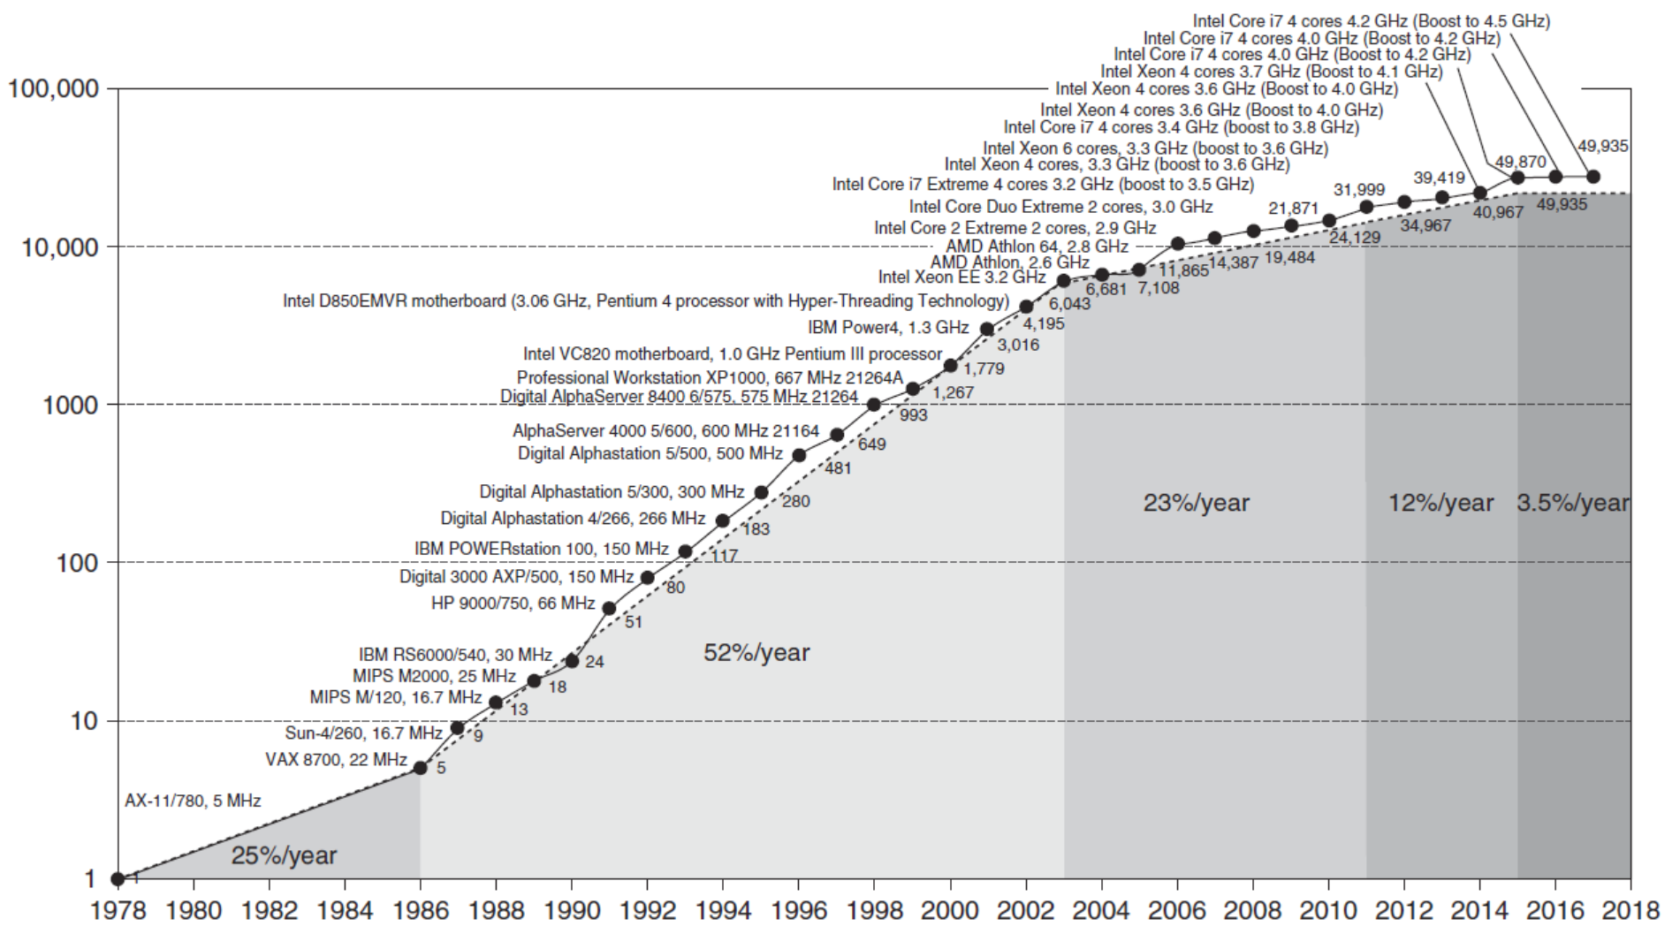
Performance trends of processors (for 1 core)

Slide 6
Trends in Computer Architecture
Cannot continue to leverage Instruction-Level parallelism (ILP)
  Single processor performance improvement ended in 2003
New models for performance:
  Data-level parallelism (DLP)
  Thread-level parallelism (TLP)
  Request-level parallelism (RLP)
These require explicit restructuring of the application

Slide 7
Trends in Technology
Integrated circuit technology (Moore’s Law)
  Transistor density: 35%/year
  Die size: 10-20%/year
  Integration overall: 40-55%/year
DRAM capacity: 25-40%/year (slowing)
  8 Gb (2014), 16 Gb (2019), possibly no 32 Gb
Flash capacity: 50-60%/year
  8-10X cheaper/bit than DRAM
Magnetic disk capacity: recently slowed to 5%/year
  Density increases may no longer be possible, maybe increase from 7 to 9 platters
  8-10X cheaper/bit then Flash
  200-300X cheaper/bit than DRAM

Slide 8
Bandwith vs Latency (developments since 1978 till 2017)
Bandwidth or throughput
  Total work done in a given time
  32,000-40,000X improvement for processors
  300-1200X improvement for memory and disks
Latency or response time
  Time between start and completion of an event
  50-90X improvement for processors
  6-8X improvement for memory and disks
  (for more on above numbers see next slide)

Slide 9
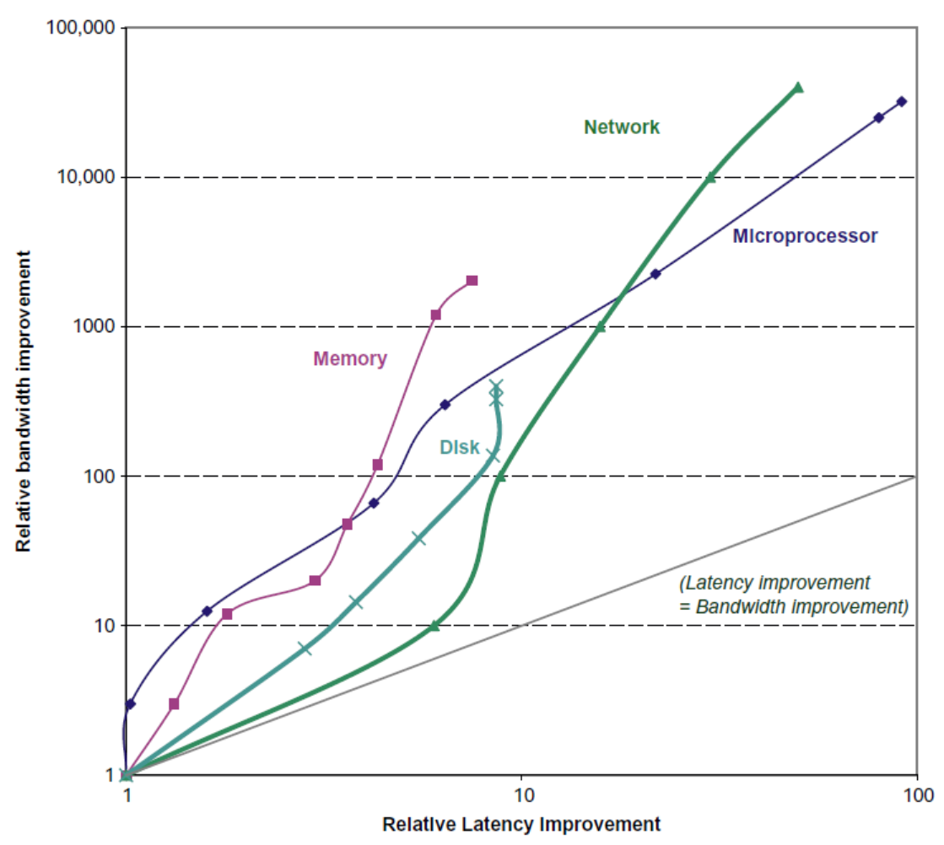
Bandwith vs Latency
Log-log plot of bandwidth
and latency milestones

Slide 10
Transistors and Wires
Feature size
  Minimum size of transistor or wire in x or y dimension
  10 microns in 1971 to .011 microns in 2017
  Transistor performance scales linearly
    Wire delay does not improve with feature size!
  Integration density scales quadratically

Slide 11
Power / Energy
Problem: Get power in, get power out
Thermal Design Power (TDP)
  Characterizes sustained power consumption
  Used as target for power supply and cooling system
  Lower than peak power (1.5X), higher than average power consumption
Clock rate can be reduced dynamically to limit power consumption
Energy per task is often a better measurement

Slide 12
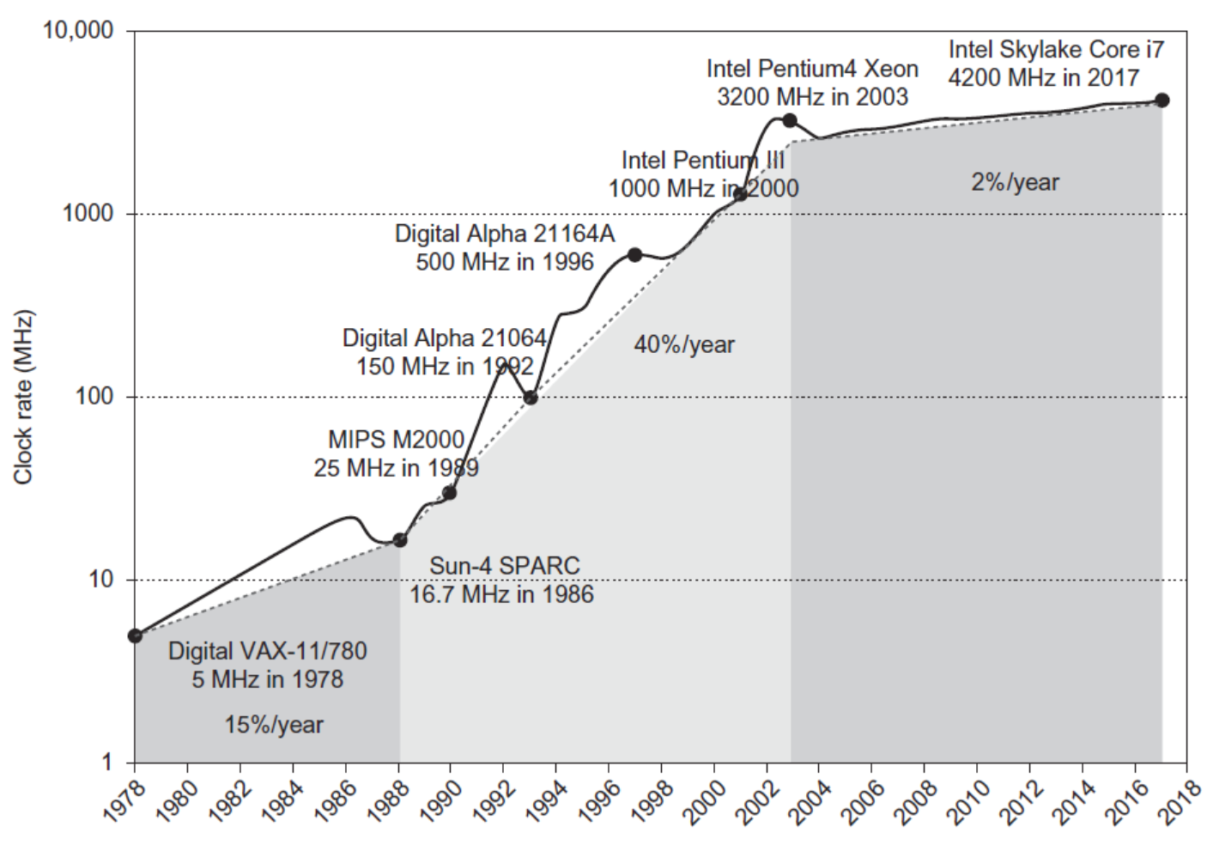
Frequency and Power trends (of processors)
Intel 80386 consumed ~ 2 W
3.3 GHz Intel Core i7 consumes 130 W
Heat must be dissipated from 1.5 x 1.5 cm chip
This is about the limit of what can be cooled by air

Slide 13
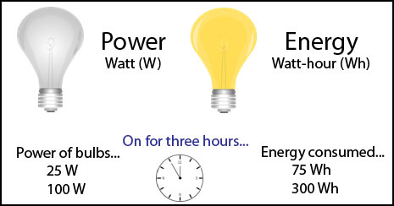
Power / Energy
Energy E = P*t
(power P, execution time t)
P = P_{static} + P_{dynamic}
static: leakage ~ chip area
dynamic: switching (0->1 or 1->0
  P_{dynamic} = ½ α f C V_{dd}²
  E_{dynamic} = ½ α C V_{dd}²
Reducing clock rate reduces power, not energy
Power vs Energy

Slide 14
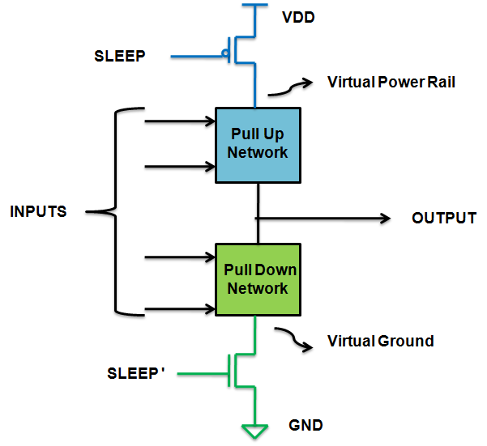
Static Power Consumption
25-50% of total power
Current_{static} x Voltage
Scales with number of transistors
To reduce: power gating:

Slide 15
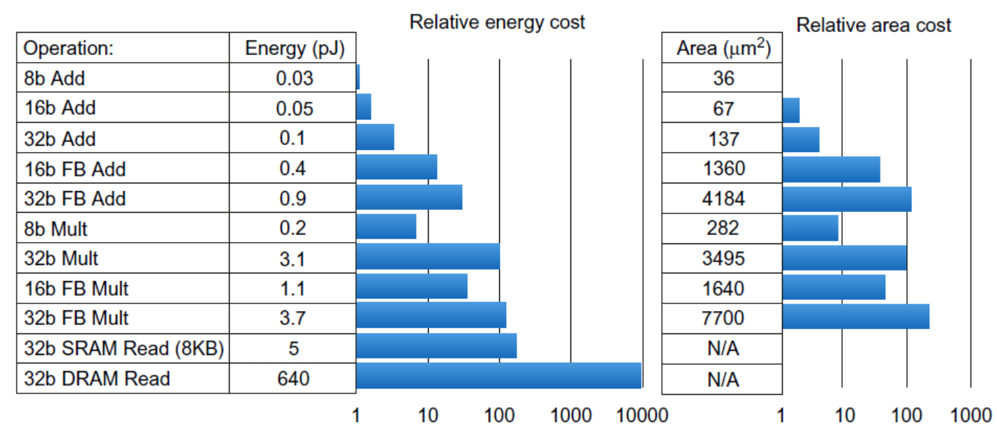
Where is the energy / power going?
Dynamic power ~ Switching energy
Static power ~ Area

Slide 16
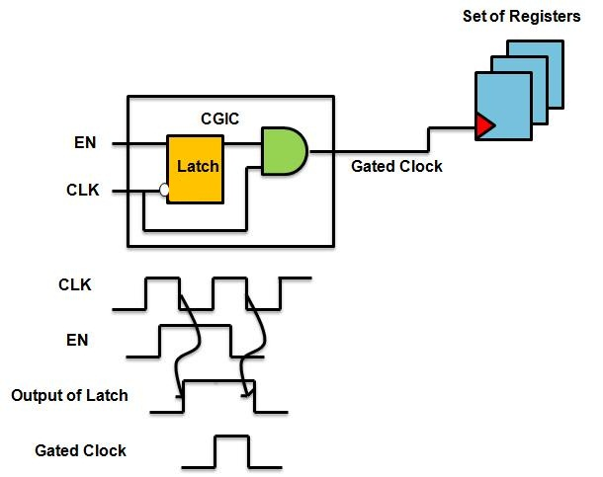
Dynamic power reduction
Reduce switching
(dynamic) energy by
clock gating:

Slide 17
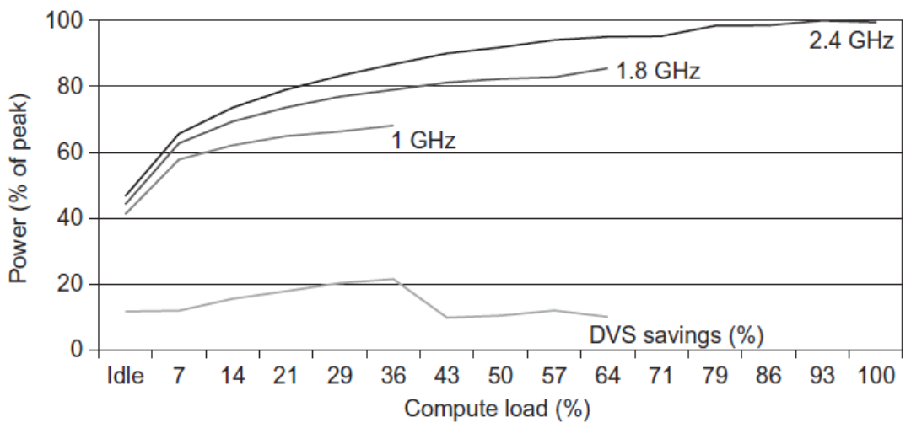
Dynamic power reduction
Dynamic Voltage-Frequency Scaling (DVFS)

Slide 18
Classes of Computers
Personal Mobile Device (PMD)
  E.g. smartphones, tablets
  Emphasis on energy efficiency (battery life time) and real-time (short latency)
Desktop Computing
  Emphasis on price-performance
Servers
  Emphasis on availability, scalability, throughput
Clusters / Warehouse Scale Computers / Clouds
  Used for “Software as a Service (SaaS)”
  Emphasis on availability and price-performance
  Sub-class: Supercomputers, emphasis: floating-point performance and fast internal networks
Internet of Things/Embedded Computers (on the IoT Edge)
  Emphasis: price

Slide 19
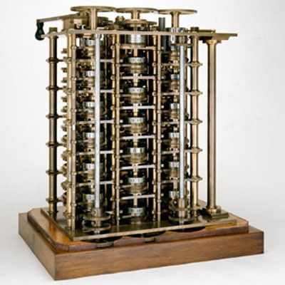
Some history: Earliest computers
Mechanical
  Charles Babbage: Difference Engines
Electro-Mechanical
  Konrad Zuse's Z1, Z2, Z3
Electronic
  ENIAC
Part of Difference Engine 1, 1832

Slide 20
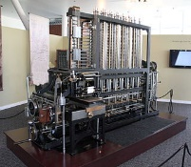
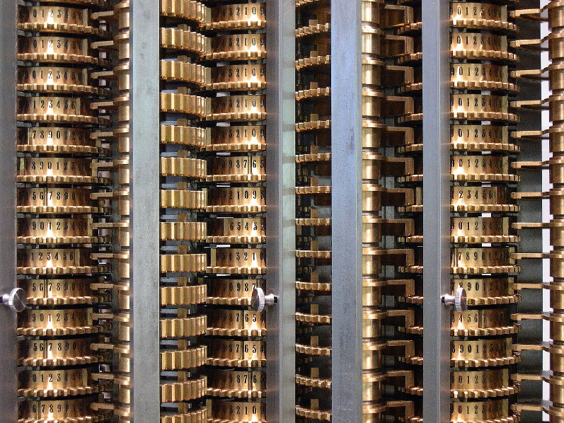
Mechanical: Difference Engine no.2
Science museum
Compute values of
polynomial functions
using finite differences
Smaller version
no.0 in 1822

Slide 21
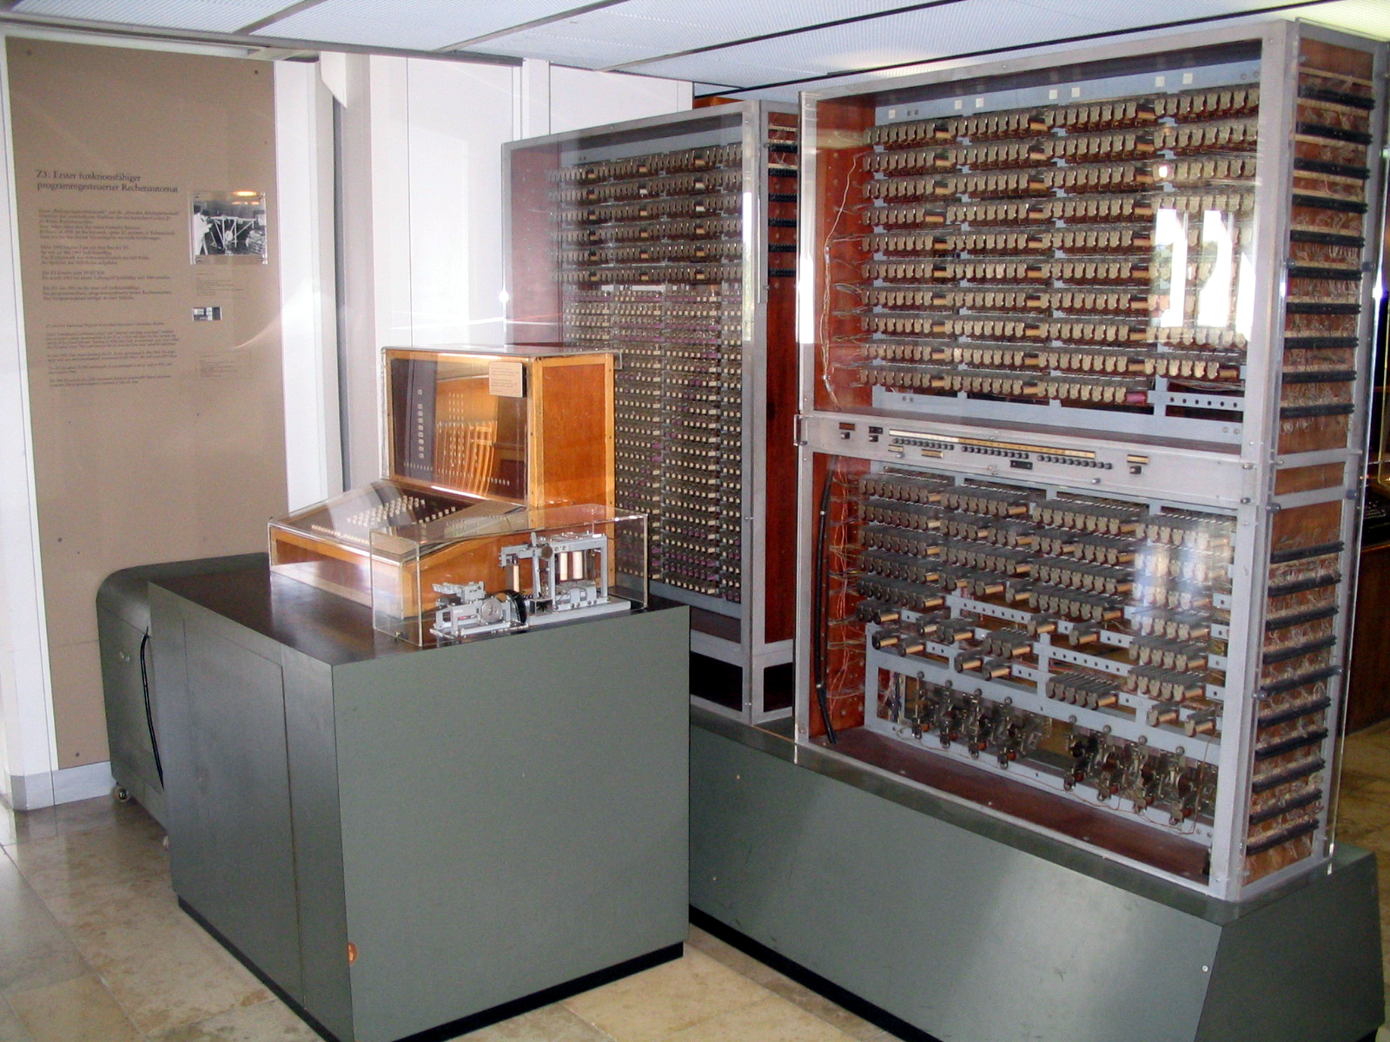
Electro-Mechanical
Z3, 1941
1400 relais
Museum Munchen

Slide 22
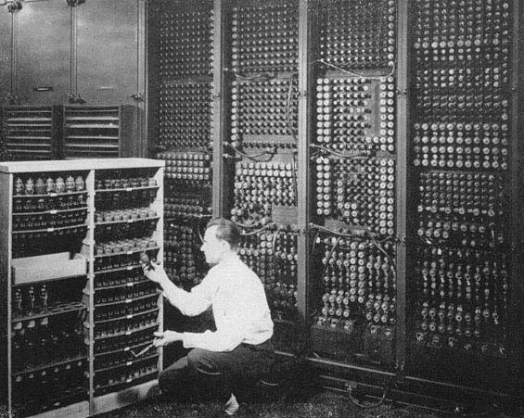
ENIAC: Electronic Numerical Integrator And Computer, 1946

Slide 23
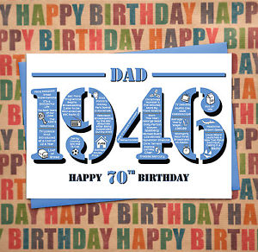
VLSI Developments: Technology Improvement
1946: ENIAC electronic numerical integrator and computer
Floor area
  140 m2
Performance
  multiplication of two 10-digit numbers in 2 ms
Power
  160 KWatt
Today: High Performance microprocessor
Chip area
  100-400 mm2 (for multi-core)
Board area
  200 cm2; improvement of 10⁴
Performance:
  64-bit multiply in O(1 ns); improvement of 10⁶
Power
  ~20 Watt; improvement ~8000
And: cost reduction!!

Slide 24
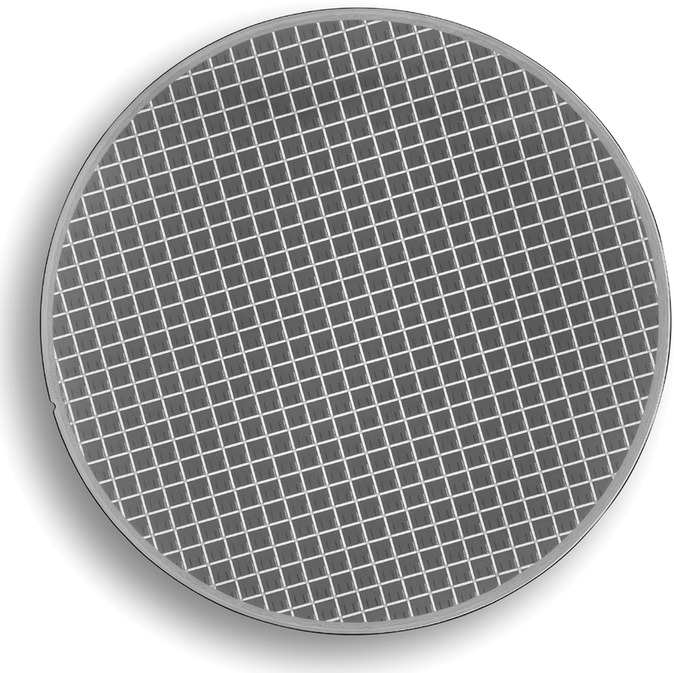
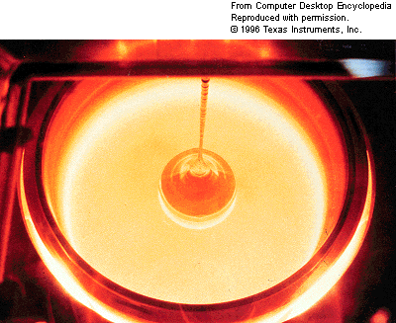
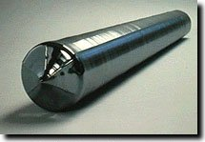
8” MIPS64 R20K wafer (564 dies)
Drawing single-crystal
Si ingot from furnace….
Then, slice into wafers and pattern it…

Slide 25
What's the price of an IC ?
Die cost + Testing cost + Packaging cost
Final test yield
Final test yield = fraction of packaged dies which pass
the final testing state
Wafer cost
Dies per Wafer * Die yield
IC cost =
Dies per wafer
Die cost =

Slide 26
Die yield
Die yield: fraction of good dies on a wafer
Bose-Einstein formula:
  Die yield = Wafer yiels * 1/(1+Defects per unit area * Die area)^{N}
    Defects per unit area = 0.016-0.057 defects per square cm (2010)
    N = process-complexity factor = 11.5-15.5 (40 nm, 2010)

Slide 27
What's the price of the final product ?
Component Costs
Direct Costs (add 25% to 40%)
  recurring costs: labor, purchasing, warranty
Gross Margin (add 82% to 186%)
  nonrecurring costs: R&D, marketing, sales, equipment maintenance, rental, financing cost, pretax profits, taxes
Average Discount to get List Price (add 33% to 66%):
  volume discounts and/or retailer markup
List Price
Average
Discount
25% to 40%
Avg. Selling Price
Gross
Margin
34% to 39%
Direct Cost
6% to 8%
Component
Cost
15% to 33%

Slide 28
Quantitative Principles of Design
Take Advantage of Parallelism
Principle of Locality
Focus on the Common Case
  E.g. common case supported by special hardware; uncommon cases in software
  However, check Amdahl’s Law, or Gustafson's Law
The Performance Equation

Slide 29
1. Parallelism
Parallelism helps performance, ..... but also energy !!
  having more performance allows to reduce Vdd (and frequency)
How to improve performance?
  Pipelining (see next slides; other methods come later during the course)
    single cycle throughput with multi-cycle latency (i.e. latency > 1/throughput)
  Powerful instructions
    MD-technique: Multiple Data operands per operation
    MO-technique: Multiple Operations per instruction
  Multiple instruction issue
    Issue more instructions per cycle in a single instruction-program stream
  Multiple (instruction) streams (or programs, or tasks)

Slide 30
Example of Pipelined Instruction Execution
Time (clock cycles)
Cycle 1
Cycle 2
Cycle 3
Cycle 4
Cycle 5
Cycle 6
Cycle 7
I
n
s
t
r.
O
r
d
e
r
Ifetch
Reg
ALU
DMem
Reg
Ifetch
Reg
ALU
DMem
Reg
Ifetch
Reg
ALU
DMem
Reg
Ifetch
Reg
ALU
DMem
Reg

Slide 31
Pipelining Limitations: Hazards:
Hazards: prevent next instruction from executing during its designated clock cycle
Structural hazards:
  Use same hardware to do two different things at once
Data hazards:
  Instruction depends on result of prior instruction still in the pipeline
Control hazards:
  It takes several cycles before
  knowing whether a
  conditional branch should
  be taken or not
Time (clock cycles)
I
n
s
t
r.
O
r
d
e
r
Ifetch
Reg
DMem
Reg
ALU
Ifetch
Reg
ALU
DMem
Reg
Ifetch
Reg
ALU
DMem
Reg
Ifetch
Reg
ALU
DMem
Reg

Slide 32
2. The Principle of Locality
Programs access a relatively small portion of the address space at any instant of time (boths for Instructions and for Data).
Two Different Types of Locality:
  Temporal Locality (Locality in Time): If an item is referenced, it will tend to be referenced again soon (e.g., instruction loops, data reuse)
  Spatial Locality (Locality in Space): If an item is referenced, items whose addresses are close by tend to be referenced soon
  (e.g., straight-line code, array access)
Last 30 years, HW relied on locality for memory perf.
Proc.
Instr$
Memory
Data$
Notes:
The principle of locality states that programs access a relatively small portion of the address space at any instant of time.
This is kind of like in real life, we all have a lot of friends. But at any given time most of us can only keep in touch with a small group of them.
There are two different types of locality: Temporal and Spatial. Temporal locality is the locality in time which says if an item is referenced, it will tend to be referenced again soon.
This is like saying if you just talk to one of your friends, it is likely that you will talk to him or her again soon.
This makes sense. For example, if you just have lunch with a friend, you may say, let’s go to the ball game this Sunday. So you will talk to him again soon.
Spatial locality is the locality in space. It says if an item is referenced, items whose addresses are close by tend to be referenced soon.
Once again, using our analogy. We can usually divide our friends into groups. Like friends from high school, friends from work, friends from home.
Let’s say you just talk to one of your friends from high school and she may say something like: “So did you hear so and so just won the lottery.”
You probably will say NO, I better give him a call and find out more.
So this is an example of spatial locality. You just talked to a friend from your high school days. As a result, you end up talking to another high school friend. Or at least in this case, you hope he still remember you are his friend.
+3 = 10 min. (X:50)

Slide 33
Memory Hierarchy Levels
Capacity
Access Time
Cost
Staging
Xfer Unit
CPU Registers
100s Bytes
300 – 500 ps (0.3-0.5 ns)
Registers
Upper Level
Instr. Operands
prog./compiler
1-32 bytes
faster
L1 and L2 Cache
10s-100s K Bytes
~1 ns - ~10 ns
~ $100s/ GByte
L1 Cache
Blocks
cache cntl
32-64 bytes
L2 Cache
cache cntl
64-128 bytes
Main Memory
many G Bytes
80ns- 200ns
~ $10/ GByte
Blocks
Memory
Pages
OS
4K-8K bytes
Disk
10s T Bytes, 10 ms
(10,000,000 ns)
~ $0.1 / GByte
Disk
Files
user/operator
Gbytes
Larger
Tape
infinite
sec-min
~$0.1 / GByte
Tape
Lower Level
still needed?

Slide 34
3. Focus on the Common Case
Favor the frequent case, e.g.
  Instruction fetch and decode units used more frequently than multiplier, so optimize it first
  If database server has 50 disks / processor, storage dependability dominates system dependability, so optimize it first
Frequent case is often simpler and can be done faster
  E.g., overflow is rare when adding 2 numbers, so improve performance by optimizing more common case of no overflow
  May slow down overflow, but overall performance improved by optimizing for the normal case
What is frequent case? How much performance improved by making case faster? => Amdahl’s Law

Slide 35
Amdahl’s Law
1
T_{exec,old}
T_{exec,new}
Speedup_{overall} =
=
(1 - f_{parallel}) + f_{parallel}
Speedup_{parallel}
parallel part
f_{parallel}= parallel fraction
exc. time
serial part
serial part

Slide 36
Amdahl’s Law: exercise
Floating point instructions improved to run 2 times faster, but only 10% of actual instructions are FP
T_{exec,new} =
Speedup_{overall}
=

Slide 37
Amdahl’s Law
Floating point instructions improved to run 2 times faster; but only 10% of actual instructions are FP
T_{exec,new} = T_{exec,old} x (0.9 + 0.1/2) = 0.95 x T_{exec,old}
1
Speedup_{overall}
=
=
1.053 => 5.3%
0.95

Slide 38
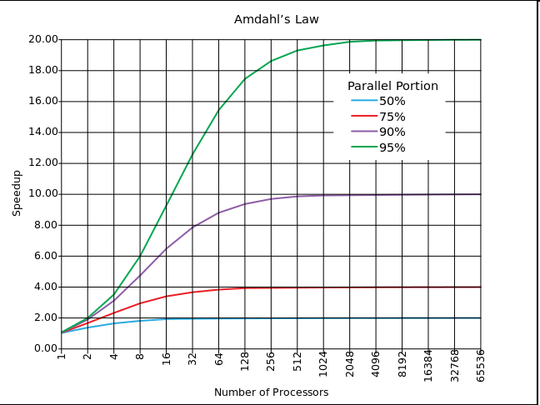
Amdahl's law

Slide 39
Are we rescued by Gustafson's law ?
Gustafson proposed a change to Amdahl's law
  assumes the data (input) set for the parallel part scales (increases) linearly with the number of processors
  => much better scaling
Speedup = P - f_{seq}(P-1)
where:
  P = # of processors (parallel speedup),
  f_{seq} = sequential fraction of the original program = 1-f_{par}
Notes:
Easy to derive
On sequential (single) single processor T = 1 ( = fseq + fpar)
On parallel system with P processors : we have much more data, the parallel part is P times bigger =>
Tseq = fseq + P*fpar, Tpar = 1 =>
Speedup = Tseq/Tpar = fseq + P*fpar = fseq + P (1- fseq) = P – fseq (P-1)

Slide 40
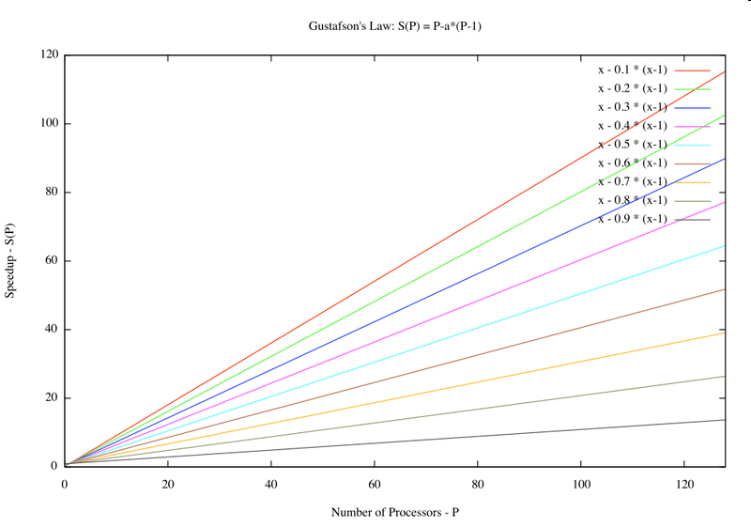
Gustafson's law

Slide 41
4. The performance equation
Main performance metric:
Total Execution Time (T_{exec})
T_{exec} = N_{cycles} * T_{cycle}
= N_{instructions} * CPI * T_{cycle}
  CPI = (Average number of) Cycles Per Instruction
  IPC = ....

Slide 42
Example: Calculating CPI
Base Machine (Reg / Reg)
Op Freq Cycles CPI(i) (% Time)
ALU 50% 1 .5 (33%)
Load 20% 2 .4 (27%)
Store 10% 2 .2 (13%)
Branch 20% 2 .4 (27%)
1.5
Typical Mix

Slide 43
Measurement Tools
Benchmarks, Traces, Mixes
Hardware: Cost, delay, area, power estimation
Simulation (many levels, see ch. 9)
  ISA, RT, Gate, Circuit level
Queuing Theory (analytic models)
Rules of Thumb
Fundamental “Laws”/Principles

Slide 44
Aspects of CPU Performance what influences what?
CPU time = Seconds = Instructions x Cycles x Seconds
Program Program Instruction Cycle
Instr. Cnt CPI Clock Rate
Program
Compiler
Instr. Set
Organization
Technology

Slide 45
Aspects of CPU Performance check the ‘x’
CPU time = Seconds = Instructions x Cycles x Seconds
Program Program Instruction Cycle
Inst Count CPI Clock Rate
Program X X
Compiler X X
Inst. Set. X X
Organization X X
Technology X

Slide 46
SPEC benchmarks, since 1989
CPU: CPU2006: CINT2006 and CFP2006
Graphics: SPECviewperf12 e.o.
HPC/OMP: HPC2002; OMP2001, MPI2006
Java Client/Server: jAppServer2004
Java runtime: SPECjvm2008
Mail Servers: MAIL2001
Network File System: SDS97_R1
Power: under development
Web Servers: WEB2005
Handheld: under development
Cloud: SPEC Cloud_laaS 2016
see for updates:
www.spec.org

Slide 47
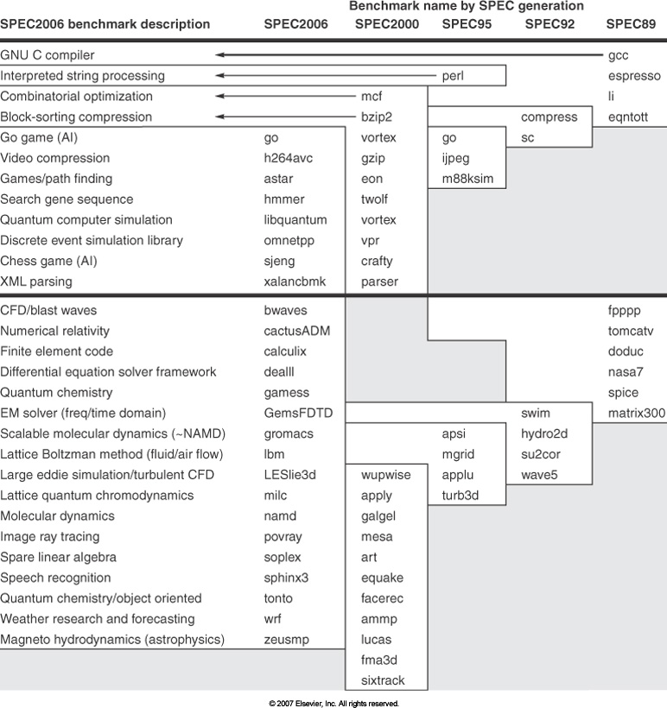
SPEC CPU benchmarks

Slide 48
How to Summarize Performance?
Arithmetic mean (or weighted arithmetic mean)
  tracks execution time: Σ(T_{i})/n , or weighted: Σ(W_{i}*T_{i})
Normalized execution time is handy for scaling performance
  e.g., speedup: X times faster than VAX-780
  (a famous computer in 1978)
Do not take the arithmetic mean of normalized execution time!
  Use the Geometric Mean = (∏_{i} Ratio_{i})^{1/n}
  Ratio can e.g. be the Speedup (compared to a Reference machine)

Slide 49
Dependability: How reliable is your system?
Metrics:
MTTF: mean time between failure (in hours)
MTTR: mean time to repair (in hours)
Availability = MTTF / (MTTF + MTTR)
FIT: failures in time (per 1 billion hours = 114k years!)
Example
  MTTF = 1,000,000 hours (= 114 years!)
  FIT = 10⁹ / MTTF = 1000 failures per billion hours

Slide 50
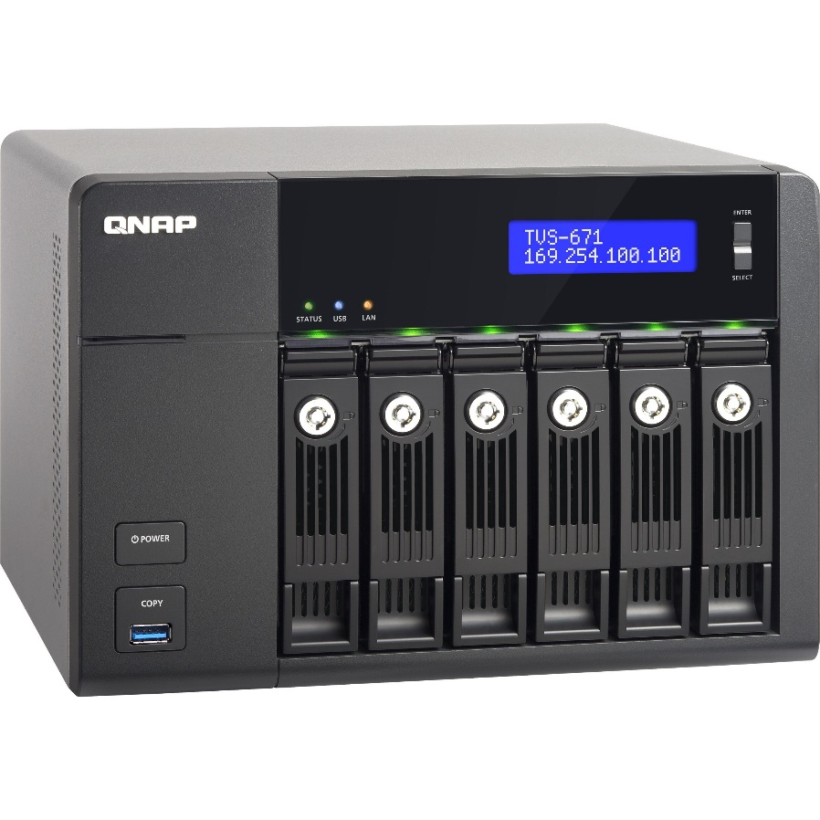
Dependability of a Disk subsystem
10 disks MTTF = 1,000,000 hours
1 Disk controller MTTF = 500,000
1 power-supply MTTF = 200,000
1 fan MTTF = 200,000
1 Disk cable MTTF = 1,000,000
Question: What is MTTF of this subsystem?
  assuming lifetimes are exponential distributed &
  failures are independ
FIT = Σ_{i} FIT_{i} = 10⁹ * {10 *1/10⁶ + 1/(5.10⁵⁾ + .. }
= 23000 failures / billion hours
MTTF = 1/FIT = 10⁹ hours / 23000 = 43,500 hours (~ 5 years)

Slide 51
Dependability: let's use redundancy
Two powersupplies:
  each MTTF = 20,000 hours (2.3 years) and
  MTTR = 1 day
What is the MTTF of the combined power supply?
On average the first disk fails in MTTF/2 = 10,000 hours
During repair second failure happens with probability
p = MTTR / MTTF = 24/20,000
MTTF_{pair} = 10,000/p = 83,000,000 hours (= 9475 years)

Slide 52

What did you learn?
Trends
  Performance increase slows down
    almost none for single processor
  Technology factors, Energy problem
Energy and Performance equations / issues
Main design issues, like parallelism, performance, cost & energy
How the cost of a computer is build up
Performance measurement
  Benchmarks & Metrics; summarizing performance
System reliability: Dependability calculations

Slide 53
Backup
some recent computer chips / systems
example of calculating Geometric mean
some extra info about course topics

Slide 54
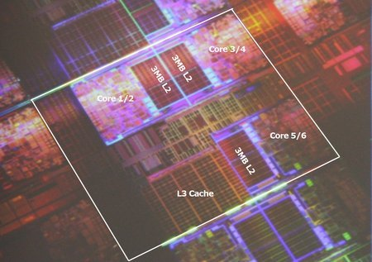
Intel Dunnington 6-core

Slide 55
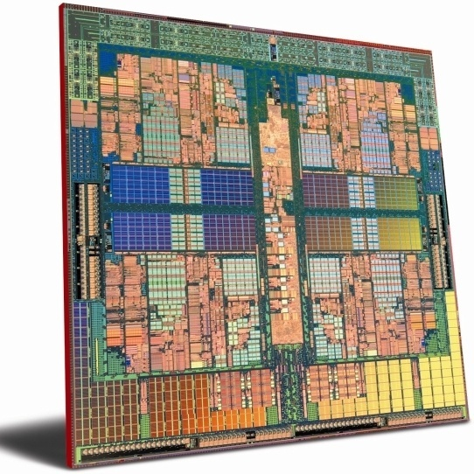
AMD Hydra 8 core
45 nm
L2: 1MByte/core
L3: shared 6MByte

Slide 56
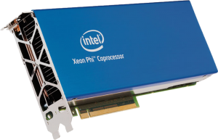
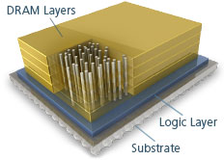
Intel Xeon Phi
Knights Landing (2015):
build on Silvermont (Atom) x86 cores
with 512-bit (SIMD) AVX units
up to 72 cores / chip => 3 TeraFlops
14 nm
using Micron’s DRAM 3D techn.
(hybrid memory cube)

Slide 57
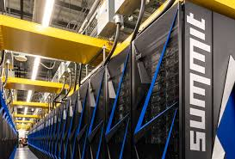
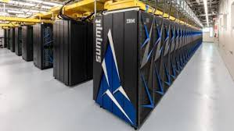
Nr 1 in the Top 500 supercomputers
IBM Summit
  122.3 petaflops on Linpack
  4356 nodes
  per node:
    2x 22-core Power9
    6 NVIDIA Tesla V100 GPUs

Slide 58
Summarize performance: example of Geometric mean
  Mean speedup comparisons between two machines are independent of the used reference machine
 | Program A | Program B | Arithmetic Mean | Speedup (ref 1) | Speedup (ref 2)
Machine 1 | 10 sec | 100 sec | 55 sec | 91.8 | 10
Machine 2 | 1 sec | 200 sec | 100.5 sec | 50.2 | 5.5
Reference 1 | 100 sec | 10000 sec | 5050 sec
Reference 2 | 100 sec | 1000 sec | 550 sec
Speedup
 |  | Program A | Program B | Arithmetic | Harmonic | Geometric
Wrt Reference 1 | Machine 1 | 10 | 100 | 55 | 18.2 | 31.6
 | Machine 2 | 100 | 50 | 75 | 66.7 | 70.7
Wrt Reference 2 | Machine 1 | 10 | 10 | 10 | 10 | 10
 | Machine 2 | 100 | 5 | 52.5 | 9.5 | 22.4

Slide 59
Computer Architecture Topics
Input/Output and Storage
Disks, WORM, Tape
RAID
Emerging Technologies
Interleaving
Bus protocols
DRAM
Memory
Hierarchy
Coherence,
Bandwidth,
Latency
L2 Cache
L1 Cache
Addressing,
Protection,
Exception Handling
VLSI
Instruction Set Architecture
Pipelining, Hazard Resolution,
Superscalar, Reordering,
Prediction, Speculation,
Vector, DSP
Pipelining and Instruction
Level Parallelism

Slide 60
Computer Architecture Topics
Programming model
Shared Memory,
Message Passing,
Data Parallelism
P
M
P
M
P
M
P
M
° ° °
S
Interconnection Network
Network Interfaces
Processor-Memory-Switch
Topologies,
Routing,
Bandwidth,
Latency,
Dependability /
Reliability
Multiprocessors
Networks and Interconnections

