Slide 1
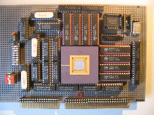


Embedded Computer Architecture
5SAI0
Micro Processor Architecture part 2
Henk Corporaal
www.ics.ele.tue.nl/~heco/courses/ECA
h.corporaal@tue.nl
TUEindhoven
2019-2020

Slide 2
Topics
Introduction, Hazards (short recap)
Out-Of-Order (OoO) execution:
  Dependences limit ILP: dynamic scheduling
  Hardware speculation
Branch prediction
Multiple issue
How much ILP is there?
Material Ch 3 (H&P or Dubois, second part)

Slide 3
Introduction
ILP = Instruction level parallelism
multiple operations (or instructions) can be executed in parallel, from a single instruction stream
  so we are not yet talking about MIMD, multiple instruction streams
Needed:
Sufficient (HW) resources
Parallel scheduling
  Hardware solution
  Software solution
Application should contain sufficient ILP

Slide 4
Single Issue RISC vs Superscalar
instr
op
instr
op
instr
op
instr
op
instr
op
instr
op
instr
op
instr
op
instr
op
instr
op
instr
op
Change HW,
but can use
same code
instr
op
instr
op
instr
op
instr
op
instr
op
instr
op
instr
op
instr
op
instr
op
instr
op
instr
op
instr
op
instr
op
execute
1 instr/cycle
issue and (try to) execute
3 instr/cycle
3-issue Superscalar
(1-issue)
RISC CPU

Slide 5
Recap (from pipelining lectures): Hazards
Three types of hazards (see previous lecture)
  Structural
    multiple instructions need access to the same hardware at the same time
  Data dependence
    there is a dependence between operands (in register or memory) of successive instructions
  Control dependence
    determines the order of the execution of basic blocks
Hazards cause scheduling problems and delay the pipeline

Slide 6
Data dependences
(see earlier lectures for details & examples)
RaW read after write
  real or flow dependence
  can only be avoided by value prediction (i.e. speculating on the outcome of a previous operation)
WaR write after read
WaW write after write
  WaR and WaW are false or name dependencies
  Could be avoided by renaming (if sufficient registers are available); see later slide
Notes:
data dependences can be both between registers and memory data operations
data dependencies are shown in de DDG: Data Dependence Graph

Slide 7
Impact of Hazards
Hazards cause pipeline 'bubbles'
Increase of CPI (and therefore execution time)
T_{exec} = N_{instr} * CPI * T_{cycle}
  CPI = CPI_{base} + Σ_{i} <CPI_{hazard_i}>
  <CPI_{hazard}> = f_{hazard} * <Cycle_penalty_{hazard}>
  f_{hazard} = fraction [0..1] of occurrence of this hazard

Slide 8
Control Dependences: CFG
C input code:
1
sub t1, a, b
bgz t1, 2, 3
CFG
(Control Flow Graph):
if (a > b) { r = a % b; }
else { r = b % a; }
y = a*b;
2
rem r, a, b
goto 4
3
rem r, b, a
goto 4
4
mul y,a,b
…………..
Questions:
How real are control dependences?
Can ‘mul y,a,b’ be moved to block 2, 3 or even block 1?
Can ‘rem r, a, b’ be moved to block 1 and executed speculatively?

Slide 9
Let's look at:
Dynamic Scheduling

Slide 10
Dynamic Scheduling Principle
What we examined so far is static scheduling
  Compiler reorders instructions so as to avoid hazards and reduce stalls
Dynamic scheduling:
hardware rearranges instruction execution to reduce stalls
Example:
    DIV.D F0,F2,F4 ; takes 24 cycles and
    ; is not pipelined
    ADD.D F10,F0,F8
    SUB.D F12,F8,F14
Key idea: Allow instructions behind stall to proceed
Book describes Tomasulo algorithm, but we first describe general idea
RaW; real dependence
This instruction cannot continue
even though it does not depend
on previous Div and Add

Slide 11
Advantages of Dynamic Scheduling
(compared to static scheduling, by compiler)
Handles cases when dependences are unknown at compile time
  e.g., because they may involve a memory reference
Simplifies the compiler (although a good compiler helps)
Binary compatible: Allows code compiled for one machine to run efficiently on a different machine, with different number of function units (FUs), and different pipelining
Allows hardware speculation, a technique with significant performance advantages, that builds on dynamic scheduling

Slide 12
Superscalar: General Architecture Concept
Instruction
Memory
Instruction
Instruction
Cache
Decoder
Reservation Stations
Branch
Unit
ALU-1
ALU-2
Logic &
Shift
Load
Unit
Store
Unit
Address
Data
Cache
Reorder
Buffer
Data
Data
Register
File
Data
Memory

Slide 13
Example of Superscalar Execution
Superscalar processor organization, example:
  simple pipeline: IF, EX, WB
  fetches/issues upto 2 instructions each cycle (= 2-issue)
  2 ld/st units, dual-ported memory; 2 FP adders; 1 FP multiplier
  Instruction window (buffer between IF and EX stage) is of size 2
  FP ld/st takes 1 cc; FP +/- takes 2 cc; FP * takes 4 cc; FP / takes 8 cc
Cycle 1 2 3 4 5 6 7
L.D F6,32(R2)
L.D F2,48(R3)
MUL.D F0,F2,F4
SUB.D F8,F2,F6
DIV.D F10,F0,F6
ADD.D F6,F8,F2
MUL.D F12,F2,F4

Slide 14
Example of Superscalar Processor Execution
Superscalar processor organization:
  simple pipeline: IF, EX, WB
  fetches 2 instructions each cycle
  2 ld/st units, dual-ported memory; 2 FP adders; 1 FP multiplier
  Instruction window (buffer between IF and EX stage) is of size 2
  FP ld/st takes 1 cc; FP +/- takes 2 cc; FP * takes 4 cc; FP / takes 8 cc
Cycle 1 2 3 4 5 6 7
L.D F6,32(R2) IF
L.D F2,48(R3) IF
MUL.D F0,F2,F4
SUB.D F8,F2,F6
DIV.D F10,F0,F6
ADD.D F6,F8,F2
MUL.D F12,F2,F4

Slide 15
Example of Superscalar Processor Execution
Superscalar processor organization:
  simple pipeline: IF, EX, WB
  fetches 2 instructions each cycle
  2 ld/st units, dual-ported memory; 2 FP adders; 1 FP multiplier
  Instruction window (buffer between IF and EX stage) is of size 2
  FP ld/st takes 1 cc; FP +/- takes 2 cc; FP * takes 4 cc; FP / takes 8 cc
Cycle 1 2 3 4 5 6 7
L.D F6,32(R2) IF EX
L.D F2,48(R3) IF EX
MUL.D F0,F2,F4 IF
SUB.D F8,F2,F6 IF
DIV.D F10,F0,F6
ADD.D F6,F8,F2
MUL.D F12,F2,F4

Slide 16
Example of Superscalar Processor Execution
Superscalar processor organization:
  simple pipeline: IF, EX, WB
  fetches 2 instructions each cycle
  2 ld/st units, dual-ported memory; 2 FP adders; 1 FP multiplier
  Instruction window (buffer between IF and EX stage) is of size 2
  FP ld/st takes 1 cc; FP +/- takes 2 cc; FP * takes 4 cc; FP / takes 8 cc
Cycle 1 2 3 4 5 6 7
L.D F6,32(R2) IF EX WB
L.D F2,48(R3) IF EX WB
MUL.D F0,F2,F4 IF EX
SUB.D F8,F2,F6 IF EX
DIV.D F10,F0,F6 IF
ADD.D F6,F8,F2 IF
MUL.D F12,F2,F4

Slide 17
Example of Superscalar Processor Execution
Superscalar processor organization:
  simple pipeline: IF, EX, WB
  fetches 2 instructions each cycle
  2 ld/st units, dual-ported memory; 2 FP adders; 1 FP multiplier
  Instruction window (buffer between IF and EX stage) is of size 2
  FP ld/st takes 1 cc; FP +/- takes 2 cc; FP * takes 4 cc; FP / takes 8 cc
Cycle 1 2 3 4 5 6 7
L.D F6,32(R2) IF EX WB
L.D F2,48(R3) IF EX WB
MUL.D F0,F2,F4 IF EX EX
SUB.D F8,F2,F6 IF EX EX
DIV.D F10,F0,F6 IF
ADD.D F6,F8,F2 IF
MUL.D F12,F2,F4
stall because
of data dep.
cannot be fetched because window full

Slide 18
Example of Superscalar Processor Execution
Superscalar processor organization:
  simple pipeline: IF, EX, WB
  fetches 2 instructions each cycle
  2 ld/st units, dual-ported memory; 2 FP adders; 1 FP multiplier
  Instruction window (buffer between IF and EX stage) is of size 2
  FP ld/st takes 1 cc; FP +/- takes 2 cc; FP * takes 4 cc; FP / takes 8 cc
Cycle 1 2 3 4 5 6 7
L.D F6,32(R2) IF EX WB
L.D F2,48(R3) IF EX WB
MUL.D F0,F2,F4 IF EX EX EX
SUB.D F8,F2,F6 IF EX EX WB
DIV.D F10,F0,F6 IF
ADD.D F6,F8,F2 IF EX
MUL.D F12,F2,F4 IF

Slide 19
Example of Superscalar Processor Execution
Superscalar processor organization:
  simple pipeline: IF, EX, WB
  fetches 2 instructions each cycle
  2 ld/st units, dual-ported memory; 2 FP adders; 1 FP multiplier
  Instruction window (buffer between IF and EX stage) is of size 2
  FP ld/st takes 1 cc; FP +/- takes 2 cc; FP * takes 4 cc; FP / takes 8 cc
Cycle 1 2 3 4 5 6 7
L.D F6,32(R2) IF EX WB
L.D F2,48(R3) IF EX WB
MUL.D F0,F2,F4 IF EX EX EX EX
SUB.D F8,F2,F6 IF EX EX WB
DIV.D F10,F0,F6 IF
ADD.D F6,F8,F2 IF EX EX
MUL.D F12,F2,F4 IF
cannot execute
structural hazard

Slide 20
Example of Superscalar Processor Execution
Superscalar processor organization:
  simple pipeline: IF, EX, WB
  fetches 2 instructions each cycle
  2 ld/st units, dual-ported memory; 2 FP adders; 1 FP multiplier
  Instruction window (buffer between IF and EX stage) is of size 2
  FP ld/st takes 1 cc; FP +/- takes 2 cc; FP * takes 4 cc; FP / takes 8 cc
Cycle 1 2 3 4 5 6 7
L.D F6,32(R2) IF EX WB
L.D F2,48(R3) IF EX WB
MUL.D F0,F2,F4 IF EX EX EX EX WB
SUB.D F8,F2,F6 IF EX EX WB
DIV.D F10,F0,F6 IF EX
ADD.D F6,F8,F2 IF EX EX WB
MUL.D F12,F2,F4 IF ?

Slide 21
Superscalar: General Architectur Concept
Instruction
Memory
Instruction
Instruction
Cache
Decoder
Reservation Stations
Branch
Unit
ALU-1
ALU-2
Logic &
Shift
Load
Unit
Store
Unit
Address
Data
Cache
Reorder
Buffer
Data
Data
Register
File
Data
Memory

Slide 22
Superscalar Issues
How to fetch multiple instructions in time?
(especially across basic block boundaries)
Predicting branches
Non-blocking memory system
Tune #resources(FUs, ports, entries, etc.)
Handling dependencies
How to support precise interrupts?
How to recover from a mis-predicted branch path?
For the latter two issues you may have a look at speculative and architectural state ,
  Processor Microarchitecture by Antonio González e.a., Morgan&Claypool 2011
  Superscalar Microprocessor Design, Mike Johnson, 1991 (or thesis 1989)

Slide 23
Beginning of dynamic scheduling
1967 @ IBM
  Robert Tomasulo
  Dynamic scheduling of Floating Point operations on multiple execution units
  Allowing Out-Of-Order execution
  Register renaming in HW
  Reservation stations in front of Execution Units
  CDB: Common Data Bus for all result broadcasts
see https://en.wikipedia.org/wiki/Tomasulo_algorithm

Slide 24
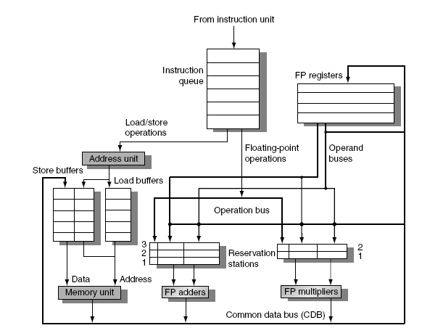
Tomasulo’s Algorithm
Top-level design:
Note: Load and Store buffers contain data and addresses, act like reservation stations

Slide 25
Tomasulo’s Algorithm
3 basic steps:
Issue
  Get next instruction from FIFO queue
  If available RS (reservation station), issue instruction to the RS with operand values if available
  If operand values not available, stall the instruction
Execute
  When operand becomes available, store it in all reservation stations waiting for it
  When all operands are ready, issue the instruction
  Loads and stores are maintained in program order
  No instruction allowed to initiate execution until all branches that proceed it in program order have completed
Write result
  Write result on CDB into reservation stations and store buffers
    (Stores must wait until address and value are received)

Slide 26
Register Renaming Technique
Eliminate name/false dependencies:
  anti- (WaR) and output (WaW)) dependencies
Can be implemented
  by the compiler
    advantage: low cost
    disadvantage: “old” codes perform poorly
  in hardware
    advantage: binary compatibility
    disadvantage: extra hardware needed

Slide 27
Register Renaming: general idea
Example, look at F6:
DIV.D F0, F2, F4
ADD.D F6, F0, F8
S.D F6, 0(R1)
SUB.D F8, F10, F14
MUL.D F6, F10, F8
name dependences with F6
(anti: WaR and output: WaW in this example)
Question: how can this code (optimally) be executed?
F6: RaW
F6: WaR
F6: WaW

Slide 28
Register Renaming
Original code:
DIV.D F0, F2, F4
ADD.D F6, F0, F8
S.D F6, 0(R1)
SUB.D F8, F10, F14
MUL.D F6, F10, F8
Same example after renaming:
  DIV.D R, F2, F4
  ADD.D S, R, F8
  S.D S, 0(R1)
  SUB.D T, F10, F14
  MUL.D U, F10, T
Each destination gets a new (physical) register assigned
Now only RaW hazards remain, which can be strictly ordered
We will see several implementations of Register Renaming
  use ReOrder Buffer (ROB) & Reservation Stations, or
  use large register file with mapping table

Slide 29
Register Renaming with Tomasulo
Register renaming can be provided by reservation stations (RS)
  Each RS entry contains 3 fields:
    Instruction
    Buffered operand values (when available)
    Reservation station number of instruction providing the operand values
Operation of RS:
  RS fetches and buffers an operand as soon as it becomes available
    not necessarily involving register file
  Pending instructions designate the RS to which they will send their output
    Result values broadcast on a result bus, called the common data bus (CDB)
  Only the last output updates the register file
  As instructions are issued, the register-IDs (register#)) are renamed with the reservation station
  We can have many more reservation stations than (architectural) registers

Slide 30
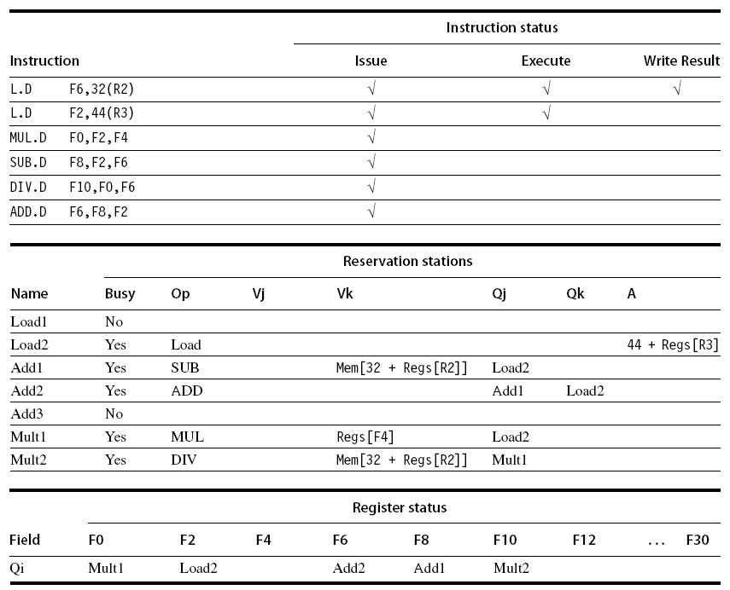
Example: snapshot, first L.D just finished

Slide 31
Speculation (Hardware based)
Execute instructions along predicted execution paths but only commit the results if the prediction was correct
Instruction commit: allowing an instruction to update the register file when instruction is no longer speculative
Need an additional piece of hardware to prevent any irrevocable action until an instruction commits:
  Reorder buffer, or Large renaming register file
  why? think about it?

Slide 32
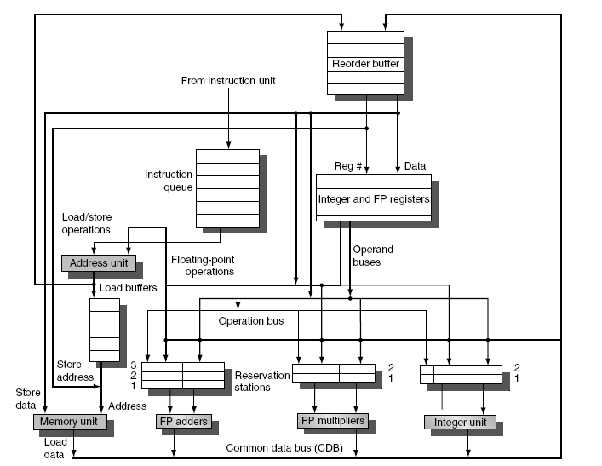
OoO execution with speculation using RoB
NEW

Slide 33
Reorder Buffer (RoB)
RoB – holds the result of instruction between completion and commit
  Four fields per entry:
    Instruction type: branch/store/register
    Destination field: register number
    Value field: output value
    Ready field: completed execution? (is the data valid)
Modify reservation stations:
  Operand source-id is now RoB (if its producer is still in the RoB) instead of functional unit (check yourself!)

Slide 34
Reorder Buffer (RoB)
Register values and memory values are not written until an instruction commits
RoB effectively renames the destination registers
  every destination gets a new entry in the RoB
On misprediction:
  Speculated entries in RoB are cleared
Exceptions:
  Not recognized/taken until it is ready to commit

Slide 35
Register renaming
The RoB together with the Reservation station effectively implement register renaming => avoiding WaW and WaR Hazards when reordering code
But...
  there is an alternative.....

Slide 36
Register Renaming using RAT
there’s a physical register file larger than logical register file
mapping table associates logical registers with physical register
  called RAT = Register Alias Table
when an instruction is decoded:
  its physical source registers are obtained from mapping table
  its physical destination register is obtained from a free list
  mapping table is updated
before:
addi r3,r3,4
after:
addi R2,R1,4
current
mapping table:
new
mapping table:
r0
R8
r0
R8
r1
R7
r1
R7
r2
R5
r2
R5
r3
R1
r3
R2
r4
R9
r4
R9
current free list:
R2 R6
new free list:
R6

Slide 37
Register Renaming using mapping table
Another example:
Before (assume r0->R8, r1->R6, r2->R5, .. ):
    addi r1, r2, 1
    addi r2, r0, 0 // WaR
    addi r1, r2, 1 // WaW + RaW
After (free list: R7, R9, R10)
    addi R7, R5, 1
    addi R10, R8, 0 // WaR disappeared
    addi R9, R10, 1 // WaW disappeared,
    // RaW renamed to R10

Slide 38
Summary O-o-O architectures
Instructions issue in-order, execute out-of-order, and commit in-order !!
Renaming avoids naming dependences
  via RoB: allocating an entry for every result, or
  via Register Mapping: Architectural registers are mapped on (many more) Physical registers
Speculation beyond branches
  branch prediction required (see next slides)
  recovery needed in case of miss prediction
    in-order-completion
    also needed for precise exception support

Slide 39
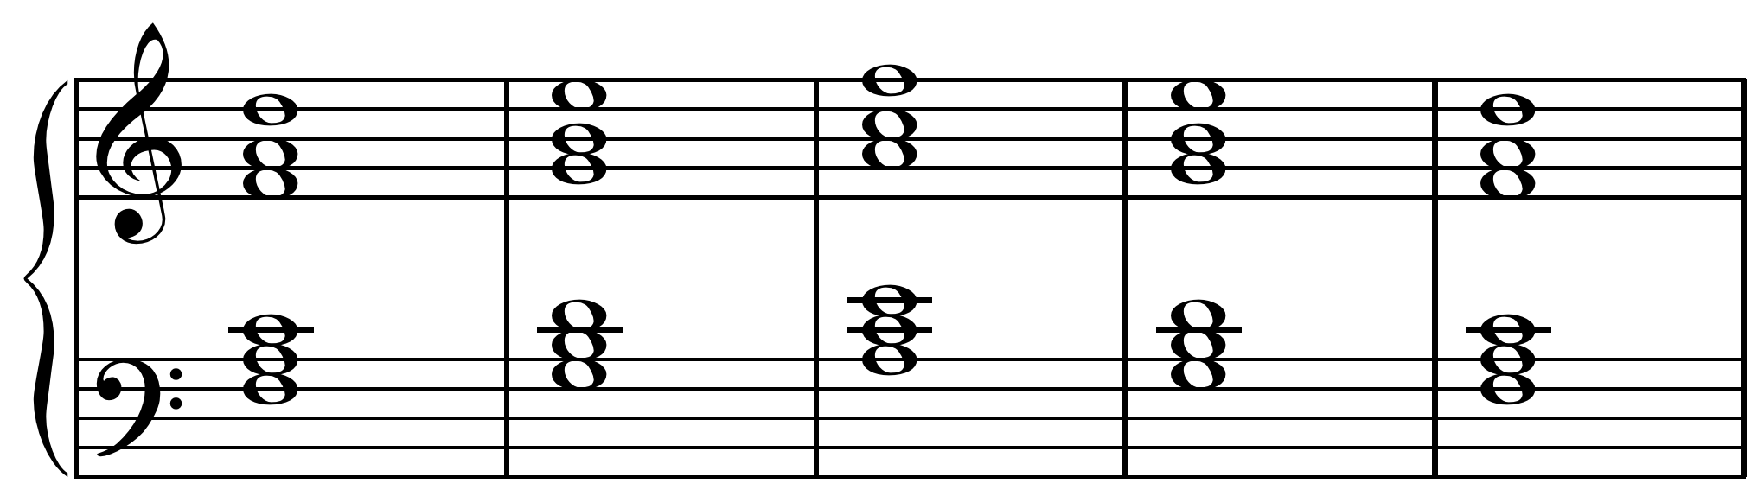
Going Parallel: Multiple Instructions
Issue multiple instructions (or operations) per cycle

Slide 40
Going parallel: Multiple Issue
Multiple parallel pipelines: CPI can get < 1
  complete multiple instructions per clock
Two Options:
  Statically scheduled superscalar processors
    VLIW (Very Long Instruction Word) processors
  Dynamically scheduled superscalar processors
    Superscalar processor
  EPIC (explicit parallel instruction computer)
    somewhat in between

Slide 41
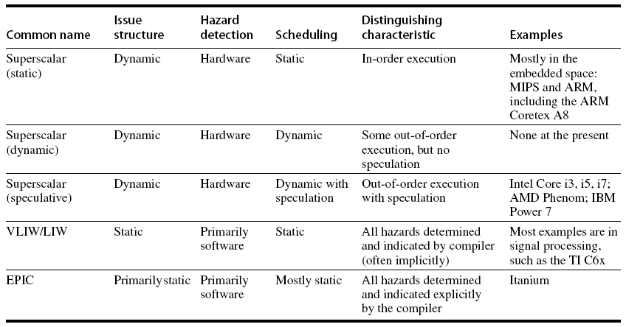
Multiple Issue Options:

Slide 42
Modern Superscalar
Modern (superscalar) microarchitectures =
  Dynamic scheduling + Multiple Issue + Speculation
Issue logic can become bottleneck
  Several approaches:
    Assign reservation stations and update pipeline control table in half a clock cycle
      Only supports 2 instructions/clock
    Design logic to handle any possible dependencies between the instructions
    Hybrid approaches

Slide 43
Multiple Issue: reduce complexity
Limit the number of instructions of a given class that can be issued in a “bundle”
  I.e. one FloatingPt, one Integer, one Load, one Store
Examine all the dependencies among the instructions in the bundle
If dependencies exist in bundle, encode them in reservation stations
Need multiple completions&commits per cycle

Slide 44
Example: increment array elements
Loop: LD R2,0(R1) ;R2=array element
DADDIU R2,R2,#1 ;increment R2
SD R2,0(R1) ;store result
DADDIU R1,R1,#8 ;increment R1 to point to next double
BNE R2,R3,LOOP ;branch if not last element

Slide 45
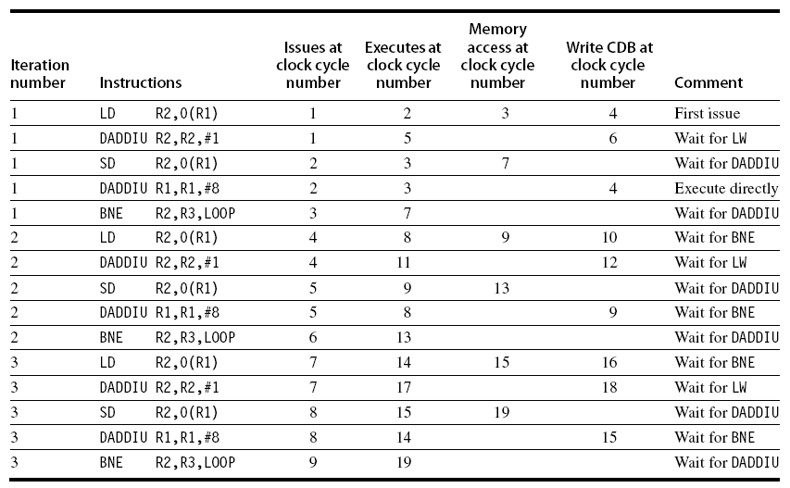
Example (No Speculation)
Note: LD following BNE must wait on the branch outcome (no speculation)!

Slide 46
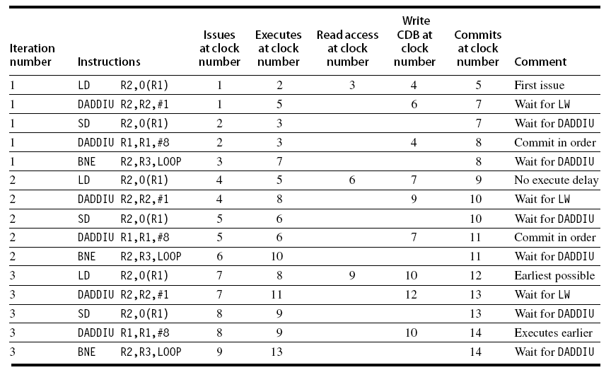
Example (with branch Speculation)
Note: Execution of 2nd DADDIU is earlier than 1th, but commits later, i.e. in order!

Slide 47
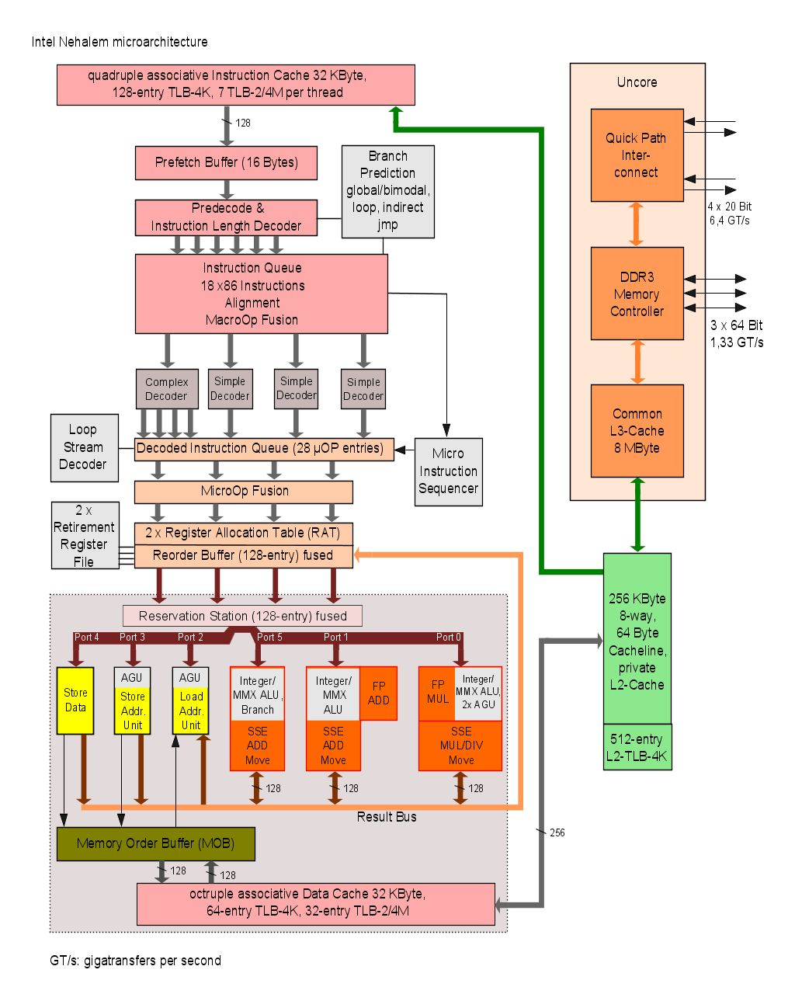
Nehalem microarchitecture
(Intel)
first use: Core i7
  2008
  45 nm
hyperthreading
shared L3 cache
3 channel DDR3 controler
QIP: quick path interconnect
32K+32K L1 per core
256 L2 per core
4-8 MB L3 shared between cores

Slide 48
Branch Prediction
what is it?
why do we need it?
how does it work?
various schemes

Slide 49
Branch Prediction Principles
breq r1, r2, label // if r1==r2
// then PCnext = label
// else PCnext = PC + 4 (for a RISC)
Questions:
do I jump ? -> branch prediction
where do I jump ? -> branch target prediction
what's the average branch penalty?
  <CPI_{branch_penalty}>
  i.e. how many instruction slots do I miss (or squash) due to branches

Slide 50
Branch Prediction & Speculation
High branch penalties in pipelined processors:
  With about 20% of the instructions being a branch, the maximum ILP is five (but actually much less!)
CPI = CPI_{base} + f_{branch} * f_{misspredict} * cycles_penalty
  Large impact if:
    Penalty high: long pipeline
    CPI_{base} low: for multiple-issue processors,
Idea: predict the outcome of branches based on their history and execute instructions at the predicted branch target speculatively

Slide 51
Branch Prediction Schemes
Predict branch direction:
1-bit Branch Prediction Buffer
2-bit Branch Prediction Buffer
Correlating Branch Prediction Buffer
Predicting next address:
Branch Target Buffer
Return Address Predictors
+ Or: try to get rid (some) of those malicious branches

Slide 52
1-bit Branch Prediction Buffer
1-bit branch prediction buffer or branch history table (BHT):
Buffer is like a cache without tags
Does not help for our MIPS pipeline because target address calculations performed in same stage as branch condition calculation
PC
10…..10 101 00
BHT
0
1
0
1
0
1
1
0
k-bits
size=2^{k}

Slide 53
Two 1-bit predictor problems
PC
10…..10 101 00
BHT
0
1
0
1
0
1
1
0
k-bits
size=2^{k}
Aliasing: lower k bits of different branch instructions could be the same
  Solution: Use tags (the buffer becomes a tag); however very expensive
Loops are predicted wrong twice
  Solution: Use n-bit saturation counter prediction
    taken if counter ≥ 2 ^{(n-1)}
    not-taken if counter < 2 ^{(n-1)}
  A 2-bit saturating counter predicts a loop wrong only once

Slide 54
2-bit Branch Prediction Buffer
Solution: 2-bit scheme where prediction is changed only if mispredicted twice
Can be implemented as a saturating counter, e.g. as following state diagram:
T
NT
Predict Taken
Predict Taken
T
T
NT
NT
Predict Not
Taken
Predict Not
Taken
T
NT

Slide 55
Next step: Correlating Branches
Fragment from SPEC92 benchmark eqntott:
if (aa==2)
aa = 0;
if (bb==2)
bb=0;
if (aa!=bb){..}
subi R3,R1,#2
b1: bnez R3,L1
add R1,R0,R0
L1: subi R3,R2,#2
b2: bnez R3,L2
add R2,R0,R0
L2: sub R3,R1,R2
b3: beqz R3,L3

Slide 56
Correlating Branch Predictor
  4 bits from branch address
Idea: behavior of current branch is related to (taken/not taken) history of recently executed branches
  Then behavior of recent branches selects between, say, 4 predictions of next branch, updating just that prediction
(2,2) predictor: 2-bit global, 2-bit local
(k,n) predictor uses behavior of last k branches to choose from 2^{k} predictors, each of which is n-bit predictor
2-bits per branch
local predictors
Prediction
shift register,
remembers
last 2 branches
2-bit global
branch history register
(01 = not taken, then taken)

Slide 57
Branch Correlation: the General Scheme
4 parameters: (a, k, m, n)
Pattern History Table
2^{m}-1
n-bit
saturating
Up/Down
Counter
m
1
Prediction
Branch Address
0
0
1
2^{k}-1
a
k
Branch History Table (BHT)
Table size (usually n = 2): N_{bits} = k * 2ª + 2^{k} * 2^{m} *n
mostly n = 2

Slide 58
Two varieties
GA: Global history, a = 0
  only one (global) history register ⇒ correlation is with previously executed branches (often different branches)
  Variant: Gshare (Scott McFarling’93): GA which takes logic OR of PC address bits and branch history bits
PA: Per address history, a > 0
  if a large almost each branch has a separate history
  so we correlate with same branch

Slide 59
Accuracy, taking the best combination of parameters (a, k, m, n) :
GA (0,11,5,2)
98
PA (10, 6, 4, 2)
97
96
95
Bimodal
94
GAs
Branch Prediction Accuracy (%)
93
PAs
92
91
89
64
128
256
1K
2K
4K
8K
16K
32K
64K
Predictor Size (bytes)

Slide 60
Branch Prediction; summary
Basic 2-bit predictor:
  For each branch:
    Predict taken or not taken
    If the prediction is wrong two consecutive times, change prediction
Correlating (global history) predictor:
  Multiple 2-bit predictors for each branch
  One for each possible combination of outcomes of preceding n branches
Local predictor:
  Multiple 2-bit predictors for each branch
  One for each possible combination of outcomes for the last n occurrences of this branch
Tournament predictor:
  Combine correlating global predictor with local predictor

Slide 61
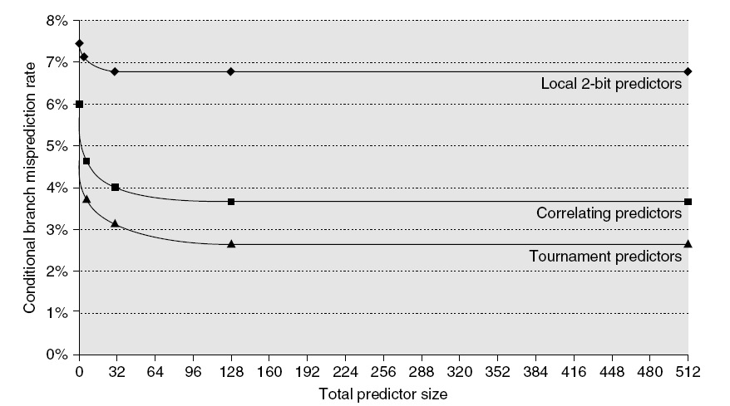
Branch Prediction Performance

Slide 62
Branch predition performance details for SPEC92 benchmarks
18%
Mispredictions Rate
0%
4096 Entries Unlimited Entries 1024 Entries
n = 2-bit BHT n = 2-bit BHT (a,k) = (2,2) BHT
Notes:
As you see, using unlimited number of entries does not bring a big improvement w.r.t. 4 k entries (it just reduces the alias problem),
however, exploiting correlation is a big gain.

Slide 63
Branch Prediction Accuracy
Mispredict because either:
  Wrong guess for that branch
  Got branch history of wrong branch when indexing the table (i.e. an alias occurred)
4096 entry table: misprediction rates vary from 1% (nasa7, tomcatv) to 18% (eqntott), with spice at 9% and gcc at 12%
For SPEC92, 4096 entries almost as good as infinite table
Real programs + OS are more like 'gcc'

Slide 64
Branch Target Buffer
Predicting the Branch Condition is not enough !!
Where to jump? Branch Target Buffer (BTB):
  each entry contains a Tag and Target address
PC
10…..10 101 00
Tag branch PC
PC if taken
Yes: instruction is branch. Use predicted PC as next PC if branch predicted taken.
=?
Branch
prediction
(often in separate
table)
No: instruction is not a
branch. Proceed normally

Slide 65
Instruction Fetch Stage
4
Instruction
Memory
PC
Instruction register
BTB
found & taken
target address
Not shown: hardware needed when prediction was wrong

Slide 66
Special Case: Return Addresses
Register indirect branches: hard to predict target address
  MIPS instruction: jr r3 // PC_{next} = (r3)
    implementing switch/case statements
    FORTRAN computed GOTOs
    procedure return (mainly): jr r31 on MIPS
SPEC89: 85% of indirect branches used for procedure return
Since stack discipline for procedures, save return address in small buffer that acts like a stack:
  8 to 16 entries has already very high hit rate

Slide 67
Return address prediction: example
main()
{ …
f();
…
}
f()
{ …
g()
…
}
100 main: ….
104 jal f
108 …
10C jr r31
120 f: …
124 jal g
128 …
12C jr r31
308 g: ….
30C
310 jr r31
314 ..etc..
128
108
main ra
return stack
Q: when does the return stack predict wrong?

Slide 68
Dynamic Branch Prediction: Summary
Prediction important part of scalar execution
Branch History Table: 2 bits for loop accuracy
Correlation: Recently executed branches correlated with next branch
  Either correlate with previous branches
  Or different executions of same branch
Branch Target Buffer: include branch target address (& prediction)
Return address stack for prediction of indirect jumps

Slide 69
Or: ……..??
Avoid branches !

Slide 70
Predicated Instructions (discussed before)
Avoid branch prediction by turning branches into conditional or predicated instructions:
If false, then neither store result nor cause exception
  Expanded ISA of Alpha, MIPS, PowerPC, SPARC have conditional move; PA-RISC can annul any following instr.
  IA-64/Itanium: conditional execution of any instruction
Examples:
  if (R1==0) R2 = R3; CMOVZ R2,R3,R1
  if (R1 < R2) SLT R9,R1,R2
  R3 = R1; CMOVNZ R3,R1,R9
  else CMOVZ R3,R2,R9
  R3 = R2;

Slide 71
General guarding: if-conversion
if (a > b) { r = a % b; }
else { r = b % a; }
y = a*b;
4 basic blocks
sub t1,a,b
bgz t1,then
else: rem r,b,a
j next
then: rem r,a,b
next: mul y,a,b
CFG:
1
sub t1, a, b
bgz t1, 2, 3
2
rem r, a, b
goto 4
3
rem r, b, a
goto 4
4
mul y,a,b
…………..
1 basic block
sub t1,a,b
t1 rem r,a,b
!t1 rem r,b,a
mul y,a,b
Guards t1 & !t1

Slide 72
Limitations of OoO Superscalar
Available ILP is limited
  usually we’re not programming with parallelism in mind
Huge hardware cost when increasing issue width
  adding more functional units is easy, however:
  more memory ports and register ports needed
  dependency check needs O(n²) comparisons
  renaming needed
  complex issue logic (check and select ready operations)
  complex forwarding circuitry
Any cheaper alternatives ???

Slide 73
VLIW: alternative to Superscalar
Hardware much simpler!! Why??
Limitations of VLIW processors
  Very smart compiler needed (but largely solved!)
  Loop unrolling helps but increases code size
  Unfilled slots waste bits
  Cache miss stalls whole pipeline
    Research topic: scheduling loads
  Binary incompatibility
    (.. can partly be solved: EPIC or JITC .. )
  Note:
    Still many ports on register file needed
    Complex forwarding circuitry and many bypass buses

Slide 74
Single Issue RISC vs Superscalar
instr
op
instr
op
instr
op
instr
op
instr
op
instr
op
instr
op
instr
op
instr
op
Change HW,
but can use
same code
instr
op
instr
op
instr
op
instr
op
instr
op
instr
op
instr
op
instr
op
instr
op
instr
op
instr
op
instr
op
instr
op
instr
op
instr
op
execute
1 instr/cycle
issue and (try to) execute
3 instr/cycle
3-issue Superscalar
(1-issue)
RISC CPU

Slide 75
Single Issue RISC vs VLIW
instr
op
instr
op
instr
op
instr
op
instr
op
op
op
instr
op
instr
nop
op
op
Compiler
instr
op
op
nop
instr
op
instr
op
instr
op
nop
op
instr
op
instr
op
op
op
instr
op
execute
1 instr/cycle
3 ops/cycle
instr
op
instr
op
instr
op
execute
1 instr/cycle
3-issue VLIW
RISC CPU

Slide 76
VLIW: general concept
A VLIW architecture with 7 FUs
Instruction Memory
Instruction register
Function
units
Int FU
Int FU
Int FU
LD/ST
LD/ST
FP FU
FP FU
Int Register File
Floating Point
Register File
Data Memory

Slide 77
VLIW characteristics
add
sub
sll
nop
bne
Multiple operations per instruction
One instruction per cycle issued (at most)
Compiler is in control
Only RISC like operation support
  Short cycle times
  Easier to compile for
Flexible: Can implement any FU mixture
Extensible / Scalable
However:
tight inter FU connectivity required
not binary compatible !!
  (new long instruction format)
low code density

Slide 78
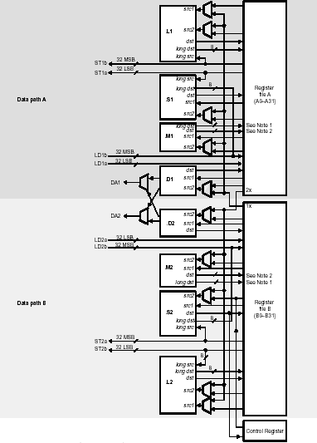

VelociTIC6x datapath

Slide 79
VLIW example: TMS320C62
TMS320C62 VelociTI Processor
8 operations (of 32-bit) per instruction (256 bit)
Two clusters
  8 Fus: 4 Fus / cluster : (2 Multipliers, 6 ALUs)
  2 x 32 registers
  One bus available to write in register file of other cluster
Flexible addressing modes (like circular addressing)
Flexible instruction packing
All instruction conditional
Originally: 5 ns, 200 MHz, 0.25 um, 5-layer CMOS
128 KB on-chip RAM

Slide 80

VLIW example: Philips TriMedia TM1000
5 constant
5 ALU
2 memory
2 shift
2 DSP-ALU
2 DSP-mul
3 branch
2 FP ALU
2 Int/FP ALU
1 FP compare
1 FP div/sqrt
Register file (128 regs, 32 bit, 15 ports)
Exec
unit
Exec
unit
Exec
unit
Exec
unit
Exec
unit
Data
cache
(16 kB)
Instruction register (5 issue slots)
PC
Instruction
cache (32kB)

Slide 81
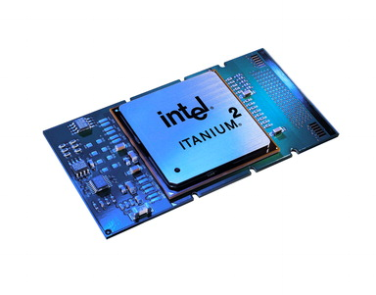
Intel EPIC Architecture IA-64
Explicit Parallel Instruction Computer (EPIC)
IA-64 architecture -> Itanium, first realization 2001
Registers:
128 64-bit int x bits, stack, rotating
128 82-bit floating point, rotating
64 1-bit boolean
8 64-bit branch target address
system control registers
See http://en.wikipedia.org/wiki/Itanium

Slide 82
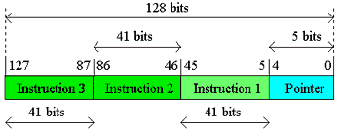
EPIC Architecture: IA-64
Instructions grouped in 128-bit bundles
  3 * 41-bit instruction
  5 template bits, indicate type and stop location
Each 41-bit instruction
  starts with 4-bit opcode, and
  ends with 6-bit guard (boolean) register-id
Supports speculative loads

Slide 83
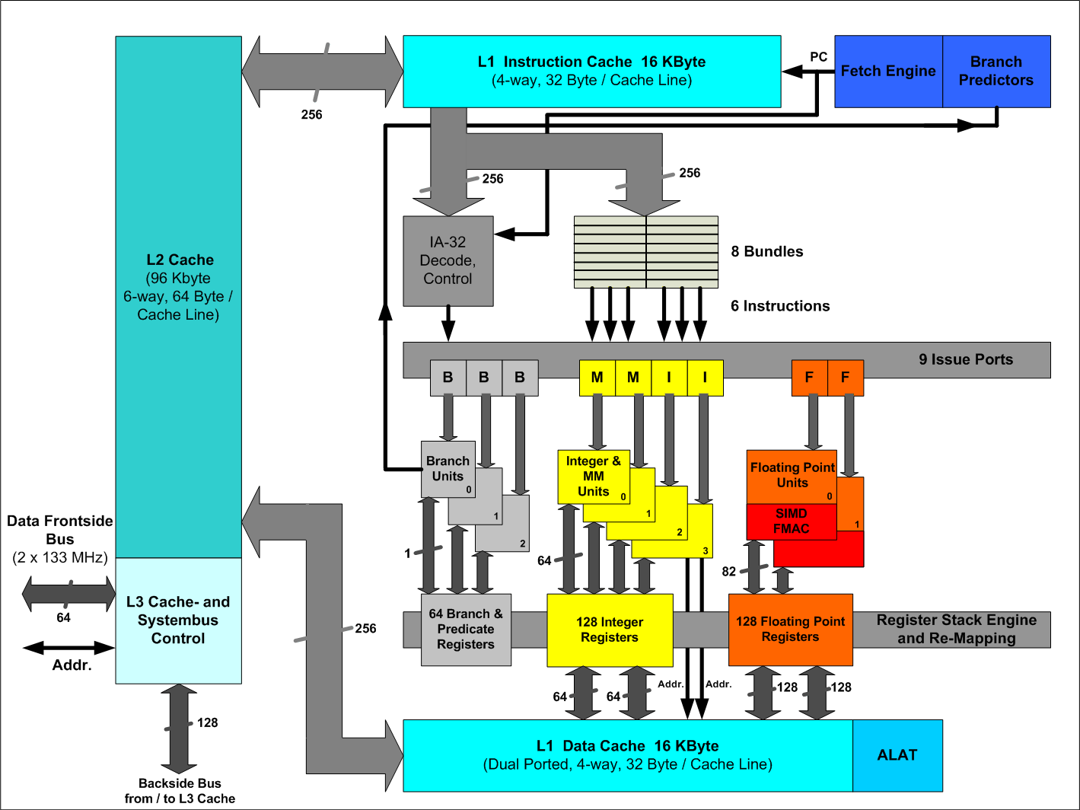
Itanium organization

Slide 84
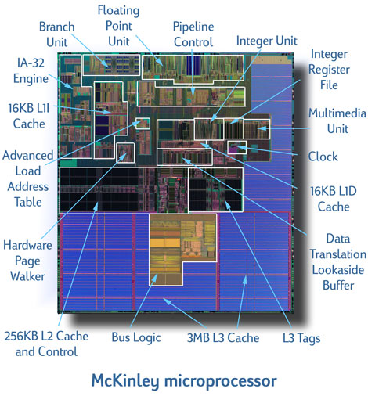
Itanium 2: McKinley

Slide 85
EPIC Architecture advantages
EPIC allows for more binary compatibility then a plain VLIW:
  Function unit assignment performed at run-time
    => Nr of FUs architectural invisible
  Lock when FU results not available
    => FU pipeline latencies not architectural visible
See website for more info
  (look at related material)

Slide 86
What did we talk about?
ILP = Instruction Level Parallelism =
ability to perform multiple operations (or instructions),
from a single instruction stream,
in parallel
VLIW = Very Long Instruction Word architecture
Example Instruction format (5-issue):
operation 1
operation 2
operation 3
operation 4
operation 5

Slide 87
VLIW evaluation
Instruction memory
Instruction fetch unit
Control problem
CPU
Instruction decode unit
FU-5
FU-4
FU-3
FU-2
FU-1
With N function units
O(N²)
Bypassing network
O(N)-O(N²)
Register file
87
Data memory

Slide 88
VLIW evaluation
Strong points of VLIW:
  Scalable (add more FUs)
  Flexible (an FU can be almost anything; e.g. multimedia support)
Weak points:
With N FUs:
  Bypassing complexity: O(N²)
  Register file complexity: O(N)
  Register file size: O(N²)
Register file design restricts FU flexibility
Solution: .................................................. ?

Slide 89
Solution
Mirroring the Programming Paradigm
TTA: Transport Triggered Architecture
+
-
+
-
>
*
>
*
st
st

Slide 90
Transport
Triggered
Architecture
Instruction memory
Instruction fetch unit
CPU
General organization
of a TTA
Instruction decode unit
Bypassing network
Register file
FU-5
FU-4
FU-3
FU-2
FU-1
Data memory

Slide 91
TTA structure; datapath details
Data Memory
load/store
unit
load/store
unit
integer
ALU
integer
ALU
float
ALU
Socket
integer
RF
float
RF
boolean
RF
instruct.
unit
immediate
unit
Instruction Memory

Slide 92
TTA hardware characteristics
Modular: building blocks easy to reuse
Very flexible and scalable
  easy inclusion of Special Function Units (SFUs)
Very low complexity
  > 50% reduction on # register ports
  reduced bypass complexity (no associative matching)
  up to 80 % reduction in bypass connectivity
  trivial decoding
  reduced register pressure
  easy register file partitioning (a single port is enough!)

Slide 93
TTA software characteristics
That does not
look like an
improvement !?!
add r3, r1, r2
  r1 → add.o1;
  r2→ add.o2;
  add.r → r3
o1
o2
+
r

Slide 94
Program TTAs
How to do data operations ?
1. Transport of operands to FU
  Operand move (s)
  Trigger move
2. Transport of results from FU
  Result move (s)
Trigger
Operand
Internal stage
Example Add r3,r1,r2 becomes
r1 → Oint // operand move to integer unit
r2 → Tadd // trigger move to integer unit
…………. // addition operation in progress
Rint → r3 // result move from integer unit
Result
FU Pipeline
How to do Control flow ?
1. Jumps: #jump-address → pc
2. Branch: #displacement → pcd
3. Call: pc → r; #call-address → pcd

Slide 95
Scheduling example
VLIW
load/store
unit
integer
ALU
integer
ALU
add r1,r1,r2
sub r4,r1,95
TTA
r1 -> add.o1, r2 -> add.o2
add.r -> sub.o1, 95 -> sub.o2
integer
RF
immediate
unit
sub.r -> r4

Slide 96
TTA Instruction format
General MOVE field:
g : guard specifier
i : immediate specifier
src : source
dst : destination
g
i
src
dst
General MOVE instructions: multiple fields
move 1
move 2
move 3
move 4
How to use immediates?
Small, 6 bits
Long, 32 bits
g
1
imm
dst
g
0
Ir-1
dst
imm

Slide 97
How parallel should we make a processor?
Depends on how much parallelism is there in your application?

Slide 98
Measuring available ILP: How?
Using existing compiler
Using trace analysis
  Track all the real data dependencies (RaWs) of instructions from issue window
    register dependences
    memory dependences
  Check for correct branch prediction
    if prediction correct continue
    if wrong, flush schedule and start in next cycle

Slide 99
Trace analysis
Trace
set r1,0
set r2,3
set r3,&A
st r1,0(r3)
add r1,r1,1
add r3,r3,4
brne r1,r2,Loop
st r1,0(r3)
add r1,r1,1
add r3,r3,4
brne r1,r2,Loop
st r1,0(r3)
add r1,r1,1
add r3,r3,4
brne r1,r2,Loop
add r1,r5,3
Compiled code
set r1,0
set r2,3
set r3,&A
Loop: st r1,0(r3)
add r1,r1,1
add r3,r3,4
brne r1,r2,Loop
add r1,r5,3
Program
For i := 0..2
A[i] := i;
S := X+3;
How parallel can this code be executed?
Notes:
Explain trace analysis using the trace on the right-hand side for different models.
No renaming + oracle prediction + unlimited window size
Full renaming + oracle prediction + unlimited window size (shown in next slide)
Full renaming + 2-bit prediction (assuming back-edge taken) + unlimited window size
etc.

Slide 100
Trace analysis
Parallel Trace
set r1,0 set r2,3 set r3,&A
st r1,0(r3) add r1,r1,1 add r3,r3,4
st r1,0(r3) add r1,r1,1 add r3,r3,4 brne r1,r2,Loop
st r1,0(r3) add r1,r1,1 add r3,r3,4 brne r1,r2,Loop
brne r1,r2,Loop
add r1,r5,3
Max ILP = Speedup = Lserial / L_{parallel} = 16 / 6 = 2.7
Is this the maximum?
Notes:
Note that with oracle prediction and renaming the last operation, add r1,r5,3, can be put in the first cycle.

Slide 101
Ideal Processor
Assumptions for ideal/perfect processor:
1. Register renaming – infinite number of virtual registers => all register WAW & WAR hazards avoided
2. Branch and Jump prediction – Perfect => all program instructions available for execution
3. Memory-address alias analysis – addresses are known. A store can be moved before a load provided addresses not equal
Also:
  unlimited number of instructions issued/cycle (unlimited resources), and
  unlimited instruction window
  perfect caches
  1 cycle latency for all instructions (FP *,/)
Programs were compiled using MIPS compiler with maximum optimization level

Slide 102
Upper Limit to ILP: Ideal Processor
Integer: 18 - 60
FP: 75 - 150
IPC

Slide 103
Window Size and Branch Impact
Change from infinite instr. window to examine 2000, and issue at most 64 instructions per cycle
FP: 15 - 45
Integer: 6 – 12
IPC
Perfect Tournament BHT(512) Profile No prediction

Slide 104
Impact of Limited Renaming Registers
Assume: 2000 instr. window, 64 instr. issue, 8K 2-level predictor (slightly better than tournament predictor)
Integer: 5 - 15
FP: 11 - 45
IPC
Infinite 256 128 64 32

Slide 105
Memory Address Alias Impact
Assume: 2000 instr. window, 64 instr. issue, 8K 2-level predictor, 256 renaming registers
FP: 4 - 45
(Fortran,
no heap)
IPC
Integer: 4 - 9
Memory
disambiguation
quality:
Perfect Global/stack perfect Inspection None

Slide 106
Window Size Impact
Assumptions: Perfect disambiguation, 1K Selective predictor, 16 entry return stack, 64 renaming registers, issue as many as window
FP: 8 - 45
IPC
Integer: 6 - 12
Window and
issue size:

Slide 107
How to Exceed ILP Limits of this Study?
Solve WAR and WAW hazards through memory:
  eliminated WAW and WAR hazards through register renaming, but not yet for memory operands
Avoid unnecessary dependences
  (compiler did not unroll loops so we keep the iteration index variable dependence; e.g. in i=i+1)
Overcoming the data flow limit: value prediction = predicting values and speculating on prediction
  E.g. predict next load address and speculate by reordering loads and stores.

Slide 108

What can the compiler do?
Loop transformations
Code scheduling
Special course 5LIM0
on Parallelization and
Compilers
  LLVM based
An oldy on
compilers

Slide 109
Basic compiler techniques
Dependencies limit ILP (Instruction-Level Parallelism)
  We can not always find sufficient independent operations to fill all the delay slots
  May result in pipeline stalls
Scheduling to avoid stalls (= reorder instructions)
(Source-)code transformations to create more exploitable parallelism
  Loop Unrolling
  Loop Merging (Fusion)
    see online slide-set about loop transformations !!

Slide 110
Dependencies Limit ILP: Example
C loop:
  for (i=1; i<=1000; i++)
  x[i] = x[i] + s;
MIPS assembly code:
  ; R1 = &x[1]
  ; R2 = &x[1000]+8
  ; F2 = s
  Loop: L.D F0,0(R1) ; F0 = x[i]
  ADD.D F4,F0,F2 ; F4 = x[i]+s
  S.D 0(R1),F4 ; x[i] = F4
  ADDI R1,R1,8 ; R1 = &x[i+1]
  BNE R1,R2,Loop ; branch if R1!=&x[1000]+8

Slide 111
Schedule this on an example processor
FP operations are mostly multicycle
The pipeline must be stalled if an instruction uses the result of a not yet finished multicycle operation
We’ll assume the following latencies
  Producing Consuming Latency
  instruction instruction (clock cycles)
  FP ALU op FP ALU op 3
  FP ALU op Store double 2
  Load double FP ALU op 1
  Load double Store double 0

Slide 112
Where to Insert Stalls?
How would this loop be executed on the MIPS FP pipeline?
Inter-iteration
dependence !!
Loop: L.D F0,0(R1)
  ADD.D F4,F0,F2
  S.D F4,0(R1)
  ADDI R1,R1,8
  BNE R1,R2,Loop
What are the true (flow) dependences?

Slide 113
Where to Insert Stalls
How would this loop be executed on the MIPS FP pipeline?
10 cycles per iteration
Loop: L.D F0,0(R1)
stall
ADD.D F4,F0,F2
stall
stall
S.D 0(R1),F4
ADDI R1,R1,8
stall
BNE R1,R2,Loop
stall
Producing Consuming Latency
instruction instruction ( cycles)
FP ALU FP ALU op 3
FP ALU Store double 2
Load double FP ALU 1
Load double Store double 0

Slide 114
Code Scheduling to Avoid Stalls
Can we reorder the order of instruction to avoid stalls?
Execution time reduced from 10 to 6 cycles per iteration
But only 3 instructions perform useful work, rest is loop overhead.
How to avoid this ???
Loop: L.D F0,0(R1)
ADDI R1,R1,8
ADD.D F4,F0,F2
stall
BNE R1,R2,Loop
S.D -8(R1),F4
watch out!

Slide 115
Loop Unrolling: increasing ILP
Code after scheduling:
  Loop: L.D F0,0(R1)
  L.D F6,8(R1)
  L.D F10,16(R1)
  L.D F14,24(R1)
  ADD.D F4,F0,F2
  ADD.D F8,F6,F2
  ADD.D F12,F10,F2
  ADD.D F16,F14,F2
  S.D 0(R1),F4
  S.D 8(R1),F8
  ADDI R1,R1,32
  SD -16(R1),F12
  BNE R1,R2,Loop
  SD -8(R1),F16
At source level:
  for (i=1; i<=1000; i++)
  x[i] = x[i] + s;
  for (i=1; i<=1000; i=i+4)
  {
  x[i] = x[i] + s;
  x[i+1] = x[i+1]+s;
  x[i+2] = x[i+2]+s;
  x[i+3] = x[i+3]+s;
  }
Any drawbacks?
  loop unrolling increases code size
  more registers needed

Slide 116
Strip Mining
Unknown number of loop iterations?
  Number of iterations = n
  Goal: make k copies of the loop body
Solution: Generate pair of loops:
    First executes n mod k times
    Second executes n / k times
    “Strip mining”

Slide 117
Hardware support for compile-time scheduling
Predication
  see earlier slides on conditional move and
  if-conversion
Speculative loads
  Deferred exceptions

Slide 118
Deferred Exceptions
  ld r1,0(r3) # load A
  bnez r1,L1 # test A
  ld r1,0(r2) # then part; load B
  j L2
  L1: addi r1,r1,4 # else part; inc A
  L2: st r1,0(r3) # store A
if (A==0)
A = B;
else
A = A+4;
How to optimize when then-part (A = B;)
is usually selected? => Load B before the branch
ld r1,0(r3) # load A
ld r9,0(r2) # speculative load B
beqz r1,L3 # test A
addi r9,r1,4 # else part
L3: st r9,0(r3) # store A
What if this load generates a page fault?
What if this load generates an “index-out-of-bounds” exception?

Slide 119
HW supporting Speculative Loads
2 new instructions:
  Speculative load (sld): does not generate exceptions
  Speculation check instruction (speck): check for exception. The exception occurs when this instruction is executed.
  ld r1,0(r3) # load A
  sld r9,0(r2) # speculative load of B
  bnez r1,L1 # test A
  speck 0(r2) # perform exception check
  j L2
  L1: addi r9,r1,4 # else part
  L2: st r9,0(r3) # store A

Slide 120

What did you learn?
O-O-O execution mechanisms
Multi-issue
VLIW vs Superscalar
Advanced branch prediction techniques
HW and SW speculation techniques
TTAs
Measuring ILP in programs
And.... many illustrative examples

Slide 121
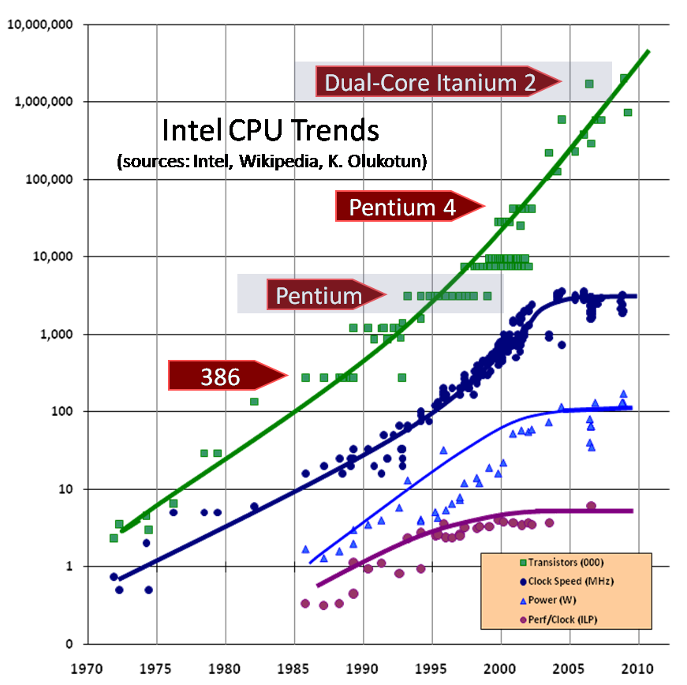
Next?
Core i7
3GHz
100W
Trends:
#transistors follows
Moore
but not freq. and
performance/core
5

