Slide 1
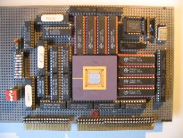
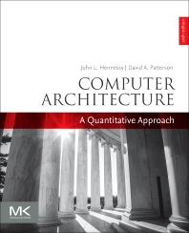
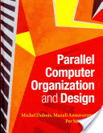
Embedded Computer Architecture 5SAI0 Chip Multi-Processors
Henk Corporaal
www.ics.ele.tue.nl/~heco/courses/ECA
h.corporaal@tue.nl
TUEindhoven
2019-2020

Slide 2
Welcome back
Chip Multi-Processors
8.3: Multi-threading:
Coarse grain multi-threading
Fine-grain multi-threading
SMT (simultaneous multi-threading)
called hyperthreading by Intel
Material:
Our study books
Dubois e.a. section 8.3: SMT
H&P section 3.11: Multithreading

Slide 3
New Approach: Multi-Threaded
Multithreading = multiple threads share the functional units of 1 processor
duplicate independent state of each thread e.g., a separate copy of register file, a separate PC
HW for fast thread switch; much faster than full process switch ≈ 100s to 1000s of clocks
When to switch?
Fine grain: Next instruction is next thread, or
Coarse grain: When a thread is stalled, perhaps for a cache miss, another thread can be executed

Slide 4
Multithreaded Categories
Simultaneous
Multithreading
Time (processor cycle)
Superscalar
Fine-Grained
Coarse-Grained
Multiprocessing
Thread 1
Thread 3
Thread 5
Thread 2
Thread 4
Idle slot

Slide 5
Fine-Grained Multithreading
Switches between threads on each instruction, causing the execution of multiples threads to be interleaved
Usually done in a round-robin fashion, skipping any stalled threads
CPU must be able to switch threads every clock
Advantage: it can hide both short and long stalls, since instructions from other threads executed when one thread stalls
Disadvantage: may slow down execution of individual threads
Used in e.g. Sun’s Niagara

Slide 6
Course-Grained Multithreading
Switches threads only on costly stalls, such as L2 cache misses
Advantages
Relieves need to have very fast thread-switching
Doesn’t slow down thread, since instructions from other threads issued only when the thread encounters a costly stall
Disadvantage: hard to overcome throughput losses from shorter stalls, due to pipeline start-up costs
Since CPU issues instructions from 1 thread, when a stall occurs, the pipeline must be emptied or frozen
New thread must fill pipeline before instructions can complete
Because of this start-up overhead, coarse-grained multithreading is better for reducing penalty of high cost stalls, where pipeline refill << stall time
Used in e.g. IBM AS/400

Slide 7
Simultaneous Multi-threading ...
One thread, 8 units
Two threads, 8 units
Cycle
M
M
FX
FX
FP
FP
BR
CC
Cycle
M
M
FX
FX
FP
FP
BR
CC
1
2
3
4
5
6
7
8
9
1
2
3
4
5
6
7
8
9
M = Load/Store, FX = Fixed Point, FP = Floating Point, BR = Branch, CC = Condition Codes

Slide 8
Simultaneous Multithreading (SMT)
SMT: in each cycle operations from multiple threads can be issued and active
dynamically scheduled processors already has many HW mechanisms to support multithreading:
Large set of virtual registers that can be used to hold the register sets of independent threads
Register renaming provides unique register identifiers, so instructions from multiple threads can be mixed in datapath without confusing sources and destinations across threads
Out-of-order completion allows the threads to execute out of order, and get better utilization of the HW
Just adding a per thread renaming table and keeping separate PCs

Slide 9
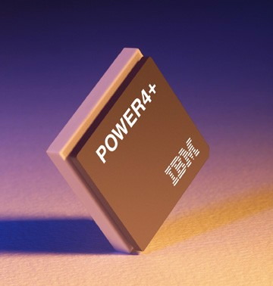
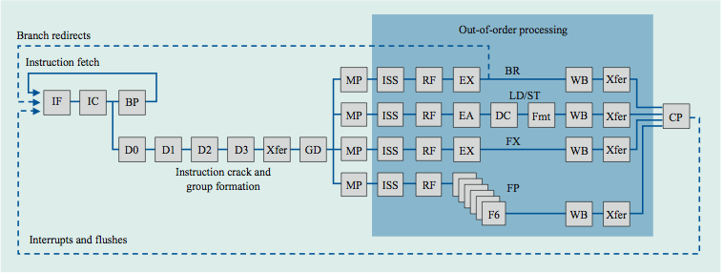
IBM Power4
Single threaded
8 FUs
4-issue out-of-order

Slide 10
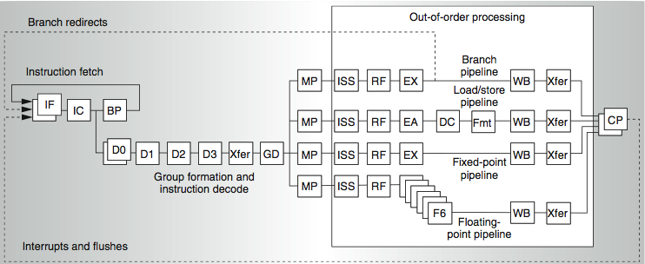
IBM Power5
supports 2 threads
2 commits (architected register sets)
2 fetch (PC), 2 initial decodes

Slide 11
Changes in Power 5 to support SMT
Increased associativity of L1 instruction cache and the instruction address translation buffers
Added per thread load and store queues
Increased size of the L2 (1.92 vs. 1.44 MB) and L3 caches
Added separate instruction prefetch and buffering per thread
Increased the number of virtual registers from 152 to 240
Increased the size of several issue queues
The Power5 core is about 24% larger than the Power4 core because of the addition of SMT support

Slide 12
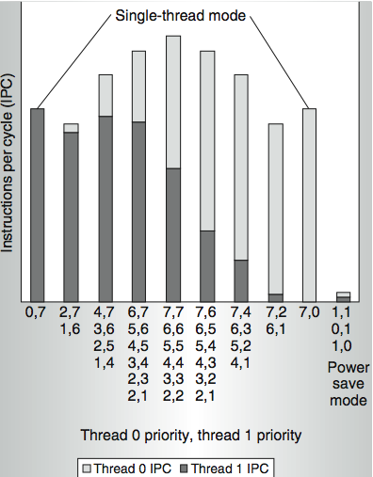
Power 5 thread performance ...
Relative priority of each thread controllable in hardware.
For balanced operation, both threads run slower than if they “owned” the machine.

Slide 13
What is exactly Multi-Threading?
how does it differ from multi-processing?
What processor changes are needed to support Multi-Threading?
What is the performance impact?
running a single thread? When
running multiple threads?
Do we need it?
when?
Can you compare pros and cons of MT and Multi-Processing ?

