Slide 1
CGRA Cookbook 2019

Slide 2
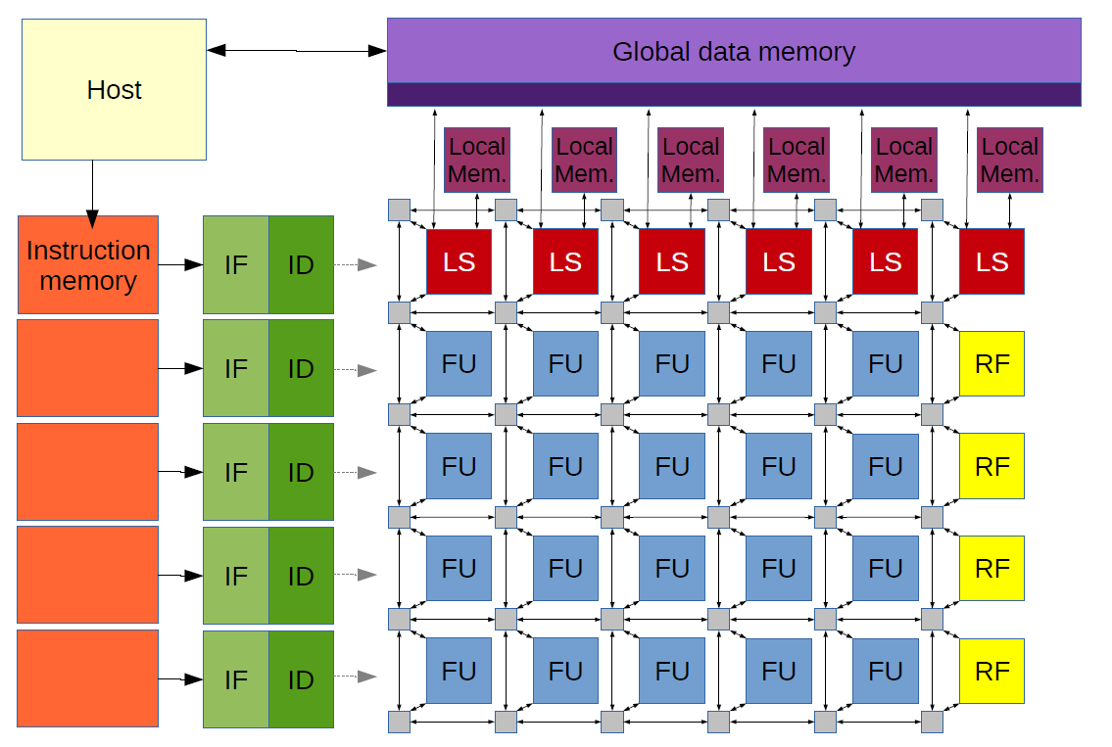
Task Implementing Butterworth filter on the CGRA
Naive implementation of Butterworth filter

Slide 3
Task Implementing Butterworth filter on the CGRA
Naive implementation of Butterworth filter
Goal Finding the best performance for minimal energy & area.

Slide 4
Where can you optimize?
Change the algorithm.
Change the architecture.
Optimized code mapping.

Slide 5
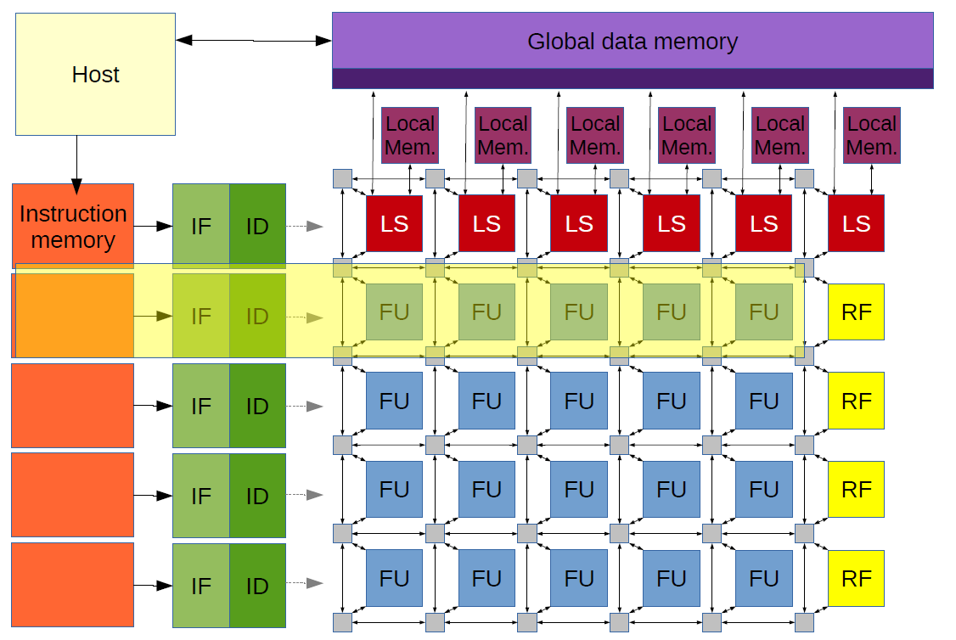
Changing the architecture.
SIMD
Exploit data level parallelism (DLP)

Slide 6
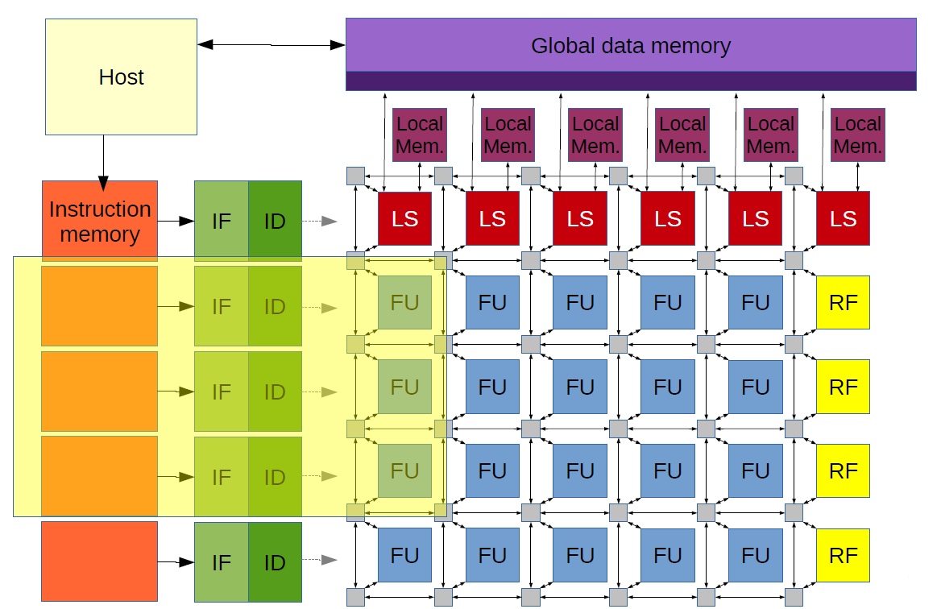
Changing the architecture.
VLIW
Exploit instruction level parallelism (ILP)

Slide 7
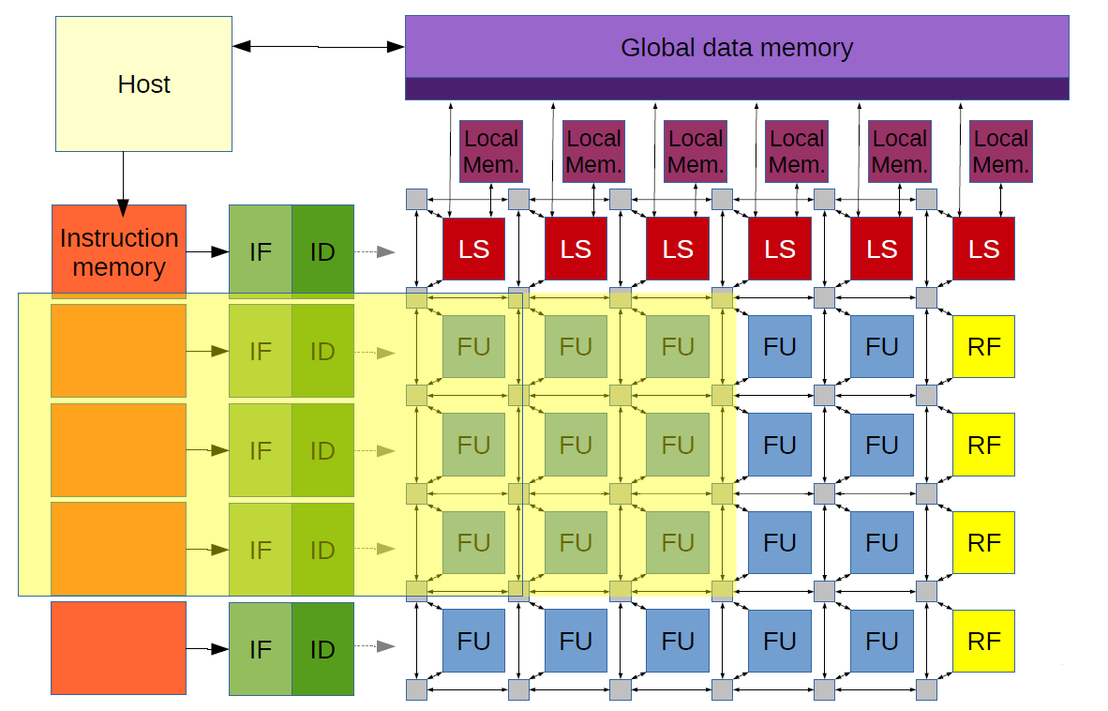
Changing the architecture.
ILP + DLP

Slide 8
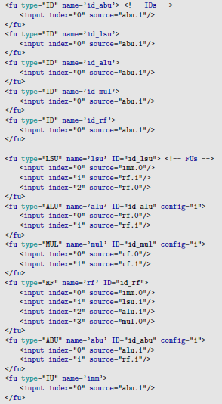
Changing the architecture.

Slide 9
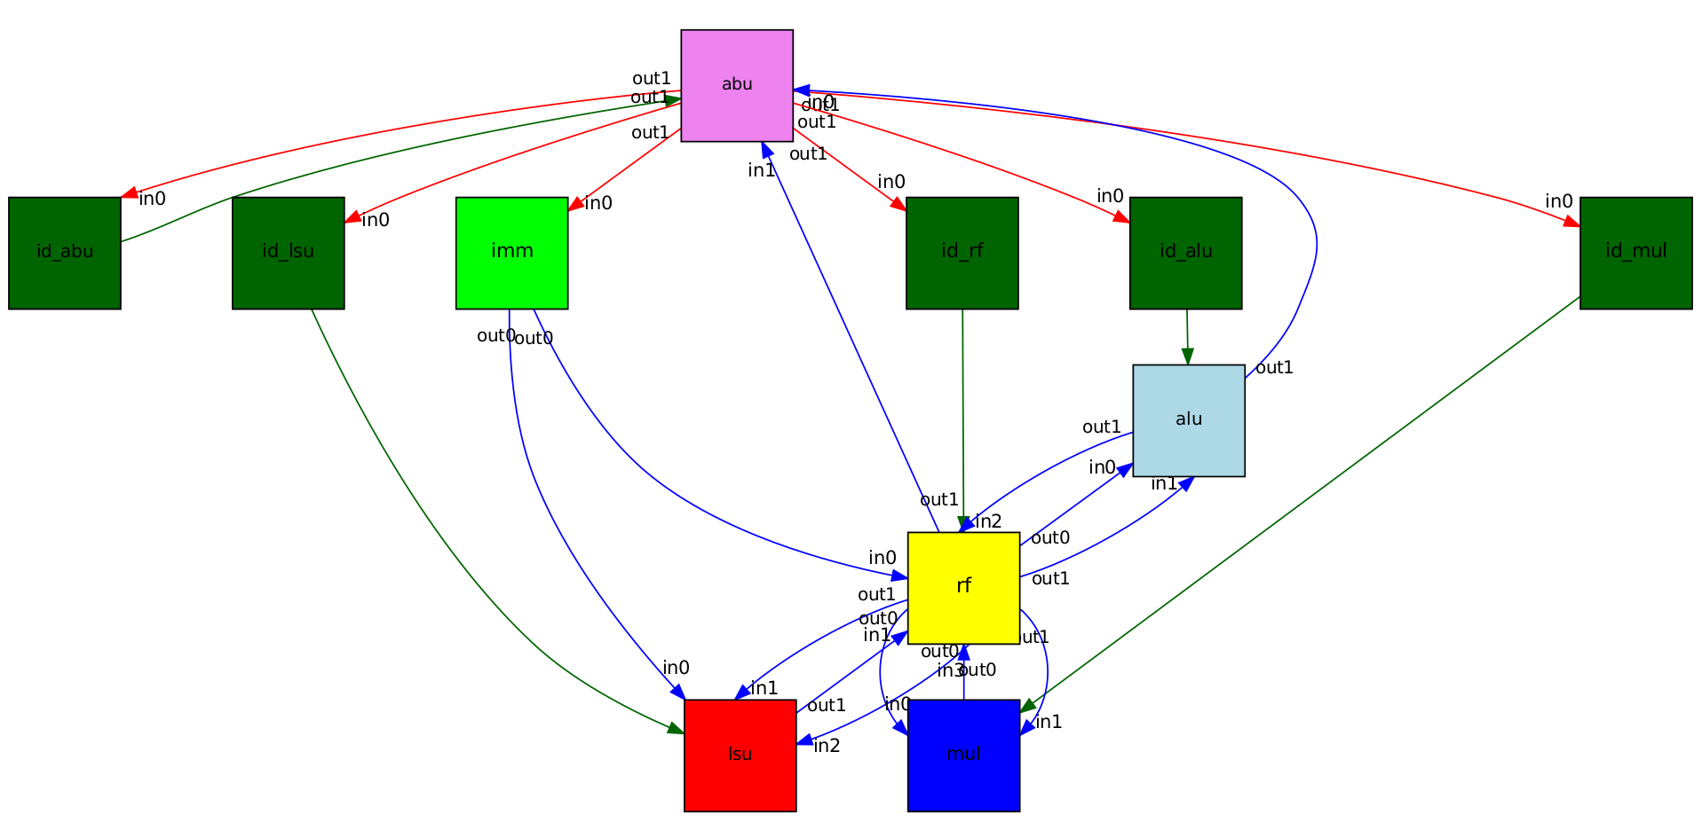
Changing the architecture.
Graphical view.
$ xdot ~/CGRA/build/butterworth/<name>/report/architecture.dot

Slide 10
Changing the architecture.
Important points.
Each ID must have a unique name.
All IDs must be connected to the ABU, for the program to advance.
FUs are connected to their corresponding IDs.

Slide 11
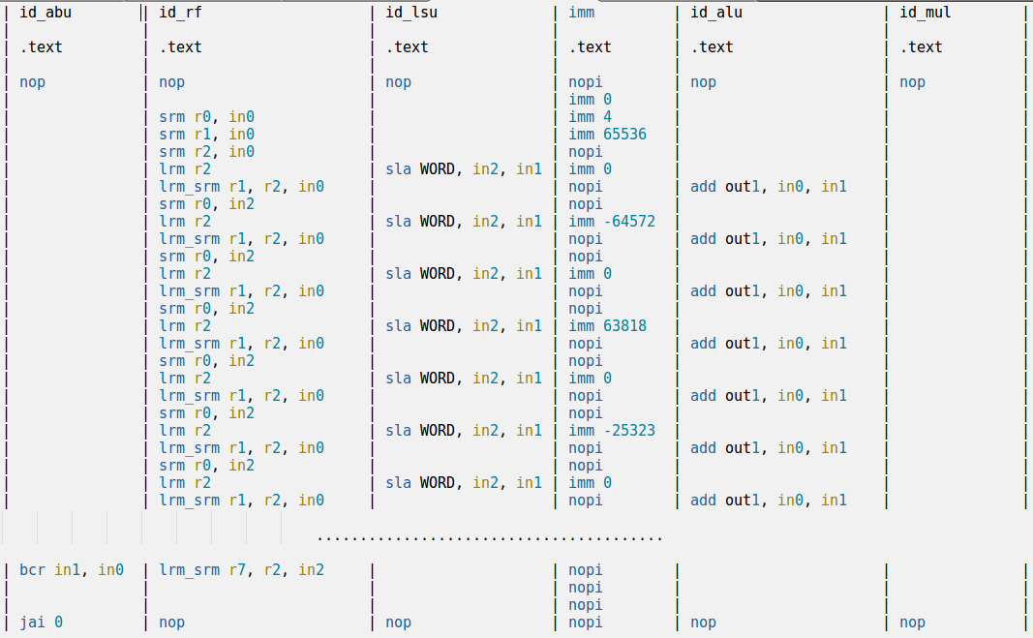
Optimizing code mapping.
Parallel Assembly (PASM)

Slide 12
Optimizing code mapping.
Important points.
All IDs are specified in different columns.
Parallel Assembly (PASM)

Slide 13
Optimizing code mapping.
Important points.
All IDs are specified in different columns
Instruction execution starts at count 1 ,
(not count 0)
Parallel Assembly (PASM)

Slide 14
Optimizing code mapping.
Important points.
All IDs are specified in different columns
Instruction execution starts at count 1 ,
(not count 0)
3. “jai 0” ends program execution.
Detailed ISA can be found on https://oncourse.tue.nl
Parallel Assembly (PASM)

Slide 15
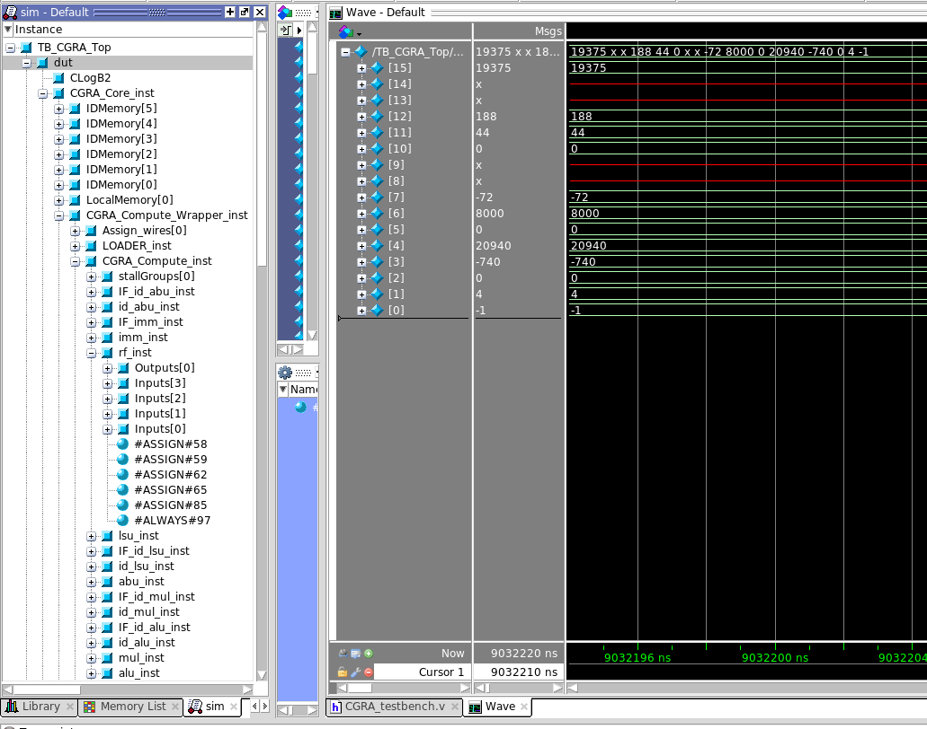
Debugging
Use Modelsim.
$ cd ~/CGRA/benchmarks/butterworth/<name>
$ make sim
To add register file :
TB_CGRA_Top
dut
CGRA_Core_inst
CGRA_Compute_Wrapper_inst
CGRA_Compute_inst
rf_inst
Parallel Assembly (PASM)

Slide 16
Makefile
make sim
Runs modelsim with GUI.
make run
Runs modelsim in the command line.
make compare
Runs simulation and compares the output with actual one (given in compare directory).
make performance
Runs simulation and gives quick performance estimates (less accurate).
make report
Runs simulation and generates a report in build/<name>/report (slower but accurate).
make clean
Cleans the build directory for the benchmark.

Slide 17
Optimization Hints
Bypassing

Slide 18
Optimization Hints
Bypassing
Multiply

Slide 19
Optimization Hints
Bypassing
Multiply
Store

Slide 20
Optimization Hints
Bypassing
Multiply
Store
Load

Slide 21
Optimization Hints
Bypassing
Multiply
Store
Load
Add

Slide 22
Optimization Hints
Bypassing
Multiply
Store
Load
Add

Slide 23
Optimization Hints
Bypassing
Multiply
Store
Load
Add

Slide 24
Optimization Hints
SIMD

Slide 25
Optimization Hints
Bypassing + SIMD

Slide 26
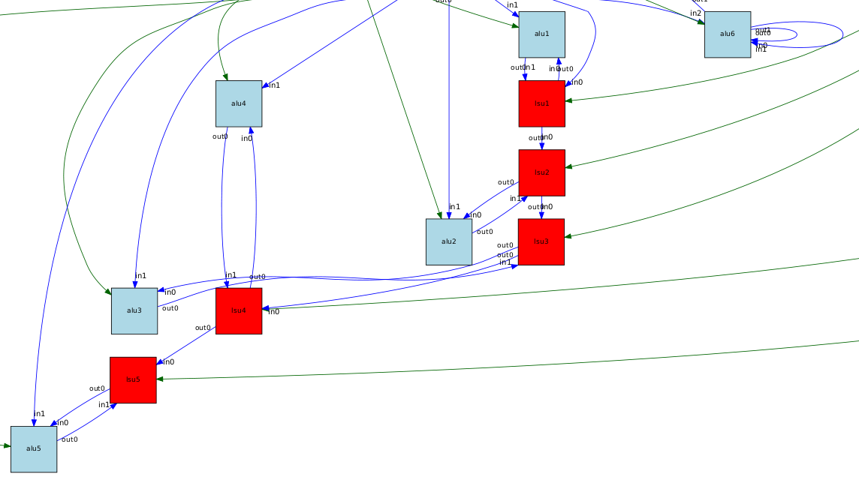
Optimization Hints
Single Cycle Loop

Slide 27
Optimization Hints
Single Cycle Loop

Slide 28
Optimization Hints
Data reuse
Automatic address generation
Adding ABU (for accumulation)

Slide 29
Changing the algorithm
Given direct implementation
Change the Butterworth algorithm.
Biquad
implementation

Slide 30
Changing the algorithm
Given direct implementation
Change the Butterworth algorithm.
Biquad
implementation
In case, you use a different algorithm, provide us with the C implementation as well.

Slide 31
Updated Server List
co2.ics.ele.tue.nl
co3.ics.ele.tue.nl
co4.ics.ele.tue.nl
co9.ics.ele.tue.nl
co10.ics.ele.tue.nl
co13.ics.ele.tue.nl
co17.ics.ele.tue.nl

Slide 32
Resources
Assignment details and guideline
https://oncourse.tue.nl

