Slide 1
Deep Neural Network optimization: Binary Neural Networks
Barry de Bruin
Electrical Engineering – Electronic Systems group

Slide 2
Outline of Today’s Lecture
Main theme: Case Study on Binary Neural Networks
Introduction
Overview
Designing a Binary Neural Network
Training and evaluation
State-of-the-art models
Optimizations for efficient inference on 32-bit platform
Specialized BNN accelerators
Conclusion

Slide 3
Recap – last lecture
During the last lecture we covered the DNN quantization problem for off-the-shelf platforms, such as CPUs and DSPs.
We found that 8-bit quantization is sufficient for many application.
However, we can do better!
In this lecture we want to focus a bit more on a special type of DNNs, targeting computer vision applications: Binary Neural Networks.

Slide 4
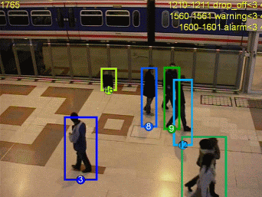
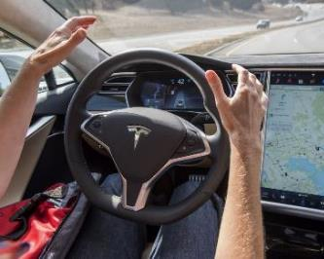
Rise of Computer Vision
Enhance computers with vision capabilities for object recognition
Many opportunities and applications
Shift to embedded vision
Industrial
Surveillance
Automotive
Notes:
Computer Vision is the field of research and engineering that tries to let computers, machines and devices observe, understand, and react accordingly to their environment in a natural way. This is done by using cameras.
Camera (sensors) capture images that contain a lot of information about the environment (colors, high resolution, and depth with more cameras), similar to human vision, are really cheap. This makes them preferred over more specialized solutions that are used for a subset of tasks like LIDAR.
Over the last decade computer vision has been applied extensively for monitoring factory processes, but now its extending to the outside world, which has a lot more diversity, thus making it a more difficult approach
Current applications include automatic surveillance to prevent crimes or terrorism, semi-automatic driving to make traffic more safe, and in the future even self-driving cares
Embedded Devices and Consumer devices could also benefit from better computer vision support
Challenges: no room for error, computation complexity, real-time constrains, privacy

Slide 5
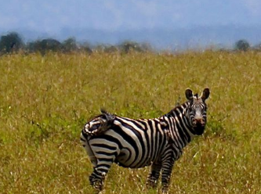
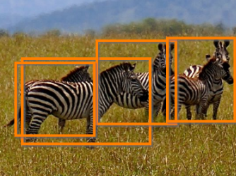
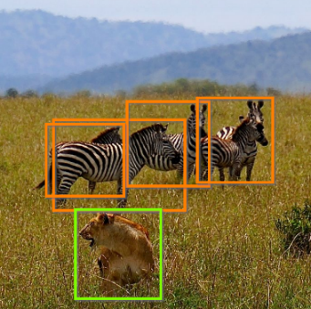
Object Recognition
A difficult Computer Vision problem:
Objects can be visualized in countless ways
Natural scenes contain a lot of noise
classification
detection
recognition
Ground-truth: zebra
Ground-truth: zebra
Ground-truth: zebra, lion
Notes:
----------------------------------------
Main points:
Some examples of object recognition tasks, from simple to more difficult (left to right)
1. Classify the ground-truth object correctly (multiple classes, classify)
2. Classify and locate instances of the ground-truth (single class, classify and locate)
3. Recognize as many instances of objects as possible (multiple classes, classify and locate)
----------------------------------------
Background:
Detection vs Recognition: “Detect and localize all cars in the image” vs “Classify and localize all objects in pictures”
Detection is somewhat simpler (bounding box of all cars (only 1 class: car or no car)
Recognition (bounding box + class label)
Quality of Object Recognition algorithms is tested on labelled datasets. Primary metrics:
- Sensitivity: fraction of objects that is detected
- Accuracy: fraction of detected objects that are classified correctly
- Overlap: predicted bounding-box overlap with ground-truth

Slide 6
Deep Learning algorithms for Computer Vision
Convolutional Neural Networks
Large pipelines with self-learning feature extractors (up to 100+ layers)
Multiply-accumulates dominate runtime: 75% – 85%
Significant memory traffic between layers: 1MB – 200MB per layer

Slide 7
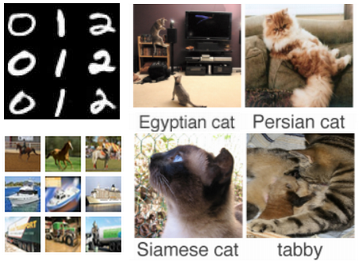
Workload for different image classification tasks
Dataset | Image size | #classes
MNIST | 28x28x1 | 10
CIFAR-10 | 32x32x3 | 10
ILSVRC | 227x227x3 | 1000
Architecture | #layers | #weights | #MACs/image
LeNet5 | 5 | 0.3M | 1.3M
All-CNN-C | 9 | 1.4M | 281M
AlexNet | 8 | 61M | 714M
More recent ILSVRC2012 networks require >25x MACs/image than AlexNet!

Slide 8
Improvements in CV algorithms
2012: DL (AlexNet) beats traditional methods*
2015: DL beats human!
*(task 2a, 16.4% error Vs. 26.2% error for 2nd place)
(data sources: ImageNet Large Scale Visual Recognition Challenge paper (2014) and website)
Notes:
--------------------------------
Main points:
The advent of Deep Learning algorithms
2012: DL beats traditional methods*
2015: DL beats human!
--------------------------------
Background:
Before 2012:
For a long time computer vision algorithms were not possible to compete with humans, until the last decade
ImageNet Large Scale Visual Recognition Challenge
Benchmark in object classification, localization, and recognition
Labelled dataset contains 1.2 Million natural images with 1000 classes
Many large companies participate e.g. Microsoft, Facebook, Google, Baidu, …
After 2012: Rise of Deep Neural Networks
Deep learning provides an answer to the error problem
Very good at classification and recognition tasks
Critical systems like autonomous cars do not have to be error-free, just better than humans
Main enablers
Data availability
Computational power got cheaper
Improvements in algorithms
Why top-5 accuracy?
ILSVRC 2012 contains >1 Million images with 1000 classes, which makes labelling very time-consuming
Therefore only one label per image -> may be ambigious if there are multiple classes

Slide 9
Advent of Binary Neural Networks
Due to large computational workload and memory requirements, binarized networks were proposed!
In CNNs, two types of values can be binarized:
Input signals (activations) to the convolutional layers and the fully-connected layers
Weights in the convolutional layers and the fully-connected layers
Gradients are kept in high precision!

Slide 10
A Binary Neuron
Simulated using real numbers:
Implemented using binary encoding:
$$φ\left(x\right)=\left\{\begin{matrix}1 if x≥0, \\ −1 otherwise.\end{matrix}\right.$$
$$w_{B}^{0}$$
$$d_{R}^{0}$$
+
$$d_{B}^{0}$$
accumulator
$$w_{R}^{0}$$
Encoding:
-1 → 0
+1 → 1
$$N times$$
$$d_{R}^{1}$$
$$w_{B}^{1}$$
$$w_{R}^{1}$$
$$y_{R}$$
$$a_{R}$$
<< 1
$φ$(∙)
$$y_{R}$$
$$a_{B}$$
$$∑$$
$$d_{B}^{1}$$
K-bit PopCount compressor tree
$φ$(∙)
$$d_{R}^{2}$$
$$w_{R}^{2}$$
+
$$w_{R}^{K\text{−}1}$$
$$w_{B}^{K\text{−}1}$$
$−K⋅N$
(kernel size)
$$d_{R}^{K\text{−}1}$$
$$d_{B}^{K\text{−}1}$$
$$d_{R},w_{R},a_{R}∈\left\{−1,+1\right\},{ y}_{R}∈𝕫$$
$$d_{B},w_{B},a_{B}∈\left\{0,1\right\},{ y}_{R}∈𝕫$$
$$a_{B}=φ\left(\sum_{i=0}^{K−1}{w_{R}^{i}⋅d_{R}^{i}}\right)$$
$$a_{B}=φ\left(2⋅PopCnt\left(\sim \left(w_{B}^{i}^d_{B}^{i}\right)\right)−K⋅N \right)$$

Slide 11
Convolution with bitwise operations
Multiplication and addition are replaced by bitwise XNOR and PopCount.
$$d_{R}$$
+1
+1
-1
-1
Mult.
Accumulate
-1
+1
+1
+1
+2
$$w_{R}$$
-1
+1
-1
-1
$4×float32$*
$$d_{B}$$
1
1
0
0
XNOR
PopCount
0
1
1
1
+2
$$w_{B}$$
0
1
0
0
$$\#pos −\#neg$$
$$=2⋅PopCnt(x)−bits$$
$$bits$$
* To enable usage of fast floating-point GPU kernels in PyTorch/Tensorflow during BNN training.

Slide 12
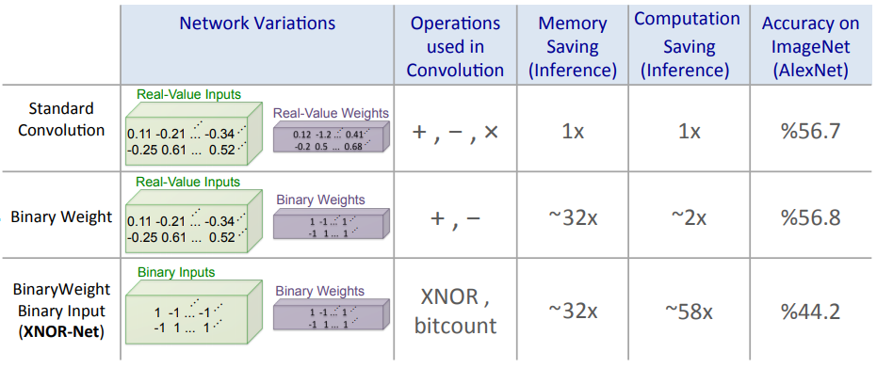
Binary convolutions – savings
Savings on off-the-shelf platforms:
Memory size and accesses: 1/32 → memory energy savings: >32x*
Speedup (compared to float32 version):
CPU (64-bit): ~58x**
GPU: ~23x***
Energy per convolutional operation:
* → bitwise XNOR (and/or AND)
+ → popcount
However: large accuracy reduction!
How to deal with this?
→ more REPAIR actions needed!
XNOR-Net repairs:
weight scaling factors
pooling before sign
* More than 32x reduction as the energy per access of SRAM memories scales proportional to the square root of size.
** XNOR-Net: ImageNet Classification Using Binary Convolutional Neural Networks – Rastegari et al. (2016) (also picture)
*** Binarized Neural Networks: Training Deep Neural Networks with Weights and Activations Constrained to +1 or -1 – Courbariaux et al. (2016)
Notes:
XNOR-net has the following repairs already:
Scaling factors
Pooling layer before activation

Slide 13
Outline of Today’s Lecture
Main theme: Case Study on Binary Neural Networks
Introduction
Overview
Designing a Binary Neural Network
Training and evaluation
State-of-the-art models
Optimizations for efficient inference on 32-bit platform
Specialized BNN accelerators
Conclusion

Slide 14
BNN basic blocks
Structure of Binary Neural Networks, as proposed by Courbariaux et al. (2016), is very similar to other reduced-precision CNNs:
Convolutional layer
Fully-connected layer
Binarized input*
Binarized
Weights*
Binarized input*
Binary Conv2D
Binarized
Weights*
Max Pooling
Binary Linear
Repeat
N times
Repeat
M times
Batch Normalization
Batch Normalization
Binary Activation
Binary Activation**
Binarized output
Binarized output
Source: BinaryNet: Training Deep Neural Networks with Weights and Activations Constrained to +1 or -1 – Courbariaux et al. (2016)
* First and/or last layer is often not binarized; sometimes the weights are still binarized but the input is not.
Notes:
BinConv2d -> MaxPool -> BatchNorm -> Binarization
Batchnorm after MaxPool because
Maxpool after activation has no information about the magnitude of the inputs which causes the gradient of maxpool to be passed to all +1 activations, rather than the largest.

Slide 15
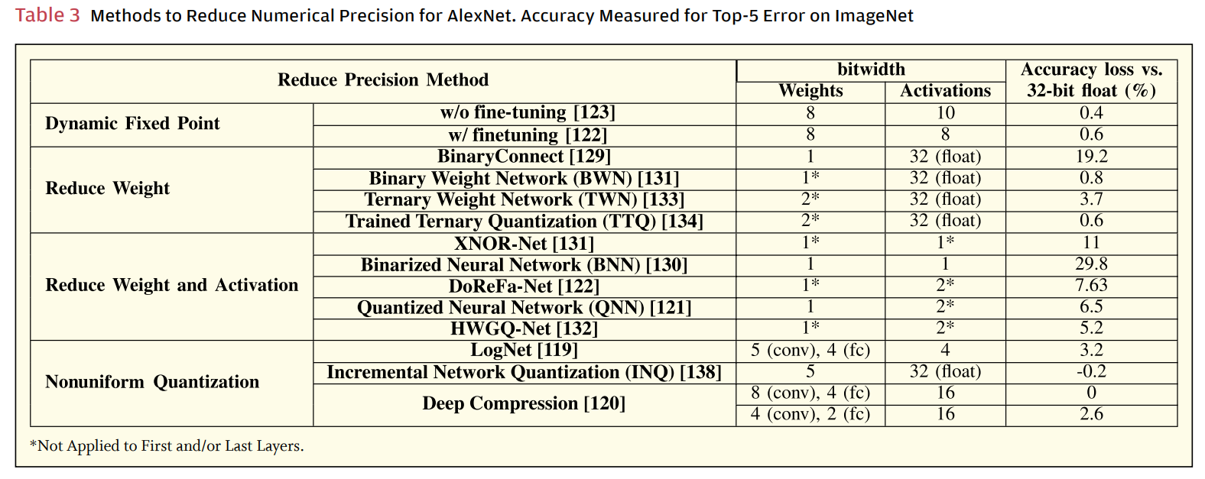
Overview of Quantized Neural networks
Table source: Efficient Processing of Deep Neural Networks: A Tutorial and Survey – Sze et al. (2017)

Slide 16
BNN learning
To train a BNN, we have to
Binarize the weights
Binarize the activations
Binarized training is typically simulated on a GPU, as we still require high-precision weights for the weight updates.

Slide 17
Learning with Binary Weights
Weight Binarization
Computing the gradient w.r.t binarized weights is not useful:
Use clipped STE to approximate the real gradient.
Updating binary weights $w_{B}$ during gradient descent is not possible:
Real weights $w_{R}$ are kept and updated during training.
$w_{R}$ are constrained to reduce the mismatch with $w_{B}$.
After learning:
Binary weights are stored.
Real weights can be discarded.
Forward pass of the weights
$$w_{R}$$
$$Clip$$
$$Sign$$
$$w_{B}$$
$$STE$$
Backward pass of the gradient
$$x_{B}=Sign\left(x_{R}\right)=\left\{\begin{matrix}1 if x_{R}≥0, \\ −1 otherwise.\end{matrix}\right.$$
$$Clip(x_{R})=\left\{\begin{matrix}x_{R} if \left|x_{R}\right|≤1, \\ x_{R}⋅{\left|x_{R}\right|}^{−1} otherwise.\end{matrix}\right.$$
$$\frac{∂x_{B}}{∂x_{R}}=STE(x_{R})=\left\{\begin{matrix}1 if \left|x_{R}\right|≤1, \\ 0 otherwise.\end{matrix}\right.$$
Slide based on: A Review of Binarized Neural Networks – Simons and Lee (Electronics 2019) and
BinaryNet: Training Deep Neural Networks with Weights and Activations Constrained to +1 or -1 – Courbariaux et al. (2016)
Notes:
@article{Courbariaux2016BinaryNetTD, title={BinaryNet: Training Deep Neural Networks with Weights and Activations Constrained to +1 or -1}, author={Matthieu Courbariaux and Yoshua Bengio}, journal={ArXiv}, year={2016}, volume={abs/1602.02830} }

Slide 18
Learning with Binary Activations
Activation Binarization
Similar to weight quantization:
Sign function is used during the forward pass.
Real weights are kept during training.
Gradient steps are canceled when the activation becomes too large by clipped STE.
Activations are not clipped.
Forward pass of the activations
$$d_{R}$$
$$Sign$$
$$d_{B}$$
$$STE$$
Backward pass of the gradient
$$x_{B}=Sign\left(x_{R}\right)=\left\{\begin{matrix}1 if x_{R}≥0, \\ −1 otherwise.\end{matrix}\right.$$
$$\frac{∂x_{B}}{∂x_{R}}=STE(x_{R})=\left\{\begin{matrix}1 if \left|x_{R}\right|≤1, \\ 0 otherwise.\end{matrix}\right.$$
Slide based on: A Review of Binarized Neural Networks – Simons and Lee (Electronics 2019)

Slide 19
BNN network design issues
Open issues:
Do we need biases, or not?
Location of BatchNorm layer in block?
Location of Max-pool layer in block?
Notes:
Feature scaling necessary?
-

Slide 20
Combining Convolutions and BatchNorm (in general)
Batch normalization (BN) is computed with the training set sample mean and variance and has two learnable scaling factors $γ$and $β$ (per output channel):*
$\hat{x}=\frac{x−E\left(x\right)}{\sqrt{Var\left(x\right)+ε}}$ // normalize
$BN_{γ,β}\left(x\right)=γ⋅\hat{x}+β$ // scale and shift
A BN layer is traditionally placed before the non-linear activation $σ$ of a convolutional or fully-connected layer, which makes bias $b$ unnecessary ($b$ can be fused into $β$):
$$\overset{⃑}{a}=σ(BN_{γ,β}(\underset{}{\underbrace{W\overset{⃑}{x}+\overset{⃑}{b}}}))$$
Inlined Conv./FC layer
* Batch Normalization: Accelerating Deep Network Training b y Reducing Internal Covariate Shift – Ioffe and Szegedy (2015)

Slide 21
Location of Max-pooling layer in BNNs
During training the Max-pooling layer should be put before activation.*
After binary activation, Max-pool has no information about the activation magnitude, which causes the gradient to be passed to all +1 activations.
This is incorrect, as non-maximum values do not contribute to the output loss, and should therefore not be updated.
* XNOR-Net: ImageNet Classification Using Binary Convolutional Neural Networks – M. Rastegari et al. (2016)
Notes:
Maxpool after activation has no information about the magnitude of the inputs which causes the gradient of maxpool to be passed to all +1 activations, rather than the largest.

Slide 22
Location of Max-pooling layer in BNNs (2)
Numerical example:
Max-pooling after activation
Max-pooling before activation
$$\left[\begin{matrix}0.5 & −0.4 \\ 0.2 & 0.7\end{matrix}\right]$$
$$\left[\begin{matrix}1 & 0 \\ 1 & 1\end{matrix}\right]$$
$$\left[1\right]$$
$$\left[\begin{matrix}0.5 & −0.4 \\ 0.2 & 0.7\end{matrix}\right]$$
$$\left[0.7\right]$$
$$\left[1\right]$$
$Max$-
$Max$-
$$\overset{⃑}{y_{R}}$$
$$Sign$$
$$\overset{⃑}{a_{B}}$$
$$pool$$
$$r_{B}$$
$$\overset{⃑}{y_{R}}$$
$$pool$$
$$r_{B}$$
$$Sign$$
$$a_{B}$$
$$\frac{∂r_{B}}{∂a_{B}^{i}}$$
$$\frac{∂r_{B}}{∂a_{B}^{i}}$$
$$\left[\begin{matrix}1 & 0 \\ 1 & 1\end{matrix}\right]$$
$$\left[\begin{matrix}0 & 0 \\ 0 & 1\end{matrix}\right]$$
Backward pass of the gradient
Backward pass of the gradient
$$\frac{∂r_{B}}{∂a_{B}^{i}}=\left\{\begin{matrix}1 if{ a}_{B}^{i}=Max\left(\overset{⃑}{a_{B}}\right), \\ 0 otherwise. \end{matrix}\right.$$
Max-pool partial derivative:

Slide 23
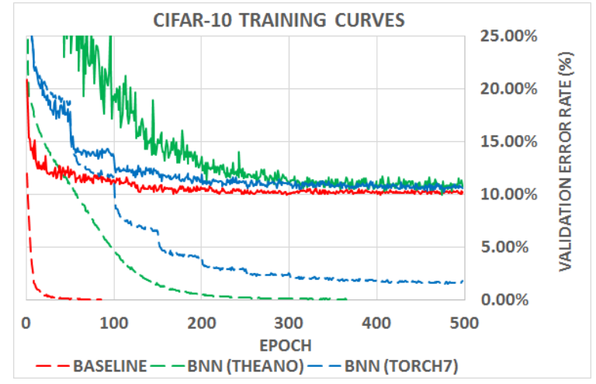
Training procedure – results on CIFAR-10
Observations:
BNNs typically learn a bit slower compared to floating-point baseline.
In the end, the BNN is nearly as accurate on the 10-class CIFAR-10 task.
Validation error
curves
Source: Binarized Neural Networks – Hubara et al. (NIPS 2016)

Slide 24
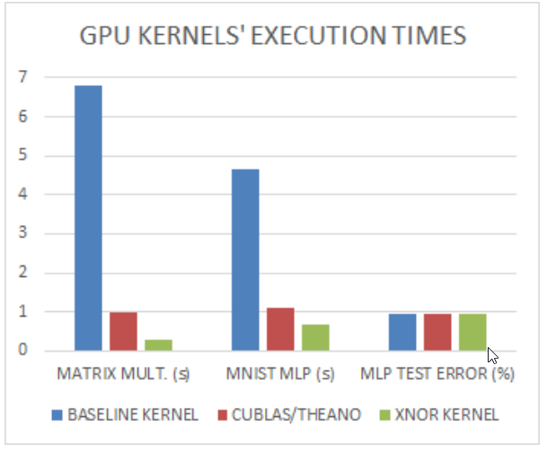
What do we gain on a GPU?
Observations:
23x speedup on large Matrix Multiplication.
3.4x faster than optimized cuBLAS.
7x faster on MNIST CNN.
GPU inference with custom binary kernel
23x
7x
Same
accuracy
Source: Binarized Neural Networks – Hubara et al. (NIPS 2016)

Slide 25
From MNIST to ImageNet
Previous results were one of the first successful binarization approaches for both weights and activations.
However, the approach was only validated on CIFAR-10 and MNIST, which are relatively simple classification tasks.
The authors provide some preliminary results on ImageNet (Top-5 accuracy):
AlexNet: 80.2% → 60.1% after binarization.
GoogLeNet: 89.5% → 69.1% after binarization.
Huge loss! More advanced repair techniques are required!

Slide 26
Outline of Today’s Lecture
Main theme: Case Study on Binary Neural Networks
Introduction
Overview
Designing a Binary Neural Network
Training and evaluation
State-of-the-art models
Optimizations for efficient inference on 32-bit platform
Specialized BNN accelerators
Conclusion

Slide 27
Improvements in BNN architectures
XNOR-Net (2016)
Binary-Net (2016)
Group-Net (2018)
ABC-Net (2017)
Bi-Real-Net (2018)
Following slides are adopted from Floran de Putter

Slide 28
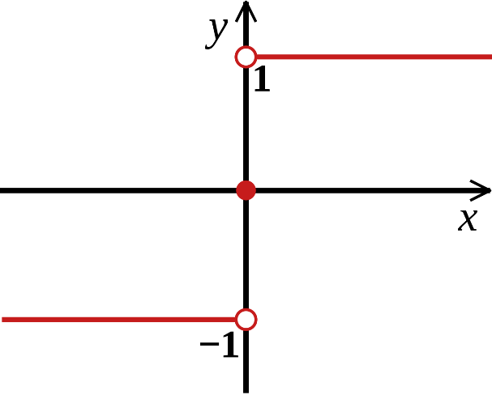
BinaryNet
First and last layer still in full precision
Binarization by using the sign-function
Learning: Use a modified straight-through estimator to pass gradients through the sign-function
Source: Binarized Neural Networks – Hubara et al. (NIPS 2016)

Slide 29
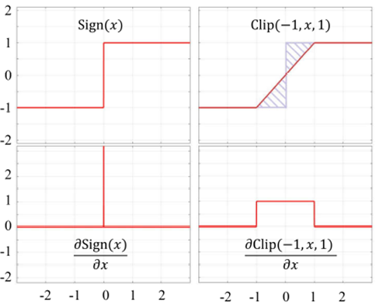
BinaryNet – Straight-through-estimator (STE)
As discussed before, an (clipped) STE addresses the zero-derivative issue:
STE (forward)
STE (backward)

Slide 30
XNOR-Net
Binarization using scaling matrix or factor (for data $I$and weights $W$):
$$I≈K∙\text{sign}\left(I\right)$$
$$W≈α∙\text{sign}(W)$$
Binary convolution becomes:
$$I∗W≈(\text{sign}\text{(}\text{I}\text{)}⊛\text{sign}\text{(}\text{W}\text{))}∙Kα$$
Different layer order (pooling before activation improves training):
Real-valued scaling matrix
* XNOR-Net: ImageNet Classification Using Binary Convolutional Neural Networks – M. Rastegari et al. (2016)
Notes:
Note: K is a matrix of FP scalars, where alpha is a single FP scalar.
Min J = ||W-aB||^2 J=a^2.n – 2aWtB +c
dJ/da=0 => a=WtB/n=sum(W)/n

Slide 31
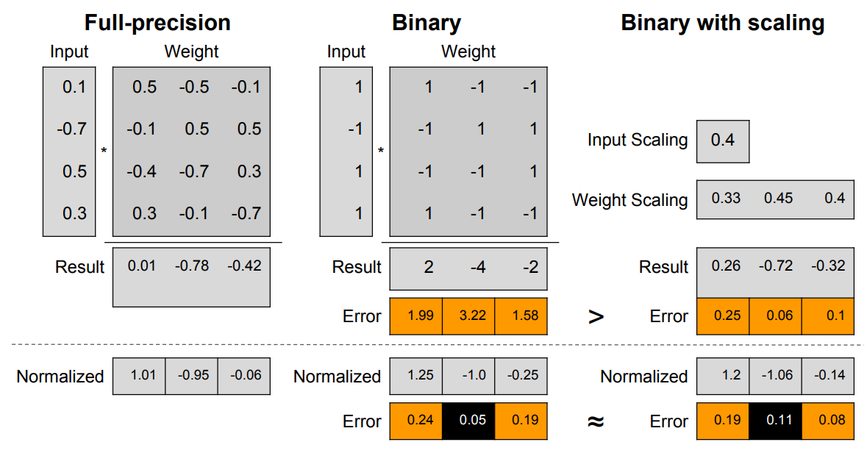
XNOR-Net – impact of scaling factors
Scaling factors help to minimize the difference between a binary convolution and full-precision.
Scaling factors still
useful after BatchNorm?
Example from paper: Back to Simplicity: How to Train Accurate BNNs from Scratch? – Betghe et al. (ArXiv 2019)
Notes:
However, a recent work claims that batch normalization might make these scaling factors unnecessary.

Slide 32
ABC-Net – intuition
Say you want to binarize $x=0.5$:
$$f_{1}\left(x\right)=\text{sign}\left(x\right)$$
$$⇒x>0$$
With two bases (zero and one) we can derive a more accurate bound:
$$f_{1}\left(x\right)=\text{sign}\left(x\right), f_{2}\left(x\right)=\text{sign}\left(x−1\right) \\ ⇒0<x≤1$$
After evaluating $f_{1}$ and $f_{2}$ we can determine in what range $x$ lies:
${¬f}_{1}\left(x\right) ∧{¬f}_{2}\left(x\right)⇒x≤0$
$f_{1}\left(x\right) ∧{¬f}_{2}\left(x\right)⇒0<x≤1$
$f_{1}\left(x\right) ∧f_{2}\left(x\right)⇒x>1$
This predicate holds for $x=0.5$
Source: Towards Accurate Binary Convolutional Neural Network – Lin et al. (NIPS 2017)

Slide 33
ABC-Net – weight approximation
Estimate real-value weights $W$using a linear combination of $M$ binary filters $B_{1}$, $B_{2}$, …, $B_{M}$, such that the full precision weights are estimated as
$$W≈α_{1}B_{1}+α_{2}B_{2}+…+α_{M}B_{M}$$
Every binary base $B_{i}$, $i=1,2,…,M$ is constructed using an user-defined set of shifting parameters $u_{i}$ over the $\text{std}\left(W\right)$ i.e.
$$B_{i}=\text{sign}\left(W−\text{mean}\left(W\right)+u_{i}⋅\text{std}\left(W\right)\right)$$
Scaling parameters $α_{i}$, $i=1,2,…,M$ are calculated by solving the following linear regression problem for every $B_{i}$ i.e.
$$\min_{α_{i}}{ {\left\|W −B_{i}α_{i}\right\|}^{2}}$$

Slide 34
ABC-Net – weight approximation implementation
Observations:
Binarized input data $I_{B}$ is the same for all binary convolutions.
Binary convolutional workload increases by the number of bases.
$$I_{B}$$
Approximate weights using 3 binary bases
$$I_{B}$$
$$f\left(W,u_{1}\right)=B_{1}$$
BinConv
$$α_{1}$$
$$W_{B}$$
Conv
$$output$$
$$B_{2}$$
$$α_{2}$$
+
$$output$$
BinConv
$$α_{3}$$
$$B_{3}$$
BinConv

Slide 35
ABC-Net – weight approximation numerical example
Say you want to approximate $W=\left[\begin{matrix}−0.135 & 0.125 \\ −0.065 & 0.075\end{matrix}\right]$ by three binary bases for $μ_{i}={\left[−1, 0, 1\right]}^{T}$.
Then $\text{mean}\left(W\right)≈0\text{, }\text{std}\left(W\right)≈0.12$ and bases are
$$B_{1}=sign\left(W−0.12\right)=\left[\begin{matrix}−1 & 1 \\ −1 & −1\end{matrix}\right]{ B}_{2}=sign\left(W+0.00\right)=\left[\begin{matrix}−1 & 1 \\ −1 & 1\end{matrix}\right]$$
$$B_{3}=sign\left(W+0.12\right)=\left[\begin{matrix}−1 & 1 \\ 1 & 1\end{matrix}\right]$$
From$\min_{ α_{i}}{ {\left\|W −B_{i}α_{i}\right\|}^{2}}$, it follows that $α={\left[0.0275, 0.07, 0.0325\right]}^{T}$, thus
$$W≈\left[\begin{matrix}−0.0275−0.07−0.0325 & 0.0275+0.07+0.0325 \\ −0.0275−0.07+0.0325 & −0.0275+0.07+0.0325\end{matrix}\right]=\left[\begin{matrix}−0.13 & 0.13 \\ −0.065 & 0.075\end{matrix}\right]$$
Notes:
Idea: with binary weights and scaling factors you can recover the original weights.
Python code:
import numpy as np
vec = lambda x: x.flatten() # matrix to vector
sign = lambda x: np.where(x >= 0, 1, -1) # sign activation
# base parameters and input weights
u = [-1, 0, 1]
W = np.array([[-0.135, -0.065],[0.125, 0.075]])
# compute reconstruction
mu, std = np.mean(W), np.std(W, ddof=1)
B = np.array([vec(sign(W - mu + i*std)) for i in u]) # compute bases
a, _, _, _ = np.linalg.lstsq(B.T, vec(W))
W_hat = (B * a[:,None]).sum(axis=0).reshape(W.shape)

Slide 36
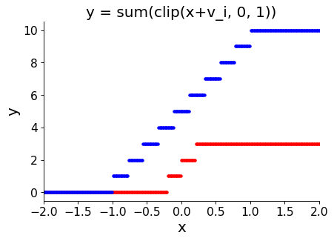
ABC-Net – activation approximation
Full precision activations are estimated with $N$ binary bases using a similar idea as weights:
$$R≈β_{1}A_{1}+β_{2}A_{2}+…+β_{N}A_{N}$$
Each activation is binarized for every base as follows using shift vector $v$:
$$A_{i}=\text{cli}p\left(sign(x+v_{i}),0, 1\right)$$
This approximates a bounded rectifier activation!
Two examples (assuming $β=[1,…,1]$, for simplicity) :
3 bases; $v=\left[−0.2,0,0.2\right]$
10 bases; $v=\left[−1,−0.78,…,0.78,1\right]$
Notes:
import numpy as np
import matplotlib.pyplot as plt
sign = lambda x: np.where(x >= 0, 1, -1) # sign activation
clip = lambda x: np.clip(sign(x), 0, 1)
v1 = np.linspace(-1/5,1/5,3)
v2 = np.linspace(-1,1,10)
x = np.linspace(-10,5,1000)
y1 = np.array([clip(x+i) for i in v1]).sum(axis=0)
y2 = np.array([clip(x+i) for i in v2]).sum(axis=0)
fig,ax = plt.subplots(dpi=80)
ax.scatter(x, y1, marker='.', c='r')
ax.scatter(x, y2, marker='.', c='b')
ax.set_xlabel("x", fontsize=18)
ax.set_ylabel("y", fontsize=18)
ax.set_title("y = sum(clip(x+v_i, 0, 1))", fontsize=18)
plt.xticks(fontsize=14)
plt.yticks(fontsize=14)
ax.spines['right'].set_visible(False)
ax.spines['top'].set_visible(False)
ax.set_xlim([-2,2])

Slide 37
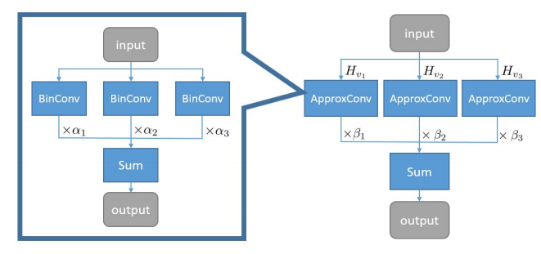
ABC-Net – block structure
Convolution becomes: $I∗W≈\sum_{i=1}^{M}{\sum_{j=1}^{N}{α_{i}β_{j}∙(B_{m}⊛A_{n}\text{)}}}$.
Workload increases by $M×N$ plus some high-precision scaling multiplications.
Number of weights increases by $M$ times (number of weight bases).

Slide 38
ABC-Net – results
Adding weight bases improves performance on ImageNet significantly:
Accuracy improves tremendously over other fully binarized networks:

Slide 39
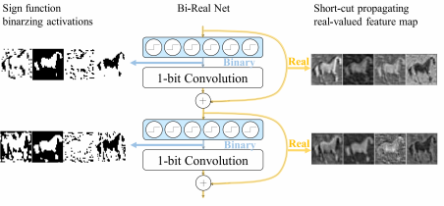
Bi-Real Net - summary
Overview:
Add shortcuts to improve information flow.
Similar to ResNet, with twice the shortcuts.
Shortcuts also beneficial for floating-point model.
Difficult to train, Darabi et al. (2019) claims.
Results:
Comparison against state-of-the-art on ResNet-18 for ImageNet. Note that ABC-Net has only 1 weight and activation base, to make the comparison more fair (in terms of FLOPs):
Bi-Real Net: Enhancing the Performance of 1-bit CNNs With Improved Representational Capability and Advanced Training Algorithm – Liu et al. (ECCV 2018)
BNN+: Improved Binary Network Training – Darabi et al. (2019)
Notes:
We wont discuss these in this lecture

Slide 40
Further accuracy repair optimizations
Ternary Binary Network (TBN) – Wan et al. (ECCV 2018)
Group-Net – Zhuang et al. (CVPR 2019)
Recommended reading
Revisits commonly used repair techniques in BNNs and distills which ones are actually mandatory for State-of-the-Art ImageNet performance.

Slide 41
State-of-the-Art in Binarized Neural Networks
Notes:
Hoe dichtbij zijn we

Slide 42
Outline of Today’s Lecture
Main theme: Case Study on Binary Neural Networks
Introduction
Overview
Designing a Binary Neural Network
Training and evaluation
State-of-the-art models
Optimizations for efficient inference on 32-bit platform
Specialized BNN accelerators
Conclusion

Slide 43
Max-pooling with bitwise operations
During training the Max-pooling layer was put before binary activation.
During inference, the max-pooling layer should be put after the binary activation to optimize the computation:*
$$a_{R}^{i+0}$$
$$a_{R}^{i+1}$$
$$a_{R}^{i+2}$$
$$a_{R}^{i+3}$$
$$a_{R}^{i}$$
$$Max$$
$$Max$$
$$Sign$$
+3 Sign operations
$$Max$$
$$a_{B}^{i+0}$$
$$a_{B}^{i+1}$$
$$a_{B}^{i+2}$$
$$a_{B}^{i+3}$$
$$r_{R}$$
$$Sign$$
$$r_{B}$$
$$r_{B}$$
* Finn: A framework for fast, scalable binarized neural network inference – (FPL 2017)
Notes:
Maxpool after activation has no information about the magnitude of the inputs which causes the gradient of maxpool to be passed to all +1 activations, rather than the largest.

Slide 44
Fusing BatchNorm with Sign activation
The original Batch normalization computation
$BN_{γ,β}\left(x\right)=γ⋅\hat{x}+β$ $\hat{x}=\frac{x−E\left(x\right)}{\sqrt{Var\left(x\right)+ε}}$
can be merged with the sign function during test time.
$$Sign\left(x_{R}\right)=\left\{\begin{matrix}1 if x_{R}≥0, \\ −1 otherwise.\end{matrix}\right.$$
For $x_{R}=$ $BN_{γ,β}\left(x\right)$ we get the following expression:
$$γ⋅\frac{x−E\left(x\right)}{\sqrt{Var\left(x\right)+ε}}+β≥0 ≡ γ⋅\left(x−E\left(x\right)\right)≥−β⋅\sqrt{Var\left(x\right)+ε}$$

Slide 45
Fusing BatchNorm with Sign activation
which can be simplified further in two cases:
$$x≥E\left(x\right)−β⋅\frac{\sqrt{Var\left(x\right)+ε}}{γ},γ>0 x≤E\left(x\right)−β⋅\frac{\sqrt{Var\left(x\right)+ε}}{γ},γ<0$$
To get rid of these two cases we can negate the mean and weights of output channels in the preceding convolution layer that have negative $γ$ i.e.
$$Conv2d\left(d,±w\right)≥±E\left(x\right)−β⋅\frac{\sqrt{Var\left(x\right)+ε}}{γ}$$
* Finn: A framework for fast, scalable binarized neural network inference – Y. Umuroglu et al. (FPL 2017) and
similar to Eq. 3 in XNOR Neural Engine: A Hardware Accelerator IP for 21.6-fJ/op Binary Neural Network Inference – F. Conti et al. (TCAD 2018)

Slide 46
Further optimizations
If your weights have a scaling factor (e.g. in XNOR-Net or ABC-Net), this scaling factor can also be fused into the comparison.
The subtract in the PopCount operator ($K⋅N$) can also be merged:
$$a_{B}=φ\left(2⋅PopCnt\left(\sim \left(w_{B}^{i}^d_{B}^{i}\right)\right)−K⋅N \right)$$

Slide 47
Putting it together
Accumulate K times
$$d_{B}$$
1
1
0
0
XNOR
PopCount
0
1
1
1
+2
$$w_{B}$$
0
1
0
0
$$a_{R}$$
$$bits$$
Fused
BN + Sign
$$−κ/λ$$
To implement a BNN for efficient inference on a 32-bit architecture, several other issues need to be addressed:
Scheduling and bitpacking
Input feature map border padding
$$≥$$
$$a_{B}^{i+0}$$
$$a_{B}^{i+1}$$
$$a_{B}^{i+2}$$
$$a_{B}^{i+3}$$
Max Pooling
$$r_{B}$$

Slide 48
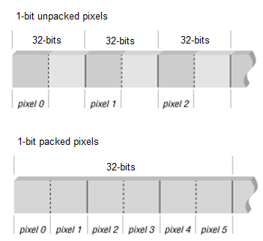
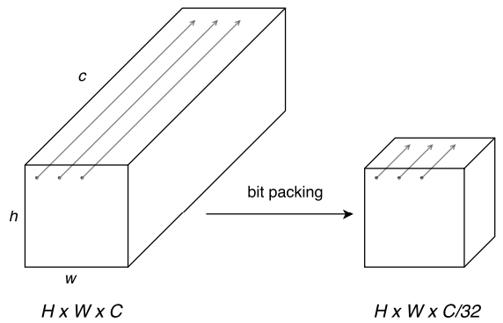
Issue 1 – Scheduling and bit-packing
Bit-packing of weights and activations:
Weights are packed off-line to save model size (typically over input channel dimension).
Activations are packed after first layer and never unpacked until the last layer.
Input feature map bit-packing

Slide 49
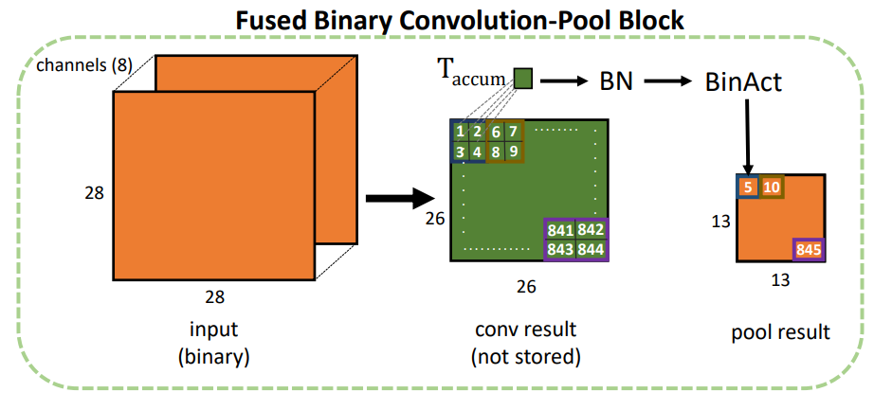
Issue 1 – Scheduling and bit-packing
Scheduling strategy for general-purpose processor:
This example computes 8 channels in parallel using a bitwise XNOR and PopCount.
After 4 pixels are computed, the output is immediately normalized, binarized and pooled.
Data in overlapping 3x3 kernel windows is reused within a feature map.
3
Compution order
Paper and Code: https://github.com/kunglab/ebnn

Slide 50
Issue 1 – Scheduling and bit-packing
The scheduling problem is actually not easy to solve:
What happens if we have $>8$input channels and/or multiple output maps? In what order should we compute all output pixels? Can we do better if we process multiple images in parallel?
The keyword is: data locality and reuse distance analysis.
What computation schedule yields the best data locality and/or highest throughput?
This depends on many factors, such as cache/memory size, layer dimensions, amount of memory bandwidth and parallelism on target platform, …
How to find these schedules will be discussed in the upcoming lectures!

Slide 51
Issue 2 – Input feature map padding
Problem: zero-padding input feature maps in convolutional layers is a problem when you can only use +1 and -1 during model deployment.
Proposed solutions:
Use zero-padding and train with {-1, 0, +1}. After training the padding values are replaced by +1 and the model is retrained to regain some of the lost accuracy.*
Use odd-even padding and train with real binary i.e. {-1, +1}. **
* Accelerating binarized convolutional neural networks with software-programmable fpgas – R. Zhao et al. (FPL 2017) and
Finn: A framework for fast, scalable binarized neural network inference – Y. Umuroglu et al. (FPL 2017)
** FBNA: A Fully Binarized Neural Network Accelerator – P. Guo et al. (FPL 2018)
Notes:
Finn: A framework for fast, scalable binarized neural network inference – (FPL 2017)
FBNA: A Fully Binarized Neural Network Accelerator – P. Guo et al. (FPL 2018)

Slide 52
Issue 2 – Input feature map padding (2)
Odd-even padding performs comparable to zero-padding (essentially ternary) without fine-tuning:
Image source: FBNA: A Fully Binarized Neural Network Accelerator – P. Guo et al. (FPL 2018)

Slide 53
Outline of Today’s Lecture
Main theme: Case Study on Binary Neural Networks
Introduction
Overview
Designing a Binary Neural Network
Training and evaluation
State-of-the-art models
Optimizations for efficient inference on 32-bit platform
Specialized BNN accelerators
Conclusion

Slide 54
Specialized BNN accelerators
XNOR Neural Engine: a Hardware Accelerator IP for 21.6 fJ/op Binary Neural Network Inference – F. Conti et al. (TCAD 2018)
Design of BNN accelerator that is tightly coupled with micro-controller platform.
Platform is evaluated on real-world BNN networks, such as ResNet and Inception.

Slide 55
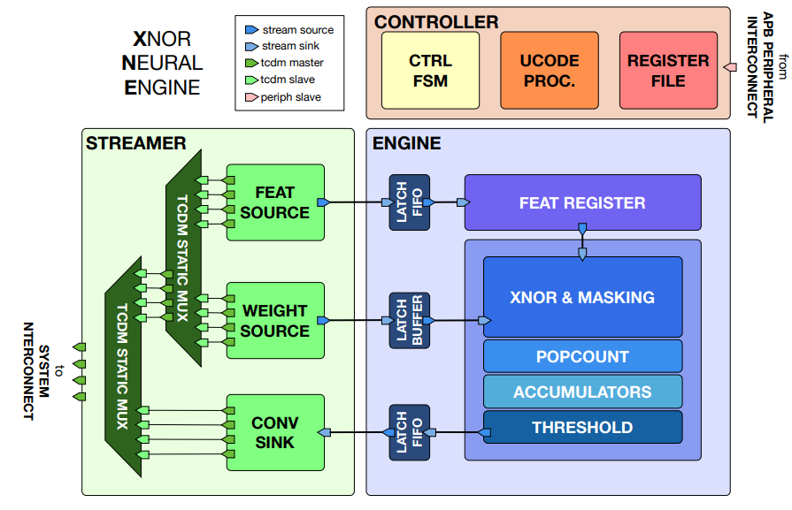
XNE accelerator – overview
Streamer
TP x 32b memory interface for input data, weights, and activations.
Address generation and word-alignment functionality.
Controller
Small 28 Byte register file to load layer configuration for execution.
Small micro-processor to generate loop counters and addresses.
Engine
XNE datapath that can process binary convolution and fully-connected layers.
Throughput Parameter TP = 4

Slide 56
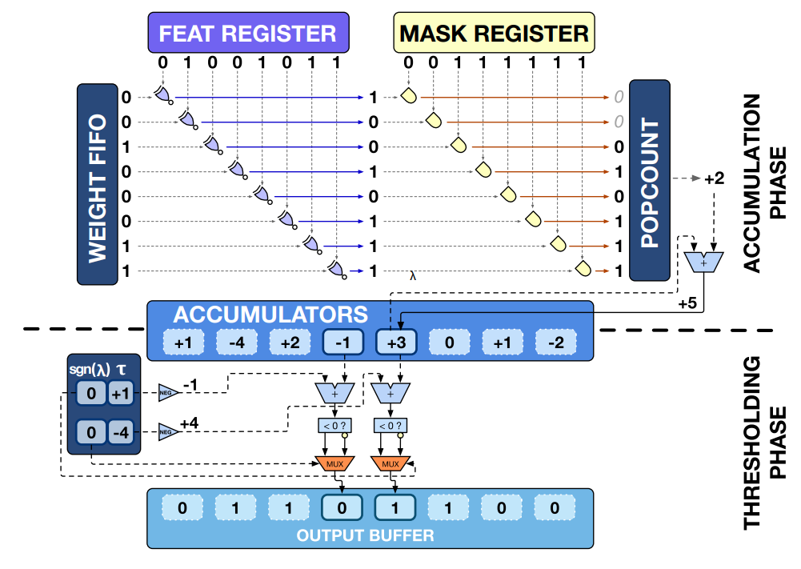
XNE datapath – detailed implementation
TP XNORs are computed in parallel over input channel dimension.
Input data is stored in Feature Register and reused for all output maps.
Every cycle a new weight bit vector is loaded.
TP 16-bit accumulators are used to compute TP pixels from different output maps in parallel.
PopCount is masked when TP is not a multiple of the number of input channels.
Fused Binarization + BatchNorm. 2 cases:
s = t < tau if sign(λ) = 0
s = t ≥ tau if sign(λ) = 1
TP x (7 + 1) bit register file to keep thresholds.
Throughput Parameter TP = 8

Slide 57
Data reuse opportunities in CNNs/BNNs
Input data
Reused for every output channel (N_out times)
Reused several times within a feature map (~ fs x fs times; slightly less reuse at borders)
Weights
Reused for every output pixel in an output feature map (h_out x w_out times)
Reused for every image within a batch (not applicable for this accelerator)
Output data
Partial results are reused to accumulate the products of every input channel (N_in times)
Notes:
What reuse do they exploit?
input- and output stationary.
All reuse within output elements will be exploited (N_in times
Input data reuse will be partially exploited ((N_out/TP) / N_out * fs * fs )

Slide 58
XNE accelerator – implemented schedule
Partial result reuse is fully exploited; partial results are kept in the accelerator until the final result is computed.
Input data reuse is exploited over output maps, but not within a feature map (fs x fs reloads; slightly less at the borders).
Weight reuse not exploited; batch size is one and weights are reloaded for every output pixels (h_out x w_out reloads).
They motivate this schedule as follows: modern networks have many channels but small feature maps and kernels. Therefore the amount of input reuse within a feature map and weight reuse is limited.

Slide 59
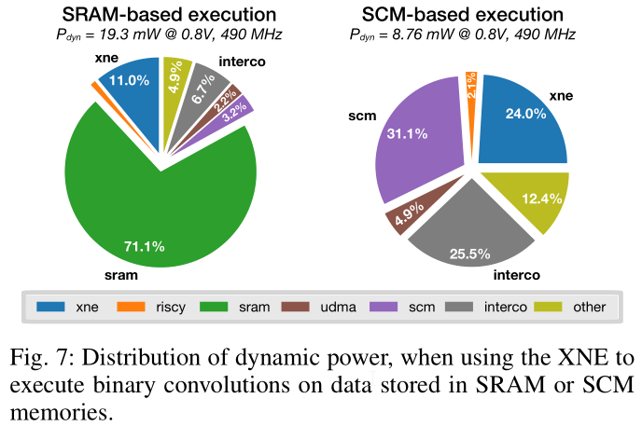
XNE accelerator – main results
Accelerator is implemented with TP = 128 → peak 256 Ops/cycle
(XNOR + PopCount = 256 Ops)
Throughput of 220 Ops/cycle under normal conditions.
Memory power dominates over computation by factor 7.1x.
Most of the memory traffic caused by weight reloads, according to authors.

Slide 60
XNE accelerator – main results (2)
ResNet-18 runs at 1.45mJ/frame @ 14.7 fps
ResNet-34 runs at 2.17mJ/frame @ 8.9 fps
Typical coin cell battery:
Panasonic CR2032 3V battery: 224mAh x 3.0V x 3.6 ≈ 2.5kJ
> 1.1 million classifications!
> 30 hour continuous battery life!

Slide 61
BNN hardware accelerators – more references
Related works:
XNOR Neural Engine: a Hardware Accelerator IP for 21.6 fJ/op Binary Neural Network Inference – F. Conti et al. (TCAD 2018)
FBNA: A Fully Binarized Neural Network Accelerator – P. Guo et al. (FPL 2018)
A Ternary Weight Binary Input Convolutional Neural Network: Realization on the Embedded Processor – H. Yonekawa (ISMVL 2018)
Accelerating binarized convolutional neural networks with software-programmable fpgas – R. Zhao et al (FPL 2017)
Finn: A framework for fast, scalable binarized neural network inference – Y. Umuroglu et al. (FPL 2017)
Important aspects:
Hardware architecture, bit-packing, execution schedule, memory-efficiency and energy-efficiency on complete networks.

Slide 62
Outline of Today’s Lecture
Main theme: Case Study on Binary Neural Networks
Introduction
Overview
Designing a Binary Neural Network
Training and evaluation
State-of-the-art models
Optimizations for efficient inference on 32-bit platform
Specialized BNN accelerators
Conclusion

Slide 63
Summary – Training and efficient inference with BNNs
Binary Neural Networks might be a good alternative for running computer vision algorithms on the edge.
All expensive layers in an BNN can be replaced by cheap XNOR and PopCount operators. With some effort it is also possible to replace operators in other layers by cheap bitwise operations or comparison.
However, there is still some research required to make them competitive with a reasonable increase in binary computational workload.
State-of-the-Art BNN accelerators might run over a day on a single coin cell battery. Is this sufficient?

Slide 64
Recommended reading
A recent overview paper on BNNs:

Slide 65
Deep Neural Network optimization: Binary Neural Networks
Barry de Bruin
Electrical Engineering – Electronic Systems group

