Slide 1
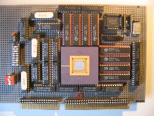
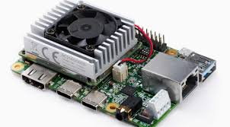
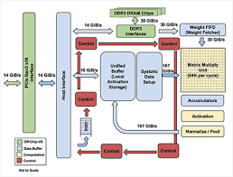
Intelligent Architectures
5LIL0
Recap
TPU board
Henk Corporaal
www.ics.ele.tue.nl/~heco/courses/IA
h.corporaal@tue.nl
TUEindhoven
2019
TPU datapath

Slide 2
Intelligent Architectures (IA, 5LIL0)
Experimental course, with focus on Deep Learning
What's Deep Learning?
  self learning algorithms
  using huge data sets to learn
  deep: many "learning layers"
  brain inspired, based on neurons and synapses (connections)
  high classification accuracy
Many applications; the hype started with: ImageNet

Slide 3
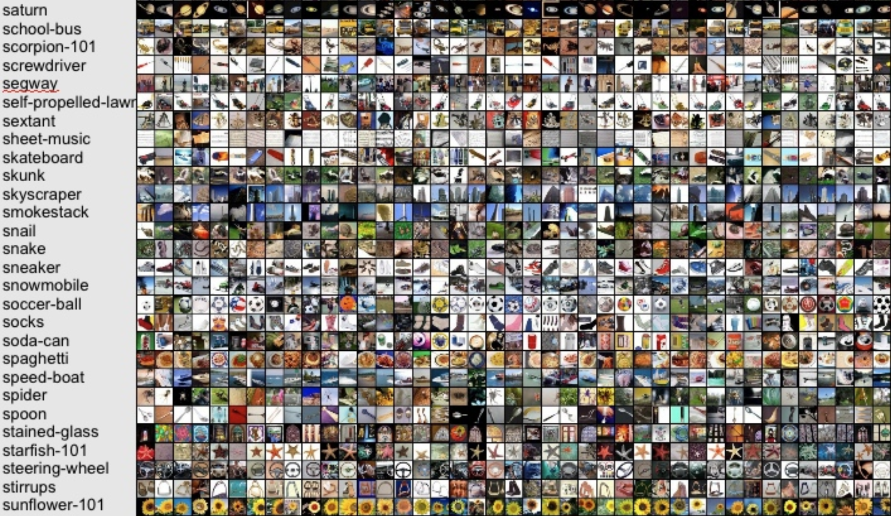
ImageNet challenge: 10M images, 10000 classes

Slide 4
ImageNet Winners (top-5 classification error)
2012: DL beats traditional methods
2015: DL beats human!

Slide 5
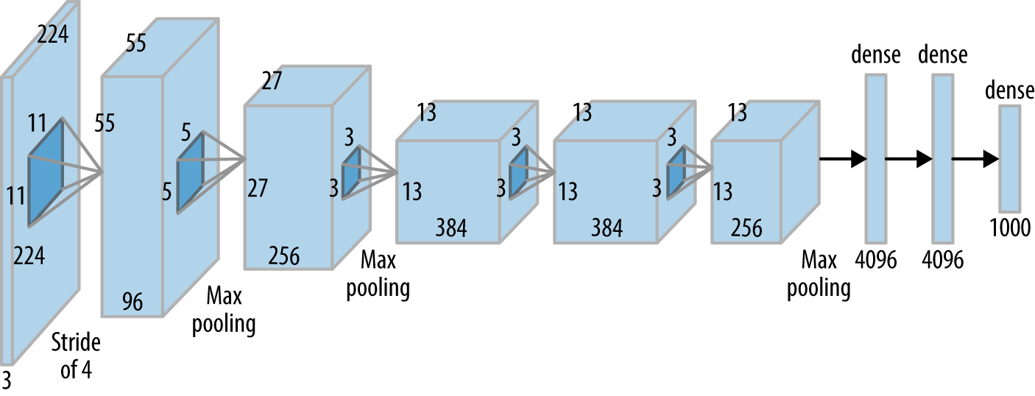
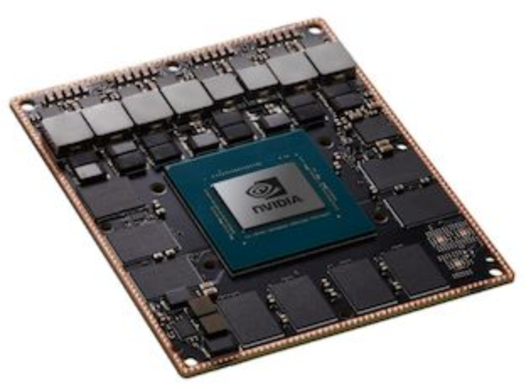
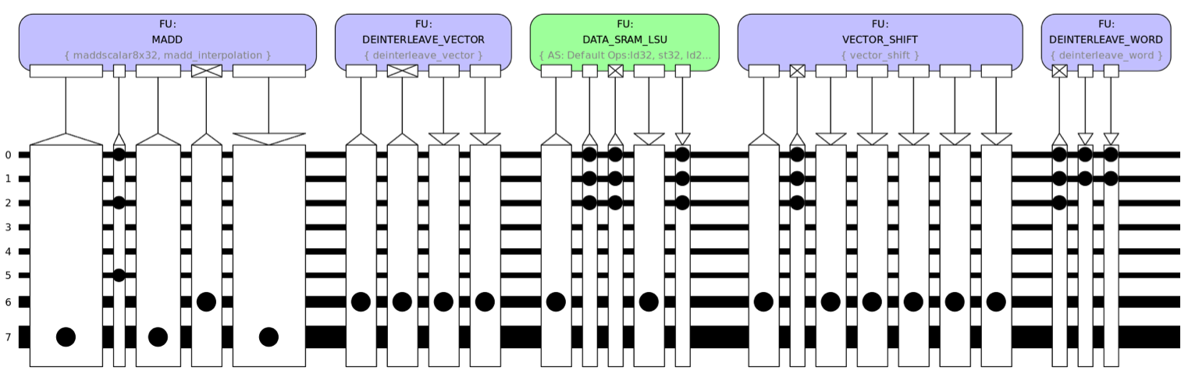
Intelligent Architectures
Summary
AlexNet (partly)
AivoTTA (partly)
NVIDIA Xavier
embedded GPU
Notes:
Photo is of an Intel Conroe (Core 2 Duo Desktop processor). Photo taken from Intel web site.

Slide 6

Learning goals
Understanding deep learning, including:
  network architectures
  inference
  learning methods
Design of Deep Neural Networks (DNNs), using current frameworks
  in particular Convolutional Neural Networks (CNNs)
Implement and optimize DNNs using various optimization methods
Current DNNs, including newest operators
Special processing hardware efficiently supporting Deep Learning
Alternative approaches to the ''classical'' DNNs, like:
  Bayesian learning and Neuromorphic computing

Slide 7
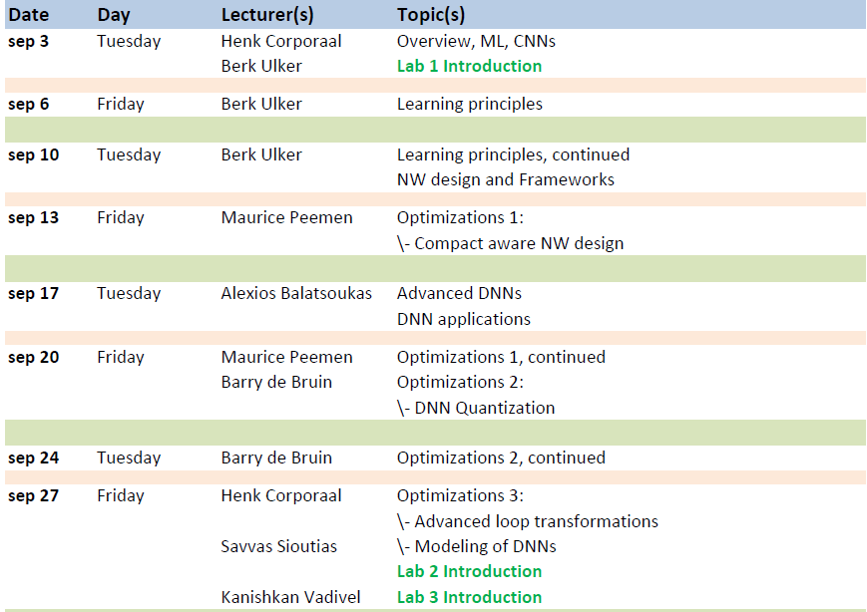
Schedule
September '19

Slide 8
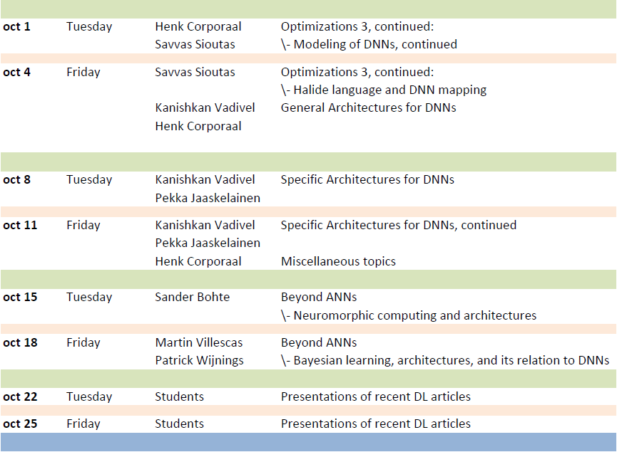
Schedule
October '19

Slide 9
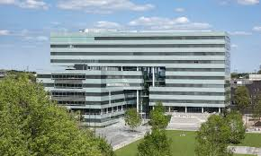
Course Administration
Credits:
  5LIL0: 5 credit points (ECTS)
Labs
  finish Lab 2 / 3
Oral exam on Wednesday Nov 6
  Theory: 20 min (30 pts)
  Lab 1: 20 min (35 pts)
  Lab 2 or 3: 20 min (35 pts)
Bonus: article presentation on Monday Nov 18

Slide 10
The Intelligent Architectures Team
Lecturers:
  Maurice Peemen
  Alexios Balatsoukas
  Barry de Bruin
  Pekka Jaaskelainen
  Sander Bohte
  Martin Roa Villescas
  Kanishkan Vadivel
  Henk Corporaal
Labs assistents:
  Berk Ulker
  Kanishkan Vadivel
  Martin Roa Villescas
  Savvas Sioutas
  Barry de Bruin

Slide 11
Material
Handouts and slides; see oncourse and course web sites:
  https://oncourse.tue.nl/2019 (go to 5LIL0)
  http://www.es.ele.tue.nl/~heco/courses/IA-5LIL0
Articles
  Efficient Processing of Deep Neural Networks: A Tutorial and Survey by Vivienne Sze, e.a.; arXiv, August 2017 (also slides available)
Study recent (>= 2017) article from top conferences and journals
  http://www.guide2research.com/topconf/machine-learning
  http://www.guide2research.com/journals/machine-learning
  http://www.es.ele.tue.nl/~heco/lit/conf+journals.html

Slide 12

Recap topics
What is learning?
What is a DNN, and in particular a CNN?
DNN Learning principles
Optimization 1
Optimization 2
Optimization 3
DNN Hardware support
Beyond DNNs
  Neuromorphic and Bayesian networks

Slide 13
Learning
Traditional CS
Program
Output
Data
Machine Learning
Data
Program
Output
Concl: We learn 'by example'

Slide 14
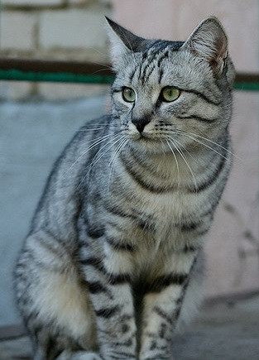
3 key components
Score function (Classifier) : Function to map input to output
Loss Function : Evaluate quality of mapping
Optimization Function : Update classifier
Label 'cat'
Classifier
(DNN or Bayesian model)
Loss
(measure of the error)
Class
values
Optimization:
Improve
classifier

Slide 15
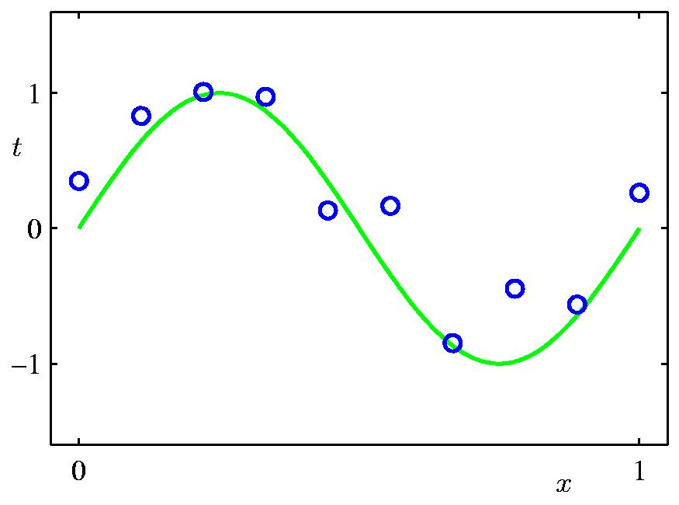
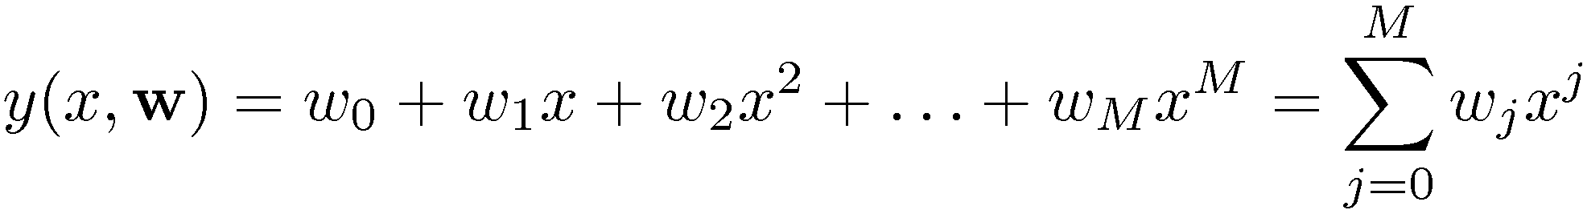
Example: Polynomial Curve Fitting
Measured values (x_{i},t_{i})
Generated by t=sin(x) + noise
Can we learn this curve from
the measurements?
Example taken from C.M. Bishop: Pattern Recognition and Machine Learning

Slide 16
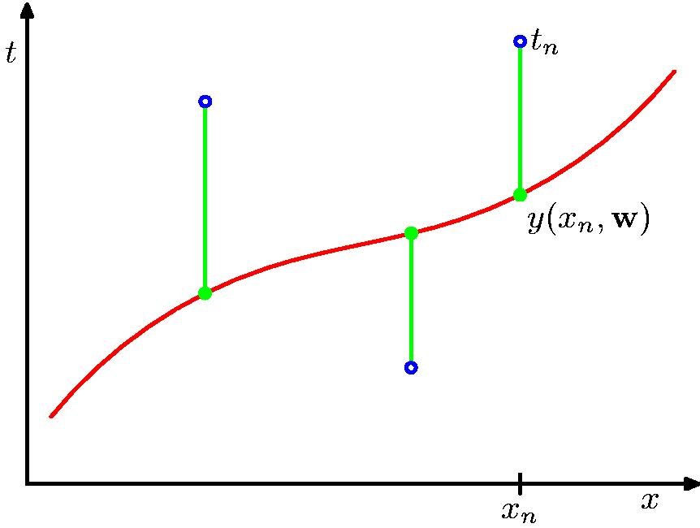
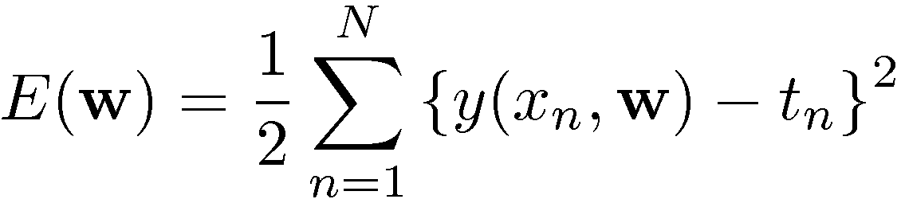
Loss E(w): Sum-of-Squares Error Function

Slide 17
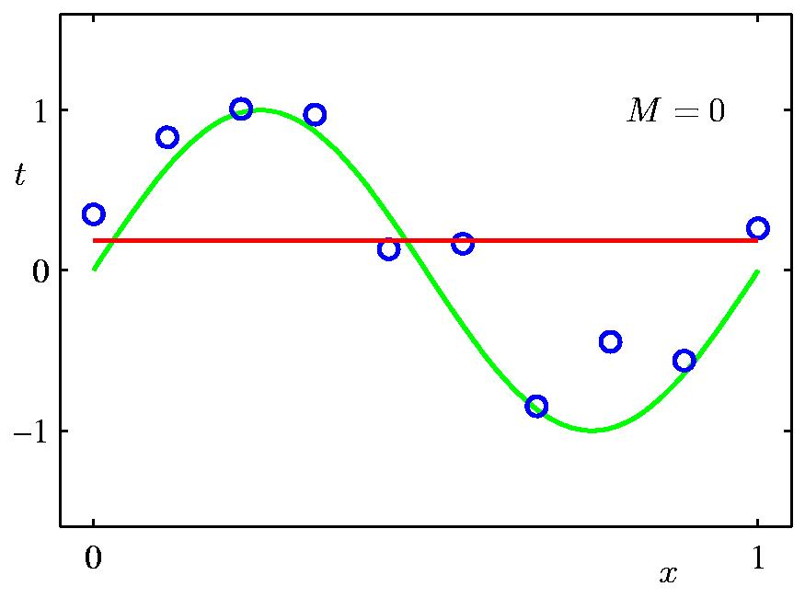
0th Order Polynomial

Slide 18
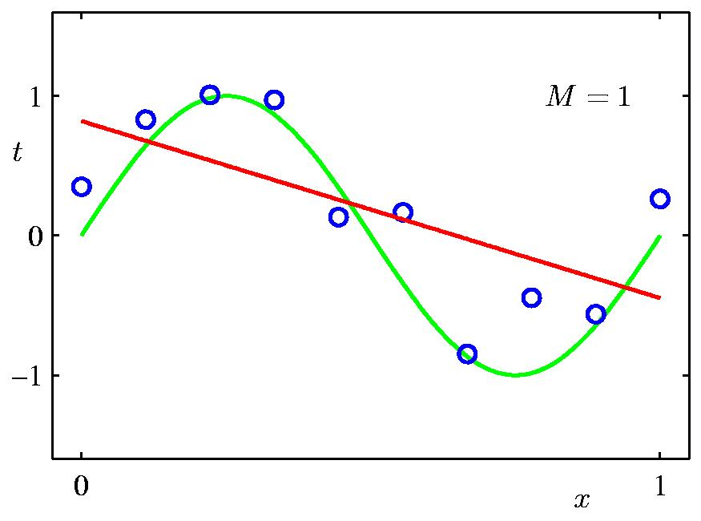
1st Order Polynomial

Slide 19
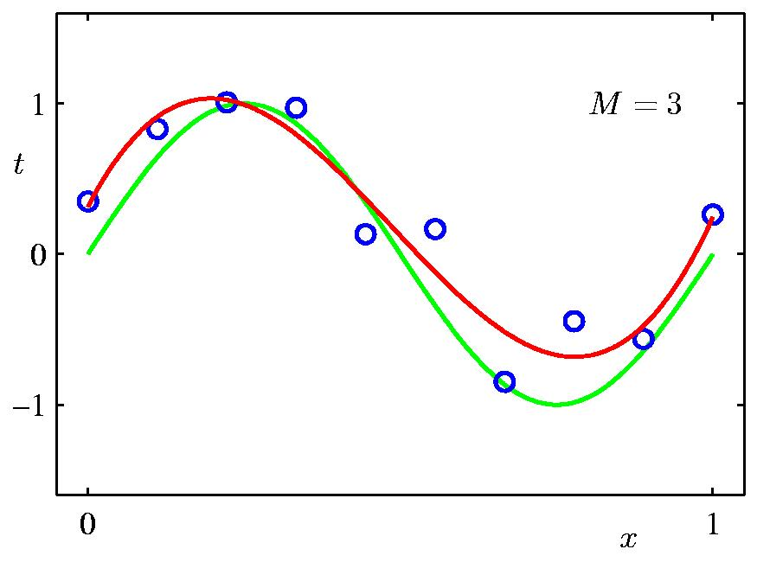
3rd Order Polynomial

Slide 20
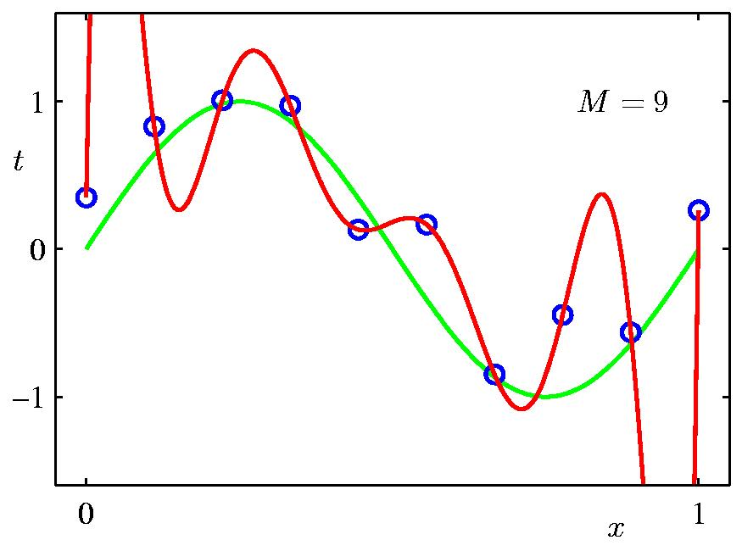
9th Order Polynomial

Slide 21
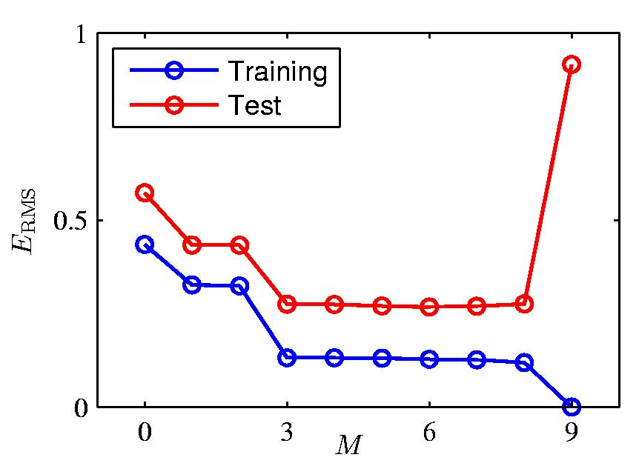
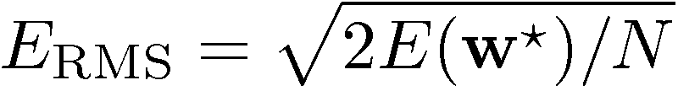
Over-fitting
Root-Mean-Square (RMS) Error:

Slide 22
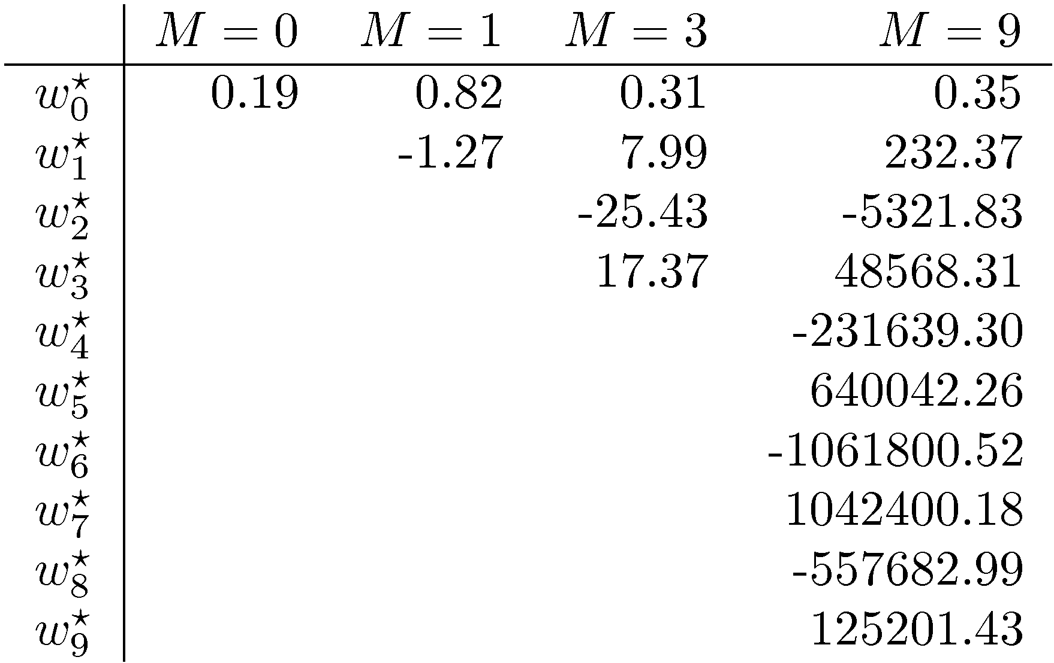
Polynomial Coefficients

Slide 23
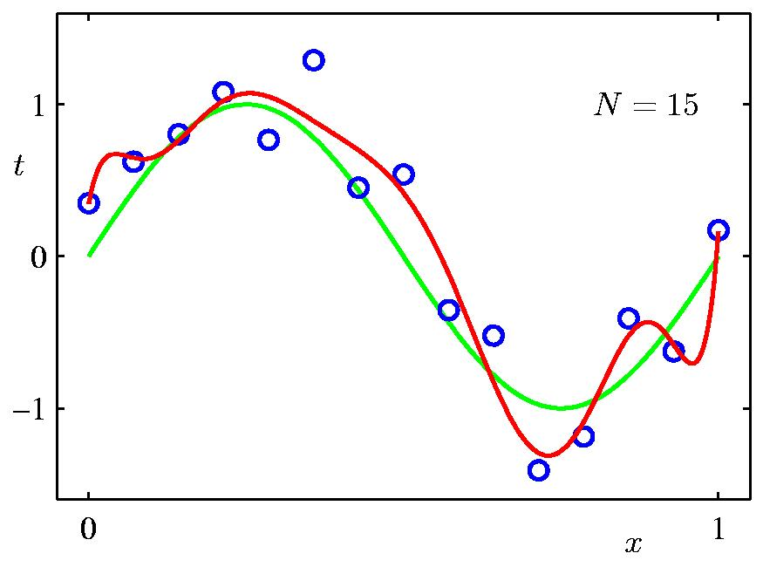
Increasing Data Set Size
9th Order Polynomial
N = 15

Slide 24
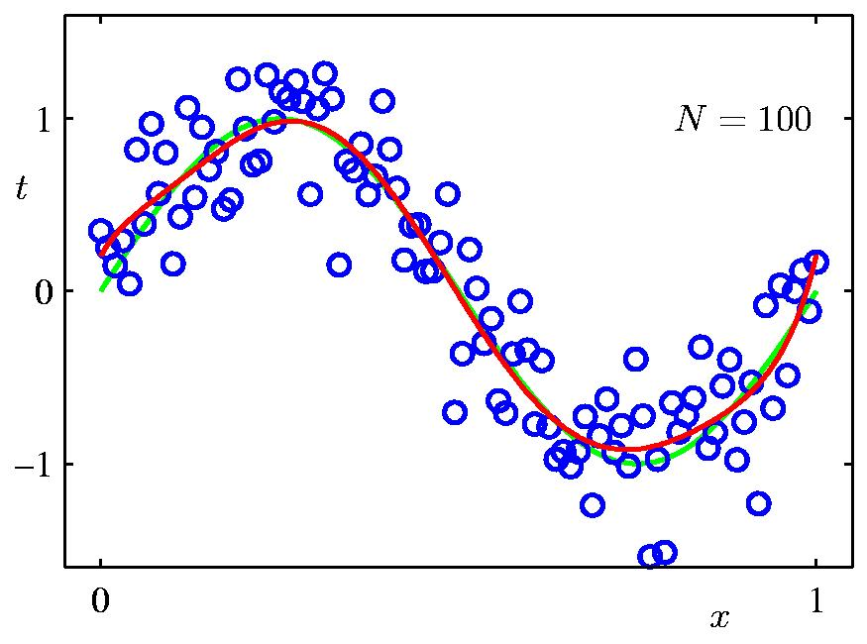
Increasing Data Set Size
9th Order Polynomial
N = 100

Slide 25
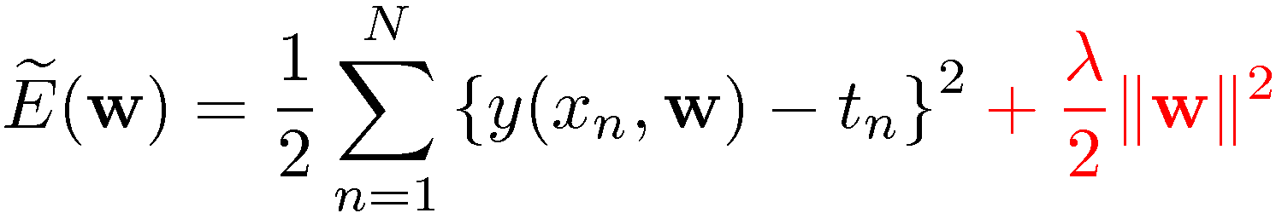
Regularization
Penalize large coefficient values =>
add regularization term:

Slide 26
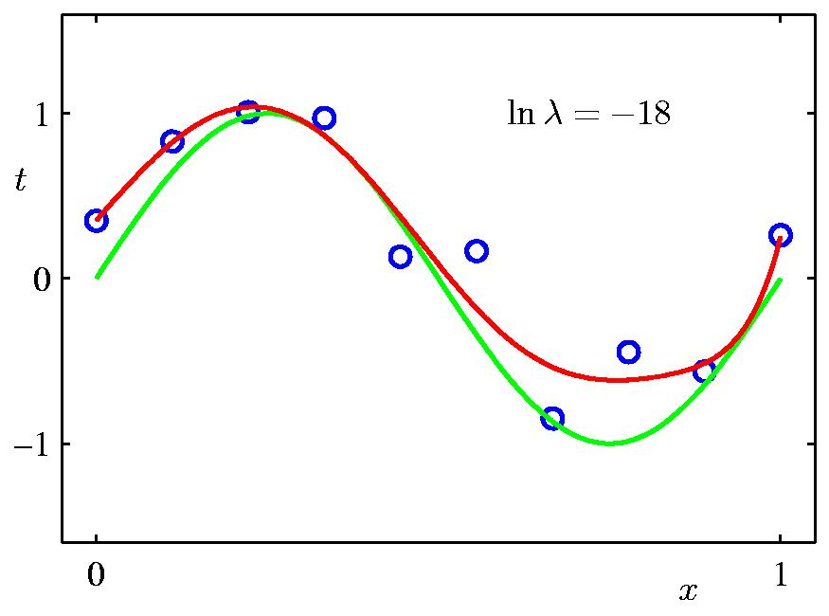
Regularization: ln λ = -18

Slide 27
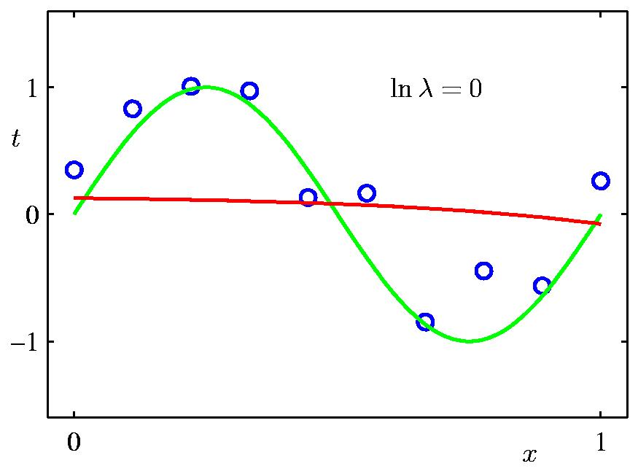
Regularization: ln λ = 0

Slide 28
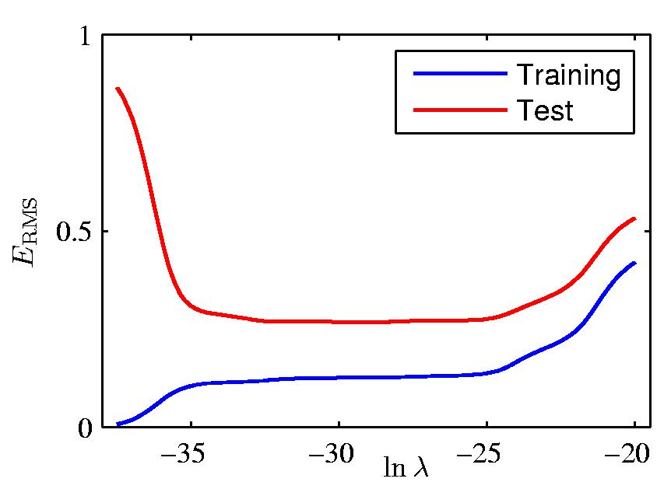
Regularization: E_{RMS} vs. ln λ
Right value of
λ is critical !

Slide 29
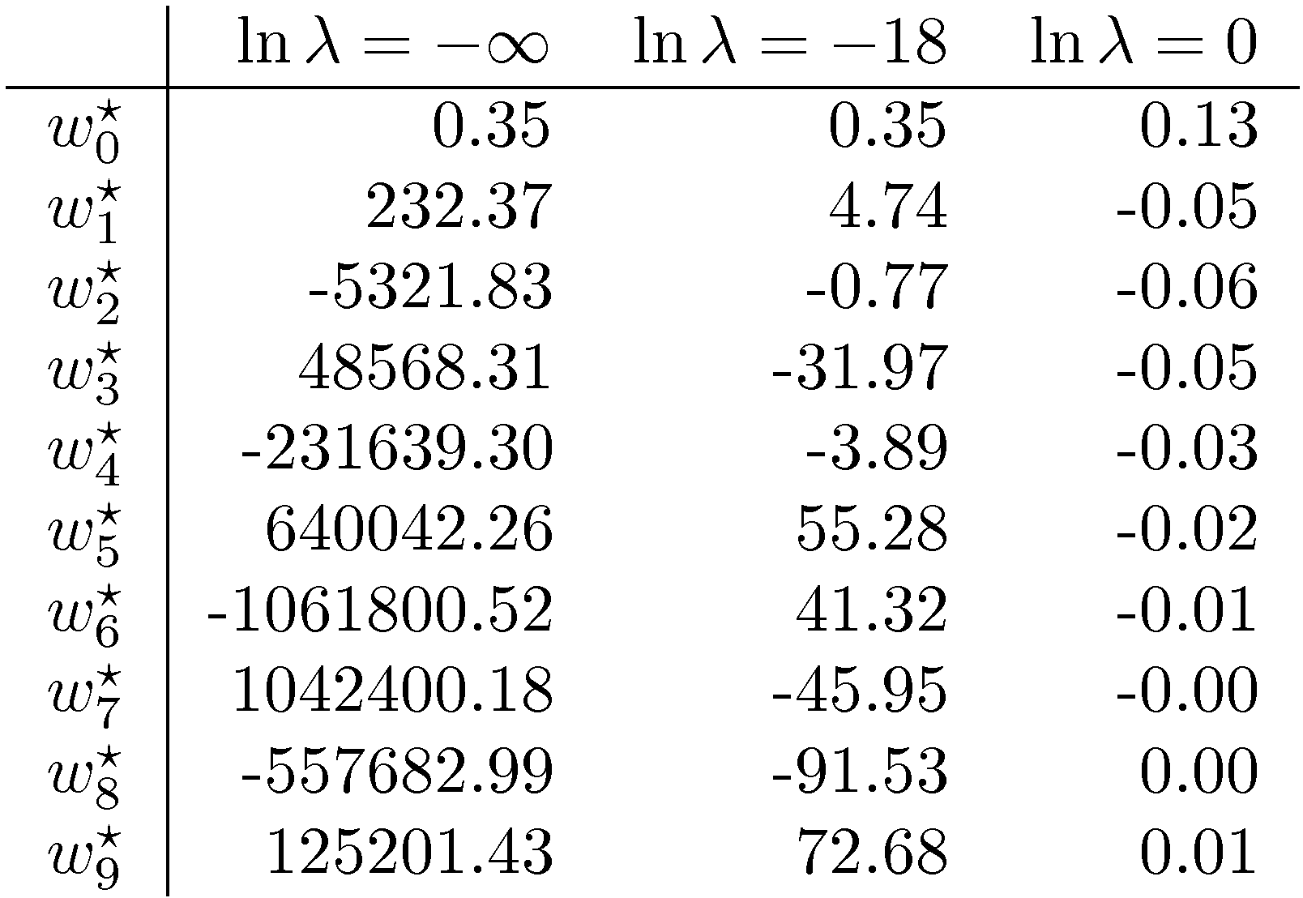
Polynomial Coefficients

Slide 30
Terminology
training or learning phase: determine a model for y(x) on the basis of the training data
  training set, validation set, test set
  inference: use the learned model for classification
supervised learning (input/target vectors in the training data)
classification (discrete categories) vs. regression (continuous variables)
unsupervised learning (no target vectors in the training data) also called clustering, or density estimation
reinforcement learning, credit assignment, exploration, exploitation
overfitting, generalization

Slide 31
Learning methods
Supervised learning
  using labeled data set
Semi-supervised learning
  using a small labeled data set + large unlabeled set
  see https://en.wikipedia.org/wiki/Semi-supervised_learning#Methods
Unsupervised learning
  .e.g clustering
Reinforcement learning
  getting feedback from the environment

Slide 32
Recap topics
What is learning?
What is a DNN, and in particular a CNN?
DNN Learning principles
Optimization 1
Optimization 2
Optimization 3
DNN Hardware support
Beyond DNNs
  Neuromorphic and Bayesian networks

Slide 33
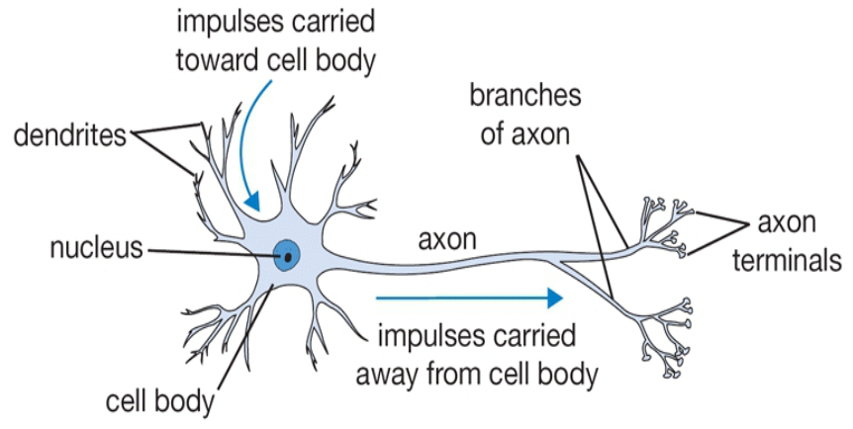
Our Brain
The basic computational unit of the brain is a neuron
  about 80 Billion neurons in our brain
  Neurons are connected with nearly 10¹⁴ – 10¹⁵ synapses
  Neurons receive input signals from dendrites and produce output signal along axon, which interact with the dendrites of other neurons via synaptic weights
Synaptic weights – learnable & control influence strength

Slide 34
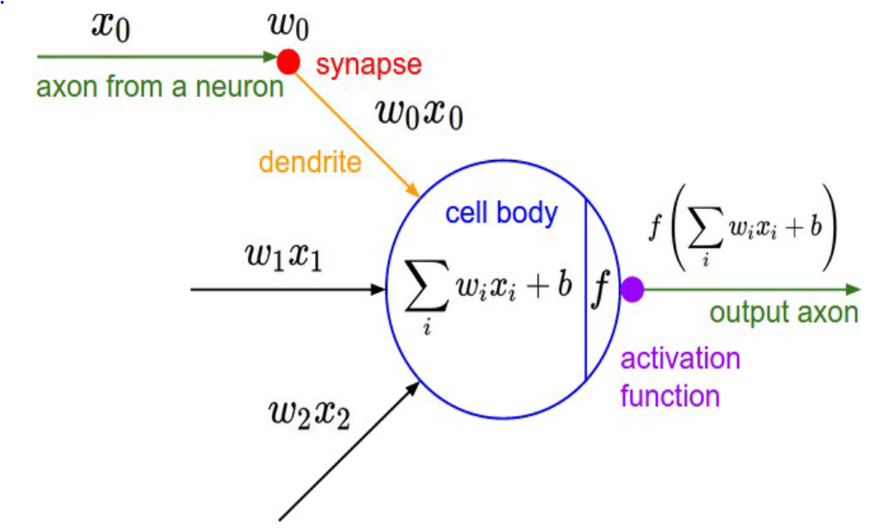
Artificial Neuron

Slide 35
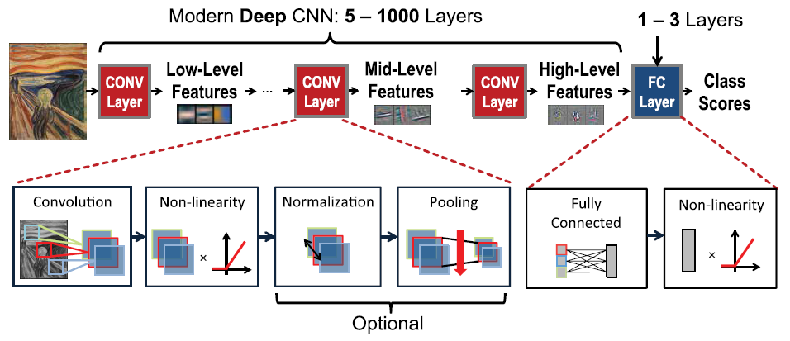
DNN structure

Slide 36
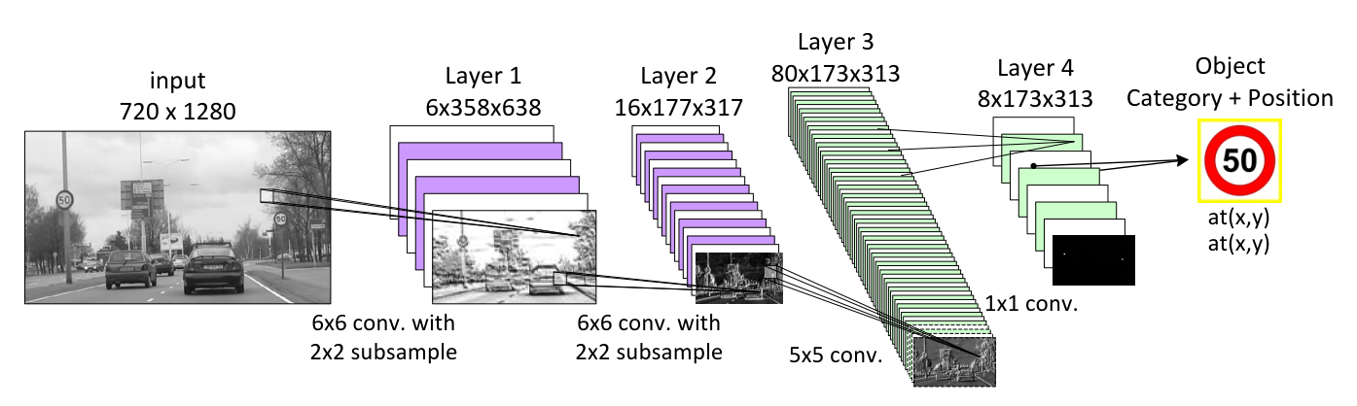
A (small) CNN for traffic sign recognition

Slide 37
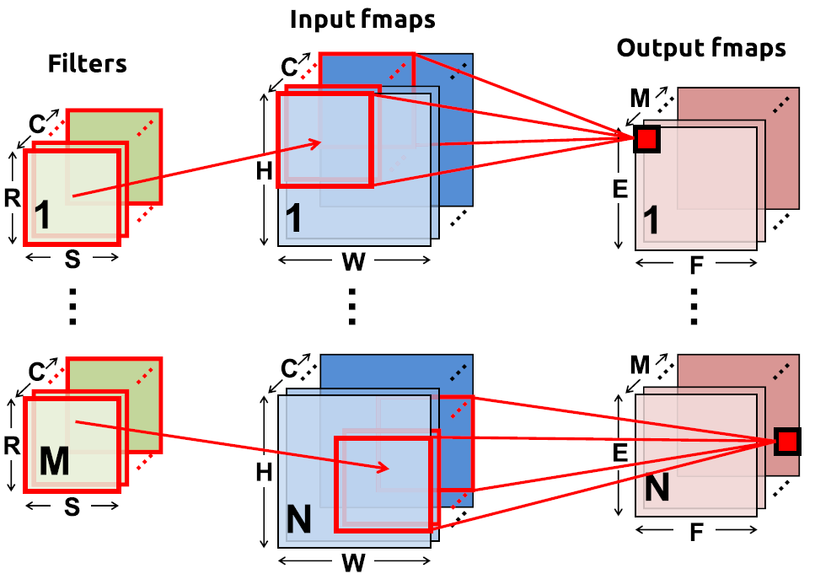
Convolution in CNNs
N = batch size
C input feature maps of size HxW
M output feature maps of size ExF
M filters of size RxS

Slide 38
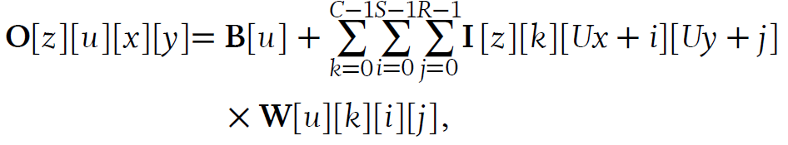
Convolution equations
U = stride
B = bias vector
Note: W has 4-dimensions
  i,j for kernel
  k for input feature maps
  u for output feature maps

Slide 39
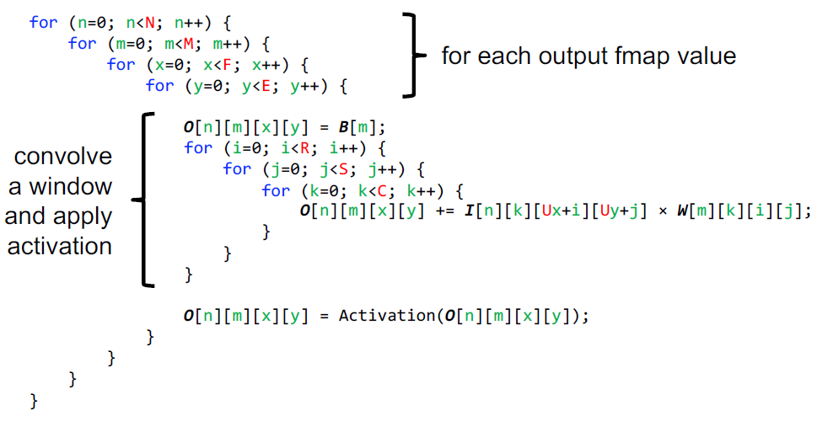
Convolution code

Slide 40
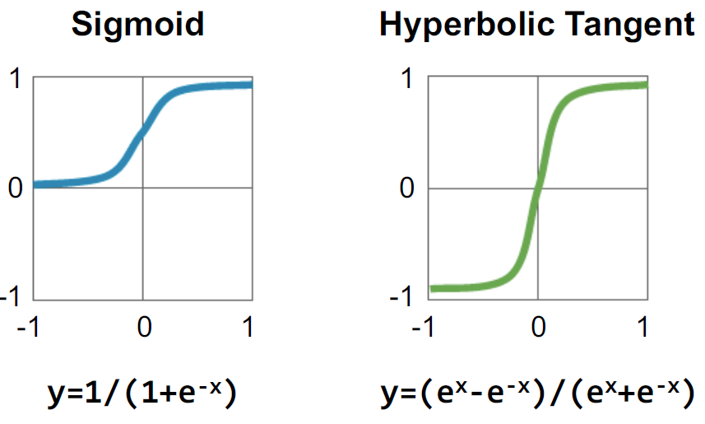
Activation functions: traditional

Slide 41
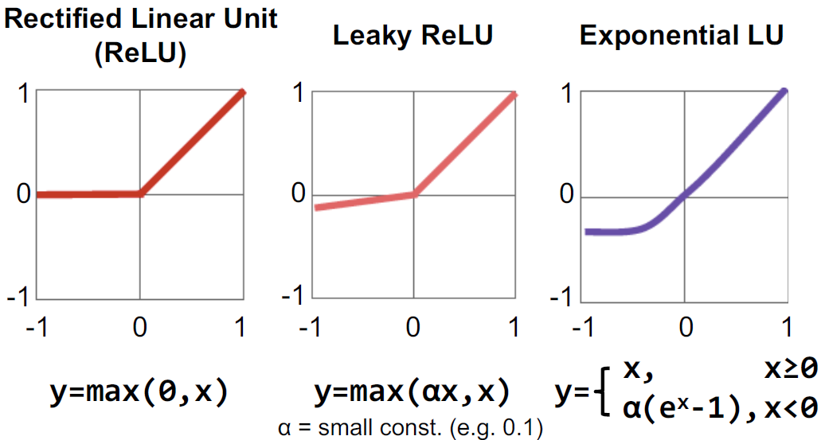
Activation functions: modern

Slide 42
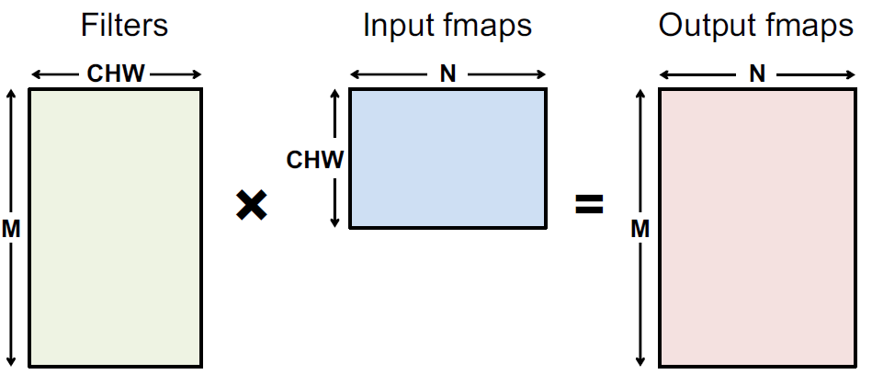
Fully Connected (FC) layer
FC can be viewed as a special case of convolution, with:
  H=R
  W=S
  E=F=1
Size of input fmaps = size of convolution kernel
Output fmaps have size 1x1, i.e. each output fmap represents 1
output neuron

Slide 43
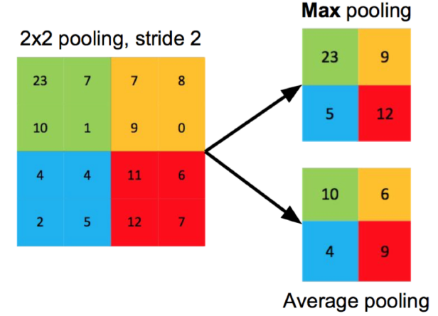
Pooling
Reduce resolution
Increase receptive (input) area of outputs
Overlapping or
Non-overlapping,
depending on stride U
Using the max or average

Slide 44
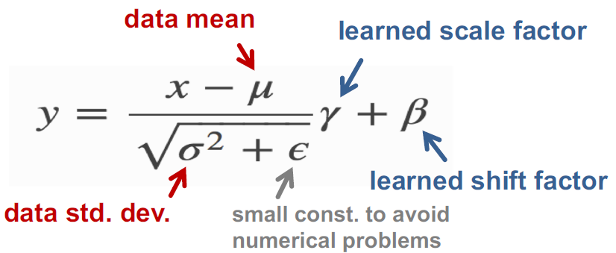
Normalization: correction of activation y
this equation can be ''absorbed'' in the weights => no overhead

Slide 45

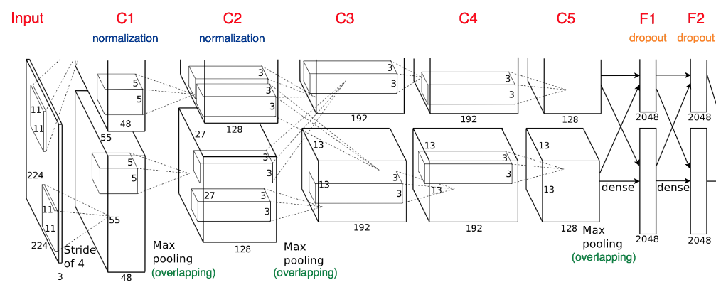
Example: Alexnet
Fully-Connected:
4096 to 1000
Class Scores
Cat: 0.9
Dog: 0.05
Car: 0.01
Vector:
4096

Slide 46
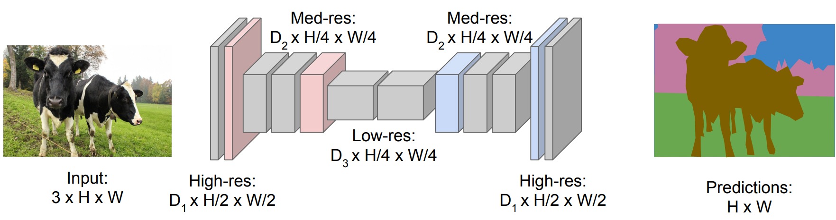
Semantic Segmentation: Fully Convolutional
Downsampling: Pooling or strided convolution
Upsampling: ???
Long et al. “Fully Convolutional Networks for Semantic Segmentation” CVPR 2015

Slide 47
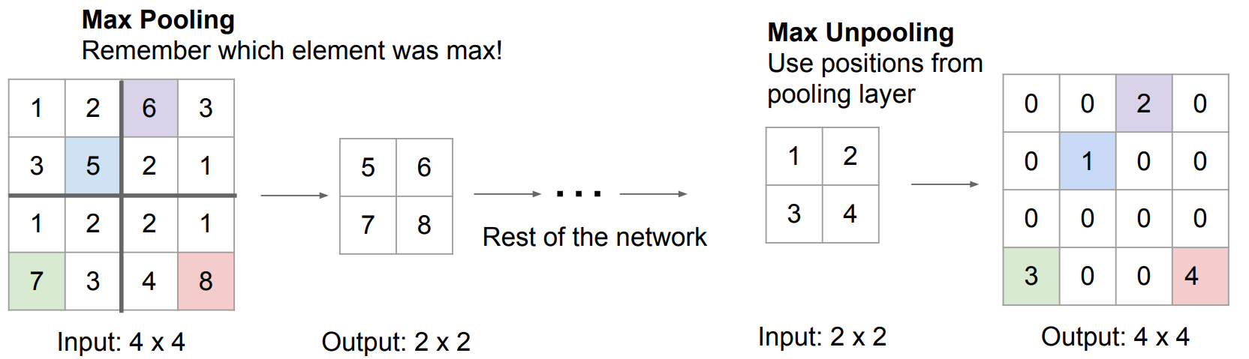
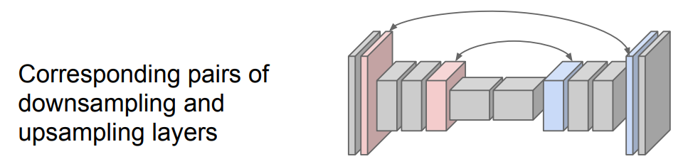
In-Network upsampling: “Max Unpooling”

Slide 48
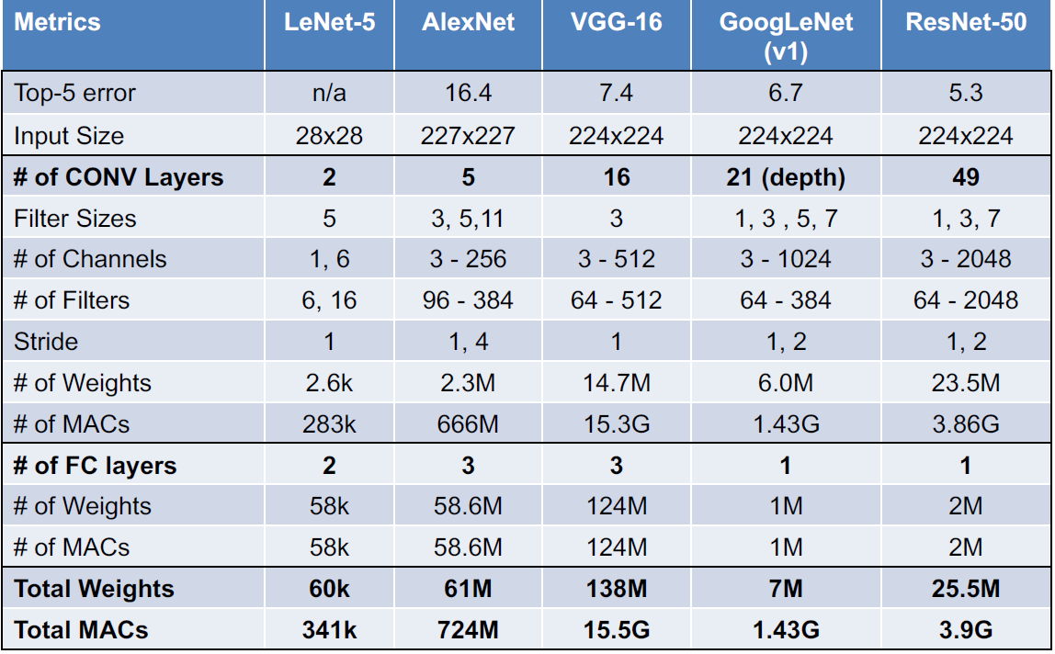
Popular
DNNs

Slide 49
Recap topics
What is learning?
What is a DNN, and in particular a CNN?
DNN Learning principles
Optimization 1
Optimization 2
Optimization 3
DNN Hardware support
Beyond DNNs
  Neuromorphic and Bayesian networks

Slide 50
How to learn a DNN?
Use backpropagation => Chain rule
Loss function
  Regularization terms can be added to loss function
Stochastic Gradient Descent (SGD), and several varieties
Batch learning
Learning rate

Slide 51
A Recipe for Machine Learning
1. Given training data:
3. Define goal:
2. Choose each of these:
  Decision function
  Loss function
4. Train with SGD:
(take small steps opposite the gradient)

Slide 52
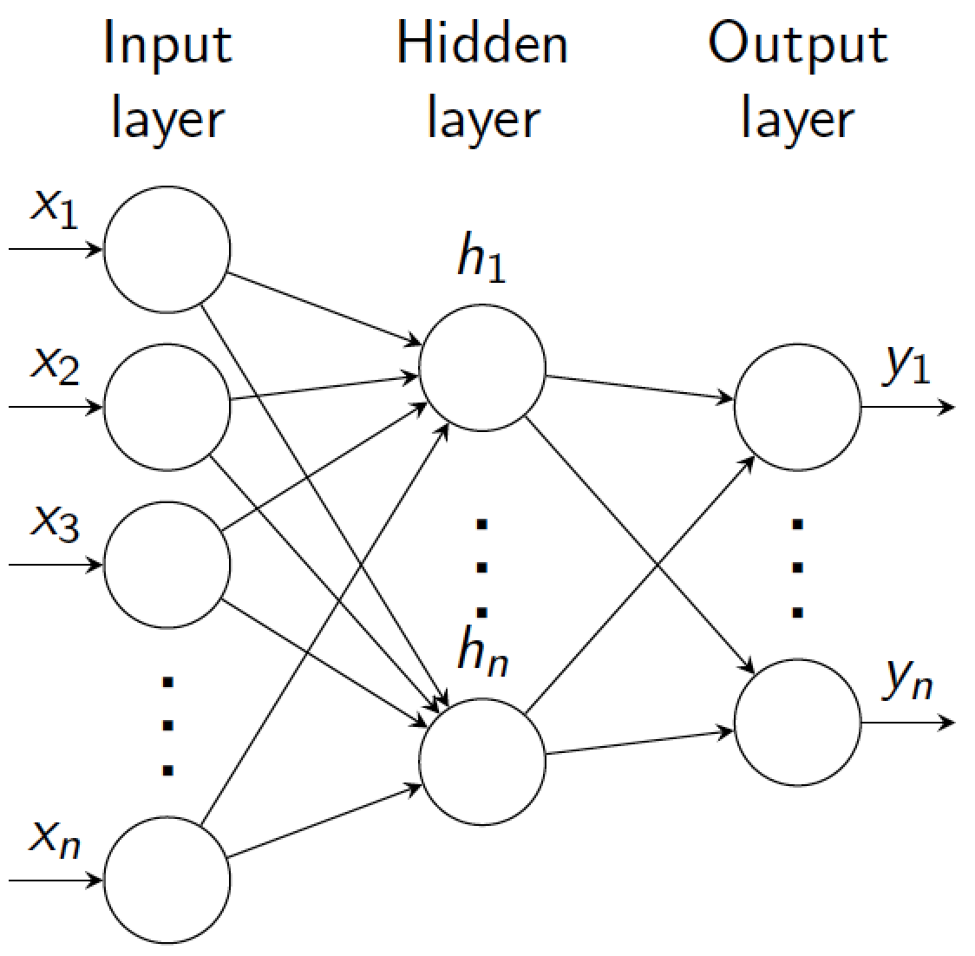
Backpropagation in multiple layers
(output)
x_{n}
Output layer n
F_{n}(x_{n-1}, W_{n})
x_{n-1}
…
…
x_{i}
Layer i
F_{i}(x_{i-1}, W_{i})
…
x_{i-1}
…
…
x₁
Layer 1
F₁(x₀, W₁)
Input layer
(input)
x₀

Slide 53
Training a model: overview
Given a training dataset {x^{m}; y^{m}}_{m=1,…,M}, pick appropriate cost function C
Forward-pass (= inference) training examples through the model to get network output.
Get error (loss) using cost function C to compare outputs to targets y^{m}
Use Stochastic Gradient Descent (SGD) to update weights
  adjusting parameters to minimize loss/energy E (sum of the costs for each training example)

Slide 54
Cost function
E
C(x_{n}, y)
Consider model with n layers. Layer i has weights W_{i}
Forward pass: takes input x and passes it through each layer F_{i}:
x_{i} = F_{i} (x_{i-1}, W_{i})
Output of layer i is x_{i}. Network output (top layer) is x_{n}
Cost function C compares x_{n} to y
Overall energy is the sum of the cost over all training examples:
(output)
x_{n}
F_{n}(x_{n-1}, W_{n})
x_{n-1}
…
x_{i}
F_{i}(x_{i-1}, W_{i})
x_{i-1}
…
x₂
F₂(x₁, W₂)
x₁
F₁(x₀, W₁)
(input)
x₀
y

Slide 55

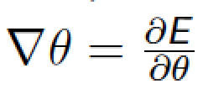
Stochastic gradient descend
Minimize overall loss function E = sum of individual losses over each example
In gradient descent, we start with some initial set of parameters θ
Update parameters:
  k is iteration index, η is learning rate (negative scalar; set semi-manually).
Gradients computed by backpropagation.
In SGD, compute gradient on sub-set (batch) of data:
  If batchsize=1 then θ is updated after each example.
  If batchsize=N (full set) then this is standard gradient descent.
  Gradient direction is noisy, relative to average over all examples

Slide 56
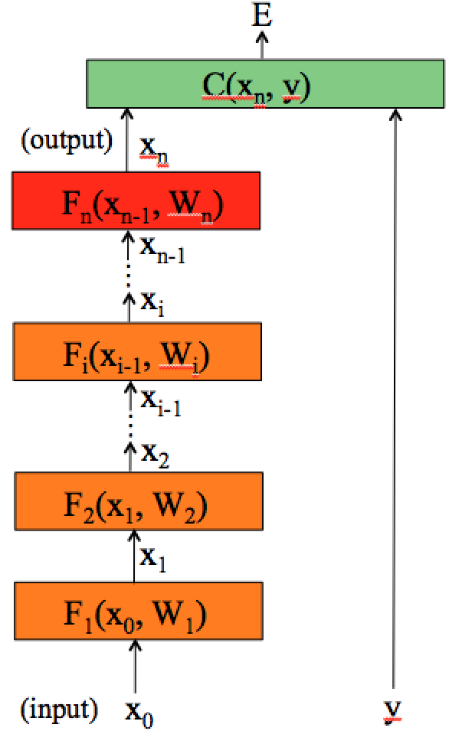
Computing gradients
To compute the gradients, we could start by wring the full energy E as a function of the network parameters.
And then compute the partial derivatives… instead, we can use the chain rule to derive a compact algorithm: back-propagation

Slide 57
Computing gradients
The energy E is the sum of the costs associated to each training example x^{m}, y^{m}
Its gradient with respect to the networks parameters is:
Indicates how much E varies when the parameter θ_{i} is varied.

Slide 58
Computing gradients: cost layer
If we compute the gradient with respect to the parameters of the last layer (output layer) w_{n}, using the chain rule:
Will depend on the
layer structure and
non-linearity.
For example, for an Euclidean loss:
The gradient is:

Slide 59
Computing gradients: layer i
We could write the full cost function to get the gradients:
If we compute the gradient with respect to w_{i}, using the chain rule:
And this can be
computed iteratively!
This is easy.

Slide 60
Backpropagation: layer i
Layer i has two inputs (during training)
x_{i-1}
F_{i+1}
For layer i, we need the derivatives:
x_{i}
Layer i
F_{i}(x_{i-1}, W_{i})
x_{i-1}
We compute the outputs
F_{i-1}
Forward
pass
Backward
pass
The weight update equation is:
(sum over all training examples to get E)
Notes:
During training, each layer will have three outputs:
the forward pass. To compute the operating point for each layer and training example
the backwards pass to propagate the energy derivative with respect to the input of the layer
- and the derivative of the energy with respect to the weights.

Slide 61
Backpropagation: summary
E
Forward pass: for each training example. Compute the outputs for all layers
Backwards pass: compute cost derivatives iteratively from top to bottom:
Compute gradients and update weights
C(X_{n},Y)
(output)
x_{n}
F_{n}(x_{n-1}, W_{n})
x_{n-1}
…
x_{i}
F_{i}(x_{i-1}, W_{i})
x_{i-1}
…
x₂
F₂(x₁, W₂)
x₁
F₁(x₀, W₁)
(input)
x₀
y

Slide 62
Recap topics
What is learning?
What is a DNN, and in particular a CNN?
DNN Learning principles
Optimization 1: DNN pruning
Optimization 2
Optimization 3
DNN Hardware support
Beyond DNNs
  Neuromorphic and Bayesian networks

Slide 63
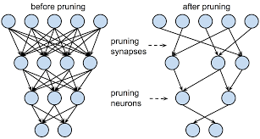
Pruning
Reduce the Network
Fine grain pruning
  removing connections with small weigths
  remove
Structured pruning:
  try to keep e.g. SIMD regularity (vector computing)
Coarse grain pruning
  remove kernel (2D): i.e., skip input feature map for a certain filter
  removing complete filter (3D), i.e. reduce nr. of output feature maps

Slide 64

Reducing filter sizes: filter decomposition

Slide 65

Reducing filter sizes: decouple correlations
Decouple the cross-channels correlations and spatial correlations in the feature maps of the DNN:
+

Slide 66
Pruning
Retrain after pruning improves accuracy
Smaller NW does not necessarily mean
  less MAC operations, or
  lower energy
Energy aware pruning [TJ Yang, CVPR2017]

Slide 67
Recap topics
What is learning?
What is a DNN, and in particular a CNN?
DNN Learning principles
Optimization 1
Optimization 2: Quantization
Optimization 3
DNN Hardware support
Beyond DNNs
  Neuromorphic and Bayesian networks

Slide 68

Quantization: why?

Slide 69

Number representations

Slide 70

Float vs Fixpoint

Slide 71

How many bits can your MAC unit handle?
For no loss in precision, M is determined based on largest
filter size (in the range of 10 to 16 bits for popular DNNs)

Slide 72

Quatization method
Reducing the number of levels (bit width) for weights and/or activations
E.g., Caffe-Restretto tool (2016):

Slide 73
Recap topics
What is learning?
What is a DNN, and in particular a CNN?
DNN Learning principles
Optimization 1
Optimization 2
Optimization 3: Exploiting Data Reuse
DNN Hardware support
Beyond DNNs
  Neuromorphic and Bayesian networks

Slide 74

Reducing external memory accesses
VGG16 example
Original code
Rescheduled code
Conclusion: we need advanced loop transformation to exploit data locality (in local buffers),
reducing external accesses

Slide 75

What can we reuse in a CNN layer?

Slide 76

Types of reuse

Slide 77
Exploiting reuse
Iteration Scheduling (Mapping) Options
  output stationary
  input stationary
  weight stationary
  row stationary (Eyeriss)
Advanced loop transformations needed, in particular
  Tiling: making sure data/weights fit into local memory/cache
  Loop interchange (permutation)
  Fusion of loops
    bringing production and consumption close together
If you don't like these transformations ... use Halide

Slide 78
Loop Fusion (Merging):
Location
Production/Consumption
for (i=0; i<N; i++)
B[i] = f(A[i]);
for (j=0; j<N; j++)
C[j] = f(B[j],A[j]);
Consumption(s)
Time
Location
for (i=0; i<N; i++)
B[i] = f(A[i]);
C[i] = f(B[i],A[i]);
Production/Consumption
Consumption(s)
Consumptions of second loop closer to
productions and consumptions of first loop
Time

Slide 79
Recap topics
What is learning?
What is a DNN, and in particular a CNN?
DNN Learning principles
Optimization 1
Optimization 2
Optimization 3
DNN Hardware support
Beyond DNNs
  Neuromorphic and Bayesian networks

Slide 80

General processors
SIMD / Vector units
Special units: e.g. Tensor Cores in GPU
  act on 4x4 matrices
  16 bit floating point precision

Slide 81
Accelerators: Google's TPU

Slide 82

  XNOR-popcount
Current systems cannot execute BNNs efficiently
Need for a hardware accelerator that supports various levels of precision

Slide 83

Binary AivoTTA
MADD: xnor+popcount+acc scalar-vector 32b x (32x32b) into 32x16b
VOPS: shift, insert, activation, max; relu
DMA
LSU: multiple widths
2 wide busses
Notes:
MADD: xnorpopcountacc scalar-vector 32b x 32x32b into 32x16b
VOPS: shift, insert, activation, max; relu
DMA
LSU: multiple widths
Add-fu: not needed, already 2 addr calcs
2 wide busses: more not needed

Slide 84

Roofline Model: how good is my application mapping?
Performance bottleneck: computation bound v.s. bandwidth bound
Note the log-log scale
Roofline for
8800 Nvidia GPU
Where is your
application
in this space?
Notes:
The Roofline model is a first-order model for bottleneck analysis:
http://dx.doi.org/10.1145/1498765.1498785
For the architecture, it takes peak performance and memory bandwidth into account.
For the algorithm, it take operational intensity (or computation to off-chip memory ratio) into account
The figure is taken from 8800 GPU. According to the analysis, if an algorithm has an operational intensity of 8 or higher, the algorithm will hit the peak performance of the GPU, which is computation bounded. If an algorithm has an operational intensity less than 8, the algorithm will hit the bandwidth limit, thus making it bandwidth bounded.

Slide 85
Recap topics
What is learning?
What is a DNN, and in particular a CNN?
DNN Learning principles
Optimization 1
Optimization 2
Optimization 3
DNN Hardware support
Beyond DNNs
  Neuromorphic
  Bayesian networks

Slide 86

Beyond DNNs: Neuromorphic computing
Neuromorphic computing
  mimic our brain
  using spiking neurons
Why?
  Brain proven to work, and
  our Brain is orders of magnitude more energy efficient

Slide 87

Brain as extremely efficient computing machine
Power = 20 Watt
Speed = 1000 Exa Op/s*
Energy/operation =
Power/Speed =
2x10⁻⁸ pJ/operation
*Tim Dettmers:
"making deep learning accessible"
2015
Notes:
3.2*10^9 more efficient
Spikes x100
Double x100
Brain is sparse active so only 1-10% active x100
Leaky bucket 10x suppresses propagation

Slide 88

Top 500 computers: Performance and Energy
Brain consumes
about 20 Watt
Compare this to
current super
computer
(top 500)
Summit
  Power = 13 MW
  Speed = 200 PFlop/s
  Energy/op. = 65 pJ/op
Summit
200 PF/s
13 MW
Notes:
3.2 x 10^9

Slide 89

Beyond DNNs: Bayesian learning
everything is a distribution / density function
using a (causality) model
Why?
  Taking uncertainty into account
  Can deal with small data set
  DNNs can only determine correlation, not causality

Slide 90


Bayes' theorem
posterior ∝ likelihood × prior

Slide 91
The 3 levels of cognitivity
From: The Book of Why
Judea Pearl, Dana Mackenzie
Claim: Deep Learning does not
go beyond level 1 (Association)
- DL only learns correlations

Slide 92

Can you answer all questions?
What was the main goal of this course?
What is the essense of computer learning?
What is a DNN, and in particular a CNN? Calculate its complexity!
How do the newest DNNs look like, and what new operators do they use?
How do we learn DNNs? What is backpropagation? Learning tricks?
What optimizations can we apply?
Can you explain the different scheduling options of CNNs, exploiting reuse?
What specific HW support can make DNNs execute energy efficiently
How do Neuromorphic Neurons operate, and what are their advantages?
What is Bayesian learning, and what are its advantages?

Slide 93

Intelligent Architectures, 5LIL0
Deep & Automated, Learning
is even more fun
We hope you learned a lot and
enjoyed our course !!
Questions?
Making it efficient, that's really fun

