Slide 1
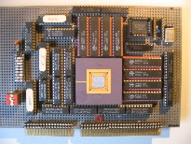
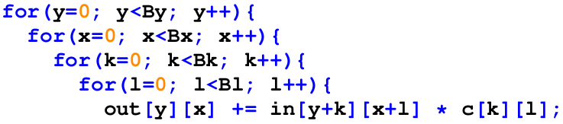
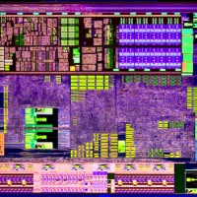

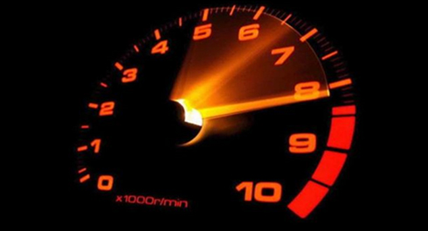

Intelligent Architectures
5LIL0
Accelerators for Deep Learning
Kanishkan Vadivel
Henk Corporaal
www.ics.ele.tue.nl/~heco/courses/IA
h.corporaal@tue.nl
TUEindhoven
2022

Slide 2
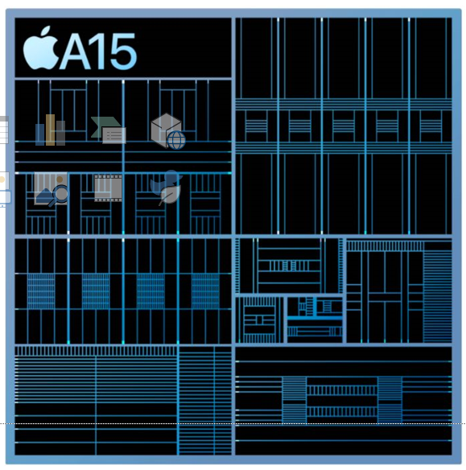
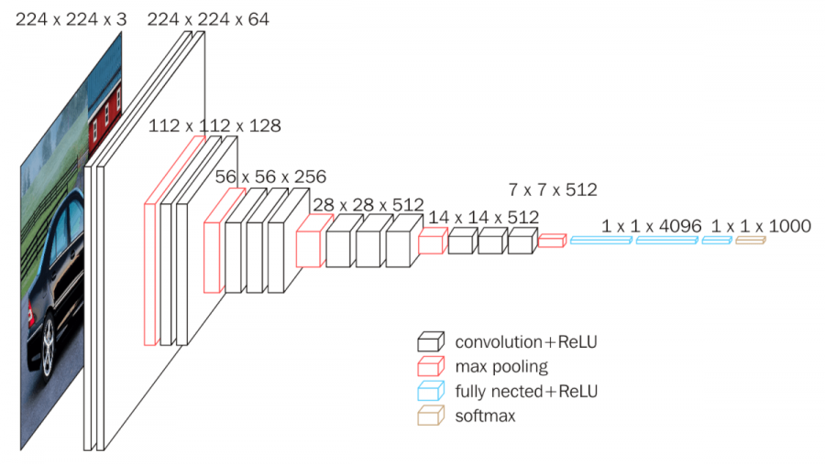
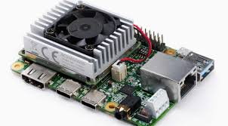
Deep ANN => Architecture
Apple’s A15 chip
2 high perf. cores
4 efficient (smaller) cores
Neural Engine (16 proc)
Video encoder / decoder
signal processor
display processor
TPU board

Slide 3
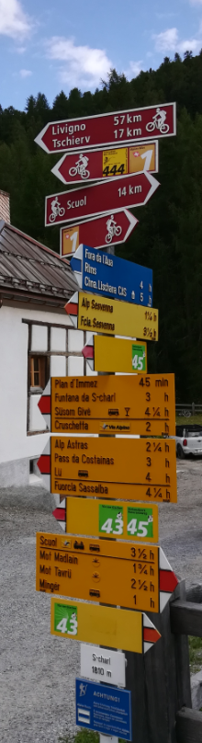
Topics overview
Introduction
  Architecture choices
  Flexibility vs Energy efficiency
Basic Schedules and Architectures exploiting data reuse
Row stationary mapping
TPU & other Architectures
  Systolic array processing
Summary & Conclusion

Slide 4
Choices for hardware architecture
Paper: How flexible is your computing system, Shihua Huang, Luc Waeijen e.a, Transaction on Embedded Computing Systems (TECS) 2022
  Very efficient
  Not flexible
ASIC
  Quite flexible
  Low efficiency
  Often lack performance.
SIMD
Energy Efficiency
VLIW
GPU
DSP
FPGA
CPU
  Improve efficiency by giving up some flexibility
  More application specific
More efficient due to spatial layout
High static control cost
Flexibility

Slide 5
Flexibility has its price
Where does the energy go?
RISC @ 45 nm, 0.9 V
32-bit ADD : 0.5 pJ out of 70 pJ for the ADD instruction => efficiency 1/140
Overall efficiency:
1 / 850 = 0.12 %

Slide 6

Reduce the price of flexibility: SIMD
Perform more effective work per instruction
Very programmable
1/140 vs 16/180 → 10 times efficiency improvement

Slide 7
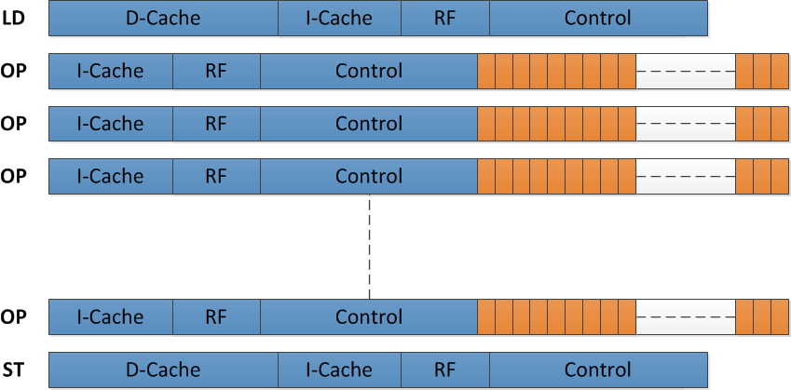
Further improve efficiency
Maximize effective operations
  Minimize load stores: exploit RF data reuse
  E.g. 1/5 (1 instr out of 5) effective vs 9/11 → additional 4 times efficiency increase
~40 times efficiency improvement

Slide 8
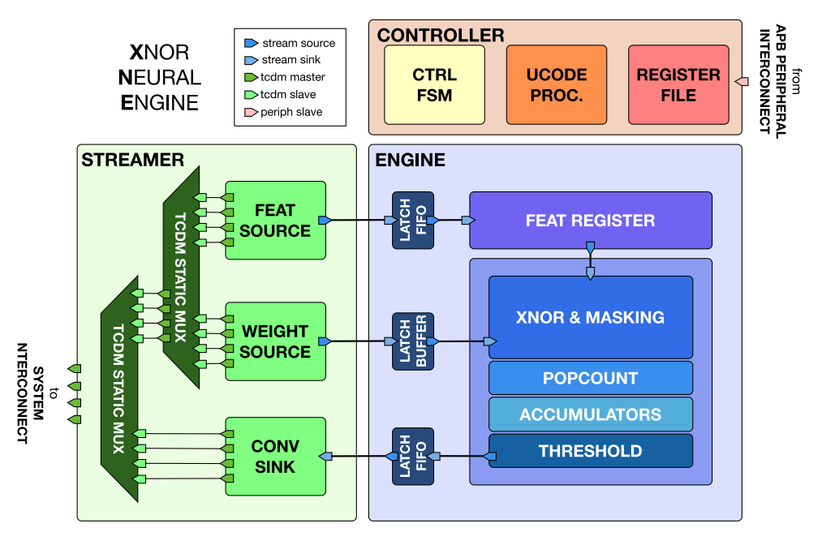
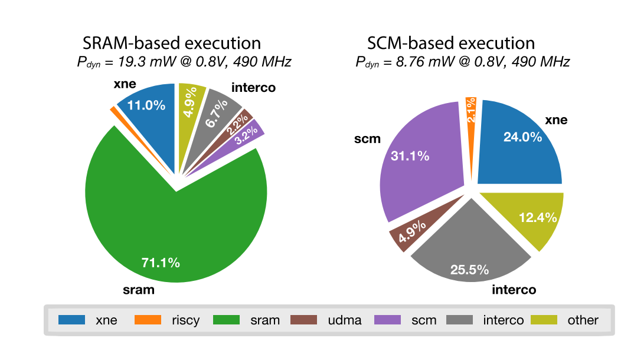
XNOR Neural Engine (Conti e.a., 2018)
BNN architecture
Optimum energy point (22 nm, ResNet-34)
SRAM design: 115fJ/op @ 0.5V
SCM design: 21.6fJ/op @ 0.4V
Vector binary MUL-ADD-Threshold unit
SRAM dominates power!
Notes:
Closest match = most close to our architecture in terms of flexibility
Able to change computational order in outer loops (enabled by micro-code)
(See next hidden slide to see which loops)

Slide 9
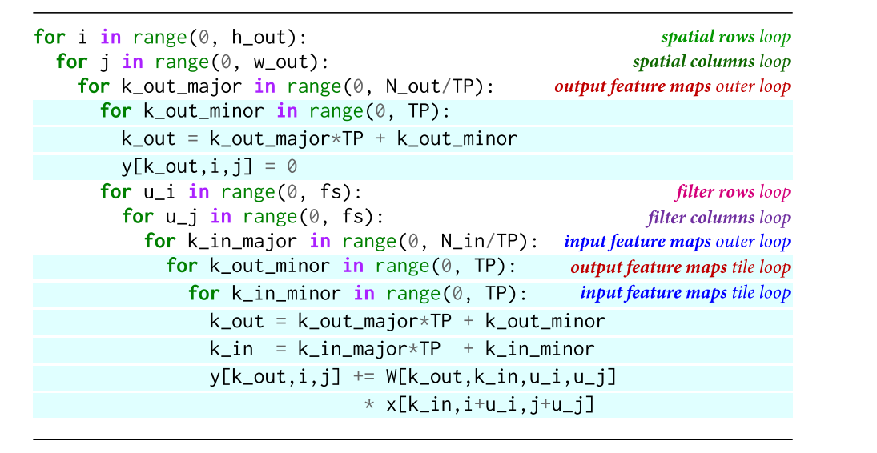
XNOR-Neural Engine
Blue loops are hard-wired in XNE, μCode implements the rest
Outer loops
(in SW)
HW
initialization
(by accel HW)
Outer loops
(in SW)
HW
core loop
(by accel HW)

Slide 10
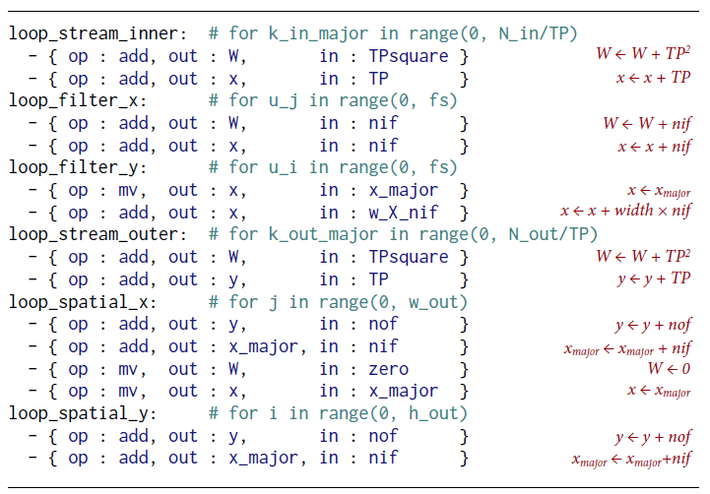
XNOR code
Micro code for the nested 6 SW loops
  W, x, y and x_major = R/W registers
  TPsquare, TP, nif, nof, w_X_nif, ow_X_nof, zero = R/O registers

Slide 11
Topics overview
Introduction
  Architecture choices
  Flexibility vs Energy efficiency
Basic Schedules and Accelerators exploiting data reuse
  Output stationary
    NVE: Neuro Vector Engine
  Weight stationary
  Input stationary
Row stationary mapping
TPU and other architectures
  Systolic array processing
Summary and Conclusions

Slide 12
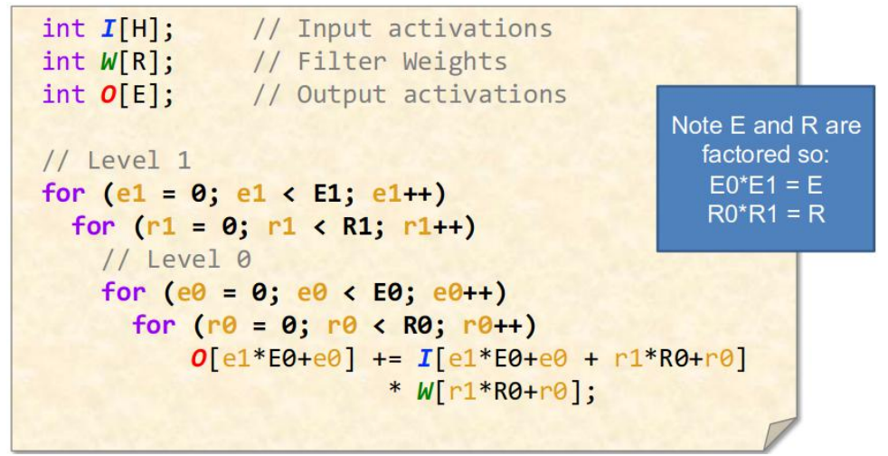
Schedules exploiting data reuse
Output Stationary (OS)
Weight Stationary (WS)
Input Stationary (IS)
In traditional compute platforms such as CPUs and GPUs, these are “Software Optimization” strategies.
In ASIC world, these can be “Hardware Design” strategy!
- With custom hardware, we can exploit maximum data-reuse
- But we still need “Software tricks” to make it really work
Credits: Tutorial on Hardware Accelerators for Deep Neural Networks, MIT, ISCA 2019

Slide 13
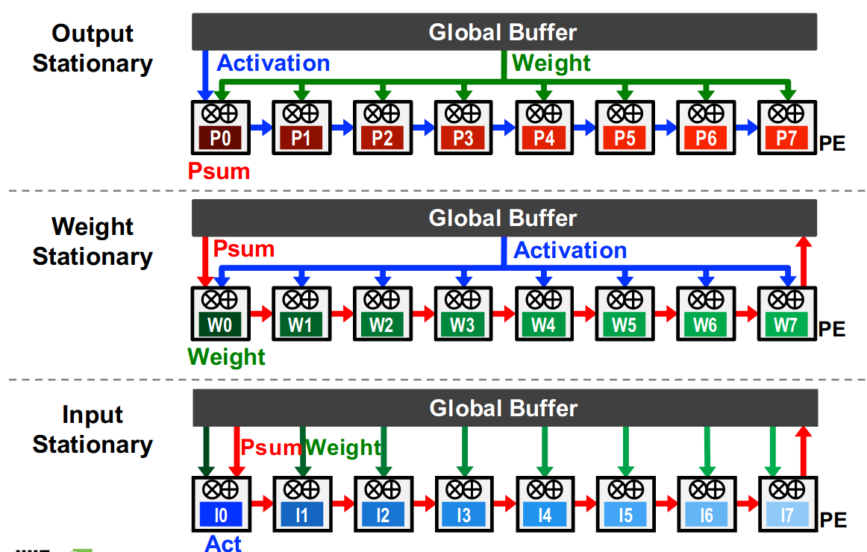
Output Stationary – Simplified View
Minimizes Psum (Partial Sum) R/W to memory
  Maximize local accumulation
Broadcast/Multi-cast filter weight and reuse activations spatially across the PE array

Slide 14
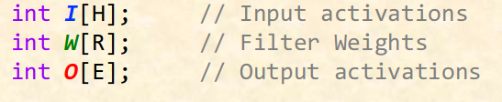
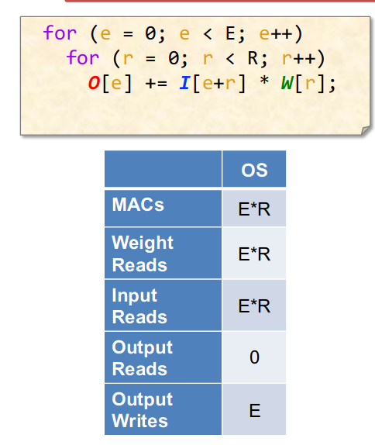
1D Convolution – Output Stationary
Weights
Inputs
Outputs
*
=
R
H
E = H – R + 1

Slide 15
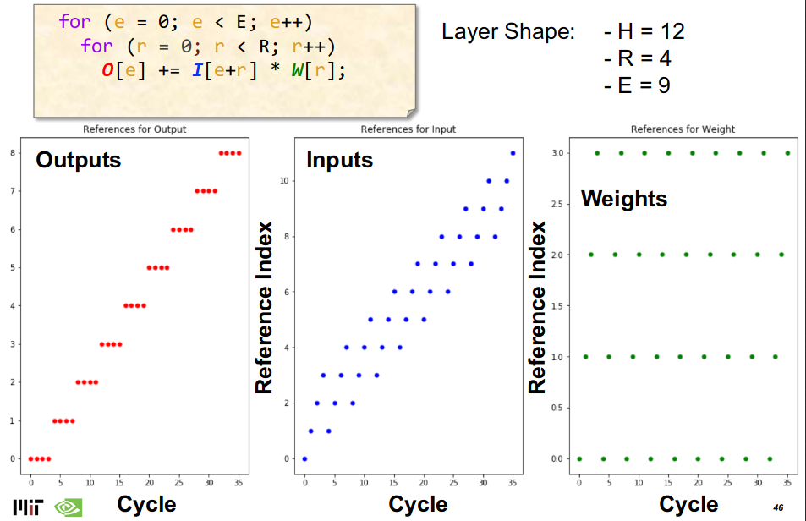
Output Stationary – 1D Conv Reference Pattern
inputs
filter size
outputs

Slide 16
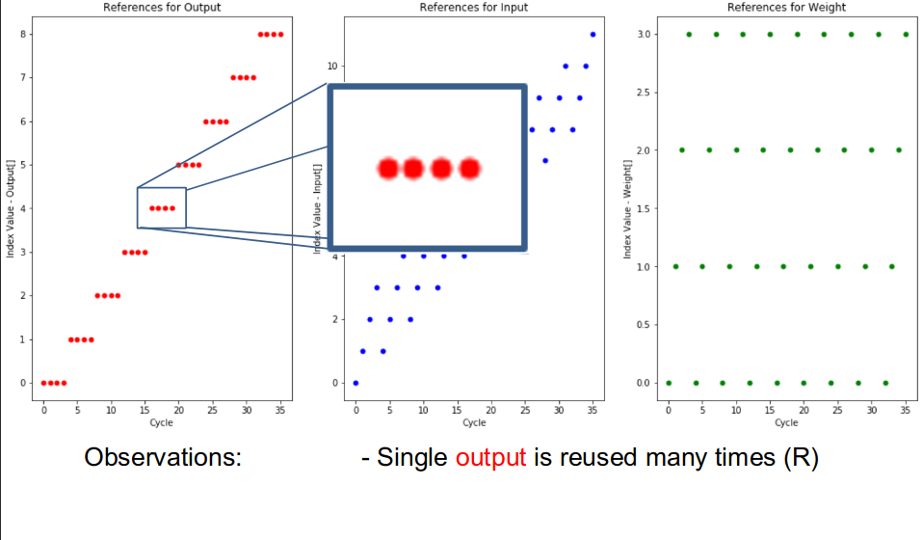
Output Stationary – 1D Conv Reference Pattern
[0 reads]

Slide 17
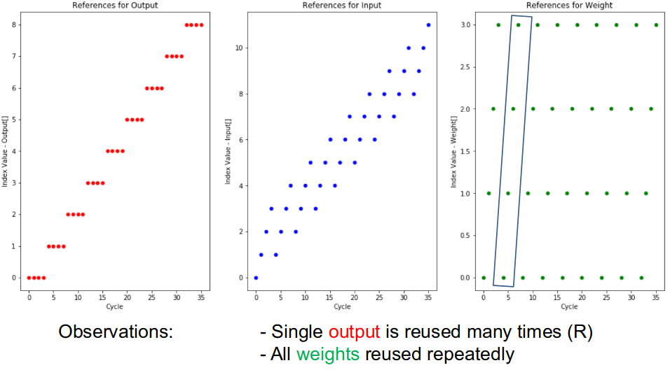
Output Stationary – 1D Conv Reference Pattern
[E x R reads]

Slide 18
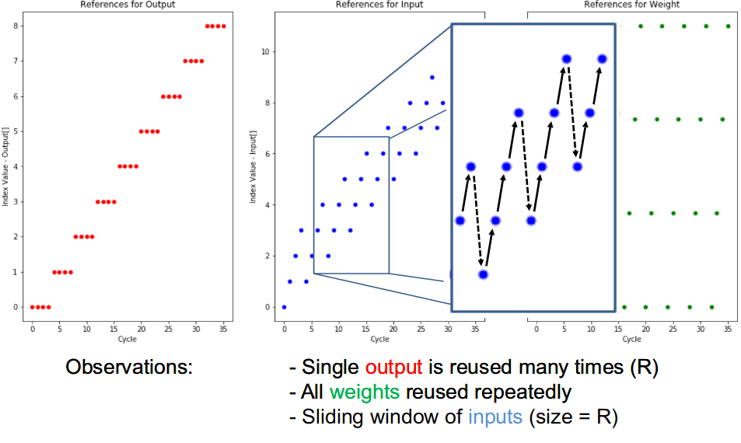
Output Stationary – 1D Conv Reference Pattern
[ExR reads]

Slide 19
1D Output Stationary – Summary
Minimize partial sum Reads & Writes
Local accumulation
Minimizes energy
H inputs
R filter size
E outputs

Slide 20
2D Convolution Layer – Output Stationary
weights
Input fmap
C
Output fmap
C
H
M
E
R
=
S
M
X
W
F
Output to be calculated

Slide 21
2D Convolution Layer – Output Stationary
Cycle through weight and input fmap
In example we are calculating M output pixels at once (vectorization)
weights
Input fmap
C
Output fmap
C
H
M
E
R
=
S
M
X
W
F
Current calculation
Partial sum

Slide 22
2D Convolution Layer – Output Stationary
Cycle through weight and fmap
weights
Input fmap
C
Output fmap
C
H
M
E
R
=
S
M
X
W
F
Current calculation
Partial sum

Slide 23
2D Convolution Layer – Output Stationary
Cycle through weight and fmap
weights
Input fmap
C
Output fmap
C
H
M
E
R
=
S
M
X
W
F
Current calculation
Partial sum

Slide 24
2D Convolution Layer – Output Stationary
Move to Next pixel
weights
Input fmap
C
Output fmap
C
H
M
E
R
=
S
M
X
W
F
Current calculation
Partial sum

Slide 25
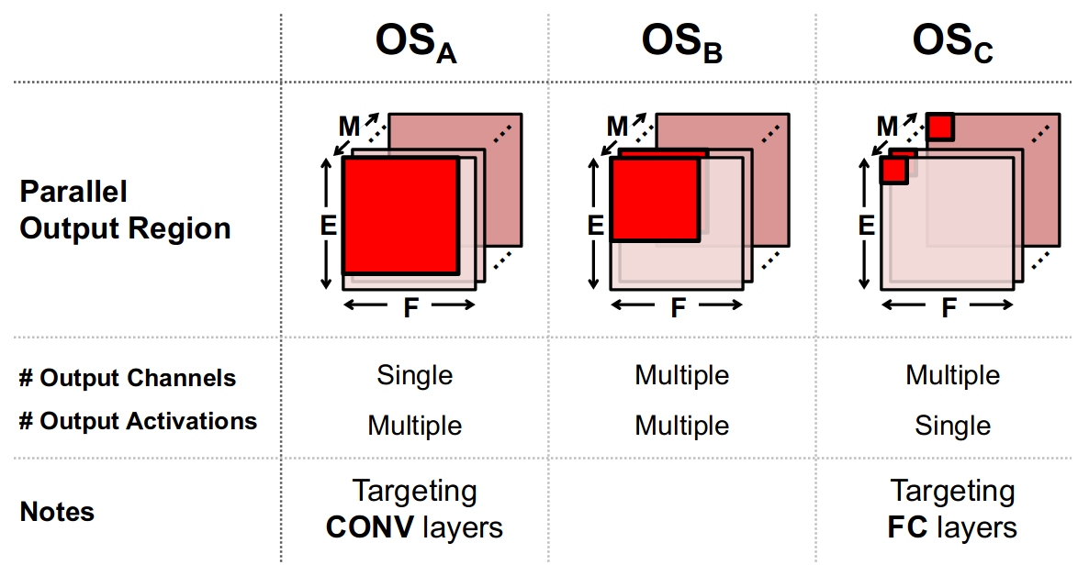
Variants of Output Stationary: Multiple outputs in parallel

Slide 26
The Neuro Vector Engine: Output stationary
Programmable
SIMD operations
Deep pipelining
ILP
Locality oriented
The neuro vector engine:
Flexibility to improve convolutional
net efficiency for wearable vision
Maurice Peemen e.a., DATE 2016

Slide 27
Convolutional Network Processing
M. Peemen et al. “Inter-Tile Reuse Optimization Applied to Bandwidth
Constrained Embedded Accelerators” DATE 2015

Slide 28
NVE Operation

Slide 29
VLIW Programming Model
3x3 Convolution filter
Software Pipelining
Steady state 10 cycles
  16 neighboring 3x3 convolutions
  144 Multiply Accumulate ops
Code reuse with instruction buffer
Loop
Prologue
Steady state
(= loop body)

Slide 30
Topics overview
Introduction
  Architecture choices
  Flexibility vs Energy efficiency
Basic Schedules and Architectures exploiting data reuse
  Output stationary
    NVE: Neuro Vector Engine
  Weight stationary
    CIM: Computation in Memory
  Input stationary
Row stationary mapping
TPU and other architectures
  Systolic array
Conclusions

Slide 31
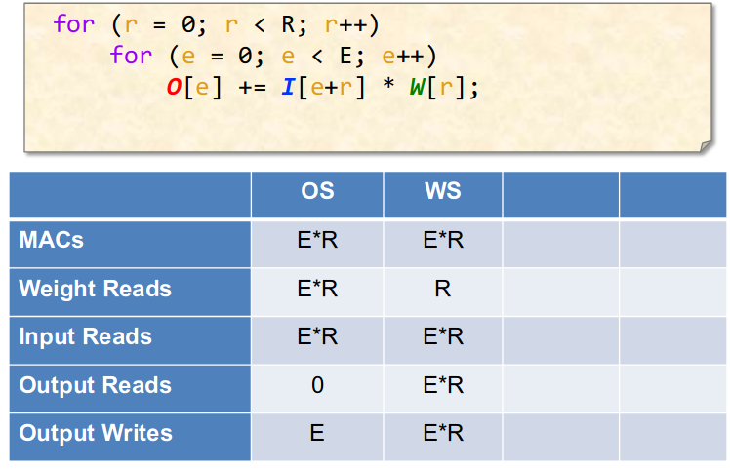
Weight Stationary

Slide 32
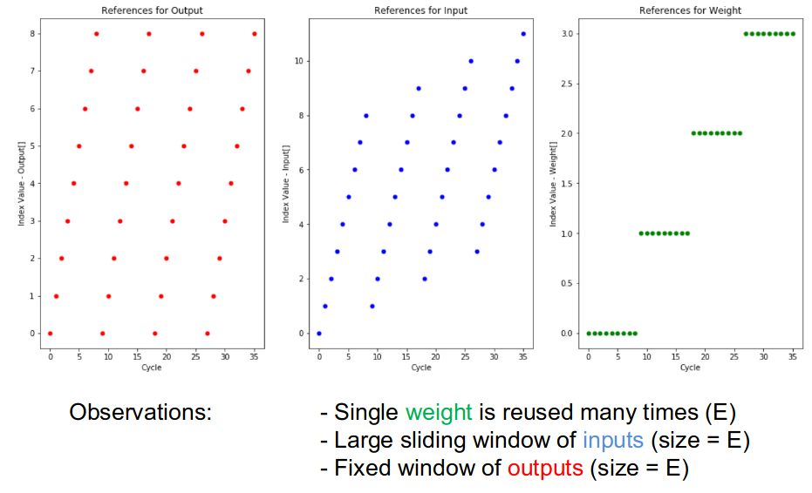
Weight Stationary – Reference Pattern

Slide 33
Convolution Layer – Weight Stationary
Hold weights
weights
Input fmap
C
Output fmap
C
H
M
E
R
=
S
M
X
W
F
Current calculation
Partial sum

Slide 34
Convolution Layer – Weight Stationary
Hold weights; move window
Input fmap
New partial sum
weights
C
Output fmap
C
H
M
E
R
=
S
M
X
W
F
Current calculation
Partial sum

Slide 35
Convolution Layer – Weight Stationary
Hold weights; for all output psum
Input fmap
Output partial sums
weights
C
Output fmap
C
H
M
E
R
=
S
M
X
W
F
Current calculation
Partial sum

Slide 36
Convolution Layer – Weight Stationary
Load new weight and repeat the same
weights
Input fmap
C
Output fmap
C
H
M
E
R
=
S
M
X
W
F
Current calculation
Partial sum

Slide 37
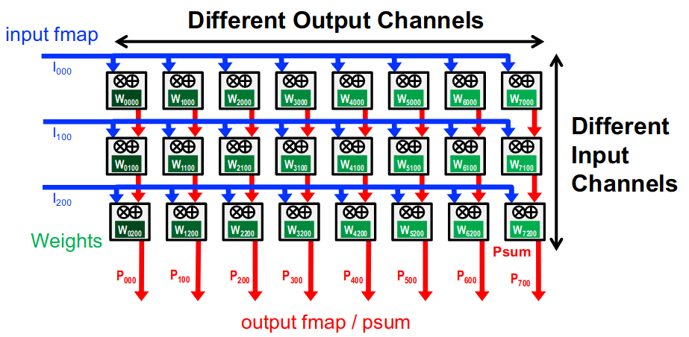
WS – Simplified View
Notes:
Weights stationary at the Processing Elements (PEs)

Slide 38
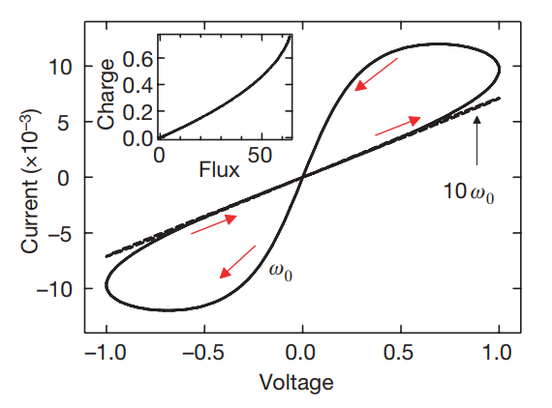
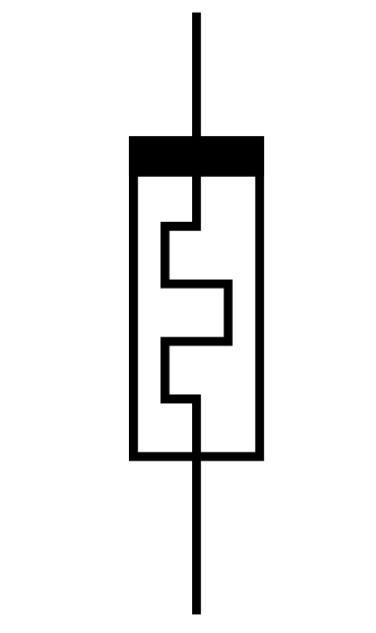
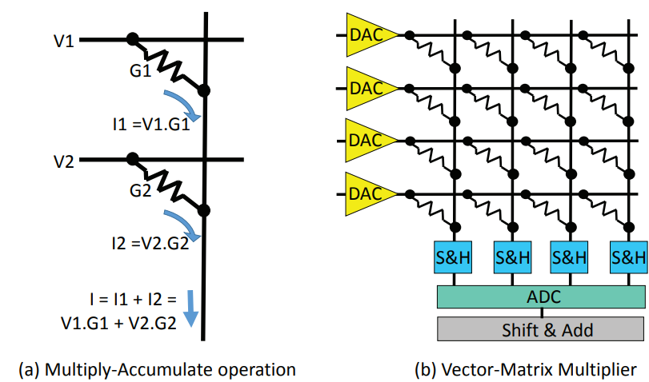
WS Example: Computation-in-Memory with Memristor crossbar
Memristors
Built in 2008 in HP Labs
Non-Linear, Two terminal device
Computation-in-memory

Slide 39
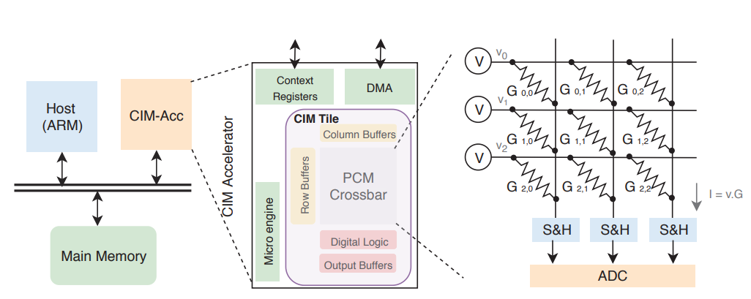
WS Example: TDO-CIM
Transparent Detection and Offloading for Computation-in-Memory (DATE 2019)
Crossbar performs Matrix-vector computation in analog domain; ideal for GEMM Kernel (FC layer)

Slide 40
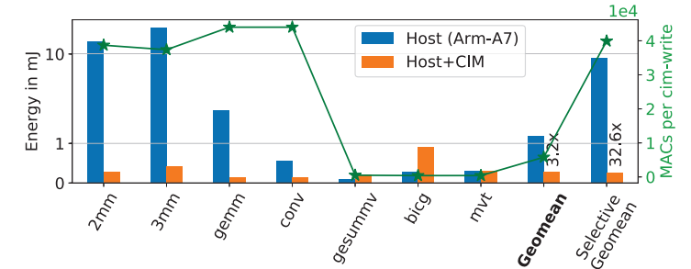
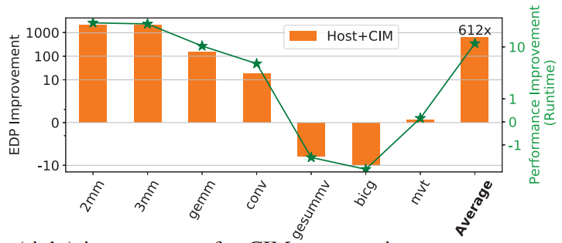
TDO-CIM - Results
Energy-Delay-Product (EDP)
Improvement = ~612x

Slide 41
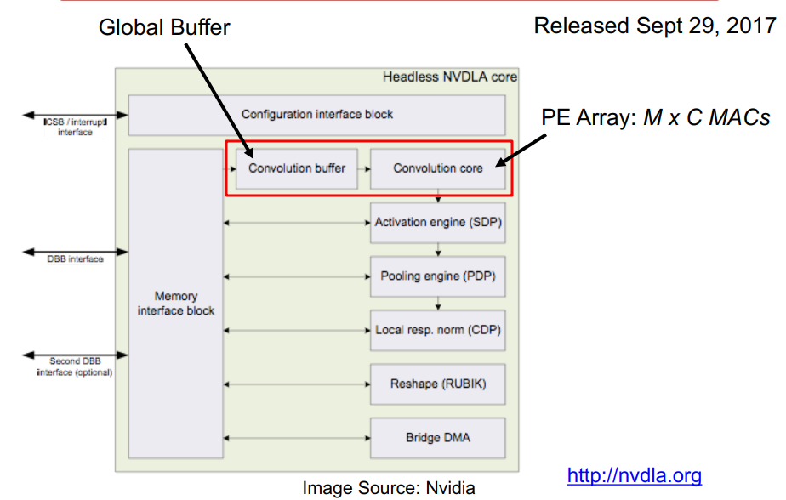
WS Example: NVDLA
NVIDIA Deep Learning Accelerator
Open-source Verilog !!
Conv Engine
  sparse weight compression
  Winograd
  weight reuse
  (in conv buffer)

Slide 42
Topics overview
Introduction
  Architecture choices
  Flexibility vs Energy efficiency
Basic Schedules exploiting data reuse
  Output stationary
    NVE: Neuro Vector Engine
  Weight stationary
  Input stationary
Row stationary mapping
TPU and other architectures
  Systolic array processing
Summary and Conclusions

Slide 43
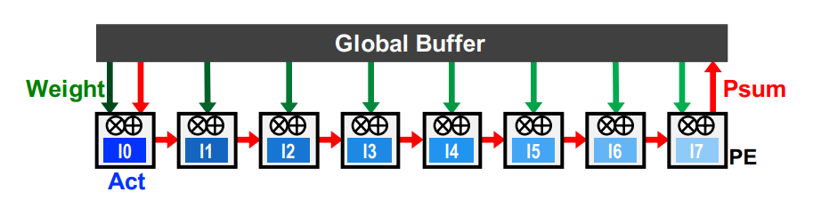
Input Stationary – Simplified view
Unicast Weights and accumulates psum spatially across PE array

Slide 44
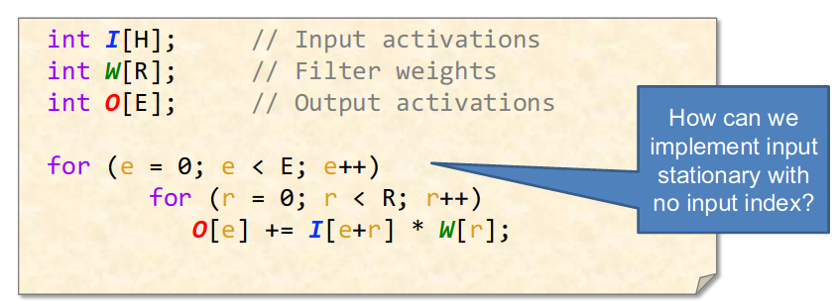
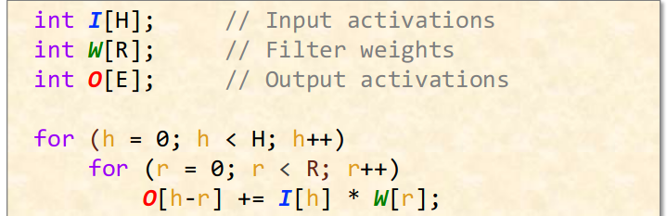
Input Stationary
Weights (R)
Inputs (H)
Outputs ( E = H-R+1)
*
=

Slide 45
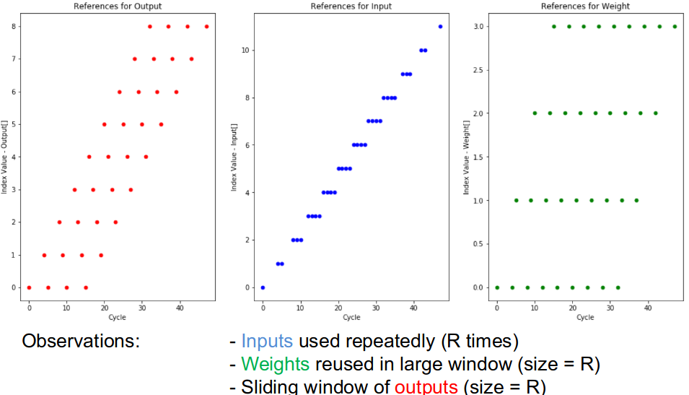
Input Stationary – Reference Pattern

Slide 46
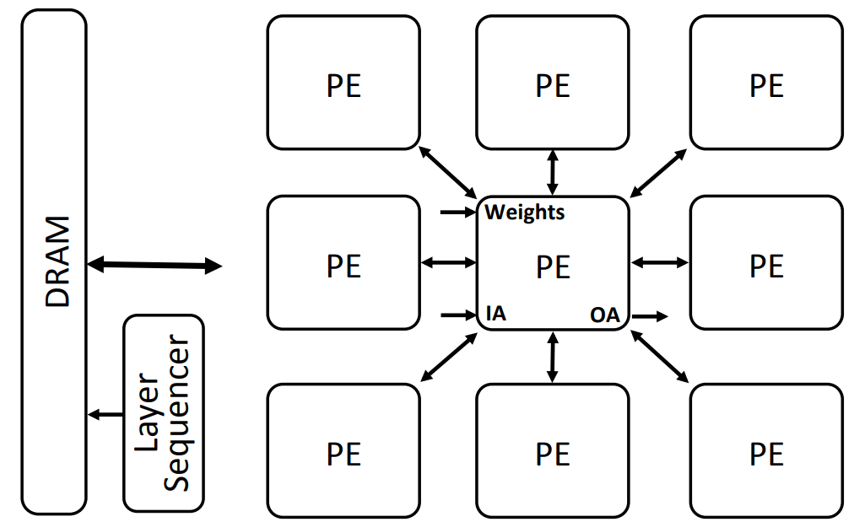
Input Stationary Example – SCNN, ISCA 2017
Input fmap tiling across PEs
  keep these tiles stationary in each PE
Complete unrolling inside PE
  Creates FxI Cartesian products from F and I compressed fmap and filter vectors
  Maps FxI products to Kc x Ht x Wt partial outputs via XBAR
Sparse CNN Architecture

Slide 47
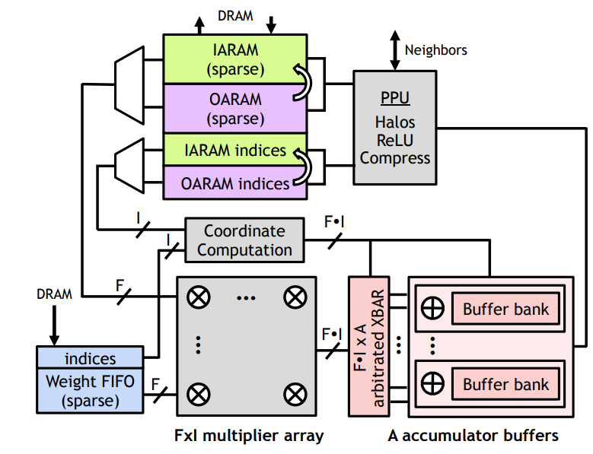
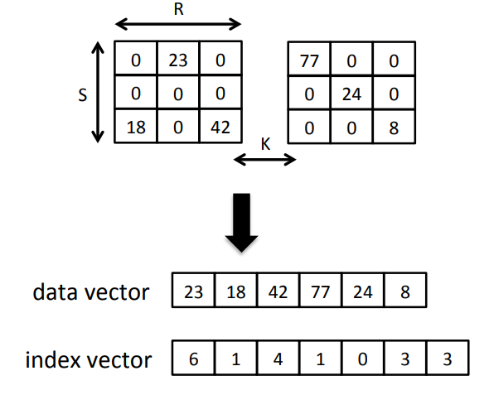
Input Stationary Example – SCNN, ISCA 2017
Weight Compression
PE Architecture in SCNN
- Input compression follows similar approach
IxF -> O mapping: Huge overhead calculation based on I and F non-zero indices, F.IxA XBAR to instantly map outputs

Slide 48
Summary of Stationary Schedules

Slide 49
Topics overview
Introduction
  Architecture choices
  Flexibility vs Energy efficiency
Basic Schedules and Architectures exploiting data reuse
Row stationary mapping
  Eyeriss architecture
TPU and other Architectures
  Systolic array processing
Summary and Conclusions

Slide 50
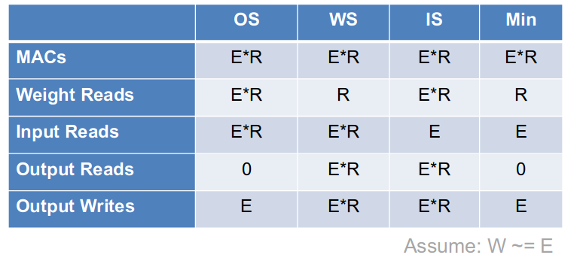
Minimum Costs
Which one is the best solution?
Can we do better than OS, WS, and IS?

Slide 51
Energy-Efficient Dataflow: Row Stationary (RS)
Maximize data reuse at RF level
Slides based on: Chen e.a.: ISCA 2016

Slide 52
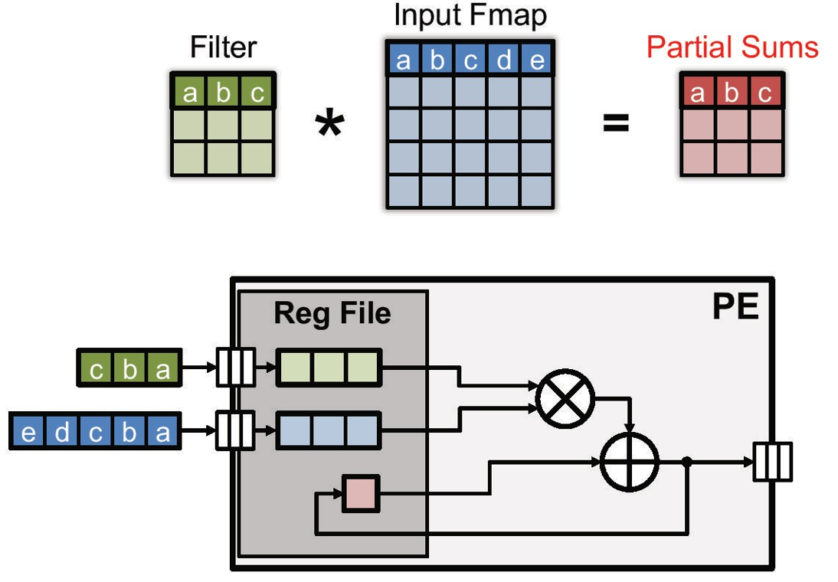
1-D row convolution in PE (processing element)

Slide 53
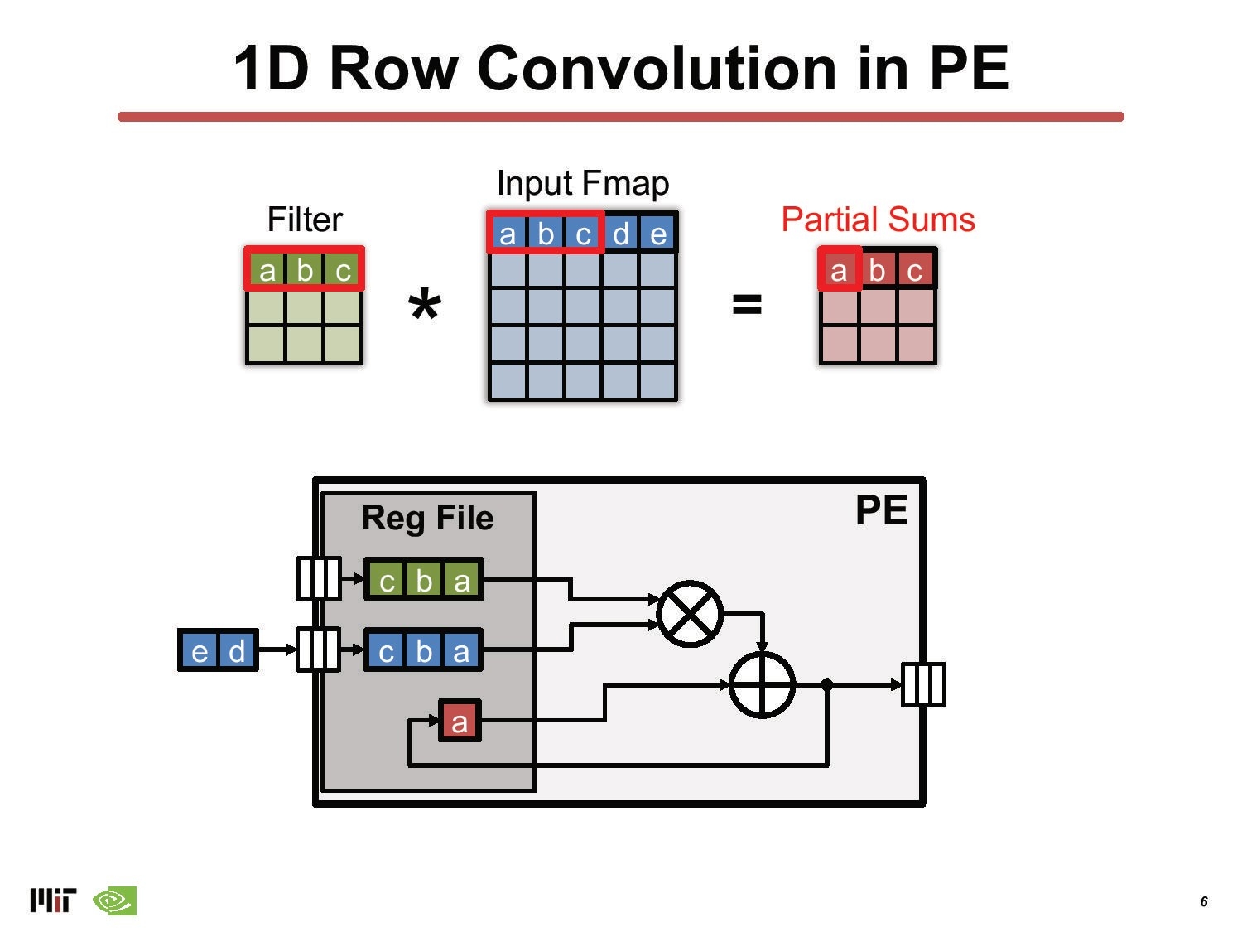

Slide 54
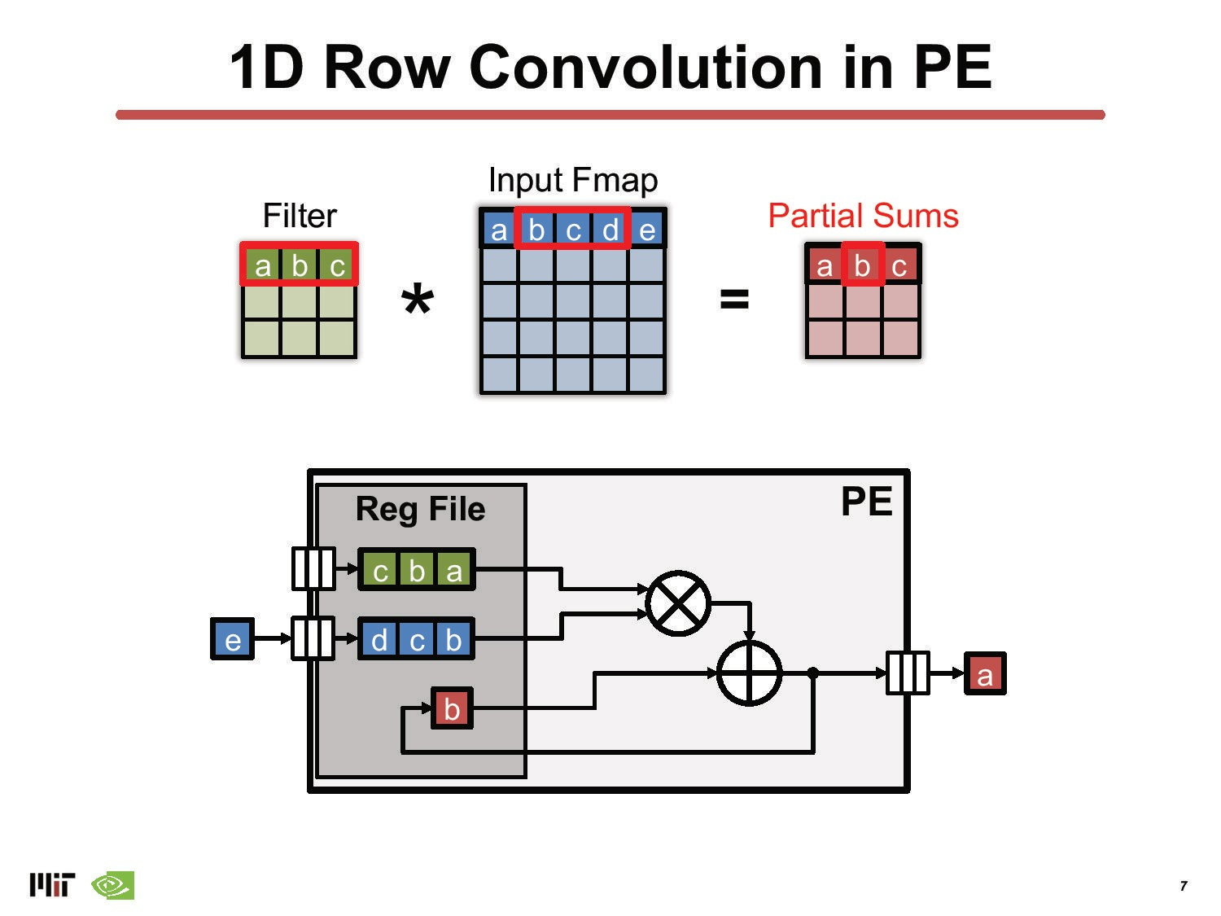

Slide 55
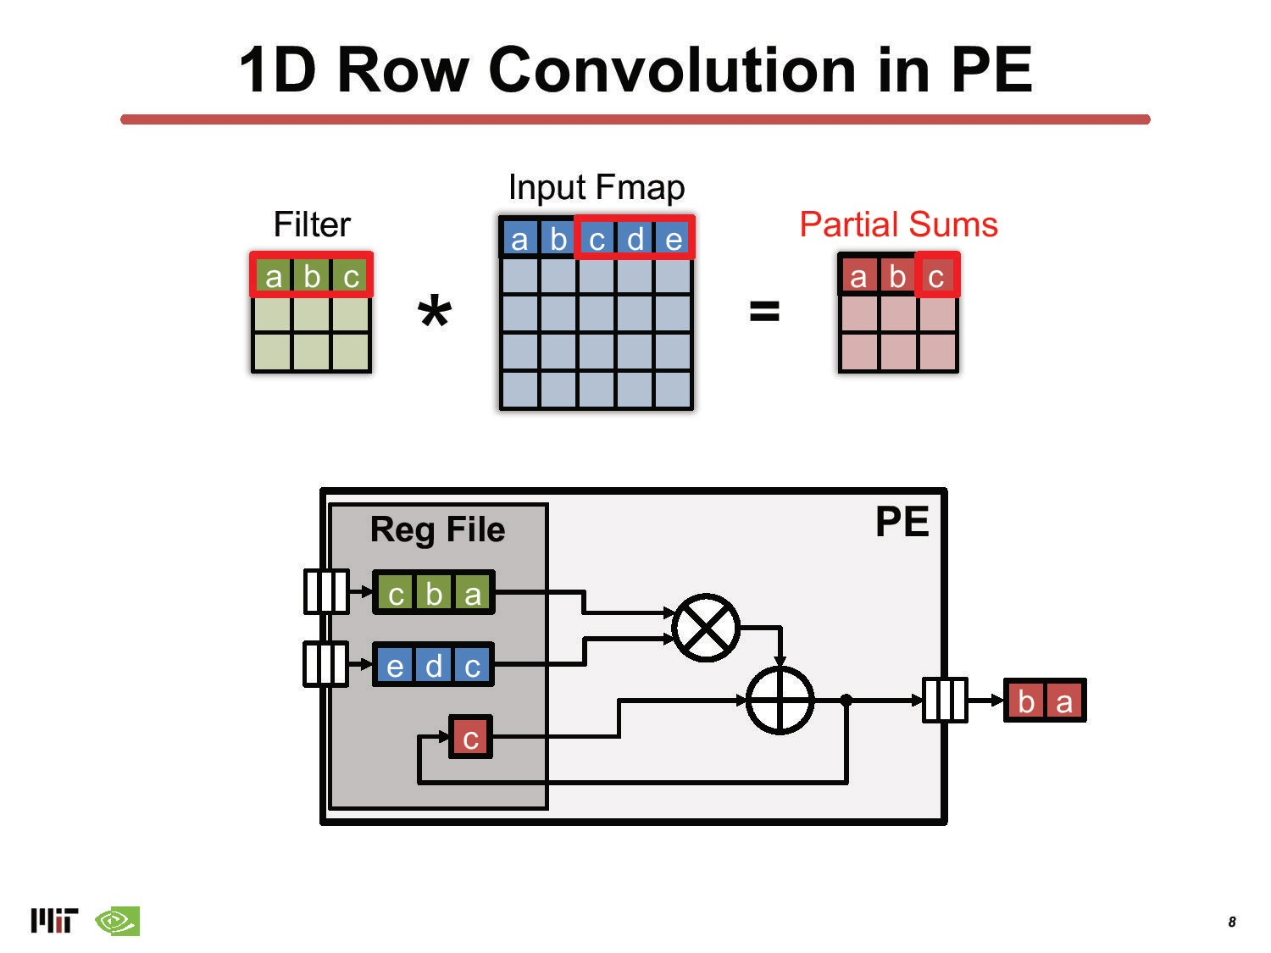

Slide 56
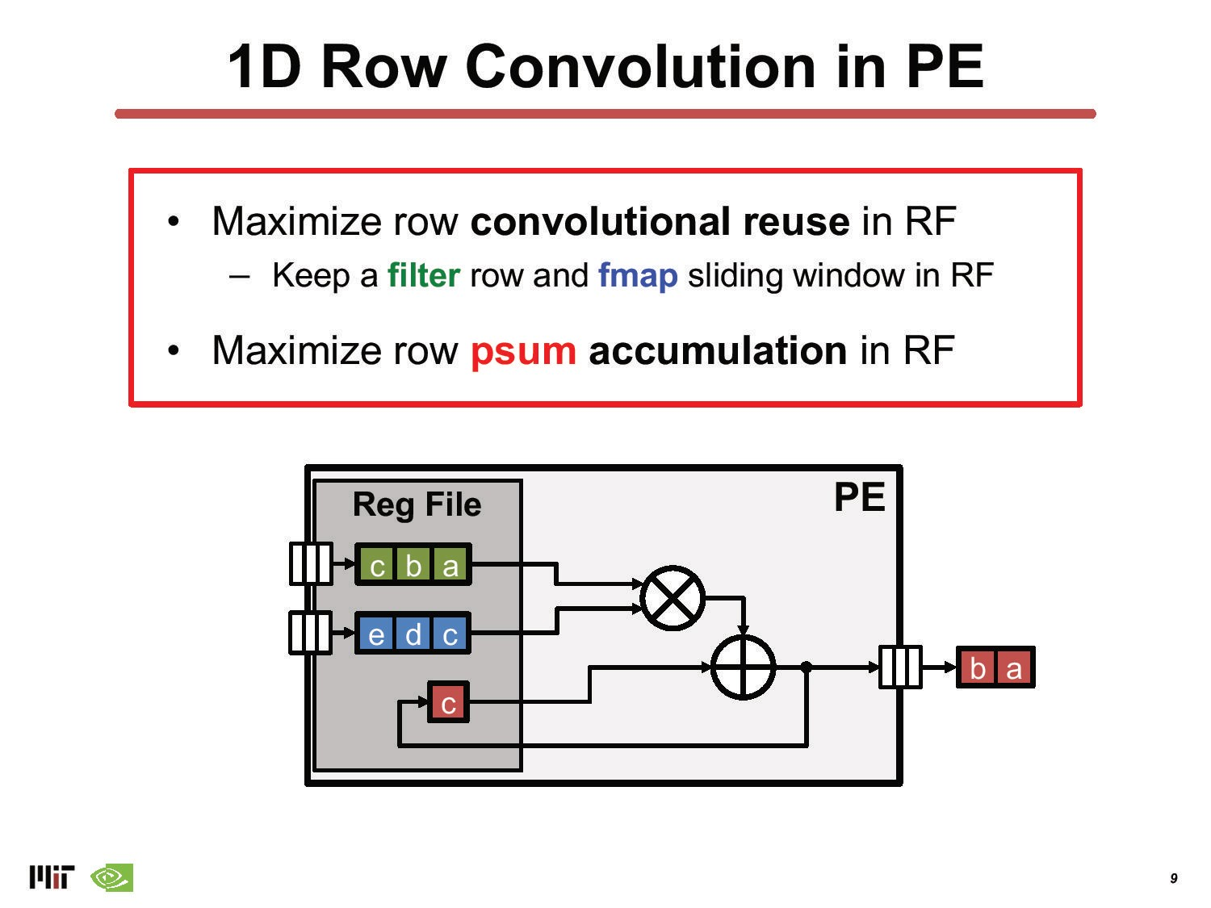

Slide 57
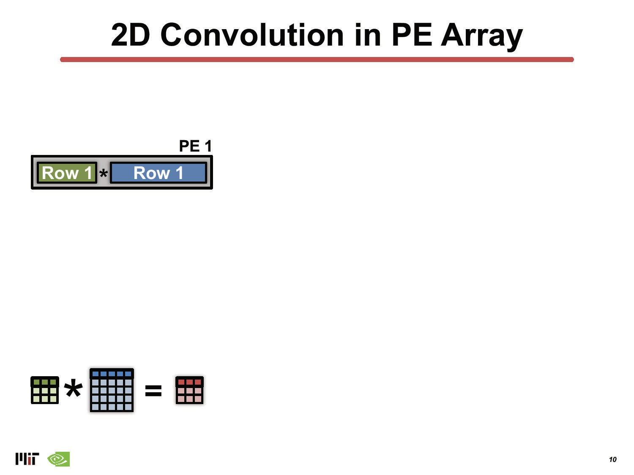

Slide 58
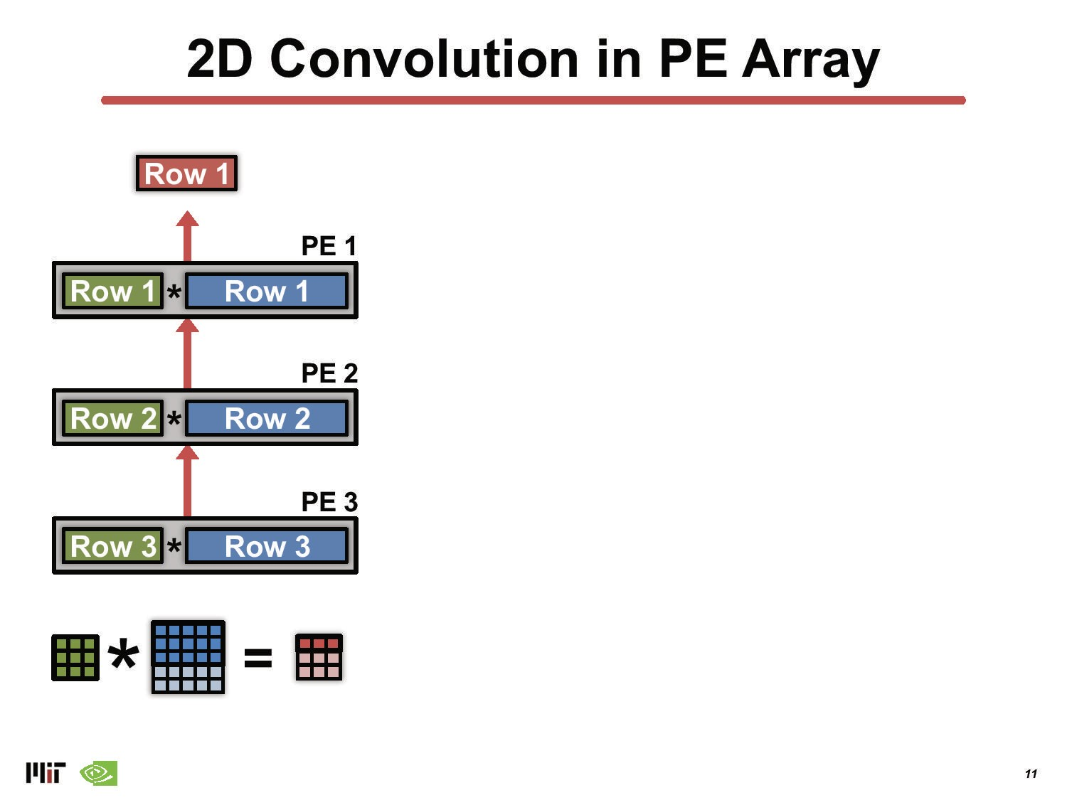

Slide 59
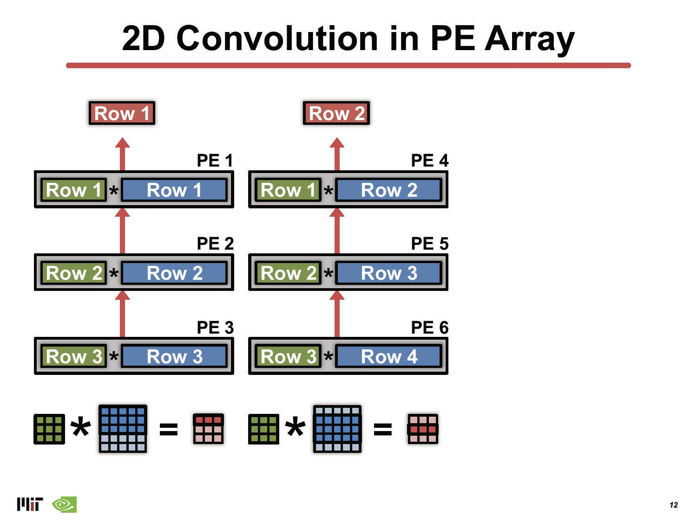

Slide 60
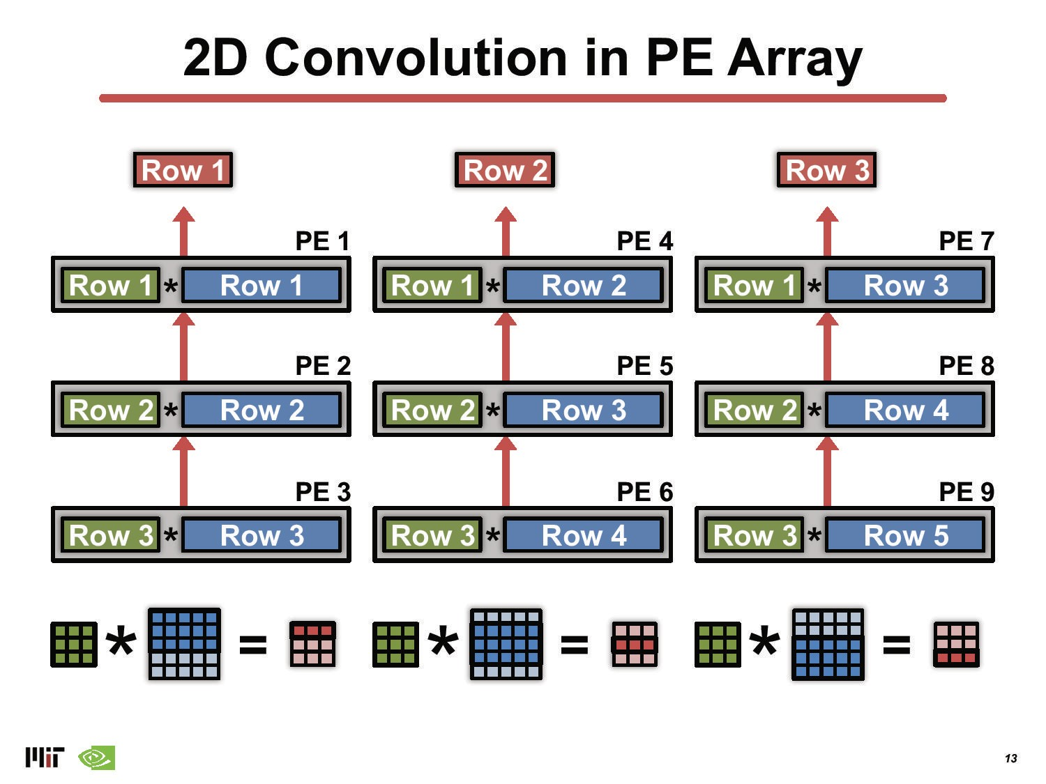

Slide 61
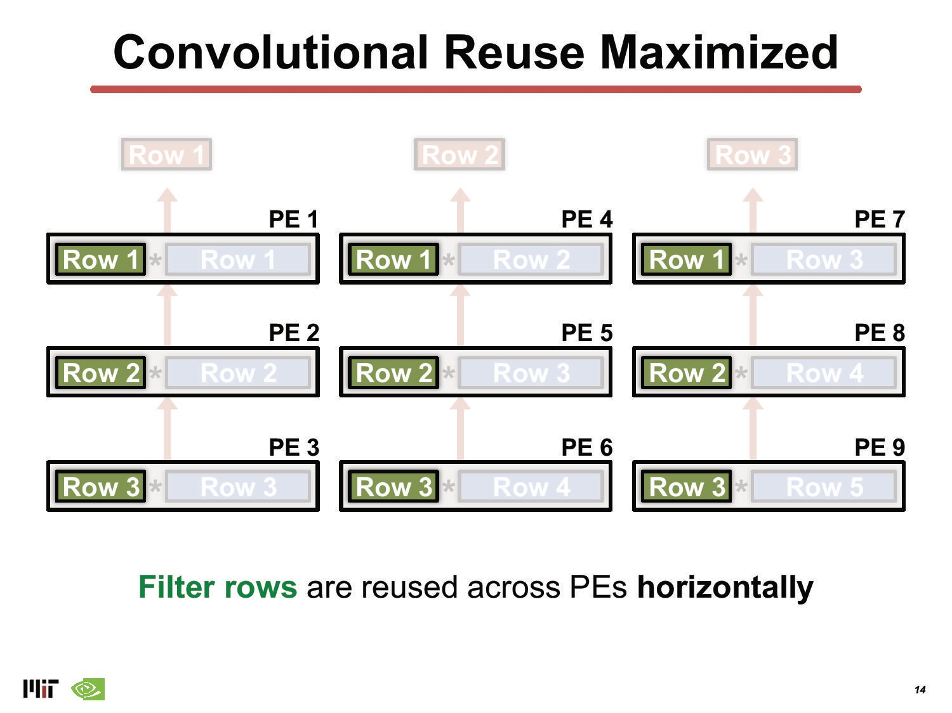

Slide 62


Slide 63


Slide 64

(Batch)

Slide 65


Slide 66

(Batch)

Slide 67


Slide 68


Slide 69


Slide 70


Slide 71


Slide 72


Slide 73


Slide 74


Slide 75


Slide 76


Slide 77

Eyeriss: Deep Neural Network Accelerator
Combining reuse in
on-chip global buffer
  see lecture on data reuse, and
row stationary schedule
  reusing data in the Register files within the PEs

Slide 78
Topics overview
Introduction
  Architecture choices
  Flexibility vs Energy efficiency
Basic Schedules exploiting data reuse
  Architectures exploiting data reuse
Row stationary mapping
TPU: Tensor Processing Unit
  Systolic array processing
Other Architectures supporting DL
Summary and Conclusions

Slide 79


Example: Google TPU (Tensor Processing Unit)
TPU v1 (Edge)
2016
Based upon: In-Data Center Performance Analysis of a tensor Processing Unit
ISCA 2017, Jouppi, Young, Patil, Patterson, et al.
TPU Data centre

Slide 80

Implement large 2D systolic matrix multiplication unit
Systolic Execution to compute data on the fly in buffers
Pipeline control and data
Relies on data from different directions arriving at
regular intervals and being combined
X11
*
W11
W12
X12
W21
W22
X13
W31
W32

Slide 81
Implement large 2D systolic matrix multiplication unit
Systolic Execution to compute data on the fly in buffers
Pipeline control and data
Relies on data from different directions arriving at
regular intervals and being combined
W11 X1
W12
X2
+
*
W21
W22
X3
W31
W32

Slide 82
Implement large 2D systolic matrix multiplication unit
Systolic Execution to compute data on the fly in buffers
Pipeline control and data
Relies on data from different directions arriving at
regular intervals and being combined
W11
W12 X1
W21 X2
+
W22
X3
+
*
W31
W32

Slide 83
Implement large 2D systolic matrix multiplication unit
Systolic Execution to compute data on the fly in buffers
Pipeline control and data
Relies on data from different directions arriving at
regular intervals and being combined
W11
W12
W21
W22 X2
W31 X3
+
W32
y₁=w₁₁x₁+w₂₁x₂+w₃₁x₃

Slide 84
Implement large 2D systolic matrix multiplication unit
Systolic Execution to compute data on the fly in buffers
Pipeline control and data
Relies on data from different directions arriving at
regular intervals and being combined
W11
W12
W21
W22
W31
W32 X3
y₂=w₁₂x₁+w₂₂x₂+w₃₂x₃
y₁=w₁₁x₁+w₂₁x₂+w₃₁x₃

Slide 85
Implement large 2D systolic matrix multiplication unit
Systolic Execution to compute data on the fly in buffers
Pipeline control and data
Relies on data from different directions arriving at
regular intervals and being combined
Matrix Matrix Multiply takes more cycles and has better utilization
X31
X21
X11
W11
W12
X32
X22
X12
W21
W22
X33
X23
X13
W31
W32

Slide 86

High-level Chip Architecture
Matrix Unit: 65,536 (256x256)
8-bit multiply-accumulate units
700 MHz clock rate
Peak: 92 TeraOps/second
    65,536 * 2 * 700M
4 MiB of on-chip Accumulator mem.
24 MiB of on-chip Unified Buffer
(activation memory)
8 GiB of off-chip weight DRAM mem.
Two 2133MHz DDR3 DRAM channels

Slide 87
TPUv1 Chip area breakdown
  Main focus:
    On-chip memory 35%
    Matrix Multiply Unit 24%
  Control is just 2%

Slide 88
TPUv1 from a programmer’s view
5 main (CISC) instructions:
  Read_Host_Memory
    Reads memory from the CPU memory into the unified buffer
  Read_Weights
    Reads weights from the Weight Memory into the Weight FIFO as input to the Matrix Unit
  MatrixMatrixMultiply/Convolve
    Perform a matrix-matrix multiply, a vector-matrix multiply, an element-wise matrix multiply, an element-wise vector multiply, or a convolution from Unified Buffer into the accumulators
    Takes a variable-sized B*256 input, multiplies it by a 256x256 constant input, and produce a B*256 output, taking B pipelined cycles to complete
  Activate (ReLU, Sigmoid, Maxpool, LRN, …)
    Computes activation function
  Write_Host_Memory
    Writes data from unified buffer into host memory
  Average Clock cycles per instruction: >10

Slide 89
Relative TPU Performance: 3 Contemporary Chips 2015/2016
Processor | mm² | Clock [MHz] | TDP [Watts] | Idle [Watts] | Memory GB/sec | Peak TOPS/Chip
 |  |  |  |  |  | 8b int. | 32b FP
CPU: Haswell (18 core) | 662 | 2300 | 145 | 41 | 51 | 2.6 | 1.3
GPU: Nvidia K80 (2/card) | 561 | 560 | 150 | 25 | 160 | -- | 2.8
TPUv1 | <331 | 700 | 75 | 28 | 34 | 91.8 | --

Slide 90
Relative Performance of TPUv1 server
Processor | Chips / Server | DRAM | TDP Watts | Idle Watts | Observed Busy Watts in Datacenter
CPU: Haswell (18 cores) | 2 | 256GB | 504 | 159 | 455
NVIDIA K80 (2 die per card; 4 cards per server) | 8 | 256GB (host) + 12GB x 8 | 1838 | 357 | 991
TPUv1 (1Core) | 4 | 256GB (host) + 8GB x 4 | 861 | 290 | 384

Slide 91
Roofline Visual Performance Model
2 Limits to performance
Peak Computation
Peak Memory Bandwidth
(for apps with large data that
don’t fit in chache)
Arithetic Intensity (FLOP/Byte
or reuse) determines which limit
Weight-reuse = Arithmetic
Intensity for DNN roofline
Samuel Williams, Andrew Waterman, and David Patterson. "Roofline: an insightful visual
performance model for multicore architectures."Communications of the ACM 52.4 (2009): 65-76.

Slide 92
TPUv1 Die Roofline

Slide 93
Haswell (CPU) Die Roofline

Slide 94
K80 (GPU) Die Roofline

Slide 95

Many benchmark far below roofline, e.g. MLP0
Increase Batch Size = More Weight Reuse

Slide 96

Combined log rooflines CPU, GPU, TPUv1

Slide 97
Perf/Watt TPUv1 vs CPU & GPU

Slide 98

Practical Example: Google TPU v2/v3
TPU v2:
8 GiB of HBM for each TPU core
One MXU for each TPU core
Up to 512 total TPU cores
4 TiB of total memory in a TPU Pod
TPU v3:
16 GiB of HBM for each TPU core
Two MXUs for each TPU core
Up to 2048 total TPU cores
32 TiB of total memory in a TPU Pod

Slide 99
Topics overview
Introduction
  Architecture choices
  Flexibility vs Energy efficiency
Basic Schedules exploiting data reuse
  Architectures exploiting data reuse
Row stationary mapping
TPU: Tensor Processing Unit
  Systolic array processing
Other Architectures supporting Deep Learning:
  Tensor Streaming Processor (TSP)
  GraphCore
  Cerebras wafer-scale
  Samsung NPU (Neural Processing Unit)
  IBM RaPiD
Summary and Conclusions

Slide 100

Tensor Streaming Processor: TSP
Vectorlane
Conventional Mesh of PEs
Reorganized into sliced vector lanes
https://dl.acm.org/doi/10.1109/ISCA45697.2020.00023

Slide 101

Tensor Streaming Processor: TSP
Vertical slices contain 20 units

Slide 102


Tensor Streaming Processor: TSP
14nm
220 MiBytes SRAM

Slide 103

GraphCore MK1
The other extreme….
MIMD with 1216 Processors
  256 Kbyte/PE
  no cache
  PE interconnect
  Inter-chip interconnect
MK2 version, see
  https://www.graphcore.ai/products/ipu
  1472 PEs
  900 MB memory
  47.5 TByte/s memory bandwith

Slide 104

Cerebras Wafer-Scale Integration
Cluster scale DL in a single system
Huge, Not for embedded systems !!!
  23 kW
  850.000 cores
  40 Gbytes on-chip SRAM
  20 petaBytes/s emmory bandwidth
  220 petaBits/s interconnect bandwidth

Slide 105

Samsung NPU

Slide 106

Samsung NPU
Exploit input FM sparsity
Weight stationary
Adder trees for inner products
Reconfigurable MAC array
  INT8/INT16 support

Slide 107

IBM RaPiD
7nm chip with 4 cores:
  25.6 Tflops (FP8)
  102.5 TOPS (INT4)
Per core
  Fused MAC, supporting
    FP16/FP8/INT4/INT2
Supporting:
  range of activation functions
  pooling
  data shuffles
Sparsity-aware dynamic power management

Slide 108

IBM RaPiD core

Slide 109

Memory ⬄ Energy problem
  how to get DL at the Edge, Everywhere?
Data-reuse is key to achieve very high Energy Efficiency
  Reduce Data Reuse Distance
  Keep data/weights stationary if possible, inside local PE registers
Efficient schedules are needed for Deep Learning Networks
  => Advanced Loop transformations: tiling, interchange, fusion, etc.
Accelerator supporting for these schedules
  CIM: Computing in Memory
  TPU: Systolic (2D) computing, and others
  ASIPs: New class of architecture where HW and SW design are blended!
Hardware capability and Mapping techniques play major role in performance, Energy Efficiency, and Flexibility for DNN accelerators
Many open research questions: check our PARSE website: parse.ele.tue.nl

Slide 110
Further reading
Recent survey on accelerator design: https://dl.acm.org/doi/pdf/10.1145/3520127

