Slide 1
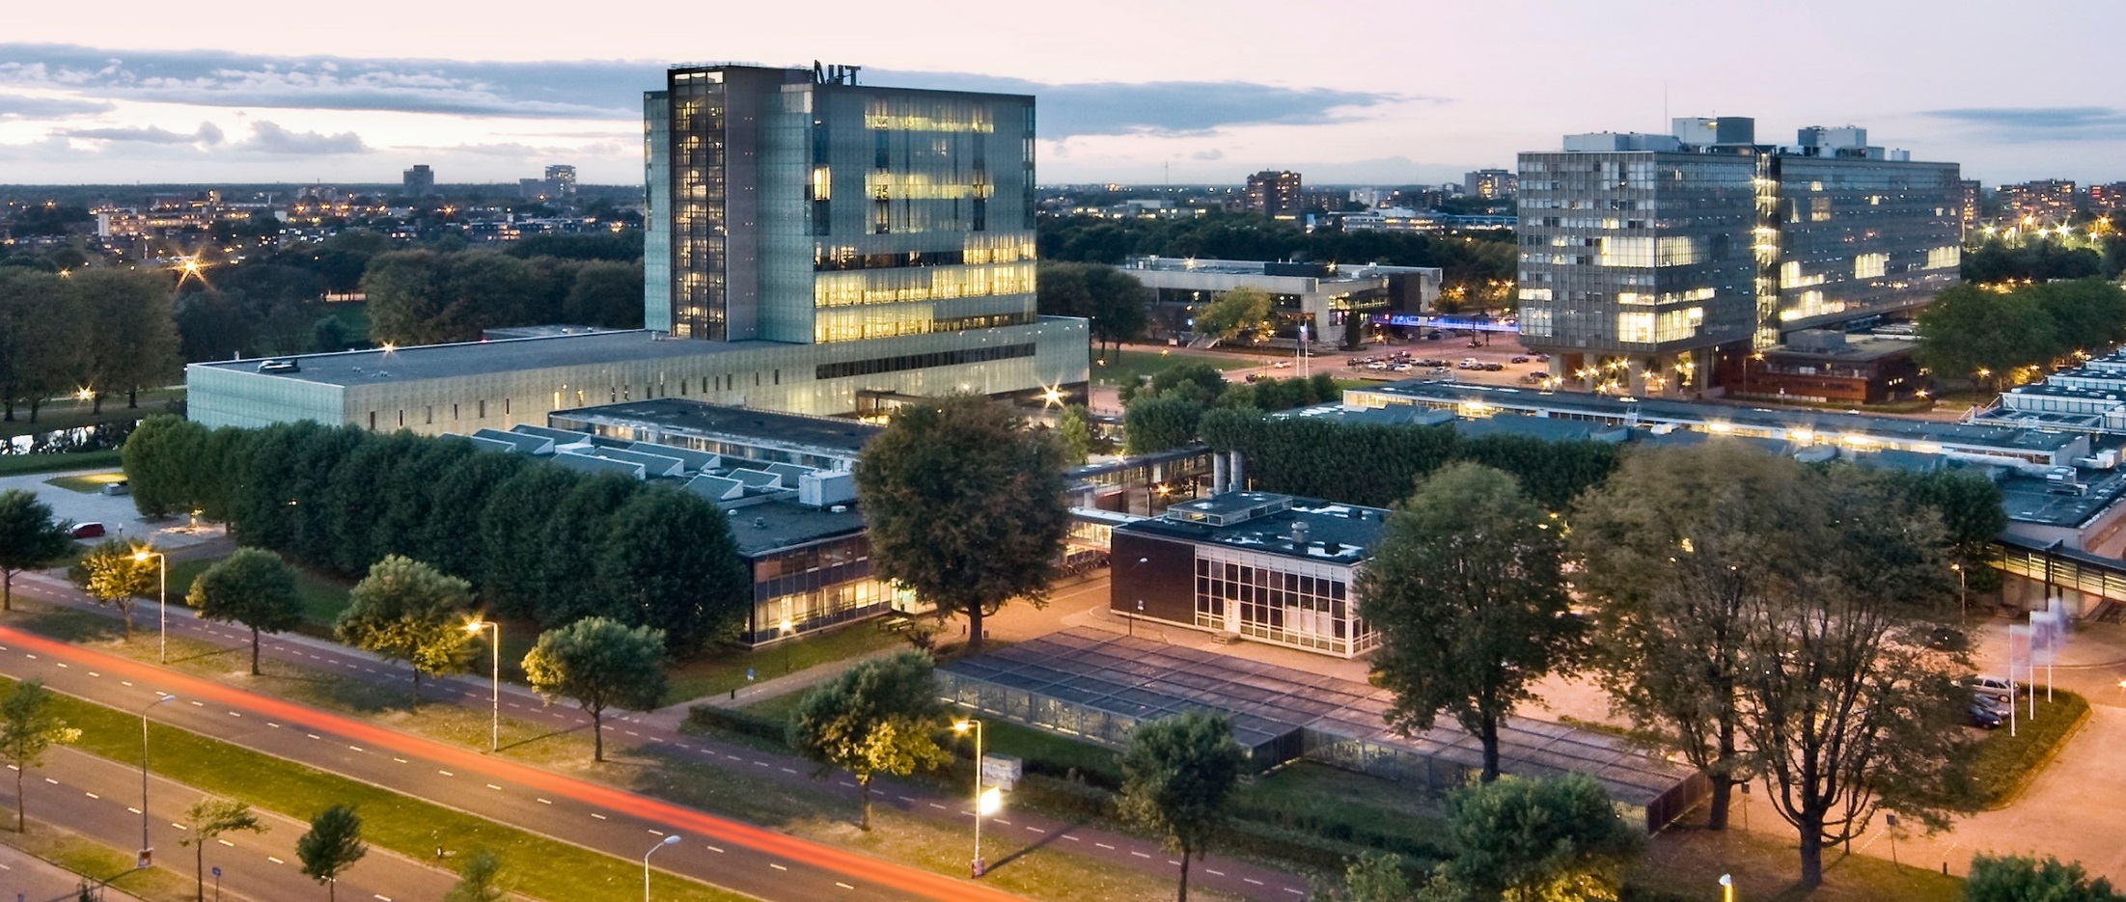
Bandwidth-Efficient Deep Learning: The Tricks of the Trade
Compact aware network design
Dr. ir. Maurice Peemen
Electrical Engineering

Slide 2
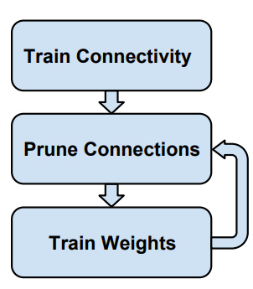
First part: Network Pruning for Efficiency
Networks with many parameters are not efficient: Storage, Speed, Energy
Data-Free pruning: up to 1.5x reduction
L1 regularization: up to 4x reduction
Retraining: up to 6.7x reduction
Iterative retraining up to 10x reduction
Speed and energy advantages are lower, 3 - 6x, due to irregularity
Structured pruning can help
    Less storage overhead and much more regular
    Architecture dependent

Slide 3
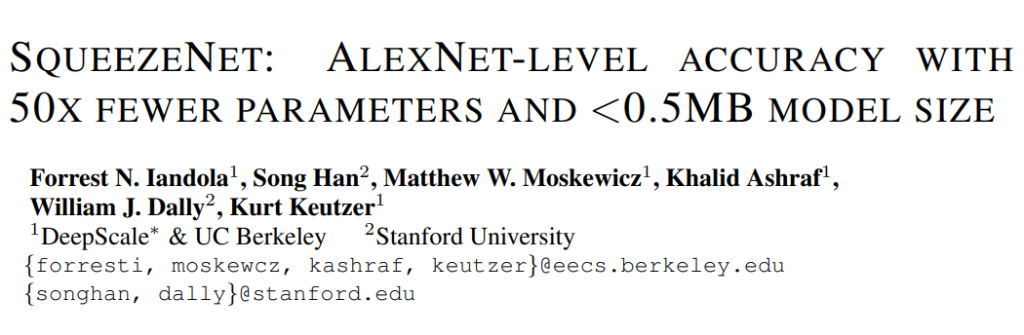
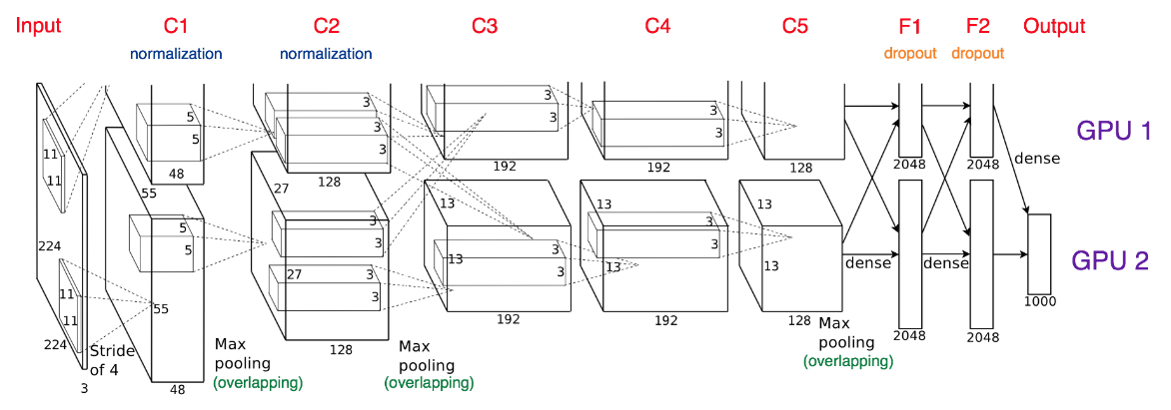
Now: Network Architecture Design for Efficiency
Can we perform better than Pruning?
Identify a model with less parameters
while preserving accuracy
Advantages:
    Less communication for
    distributed training
    Less bandwidth to export a model
    from cloud to autonomous car
    Feasible to deploy in devices with
    limited memory e.g. FPGA

Slide 4
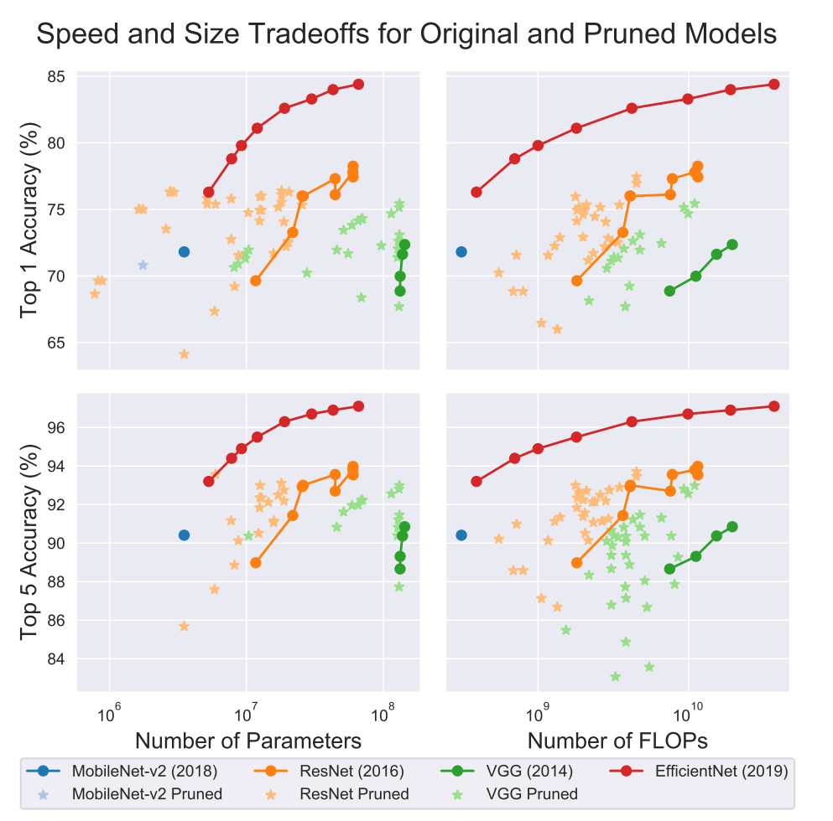
Pruning versus advanced network design methods
Efficient network design is very effective

Slide 5
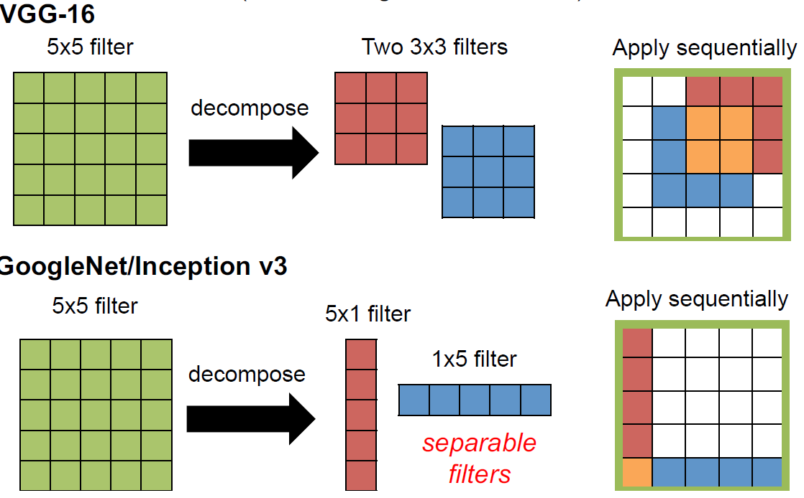
Reducing filter sizes: filter decomposition

Slide 6
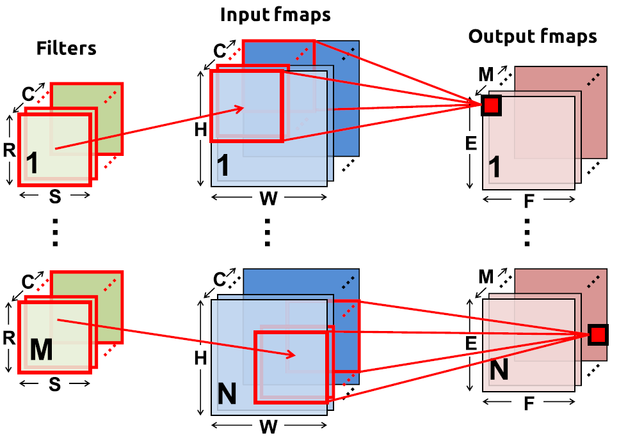
Remember the CNN terminology (single layer)
N = batch size
C input feature maps of size HxW
M output feature maps of size ExF
M filters of size RxS
Total filter size =
Mx (RxSxC)

Slide 7
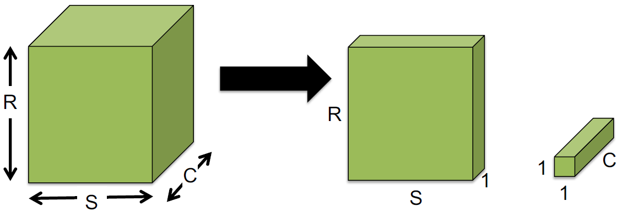
Reducing filter sizes: decouple correlations
Decouple the cross-channels correlations and spatial correlations in the feature maps of the DNN: depth wise convolution
+
Number of operations for M output channels reduces dramatically:
Left: H*W*(R*S*C)*M
Right: H*W*(R*S)*C + H*W*C*M = H*W*C*(R*S + M)

Slide 8
Network scaling
Different scaling options
  Width scaling: more channels, i.e. more filters
  Depth scaling: more layers
  Resolution scaling: increase image size
Some methods do this in systematic ways
  EfficientNet: Rethinking model scaling for CNNs
  Searching for MobileNetV3
  Many NAS, Network Architecture Search, methods

Slide 9
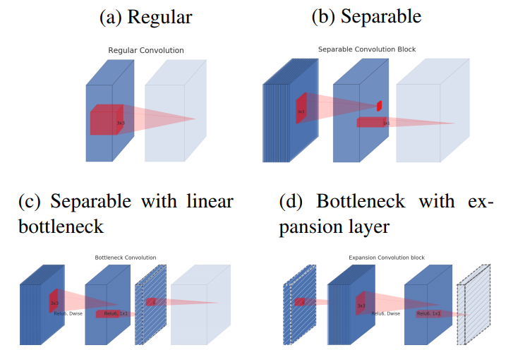
Evolution of separable convolution blocks
AlexNet, VGG
MobileNetV1
MobileNetV2/3
MnasNet
EfficientNet
Diagonally hatched layers do not use non-linearities.
Thickness of each block indicates its relative number of channels.
Note: c and d are equivalent blocks when stacked.
Notes:
see MobileNetv2 paper for more explanation

Slide 10
Architectural Design Strategies
Strategy 1:
Replace 3x3 filters with 1x1 filters
    9x less parameters
  Strategy 2:
Decrease the number of input channels to 3x3 filters
    (input channesl) x (output features) x (kernesize 3x3)
  Strategy 3:
Downsample late in the network so that large activation maps remain
    Intuition: Large activation maps give higher classification accuracy, with all other parameters equal

Slide 11
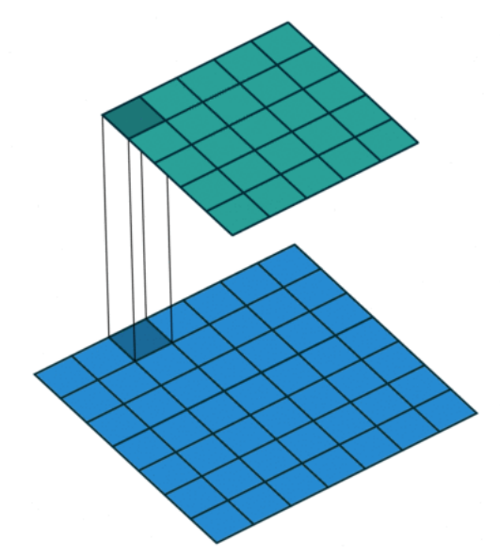
Micro Architectural Design strategy 1x1
1x1 convolution acts as coordinate-dependent
transform in filter space
1x1 convolution has less over-fitting due to small
number of parameters
Combination of multiple filters (1x1xF) is equivalent to
multi-layer perceptron

Slide 12
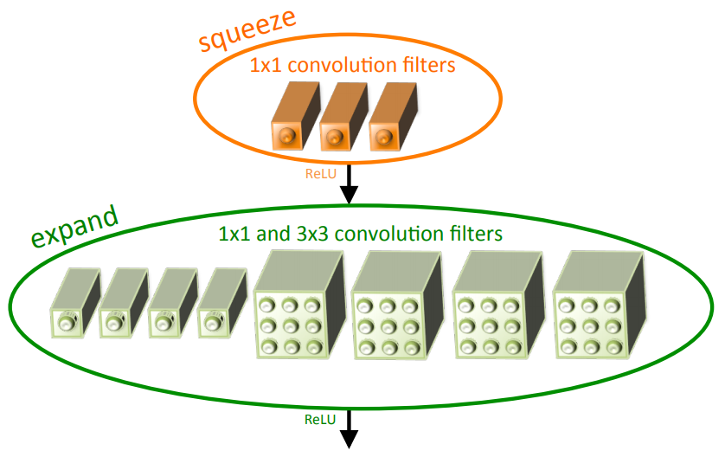
The Fire module: building block to enable strategy 1,2,3
Squeeze convolution layer 1x1
    Application of strategy 1
Expand layer mix of 1x1 and 3x3 filters
Tunable hyper parameters
    S_{1x1}: number of filters in squeeze layer
    E_{1x1}: number of 1x1 filters in expand layer
    E_{3x3}: number of 3x3 filters in expand layer
S_{1x1} < (E_{1x1} + E_{3x3})
    Squeeze should reduce number of input
    channels to 3x3 filters, Strategy 2

Slide 13
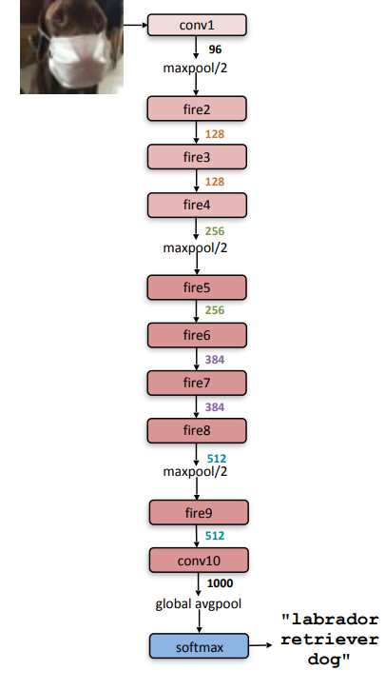
SqueezeNet Architecture: Macro Architectural Design
Strategy 3: Down sample relatively late in the network

Slide 14
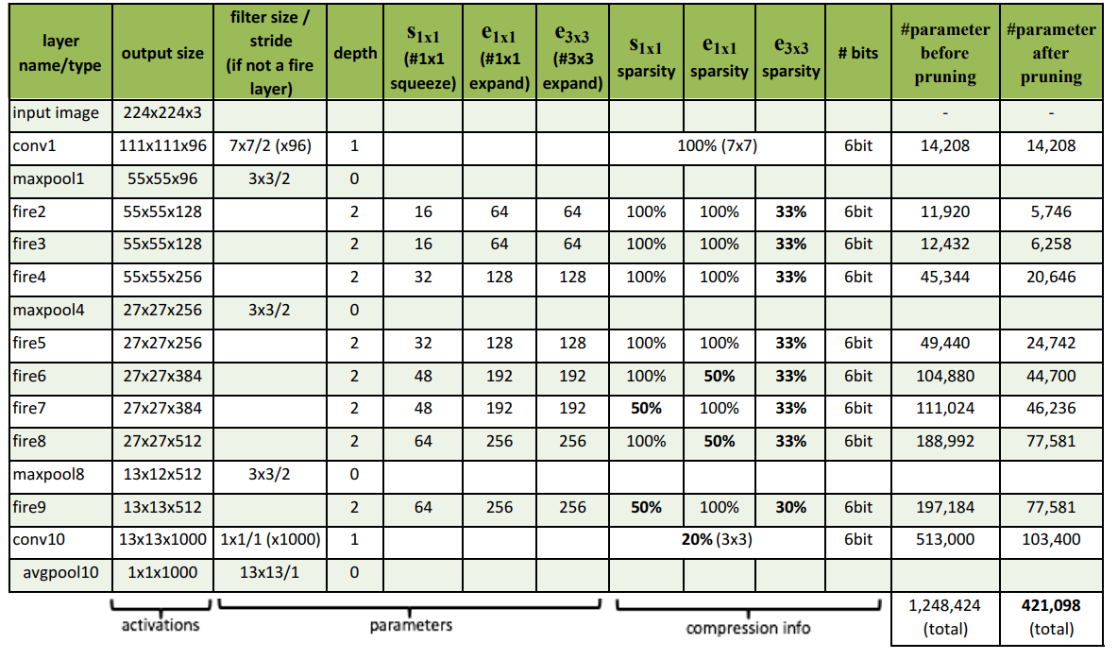
SqueezeNet Architecture: Dimensions

Slide 15
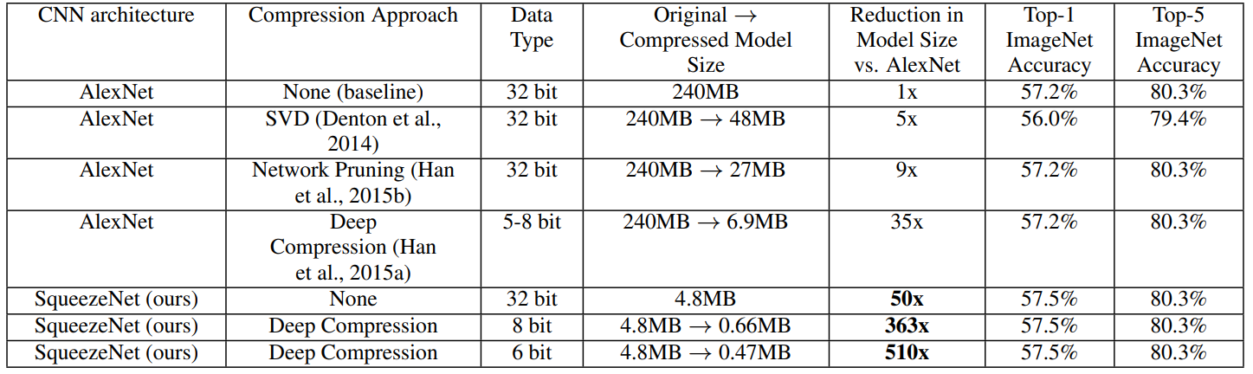
SqueezeNet Compared to Model Pruning/Compression

Slide 16
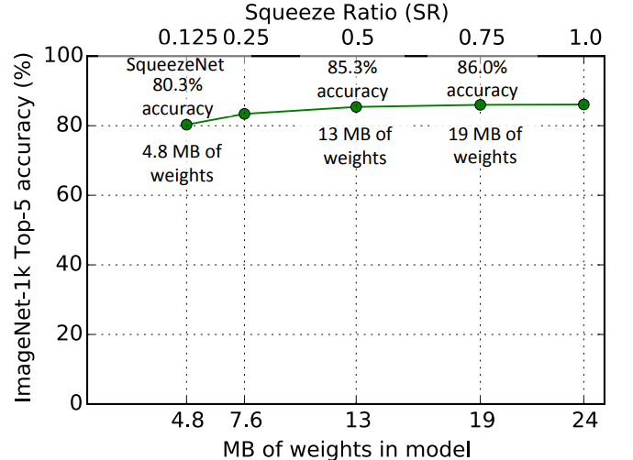
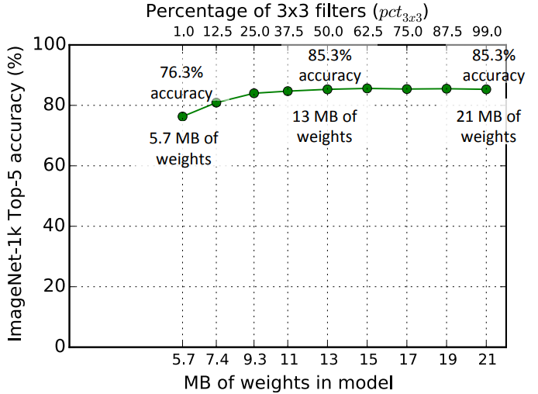
Design Space Exploration
Squeeze Ratio: Number of 1x1 filters in a squeeze layer
Increase SR beyond 0.125 can increase top-5 accuracy
at the cost of more weights
Percentage of expand layer that is 3x3:
Top-5 accuracy saturates at 85% when using 50% 3x3
further increase has no impact on accuracy

Slide 17
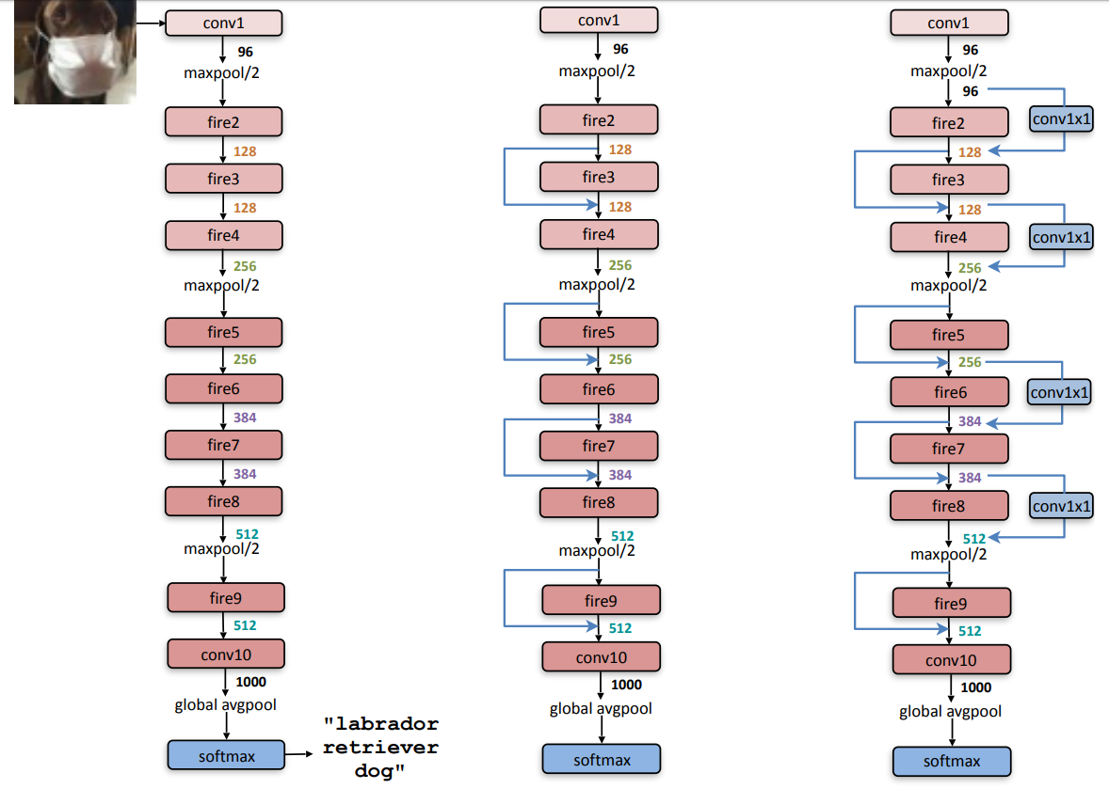
More complex architecture variants
SqueezeNet has SR 0.125
only 8x fewer output channels
bottleneck for info propagation
Equip with bypass connections
Introduce complex bypass
1x1 convolution with filters
equal to number of outputs

Slide 18
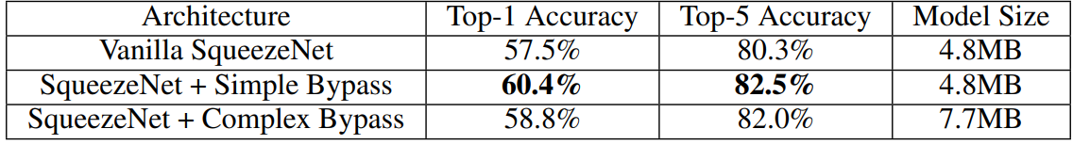
Design space exploration: Macroarchitecture
Results:
Simple bypass performs better than complex bypass
Simple bypass boosts Top-1 and Top-5 accuracy without increasing the modelsize

Slide 19
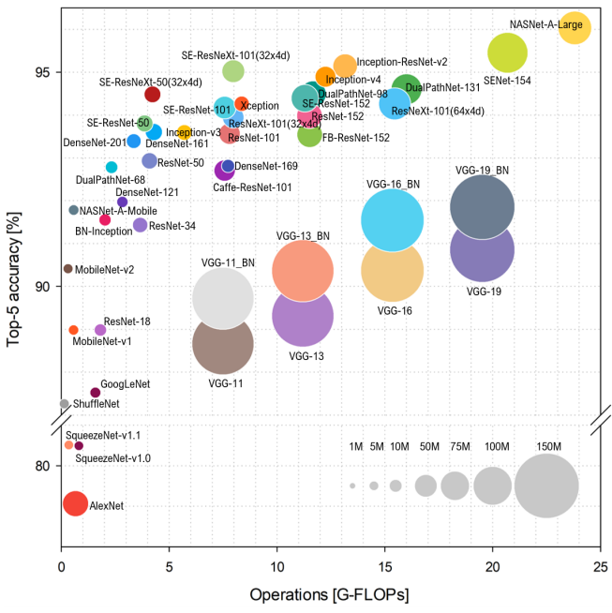
SqueezeNet compared to others
SqueezeNet a bit better than AlexNet
    Others achieve better accuracy
Very small amount of:
    Parameters
    Operations

Slide 20
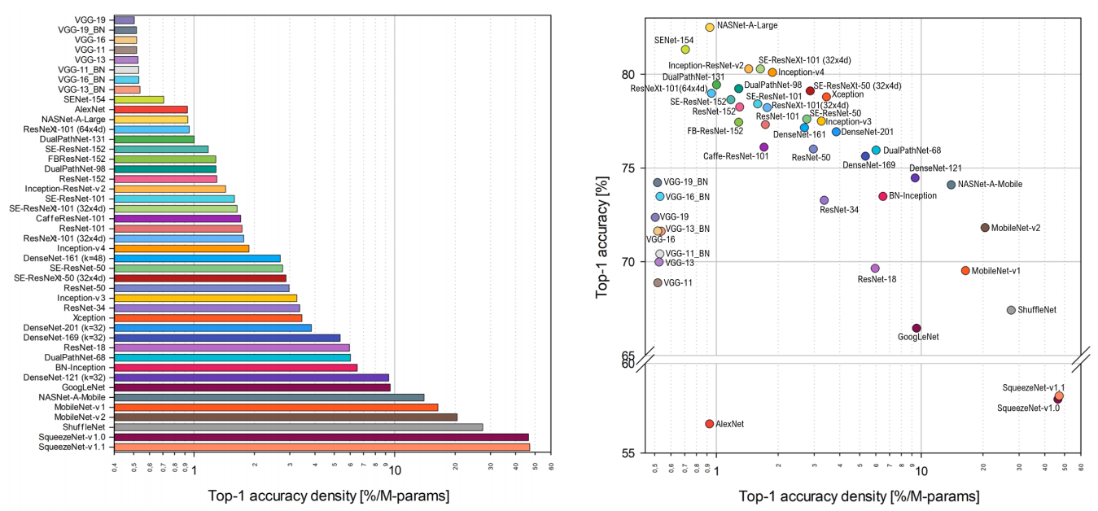
SqueezeNet compared on parameter efficiency
SqueezeNet is most efficient in parameter usage

Slide 21
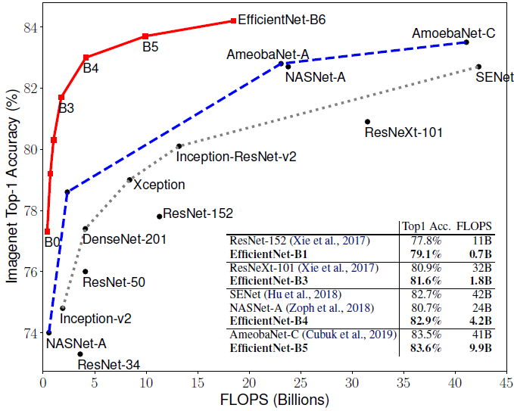
EfficientNet: Flops vs ImageNet Accuracy
Red line shows EfficientNet
options for different scalings

Slide 22
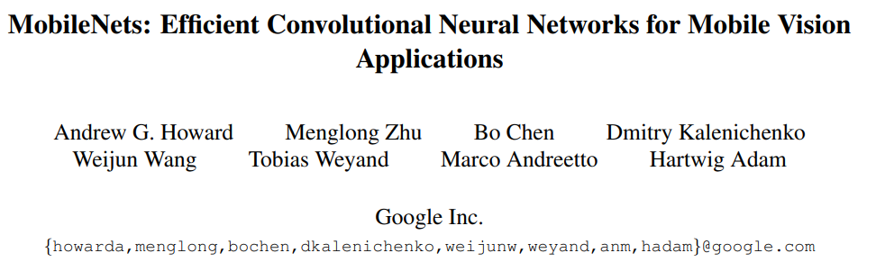
SqueezeNet Take Aways
Fire modules and the lack of fully connected layers reduce model size tremendously
These strategies achieve similar accuracy with 50x less weights
Enables mapping of powerful Convolutional Networks on mobile/embedded platforms
Self study task:
Thanks for your attention!

Slide 23
Great references to study
What is the state of Nerual Network Pruning (good overview of latest status)
https://arxiv.org/pdf/2003.03033.pdf
ShrinkBench (pytorch library to implement many pruning scripts and evaluate)
https://github.com/jjgo/shrinkbench
SqueezeNet
https://arxiv.org/abs/1602.07360
MobileNets
https://arxiv.org/abs/1704.04861
MobileNet V2
https://arxiv.org/abs/1801.04381
EfficientNet
https://arxiv.org/abs/1905.11946

