Slide 1
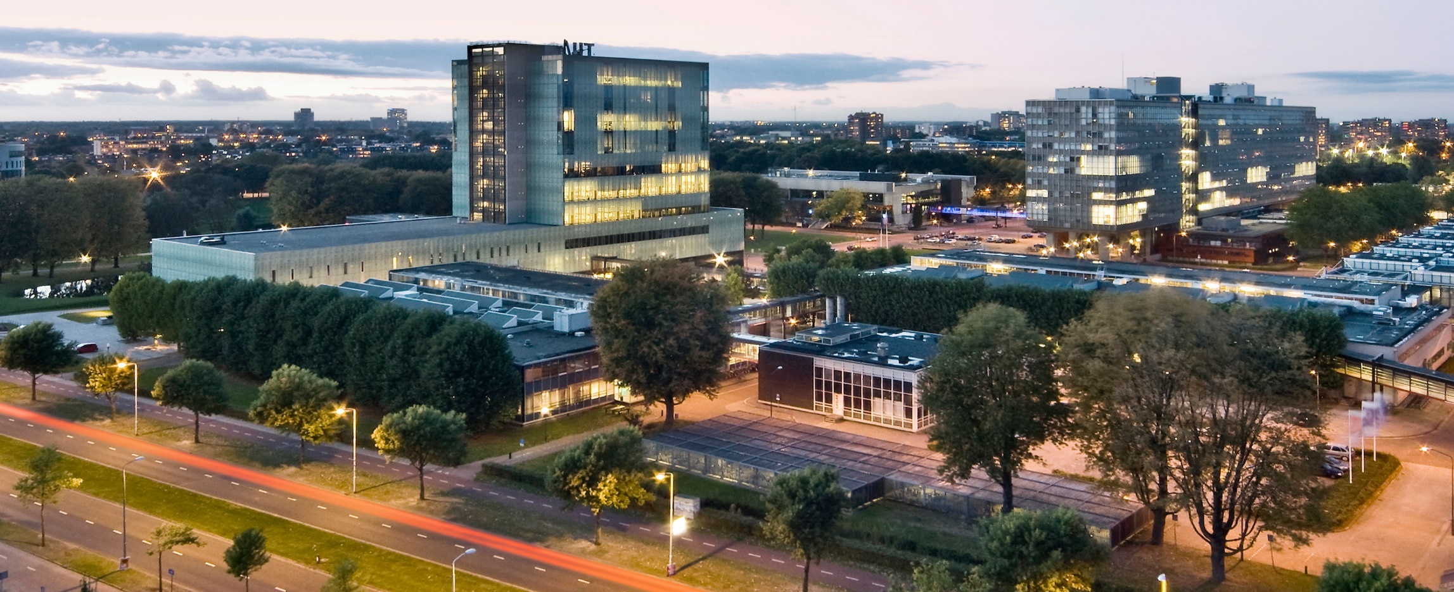
Deep Learning Applications and Advanced DNNs
March 15, 2022
Dr. Alexios Balatsoukas-Stimming & Dr. ir. Maurice Peemen
Electrical Engineering

Slide 2
Outline of Today’s Lecture
Main theme: applications and corresponding “specialized” NNs
CNNs with upsampling
Temporal neural networks
Deep unfolding

Slide 3

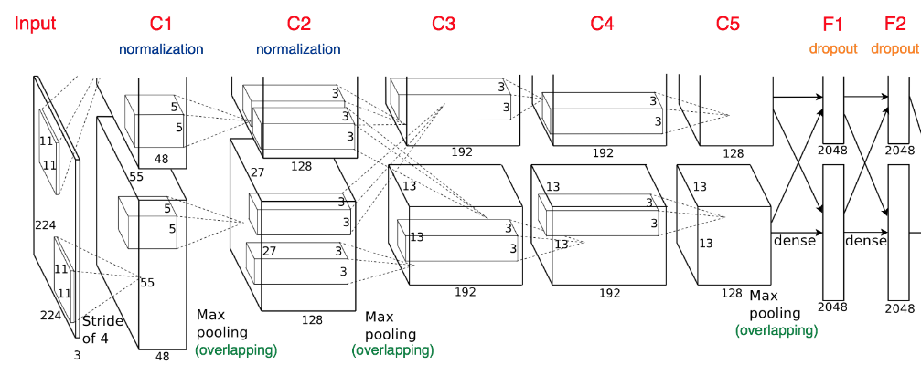
So far: Image Classification
Image Recognition: By AlexNet
Fully-Connected:
4096 to 1000
Class Scores
Cat: 0.90
Dog: 0.05
Car: 0.01
Vector:
4096

Slide 4
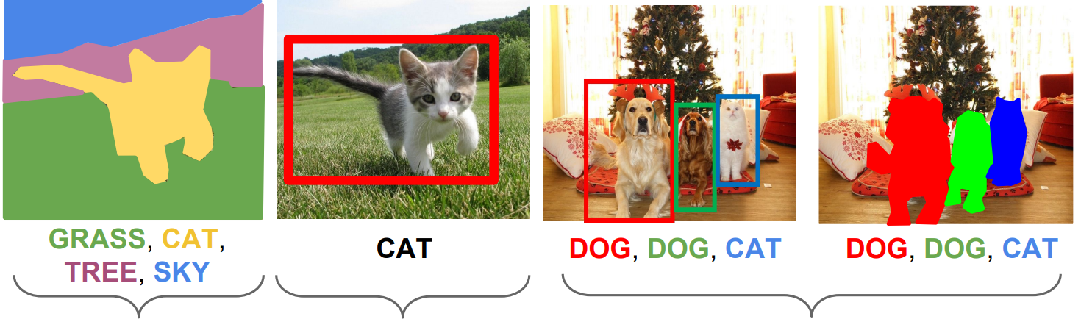
Other Computer Vision Tasks
Semantic
Segmentation
Classification
+Localization
Object
Detection
Instance
Segmentation
Pixel Classes
Single Object
Multiple Object

Slide 5
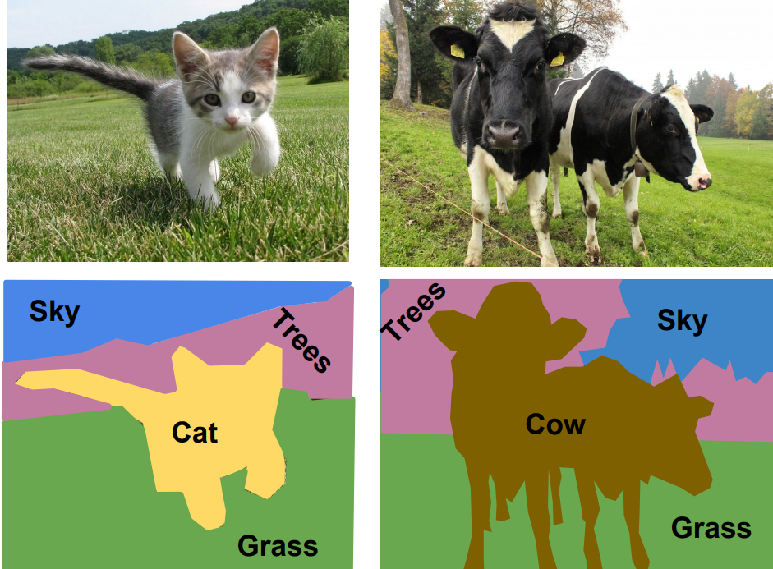
Semantic Segmentation
Label each pixel in the image with
a category label
Don’t differentiate instances,
only care about pixels

Slide 6
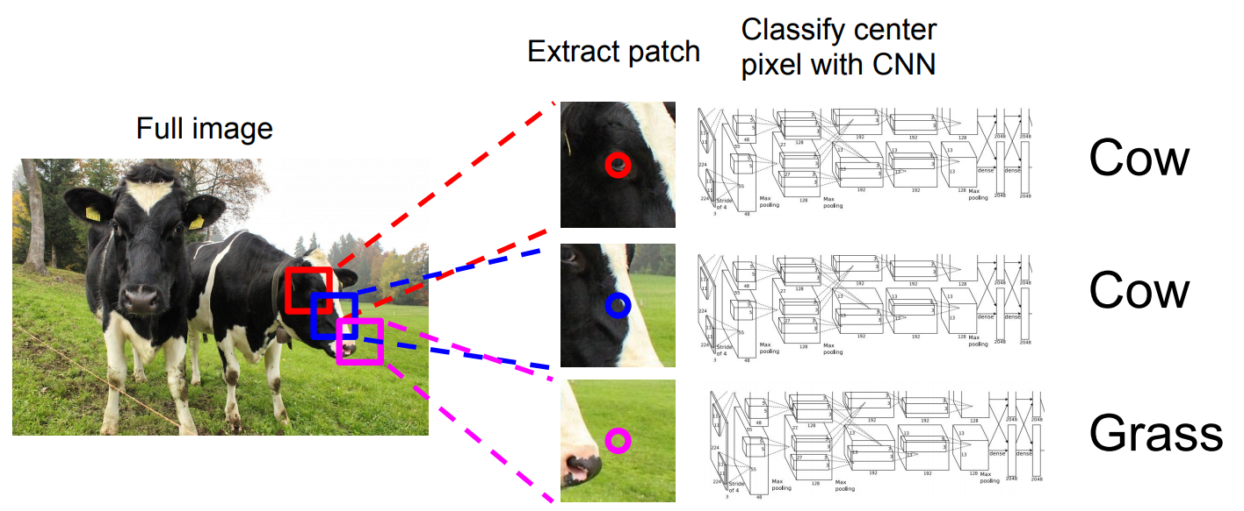
Naïve Semantic Segmentation Idea: a Sliding Window
Very inefficient, no reuse of features between overlapping patches
Farabet et al. “Learning Hierachical Features for Scene Labeling” (TPAMI 2013)

Slide 7
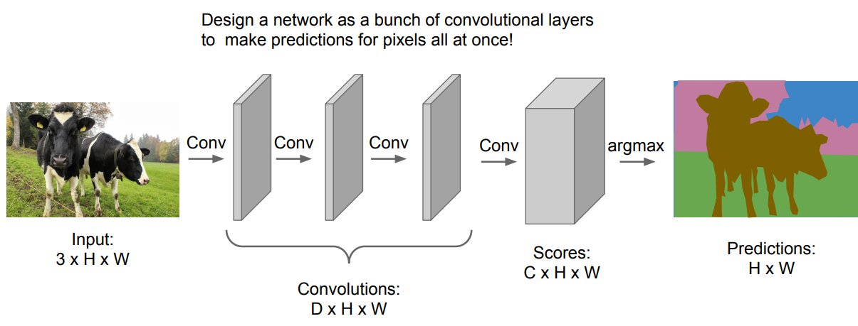
Semantic Segmentation Idea: Fully Convolutional
Convolutions at the original image resolution will be very expensive

Slide 8
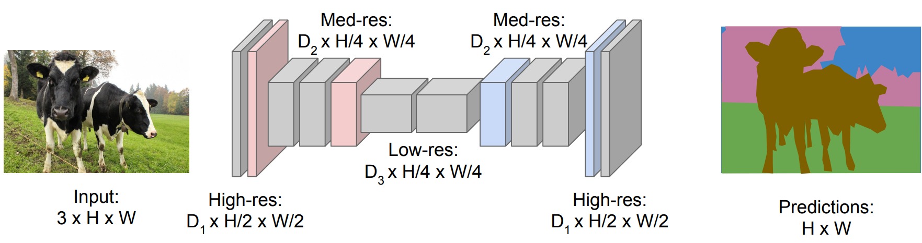
Semantic Segmentation Idea: Fully Convolutional
Design a network as series of convolution layers, with downsampling and upsampling
Downsampling: Pooling or strided convolution
Upsampling: ???
Long et al. “Fully Convolutional Networks for Semantic Segmentation” CVPR 2015

Slide 9
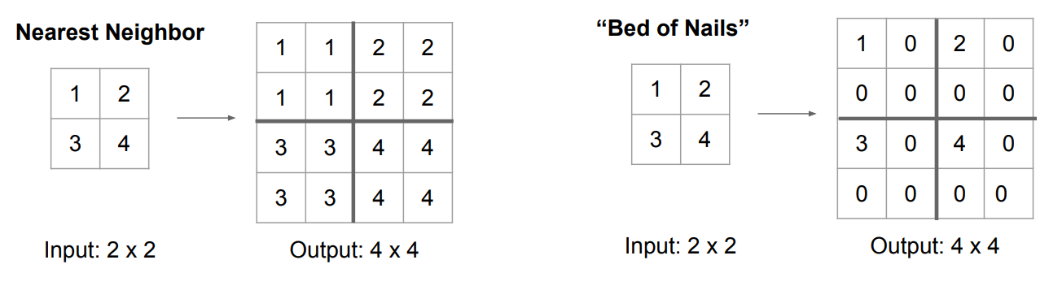
In-Network Upsampling: “Unpooling”

Slide 10
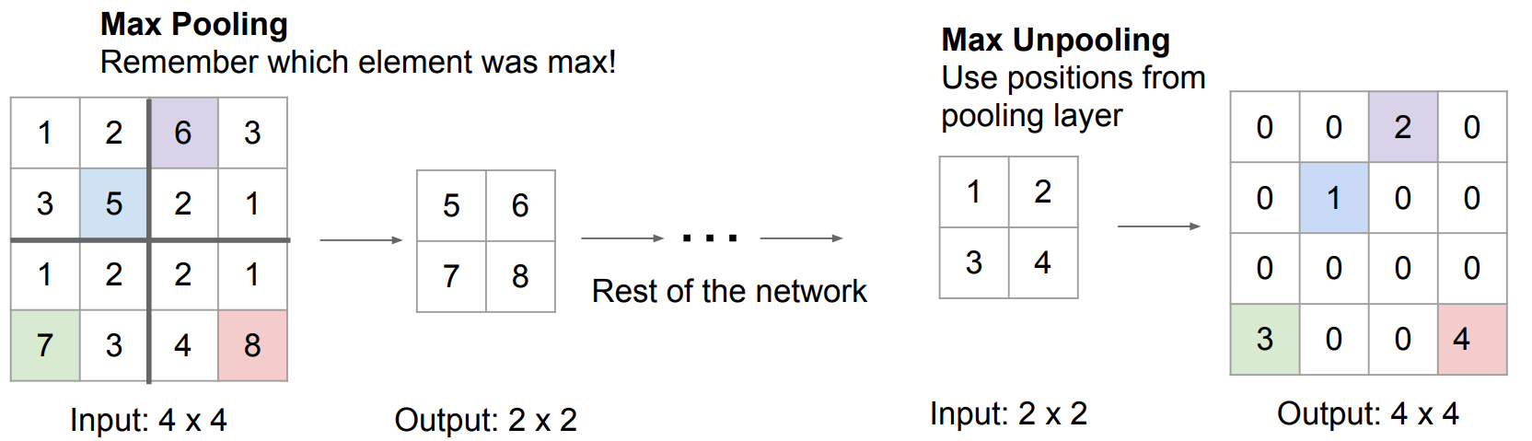
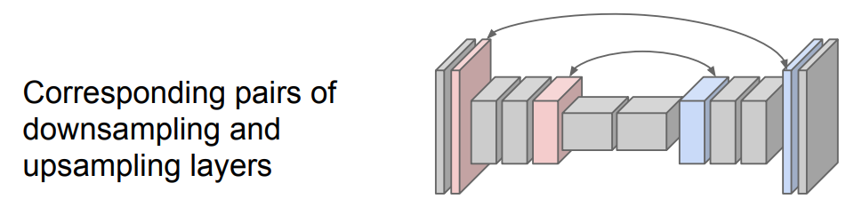
In-Network Upsampling: “Max Unpooling”

Slide 11
Learnable Upsampling: Transpose Convolution
Recall: Normal 3x3 convolution, stride 1 pad 1
Input: 4x4
Output: 4x4

Slide 12
Learnable Upsampling: Transpose Convolution
Recall: Normal 3x3 convolution, stride 1 pad 1
Dot product between
filter and input
Input: 4x4
Output: 4x4

Slide 13
Learnable Upsampling: Transpose Convolution
Recall: Normal 3x3 convolution, stride 1 pad 1
Dot product between
filter and input
Input: 4x4
Output: 4x4

Slide 14
Learnable Upsampling: Transpose Convolution
Recall: Normal 3x3 convolution, stride 2 pad 1
Input: 4x4
Output: 2x2

Slide 15
Learnable Upsampling: Transpose Convolution
Recall: Normal 3x3 convolution, stride 2 pad 1
Dot product between
filter and input
Input: 4x4
Output: 2x2

Slide 16
Learnable Upsampling: Transpose Convolution
Recall: Normal 3x3 convolution, stride 2 pad 1
Dot product between
filter and input
Input: 4x4
Output: 2x2

Slide 17
Learnable Upsampling: Transpose Convolution
3x3 transpose convolution, stride 2 pad 1
Input: 2x2
Output: 4x4

Slide 18
Learnable Upsampling: Transpose Convolution
3x3 transpose convolution, stride 2 pad 1
Input gives weight
for filter
Input: 2x2
Output: 4x4

Slide 19
Learnable Upsampling: Transpose Convolution
3x3 transpose convolution, stride 2 pad 1
Filter moves 2 pixels
in the output for
every one pixel in
the input
Input gives weight
for filter
Stride gives ratio
between movement
in output and input
Input: 2x2
Output: 4x4

Slide 20
Learnable Upsampling: Transpose Convolution
3x3 transpose convolution, stride 2 pad 1
Filter moves 2 pixels
in the output for
every one pixel in
the input
Input gives weight
for filter
Stride gives ratio
between movement
in output and input
Sum where output
overlaps
Input: 2x2
Output: 4x4

Slide 21
Learnable Upsampling: Transpose Convolution
3x3 transpose convolution, stride 2 pad 1
Other names: Deconvolution (bad), Upconvolution, Fractionally strided convolution
Filter moves 2 pixels
in the output for
every one pixel in
the input
Input gives weight
for filter
Stride gives ratio
between movement
in output and input
Sum where output
overlaps
Input: 2x2
Output: 4x4

Slide 22
Semantic Segmentation Idea: Fully Convolutional
Design a network as series of convolution layers, with downsampling and upsampling
Downsampling: Pooling or Strided Convolution
Upsampling: Unpooling or Strided Transpose Convolution
Long et al. “Fully Convolutional Networks for Semantic Segmentation” CVPR 2015

Slide 23
What Else Can Deep Neural Nets Do?
Classification
Approximation/Regression
Optimization
Clustering
23
Notes:
Four example application domains that ANN can solve very well

Slide 24
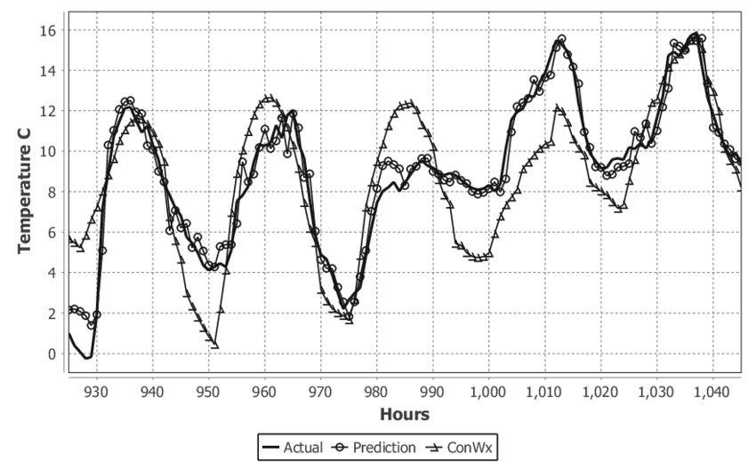
Application: Temperature Prediction
Inputs:
      Previous temperature
      Day/night indicator
      Humidity
      Atmospheric pressure
  Output:
      Temperature prediction
What changes fundamentally?
Notion of time!
M. Wollsen and B. N. Jorgensen, “Improved Local Weather Forecasts Using Artificial Neural Networks,” Advances in Intelligent Systems and Computing, 2015
24

Slide 25
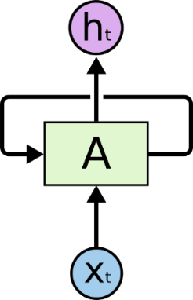
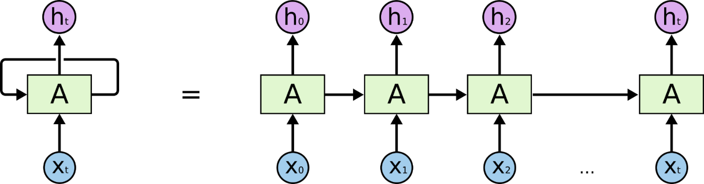
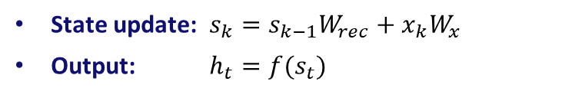
Recurrent Neural Networks - Structure
State update: $s_{k}=s_{k−1}W_{rec}+x_{k}W_{x}$
Output: $h_{t}={f(s}_{t})$
Similar to a feed-forward neural network, but very deep!
Based on: https://colah.github.io/posts/2015-08-Understanding-LSTMs/

Slide 26
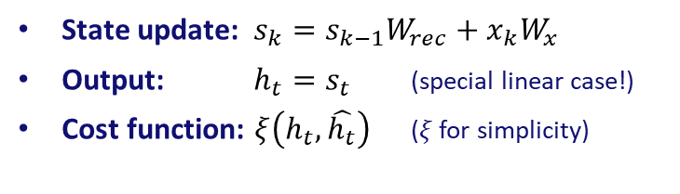

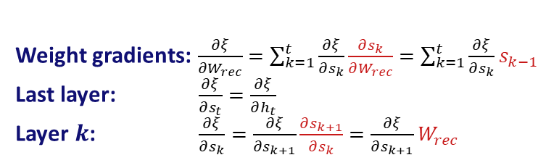
Recurrent Neural Networks - Training
State update: $s_{k}=s_{k−1}W_{rec}+x_{k}W_{x}$
Output: $h_{t}=s_{t}$ (special linear case!)
Cost function: $ξ\left(h_{t},\hat{h_{t}}\right)$ ($ξ$ for simplicity)
Weight gradients: $\frac{∂ξ}{∂W_{rec}}=\sum_{k=1}^{t}{\frac{∂ξ}{∂s_{k}}\frac{∂s_{k}}{∂W_{rec}}}=\sum_{k=1}^{t}{\frac{∂ξ}{∂s_{k}}s_{k−1} }$
Last layer: $\frac{∂ξ}{∂s_{t}}=\frac{∂ξ}{∂h_{t}}$
Layer $k$: $\frac{∂ξ}{∂s_{k}}=\frac{∂ξ}{∂s_{k+1}}\frac{∂s_{k+1}}{∂s_{k}}=\frac{∂ξ}{∂s_{k+1}}W_{rec}$
Similar derivation for $W_{x}$

Slide 27
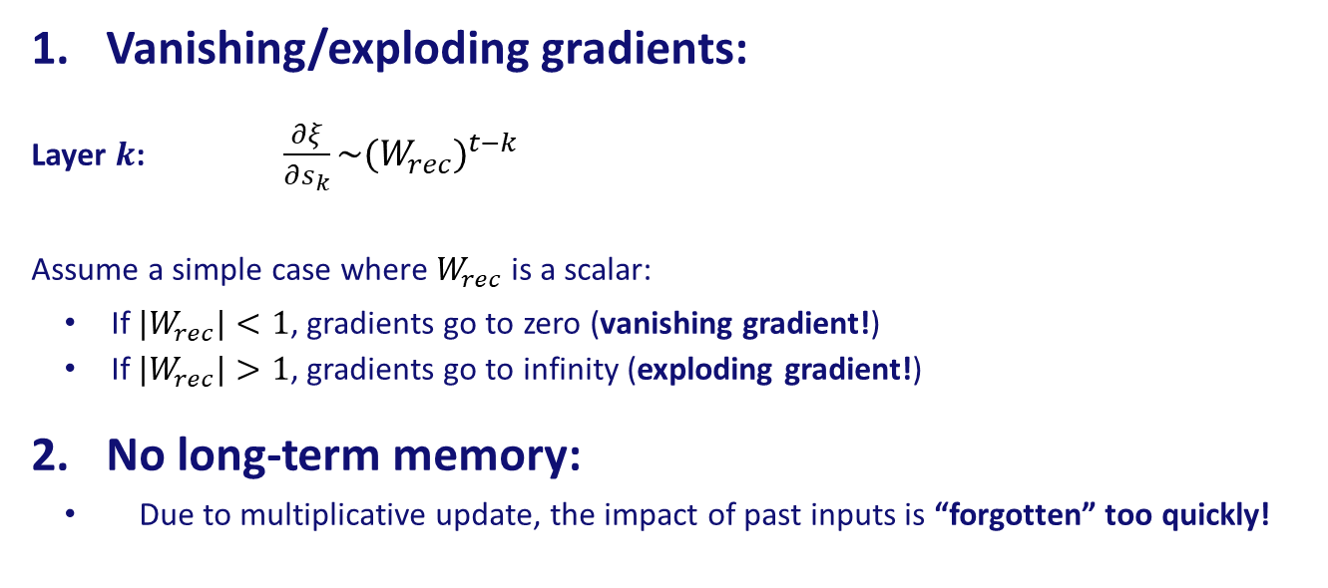
Recurrent Neural Networks - Problems
Vanishing/exploding gradients:
Layer $k$: $\frac{∂ξ}{∂s_{k}}\sim {(W_{rec})}^{t−k}$
Assume a simple case where $W_{rec}$ is a scalar:
    If ${|W}_{rec}|<1$, gradients go to zero (vanishing gradient!)
    If ${|W}_{rec}|>1$, gradients go to infinity (exploding gradient!)
  No long-term memory:
    Due to multiplicative update, the impact of past inputs is “forgotten” too quickly!

Slide 28
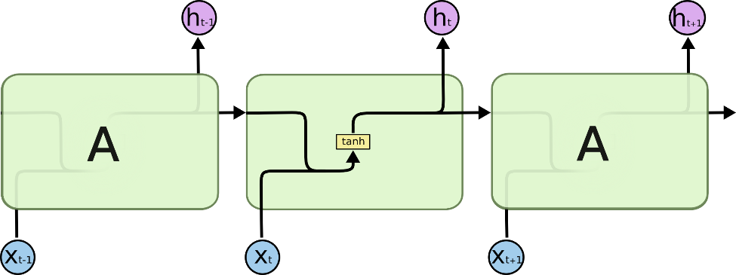
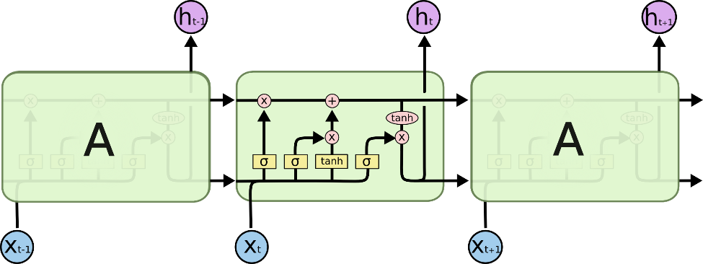
Long Short-Term Memory (LSTM) RNNs
Classic RNN:
LSTM RNN:
S. Hochreiter, J. Schmidhuber, "Long Short-Term Memory,“ 1997.

Slide 29
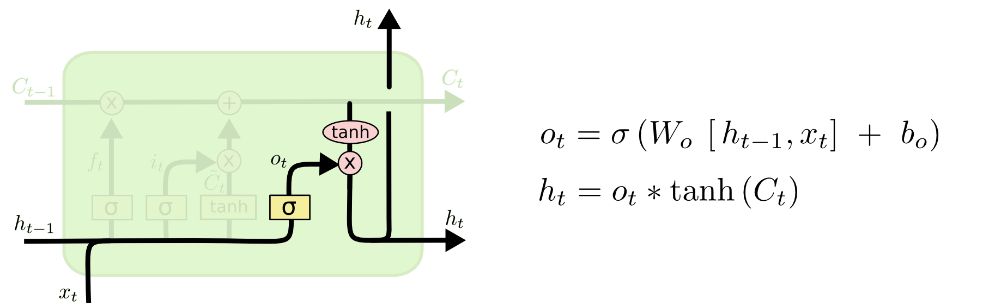
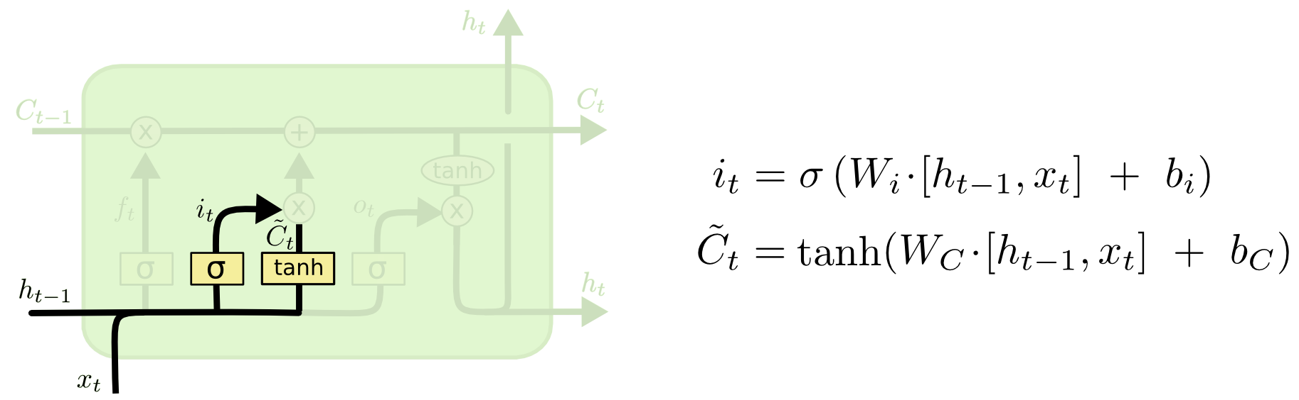
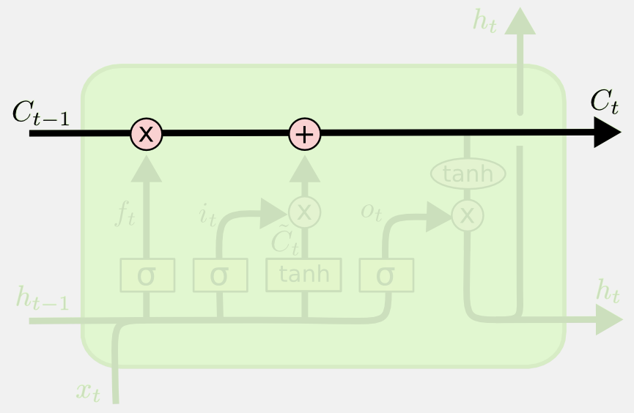
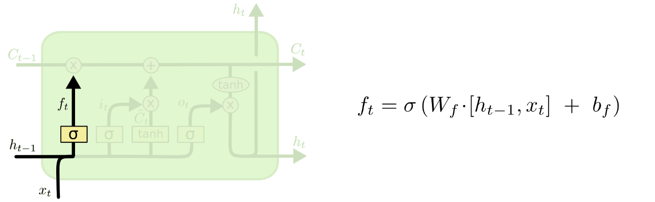
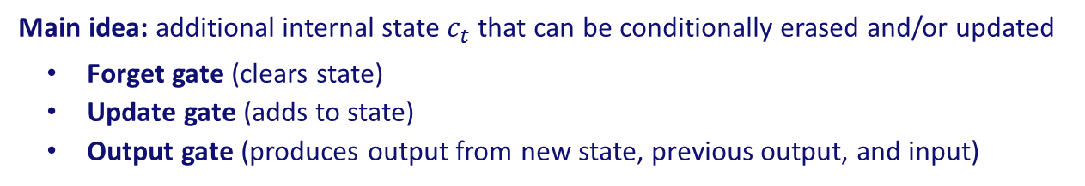
Long Short-Term Memory (LSTM) RNNs
Main idea: additional internal state $c_{t}$that can be conditionally erased and/or updated
    Forget gate (clears state)
    Update gate (adds to state)
    Output gate (produces output from new state, previous output, and input)

Slide 30
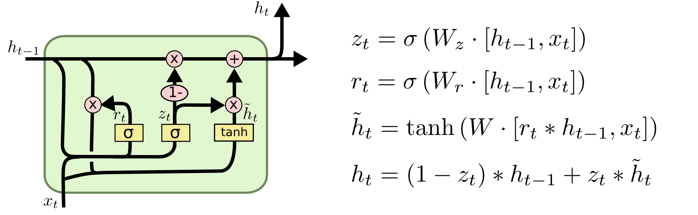
Gated Recurrent Unit (GRU) RNNs
Simpler variant of the LSTM, but very powerful and popular
      Cell state and output state are merged into one (like in classic RNNs)
      Single “forget/update” gate so that amount of update depends on amount of forgetting
K. Cho, B. van Merrienboer, C. Gulcehre, D. Bahdanau, F. Bougares, H. Schwenk, Y. Bengio, “Learning Phrase Representations using RNN Encoder-Decoder for Statistical Machine Translation,” 2014.

Slide 31
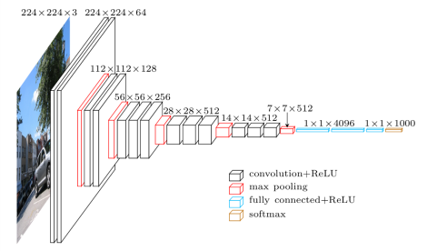
Problems With Traditional DNNs
DNNs achieve remarkable performance for a wide range of applications (e.g., VGG network for image recognition)
But traditional DNNs are “black boxes”:
Difficult to interpret results
Difficult to improve architectures
Difficult to include prior information

Slide 32
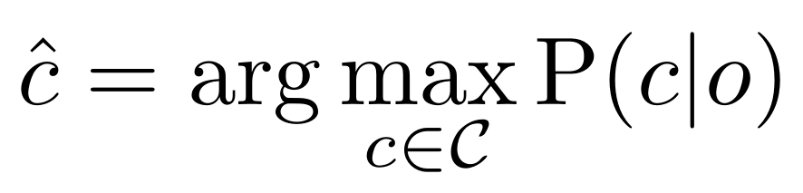
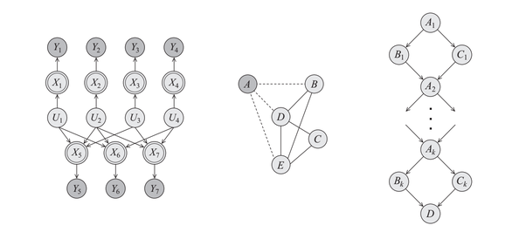
Inference Using Probabilistic Models & Optimization
Many inference tasks can be expressed using probabilistic models:
Probabilistic models are intuitive and knowledge about the problem can be easily incorporated

Slide 33
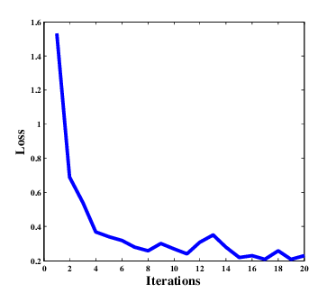
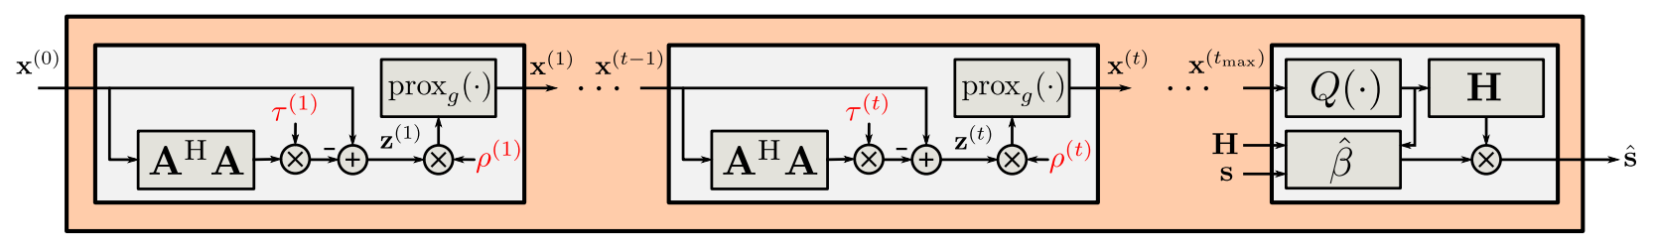
Deep Unfolding: Principle
Solving probabilistic models involves solving very complex optimization problems (often NP-hard), and iterative algorithms (e.g., gradient descent) are used in practice
In deep unfolding, every iteration of an iterative algorithm forms a layer of a DNN with trainable parameters
Layer 1
Layer t
Post-processing (optional)

Slide 34
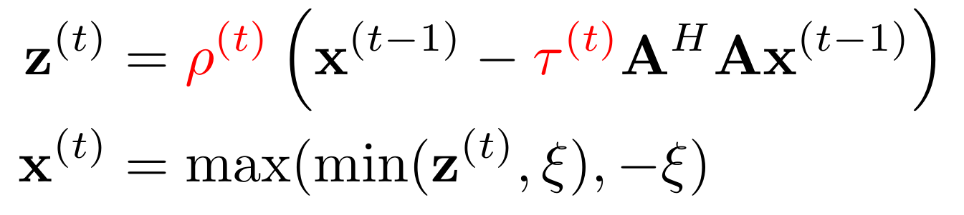
Deep Unfolding: Training
Iterative constrained optimization algorithms typically consist of:
A linear operation (gradient step)
A non-linear operation (constraint satisfaction)
Example:
The gradients of these operations w.r.t. their inputs are usually well-defined, so we can use standard backpropagation to train deep unfolded networks!

Slide 35
Deep Unfolding: Training
Cool observation:
The iterative algorithm is obtained assuming some cost function (e.g., MSE)
BUT: The deep unfolded network can be optimized for any differentiable cost function!!!
Training problems:
Non-linear operators may not be differentiable replace with “soft” versions!
Vanishing gradients 1) good known initial values, 2) incremental training, 3) windowed training, 4) multi-layer cost functions
Layer 1
Layer t
Post-processing (optional)

Slide 36
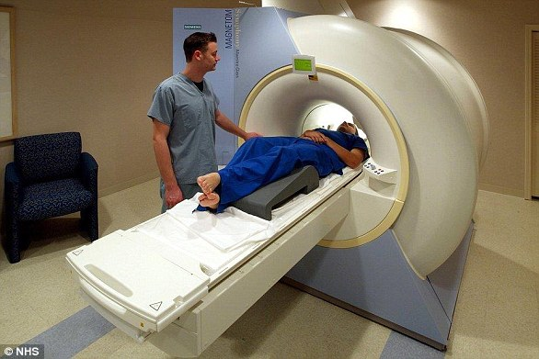
Applications: Compressed Sensing MRI
Magnetic Resonance Imaging (MRI):
A non-invasive medical imaging technique used commonly for diagnostic reasons.
Issues:
Uncomfortable for patient.
Patient movement destroys image.
Highly desirable to minimize imaging duration!

Slide 37
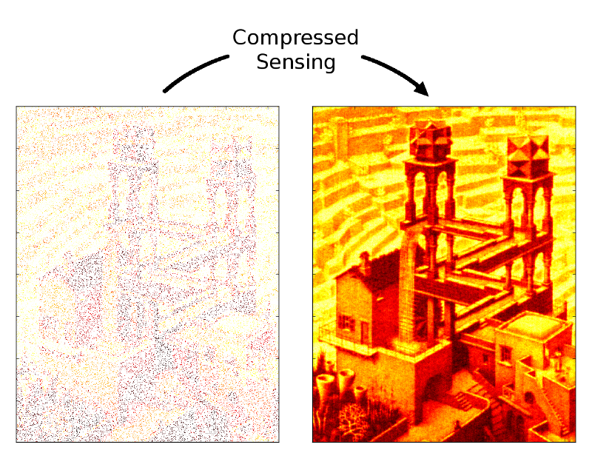
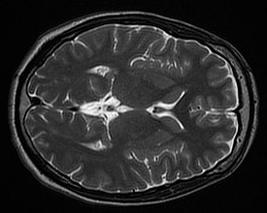
Applications: Compressed Sensing MRI
Compressed Sensing:
A principled method to reconstruct sparse signals from very few samples.
MRI images are typically very sparse!

Slide 38
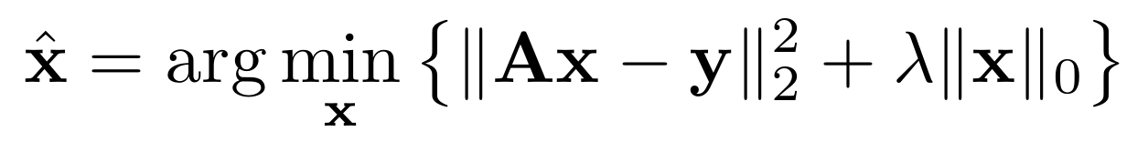
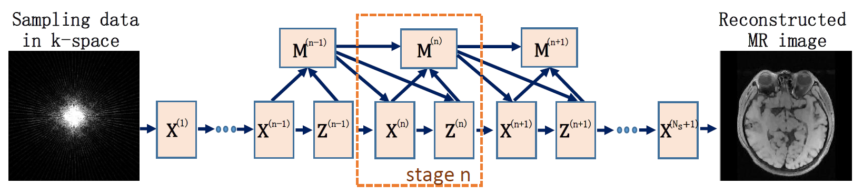
Applications: Compressed Sensing MRI
Mathematical formulation of compressed sensing:
A is the sampling matrix, x is the (sparse) signal to be reconstructed, y are the samples.
Solved using iterative methods in practice, which can be unfolded!
Y. Yang, J. Sun, H. Li, Z. Xu, “ADMM-Net: A Deep Learning Approach for Compressive Sensing MRI,” NIPS 2016.

Slide 39
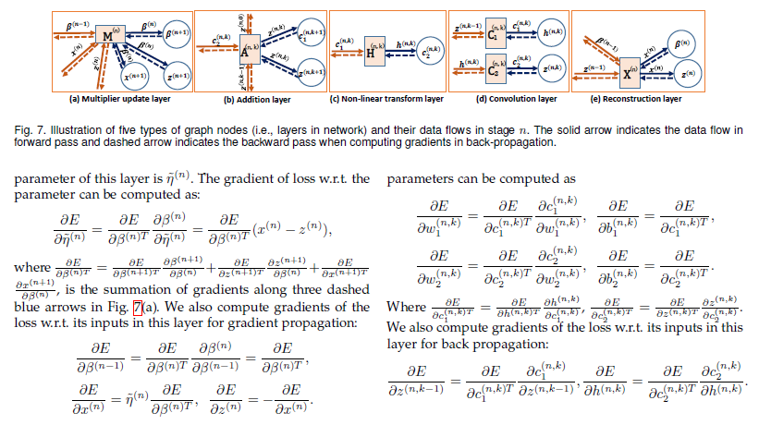
Applications: Compressed Sensing MRI
Don’t be afraid!
In most cases the gradients can be computed automatically using standard neural network frameworks (e.g., Keras).

Slide 40
Applications: Compressed Sensing MRI
Sparse signal recovery for MRI.
Ground-truth image

Slide 41
Take-Home Messages
Main theme: applications and corresponding “specialized” NNs
Applications:
    There’s more to computer vision than classification!
    Neural networks are more than just classifiers!
  Techniques:
    Unpooling (Nearest Neighbor, Bed of Nails, Learned Upsampling)
    Temporal NNs (RNNs, LSTMs, GRUs)
    Model-based NNs (Deep Unfolding)

